Slide 1


Growth and Tree Rings:
Responses of Northern Forests to Drought
(emphasis on Sugar Maple)
Heidi Asbjornsen and
Matt Vadeboncoeur

Slide 2
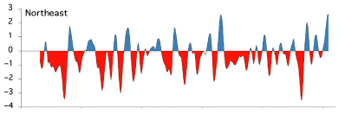

Historic Climate Variability: Northeast
1930-2005: one of the wettest periods since 1500 CE
Few drought periods: 1930s, 1960s
Pederson et al. 2015

Slide 3
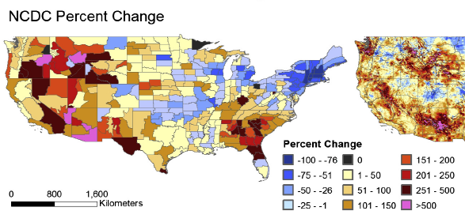
Recent Climate Variability: Northeast
Last ~ 25 years: Wetter than the previous 25 years (1960-1986)
Percent Change in Drought Severity Index (1960-1986 vs. 1987-2013)
Peters et al. 2015
Notes:
When assessing rainfall patterns over the past 50 years in the northeast, the most recent 25 years have been wetter than the previous 25 years. For example, in NH and VT, drought severity has decreased by >75%.

Slide 4
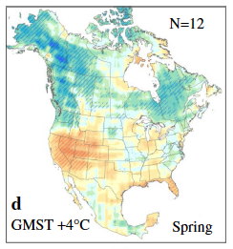
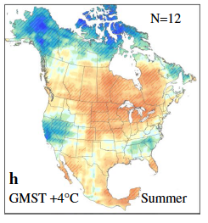
Predicted Future Precipitation: Northeast
Increasing total annual precipitation
More frequent extreme precipitation events
Spring wet spells; Summer droughts
2014 U.S. National Climate Assessment; Swain & Hayhoe 2015
Notes:
These climate change predictions are based on models. The general forecast for precipitation change throughout the U.S. is that drier areas will become drier, and wetter areas will become wetter, while extremes will also become more frequent. Here in the NE, this means that we will likely have high rainfall events in the spring, but also more prolonged dry periods in the summer.

Slide 5
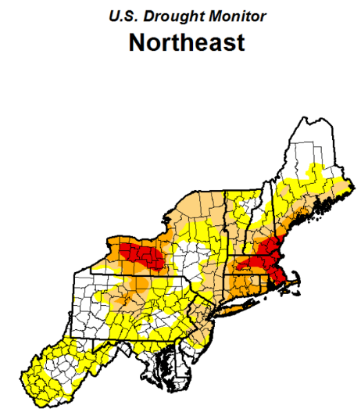
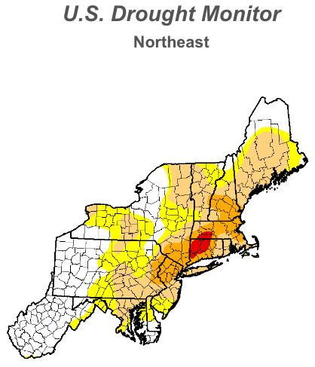
2016 Extreme/Severe Drought in the NE
September 20, 2016
January 17, 2017
Notes:
This trend is highlighted by the extreme drought that affected much of New England last year. These figures show the extent of the drought in late summer (epicenter – CT/MA and SW NH); and that even in January 2017 we continue to experience abnormally dry conditions.
Yellow – abnormally dry; Light orange – moderate drought; dark orange = severe drought; red = extreme drought

Slide 6
Sensitivity and resilience of northern forests and tree species to drought?
Future droughts (and wet spells) will likely fall outside the climate space to which NE tree species are adapted
Many northern hardwood forest species (e.g., Sugar Maple) may be especially vulnerable to drought:
  Past drought events rare
  Limiting resources: light and nutrients
  Mesophytic northern hardwood species = “drought intolerant” – but lack of research
Notes:
One of the major questions we’ve been addressing in our lab, is trying to understand what how the sensitivity and resilience to drought varies across different forest types and tree species.
We hypothesize that NE forests may be especially vulnerable to drought because tree species in this region haven’t evolved adaptations to drought (i.e., because past droughts were rare);
Within this environment, the limiting resources are light and nutrients, so species developed adaptive strategies to optimize their ability to acquire these resources (water generally not limiting).
Northeastern tree species are broadly classified as “drought intolerant” ; however, there has been relatively little research on their long-term response to drought.

Slide 7
Outline of Talk
Sugar maple response to past climate (tree rings)
2016 drought and drought experiments in NH
Sensitivity of sugar maple to drought: what do (don’t) we know?
Implications for syrup production
Summary and future research directions

Slide 8
Sugar Maple Response to Past Climate: Research Questions
What climate variables affect sugar maple growth, and do they differ across the northeast?
How does its sensitivity of sugar maple compare with other species? (beech, white ash, red spruce, hemlock, red oak, yellow birch, yellow poplar)

Slide 9
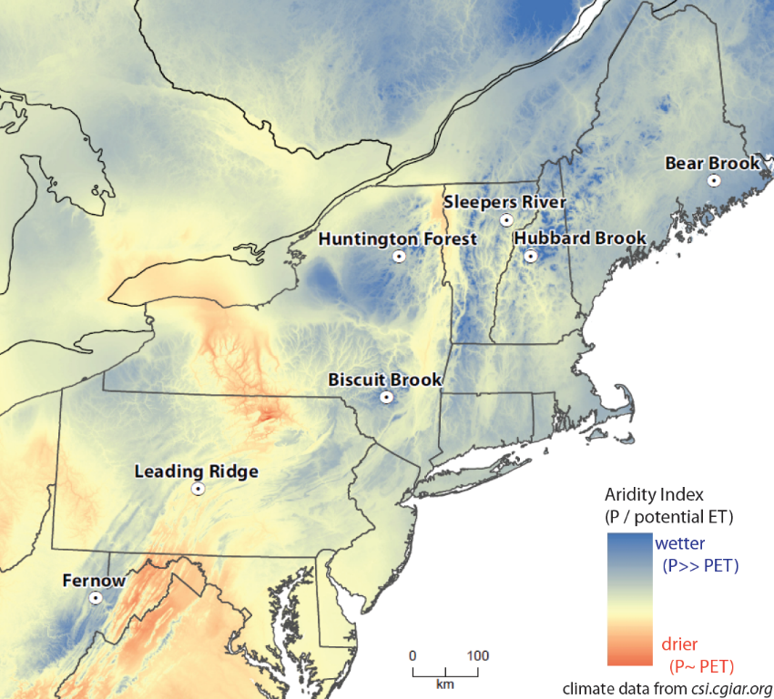
Study sites

Slide 10
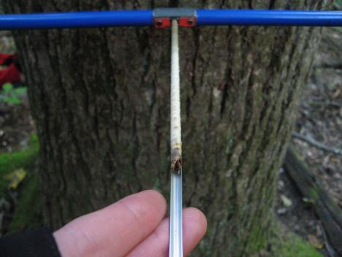
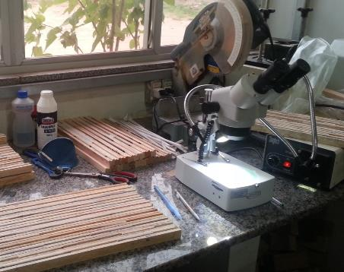
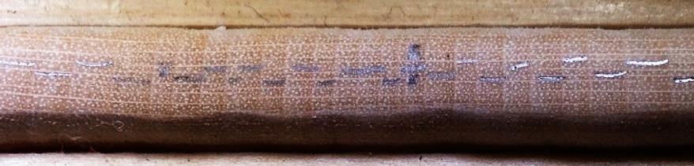
Notes:
Tree cores were collected from at least 10 trees of each dominant species per study site. These cores were then dated and the annual increment growth measured. The lines in the lower picture indicate the amount of growth for each year.

Slide 11
Growth correlations with precipitation
South (PA): SM likes wet summers
North (ME, VT): A snowy winter good for maple in climates with reliable snowpack (frost damage).
North previous year: mixed, but not very water sensitive
Notes:
This table shows the relationship between sugar maple growth and precipitation during different months.
Precipitation from the current growing season are in bold (may, jun, jul, aug, sep).
Precipitation from the winter and previous growing season are also shown (apr…prev may) – this is relevant, because trees store carbohydrates from the previous year, and these carbohydrates may be used for growth during the following growing season (especially before leaf-out). Consequently, there is often a timelag in the growth response related to the previous year’s weather conditions.
Green = positive response; red = negative response
Darker shades = stronger correlation; lighter shades = weaker correlation;

Slide 12
Growth correlations with temperature
South (PA): hot summers are bad for SM
North (NH, NY): warm winter is bad for SM (snowpack freeze-thaw?)
Notes:
Same table format as the previous slide, except looking at the relationship between temperature and sugar maple growth.

Slide 13
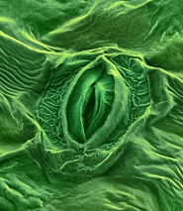
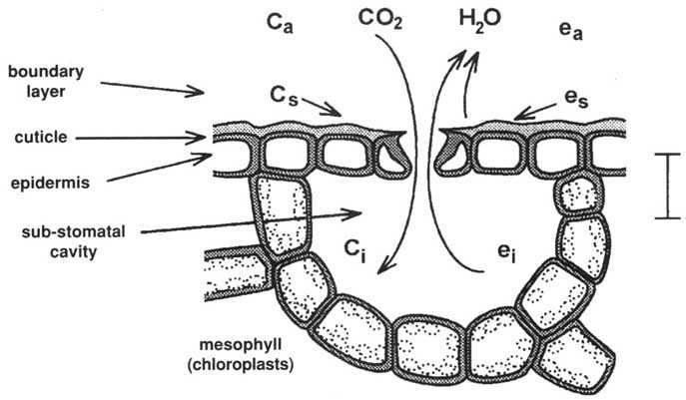
What else can we learn from tree cores?: WUE
Water use efficiency (WUE): How much water is lost relative to the amount of carbon taken up by photosynthesis
Tradeoff between photosynthesis and water loss:
  To photosynthesize, a leaf must lose water.
  To conserve water, a leaf must reduce photosynthesis.
High WUE indicates water stress (reduced photosynthesis to conserve water)
Carbon isotopes in tree rings reflect the WUE during each growing season

Slide 14

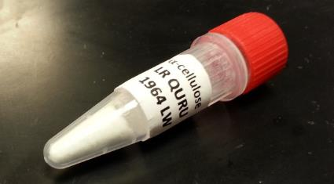
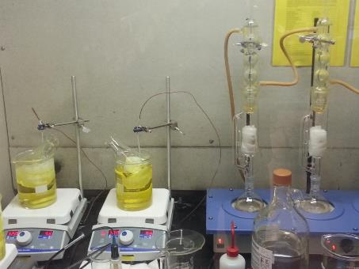


Slide 15
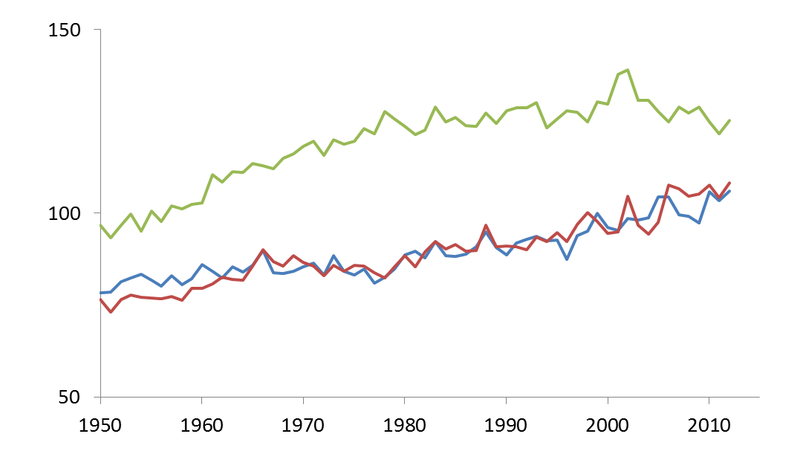
WUE increased since 1950, driven by the increase in atmospheric CO2 concentrations (30%) Enhanced drought resistance?
Average trends across all sites by species
spruce: +32%
water use efficiency
(μmol CO₂ mol⁻¹ H₂O)
beech +40%
sugar
maple: +29%
Notes:
The long-term increases are driven by increases in the CO2 concentration of the atmosphere (which increased about 30% from 1950 – 2012, the period shown here.
Note spruce is always higher but levels off after reaching a maximum. Beech and sugar maple are still increasing linearly.
The short-term variation is likely driven by climate (analysis on the next slide …)

Slide 16
WUE correlations with precipitation: Sugar Maple
High WUE = high stress (red)
South: Dry June is bad for SM
North: More correlation with previous growing season precip
VT, NH, ME: negative response due to lower carbohydrate stores (NSCs) mobilized for wood growth and metabolism?
More on NSCs later…

Slide 17
WUE correlations with temperature
PA: Hot growing seasons are especially bad for SM (more important than moisture)
NY: warm growing season less stressful
VT: Sensitive to previous growing season temperature

Slide 18
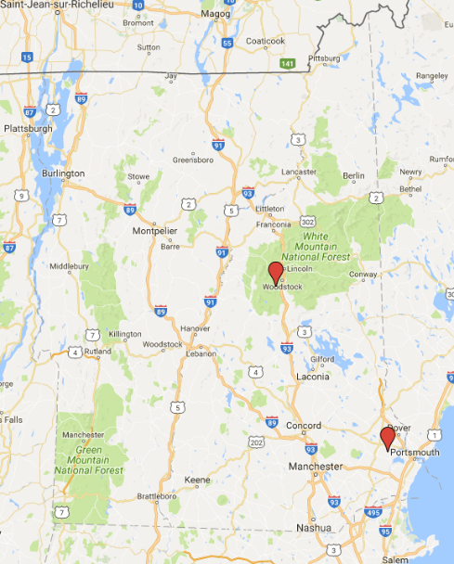
Drought Experiments in New Hampshire
Research Questions:
How do different northern forest types and species respond to extreme drought?
What are the underlying physiological mechanisms that determine processes of dieback and mortality?
Hubbard Brook, White Mnts.
UNH Thompson Farm, Durham
Notes:
Future droughts will likely be outside the climate space to which species have adapted. Therefore, to really understand responses, necessary to push ecosystems beyond their thresholds – this is the motivation for these drought experiments conducted at two different sites in NH.

Slide 19
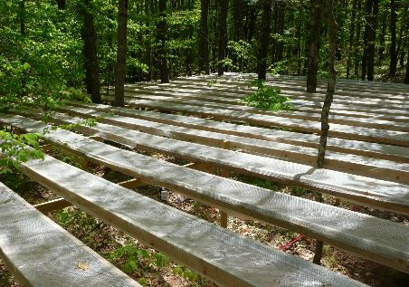
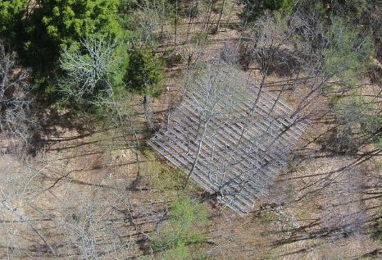
Thompson Farm
Hubbard Brook
Mature white pine and red oak forest
Two replicated 30 x 30 m plots
Pre-treatment data: 2014
First treatment year: 2015
Young red maple- dominated forest
Two replicated 15 x 15 m plots
Pre-treatment data: 2013
First treatment year: 2014
~ 50% removal of throughfall (June – September): 1-in-100-year drought

Slide 20
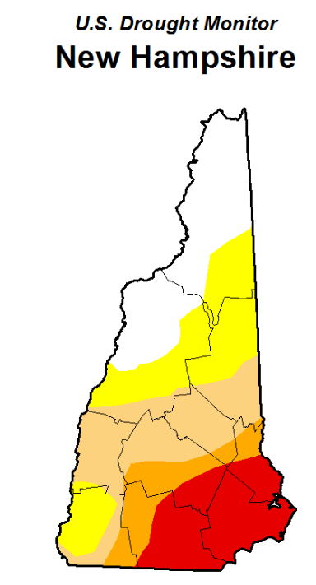
September 20, 2016
2016 drought less severe in the White Mountains compared to SE New Hampshire

Slide 21
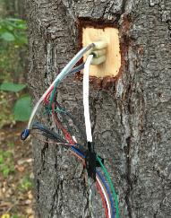
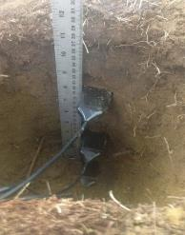
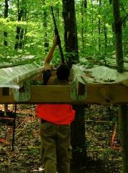
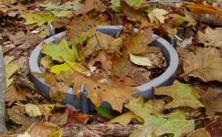
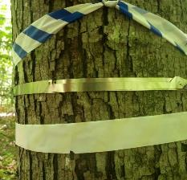
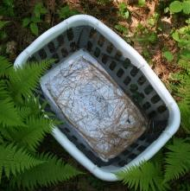
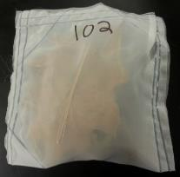
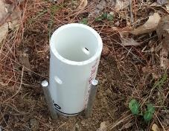
Measurements in drought plots
Tree sapflow
Foliar gas exchange
Soil moisture
Soil Respiration
Tree diameter increment
Litterfall
Decomposition
Fine root biomass

Slide 22
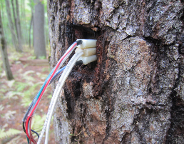
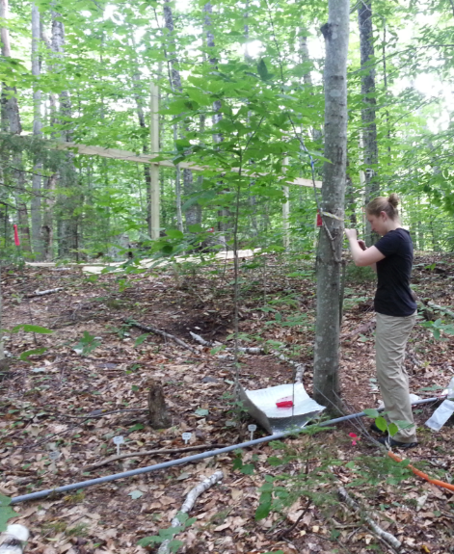
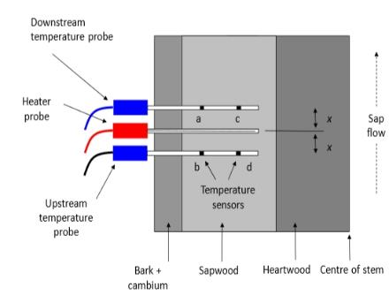
Tree water use: Sapflow measurements
Heat ratio method
Notes:
Each sapflow sensor consists of 3 probes – the middle probe emits a pulse of heat every 10 min, and the upper and lower probe record the temperature of the sap. With those data, we can then calculate the rate at which the sap is moving. This rate can be scaled up to the whole tree or stand level using sapwood area.

Slide 23
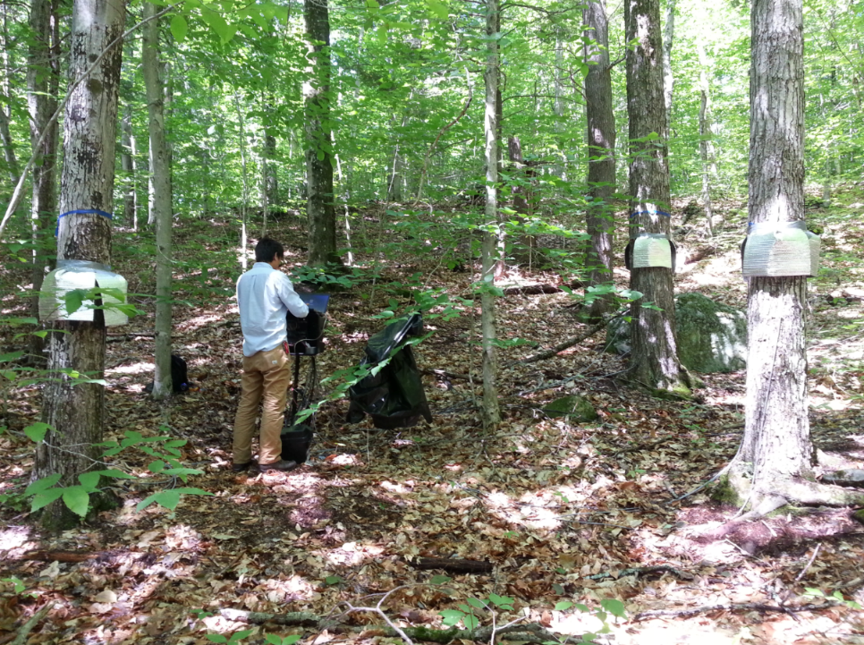

Slide 24
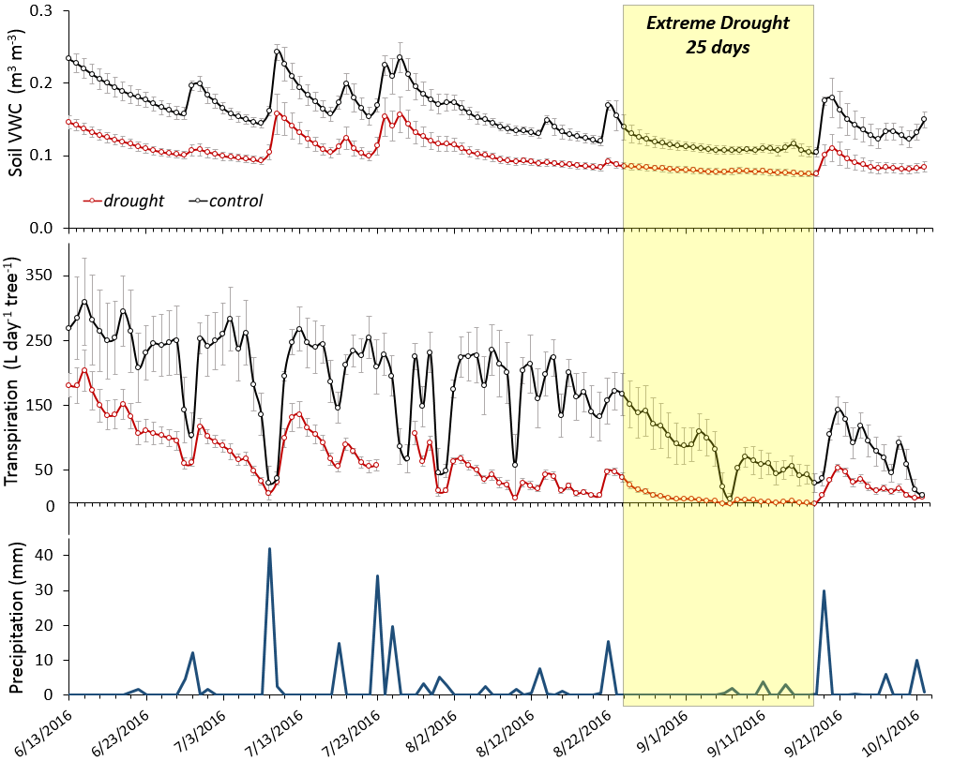

Thompson Farm: White Pine Sap Flow
100 Litres ≈ 2 kegs of beer
100 Litres ≈ 1 small bathtub
Notes:
This figure shows the results for how soil moisture and sapflow changed over the growing season. The black line is the average of the control plots, and the red line is the average for the drought plots. The op panel shows soil moisture, declining throughout the growing season. The extreme drought (mid Aug-Mid sept.) shown by the yellow shaded area.
This second panel shows the whole tree sapflow (or transpiration) for white pine – Initially, the control plots maintained significantly higher transpiration than the drought plots, then during the extreme drought, transpiration for the drought trees approaches zero, and even the control trees reach similar levels for a few days.
The bottom panel shows the rainfall events, notice that following a significant rainfall event on 9/21, the trees respond immediately by increasing their transpiration.
100 L is about 2 kegs of beer, or 1 small bathtub – so maximum T about 300 L (6 kegs beer, 3 bathtubs).

Slide 25
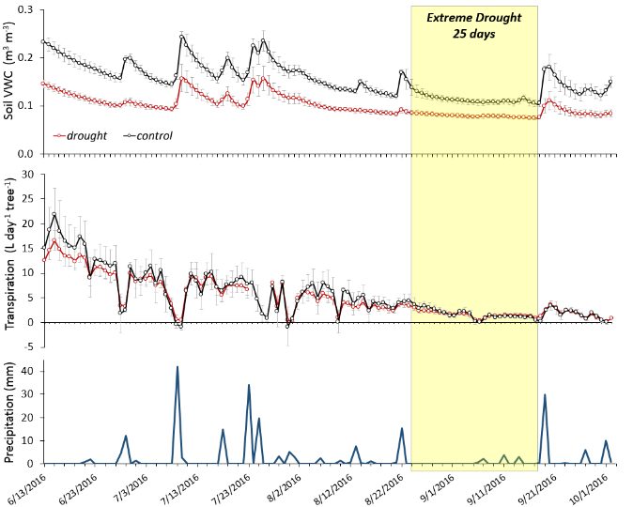

Thompson Farm: Red Oak Sap Flow
Notes:
Overall the trend is very similar for red oak, although the difference between the drought and control trees are more similar, and fewer days when transpiration nearly ceased.

Slide 26
Sapflow during the extreme drought event Aug. 24 – Sept. 10, 2016
Thompson Farm Extreme Drought
transpiration (L hr⁻¹ tree⁻¹)
Notes:
Here, we see a blow up of just the period with the extreme drought (yellow shaded area in the previous graph). This figure highlights how tranpiration is almost zero for about 10 days, and barely detectable for both plots in early September, while for red oak, there are only 2 days when transpiration approaches zero

Slide 27
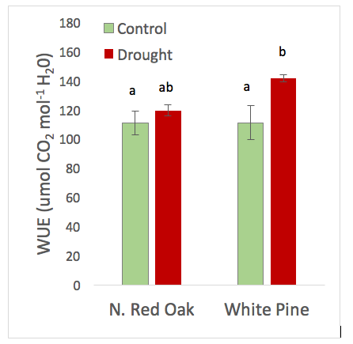
Leaf Water Use Efficiency (WUE)
August 2016
High WUE = greater stress
Red Oak
  Lower WUE
  Keeps stomata open despite low soil moisture
  More drought tolerant
White Pine
  Higher WUE
  Closes stomata to conserve water
Notes:
Here are the results for WUE, comparing the 2 dominant trees: red oak (LEFT) and white pine (RIGHT).
We can see that RO maintains fairly similar WUE in control and drought plots
WP has greater WUE in the drought plot (suggests that they are closing their stomata to conserve water).
Reflects different strategies for coping with drought

Slide 28
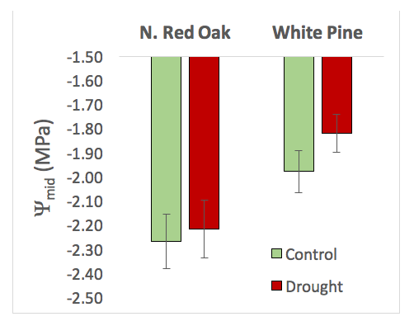

Leaf water potential – August (midday)
Red oak reaches more negative leaf water potentials than white pine; more drought tolerant strategy.
Sugar maple: more similar strategy to white pine.
Notes:
Leaf water potential is another measure that helps us understand differences in drought response.
Think of leaf water potential as the amount of pressure required to extract water from the leaf
If trees keep their stomata open even when the soil becomes drier, they will experience more negative water potentials. This means that they are at greater risk of breaking the water column and damaging the xylem (conductive tissue) in the stem.
Plants can avoid low water potential by closing their stomata; however, there is a trade off: this allows the plant to protect its xylem but reduces its ability to photosynthesize and produce more carbohydrates.
Trees have different strategies for dealing with this tradeoff– oaks allow the potential to become more negative – more risky, but can continue photosynthesizing. In contrast, white pine closes its stomata and has a more conservative (less risky) strategy.
The figure show leaf water potential, for RO and WP, comparing between pre-drought (July) and during the extreme drought (August). Again, red = drought; green = control.
Overall, WP decreases during the severe drought.
But we can also see the red oak allows its WP to reach more negative values than WP – because it is keeping it’s stomata more open and continuing to transpire, while WP tends to close its stomata more. This reflects RO’s more drought tolerant strategy.
Species and month (July vs. August) effect
No significant treatment effect
N. Red Oak: lower midday wp
August: lower midday wp

Slide 29

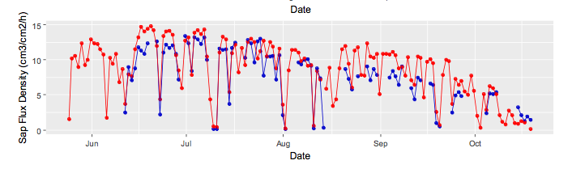
Hubbard Brook: Red Maple Sap Flow
No Significant difference between control and drought plots
2016 drought less severe?
Throughfall removal not effective?
Red maple known to be highly plastic : greater drought tolerance or ability to adapt?
Notes:
Our results for the drought experiment at Hubbard Brook were very different from Thompson farm, as we did not see any significant differences in tree water use in the drought plots vs. control plots.
Some possible reasons to explain these results: 1) the natural drought was less severe in central NH; (2) the plots were smaller and on steep slopes, so there may have been some lateral flow of water into the drought plots; (3) red maple is a highly plastic species that grows successfully on a range of different sites (e.g., from dry rocky ridge tops to swamps; from Maine to Floriday); thus, it may have greater capacity to adapt to or tolerate drought compared with red oak and white pine.

Slide 30
Sensitivity and resilience of Sugar Maple to Climate Change: What do (don’t) we know?
Vernal window for sap production earlier and more variable
Sensitive to root damage: thin snow layers; soil freeze-thaw cycles (Bertrand et al. 1994)
Soil freezing = lower sap volumes and sugar released during the season (Robitaille et al. 1995).
Warm winter temperatures = lower soluble sugar concentration in sap (Bertrand et al. 1999).
Increasing WUE may reduce drought stress (CO2 response)
Non-structure carbohydrate (NSC) storage and mobilization…
  Sugars and starches stored by trees as reserves to support metabolic functions, growth, and repair during stressful times
  “Buffering capacity” to survive drought?
Notes:
Wanted to end with trying summarize some of what we know – and don’t know – about… and what are some of the implications for syrup production
Many of these aspects you are probably more familiar with than I am. E.g., vernal window…earlier...adjust management practices.
SM is particularly sensitive to root damage (perhaps due to VAM?) – likely increase with climate change. This has implications for sugaring...
One that I’d like to focus on a bit more is NSCs...stored in leaves, branches, stemwood, roots
NSCs (sugars and starch) stored by trees as reserves to support metabolic functions and growth during stressful times.
Sap season determined by the climate during the time of year when things are changing the most – Feb – March (vernal window) – becoming more variable (challenges: predictability, quality)
Need snow on the ground for the sap to be running during leaf off season; need nights below freezing and days in the 30-40s (leaves out – too late; sugar concentrations go down because leaves need it)
SM = VA mycorrhyze, more of an inorganic N (EM species – can organic N)

Slide 31
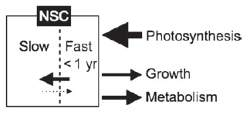
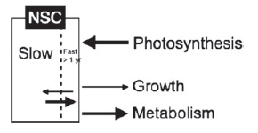
NSC Dynamics in Red Maple: Conceptual Model
High Vigor Trees
Mean age of NSCs: 10 y
Vigorous trees:
  Larger and younger NSC pools
  Used younger NSCs (< 1 yr)
  Fast pool
Low vigor trees:
  Smaller and older NSC pools
  Relied on older NSCs (> 1 yr)
  Slow pool
Stump sprouts – remobilized older NSCs for growth (17 yrs)
Buffering capacity!
Low Vigor Trees
Carbone et al. 2013

Slide 32
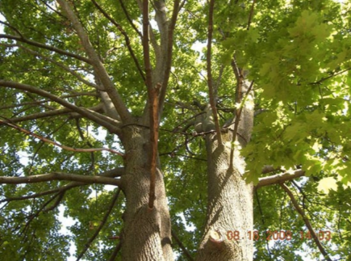
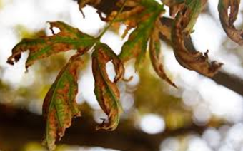
NSC Dynamics:
How buffered are sugar maple trees?
European deciduous trees: NSC can re-foliate canopy 4X (Hoch et al. 2003)
Spring heat wave (Ontario, 2010): SM shed 25% leaves, 2nd flush of neoformed leaves; LAI 64% lower (Filewod & Thomas 2013)
Unknown: Capacity of trees to mobilize old NSC under stress (drought)?

Slide 33
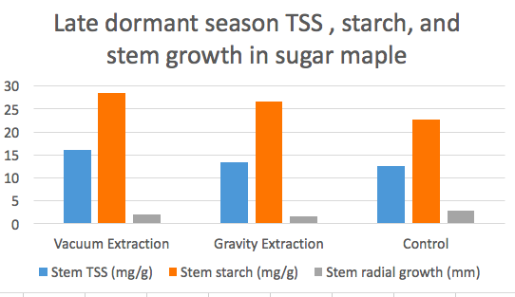
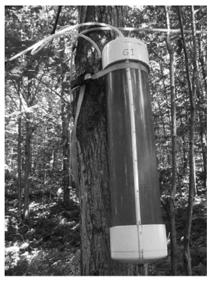
Effect of Tapping Syrup on
Non-Structural Carbohydrates (NSCs)
Isselhardt et al. 2016
Tapped trees stored more NSCs in stemwood and showed reduced stem radial growth vs. untapped trees
Vacuum sap extraction (VSE) showed more pronounced effects on NSC storage than Gravity sap extraction (GSE).
Notes:
TSS= total soluble sugars; These results suggest that the tapped trees may be prioritizing storage of carbohydrates at the expense of growth. This also raises the question of how these processes change over time with many years of tapping and in response to other factors, such as climate variability. There is still a lot we don’t understand about NSC dynamics and how management practices such as tapping of syrup influence the storage and mobilization of NSCs. More work is needed on this topic.

Slide 34
Alternative Syrup-Producing Species?
Drought tolerance class
 | Species’ range | Models (-3 - +3)
Sugar maple | Intolerant | -1
Red maple | Moderate | 1
Birch species | Moderate | -1 to -2
Sycamore |  | 1
Hickory species | Tolerant | 2 to -2
Red oak | Tolerant | 1
Nowacki & Abrams 2015
Abrams & Nowacki 2015
Peters et al. 2015
Notes:
Note: these drought tolerance classes are very general, and there are also many inconsistencies in the literature about different species’ drought tolerance. More work is needed to refine our understanding of species’ ability to tolerate or adapt to drought. However, there is some suggestion that red maple may be more drought tolerant than sugar maple or birch.

Slide 35
Summary and Future Research Directions
Sugar maple does not appear to be very sensitive to historical variability in moisture availability
Sugar maple may be more sensitive to previous season temperature (affect on NSC?s?)
Red maple may have greater capacity to tolerate or adapt to moisture stress
More work is needed to understand drought sensitivity and resilience of sugar maple, and implications for syrup production.
Experimental drought manipulations provide a useful approach for pushing ecosystems beyond ecological thresholds that they may experience under future climates.

Slide 36
Acknowledgements: Collaborators
Collaborators and Partners:
Mark Green (PSU)
John Campbell (USFS)
Lindsey Rustad (USFS)
Katie Jennings
Cameron McIntire
Adam Coble
Lauren Buzinski
Katherine Eggemeyer
Stacie Powers
Dan Bishop (Columbia LDEO)
Land owners / managers:
UNH
USFS Northern Research Station
White Mountain National Forest
SUNY-ESF
U. Maine
Penn. State U.
State of NY
State of VT
USGS
Notes:
REMOVE THE NAMES IN RED IF YOU CUT THE MELNHE STUFF.

Slide 37



Acknowledgements: Funding

Slide 38
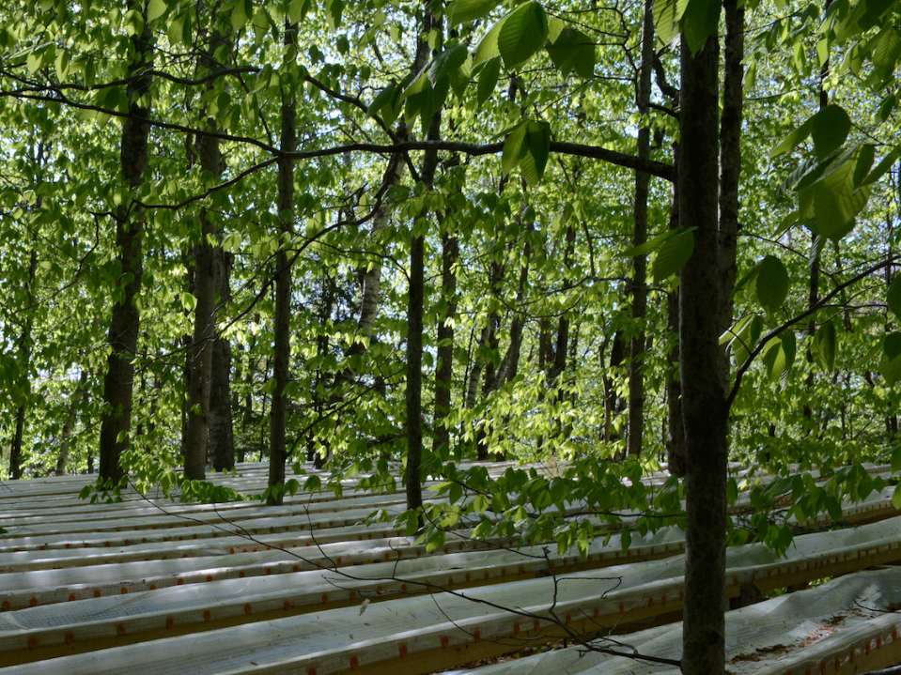
Thank you! Questions?

