Slide 1
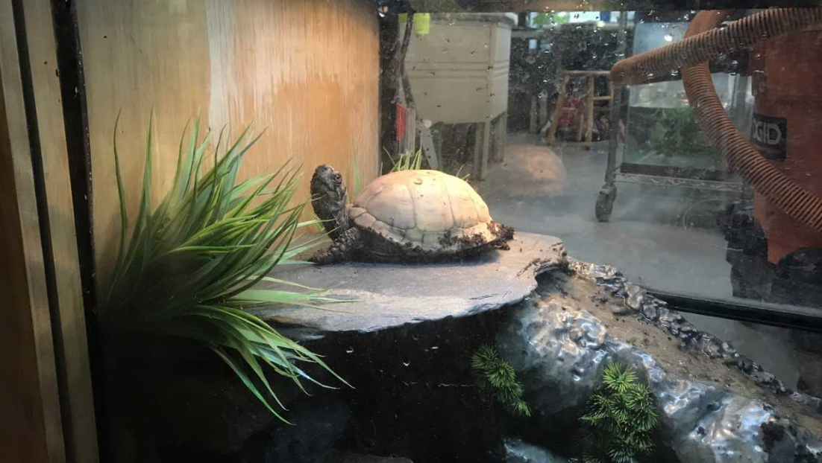
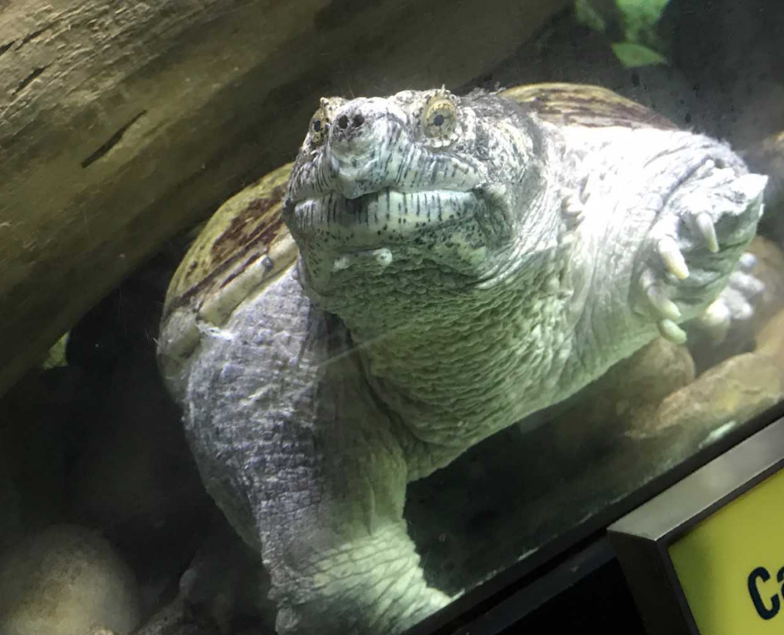
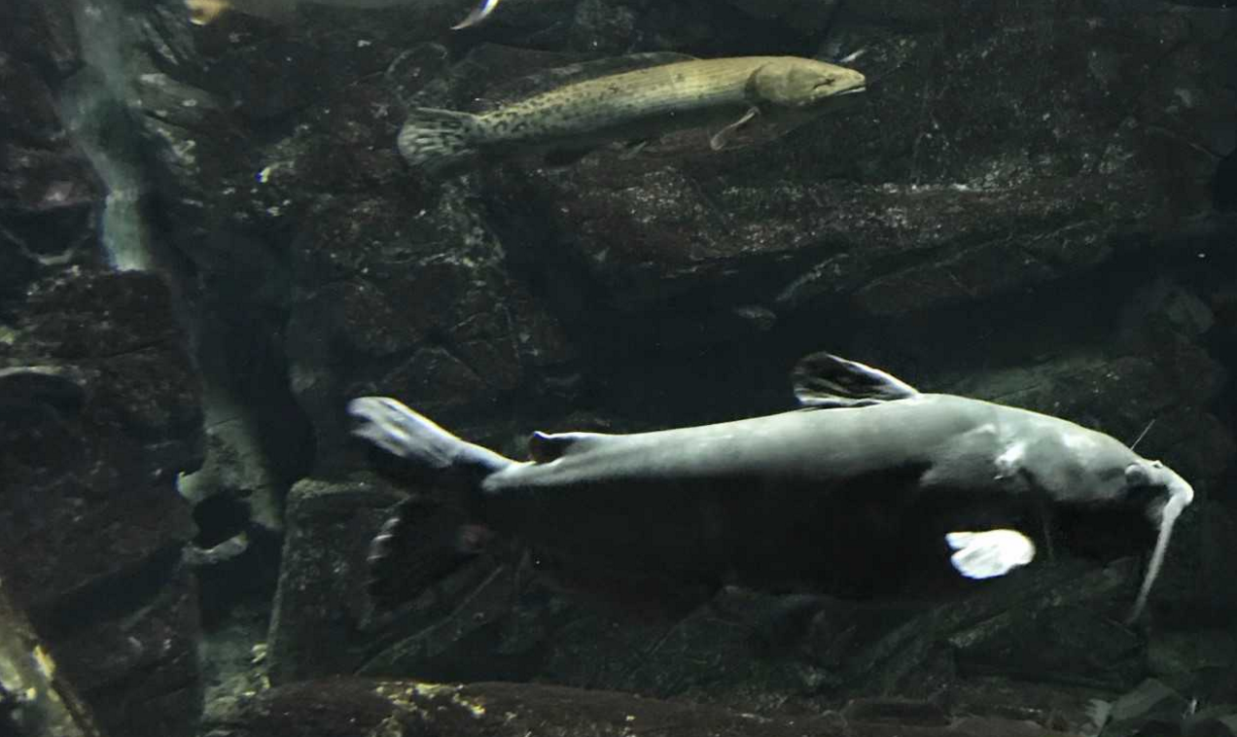
ECHO Leahy Center for Lake Champlain
A non-profit organization dedicated to education and care of Lake Champlain and global environments, scientific discovery, and wonder of nature for all ages
Animal Care Internship
Feeding
Variety of different diets and feeding methods
Cleaning
Daily habitat cleaning and building
Daily responsibilities include cleaning animal exhibits (aquatic, terrestrial, or vivarium), feeding animals (often by hand), building habitats within exhibits, and assisting animal care staff in regular duties. I was also able to attend presentations on many of these animals.
Internship provides exposure to many different types of animals and care methods specific to each of them. My favorite part of the internship was learning about these animals that I had not had exposure to before, such as sturgeon, dart frogs, and snakes.
Contact ECHO at: 1 College Street, Burlington, VT, or at info@echovermont.org

Slide 2
Photo 1- Animal Handling
This photo shows me holding a box turtle. I learned to handle all different types of animals in my time interning in the animal care department at ECHO, including different types of turtles, toads, frogs, and more. I had to be supervised three times holding/transporting an animal successfully, and then I was allowed to do it on my own without supervision. This box turtle was being placed back in his exhibit tank after being moved into a plastic container while I cleaned his tank.

Slide 3
Photo 2- Terrestrial Habitats
During daily cleanings, I often cleaned 2 main types of habitats- terrestrial and aquatic. In this photo, a turtle is in a terrestrial habitat that I cleaned every other week. I do complete disinfects on terrestrial habitats at least once a month, and regular cleanings in between the disinfects. Some other terrestrial tanks I clean are those of the spotted salamander, the spring peepers, the red bellied snake and the toad. I even got to help design the new terrestrial habitats for the latter two animals, because they were getting upgrades (doubling their tank sizes), so I got to help design and set up how all of the rocks would go in the tank after every clean, and how the fake plants and water bowls would be arranged. This habitat designing experience was unique and a really interesting part of my experience.

Slide 4
Photo 3- Aquatic Habitats
In addition to terrestrial habitats, I also cleaned many aquatic ones, including the crustacean tank, two different eels, the shipwreck tank, and the semi-aquatic green frog tank. In this photo, I am mixing salt and other minerals into chilled water. I then use a reflectometer to make sure the salt level is the same salt level that is in the original tank water. These aquatic systems either use chilled or ambient-temperature water. They do not get a full disinfect like the terrestrial habitats do because it would be very difficult to catch and move an eel or capture every tiny hermit crab. Instead, they get a 30% water change every week, which is part of my job in taking care of them.

Slide 5
Photo 4- Cleaning
There are different ways to clean different animal tanks. In the photo, I am cleaning an aquatic tank that a male eel lives in. For these aquatic tanks, I use something called a Gravel-Vac (basically a dirt vacuum) to suck up all the dirt from between the rocks at the bottom of the tanks. All of the large “furniture” (tubes, caves, etc.) are washed and disinfected, then rinsed again before returning to the tank. The tank is then filled with clean, dechlorinated water. The canister UV filter is then taken care of, rinsing the filter pads and draining the excess dirty water. The terrestrial tanks have the furniture pieces disinfected in the same way that the aquatic ones do, but instead of replacing the water, the soil at the bottom of the tank is what is being replaced.

Slide 6
Photo 5- Feeding
Photo 5 features an animal that I attempt to feed on a regular basis- a male American eel. Different animals have different dietary needs, as well as feeding methods. For example, this eel needs to be fed eels using tweezers to feed it to him. Some fish at ECHO need to be fed by hand, right out of one’s palm. Other fish are fed with a syringe, and some just get food thrown into their tank and they eat it out of the water. I have gotten to feed a variety of these animals (I work on fish-feeding days), and it is interesting how different they all are in their requirements.

Slide 7
Photo 6- Kick Start Program
I have gotten the opportunity to see the kickstart program for baby turtles in action at ECHO. This program collects baby turtles (often softshell turtles but occasionally map turtles as well) just after they have hatched, and raises them until they are a bit bigger and stronger than they would have been in the wild, and then releases them. The hope is that this gives them a larger chance of survival once they are released than they would newly-hatched. I have been able to assist in their fungal treatments, observations, and even helping move them from tank to plastic bin and back. This program is a big feature at ECHO and it has been so informative getting to watch this being done and it actually having a visible impact on wild populations.

