Slide 1
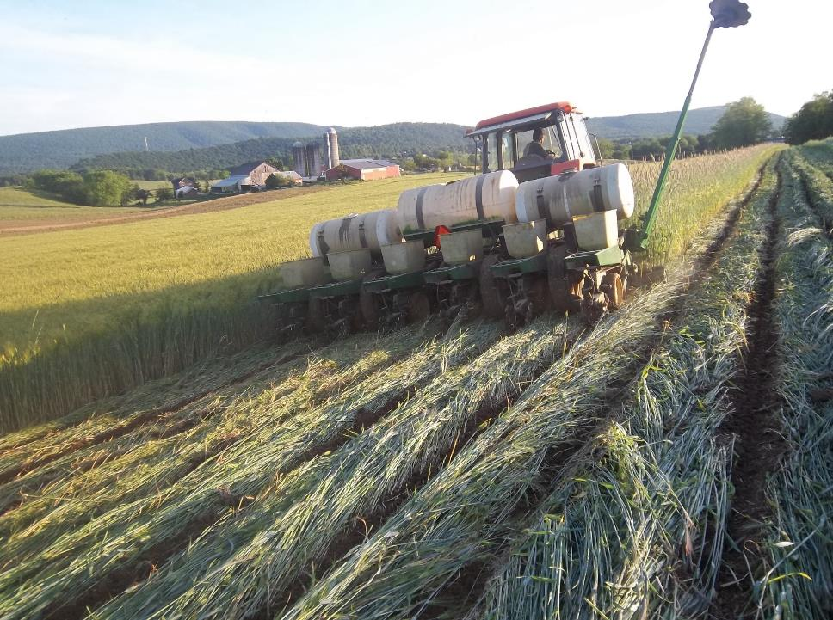

No-Till & Cover Crop Research
Heather Darby
UVM Extension Agronomist

Slide 2
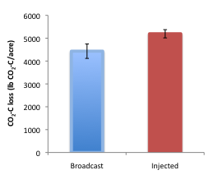
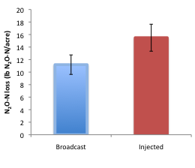
No-Till & Manure
Coming in 2017 – Full Carbon and Nitrogen Accounting in Vertical, No-Till, and Full-Till with broadcast or injected manure with or without cover crops.

Slide 3
Cover Crop Effect on Soybean Yield
B
A

Slide 4
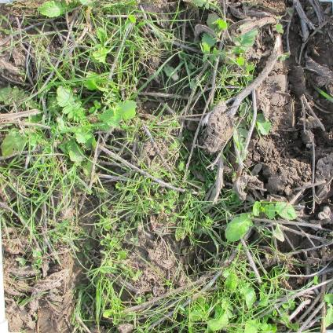
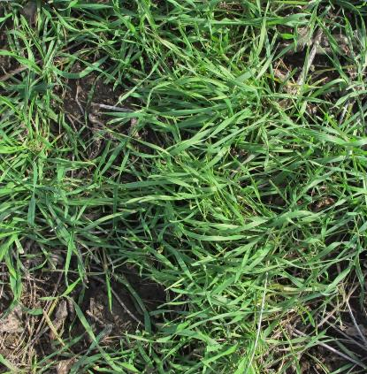
Cover Crop Treatments
Mix 2 (100 lbs ac⁻¹)
VNS Winter Rye (25 lbs ac⁻¹)
Ryegrass
Crimson clover
Arifi radish

Slide 5
Cover Crop Treatment x Percent Cover

Slide 6
Planting Date x Percent Cover
A
B

Slide 7
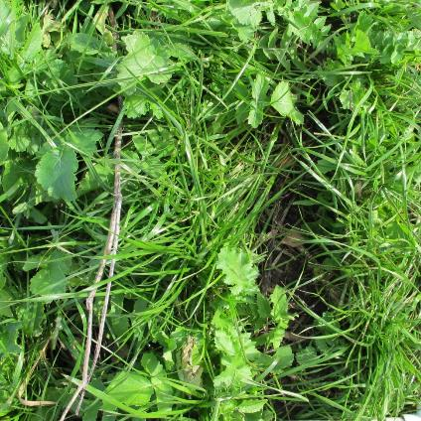
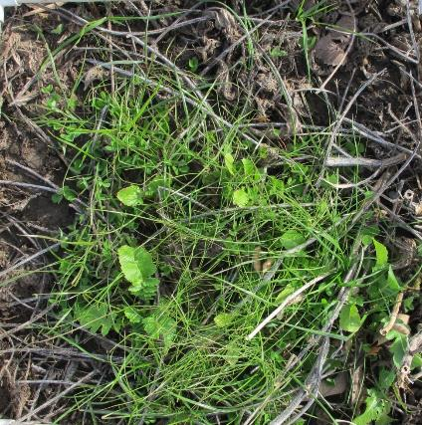
Seeding Methods
Interseeded
Hand Broadcasted

Slide 8
Seeding Method x Percent Cover
B
A

Slide 9
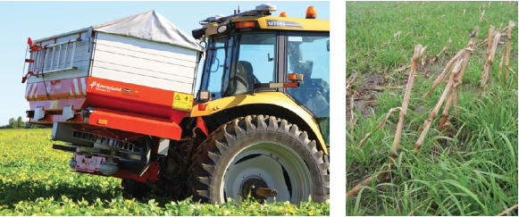
Cover Crop Interseeding - Timing

Slide 10
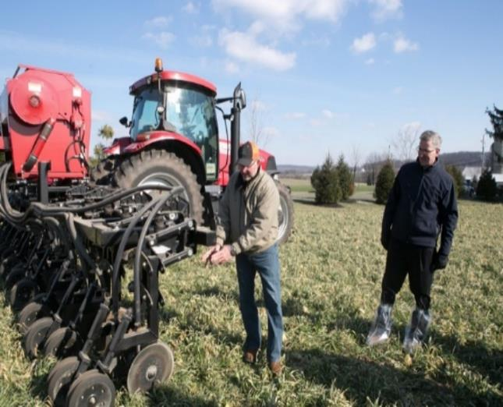
DuoSeeder
Interseeding Cover Crops

Slide 11
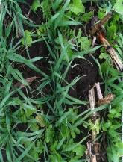
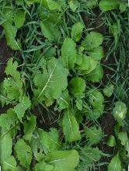
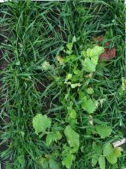
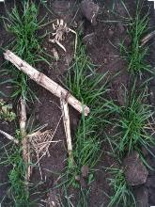
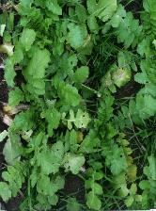
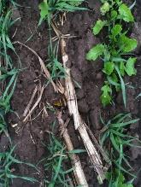
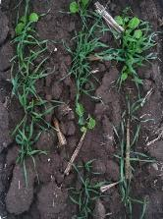
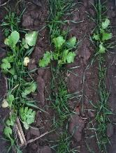
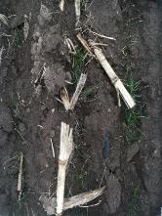
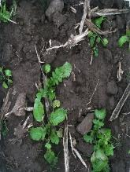
Everleaf Oats and Groundhog Radish
Winter Rye, Milvus Clover, T-Raptor Brassica
Soil Builder: TriCal Triticale, MOI and KB Supreme Ryegrass, Crimson Clover, Hairy Vetch, Daikon Radish
Prince Brand Rye Grass and Milvus Clover
Indy Mix: Tillage Root Max Ryegrass, Crimson Clover, Tillage Radish

Slide 12
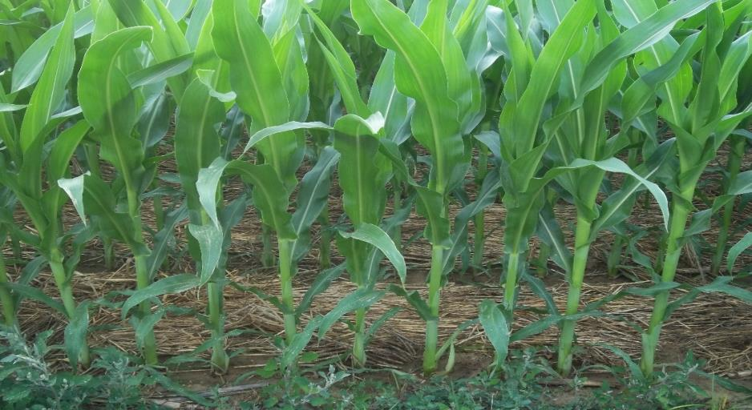

Slide 13
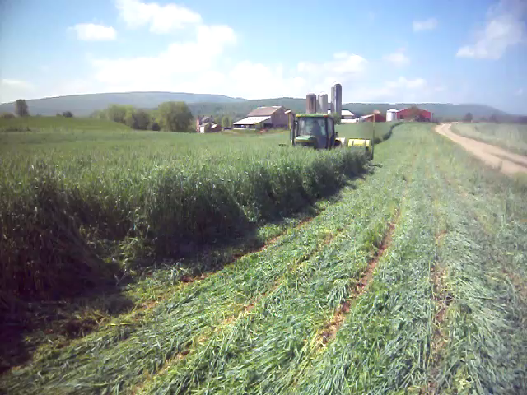

Slide 14

Planting on a bed of lush carpet

Slide 15
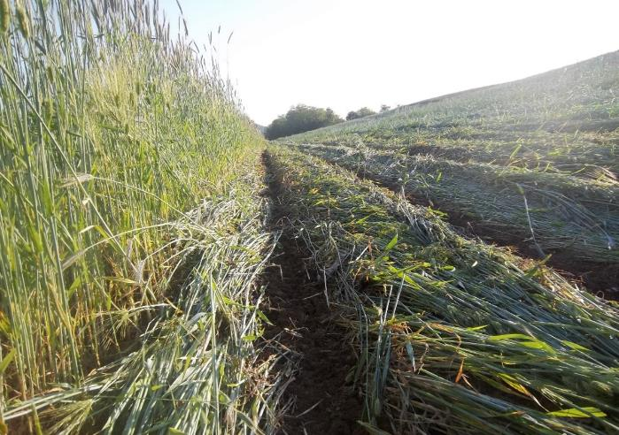

Slide 16
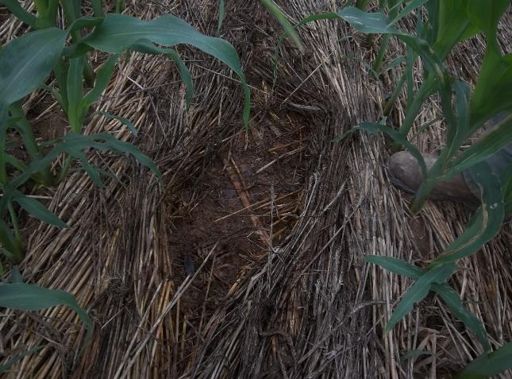
Moisture/Erosion Control
With every Rain drop

Slide 17
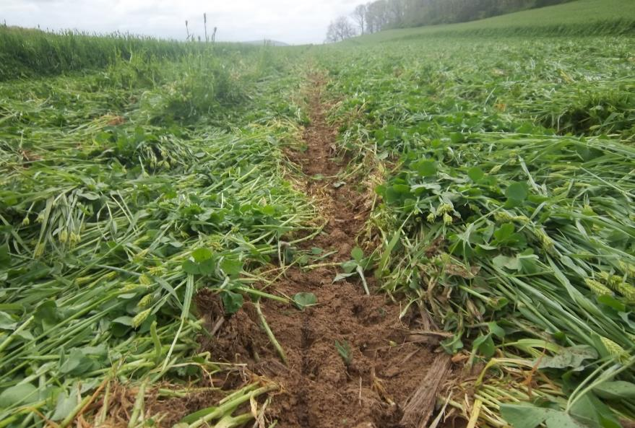

Slide 18
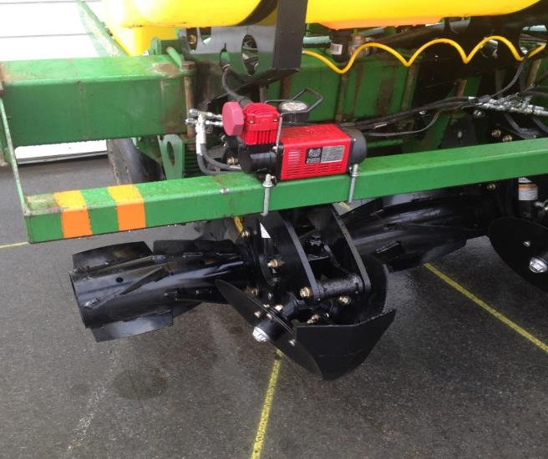
ZRX-Zone Roller

Slide 19
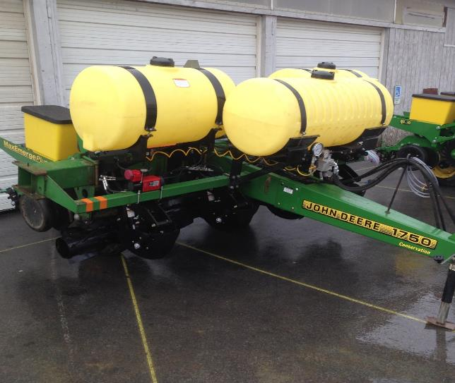
The Bradford 4 Row- ZRX
Sign up today

Slide 20
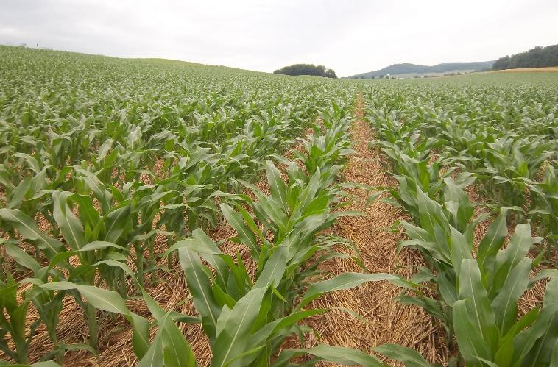

Slide 21
Charlie Martin Farm
Perry County, Pennsylvania Latitude - 40.37
(name of soil) fields
Averaging fields of 5- 18% slopes
Average Yearly Rainfall- 39.6 inches
Average planting date Conventional - End of April- beginning in May
Average planting date Rolling- Beginning of May – Mid May
Average planting date Organic Rolling – End of May – Early June
Animals- 150-200 head of cattle
Storage
120 tillable acres
  95 acres Corn- ½ Silage, ½ high moisture/dry (32,000 population)
  25 acres Barley for grain/Double crop Soybean
  All acres gets planted into cover crops
    Cereal Rye
    Working cover crop mixes into more and more acres

Slide 22
Charlie Martin-Fertility Program
200 Bushel Corn average and climbing
Soil test every 3 years
Lime/Potash added as needed
Manure from 150-200 head of cattle (Feed Lot)
Average 8-10 ton of pen pack on total acres
Nitrogen 100 units per acre- Planting (12 gal), Side dress (22-26 gal dribble on with sprayer - Standard Liquid 28%N

Slide 23
Charlie Martin- Herbicide Program
1 quart of Glyphosate with 1 ounce of Bases- same day or next day from planting
Spraying to assure control of cover crops --not for weeds
Second pass if needed- lambs quarter, red root, fox tail, common weed issue where cover crop is light
$15.00 PER ACRE AVERAGE COST

Slide 24
Charlie Martin- Pesticide Program
GMO corn-rootworm concerns
Nothing gets sprayed
Slugs and other pests are kept in balance by a healthy population of predator insects population, This is a benefit from planting into green cover crops

Slide 25
Charlie Martin-Tillage Program
No Tillage is done on his farm – 15 years of No-Till (2001)
Rolled cover crops for 5 years (2011)

