Slide 1
Vermont Farmers
In 2015 –
16,259 acres of cover crops planted on 1,299 fields throughout Vermont.
In 2016 –
25,227 acres of cover crop planted on 2,000 fields throughout Vermont.

Slide 2
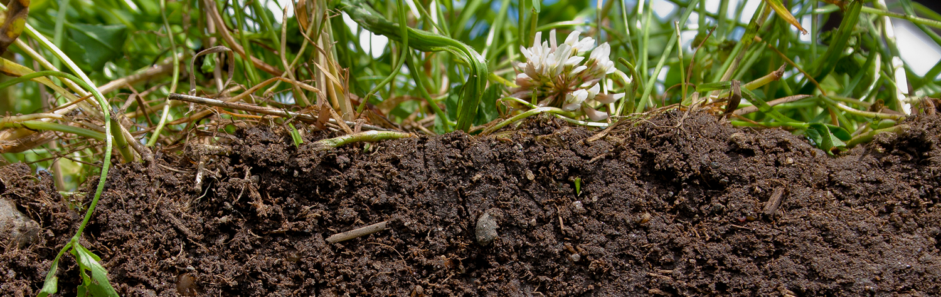


UVM Extension Field Trials
Jeff Carter
UVM Extension
Agronomy Specialist
Middlebury, VT

Slide 3
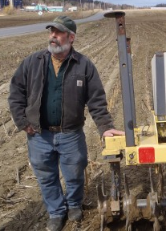
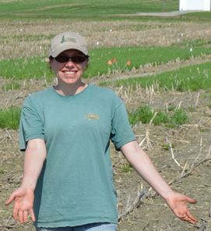
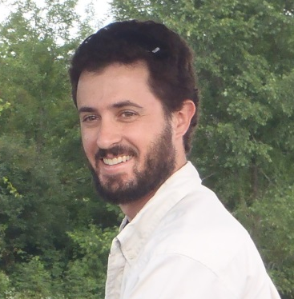
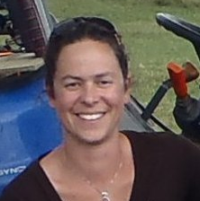
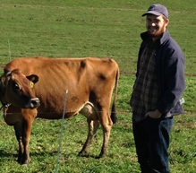
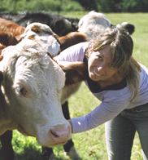
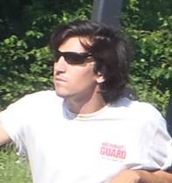
Champlain Valley Crop, Soil & Pasture Team
Forages & Crops
Grazing & Pastures
Nutrient Management
No-Till
Cover Crops
Soil Health
Agronomy Technical Assistance
Rico
Kristin
Jeff
Nate
“We are proud to work with farmers throughout the Lake Champlain Basin to investigate and share techniques to grow the highest quality crops in the most efficient way, while protecting soil health and water quality.”
Kirsten
Dan
Cheryl

Slide 4


Sustaining Rural Farm Communities in Vermont
Evaluating the Potential for Forage Radish to Enhance Winter Rye Cover Crops
This material is based upon work that is supported by the National Institute of Food and Agriculture, U.S. Department of Agriculture, under award number 2014-68006-21864.

Slide 5
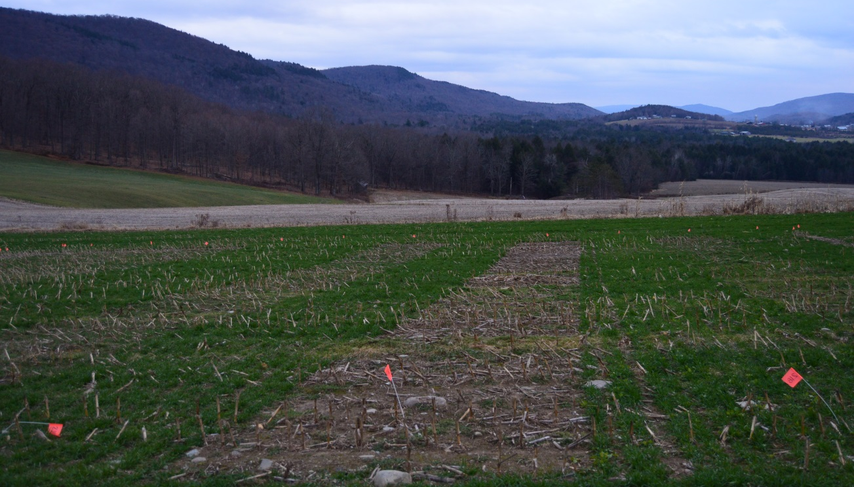
Potential for Forage Radish to Enhance Winter Rye Cover Crops
Masters Thesis
Farmers
  Clifford Farm (Starksboro)
  Vorsteveld Farm (Panton)
Randomized Complete Block with four replications
5 Site years over two growing seasons
  3 in 2014-2015
  2 in 2015-2016
10 Treatments + Negative Control
Planted after ‘timely’ corn silage harvest (early - mid September)
Liquid Dairy Manure @ planting after seeding
‘Danko’ Winter Rye
‘Tillage Radish ® ‘
No-Till Grain Drill | Broadcast
112 lbs/acre Winter Rye | 112 lbs/ acre Winter Rye
85 lbs/acre Winter Rye | 85 lbs/acre Winter Rye
85 lbs/acre Winter Rye + 3 lbs Tillage Radish® | 85 lbs/acre Winter Rye + 3 lbs Tillage Radish®
60 lbs/acre Winter Rye | 60 lbs/acre Winter Rye
60 lbs/acre Winter Rye + 3 lbs/acre Tillage Radish ® | 60 lbs/acre Winter Rye + 3 lbs/acre Tillage Radish ®

Slide 6
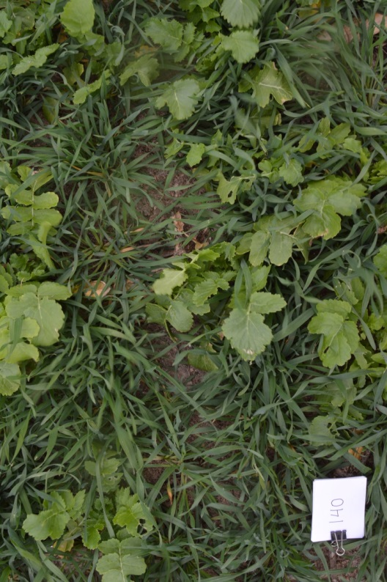
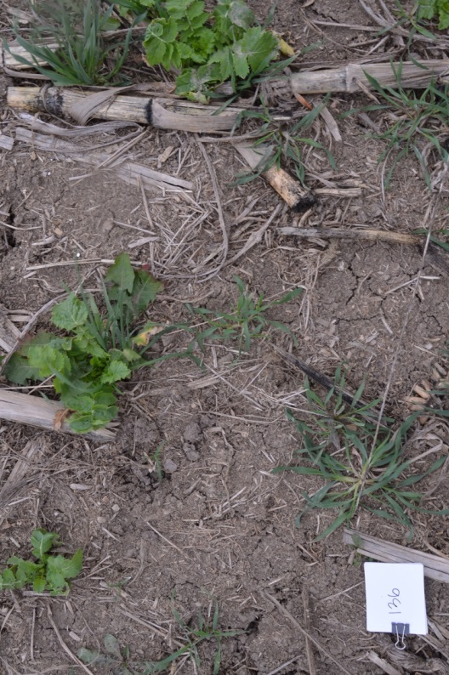
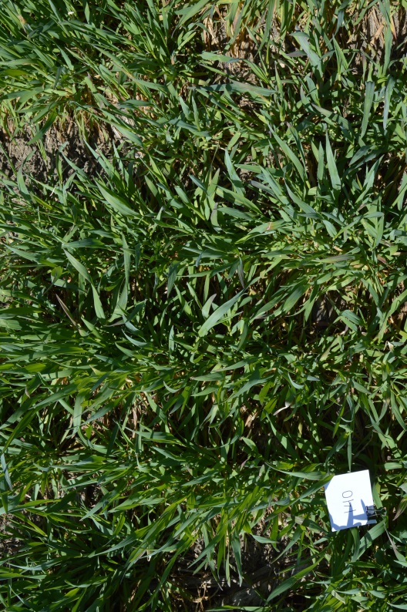
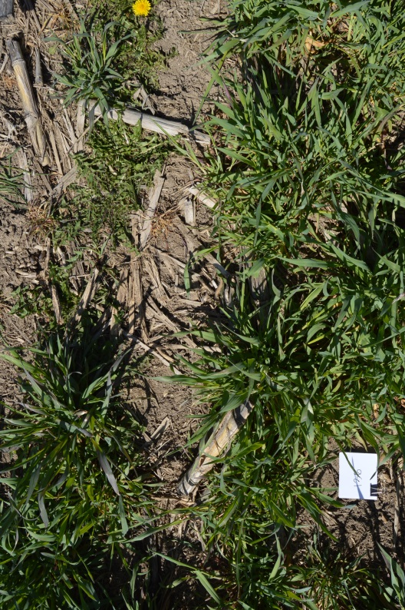
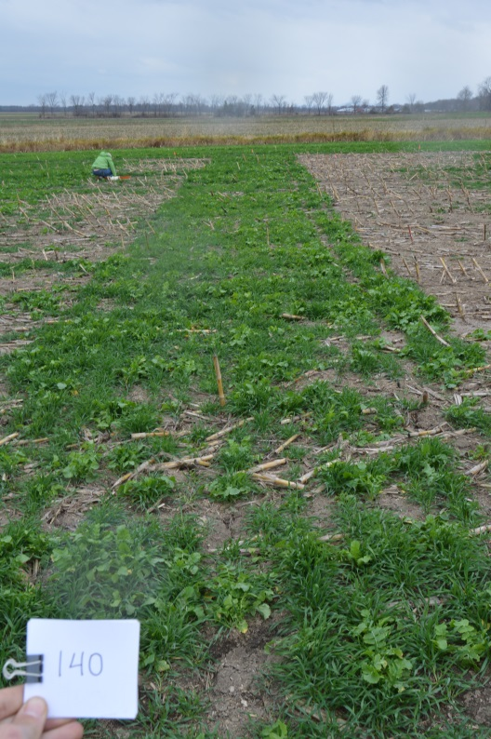
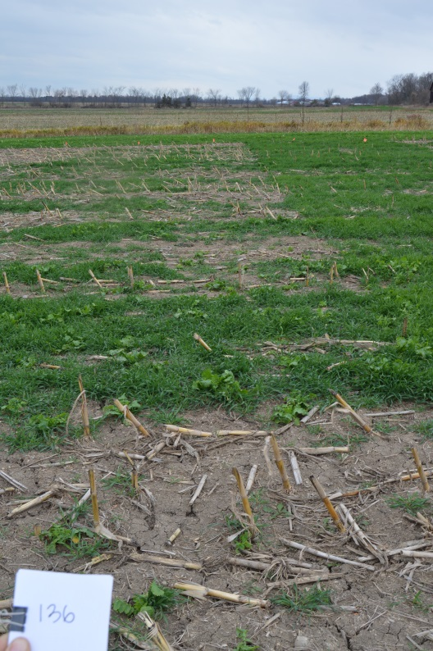
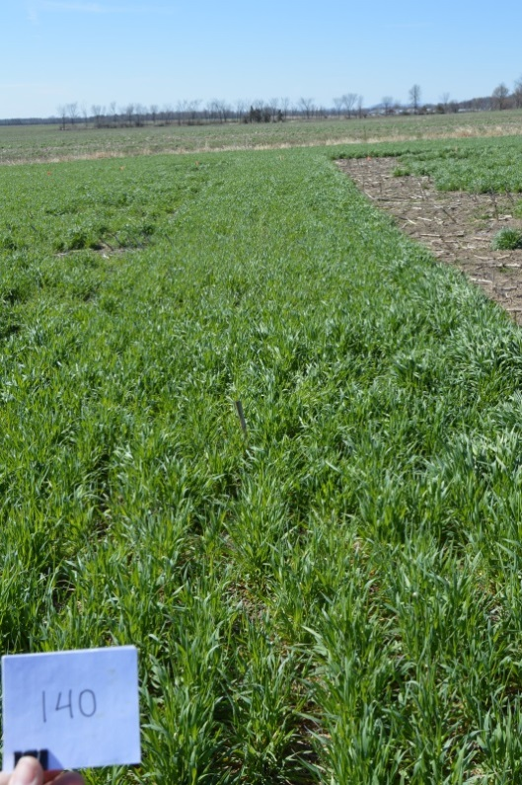
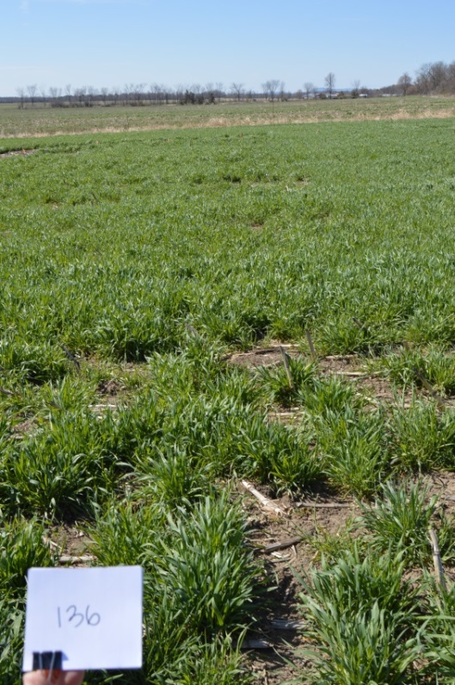
Fall 2015
85 lbs Winter Rye
+ 3 lbs Radish
Spring 2016
Drilled
Broadcast
Drilled
Broadcast

Slide 7
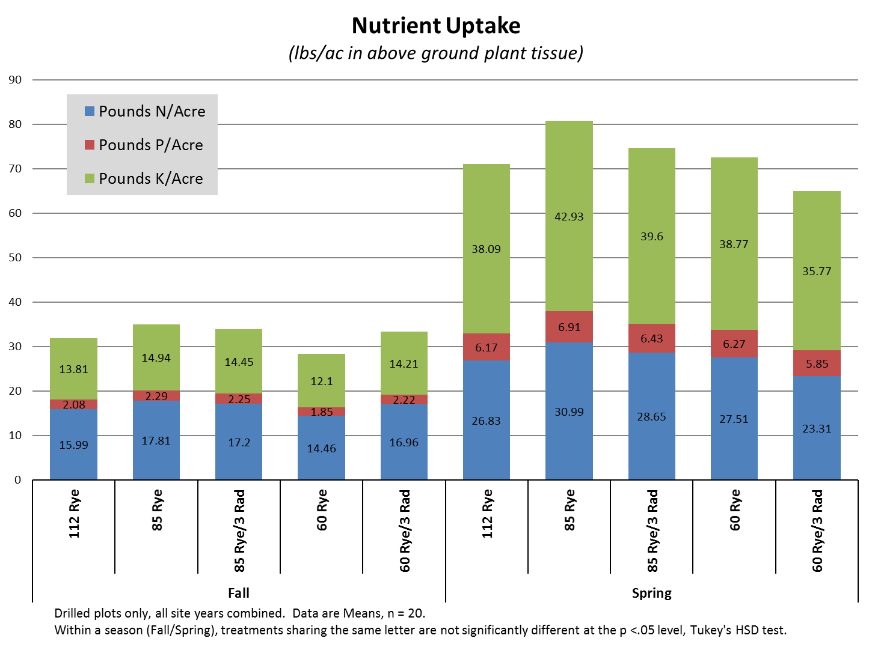

Slide 8
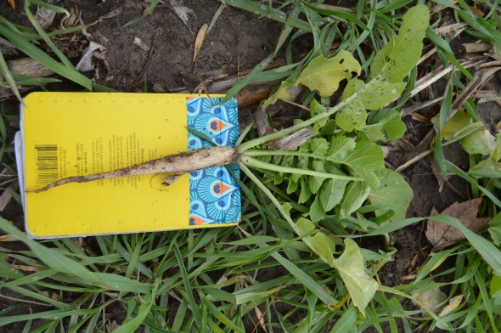
Does Adding Radish Increase Biomass ?
FALL

Slide 9
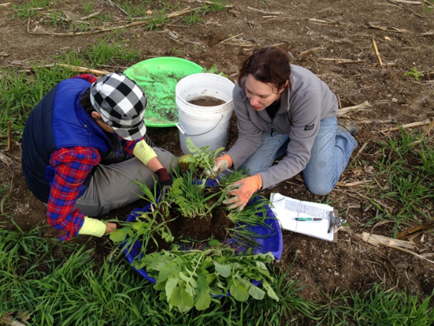


NRCS Vermont Conservation Innovation Grants
BETTER COVER CROP MIXES IN VERMONT
USDA NRCS Vermont State Conservation Innovation Grant
# 69-1644-13-5

Slide 10
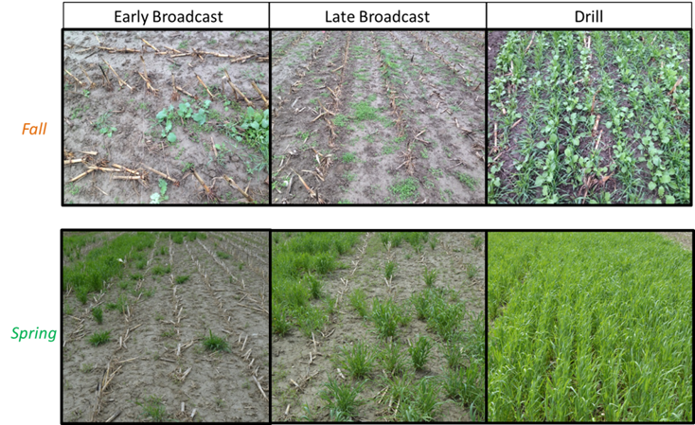
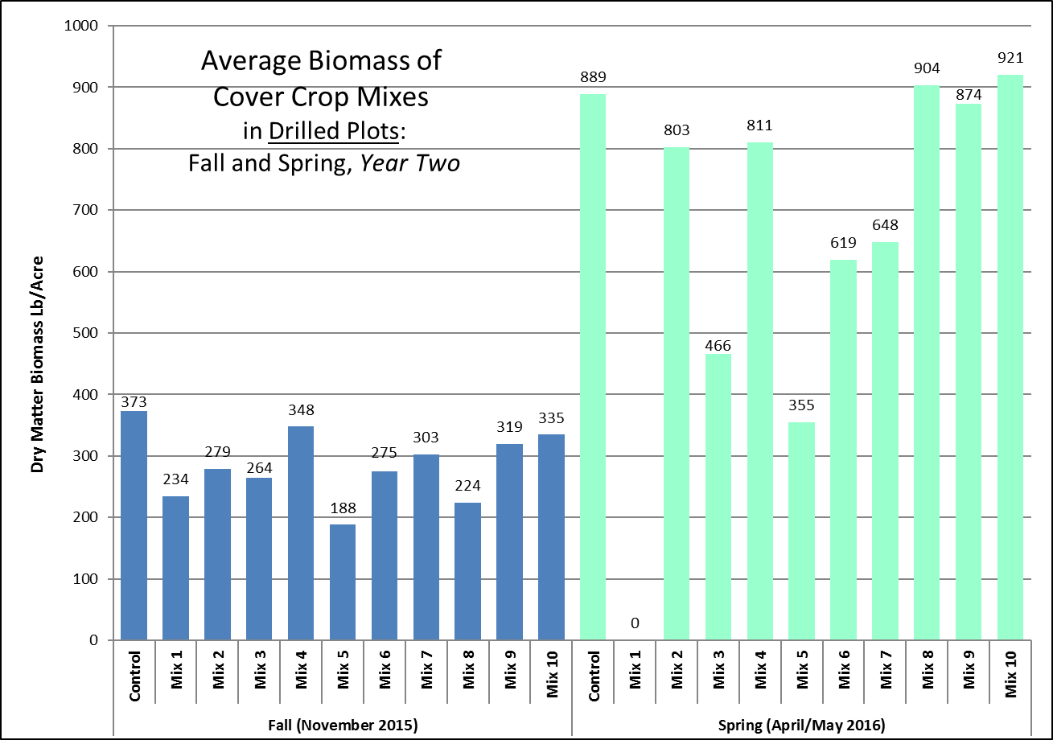
10 Different 3-Way Mixes

Slide 11
10 Different 3-Way Mixes

Slide 12
3-Way Cover Crop Mixes for Vermont

Slide 13
NRCS Vermont Conservation Innovation Grants
SOIL HEALTH DEMONSTRATION FARM
ON CLAY SOIL
USDA NRCS Vermont State Conservation Innovation Grant
# 69-1644-13-5

Slide 14
Prevented Planting Fields - Renovation with Subsoiling, Cover Crops and No-Till

Slide 15
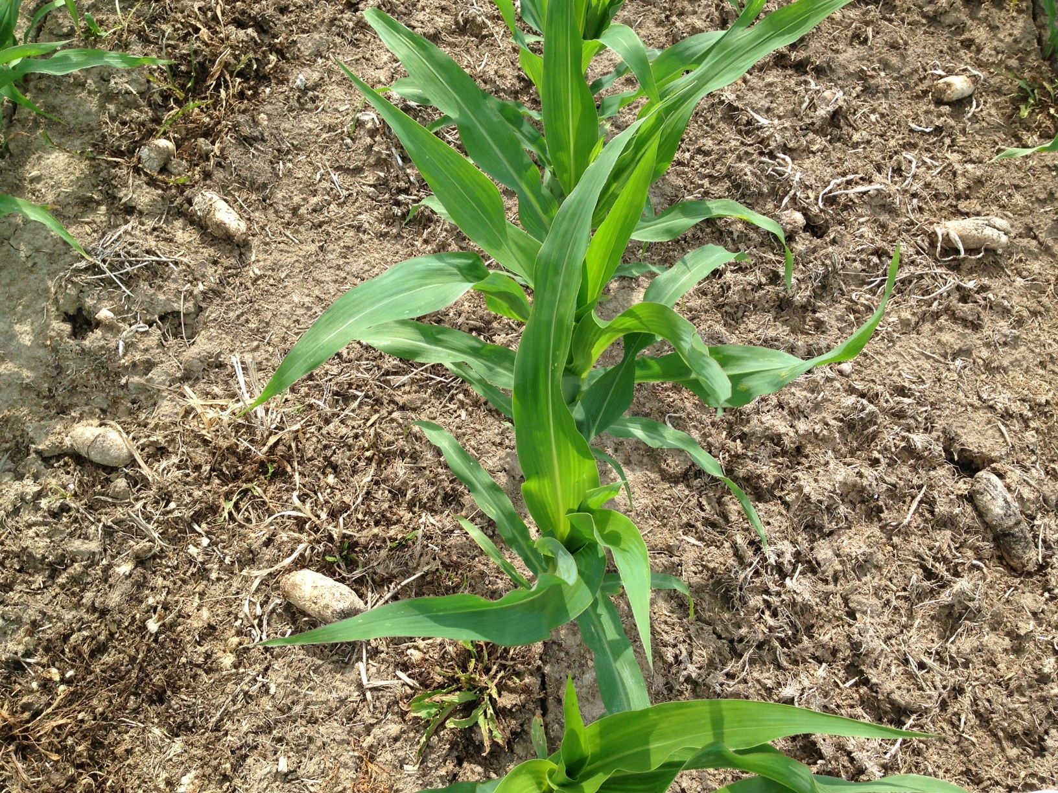
Cover Crop Mixes in No-Till Corn
Foster Brothers Farm East Middlebury, VT

Slide 16
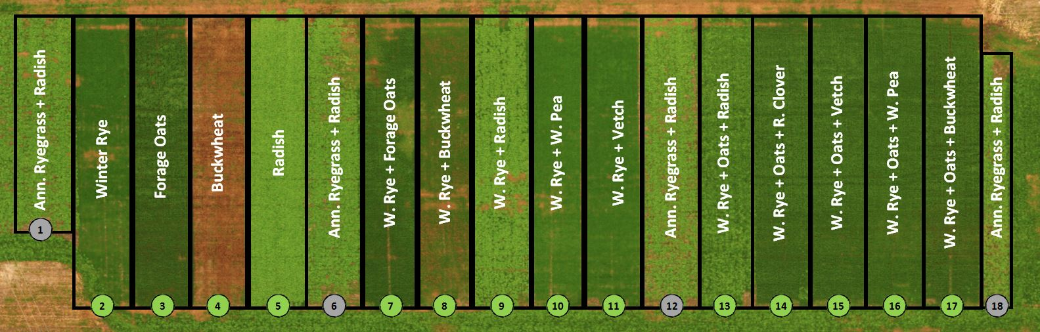
Cady Cross Road – East Middlebury
 | 1 | 2 | 3 | 4 | 5 | 6 | 7 | 8 | 9 | 10 | 11 | 12 | 13 | 14 | 15 | 16 | 17 | 18
 | ARG | Rye | Oat | Buck | Rad | ARG | Rye | Rye | Rye | Rye | Rye | ARG | Rye | Rye | Rye | Rye | Rye | ARG
lbs/ac | 19 | 75 | 75 | 60 | 10 | 19 | 60 | 60 | 60 | 60 | 60 | 19 | 50 | 50 | 50 | 50 | 50 | 19
 | Rad |  |  |  |  | Rad | Oat | Buck | Rad | Pea | Vetch | Rad | Oat | Oat | Oat | Oat | Oat | Rad
lbs/ac | 6 |  |  |  |  | 6 | 60 | 30 | 6 | 40 | 30 | 6 | 50 | 50 | 50 | 50 | 50 | 6
 |  |  |  |  |  |  |  |  |  |  |  |  | Rad | Clov | Vetch | Pea | Buck
lbs/ac |  |  |  |  |  |  |  |  |  |  |  |  | 4 | 6 | 20 | 30 | 25

Slide 17
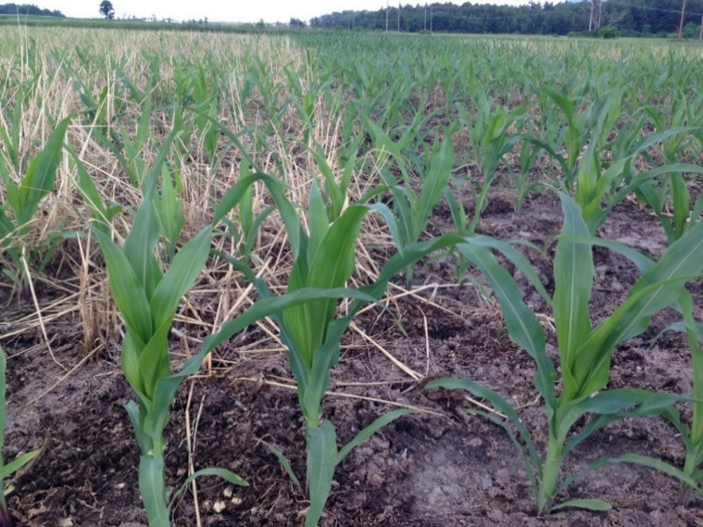
Methods
2015
Cover Crops Planted 8/20/15
Forage Samples 10/1/15
Compaction and Moisture 11/5/15
Soil Health Test 11/11/15
2016
Forage Samples 4/20/16
Percent Cover, Temperature and Moisture 4/21/16
Temperature and Moisture 4/22/16
PSNT Sample 6/26/17
Applied Urea 6/28/16
Corn Yield 9/14/16
2017
Cover Crops Planted 9/22/16
Forage Sampled 11/18/16
Data to be collected Spring 2017

Slide 18
Fall 2015 & Spring 2016 Cover Crop Biomass
Single Species
2X MIX
3X MIX

Slide 19
Phosphorus (P lb/ac) in Cover Crop
Winter rye in mix generally greater fall phosphorus uptake than alone
Winter rye with buckwheat and winter pea maximized both fall and spring phosphorus uptake
Winter rye alone did not produce as much biomass or phosphorus uptake in the fall but did in the spring
Radish alone maximized fall phosphorus uptake – it may be either easier to take up by corn and/or lost via leaching in the spring

Slide 20
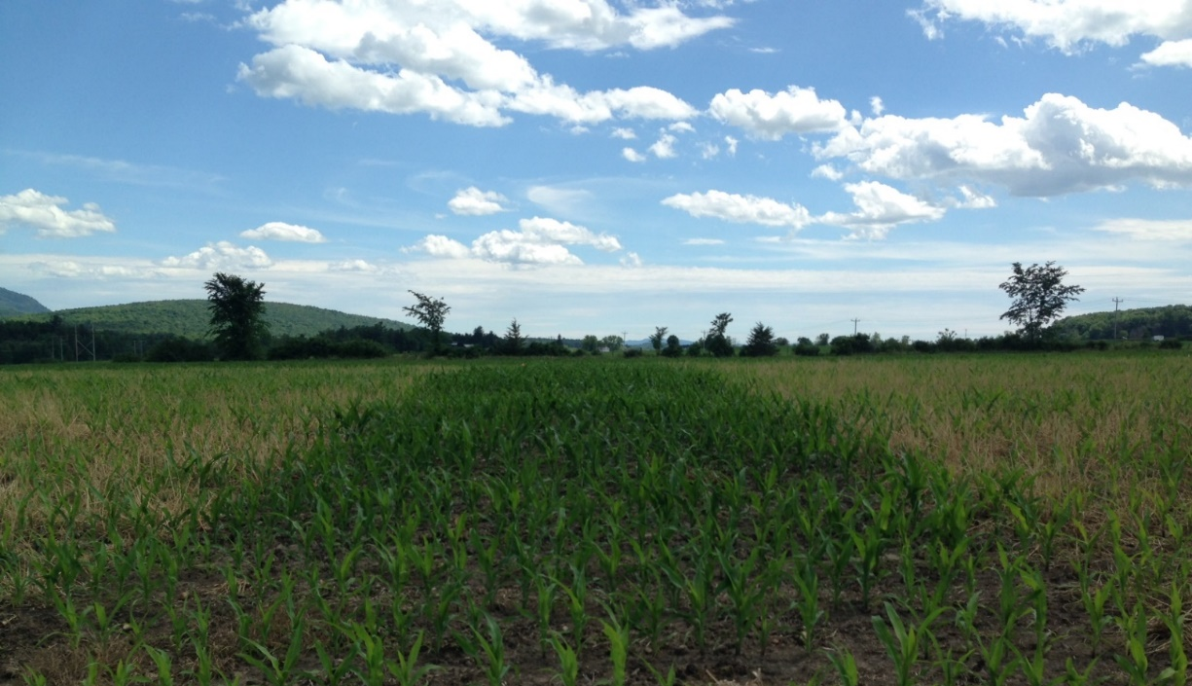
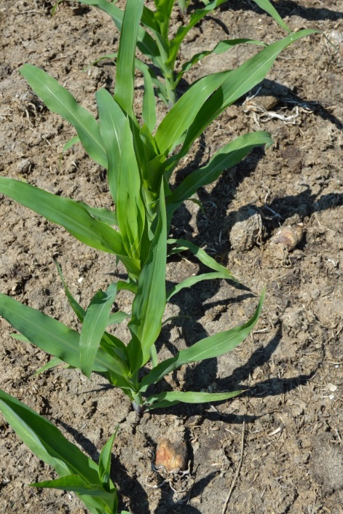
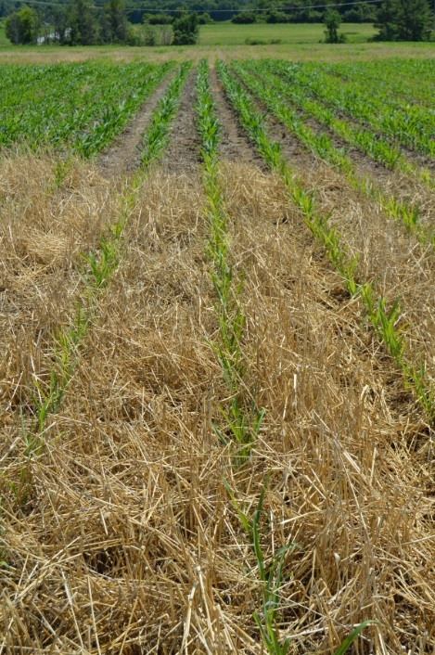
Nitrogen Immobilization or Allelopathy ?
Observations: Physical v. Chemical Issue?

Slide 21
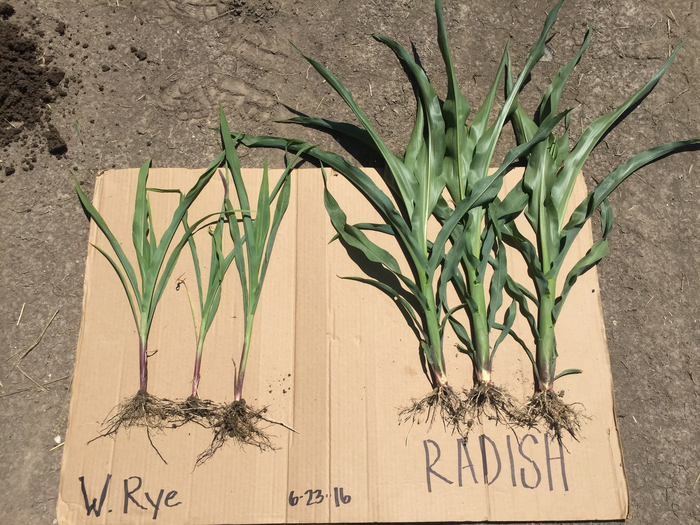
OH Oh, now what ?

Slide 22
Nitrogen (lbs/ac) in Cover Crop & PSNT
Radish alone lead to higher N in fall uptake, greater spring PSNT (also buckwheat)
However, radish in a mix with rye had higher N in fall uptake, but not translated into as high a spring PSNT
Vetch was the only legume that matched radish in fall uptake of N, but again not translated into as high spring PSNT
-> Winter Rye probably means slower mineralization of N … is this bad or good?... Depends on your management strategy
Radish (or other winter killed cover): quicker mineralization, but also more likely to leach

Slide 23
Weak Relationship – Cover Crop Biomass and PSNT

Slide 24
Corn Silage Yield and Nitrogen Applied at Sidedress Time
Single Species
2X MIX
3X MIX

Slide 25
Corn Silage Yield and Nitrogen Applied at Sidedress Time
Single Species
2X MIX
3X MIX

Slide 27
Corn Silage Yield and Nitrogen Applied at Sidedress Time
Single Species
2X MIX
3X MIX

Slide 28
Corn Silage Yield and Nitrogen Applied at Sidedress Time
Single Species
2X MIX
3X MIX

Slide 29
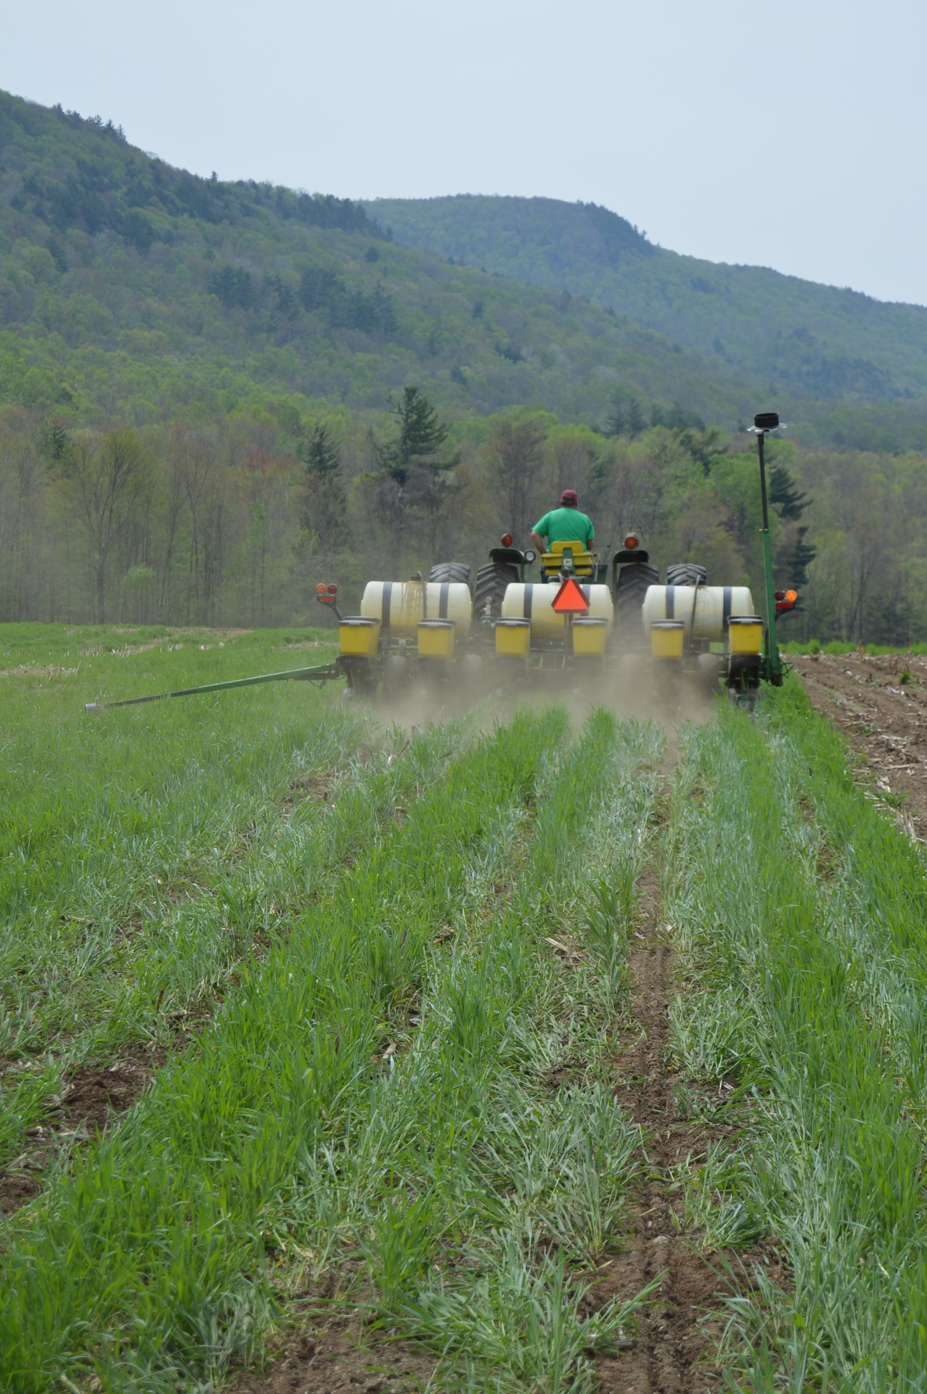
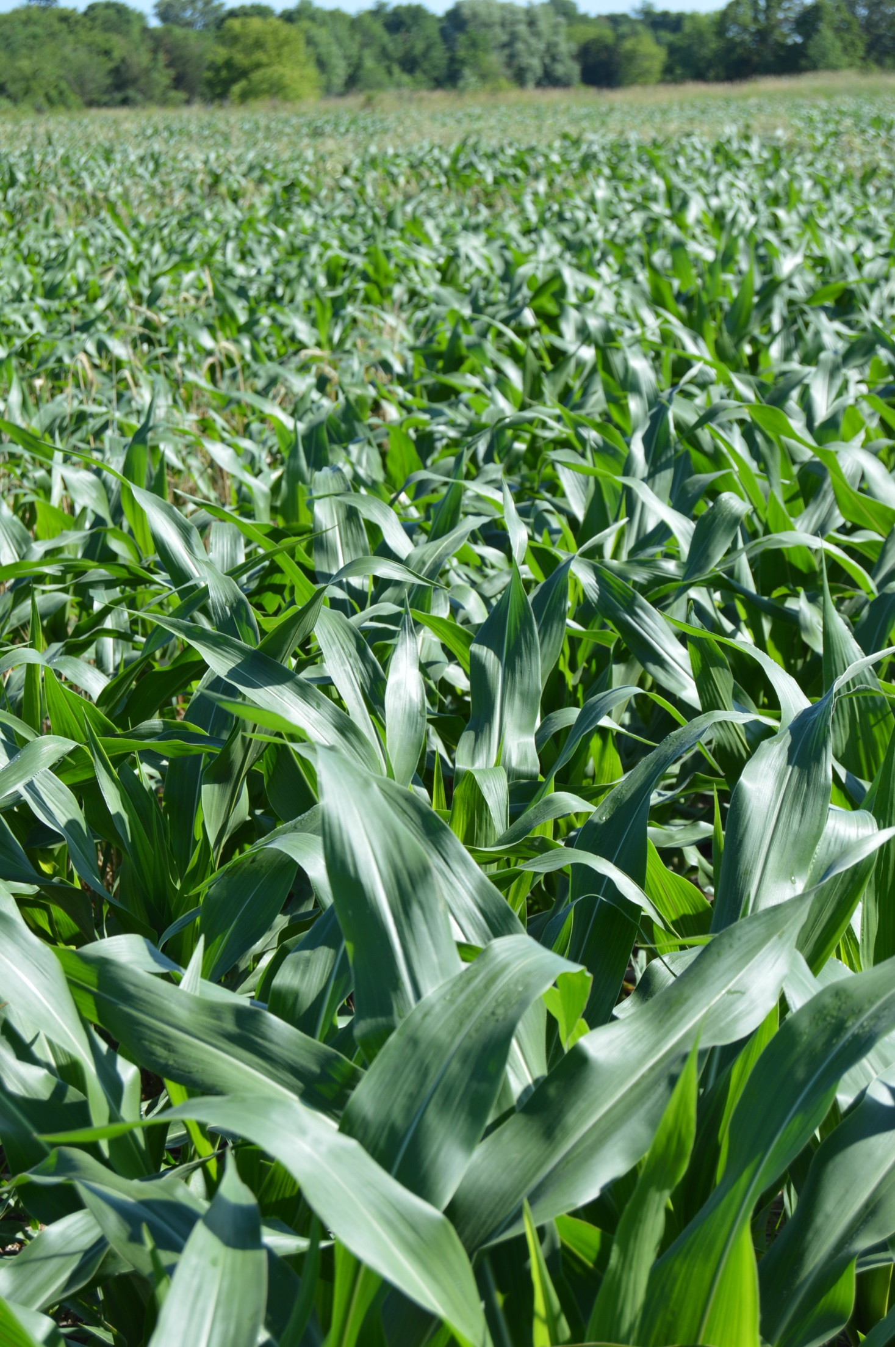
Jeff Carter
UVM Extension
Middlebury, Vermont
http://www.uvm.edu/extension/agriculture/cvcrops/

