Slide 1
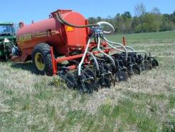
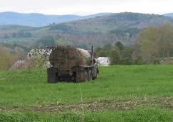
Manure Management in No-till
Douglas Beegle
Department of Plant Science
Penn State University

Slide 2
No-till System
More than just planting with a no-till planter
It takes time for the soil to adapt to no-till and see the full benefits
Residue management
Don’t abuse the soil
Pay attention to the things that tillage used to take care of
Recognized there are significant differences in no-till vs conventional tillage systems

Slide 3
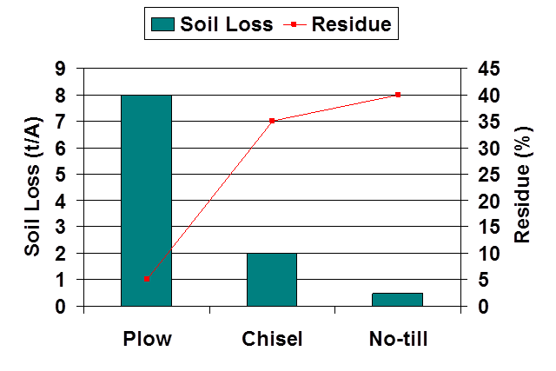
Advantages to No-till
Reduced soil erosion
More biological activity
Moisture Conservation
Better soil quality
Residue on the surface
Duiker, PSU

Slide 4
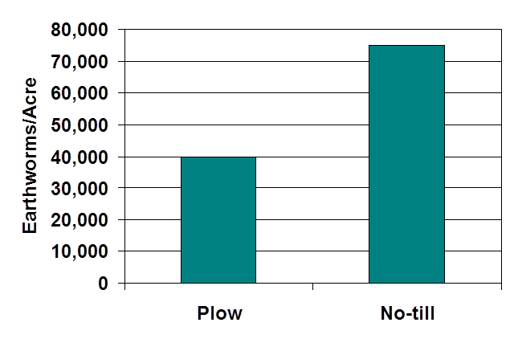
Advantages to No-till
Reduced soil erosion
Changed biological activity
Moisture Conservation
Better soil quality
Residue on the surface
Duiker, PSU
Crop
No-till
N Min.
Conv. Till
Time

Slide 5
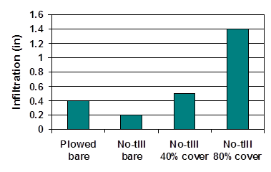
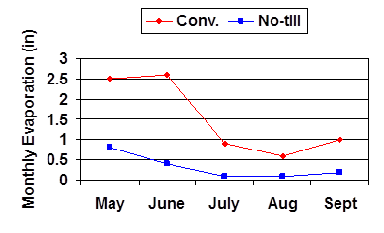
Advantages to No-till
Reduced soil erosion
More biological activity
Moisture Conservation
Better soil quality
Residue
Duiker, PSU

Slide 6
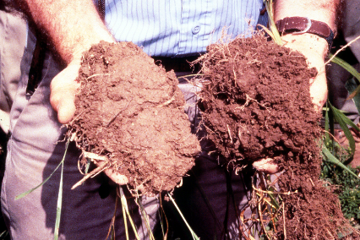
Advantages to No-till
Reduced soil erosion
More biological activity
Moisture conservation
Better soil quality
Residue on the surface

Slide 7
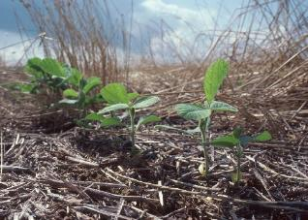
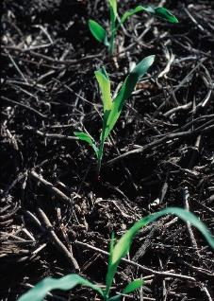
Advantages to No-till
Reduced soil erosion
More biological activity
Moisture conservation
Better soil quality
Residue on the surface

Slide 8
What does this mean for manure nutrients?
Volatilization
Denitrification
Crop
Uptake
Crop Uptake
N
P
Runoff
Runoff
Erosion
Leaching
Erosion
Leaching

Slide 9
Nutrient Management
Manure in No-till
  Greater potential for ammonia volatilization
  Less risk of P loss with erosion
  Greater risk of soluble P loss
  Greater potential for Nitrate leaching
From: Table 1.2-15 Agronomy Guide
Planned Manure Application Management | Nitrogen Availability Factors
 | Poultry | Swine | Other
Incorporation the same day Incorporation within 1 day Incorporation within 2-4 days Incorporation within 5-7 days Incorporation after 7 days or no incorporation | 0.75 0.50 0.45 0.30 0.15 | 0.70 0.60 0.40 0.30 0.20 | 0.50 0.40 0.35 0.30 0.20

Slide 10
Nutrient Management
Manure in No-till
  Greater potential for ammonia volatilization
  Less risk of P loss with erosion
  Greater risk of soluble P loss
  Greater potential for Nitrate leaching
6
Total P
mg/L
4
Conventional Till
2
Converted
to no-till
Erosion reduced 95%
0
1980
1985
1990
1995
Sharpley, USDA

Slide 11
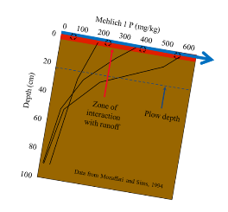
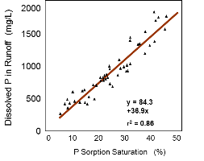
Nutrient Management
Manure in No-till
  Greater potential for ammonia volatilization
  Less risk of P loss with erosion
  Greater risk of soluble P loss
  Greater potential for Nitrate leaching
1.0
Algal-available P, mg/L
Converted
to no-till
0.5
Conventional
till
0
1980
1985
1990
1995
Sharpley, USDA
Simms, U. Del

Slide 12
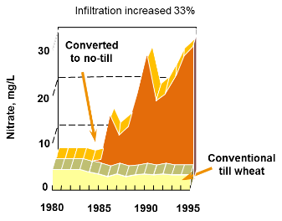
Nutrient Management
Manure in No-till
  Greater potential for ammonia volatilization
  Less risk of P loss with erosion
  Greater risk of soluble P loss
  Greater potential for Nitrate leaching
Sharpley, USDA
Duiker, PSU

Slide 13
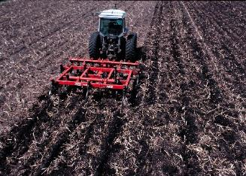
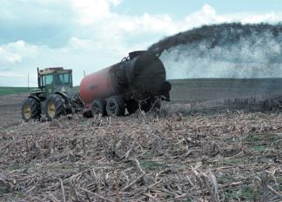
Tradeoffs
Manure Incorporation
Reduced NH₃ volatilization and odor
Decreased soluble P loss but increased sediment P loss
Increased erosion
Reduced soil quality
Reduced erosion
Improved soil quality
Increased NH₃ volatilization and odor
Increased soluble P loss but less sediment P loss
Manure in No-till

Slide 14
Questions:
Is there a way to get the benefits of manure incorporation but retain the benefits of no-till?
What are the tradeoffs?

Slide 15
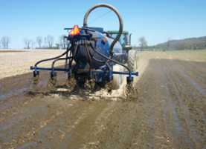
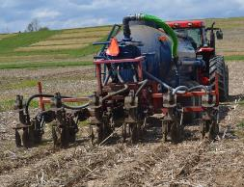
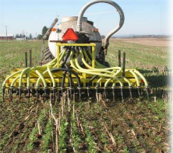

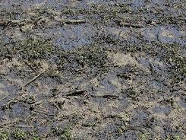
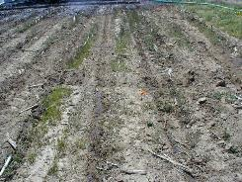
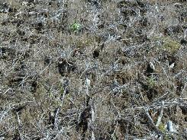
Alternative No-till Manure Application Methods?
6 in
Surface
Shallow Disk
Aerator

Slide 16
No-till and Nitrogen Loss
Volatilization
Denitrification
Crop
Uptake
N
Runoff
Erosion
Leaching

Slide 17
Manure
Nitrogen
Volatilization
Significant loss of N by volatilization when manure is applied on the surface and not incorporated
Incorporating manure significantly reduces N losses
Sometimes creates serious management conflict between nutrient management plans and conservation plans
Penn State Agronomy Guide Table 1.2-15
Notes:
This also reduces odor and P runoff. A major challenge is to incorporate manure in no-till systems. This often creates conflicts between nutrient management plans and conservation plans.

Slide 18





No-till Dairy Manure Application Method - PA
60
Compared to Surface
24% less
40
Ammonia-N Loss (lbs/ac)
79% less
84% less
99% less
20
0
No manure
ChiselPlow
Disk
Aeration
Surface
Data courtesy C. Dell, USDA-ARS

Slide 19
Ammonia
Loss from
Dairy Manure
Most of the ammonia loss occurs within the first 48 hrs after application
Dell, ARS

Slide 20
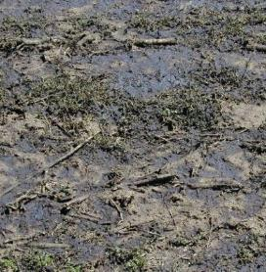
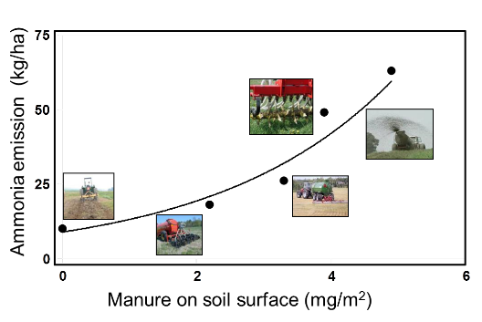
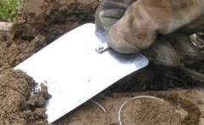
Ammonia: more manure on the surface, more ammonia emitted
Dairy manure (6,000 gal/ac)
Dell, USDA
Data courtesy C. Dell, USDA-ARS

Slide 21
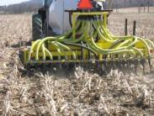
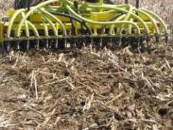
Aeration variations
Banded Manure After
  Aerator at 0° angle
Banded Manure After
  Aerator at 10° angle
Straight Manure Before
  Aerator at 0°
Angled Manure Before
  Aerator at 10° angle
Myers, Penn State

Slide 22
Aerator Swine Manure Application
– Ammonia Loss
Myers, PSU & ARS

Slide 23
Reduction in Ammonia Volatilization
Aerator applicator – Compared to surface application
Dairy vs Swine Aerway straight with manure applied after
PSU & ARS

Slide 24
What does this mean for nutrients?
Crop Uptake
P
Runoff
Leaching
Erosion

Slide 25
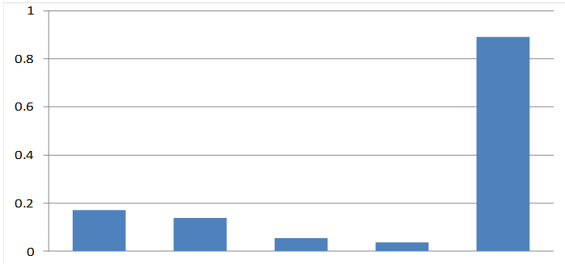

No-till Dairy Manure Application Method – PA
- Total P loss
Total P runoff (lbs/ac)
No manure
ChiselPlow
Shallow
Disk
Aeration
Surface
PSU, USDA

Slide 26






Phosphorus: more on the surface, more dissolved phosphorus in runoff
Dissolved P (mg/L)
Water extractable P on surface (mg)
Dell, USDA

Slide 27
No-till Dairy Manure Application Method - PA
No manure
ShallowDisk
Aeration
Surface
Chisel
Plow
PSU, USDA

Slide 28
No-till Dairy Manure Application Method - PA
100
Manure
75
Residue cover (%)
50
25
0
No manure
ChiselPlow
Disk
Aeration
Surface
PSU, USDA

Slide 29
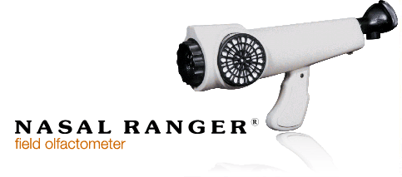
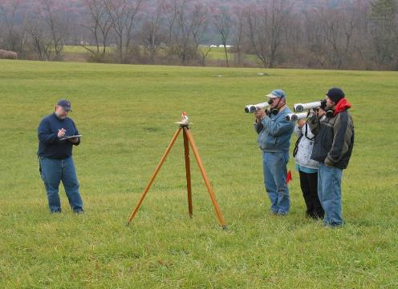
Manure Odor
One Pass with Manure
200 ft

Slide 30
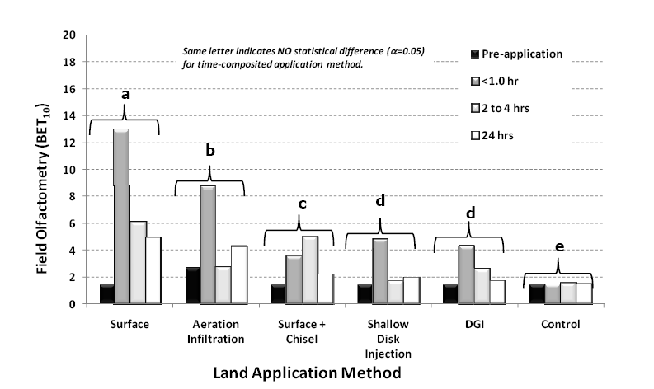
Odor from Dairy Manure
Brandt, PSU

Slide 31
No-till Dairy Manure Application Method - PA
IFSM Model Economics for 100 cow dairy
800
750
700
Farm net return, $/cow
650
600
Surface
Chisel
Plow
Aeration
ShallowDisk
Rotz, USDA-ARS

Slide 32
PA Dairy Manure Application Method Comparison
Taller bars are worse except for economics
PSU, USDA-ARS

Slide 33
Urease Inhibitors in Dairy Manure
Lab
 |  | Cumulative ammonia emission (mg/cm²)
Start date | Manure source | 0 oz/ 1000 gal¹ | 3 oz/ 1000 gal¹ | 6 oz/ 1000 gal¹ | 12 oz/ 1000 gal ¹ | 30 oz/ 1000 gal¹ | 60 oz/ 1000 gal¹ | 120 oz/ 1000 gal¹
1/15/10 | 1 | 0.65 | 0.69 | 0.63 | 0.62 | 0.62 | 0.60 | 0.68
1/18/10 | 1 | 0.56 | 0.54 | 0.56 | 0.57 | 0.48 | 0.59 | 0.53
1/22/10 | 2 | 0.76 | 0.63 | 0.83 | 0.77 | 0.70 | 0.76 | 0.78
1/25/10 | 2 | 0.79 | 0.75 | 0.74 | 0.79 | 0.77 | 0.78 | 0.71
¹ NBPT Urease Inhibitor (Agrotain)
Beegle, Dillon , Hoover, Dell, Brandt, PSU

Slide 34
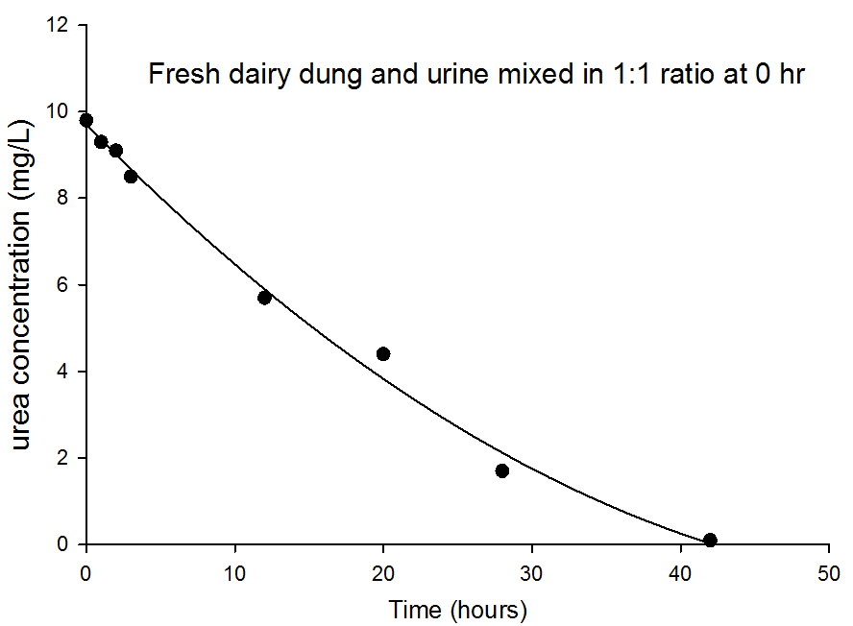
Urease Inhibitors in Dairy Manure
> Inhibit the break down of urea to ammonium carbonate which raises the pH and leads to volatilization BUT. . .
Manure contains urea, but little urea present at application
    Large amount of NH₃ lost within hours from urea after manure hits the barn floor.
    Significant ammonia volatilization when manure is applied
    Very little urea in manure at application time
Microbial activity at the manure surface results in release of CO₂ which raises the pH (~9) at the surface of the manure
  CO₃²⁻ + 2H⁺↓ → H₂CO₃→ CO₂↑+ H₂O
  NH₄⁺ in the manure from previously hydrolyzed urea reacts at high pH to form NH₃
Dell and Moyer, ARS

Slide 35
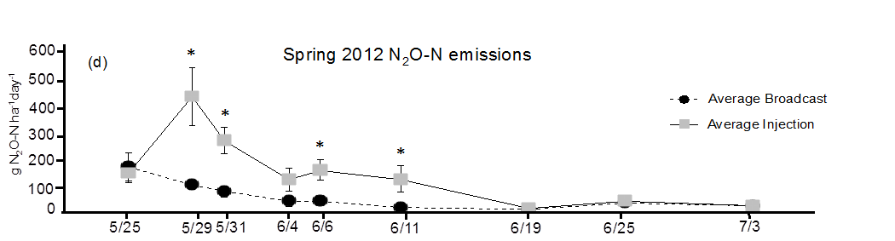
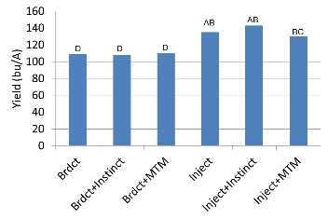
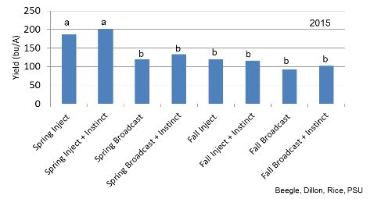
Nitrification Inhibitors with Dairy Manure
Evidence in the literature that greater denitrification with injected manure
- Injection zone: High N, High H₂O, High OM
Duncan, PSU
2012

Slide 36

Cover Crops Saving manure N
Manure N-availability factors for late fall or winter application of manure, summer utilization by corn or other summer annuals
Poultry Hog Dairy
No cover crop 0.15 0.20 0.20
Cover crop harvested 0.15 0.20 0.20
Cover crop left 0.50 0.45 0.40
Source: PSU Agronomy Guide Table 1.2-14
Scenario: apply 8000 gal/A of dairy manure
28 lbs/1,000 gal x 8000 gal/A = 224 lbs N/A total N applied
Avail. with cover = 0.40 x 224 = 90 lb N/A
Avail. Without cover = 0.20 x 224 = 45 lb N/A
Difference due to cover crop = 45 lbs N/A saved.
Notes:
Cover crops such as rye or wheat also help to get more nitrogen credits for fall-applied manure. These numbers are from the Agronomy Guide. There is a greater nitrogen recovery if a cover crop is present. The cover crop takes up nitrates that would otherwise leach to groundwater and, upon decomposition, the nitrogen becomes available to the next crop if the above-ground residue is left in the field. The nitrogen saved in fertilizer could potentially pay for the cover crop seed.

Slide 37
Early Manure Application, Delayed cover crop planting
Winter annual
Corn Silage
S O N D J F M A M J J A S O
Winter annual
Corn Silage
Immediate cover crop planting, Later Manure Application
Notes:
By establishing a winter annual in the fall, there will be a crop growing to take up available nitrogen as opposed to applying manure to bare fields.
In our experiment, we planted a winter rye before corn silage and looked at three different strategies that would keep more nitrogen in our fields and available to our crops.
1. Manage winter annual as a cover crop or for silage
2. Inject or Broadcast manure
3. Apply Manure early or late in the fall
Disclosure: we wanted to also evaluate the amount of nitrogen that would carry over to the following summer annual crop, corn silage, from a fall manure application. To do so, we did NOT apply any additional fertilizers or sidedress for either crop. The only additional source of nitrogen applied was from the fall manure application.
*watch time, if you have time you can go into the cover crop story
Go into which situations will be able to conserve more nitrogen
*PICTURES!

Slide 38
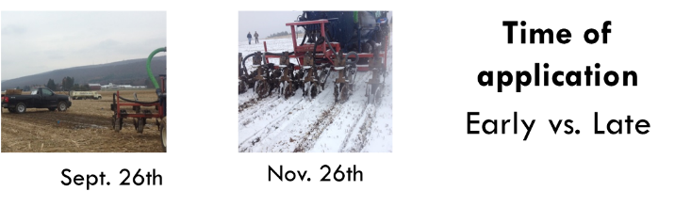
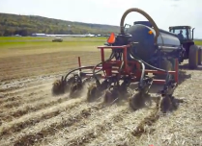

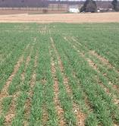
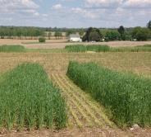
Method of application
Inject vs. Broadcast
Winter annual management
Cover crop vs. Silage
May 9th
May 19th

Slide 39
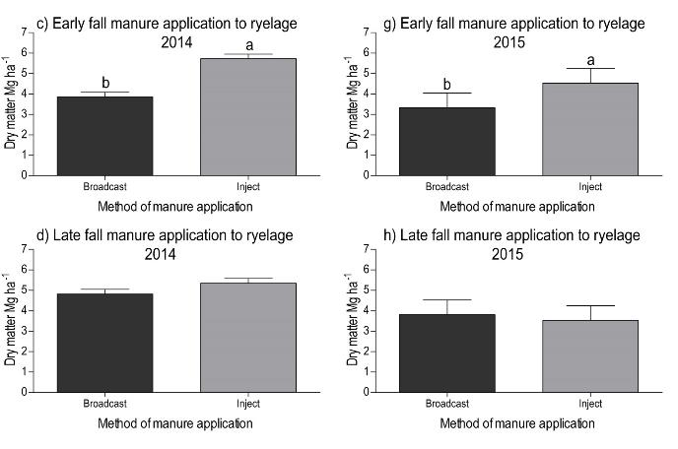
Winter Annual Biomass
Early vs Late & Bdct. Vs Inject
9 -
8 -
7 -
6 -
5 -
4 -
3 -
2 -
1 -
9 -
8 -
7 -
6 -
5 -
4 -
3 -
2 -
1 -
Ryelage 65% H₂O (ton/A)
Ryelage 65% H₂O (ton/A)
9 -
8 -
7 -
6 -
5 -
4 -
3 -
2 -
1 -
9 -
8 -
7 -
6 -
5 -
4 -
3 -
2 -
1 -
Ryelage 65% H₂O (ton/A)
Ryelage 65% H₂O (ton/A)
Rachel Milliron, PSU

Slide 40
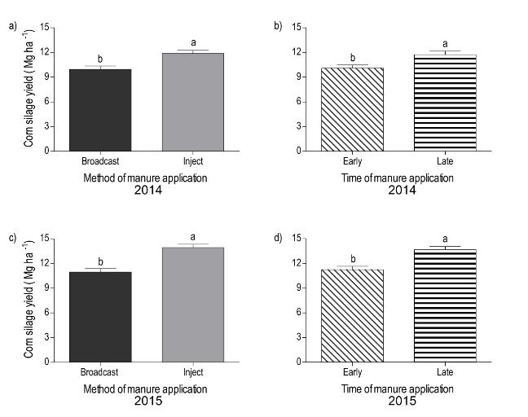
Corn silage yields following a rye cover crop
20 -
15 -
10 -
5 -
0 -
20 -
15 -
10 -
5 -
0 -
Corn Silage 65% (ton/A)
Corn Silage 65% (ton/A)
20 -
15 -
10 -
5 -
0 -
20 -
15 -
10 -
5 -
0 -
Corn Silage 65% (ton/A)
Corn Silage 65% (ton/A)
Rachel Milliron, PSU

Slide 41
Fall Manure/Cover Crop Management
Agronomically
  Chop Silage
  Plant cover crop early
    Better cover crop establishment
    More growth, holds more nutrients
  Apply manure later
    Colder temperatures
    Less N volatilization
    Little benefit to injection late compared to significant benefit to injection early
Environmental
  TBD

Slide 42
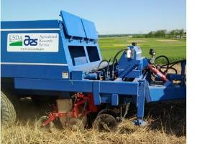
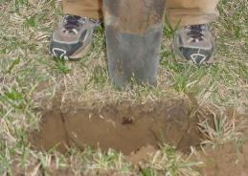
No-till
Solid Manure
Injection
PSU & ARS

Slide 43
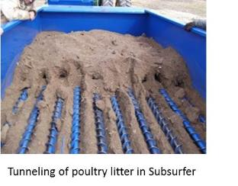
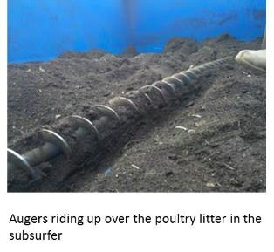
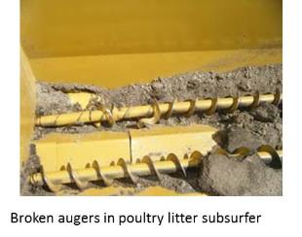
Poultry Litter Subsurfer
Not ready for prime time . . .
BUT we are working on it.
Maybe this will work for separated dairy solids?

Slide 44
Penn State Extension
http://Extension.psu.edu
Penn State Extension Crop Management Team
http://Extension.psu.edu/CMEG
Penn State Extension Nutrient Management Program
http://panutrientmgmt.cas.psu.edu

