Slide 1
2017 Vermont No-till, Cover Crop Symposium
Landview Farms LLC
A progress report

Slide 2
**Disclaimer**
No product endorsements are implied
Names have not been changed for this presentation…..they’re really not all that innocent!
The information presented today is heavily influenced by my own personal bias. Conclusions are observations only, and not drawn using any scientific protocols

Slide 3
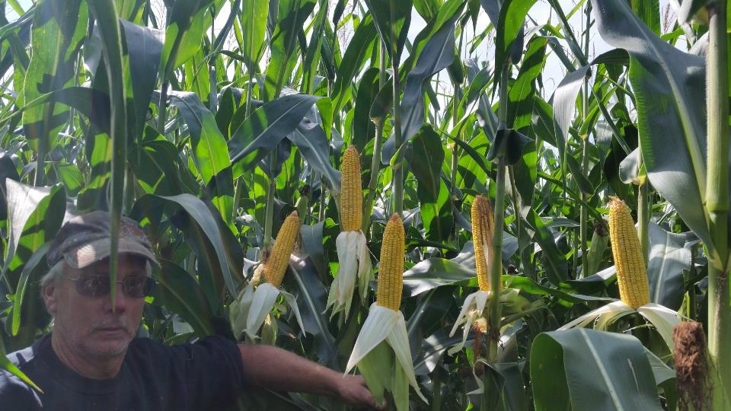

Slide 4
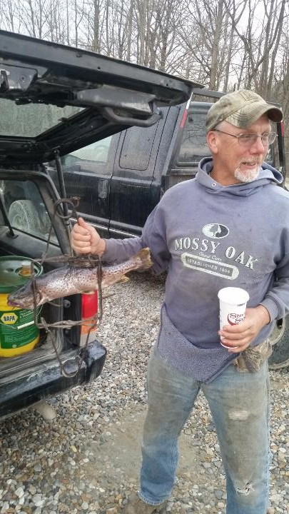

Slide 5
2015 in Review
Good success with Planting Green
Expanded No-till acres beyond 1st year corn
Setup planter to plant 2” minimum
Increased Corn Silage yields (Good season)
Excavated all the sand out of the lagoon
Increased Cover Crop acres
Planted earlier (Broadcast with truck)
Incorporated Cover Crop (Rented TurboMax)
Manure (Whenever we got there)

Slide 6
84 lbs Triticale 10 lbs Crimson Clover
Drill No Manure
Drill with Manure

Slide 7
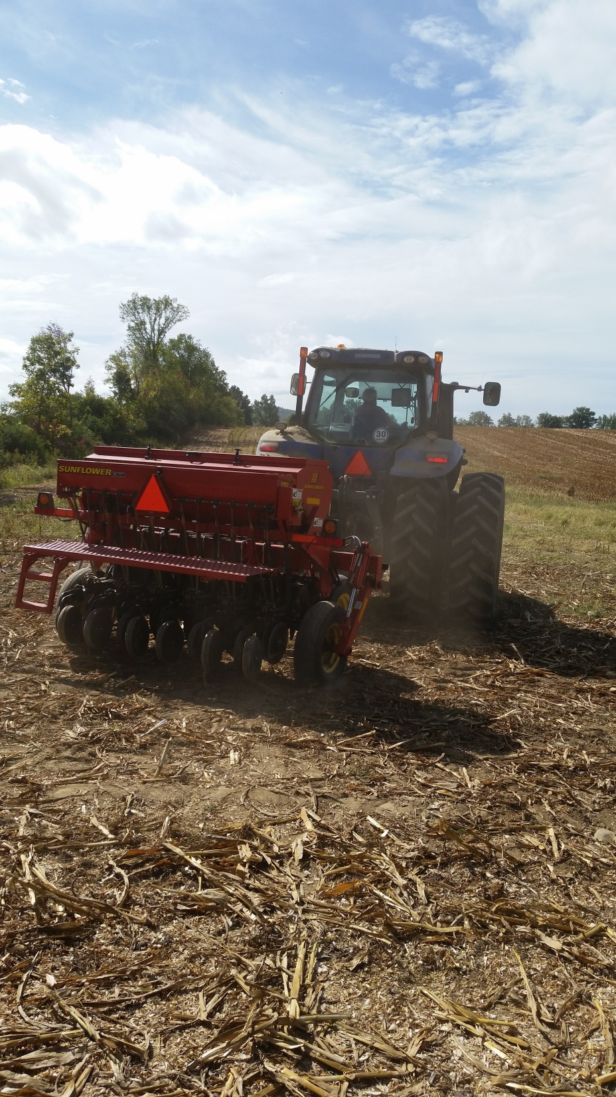

Slide 8
120 lbs Triticale Broadcast
TurboMax No Manure
TurboMax with Manure

Slide 9
120 lbs Triticale Broadcast
Aerway/Roller No Manure
Aerway/Roller with Manure

Slide 10
120 lbs Triticale Broadcast
Disk No Manure
Disk with Manure

Slide 11
Death Row

Slide 12
Cover Crop Broadcast No incorporation
No Manure
Broadcast Manure

Slide 13
Manure Spread with Trailer
9/28/15
11/23/15

Slide 14
Cover Crop Spread with SSD Aerway
110 lbs Triticale in Spreader
Aerway w/SSD distributor

Slide 15
Manure -Aerway with SSD
10/2/15
12/5/15

Slide 16
Too Much
9/28/15
11/23/15

Slide 17
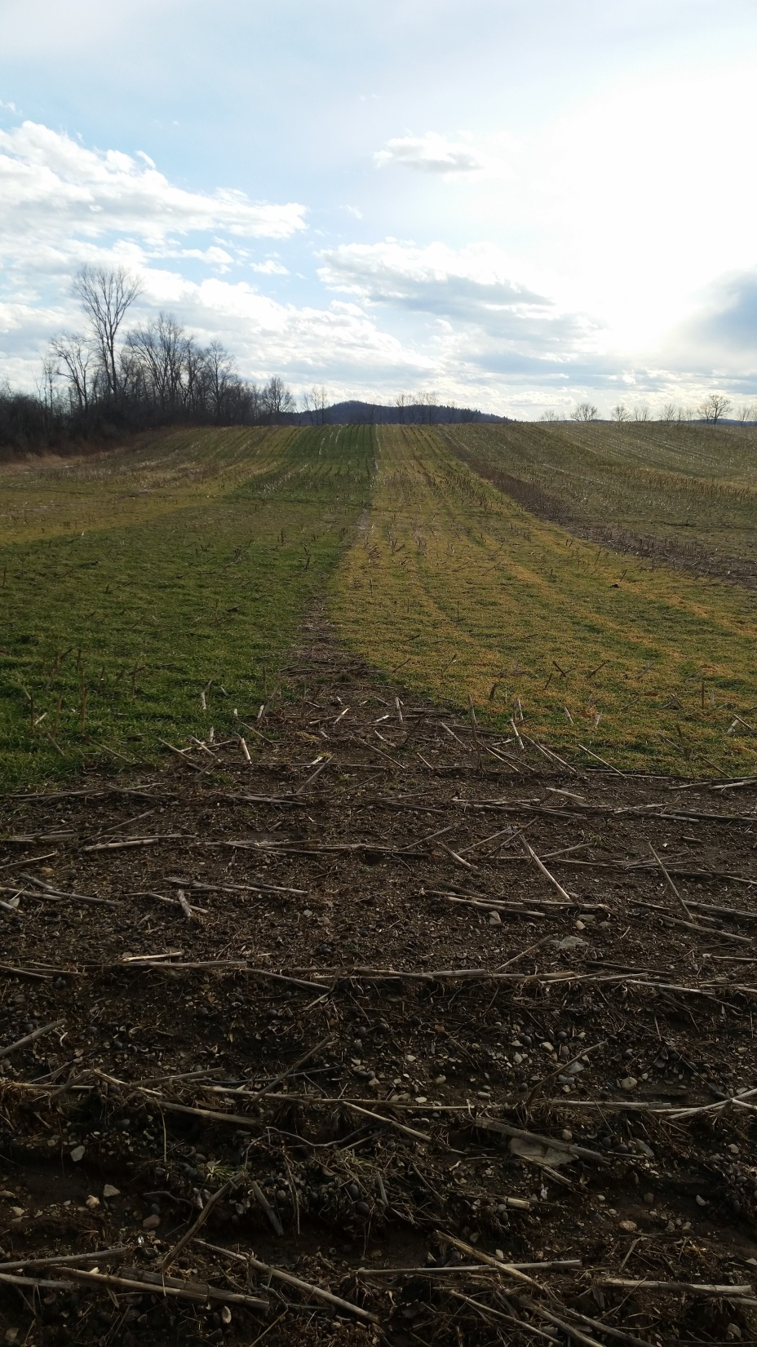

Slide 18
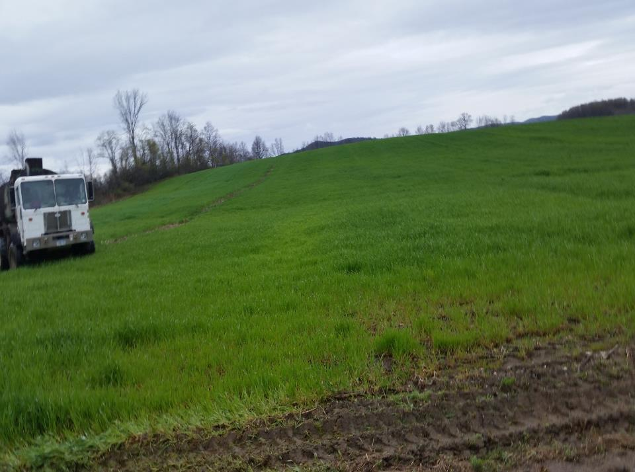

Slide 19
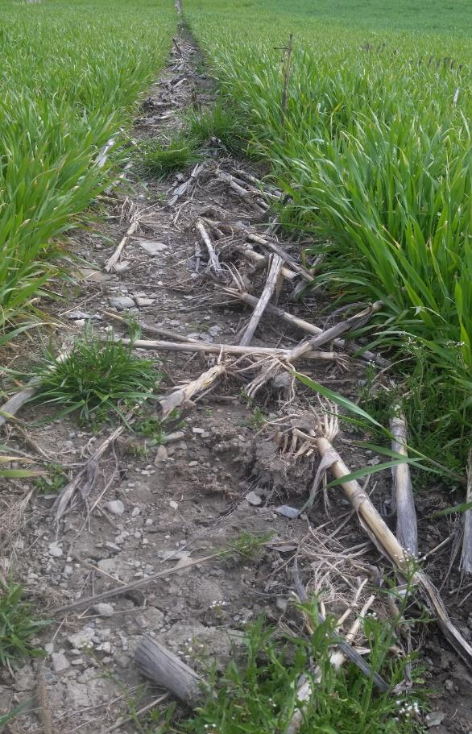

Slide 20
Conclusions from 2015 Cover Crop Planting
Earlier planting for best fall growth
Incorporation methods all work
Drill ‘looked’ the best
Adds flexibility to seed mixes
Same biomass, lower seeding rate
Manure enhances growth across all planting methods
Cereal grains pretty tough

Slide 21
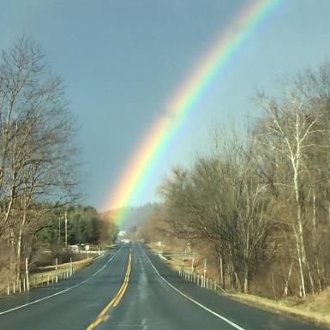
January 2016
Emptied Lagoon
4 million gallons available
700 acres cover crops
300 acres triticale for forage
120 lb seeding rate
Fall manure on 300 acres

Slide 22
That’s it….We’re all in!!!

Slide 23
Goals for 2016
Plant more acres ‘green’
No-till more acres
Evaluate planter attachments to handle planting in to tall cover crops
Cover crop seeding rate too high for planter roller attachment
100% CC on silage ground
Try some multi-species covers
Add spring manure to the No-till/CC program
Broadcast manure on living cover crops
Provide all haylage needs for the dairy
Improve quality of new seedings
Utilize some CC acres for forage

Slide 25
Key changes in seeding program
No-till Drill our New Seeding
Bought a drill
Starter Fertilizer on drill
Control Weeds
Fields smoother
Added a land roller

Slide 26
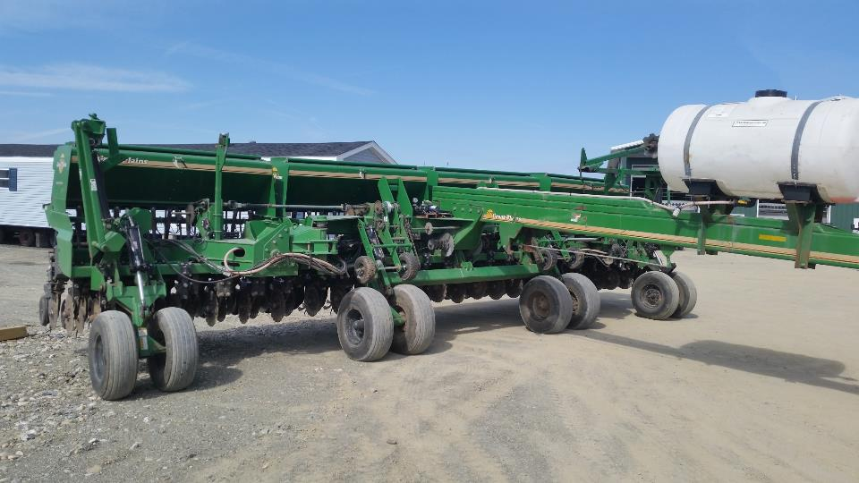

Slide 27
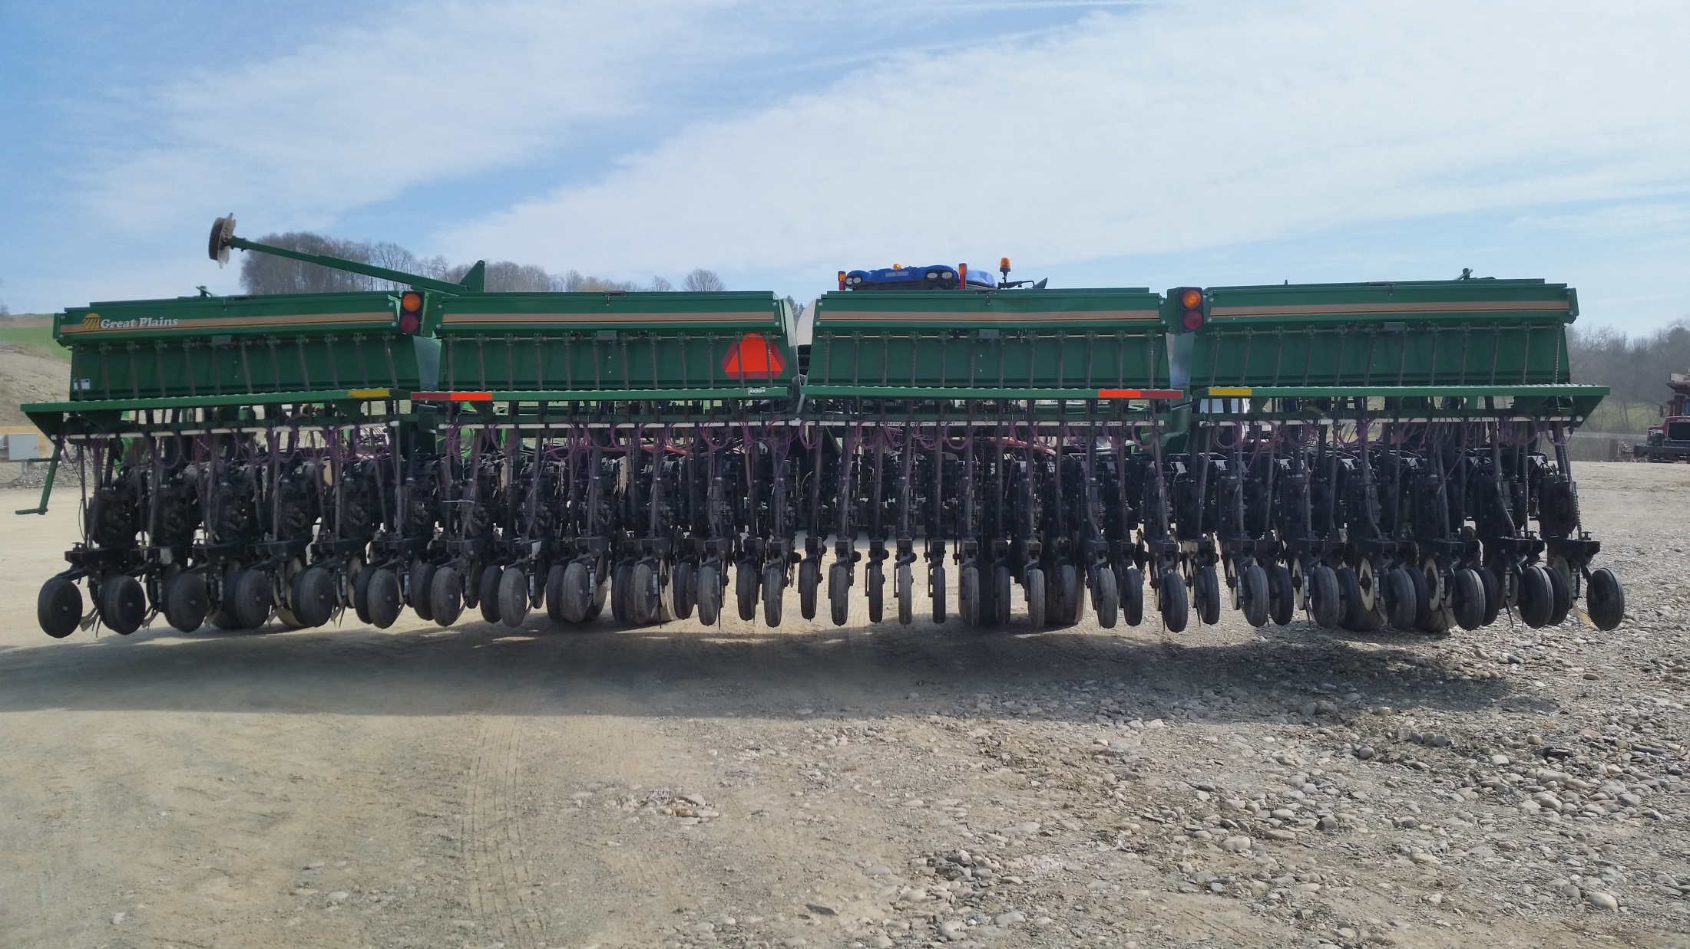

Slide 28
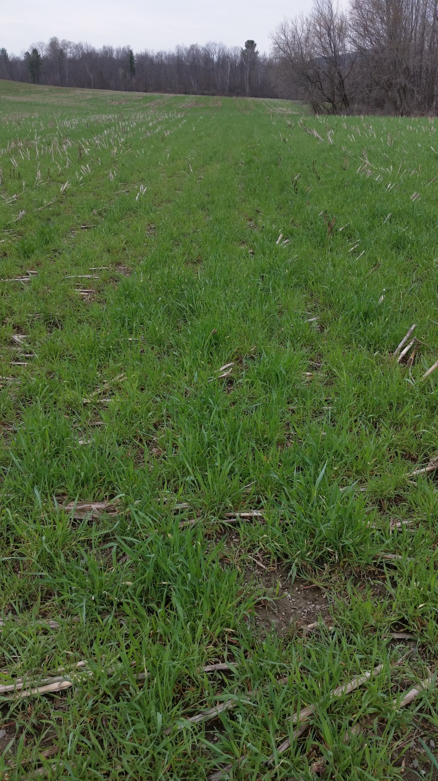

Slide 29
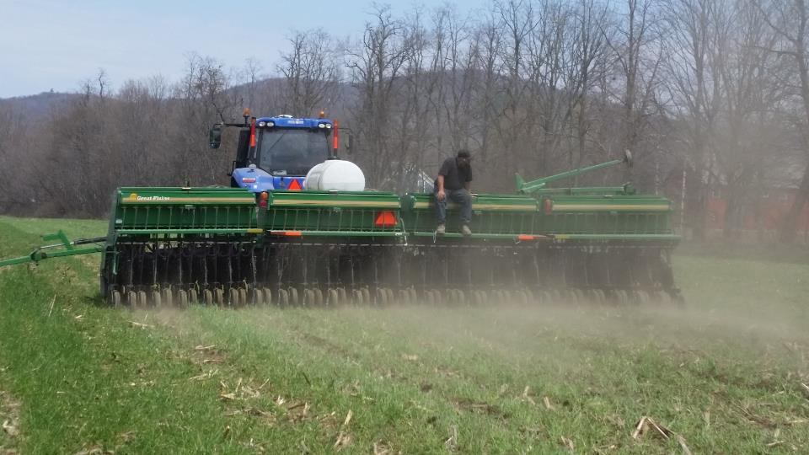

Slide 30
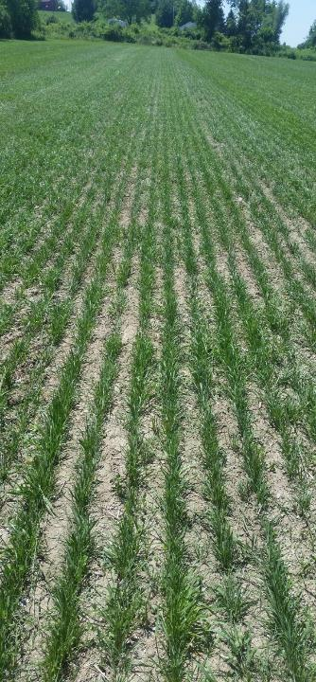
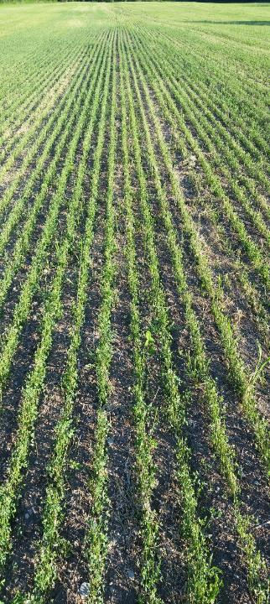
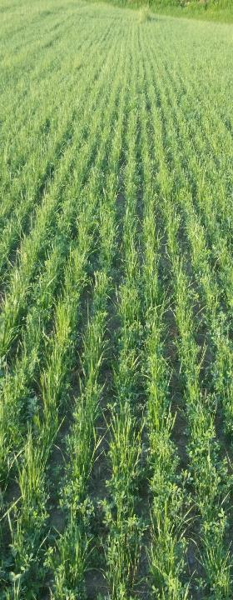

Slide 31
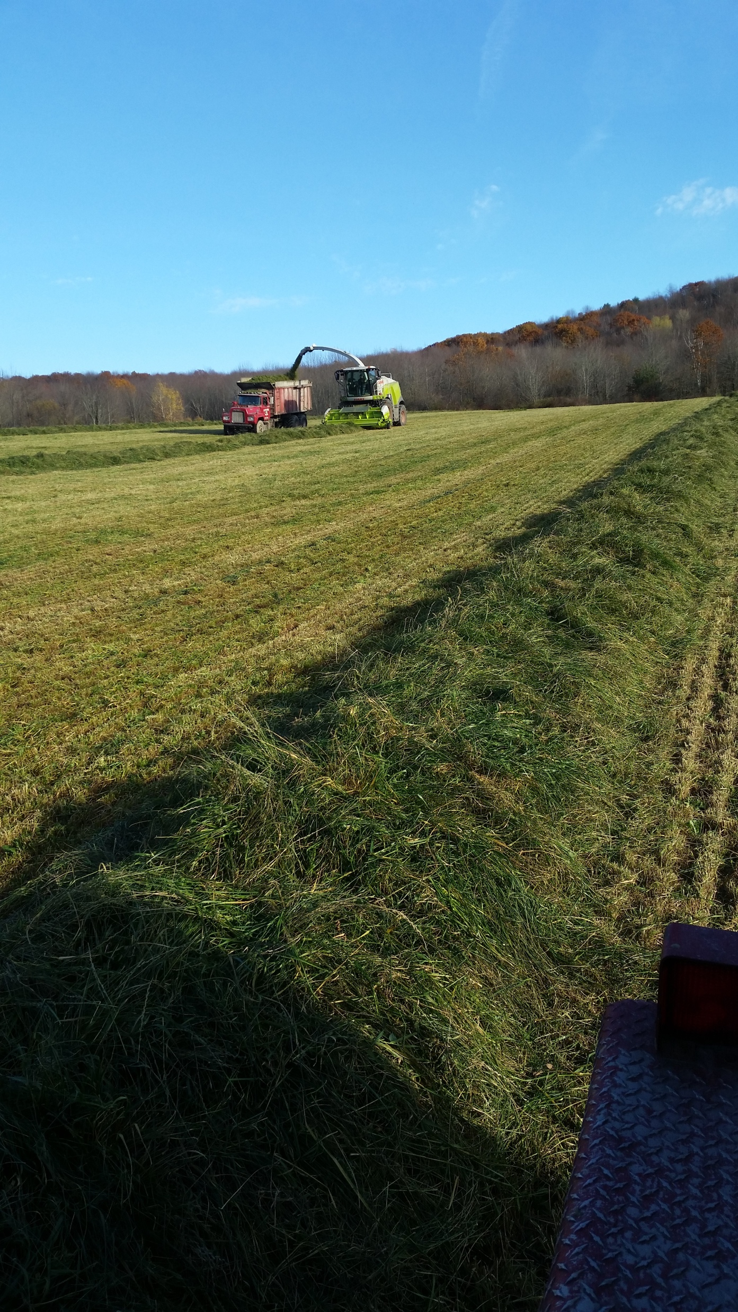

Slide 32
Triticale Forage
Usually cut vegetative stage for dairy forage
High quality, lower yield
First good weather….harvest triticale
2016 Maximize value
Clipper cut sample trying to get highest quality and yield
Applied 70 lbs of N + S at ‘green up’

Slide 33
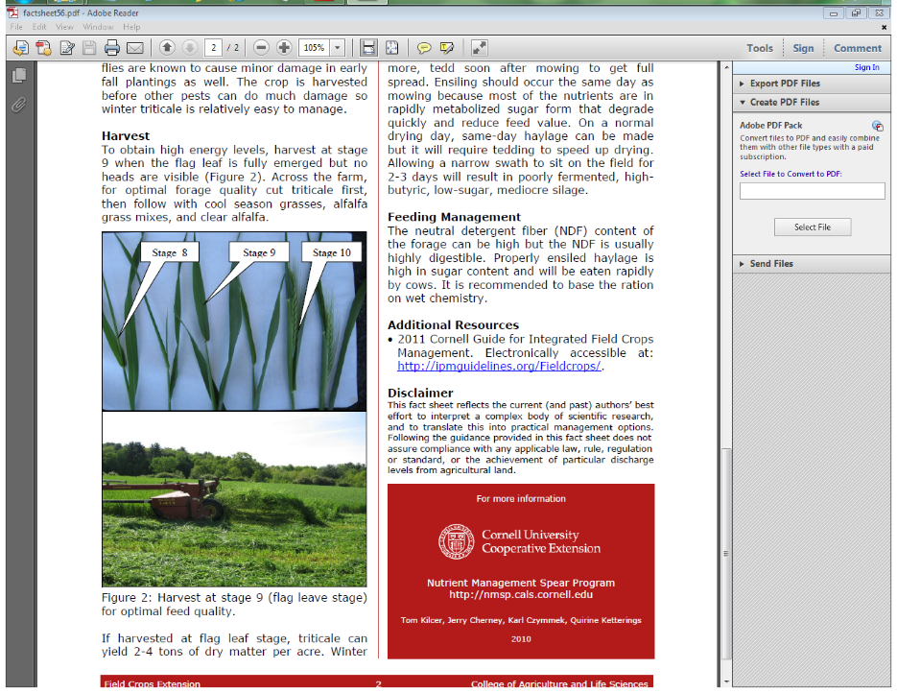
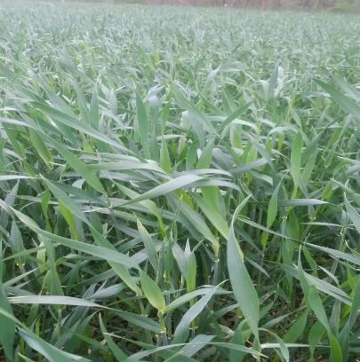

Slide 34
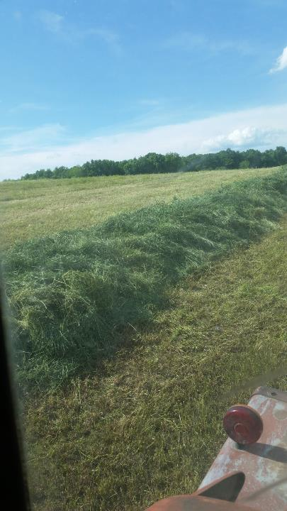
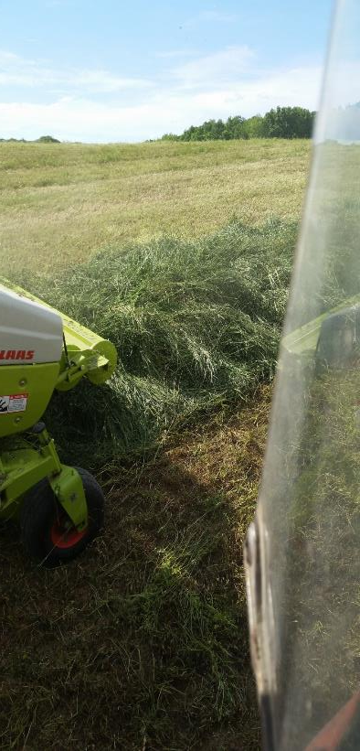

Slide 35
Triticale Forage conclusions from 2016
Pro’s
High yielding
Great heifer feed
Lower cost/ton of Dry Matter
Lots of effluent for heifer barn manure pit
Con’s
Trouble getting correct Dry Matter
Bigger tedder
Leave overnight?
Ready same time as 1st cut grass Haylage
Lots going on when triticale is ready

Slide 36
Changes in manure handling in 2016
Broadcast on ‘living covers’
Didn’t use Aerways
Cleaned lagoon
More manure to spread
Committed to spreading more acres
Better agitation
Stopped treating Lagoon

Slide 37
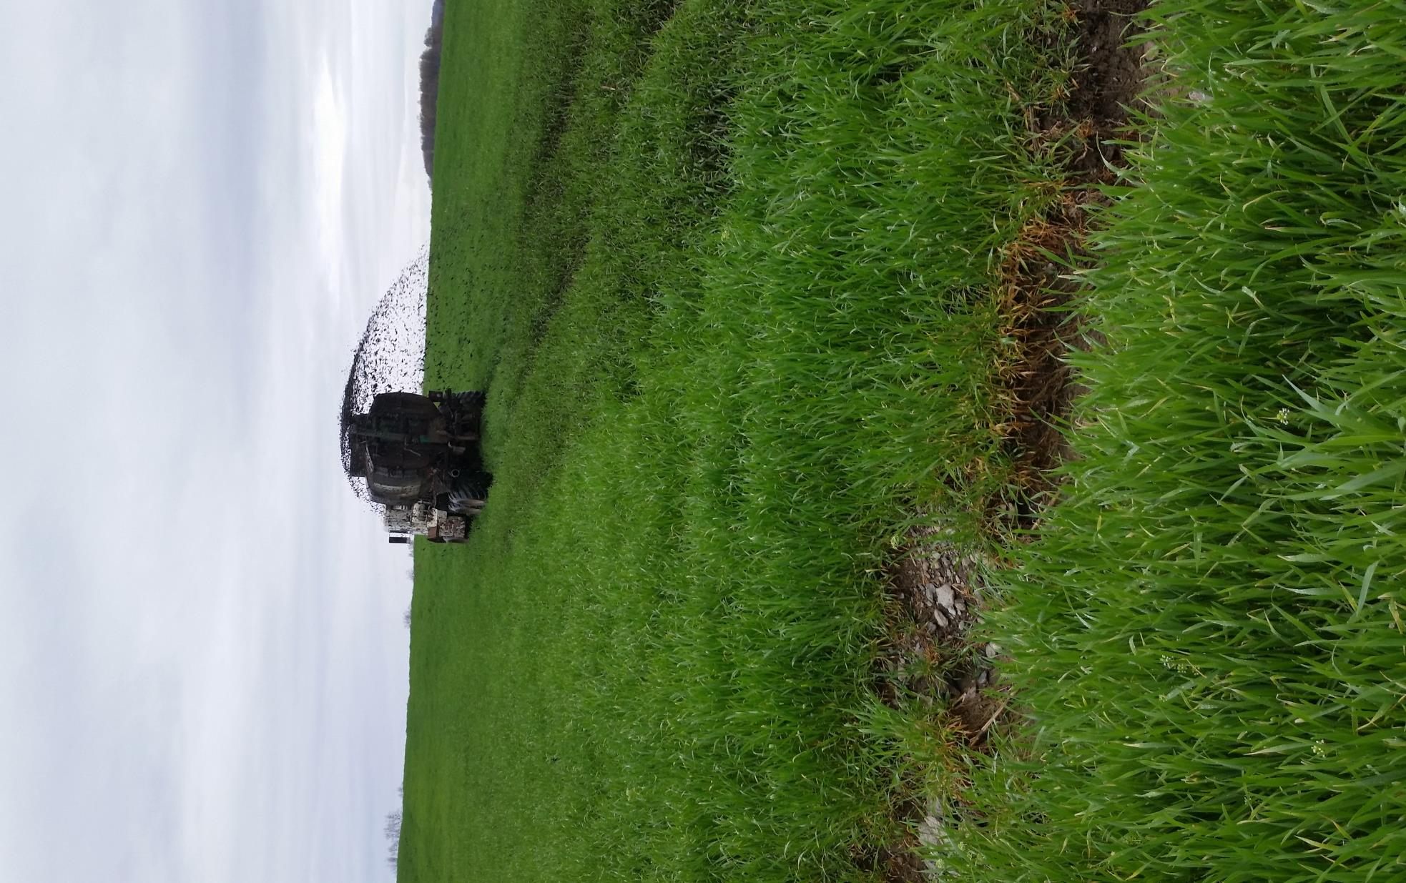
Great way to meet the neighbors

Slide 38
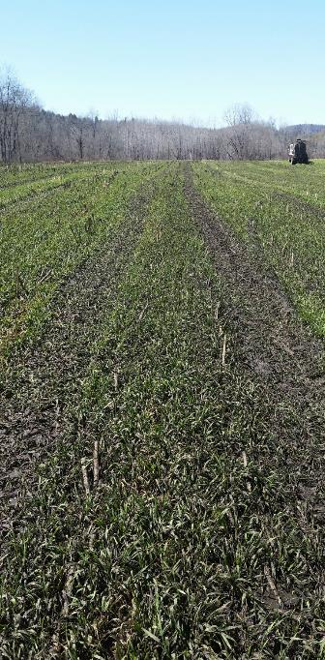
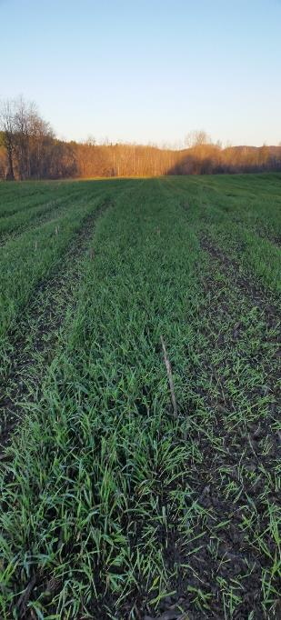
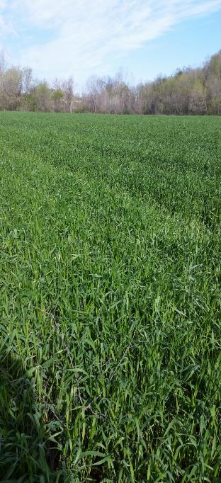

Slide 39
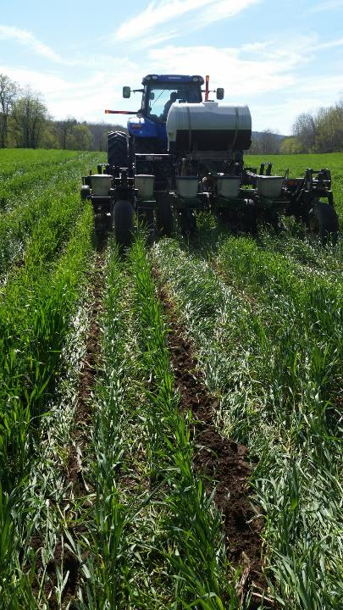
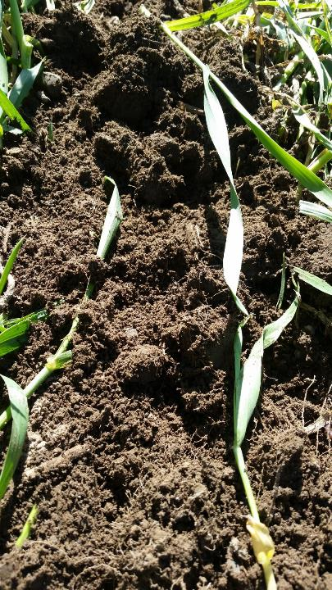

Slide 40
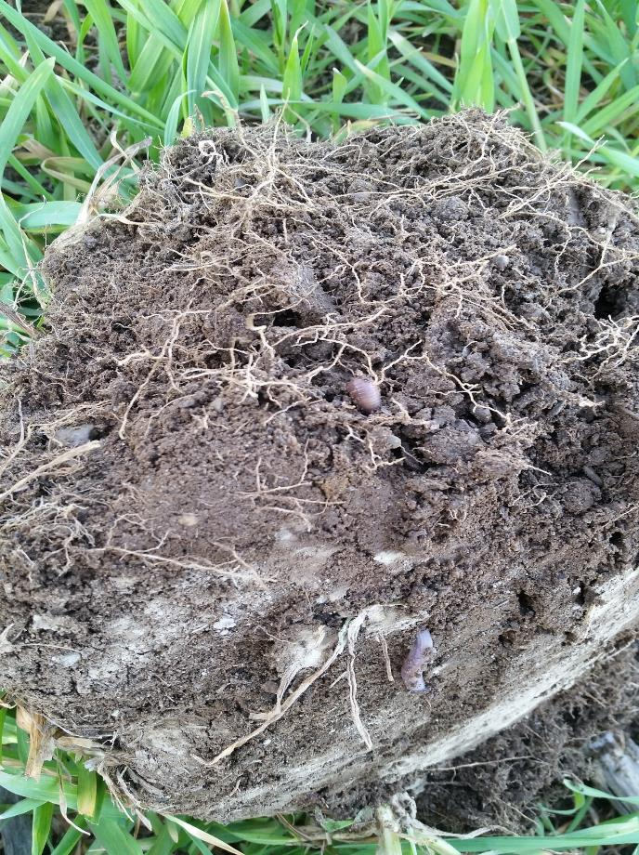

Slide 41
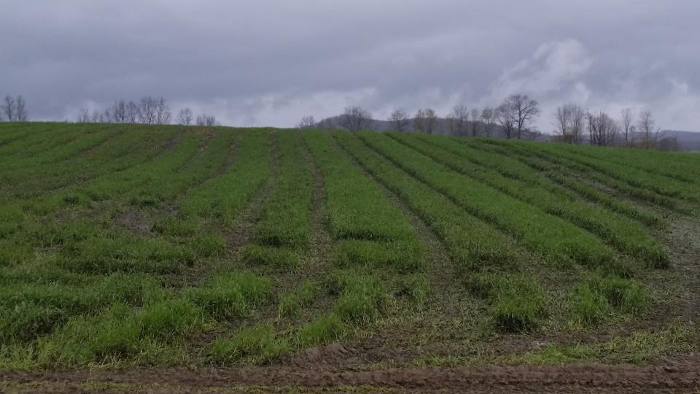

Slide 42
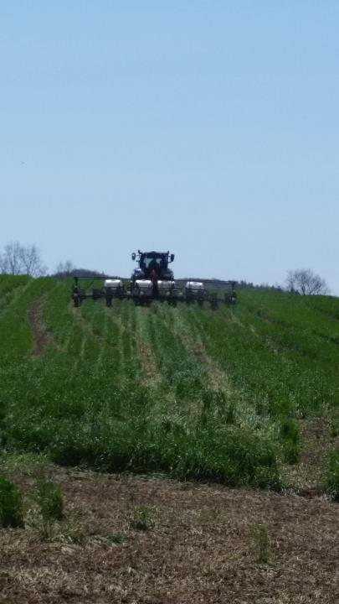

Slide 43
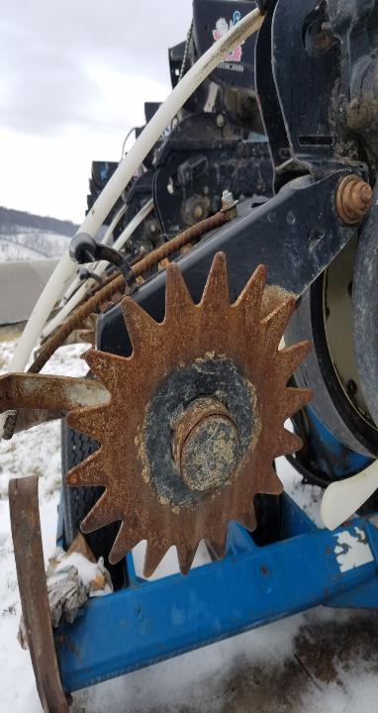
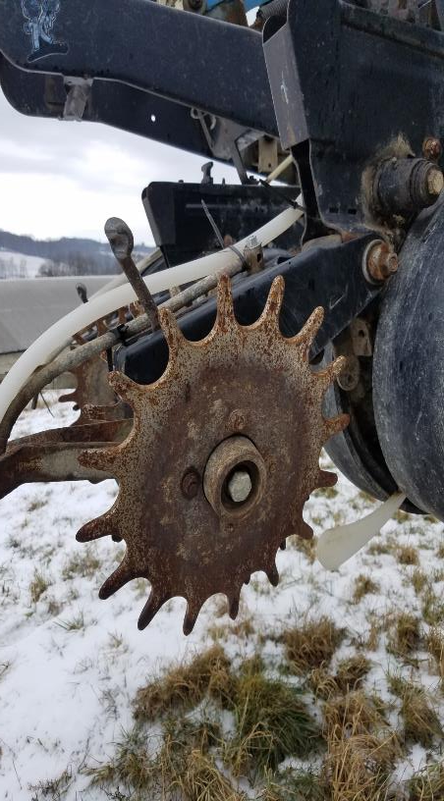
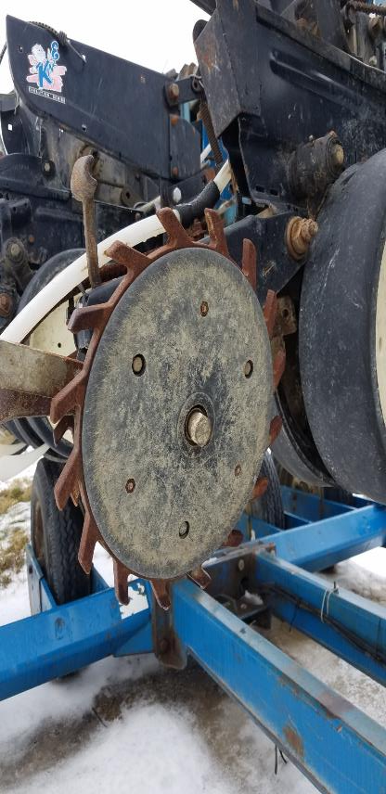

Slide 44
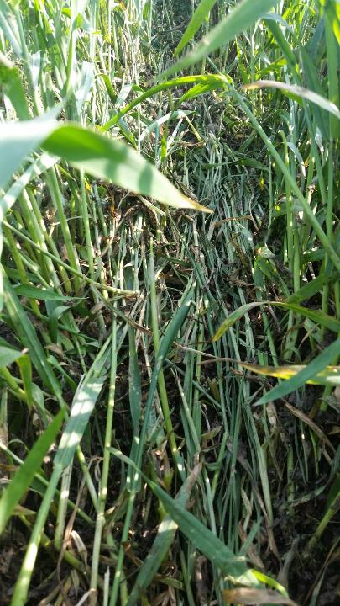
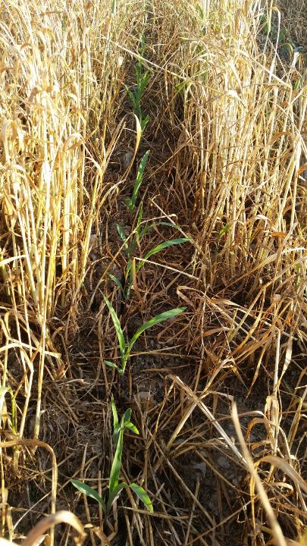

Slide 45
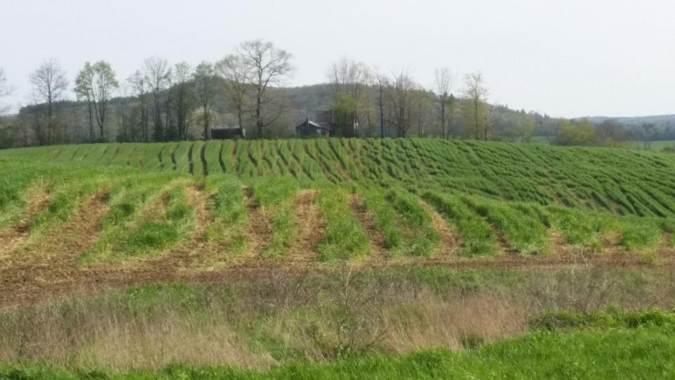

Slide 46
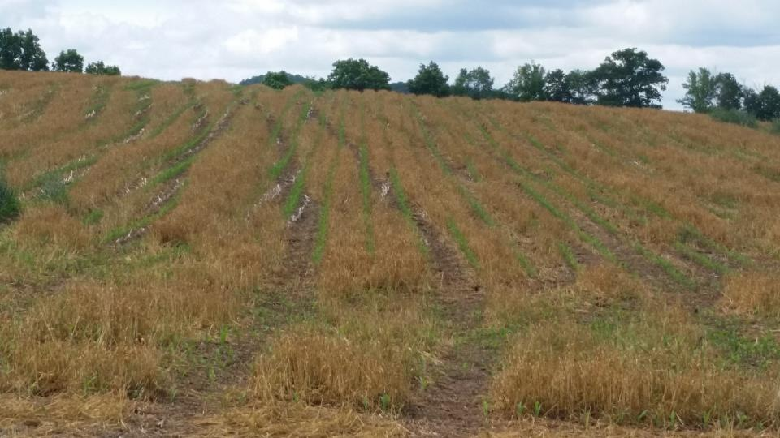

Slide 47
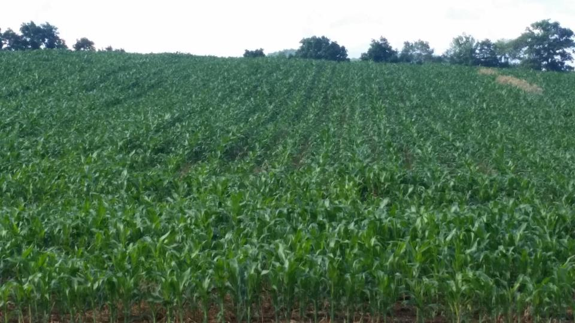

Slide 48
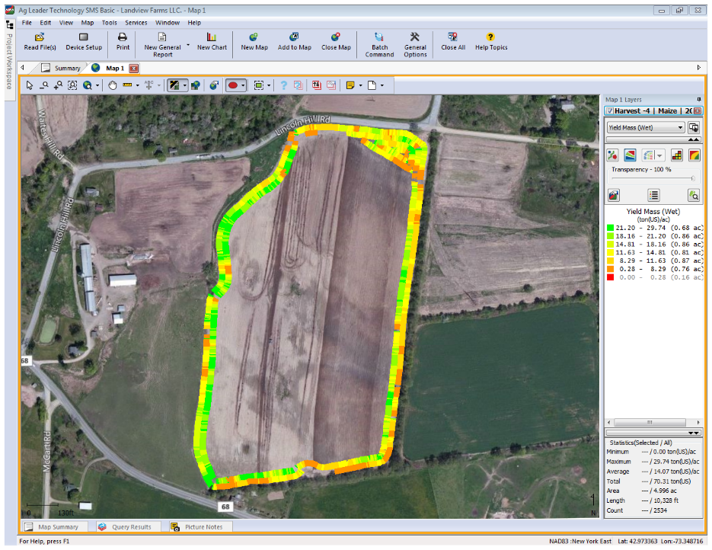

Slide 49
Cover Crop Broadcast No incorporation
No Manure
Broadcast Manure

Slide 50
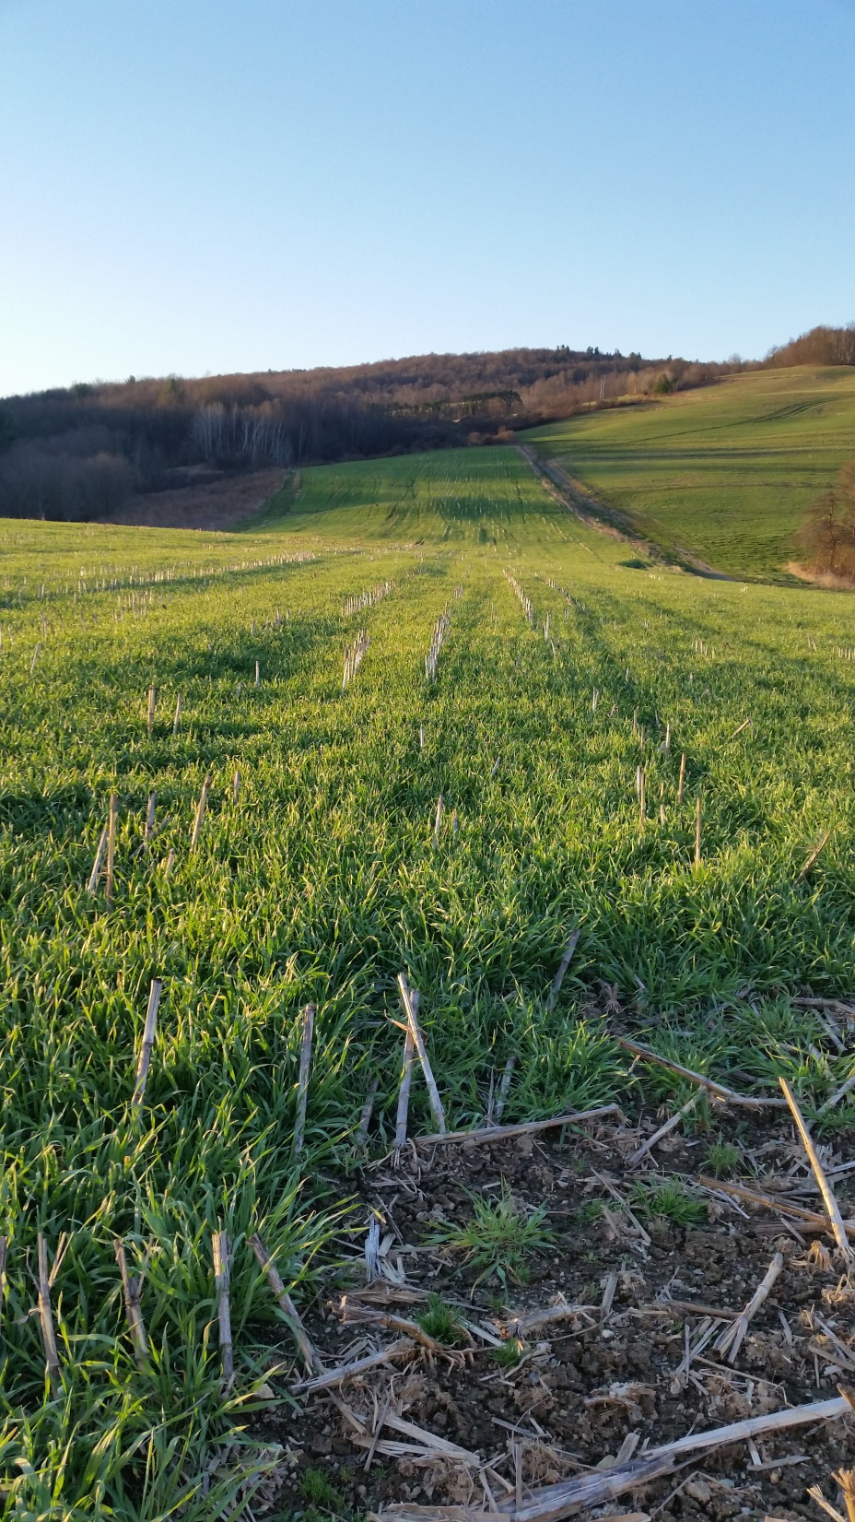

Slide 51
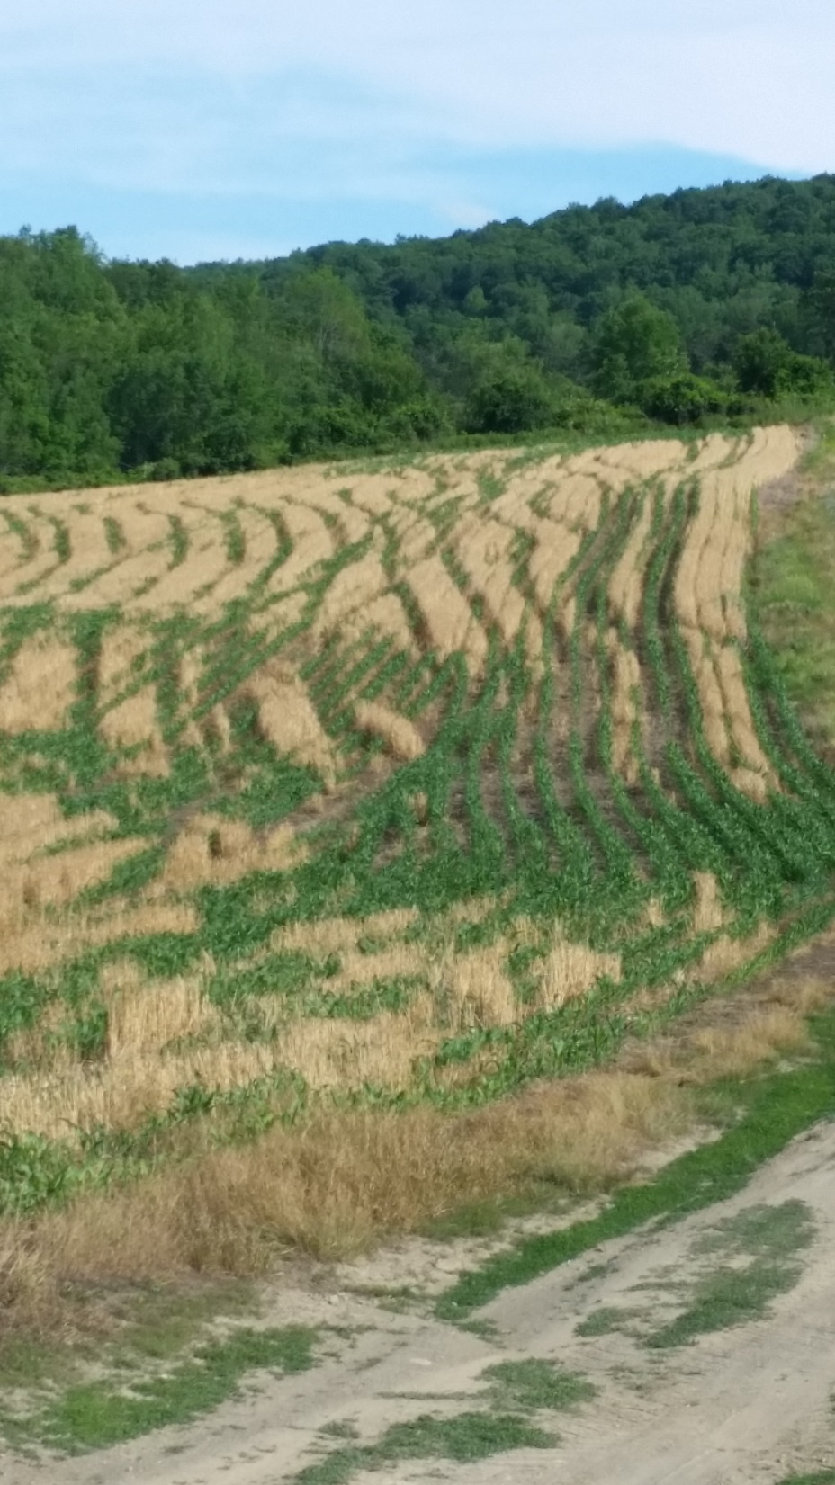

Slide 52
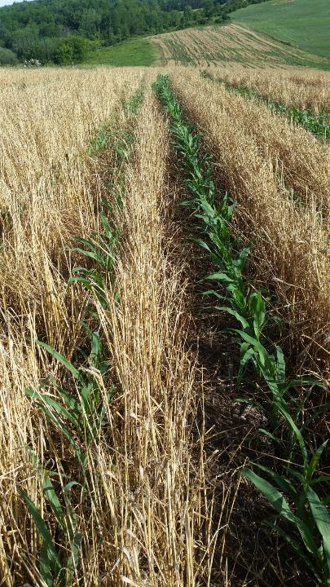

Slide 53
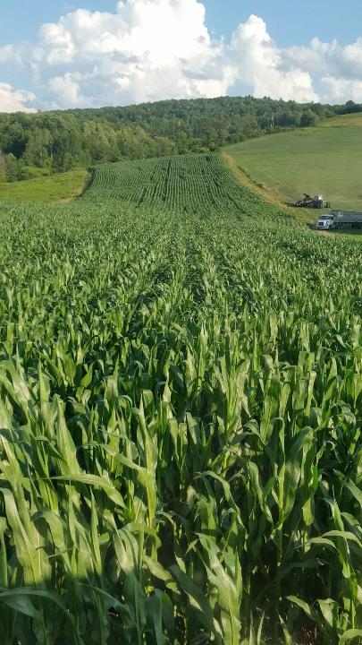

Slide 54
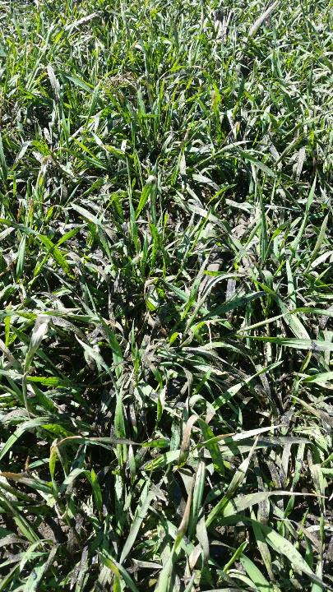
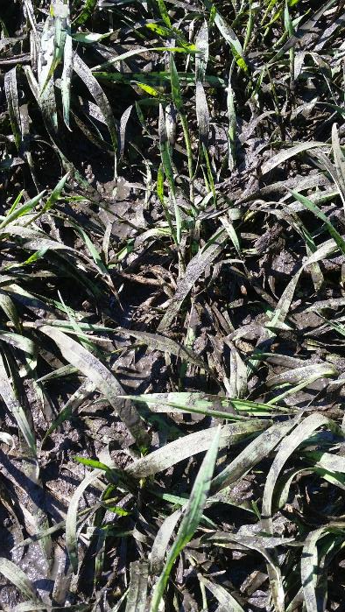

Slide 55
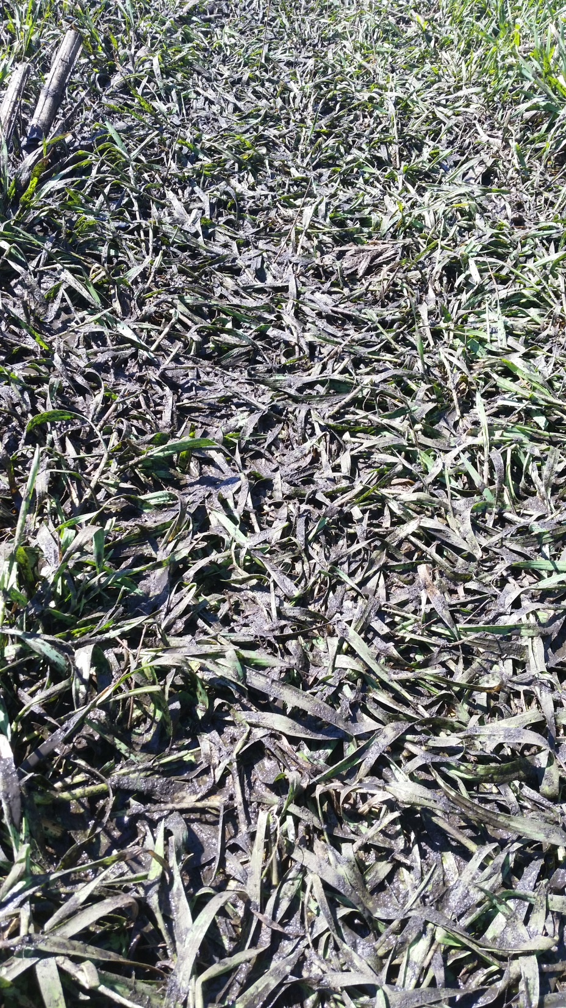

Slide 56
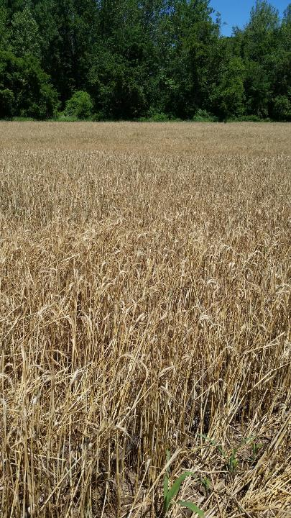
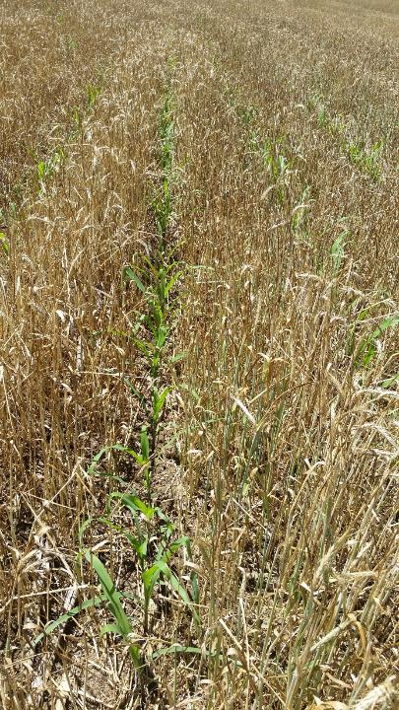

Slide 57
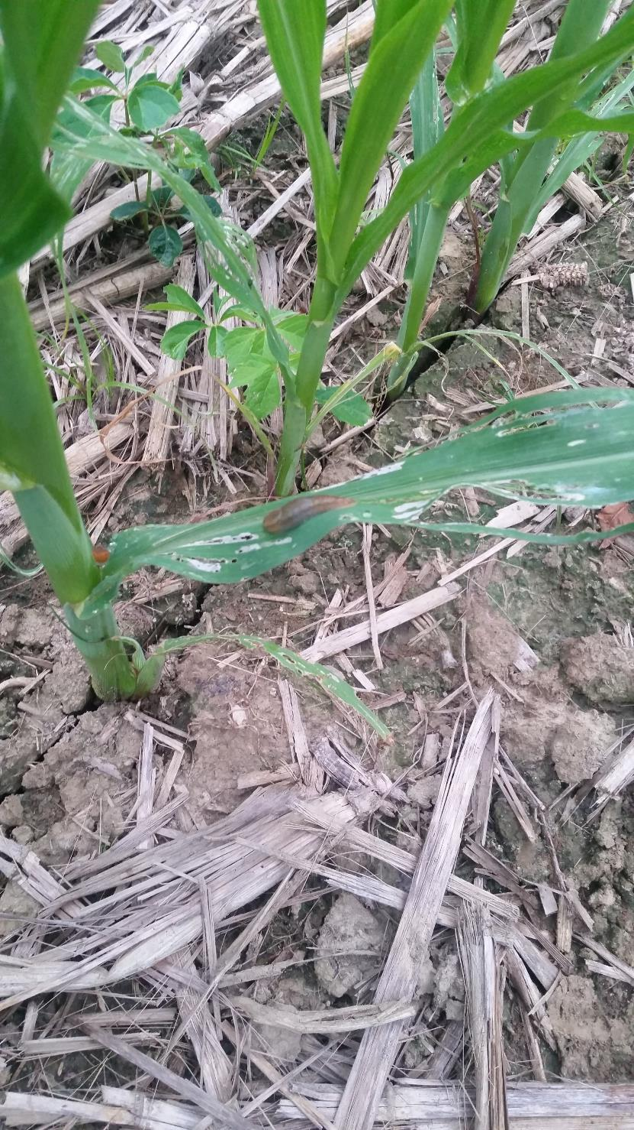

Slide 58
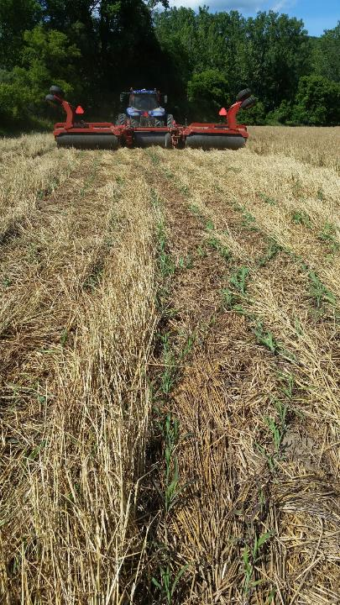
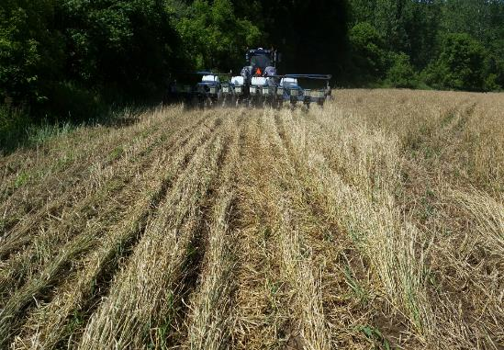

Slide 59
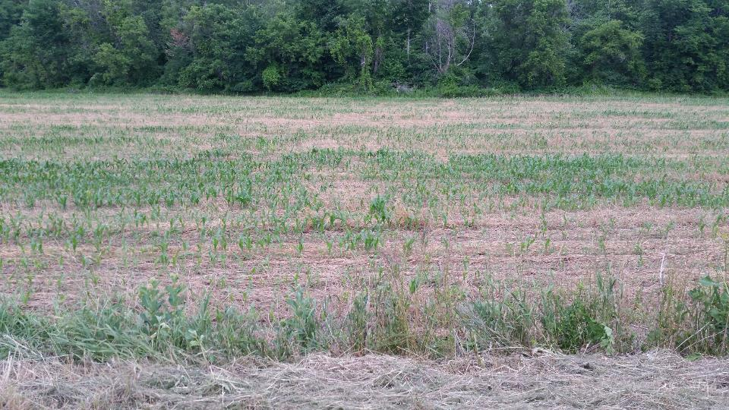

Slide 61
Uh Oh! Now what??
Uh Oh!! Now What??

Slide 62
Plan ‘B’ Panic mode- Spray the rest!!
Option 1
Roll and Plant into green rye

Slide 70
How beneficial were the soil applied herbicides?

Slide 74
This is cool!!
But…. Should have checked planting depth

Slide 78
Plan B Option 2 Bale straw then seed down

Slide 81
Why not just terminate covers Early?
Do that on the river ground now
Haven’t seen improvements in soil
Yields are flat
Soil is mellow when planting ‘green’
Noticed differences in planting in to sod
Spray-plant vs plant-spray

Slide 84
Changes for 2017
Increase No-till acres
Lower seeding rate on cover crops
Inject manure in sensitive areas
Figure out how to plant ‘medium tall’ rye
Look at narrow rows
Fertilizer placement on planter
Nitrogen 2X2, Starter under seed

Slide 87
Questions??

