Slide 1
LaunchVT – 2015 UVM Legislative summit
Katie Taylor, Director of Workforce Development and Entrepreneurship
Lake Champlain Regional Chamber of Commerce

Slide 2
WHAT IS LAUNCHVT?
SUPPORTING ENTREPRENEURS
LAUNCHVT IS A COMMUNITY INITIATIVE POWERED BY THE LAKE CHAMPLAIN REGIONAL CHAMBER OF COMMERCE TO PROVIDE ENTREPRENEURS WITH AN OPPORTUNITY FOR EXPOSURE, EDUCATION, AND REAL EXPERIENCE TO START THEIR BUSINESSES.
RESOURCES
EDUCATION

Slide 3
Elements of launchvt
COMPETITION
SEMINARS
LAUNCHVT’S BUSINESS PITCH COMPETITION AWARDS CASH AND IN-KIND RESOURCES TO ENTREPRENEURS WHO DELIVER PLANS FOR A NEW BUSINESS ENTERPRISE THAT DEMONSTRATES EXCEPTIONAL POTENTIAL IN TODAY’S MARKET.
LaunchVT's Entrepreneurial Seminar Series is open to the public and is focused on providing information to those Interested in starting or growing their business. The three topics are chosen throughout the course of LaunchVT's program.
MEETUPS
COLLEGIATE
LAUNCHVT’S MONTHLY MEETUPS PROVIDE OPPORTUNITIES FOR ENTREPRENEURS AND SERVICE PROVIDERS TO CHAT OVER A BEER OR
A CUP OF COFFEE.
LAUNCHVT’S COLLEGIATE BUSINESS PITCH COMPETITION CONNECTS EIGHT INSTITUTIONS FROM AROUND THE STATE AND AWARDS CASH AND IN-KIND RESOURCES, AS WELL AS A SPOT IN THE LAUNCHVT FINALS, TO THE BEST STUDENT TEAM.

Slide 4
THE LAUNCHVT COMPETITION
APPLICATION
FINAL COMPETITION
To qualify, A COMPANY must be an early-stage startup headquartered in Vermont. GENERALLY, THEY SHOULD NOT HAVE raised over $50K of investment OR have more than $100K in annual revenue. APPLICATIONS ARE REVIEWED AND FINALISTS ARE CHOSEN BY THE LAUNCHVT ADIVSORY BOARD.
IN THE FINAL COMPETITION, EACH TEAM has 10 minutes to present, followed by 3 minutes of Q&A. A PANEL OF JUDGES REVIEWS THE PITCHES, looking for entrepreneurs who deliver plans for a new business enterprise that demonstrates exceptional potential in today's market, including:
Likelihood of building a successful business
Scalability: potential to grow a sizeable & meaningful company over time
Potential to generate significant employment in Vermont
Prize packages
$30K (first place) and $15K (second place) IN CASH PLUS:
Lcrcc MEMBERSHIP
MEDIA BUDGET
FREE BUSINESS SPACE FOR 1YR
RISK MANAGEMENT / INSURANCE CONSULTATION
LEGAL SERVICES & INTELLECTUAL PROPERTY CONSULTING
FRACTIONAL CTO SERVICES
PR AND MARKETING
ACCOUNTING & TAX SERVICES
RUNNERS UP:
AN HOUR WITH AN ATTORNEY TO IDENTIFY THEIR LEGAL NEEDS AND CREATE A PLAN/BUDGET TO ADDRESS ANY ISSUES
A SECOND OPPORTUNITY TO PITCH IN FRONT OF 3-5 NORTH COUNTRY ANGELS AFTER THE LAUNCHVT FINAL COMPETITION
MENTORING
The selected contestants are each appointed a mentor with industry specific skill sets. This mentor will assist their contestants for over a month to review their business plans and pitches. The mentor will help them practice their presentation, review their pitch material and build entrepreneurial resources.
OFFICE HOURS
OFFICE HOURS ARE private networking opportunities for contestants, structured for mentors and Advisory Board members to connect FINALISTS with key people who can assist them in building their business. The program also allows contestants to offer feedback and assistance to each other.

Slide 5
LAUNCHVT COLLEGIATE
THE PILOT YEAR

Slide 6
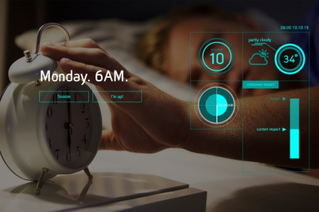
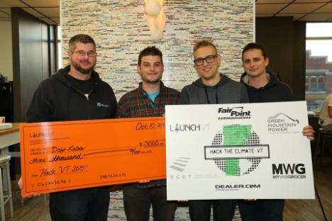
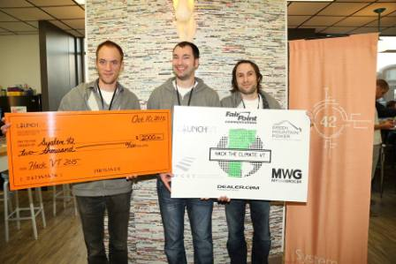
HACKVT
THE TECH-ENTREPRENEUR CONNECTION
CLIMATE CHANGE FOCUS
24-HOUR HACKATHON AWARDING $20K IN CASH AND PRIZES. TEAMS ARE PROVIDED DATA SETS AND A THEME AND SPEND THE NEXT 24 HOURS DEVELOPING A WINNING APP. EACH TEAM IS ALLOTTED 3 MINUTES TO PITCH THEIR APP, AND A PANEL OF JUDGES EVALUATES THE PRESENTATIONS FOR:
Execution of Theme
Innovation
Ambition
User Experience
Presentation Quality/Impact
Overall Quality
FIRST PLACE APP

Slide 7
“LaunchVT offers a great way for established and up-and-coming Vermont entrepreneurs to network and build their businesses. The cash reward and support resources are excellent incentives to give the winning team an edge at a crucial stage in their journey to join the next generation of awesome Vermont companies.”
Chris Little | Wintersmiths
www.launchvt.com
katie@vermont.org
802-863-3489 x208

