Slide 2
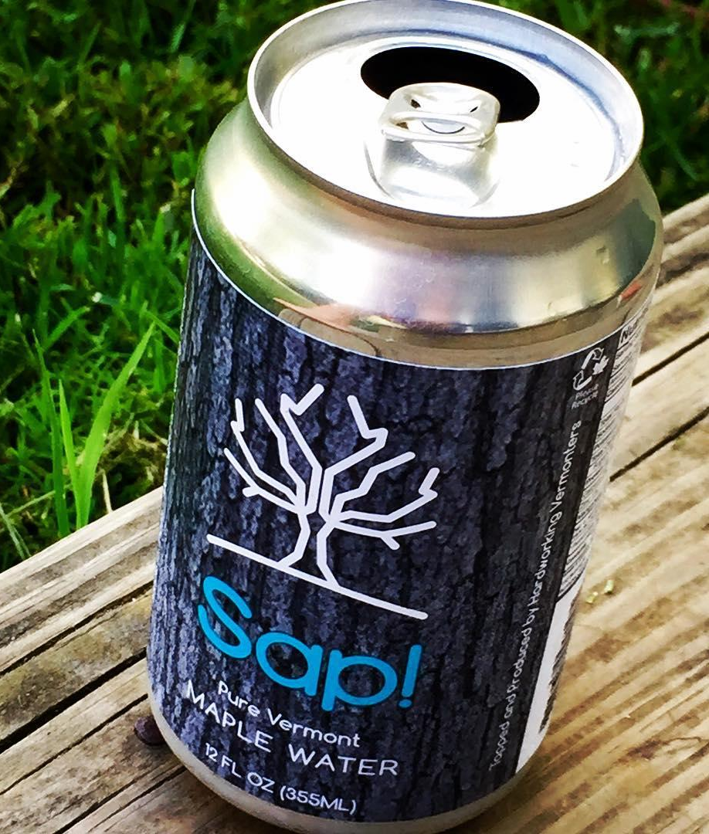
What is Sap!?
Sap! products are non-alcoholic beverages made from 100% pure maple sap straight from the maple trees of Vermont….with nothing else added.
Hydrating
Electrolytes
Similar to Coconut Water
Healthy
One Ingredient
Organic
Non-GMO
40 Vitamins & Minerals
100% Natural
Antioxidants
No Preservatives
Low Glycemic Sugar
Kosher
Gluten Free
Homegrown
$$$ back to the VT economy
VT Maple Economy - $52 M
Notes:
one ingredient, straight from a maple tree

Slide 3
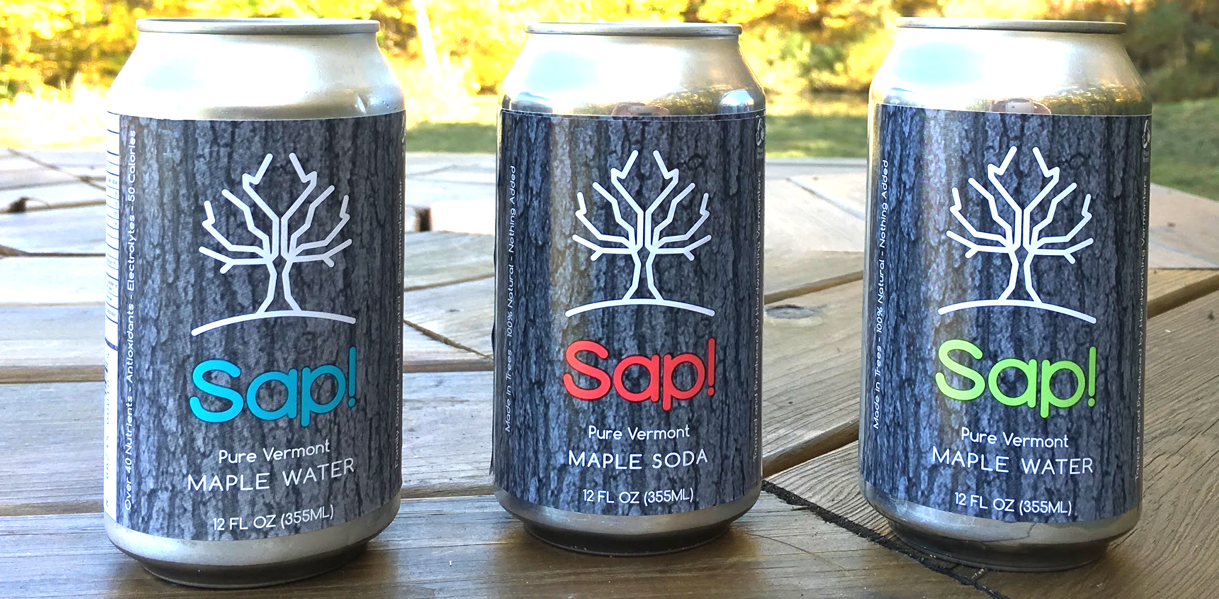
Current Products
Blue Label: “Maple Water”
50 Calories/12oz
Very Lightly Carbonated
Red Label: “Maple Sap Soda”
90 Calories/12oz
Carbonated
Green Label: “Maple Seltzer”
50 Calories/12oz
Carbonated

Slide 4
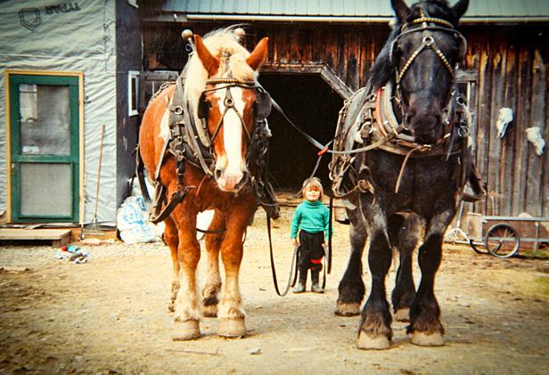
Key Stakeholders
People - Health
Planet - Working Landscape
Profit - Sustainability
Triple Bottom Line
- Nikita sugaring as a child, collecting sap with his family’s horses

Slide 5
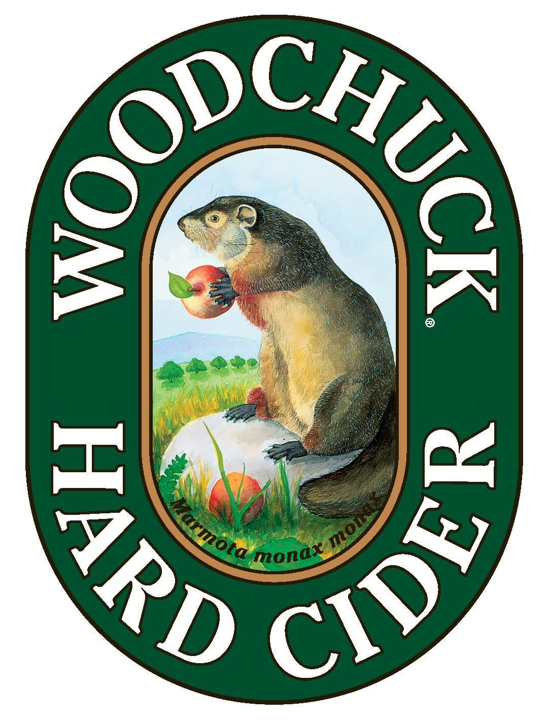
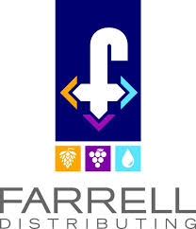
Connection to SEMBA
Education
Support
Connections
Ecosystem
Green
Mountain Mainlines

Slide 6
Path to a Better Entrepreneurial Ecosystem
Broad Points
Aggressively fix reputation of Vermont as unfriendly to business
Certainty and predictability around taxes and business costs are crucial, and hugely lacking
Mitigate my risks, protect my upside, reward my hard work
Better laws for independent contractors and the self-employed
Specific Points
Exempts startup owners from tax on his/her W2 income for seven years
Preferred capital gains tax treatment when their investment is liquidated
Make healthcare affordable by relaxing community rating for young Vermonters
Recognize the laws of supply and demand and increase responsible housing development

