Slide 1
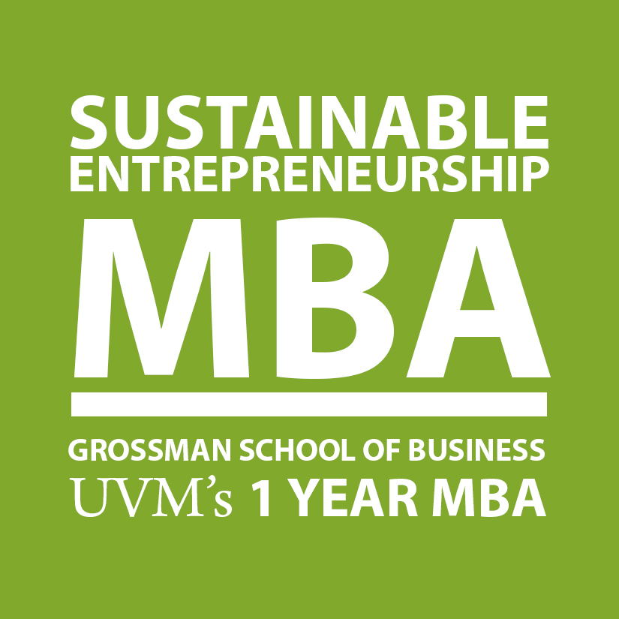
UVM’s Sustainable Entrepreneurship MBA: Entrepreneurial, Check. But Why “Sustainable”?
2015 UVM Legislative Policy Summit
Vermont’s 21st Century Economy: Building an Entrepreneurial Ecosystem
David A. Jones
Associate Professor & SEMBA Co-Director
Grossman School of Business, UVM
Chas P. Smith
SEMBA Graduate, Class of 2015
Co-Founder, SAP! Maple Water

Slide 2
Why Sustainable Entrepreneurship, & Why Now?
What is the likelihood that the next 20 years will look like the last 20 years?
Copyright Stuart Hart & David Jones 2015

Slide 3
Why Sustainable Entrepreneurship, & Why Now?
Pollution
“Clean Tech”
Depletion
Degradation
Inequity
“Base of the
Pyramid”
Poverty
Population
Copyright Stuart Hart & David Jones 2015

Slide 4
Why Sustainable Entrepreneurship, & Why Now?
Can we use the power of markets & innovative entrepreneurial models to lift the poor, & serve the underserved?
And/or to reduce the environmental footprint of an unstainable consumer-based economy to conserve the natural capital that supports all life on earth?
And make money while doing it?
Profitable enterprises can create sustained shared value
Copyright Stuart Hart & David Jones 2015

Slide 5
Why Sustainable Entrepreneurship, & Why Now?
Saturation of current markets
Purchasing Power
Parity in U.S. dollars
>$20,000
800
Wealthy
Population in millions
Emerging Middle Class (MoP)
Cost barriers; Environmental tipping points
$2.000-20,000
1,700
Base of the
Pyramid (BoP)
(Prahalad & Hart, 2002; Hart & Christensen, 2002;
London & Hart, 2004; Prahalad & Hammond, 2002)
<$2,000
Business models can fill unmet needs & serve underserved populations
4,500
Copyright Stuart Hart & David Jones 2015

Slide 6
UVM’s Sustainable Entrepreneurship MBA
Transforming Today’s Business
Creating Tomorrow’s Ventures
Copyright Stuart Hart & David Jones 2015

Slide 7
The Mission of SEMBA
To prepare and train individuals to create profitable and sustainable business opportunities in a world undergoing transformational change.
SEMBA aims to develop the next generation of leaders who will build, disrupt, innovate, & reinvent sustainable business and enterprises in a world that demands it.
Copyright Stuart Hart & David Jones 2015

Slide 8
Beyond “Saddlebag” Sustainability
Sharma & Hart, 2014
Copyright Stuart Hart & David Jones 2015

Slide 9
An MBA for the 21st Century
Traditional
MBA
Core MBA
Toolkit
Accounting
Finance
Economics
Statistics
Marketing
Operations
Management
Strategy
SEMBA
Eliminate legacy
content
Deemphasize
administration
Reduce manual
calculations
Training for functional
execution
Integrate & emphasize
sustainability & innovation
Collaborative problem-
solving skills
Project-based SB experience
via summer practicum
Preparing change agents
& visionary leaders
Copyright Stuart Hart & David Jones 2015

Slide 10
An Accelerated 1-Year MBA
45 Credit Hours
30 Courses in 4 Modules
Learning Teams
Workshops & Entrep/Execs in Residence
Summer Practicum
Copyright Stuart Hart & David Jones 2015

Slide 11
An Accelerated 1-Year MBA
Summer: Online Accounting Fundamentals Course (Aug)
Online, Self-paced, 1 Credit Hour
Module 1: Foundations of Management (Sep/Oct)
7 Courses, 10 Credit Hours
E.g., Business Strategy for a Sustainable World; Finance for Innovators; & Sustainable Brand Marketing
Module 2: Building A Sustainable Enterprise (Nov/Dec)
6 Courses, 9 Credit Hours
E.g., Crafting the Entrepreneurial Business Model; Business Sustainability and Public Policy; & Organizing for Sustainable Transformation
Copyright Stuart Hart & David Jones 2015

Slide 12
An Accelerated 1-Year MBA
Module 3: Growing A Sustainable Enterprise (Jan/Feb)
7 Courses, 9 Credit Hours
E.g., Sustainable Operations and Green Supply Chains; Financing a Sustainable Venture; & Managing and Leading for Sustainable Innovation
Module 4: Focusing On Sustainability (Mar/Apr)
8 Courses, 9 Credit Hours
E.g., Driving Innovation from the Base of the Pyramid; Sustainable Energy Technology and Policy; & Systems Tools for Sustainability
Summer Practicum (May-July)
7 Credit Hours
Copyright Stuart Hart & David Jones 2015

Slide 13
2014/15 Practicum Projects
Copyright Stuart Hart & David Jones 2015

Slide 14
2014/2015 Practicum Projects
Project Title: New Sustainable Product
This project will explore business plan scenarios to shift to a non-GMO "Plus" standard or organic. What does that look like? How could it be achieved profitably for the farmers and Ben & Jerry's? How would customers respond? Is there price elasticity, etc. This objective is to explore product options for a new value proposition for the company.
Copyright Stuart Hart & David Jones 2015

Slide 15
2014/2015 Practicum Projects
Project Title: New Models for Sustainability
Background: Burton Snowboards is the global market leader in snowboarding and is working with a team from SEMBA to explore opportunities around decoupling growth from raw material consumption through possible alternative economic models.
Copyright Stuart Hart & David Jones 2015

Slide 16
2014/2015 Practicum Projects
Project Title: Industrial Solutions Casella seeks to eliminate the concept of waste. A key part of this strategy is the industrial solutions team that works on a consultative basis with large industrial customers nationwide. With team members that are placed full-time at a manufacturer's facility, they examine processes & waste/resource streams for opportunities for the customer to efficiently manage waste & renewable material, to ensure safe disposal of non-renewables, & to meet their resource sustainability goals. The practicum will involve working with the team's business development leaders on an investigation, analysis & recommendation of potential markets, customers, service offerings, & marketing of the company's industrial solutions capabilities.
Copyright Stuart Hart & David Jones 2015

Slide 17
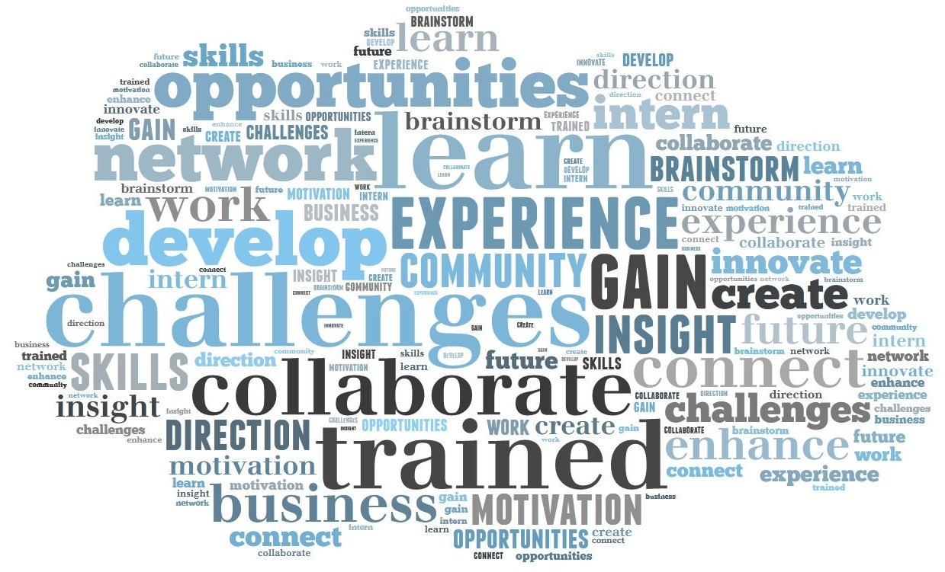
SEMBA: The Value Proposition
Intensive,
12 month
program;
A 1 year
opportunity
cost
One of the lowest tuitions on the MBA market;
In-State < $30K
Non-VT < $50K
Practicum project experience & post-graduate
consulting program
A unique value proposition;
We walk the talk
Copyright Stuart Hart & David Jones 2015

Slide 18
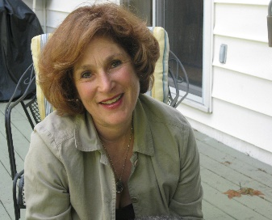
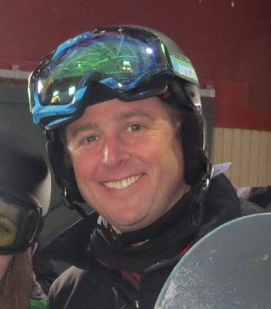
Co-Leaders, SEMBA Council of Mentors
Hinda Miller
President, Deforest Concepts
Founder of Sultana Group, Hinda just completed 10 years of service in the Vermont State Senate where she championed the creative/ local/ sustainable economy, complementary healthcare, and social change. She currently sits on the board of Keurig-Green Mountain as Chair of the Sustainability committee. Ms. Miller co-founded Jogbra, Inc., in 1977, the original maker of the "jogbra" women's sports garment. The original Jogbra is part of collections at the Smithsonian Institute and Metropolitan Museum of Art. She served as President of Jogbra, Inc., until company was purchased by Playtex Apparel and continued her leadership as President of Champion Jogbra, a division of Sara Lee Corp.
Justin Worthley
VP of HR, Burton Snowboards
Justin is a 7th generation Vermonter and 3rd generation UVM graduate (BA Environmental Studies, 1994) who obtained his MSA in Organizational Behavior from St. Michael's in 2002. He is currently the VP of Human Resources at Burton Snowboards, and has previous HR, OD and Operations experience at Rhino Foods, Bosch, Unilever and Ben & Jerry's. He lives in South Burlington with his wife Cara. His son Asa is attending Syracuse University studying business, and his daughter Hannah is an Occupational Therapist, also living and working in the Syracuse area.
Copyright Stuart Hart & David Jones 2015

Slide 19
SEMBA Council of Mentors
Anna Grady
Renewable NRG S’s
Felicity Lodge
Village Ind. Power
Joe Fusco
Casella
Beth Sachs &
David Barash
VT Energy Invest C.
Kate Williams
1% for the Planet
Andrea Cohen
VT Electric Coop
Robert Lair
St Michael's College
Dee Deluca
Living Well Group
Cairn Cross
Fresh Tracks Capital
Travis P Marcotte
Intervale
Justin Worthley
Burton Snowboards
Matthew Mole
Vermont Teddy Bear
Elizabeth Glenshaw
CleanYield Asset Mgmt
Chris Miller
Ben & Jerry's
Hinda Miller
Deforest Concepts
Jeff Bernicke
Native Energy
Copyright Stuart Hart & David Jones 2015

Slide 20
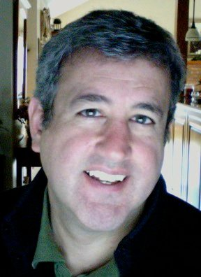
Co-Chairs, SEMBA Advisory Board
Cairn Cross
Managing Director
FreshTracks Capital
Joe Fusco
Vice President
Casella Waste Systems, Inc.
Cairn Cross is the co-founder and managing director of FreshTracks Capital a venture capital firm focused on Vermont companies and entrepreneurs which has invested in 24 companies during its 12 year history. He has spent most of his career financing startup and growth companies in Vermont as a banker and then as a venture capitalist. Cairn presently serves as a board member of NativeEnergy, Budnitz Bicycles, Mamava, Vermont Teddy Bear and Faraday. During spring 2016 semester he teaches Entrepreneurship: Business Planning in the undergraduate program at the Grossman School of Business, and Financing a Sustainable Venture in the SEMBA program.
Joe Fusco is a VP of Casella Waste Systems, Inc. He is an advisor to the company's chairman & CEO on organizational & leadership development, human performance, brand strategy, public affairs, business & market trends, and corporate communications. He's a teacher and coach to over 200 mid- & senior-level managers & numerous work teams. He speaks frequently to companies & organizations on leadership development, organizational & problem-solving culture, business & cultural trends, economic development, life/work balance, & corporate responsibility & sustainability. He is currently a trustee of the VT Youth Conservation Corps, & serves on the VT Climate Change Economy Council.
Copyright Stuart Hart & David Jones 2015

Slide 21
2015-2016 SEMBA Advisory Board
Copyright Stuart Hart & David Jones 2015

Slide 22
SEMBA Jobs & Careers
Investing
Consulting
“SEMBA Jobs”
Change
Agents
Entrepreneurs
Innovation
New Business Models
Clean Tech
Inclusive Business
Intrapreneurs
Transformation
New Business Models
Clean Tech
Inclusive Business
Jobs
Implementers
Marketing
Finance
Operations
Consulting
“MBA Jobs”
Functional
Execution
Start-Up
Established
Mature
Organizational Life Cycle
Copyright Stuart Hart & David Jones 2015

Slide 23
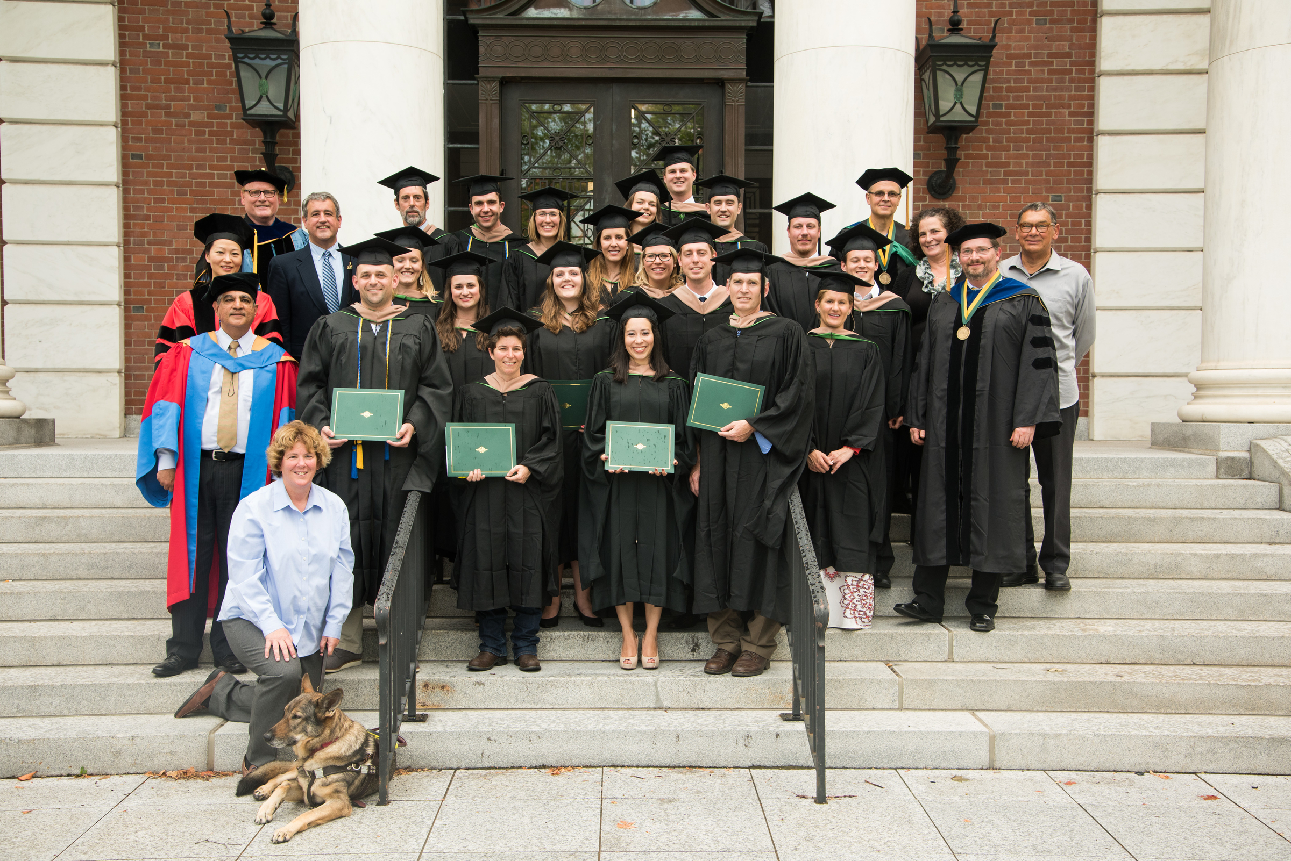
Class of 2015: “The Pioneers”
Chas P. Smith!
Co-Founder, SAP! Maple Water
Copyright Stuart Hart & David Jones 2015

