Slide 1
The importance of the Vermont brand.
Patricia Moulton, Secretary
Agency of Commerce and Community Development

Slide 2
Studies of our brand:
O’Neal Study in 2003:
Study of in and out of state visitors and businesses.
Image matched the identity.
“Beautiful, peaceful, natural, genuine, respectful of the environment, hardworking, friendly.”
Regional work
RSG Study in 2010:
Vacationer study of Canadian metro, NYC metro and Massachusetts
Profile of visitors.
Opportunities for Vermont Vacation Providers.
Ideas on how to market to which sectors. I.e. NYC metro looking for luxury; MA is looking for practical, outdoor weekend trips; Canadian looking for luxury in Canada and NE.
Notes:
There have been regional work, SeVEDS in Windham County, Bennington County
Most studies around tourism and how to attract tourists.

Slide 3
Our brand sells:
Glenn Ravdin has suggested Vermont products command a greater value in the marketplace. 10-15%
Studies have shown Vermont connotes “clean, environmental, quality, pure.”
Many entrepreneurs came to Vermont initially as tourists.
Most Vermont companies that come here had some affinity for Vermont.
Vermont on the label means something.
It is why some folks want to put “Vermont” on the label.

Slide 4
Protecting the brand
Attorney General’s office:
Rule 120 prohibits the use of a company name containing the word "Vermont" to advertise or market a food product made outside of Vermont or containing non-Vermont primary ingredients, unless the product label clearly discloses its out-of-state connection. ​
Rule covers the use of Vermont in goods and services and is enforced by the Vermont Attorney General’s office ​
State of Vermont Brand: Chief Marketing Office.
The Chief Marketing Officer of Vermont oversees the brand identity for the State and its many departments​
To ensure a consistent Vermont brand identity, a brand standards and style guide has been created and can found online at:​http://cmo.vermont.gov​
Notes:
CMO was created to develop and protect the State of Vermont brand
All agencies are supposed to use the brand standards and style guide
CMO staffed with two people with marketing and branding experience
Help is available FREE OF CHARGE

Slide 5
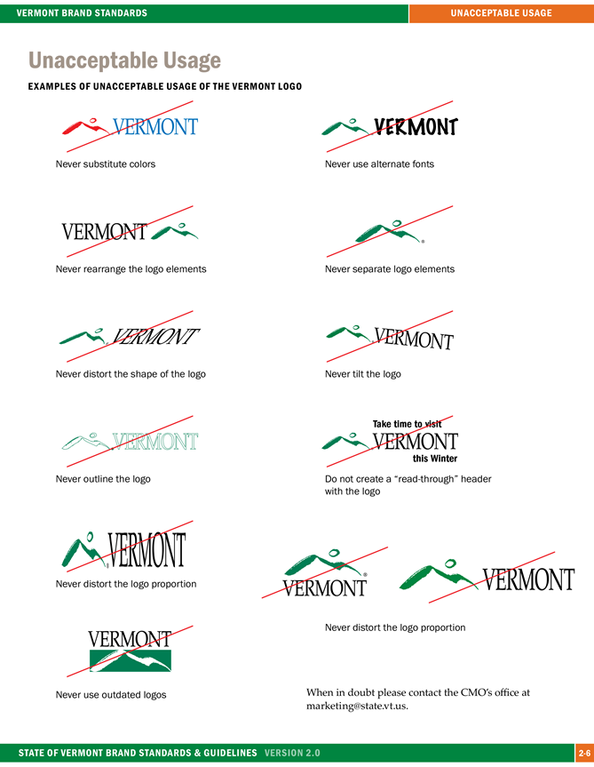
State of Vermont Brand:
Notes:
Purpose is to develop a common look, a common brand.
Most of us know Coca Cola or Pepsi or King Arthur Flour, or name your product.
This is our “state of Vermont product”
When you see it you will know it is the state.
The guidance on the use is clear.
CMO is charged with overseeing and “enforcing”

Slide 6
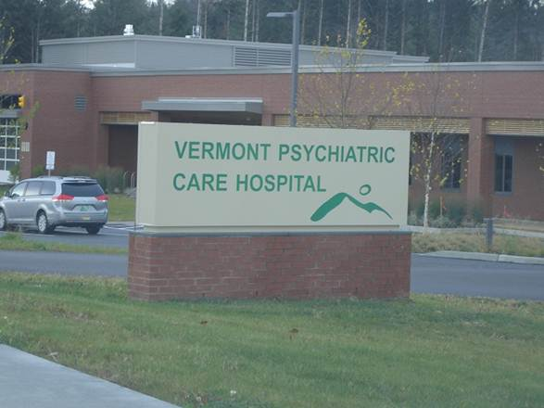
But not everyone plays well in the sand box!
Notes:
I don’t mean to be “outing” my peers
Two example of misuse.
Not supposed to be missing the state agency But should we replace the sign?
Sample of the private sector wanting to use it.
Numerous examples everything from business cards that do not carry the logo to changes in the logo.

Slide 7
What can we do to protect the brand?
More authority to the CMO.
Continue to support our branding programs:
Vermont Life, Tourism and Marketing, Agency of Agriculture, Economic Development marketing.
Review the content law.
Strong enough? Catching the right folks?
Provide adequate resources to ensure quality.
Inspectors
Develop a branding and marketing program with appropriate resources.
A way to differentiate Vermont products and Vermont in the marketplace.
YOUR THOUGHTS?

Slide 8
THANK YOU!
PATRICIA MOULTON, SECRETARY
AGENCY OF COMMERCE AND COMMUNITY DEVELOPMENT
PAT.MOULTON@VERMONT.GOV

