Slide 1
Flexible Pathways and Workforce Development UVM Legislative Summit 11/17/15
Heather Bouchey, Ph.D.
Deputy Secretary
Notes:
(in partnership with Jay Ramsey, CTE Coordinator at AOE)

Slide 2
Flexible Pathways
On June 6, 2013 Governor Peter Shumlin signed the Flexible Pathways bill (Act77) which provides for:
Expansion of the existing Statewide Dual Enrollment Program
Expansion of Early College Programs
Increased access to work-based learning
Increased virtual/blended learning opportunities
Increased access to Career and Technical Education (CTE)
Implementation of Personalized Learning Plans (PLPs)

Slide 3
Flexible Pathways
On June 6, 2013 Governor Peter Shumlin signed the Flexible Pathways bill (Act77) which provides for:
Expansion of the existing Statewide Dual Enrollment Program
Expansion of Early College Programs
Increased access to work-based learning
Increased virtual/blended learning opportunities
Increased access to Career and Technical Education (CTE)
Implementation of Personalized Learning Plans (PLPs)
Notes:
These are the foci of my remarks today.

Slide 4
Dual Enrollment Before and After Act 77: Flexible Pathways
 | FY 13 (Prior to Act 77 Implementation) | FY 14 (First Year of Implementation)
Total Participants | 612 (203 excluding summer) | 1292
subpopulations Male Female Free/Reduced Lunch Special Education English Language Learners | (data excludes summer) 62 141 53 1 7 | 448 844 353 43 86
Source: http://legislature.vermont.gov/assets/Legislative-Reports/ACT-77-Annual-Report-FY14-1-30-15.pdf
Notes:
So, how are we doing with respect to Dual Enrollment?
Numbers HAVE increased as a result of this legislation. But note that men still lag behind women. Moreover, it’s been a bit of a “free for all.” AOE will be working on some guidelines, integrated with other work re PLPs and CTE/programs of study, providing better guidance on what kinds of choices students might consider making in terms of dual enrollment courses.
For example: in terms of enhancing workforce development, we may want to think smarter and more strategically re how we encourage students to use Dual Enrollment credits. Some good examples of that when we combine CTE courses and dual enrollment.

Slide 5
Promising Partnerships
Fast Forward dual enrollment program – CTE students are entitled to two dual enrollment vouchers [in addition to the Act 77 vouchers] to use at CCV or VTC.
GW Plastics and VTC – scholarships and paid internships in mechanical engineering; using VAST (early college credits)“local student can finish his or her associate degree by the age of 19, have an excellent job, and a nearly-free college degree”
Health Science/Sports Medicine program at the Burlington Technical Center ; students graduate high school with at least 12 college credits.
CTE Director’s Association and AOE partnership meet this year with at least 12 groups of teachers to discuss programs of study and help connect them to CCV and VTC for dual enrollment opportunities.
Notes:
And at AOE

Slide 6
Needed directions
Creating state or regional level systems that require or provide incentives to coordinate available resources and programming – e.g., the career pathways model.
Notes:
DOL, Department of Commerce and ED, and AOE agree.

Slide 7
Notes:
Note: some states have FULLY adopted this approach; requires ownership and partnership with other agencies and partner organizations. We need help getting there…

Slide 8
VT CEDS Priority Sectors
Travel/Tourism and Business Systems (Culinary, Hospitality, Accounting, Management, Entrepreneurship)
Manufacturing/Engineering (STEM)
Construction/Green Building and Design
Agriculture, Local Food Systems, & Natural Resources
Health/Medical
Information Technology (Networking, Software Development, Website Design)
Notes:
*comprehensive economic development strategy

Slide 9
Notes:
Standouts = look how small STEM is. 4% (whereas Transportation, Distribution, & Logistics = 10%)
Not entirely consistent with our CEDS goals.
Also, not entirely sure where “IT” CEDS goal fits, within A/V Tech and Communications, within STEM?
Human Services is big and we need that, but where does it fit in CEDS?

Slide 10
Curricular Indicators
 | CTE Enrollment | Career Clusters Offered | Accreditation Received
Vermont | 9,461 | 6 (modified) | 72.3%
New Hampshire | 21,057 | 15 | 96%
Maine | 17,103 | 16 (modified) | 55.5%
Massachusetts | 118,152 | 10 (modified) | 55.4%
Rhode Island | 20,733 | 16 | 38.9%
Notes:
Source: Rockefeller Center, Dartmouth; 2/2014 report.
**Combines both secondary and postsecondary together.
In contrast to the 16 Career Clusters® described by the national framework, Vermont offers only six clusters: Agriculture and Natural Resources, Arts
and Communications, Business Systems, Engineering and Technical Systems, Health and Human Services, and Public Services. Under each of these broad Career Cluster
umbrellas are a variety of subfields, such as Government and Public Administration under Public Services.2although there are many subfields in which students may choose to study, not all subfields or Career Clusters® are offered at all 17 centers. Each center has discretion in deciding which program they wish
to offer to students.
Many centers thus choose to focus on local needs in deciding which programs to offer. For example, rural centers may tend to promote programs in Agriculture and Natural
Resources.3 This local control of programming decisions limits the access of all Vermont students to equitable and varied technical program offerings.

Slide 11
Current access and funding for CTE = often not until junior and senior years; limits scope and depth of programming and associated ROI
Earlier exposure to build student capacity in concepts and learning models that will come later in the CTE pipeline
Personalized Learning Plans to link this exposure with high school and post-high school experiences and goals

Slide 12
Additional Considerations

Slide 13
NECAP Reading Scores: Interaction of Poverty and Gender
All Assessed Students
Male Not Free/Reduced
Female Not Free/Reduced Lunch
Score Points
Male Free/Reduced Lunch
Female Free/Reduced Lunch
Test Year

Slide 15
High School Completion – Gender Differential

Slide 16
CTE and Gender
In FY 2013, 4,872 secondary and 4,153 postsecondary students participated in CTE.
At the secondary level, 39% were female and 61% were male.
At the postsecondary level, 62% were female and 38% were male.

Slide 17
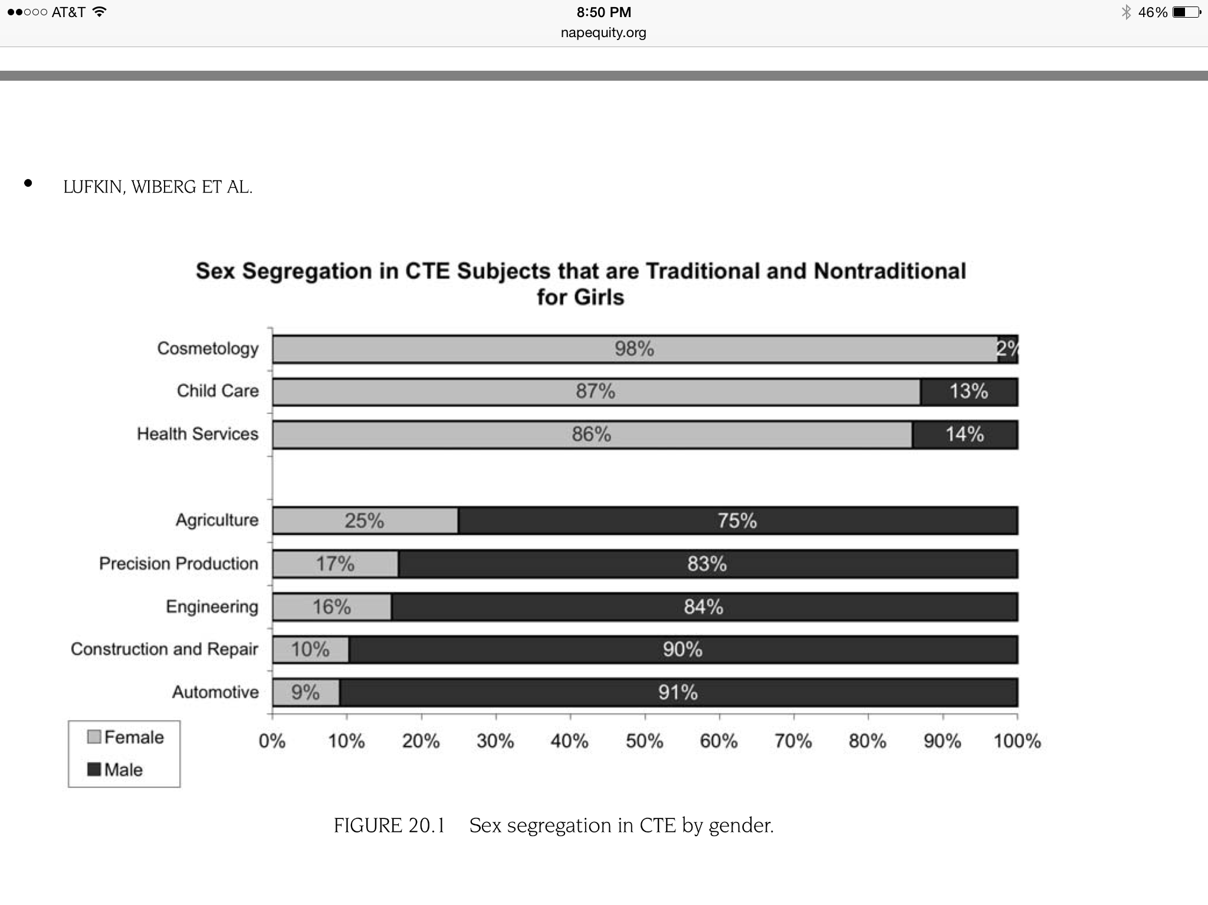

Slide 18
Take Home Points
Leveraging power of DE, CTE, and cross-organization partnerships
Introducing CTE earlier into the k-12 curriculum, PLPs
Equity and demographic concerns

