Slide 1
Outreach, Education and Technical Assistance: What We Can Do Differently
Jurij Homziak
Lake Champlain Sea Grant

Slide 2
Hazardous Events
Caused by:
Climate related changes
Land-use changes
Accidents related to economic activities
Focus on fist two

Slide 3
Goals: Improving response and resilience
Broad understanding of the risks of living, working, and doing business in hazard prone areas
Building community capacity to prepare for and respond to hazardous events

Slide 4
Education and outreach helps communities
understand how hazardous events occur
realistically assess the risks
understand vulnerability
identify the available options to reduce risk, vulnerability
Consider both risk and options in decision making
how to prepare for and respond to hazardous events

Slide 5
Audiences
Public
K-12 youth and teachers
Businesses community
Planners and agency staff
Elected officials

Slide 6
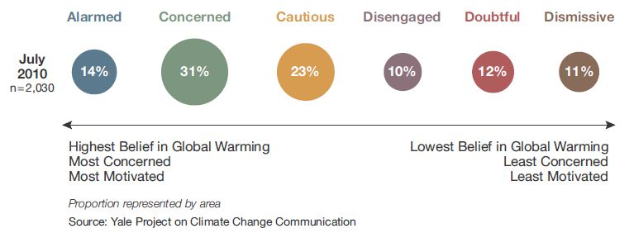
Educating the Public
Awareness of the issues
Individual decision making
Public policy choices

Slide 7
K-12 youth, teachers and climate change education
Survey of 555 K-12 U.S. science teachers, 47 % are not sure if climate change and associated hazards are valid
In another recent survey of science and environmental studies education majors showed knowledge and understanding of climate change and impacts was “unacceptably low”

Slide 8
US Teens
Less than 1 in 5 are “very well informed” about how the climate system works or the different causes, consequences, or potential solutions to global climate change
Only 27 % say they have learned “a lot” about global climate change in school
70 % would like to know more
Source: Yale University, American Teens’ Knowledge of Climate Change

Slide 9
Building community capacity among planners and decision makers
Understand vulnerabilities
Act on the knowledge
Develop comprehensive emergency preparedness and response plans

Slide 10
Education and outreach
Identify development practices to reduce vulnerability
Assist decision-makers to adopt policies, plans, and ordinances to reduce risks
Support the use of new technologies to prepare for and mitigate the impacts of hazardous events
Link to NOAA tools and databases to identify vulnerability and support hazard-related planning activities

Slide 11
NOAA Tools
forecasting and risk assessment tools
economic and environmental impact models
demographic and coastal hazard information databases
Mapping tools

Slide 12
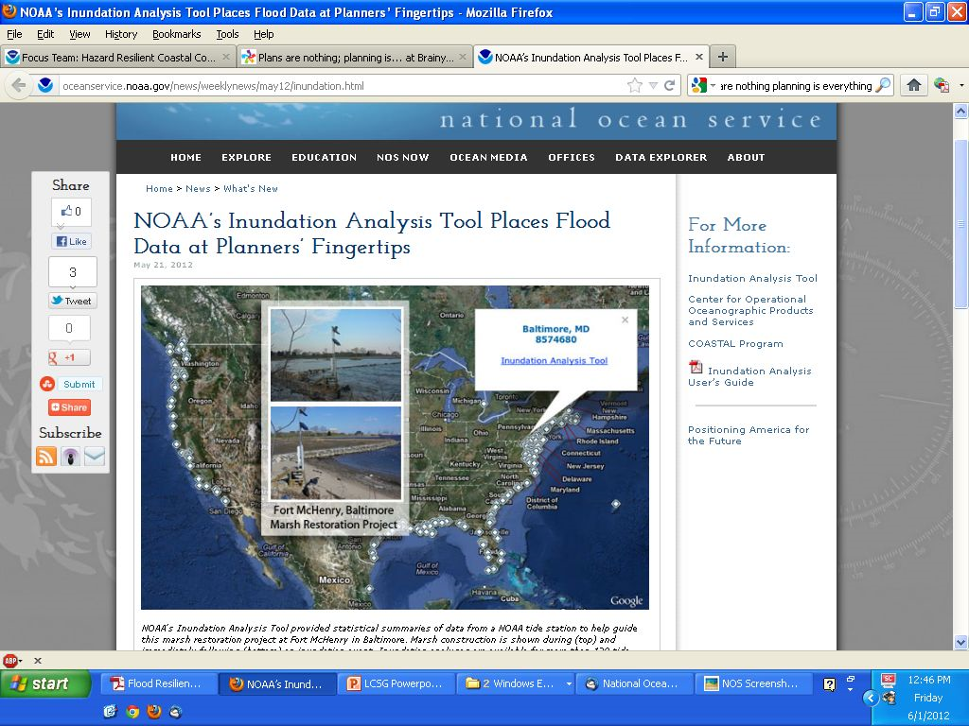

Slide 13
What needs do we do differently in outreach and education?
Make hazardous events and climate change research relevant on local scales
Develop education programs on climate change and hazardous events
Identify concerns of major stakeholders
Train in best practices to minimize risk and vulnerability
Help businesses understand effects on business operations, by disrupting suppliers, distribution or customers

Slide 14
Plans are nothing; planning is everything. Dwight D. Eisenhower
Integrate local climate change knowledge into hazardous events planning
Improve access by decision-makers to planning services
Community demonstration projects to develop policies and adaptive actions
Help communities identify new opportunities and adapt to changes

Slide 15
Take Home Message
If all of us understand of the risks of hazardous events and climate change, and
Be more aware of our vulnerability
We can build our capacity to better prepare for and respond to hazardous events

