Slide 1
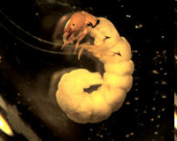
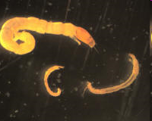
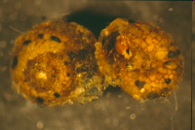
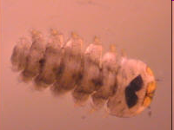
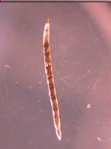
Declan McCabe; Janel Roberge; Lindsay Wieland; Patrick Clemins; Steven Exler; Erin Hayes-Pontius; Lillian Gamache; Elissa Benedetto; Jeremy Gould; My Mai; Lara Nargozian; Colum Smith
Not your parents’ field guide: a site-specific macroinvertebrate IPhone app for citizen scientists

Slide 2
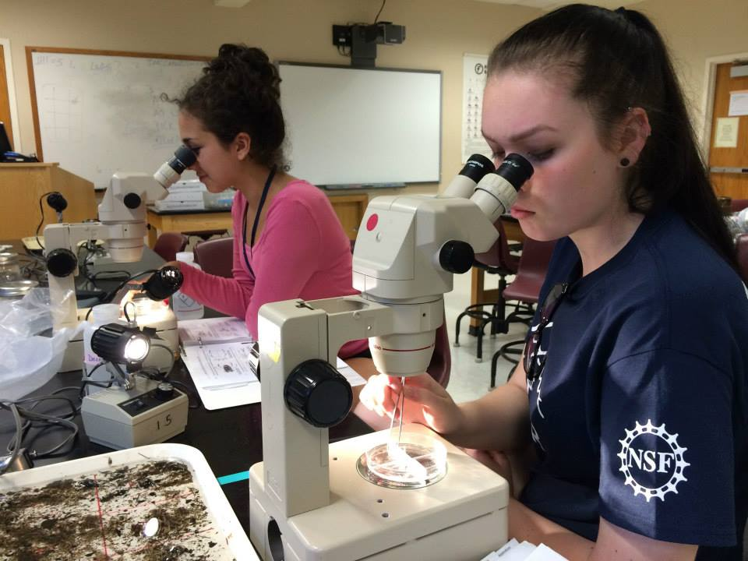
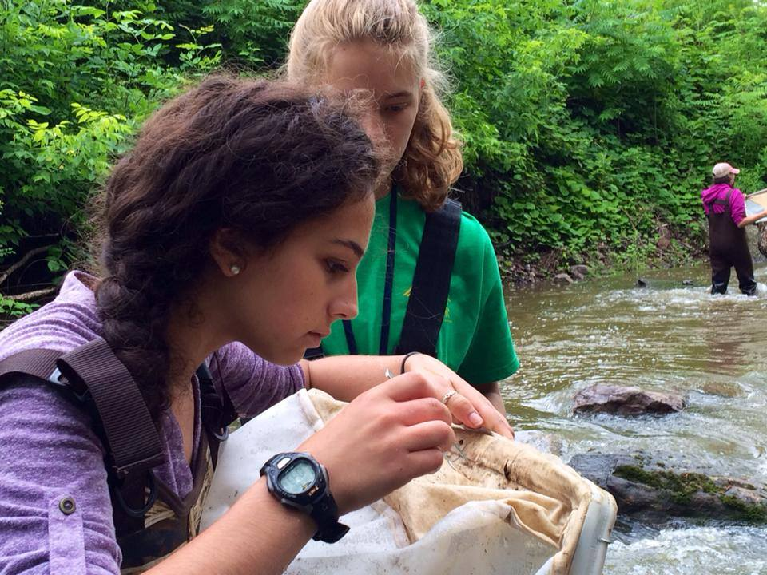
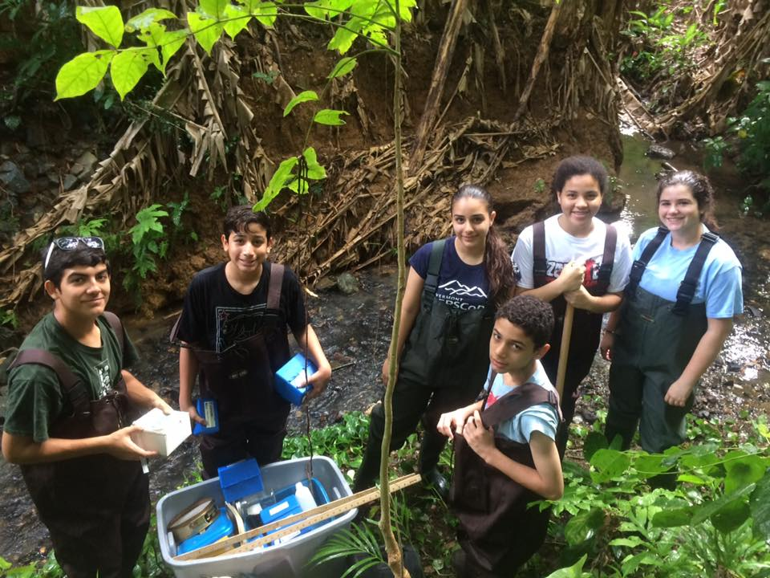
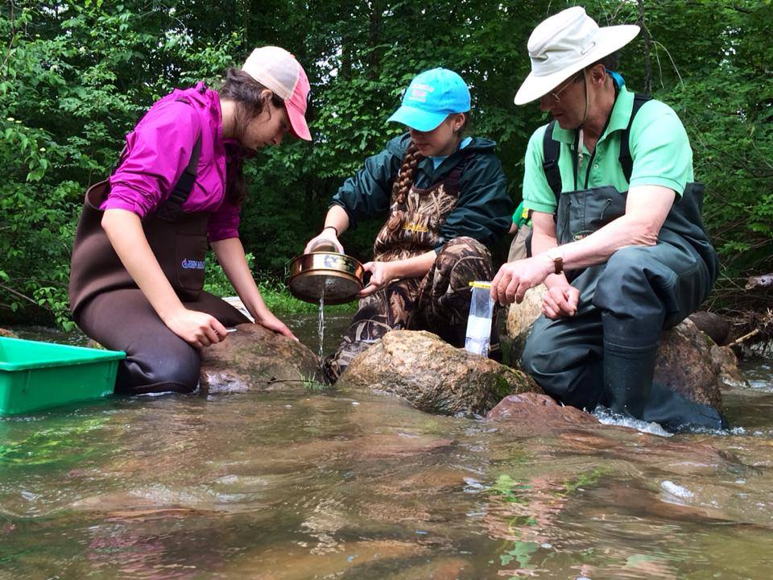
Macroinvertebrates
Wonderful gateway drug for budding scientists

Slide 3
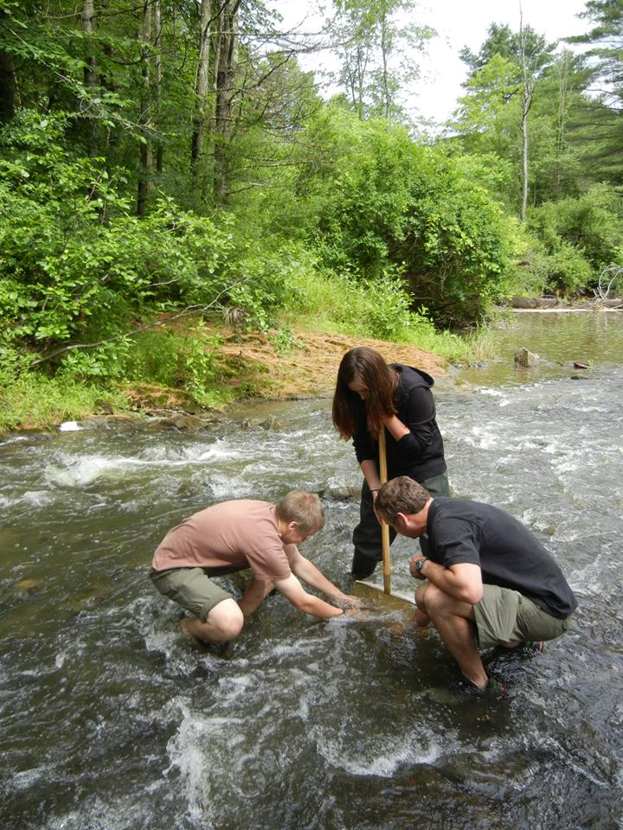
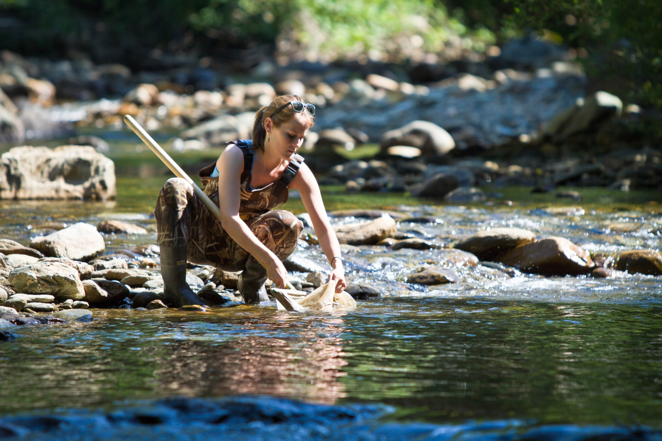
Easy to sample

Slide 4
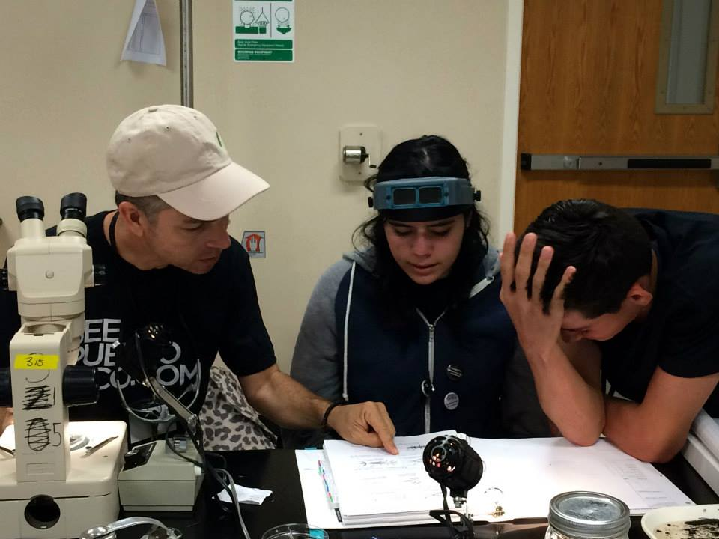
A headache to identify

Slide 5
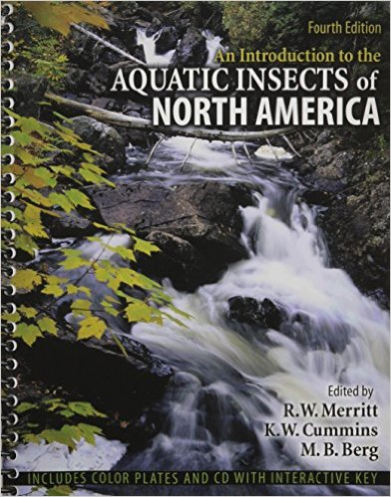
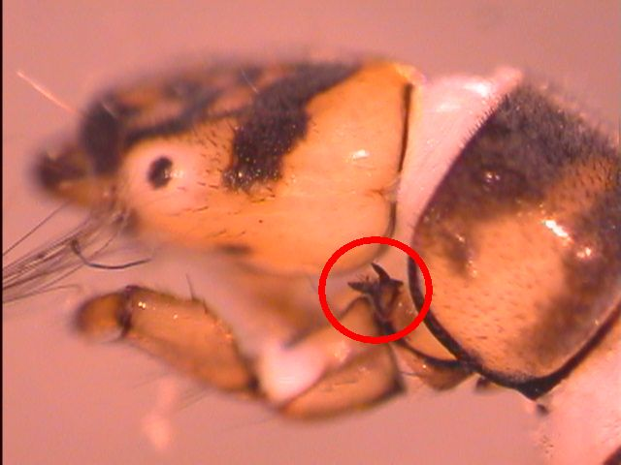
Barriers to identification
Professional keys are all-inclusive
Time consuming
Dense terminology:
“pronotum crenulate”
“flabellate antennae”
Features hard to see
26 chapters; 1158 pages; 5963 references

Slide 6
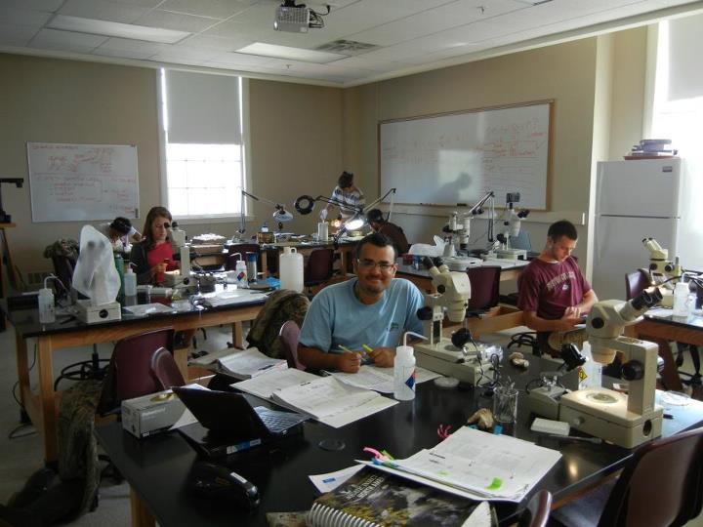
Traditional identification keys

Slide 7
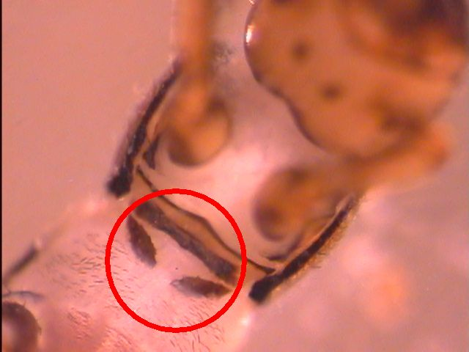
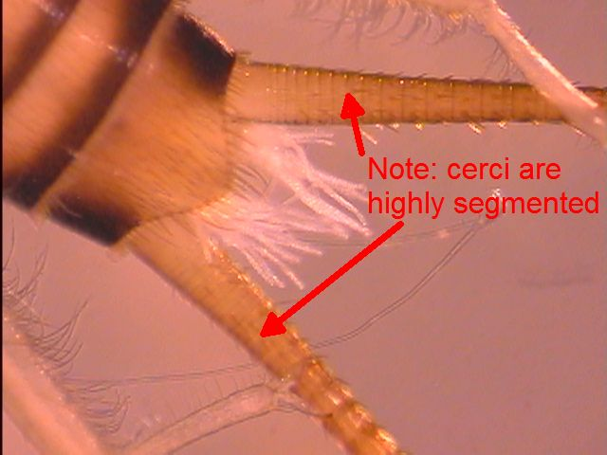
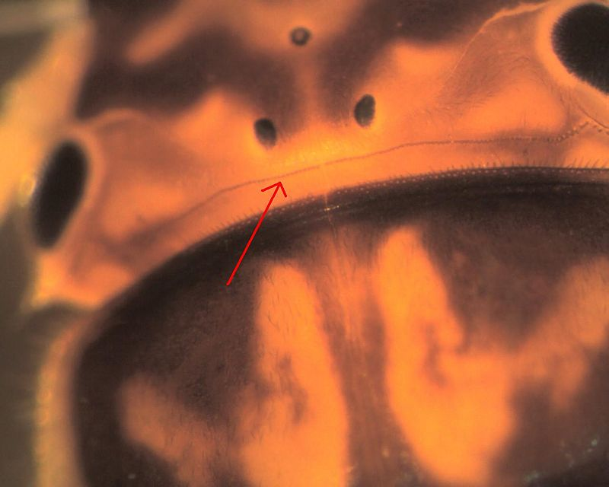
Key-reading help: a web site

Slide 8
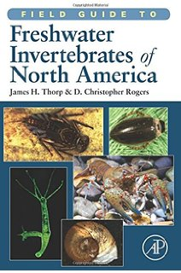
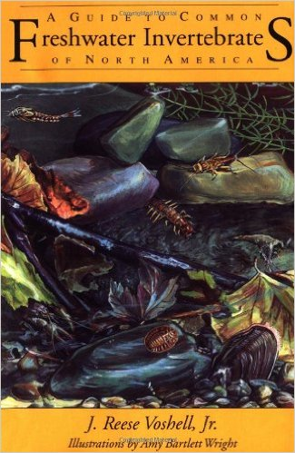
Common frustrations
Professional key issues
2 hours later you learn:…. the bug you sampled in Hinesburg ….occurs only in spring seeps in the Columbia River Gorge
Lack of confidence in data
Field guide issues
Some really common invertebrates not covered

Slide 9
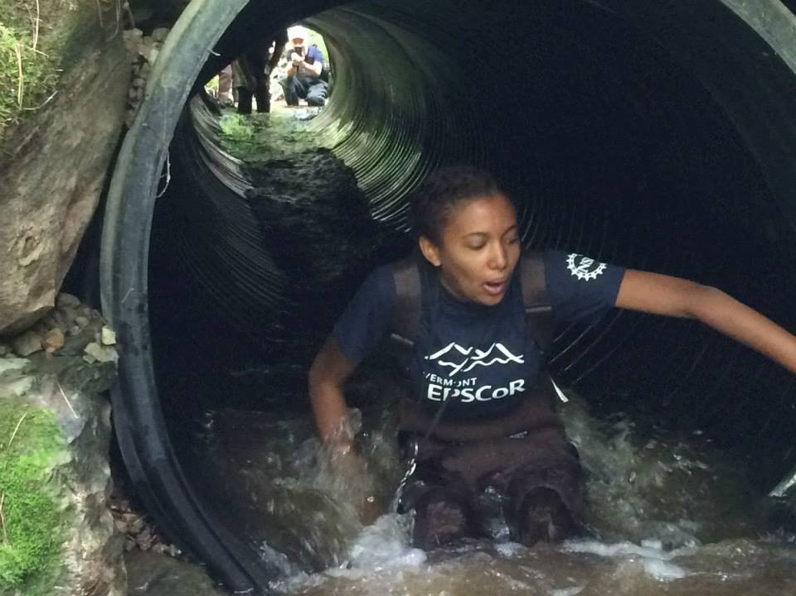
Light at the end of the tunnel?
At a specific site, we tend to repeatedly find the same invertebrates
You can list the “usual suspects”

Slide 10
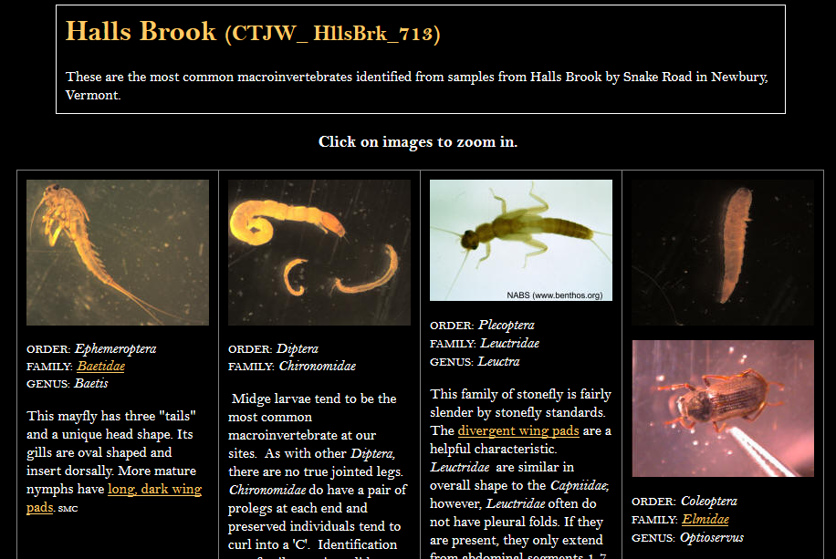
…and once you have the list
You can assemble a gallery of photos
Repeat visits improve the list

Slide 11
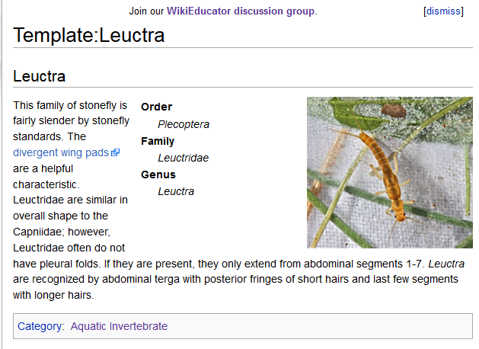
Reusable templates for common macroinvertebrates

Slide 12
Site-specific field guides
Templates gathered on stream wikis
Typically, 12 templates cover 90% of the macroinvertebrates at a site
Urban and agricultural sites require fewer

Slide 13
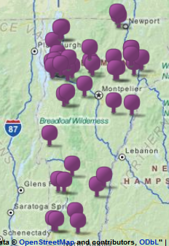
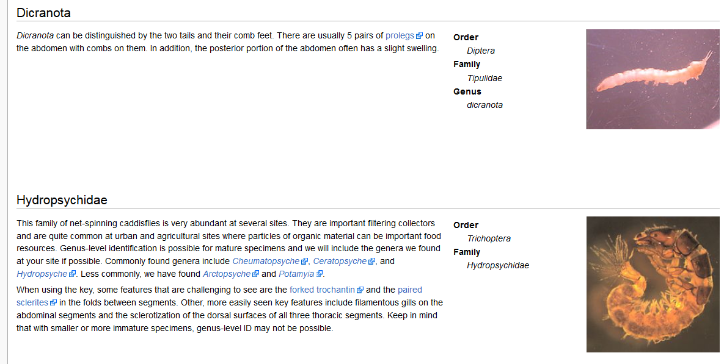
A wiki site for each stream
81 stream sites: VT; NY; PR
4 lake/pond sites

Slide 14
Iphone/Ipad app!
Wiki content downloads to portable devices

Slide 15
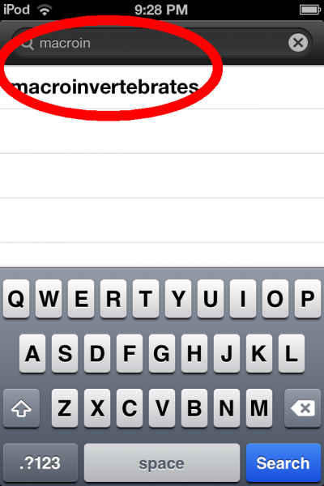
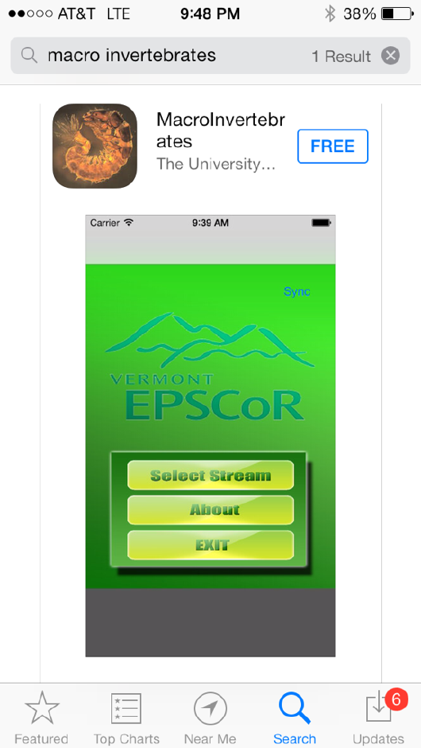
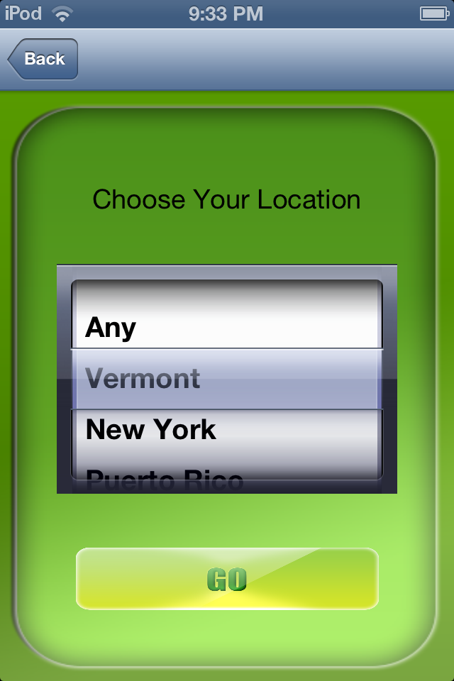

Slide 16
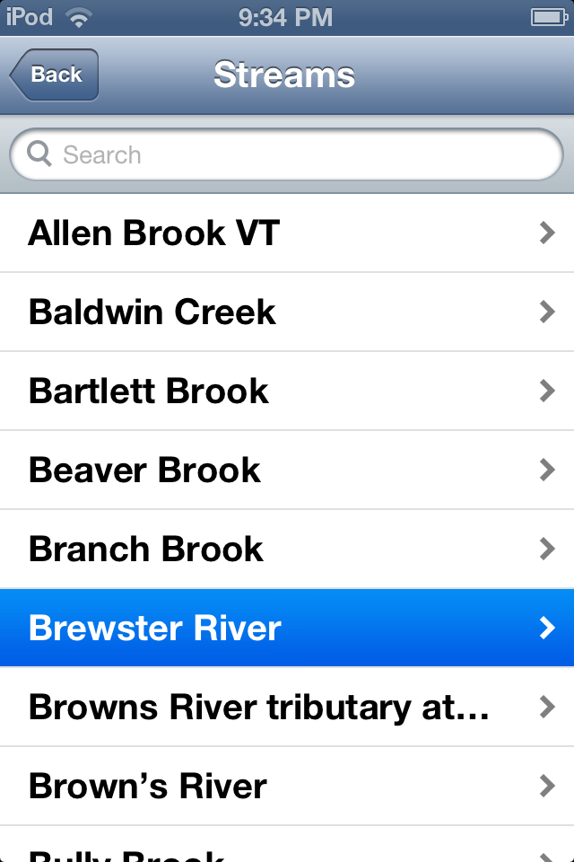
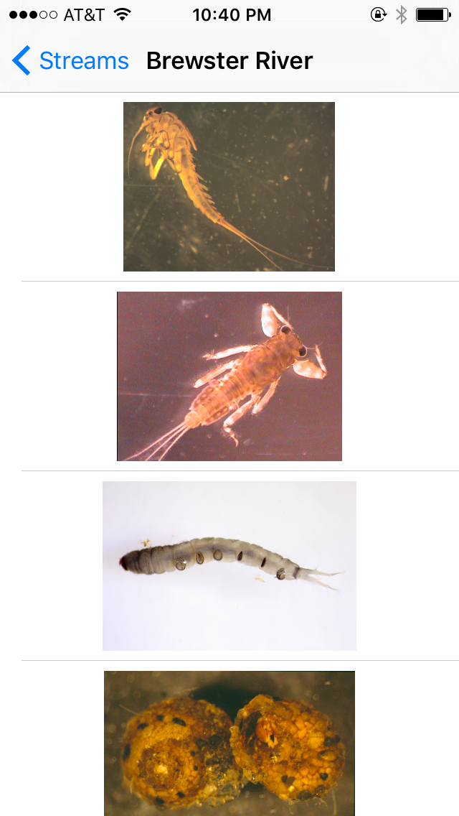

Slide 17
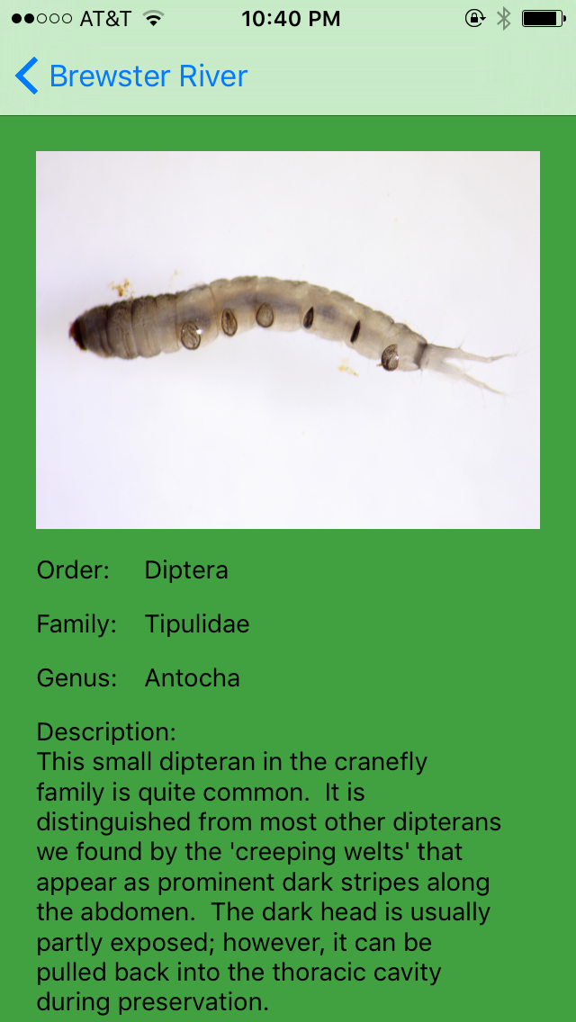
Template content from wiki reflected on iphone app:
140 templates written to date

Slide 18
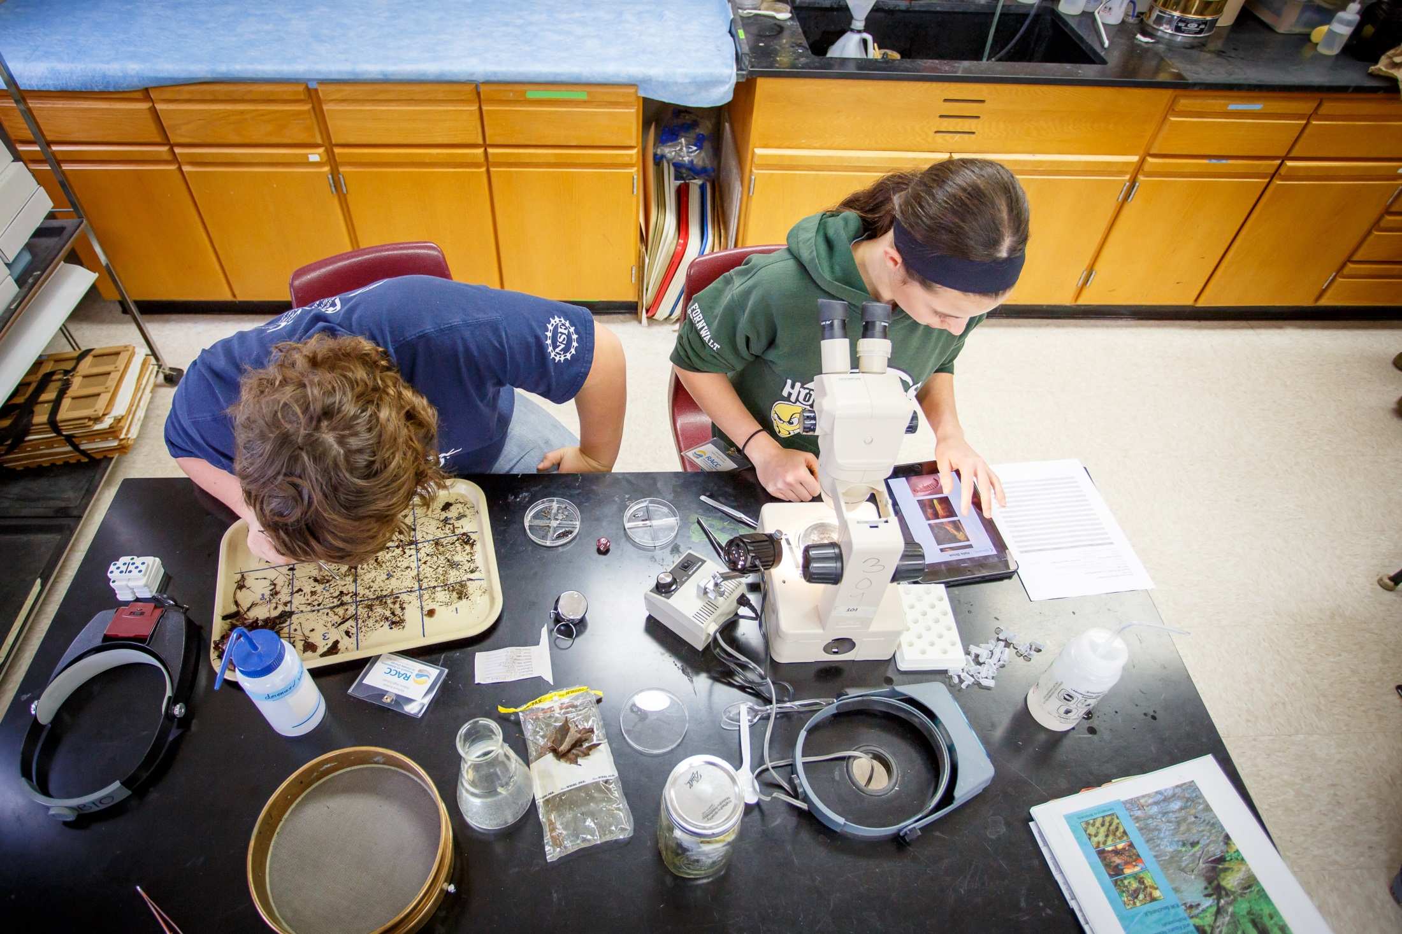

Slide 19
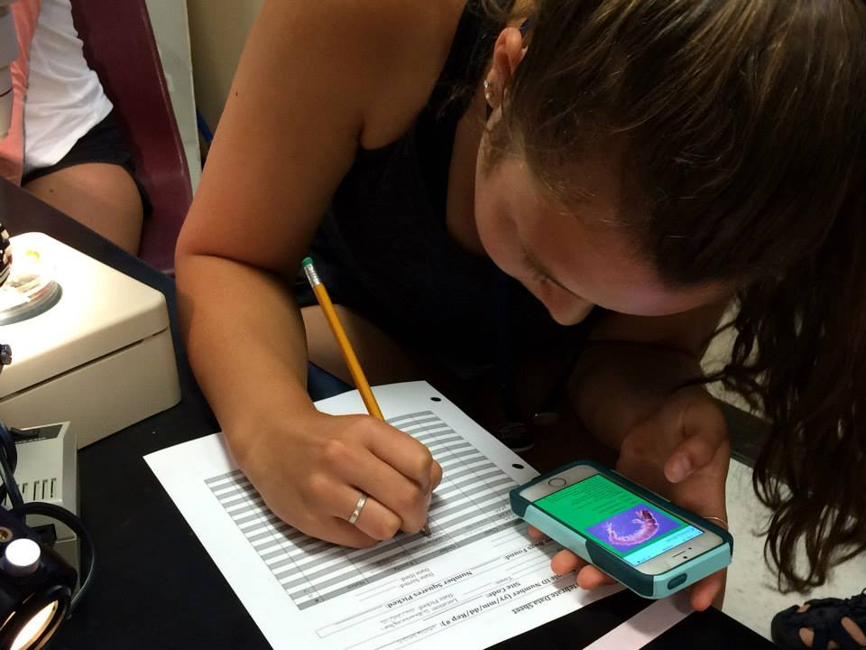

Slide 20
Coming soon
Common names
Tied fly names
App-specific and wiki-specific content
Efficient synchronization
New look

Slide 21
Slide from Bijay Koirala

Slide 22
Slide from Bijay Koirala

Slide 23
Conclusions
Training entomologists?
Doing grad research?
Use traditional keys
Working with citizen scientists?
Need data for teaching purposes?
IPad app is an efficient alternative
Questions?

