Slide 1
The Status of Vermont Forest Birds, 1989-2013 25 Years of the Vermont Forest Bird Monitoring Program
Steve D. Faccio
John D. Lloyd
Chris C. Rimmer

Slide 2
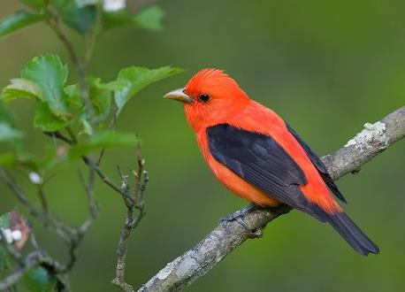
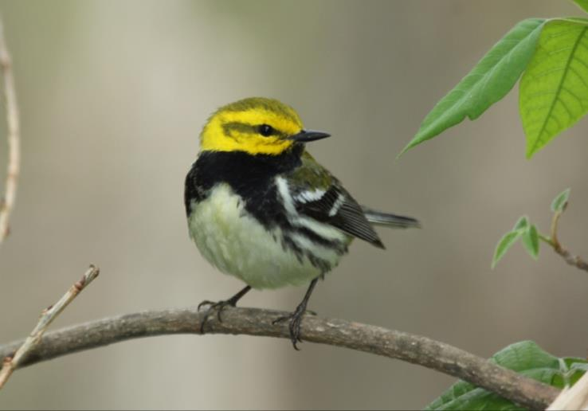
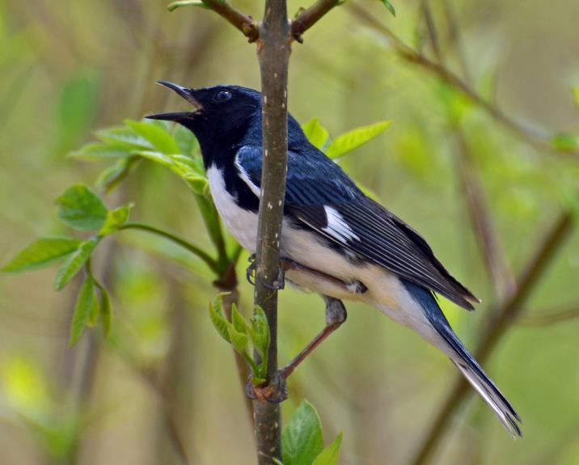
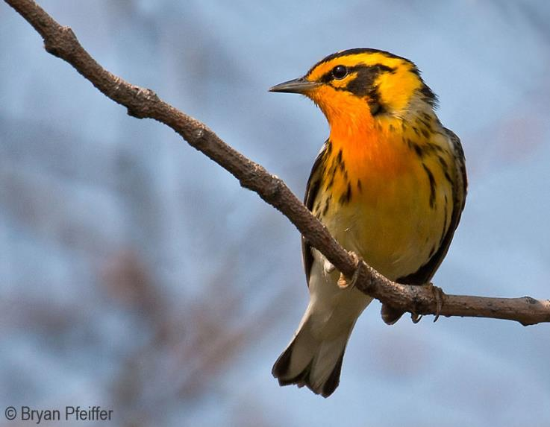
Notes:
Birds are the most diverse vertebrate group in forest ecosystems, bringing color and voice to a predominantly quiet, green landscape. And I think we’d all agree that forest birds NEED forests, but there’s a growing body of evidence showing that forests need birds as well…..

Slide 3
Ecosystem Services
Pollination
Pest Control
Seed Dispersal
Nutrient Cycling
Whelan et al. 2015. Why birds matter: from economic ornithology to ecosystem services. J. Ornithol.
Notes:
…for the roles they play in providing a variety of ecosystem services, including pollination, pest control, seed dispersal and nutrient cycling. So keeping track of bird populations is a critical step toward gaining a broader understanding of forest ecology.

Slide 4
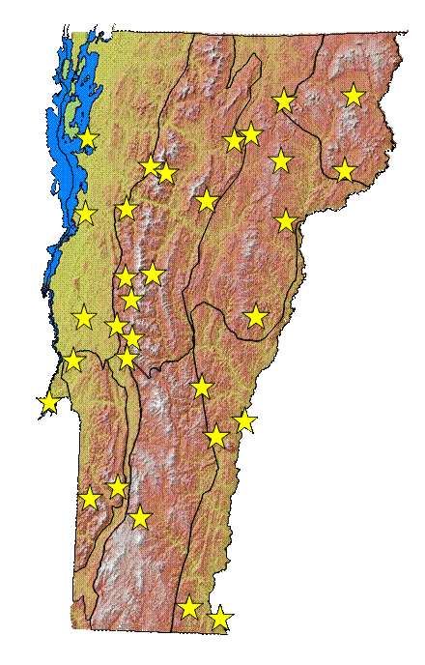
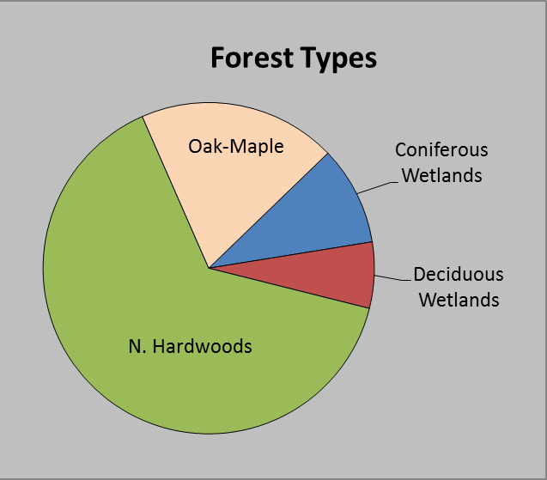
Vermont Forest Bird Monitoring Program
Study Area & Field Methods
Initiated in 1989 – 11 study sites
2012 – 31 study sites
Interior forest, unmanaged stands
Site = 5 survey points, ~200 m apart
10-minute point counts conducted annually by skilled birders
Notes:
The FBMP was initiated in 1989 with 11 study sites, and by 2012 that had increased to 31 sites. Study sites are all located in unmanaged, interior forest stands to limit habitat variability and edge effects. Each site consists of 5 survey points spaced about 200 m apart at which 10-min point counts are conducted annually by skilled birders.

Slide 5
Analytical Methods 25-year Population Trend Estimates
Developed mixed-effect models in program R
-Response Variable = Count
-Fixed Effect = Year
-Observer and Site included as random effects.
Species included in analysis if:
Count >100 and number of Sites >5
Notes:
To estimate population trends we developed mixed-effect models in Program R with count as the response variable and year as a fixed effect. We included observer and Site as random effects. We limited the analysis to those species with at least 100 detections that occurred on at least 5 study sites.

Slide 6
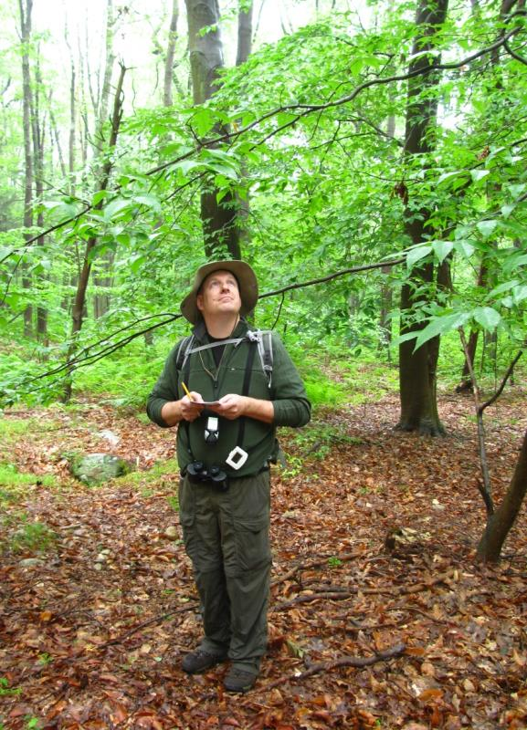
Results
Analyzed 2,464 point counts
Detected 32,381 birds of 125 species
Mean = 13.14 (+ 0.05 SE) birds/point
Notes:
We included nearly 2,500 point counts in the analysis, at which just over 32,000 birds of 125 species were detected, for a mean of about 13 birds per point.

Slide 7
Modeled trends for 34 species and 13 guilds
8 species increased significantly
13 species decreased significantly
13 species non-significant
2 guilds increased significantly
7 guilds decreased significantly
4 guilds non-significant
Notes:
We modeled trends for 34 species and 13 ecological guilds. Among species, 8 increased signif., while 13 species declined and 13 showed no signif. trend. Among the guilds, 2 increased, 7 declined, and 4 showed no trend.

Slide 8
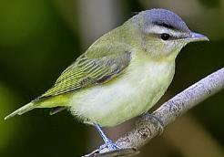
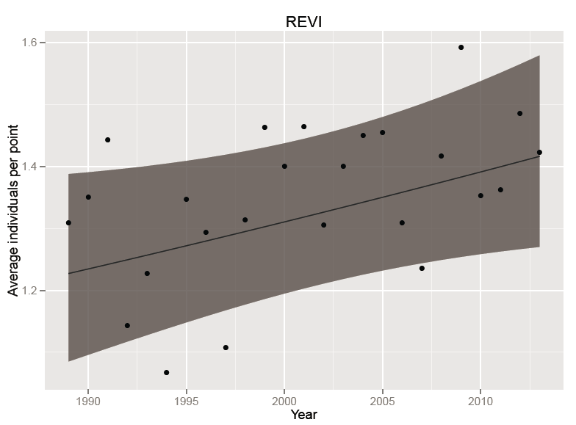
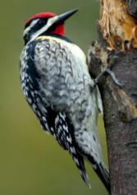
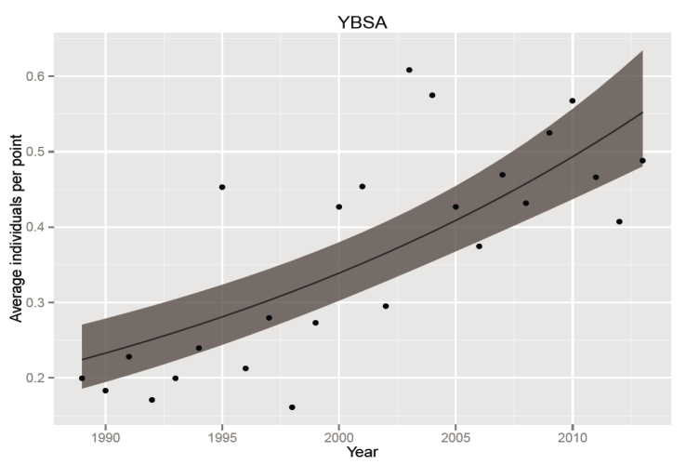
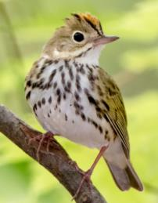
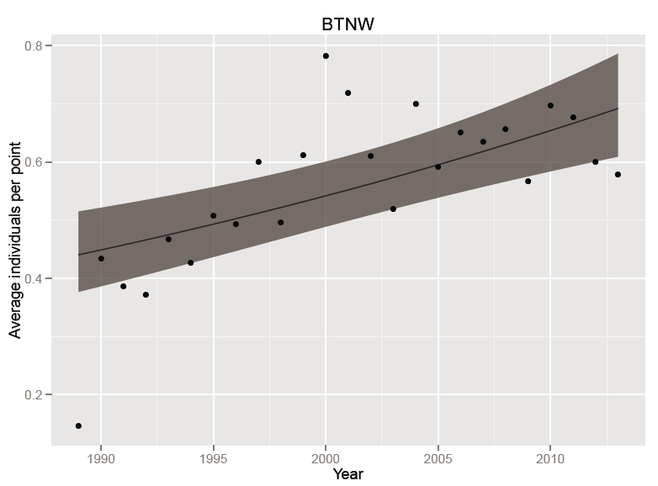
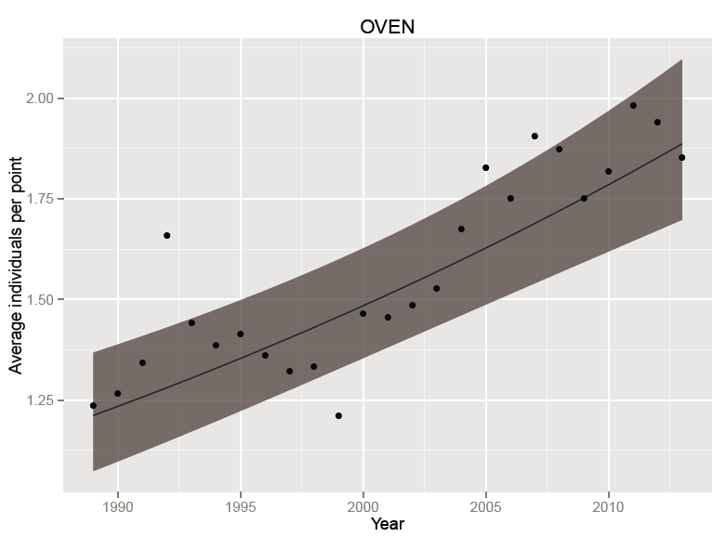
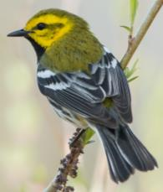
The Good News
Red-eyed Vireo
Yellow-bellied Sapsucker
Annual Change = 1.33% (SE 0.005)
P = 0.015
Annual Trend = 0.60% (SE 0.003)
P = 0.049
Annual Trend = 3.82% (SE 0.005)
P < 0.00000001
Black-throated Green Warbler
Ovenbird
Annual Trend = 1.90% (SE 0.004)
P = 0.00001
Annual Trend = 1.86% (SE 0.003)
P < 0.000001
Notes:
In the interest of time, I’m just going to focus on those species for which I have the most confidence. We’ll start with the good news; among increasing trends, we have REVI, YBSA, BTNW, and OVEN.

Slide 9
Among the most-abundant, widely-distributed, and easily-detected species on our surveys
Occupy different habitats and ecological niches
Red-eyed Vireo – interior forest; canopy forager
Yellow-bellied Sapsucker – second growth/forest edge; bark prober
Black-throated Green Warbler – mature mixed forest; canopy forager
Ovenbird – mature deciduous forest; ground forager
Listed as species of Regional Conservation Concern by Partners in Flight (PIF)
Notes:
This is good news for a variety of reasons. 1) these are among the most abundant and easily-detected spp on our surveys, so we have excellent data; 2) All four occupy different habitats and ecological niches, suggesting that VT forests are meeting a diversity of needs; and 3) all four spp. are listed as PIF Regional Concern.

Slide 10
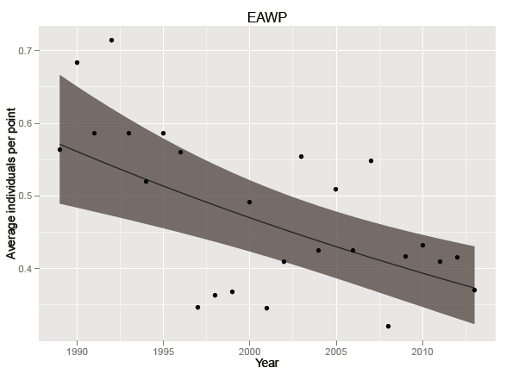
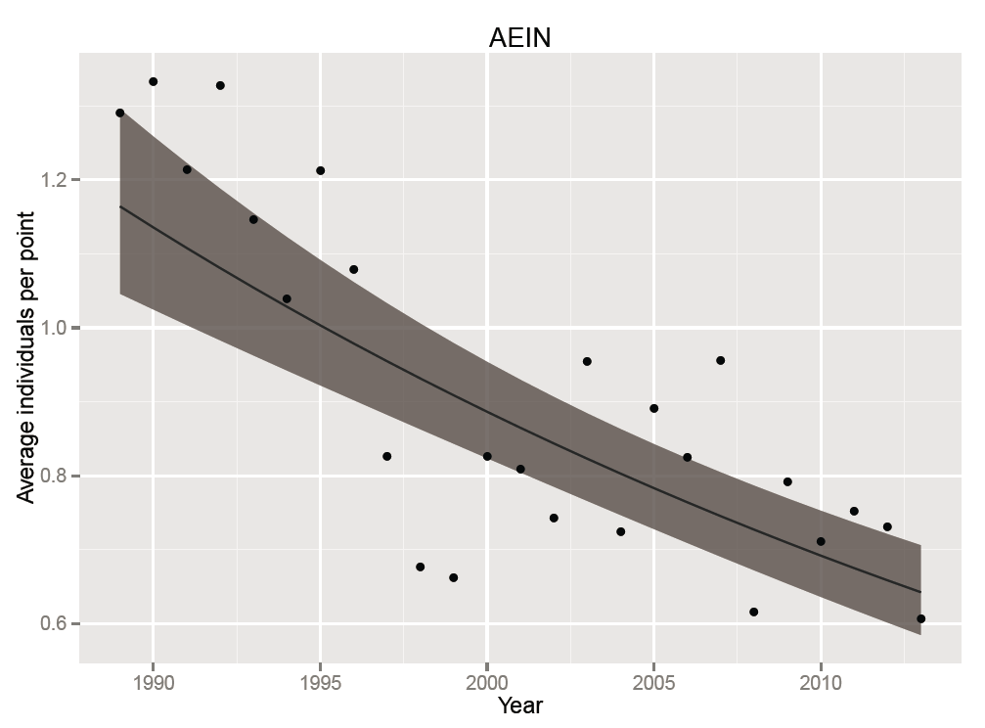
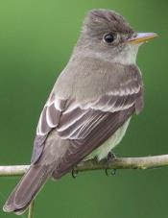
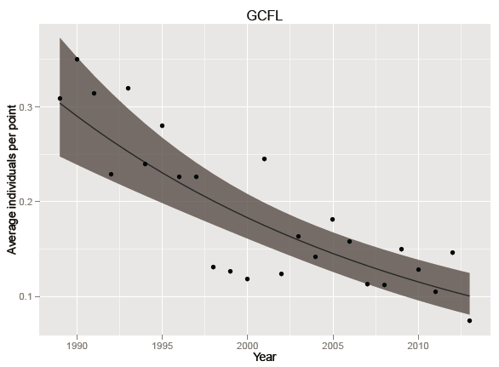
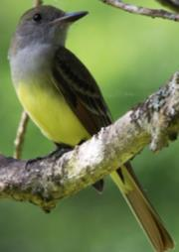
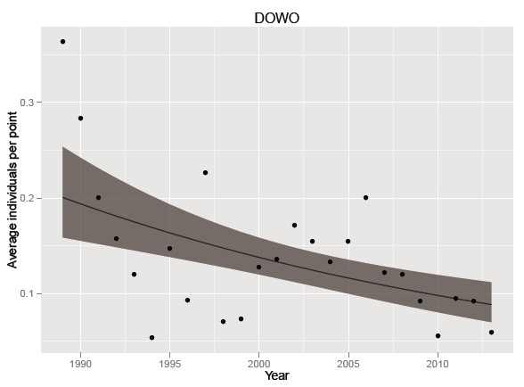
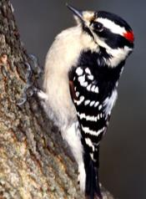
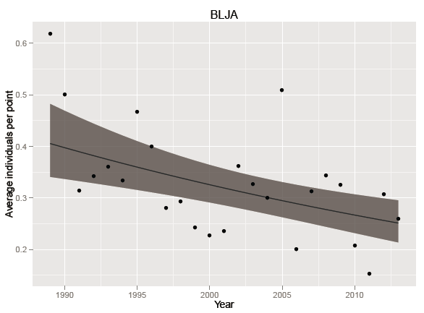
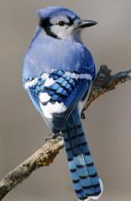
The Bad News
Eastern Wood-Pewee
Aerial Insectivores
Alder Flycatcher
Chimney Swift
Eastern Kingbird
Eastern Phoebe
Eastern Wood-Pewee
Great Crested Flycatcher
Least Flycatcher
Olive-sided Flycatcher
Tree Swallow
Willow Flycatcher
Yellow-bellied Flycatcher
Great Crested Flycatcher
Annual Trend = -1.76% (SE 0.005)
P = 0.0001
Annual Trend = -4.50% (SE 0.007)
P < 0.000000
PIF Regional Concern
Downy Woodpecker
Blue Jay
Annual Trend = -3.35% (SE 0.008)
P = 0.00002
Annual Trend = -1.97% (SE 0.005)
P = 0.0002
Annual Trend = -2.46% (SE 0.003)
P < 0.000000
Notes:
On to the bad news. EAWP and GCFL are both aerial insectivores, which as a group have shown widespread declines may be related to loss of prey. Also notice for all of these spp very low counts on either side of 2000 that correspond to the arrival of WNV, which has been shown to have a negative effect on some spp, especially jays. EAWP is also a PIF Priority.

Slide 11
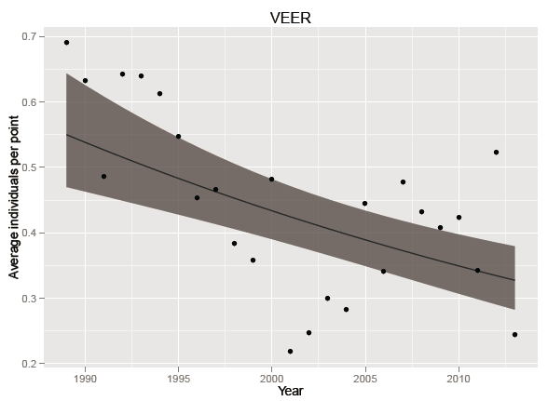
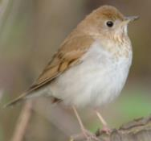
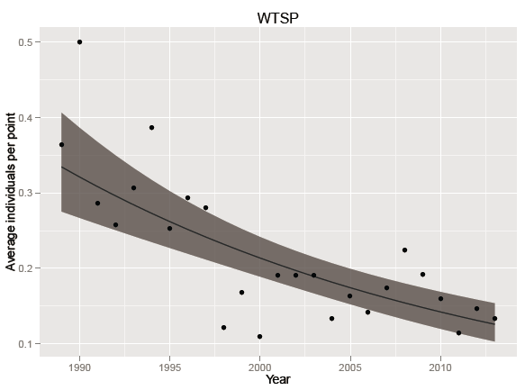
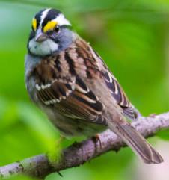
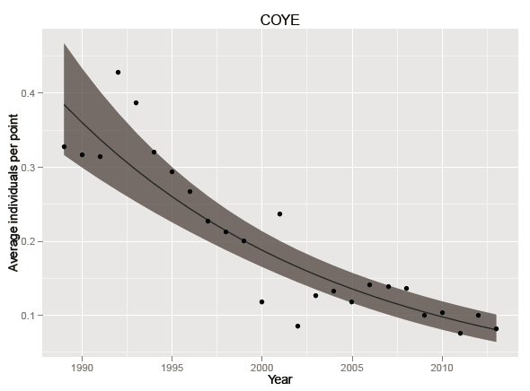
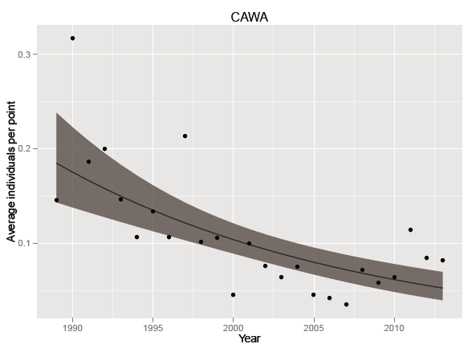
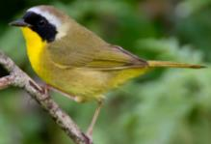
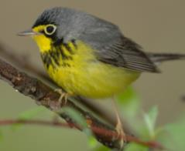
Veery
White-throated Sparrow
Annual Trend = -2.14% (SE 0.005)
P = 0.000005
Annual Trend = -3.99% (SE 0.007)
P < 0.000000
PIF Regional Concern
Common Yellowthroat
Canada Warbler
PIF Regional Concern
PIF Regional Concern
VT High Priority SGCN
Annual Trend = -6.30% (SE 0.007)
P < 0.000000
Annual Trend = -5.10% (SE 0.009)
P < 0.000000
Notes:
As a group, these four species reach their highest abundance on our surveys in forested wetlands, and again notice the WNV signature. If any habitat were to be a high-risk for WNV it would likely be wetlands. Three of these 4 are PIF Priorities.

Slide 12
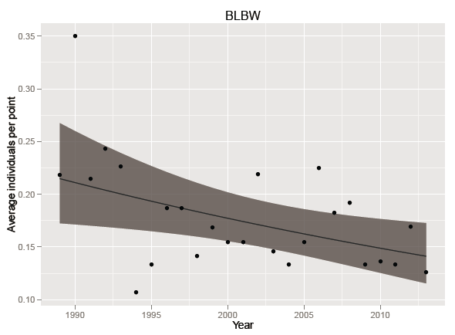
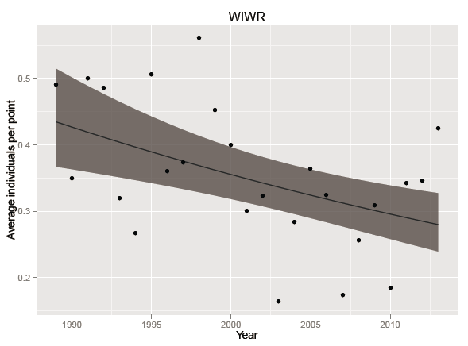
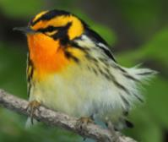
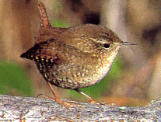
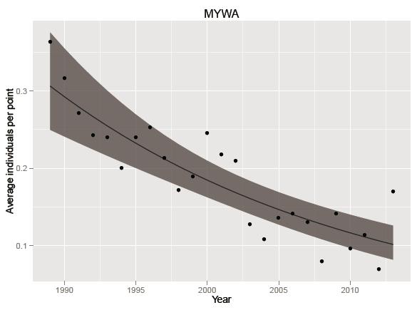
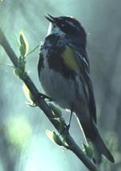
Blackburnian Warbler
Winter Wren
PIF Regional Concern
PIF Regional Concern
Annual Trend = -1.73% (SE 0.007)
P = 0.014
Annual Trend = -1.82% (SE 0.005)
P = 0.0003
Yellow-rumped Warbler
5 of 7 nest and feed on or near the ground.
Annual Trend = -4.49% (SE 0.007)
P < 0.000000
Notes:
These three reach their highest abundance on our surveys at coniferous wetlands; both BLBW and WIWR are also PIF spp.

Slide 13
Summary
24% (n=8) of species increased
63% (n=5) are PIF Priority
50% (n=4) are Neotropical migrants
38% (n=13) species declined
46% (n=6) are PIF Priority
62% (n=8) are Neotropical migrants
Notes:
High proportion of NTMBs is a reminder that they face multiple threats throughout the year, and we have to consider the full life-cycle of migratory birds in evaluating limiting factors.

Slide 14
Summary
West Nile Virus may be affecting some species
High proportion of forested-wetland birds declining, 70% ground- or shrub-nesters/feeders
Change in understory structure?
High-risk habitat for WNV?

Slide 15
Funding for 25-year Analysis
Davis Conservation Foundation
Lintilhac Foundation
William P. Wharton Trust
Private Donors

Slide 16
Many Thanks to Our Birders!
Carl Anderson
Jayson Benoit
Ken Benton
Tom Berriman
Bobbie Booth
Ernie Buford
Bridget Butler
Bill Calfee
Dwight Cargill
Sarah Carline
Brendan Collins
Ken Cox
Jason Crooks
Chip Darmstadt
Walter Ellison
Brett Engstrom
Steve Faccio
Ted Gaine
Hector Galbraith
Mary Gaudette
Jim Graves
Scott Hall
Eric Hanson
Robert Heiser
Tait Johansson
Barry King
Warren King
Mark LaBarr
Liz Lackey
Sally Laughlin
Sean MacFaden
Everett Marshall
Nancy Martin
Tom Moran
Doug Morin
Scott Morrical
Gregg Moxhay
Terry Oughton
Ron Payne
Judy Peterson
Bryan Pfeiffer
Roy Pilcher
Alan Quackenbush
Charlie Rabatin
Craig Reiser
Rosalind Renfrew
Heidi Rich
Zoe Richards
Chris Rimmer
Betty Rist
Sue Staats
Ruth Stewart
Matt Stone
Ned Swanberg
Michael Sweatman
Allon Wildgust
Paul Wilson
Ian Worley
Bob Wright

