Slide 1
VTPBIS Leadership Team Training
Within a Multi-Tiered System of Supports
Refresher – Day 1
Presented by:
VTPBIS Team
March 30-31, 2017
Notes:
CASSANDRA

Slide 2
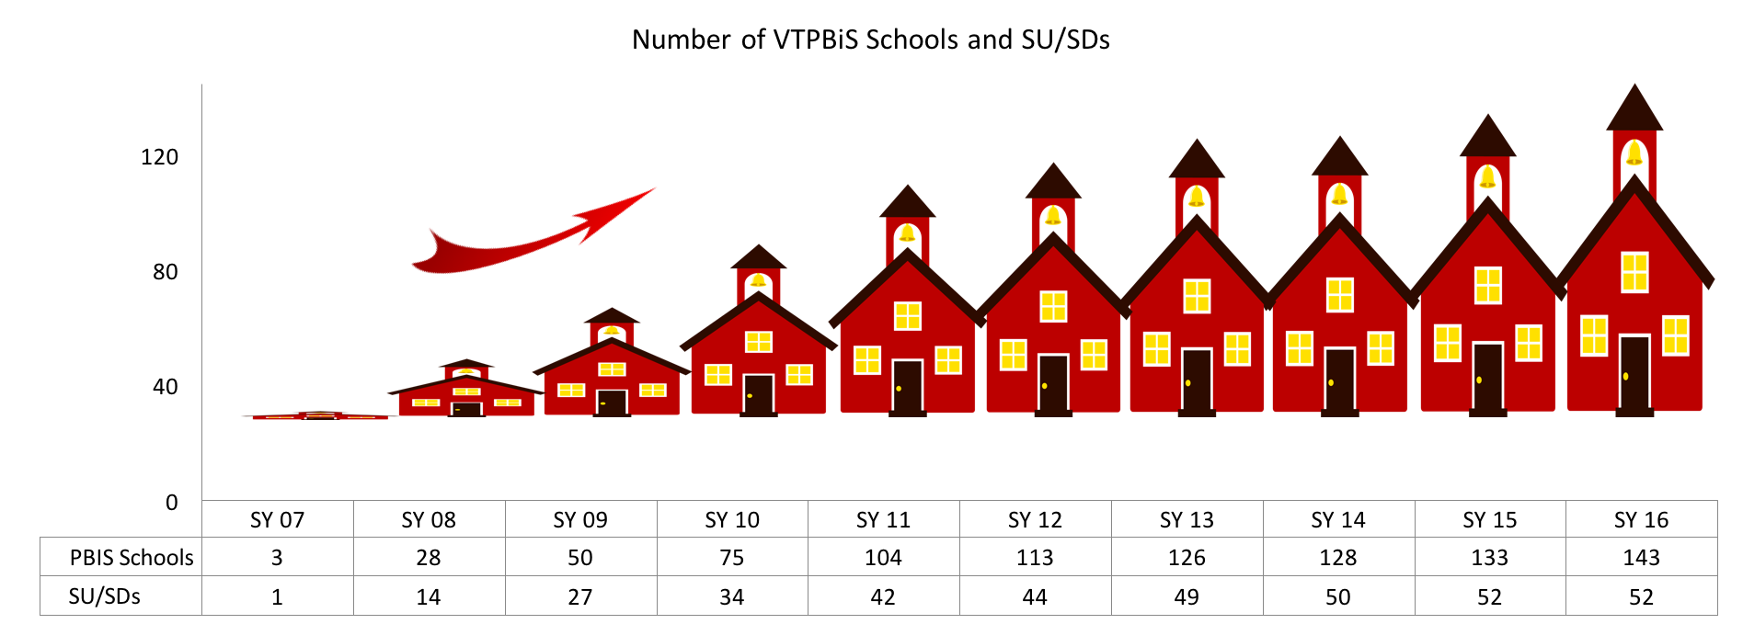
Welcome & Introductions
Notes:
The point to make here is that they are in a large “club” in VT. This is a “family” that continues to grow…

Slide 3
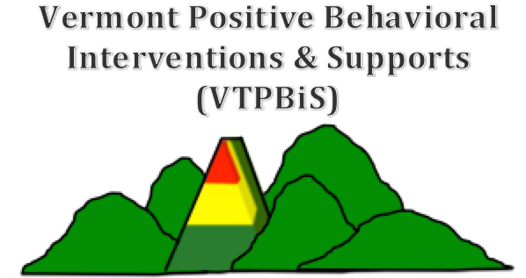

About Us
Cassandra Townshend
Kristin Beswick

Slide 4
Learning Outcomes
By the end of our time together, your team will have:
  Increased fluency in VTPBiS – systems, data and practices
  Used data to guide action planning
  Updated/developed your Staff Handbook
  Begun planning re-roll-out activities
  Planned and scheduled year-long meetings
  Had a really great time together!
Notes:
Talk about pace and differentiation activities

Slide 5
Agenda
Day 1:
Welcome and Intros
Setting Up for Success
Sustainability & Implementation Science
Team Structures
Enhance Fluency in PBIS Features
Targeted & Intensive Features
Day 2:
Identify Strategies for Analyzing Data
Family Engagement
Finalize Revitalization Plan
Present and Share Ideas!

Slide 6
Setting Up for Success

Slide 7
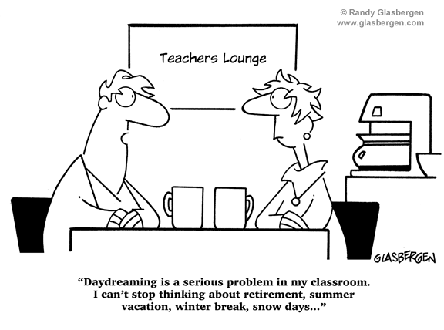
Notes:
Setting up for success begins with clear expectations. This cartoon is an example of what we don’t want in this training...

Slide 8

BEST Expectations:
Teaching Matrix
BEST Expectation | All Settings
Be Respectful | Empathic responses to presenters and colleagues Silence cell phones Be present and wait for breaks
Engage | Take a Team role Ask clarifying questions
Strengths-based | Use positive statements and re-statements Remember, four positives to one negative
Team Solutions | Establish and follow team roles and norms Consider all ideas of team members

Slide 9

VTPBIS Training
Wifi and Website
Wifi: insert location’s wifi
www.pbisvermont.org
Notes:
Explain what’s on the site and where to find the materials
PowerPoint
Staff Handbook Template
*point out TFI Action Planning Form

Slide 10



VTPBIS Signal for help:
Help Us Help You
= We’re all set. No help needed.
= We need help, but can continue with our work.
= HELP! We can’t continue with our work.

Slide 11
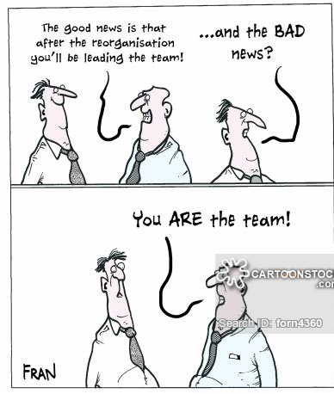
Team Structure
Notes:
Teaming is hard, particularly when trying to implement a new system

Slide 12
Team Structure
Vision
Concrete Outcomes
Systems Perspective
Shared Leadership
Consensus
Communication
Data-based Decision Making
Professional Development
Time
Notes:
What structures allow teachers to know their students well in a personalized and
caring learning environment?
What structures encourage students and teachers to be engaged in authentic,
meaningful work?
What structures encourage collaboration and reflection among colleagues to
improve their practice and student learning?
What structures connect students to the school and maximize the strengths of

Slide 13
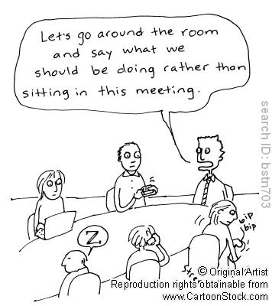
Importance of Roles and Norms
Effective collaboration
Accountability
Efficient and focused meetings
http://www.schoolimprovementcoach.org/manual/7%20Norms%20and%20Roles.pdf
Notes:
As we come together as learners and team members, it’s really important that we use our time during this training wisely so that we are most efficient. Setting up norms and roles during this training is critically important because………..Read SLIDE. In a few…… as leadership teams, you will spend some time creating your meeting norms and roles……that will be used throughout the training…….
Norms help make collaboration more effective by guiding team behavior
Norms enable team members to hold each other accountable
Roles and responsibilities help team build internal capacity for holding effective and focused meetings

Slide 14
Opening Activity
Think about your current team
Discuss your team’s strengths
As a team, develop your matrix of team roles and norms (see handout)
Select one person on your team to introduce the team members to the group and describe one strength your team brings to this process
Notes:
Have team do norm matrix

Slide 15
Here’s what we know about you…

Slide 16
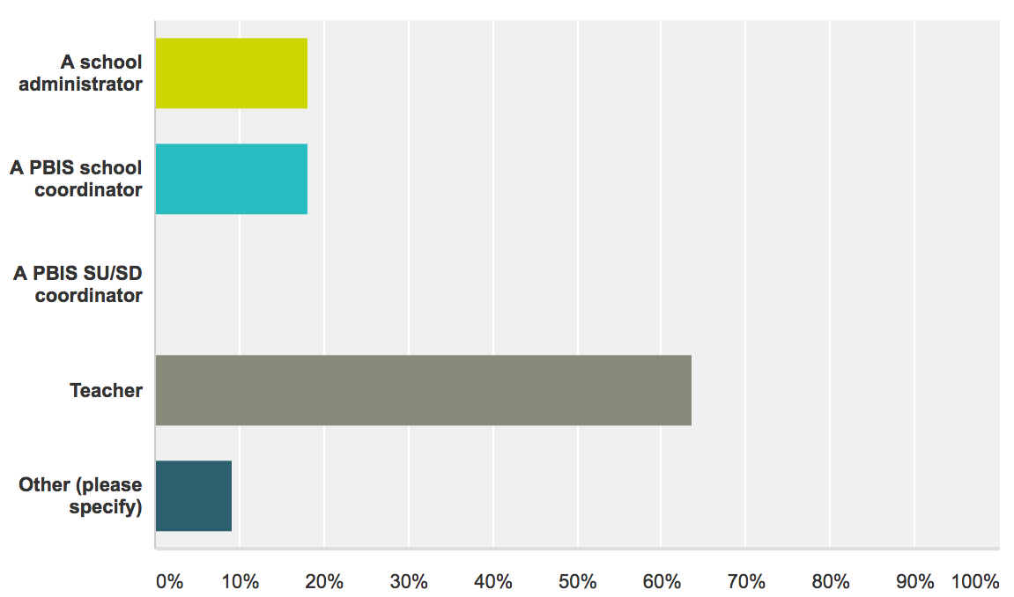
Who’s here?

Slide 17
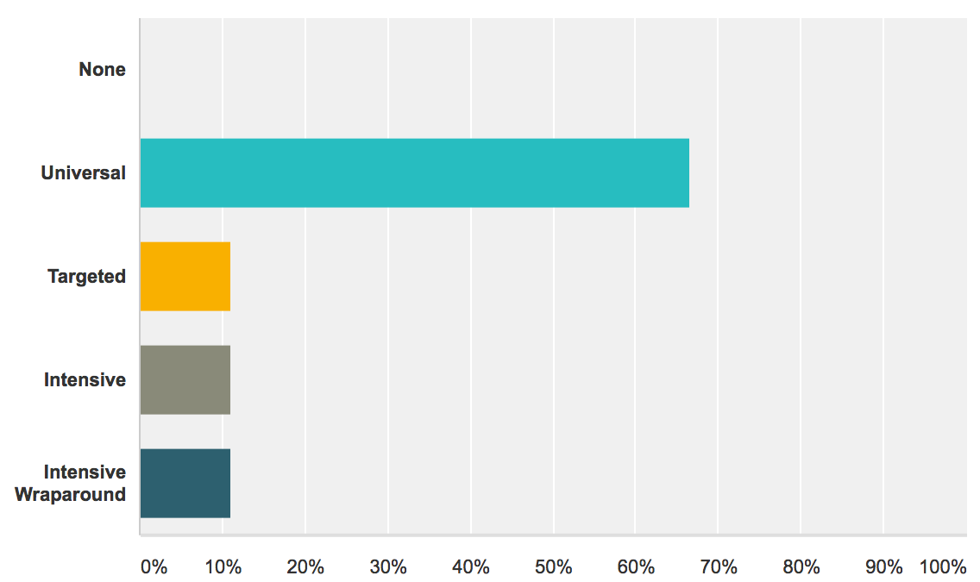
Level of Implementation

Slide 18
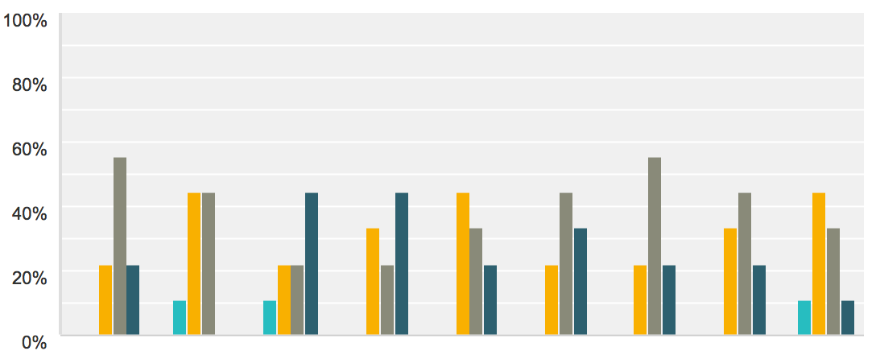
Here’s how you rated your PBIS Knowledge

Slide 19
Here’s what you said works well…
“We’ve seen a decrease in behavior referrals.”
“Our students are engaged in our HR3 expectations. They love having PBIS Celebrations.”
“Understanding of our school PBiS systems and language seems to be used across all settings and is understood by students, staff and teachers.”
“Common school-wide language, expectations, praise/reward and encouragement for positive behaviors as well as common school-wide responses for misbehaviors.”
“Adults modeling positive behaviors”

Slide 20
Here are the barriers you identified…
“Falling into the negative and punitive mind set”
“Low teacher buy-in, lack of teacher knowledge behind the PBiS best practices and rationale for those practices”
“How do we get middle school buy in, when they been doing the same system for 6+ years?”
“Time, communication, buy-in from teachers”
“Inconsistent data tracking & analysis”

Slide 21
Activity
As a team, take a moment to reflect on your PBIS journey and identify a couple of strengths and challenges
Finish this goal statement… “By the end of this training our team will walk away prepared to...”
  We’ll hear a sampling of responses from the group.

Slide 22
Review for VTPBIS Fluency
Complete the VTPBIS Test seen on the PowerPoint (and handout). Use any sheet of paper to answer the questions.
We will review as a large group.
If 80% of the Teams answer 80% of the questions correctly, the entire group will receive a reward!

Slide 23
VTPBIS Review
How does VTPBiS help prevent problem behaviors?
What is the purpose of having an administrator on the VTPBiS Leadership team? Why is it important?
Why do we spend so much time focusing only on Universal Level to begin with?
What was the purpose of completing the VTPBiS Self-Assessment Survey (SAS) and the Tiered Fidelity Inventory annually in the spring?
What PBIS activities should you do prior to the start of school every fall?
Who do you roll-out PBIS to?

Slide 24
Back to Basics:
What is the Vermont Multi-tiered System of Supports (VT MTSS)?
VT MTSS is a coherent continuum of evidence based, system-wide practices that support:
  proactive preventative core instruction for all;
  a rapid response to academic and behavioral challenges;
  frequent data-based monitoring; and
  instructional decision-making
so that each Vermont student achieves high standards.

Slide 25
Who Benefits from MTSS? Everyone! (Both Academically & Behaviorally)
1-5% of Students may need Intensive Supports
Few
10-15% of Students may need Targeted Supports
Some
ALL Students!
Universal Practices in place for 100% of students
80% of Students should be successful when accessing Universal Supports
Notes:
Why – consistent response for students and staff
Clearly articulated plan and framework
Review of data to demonstrate success and challenges

Slide 26
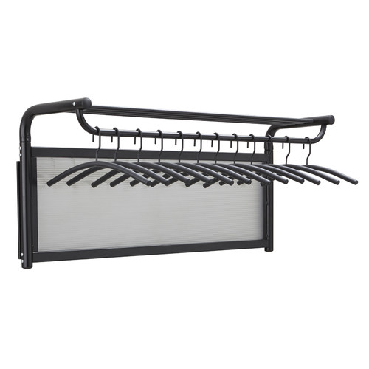
What EBP are you going to hang on your PBIS/MTSS-B Coat Rack?
PBIS/MTSS-B
Second Step
Responsive Classroom
Zones of Regulation

Slide 27
3 Keys to Sustaining PBIS
Supporting
Staff Behavior
Supporting
Decision
Making
SYSTEMS
DATA
PRACTICES
Smallest effort
Evidence-based
Biggest, durable effect
Supporting
Student Behavior
Notes:
5 Components of MTSS cuts across Data, Systems and Practices
Ask: How many of you are struggling with PBIS Systems? Please raise your hand.
How many of you are struggling with PBIS Practices?
How many of you are struggling with Data?

Slide 28
Plus… Understanding Implementation Science
Exploration
Installation
Initial Implementation
Full Implementation
Innovation
Sustainability
3-5 years (this is normal!)

Slide 29
Birth and Death Cycles of Innovations
(Latham, 1988)
Notes:
This is what we are trying to avoid! So how do we sustain what we’ve started…...next slide.

Slide 30

How do we break through these barriers, implement with fidelity so we can sustain PBIS?

Slide 31
What is Sustainability?
Definition:
  Durable implementation of a practice at a level of fidelity that continues to produce valued outcomes (McIntosh et al., 2009)
Notes:
Named one of the top ten jargoniest words by advertising age magazine

Slide 32
What is more important to sustainability?
Kent McIntosh, University of Oregon - 2014 OSEP PD Conference
Having a supportive administrator?
Having a strong PBIS team?
Notes:
Ask the group…..

Slide 33
Both!
PBIS is most sustainable with a supportive administrator and a strong team
If administrators take too much of a lead, sustainability can suffer
School teams can benefit from training in running meetings and using data
District systems (coaching, training) enable both admins and teams implement and sustain

Slide 34

Key to Sustaining PBIS: Understanding Implementation Science
Implementation Research:
A Synthesis of the Literature
Fixsen, D. L., Naoom, S. F., Blase, K. A., Friedman, R. M. & Wallace, F. (2005). Implementation Research: A Synthesis of the Literature. Tampa, FL: University of South Florida, Louis de la Parte Florida Mental Health Institute, The National Implementation Research Network (FMHI Publication #231).
Download all or part of the monograph at:
http://www.fpg.unc.edu/~nirn/resources/detail.cfm?resourceID=31
Notes:
34
National Implementation Research Network (NIRN)

Slide 35
Implementation Drivers
Adapted from Fixsen & Blase, 2008
Staff competency development with PBIS practices
Organizational capacity to support staff in implementing PBIS with fidelity
Competency
Capacity
Leadership
Ability to provide direction/vision for PBIS implementation
Notes:
Three categories of Implementation Drivers: Competency, Organization and Leadership.
Competency Drivers are mechanisms that help to develop, improve, and sustain educators’ competence and confidence to implement effective educational practices and supports.
Organization Drivers are mechanisms to ensure sustainability and improvement at the organization and systems level.
Leadership Drivers are mechanisms to help guide leaders to use the right leadership strategies for the situation.
Competency
Staff selection
Training
Coaching
Performance assessments
Organization
Decision support data system
Facilitative administration
Systems interventions
Leadership
Adaptive leadership
Technical leadership

Slide 36
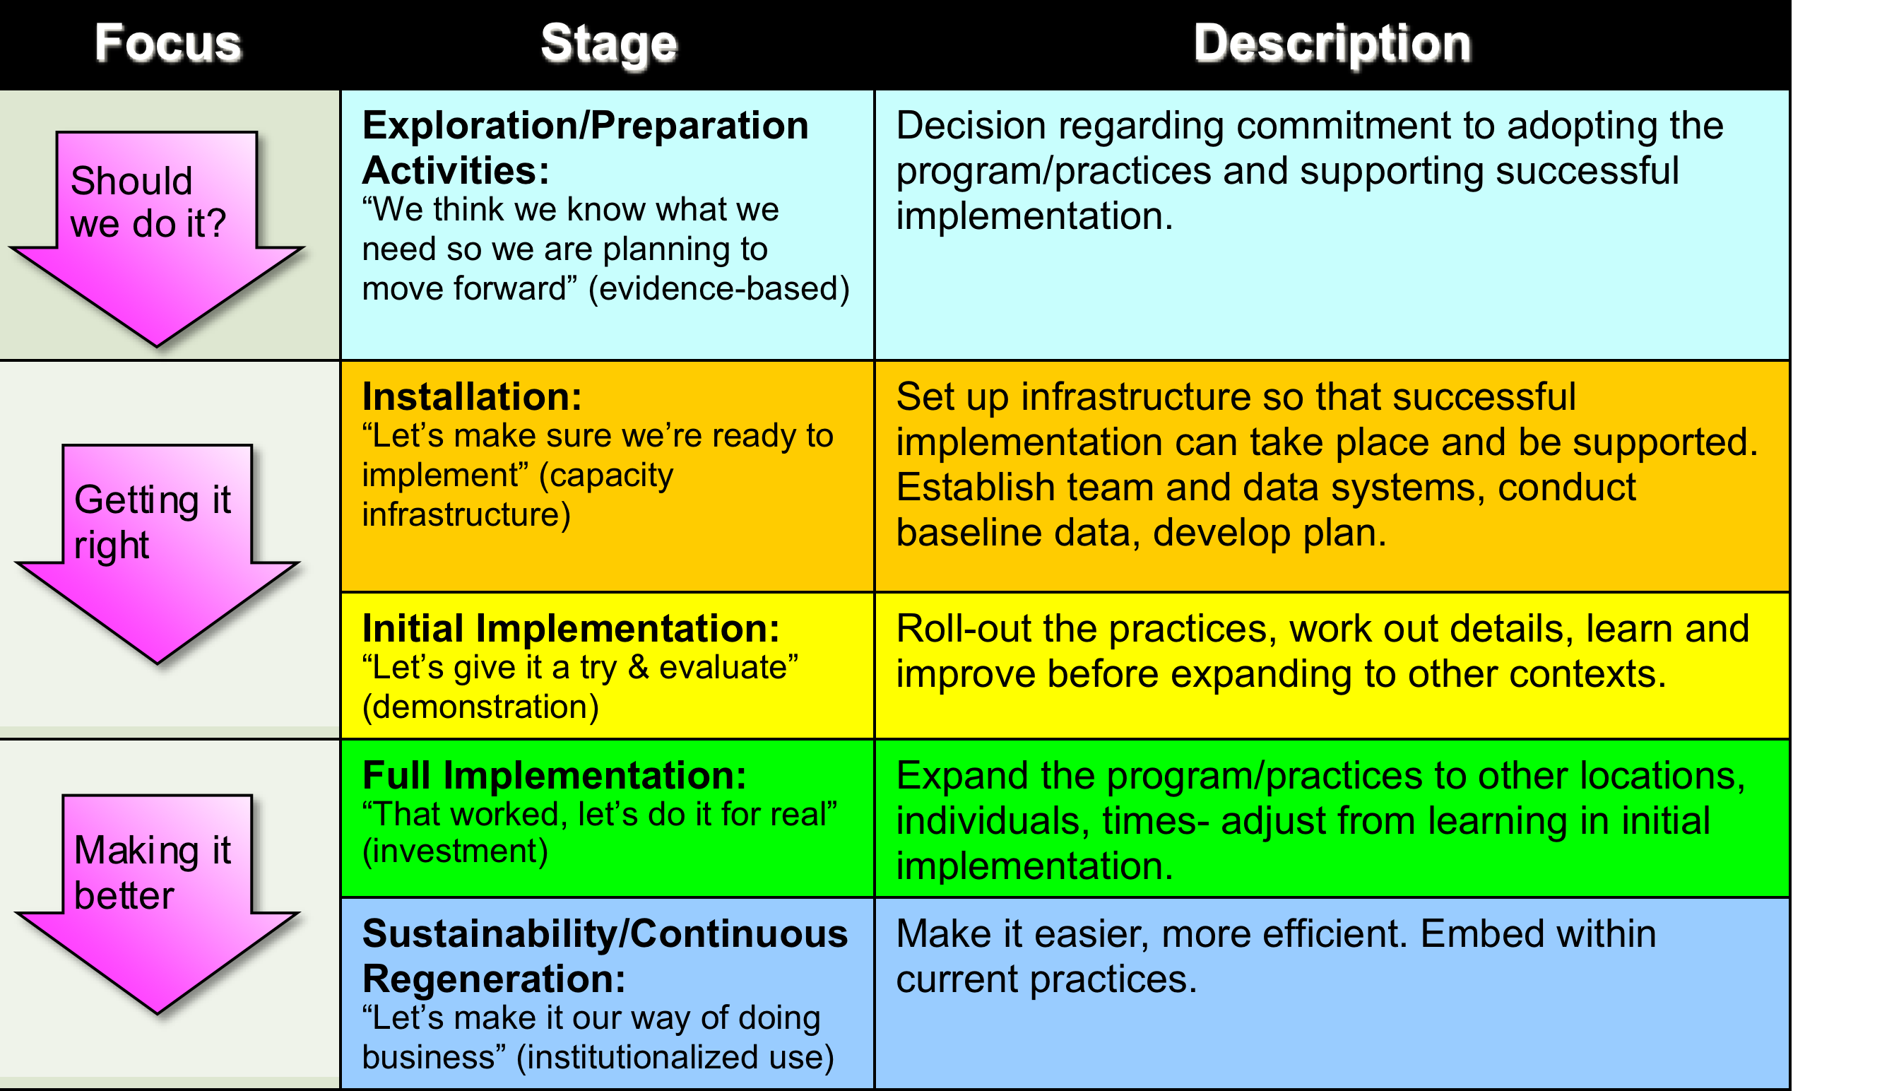
Stages of Implementation
3-5 Years

Slide 37
Activity!
In your teams, discuss what stage of implementation you’re currently at.
Given the number of years implementing, does this correspond with the stage you’re in?
Why is this important?
We’ll hear a sampling of responses
from the group
Notes:
10 minutes…..

Slide 38
Guiding Principles for Sustainability:
Never stop doing what is already working
Always look for the smallest change that will produce the largest effect
Do not add something new without also defining what you will stop doing
Collect and use data for decision-making

Slide 39
Start at the beginning:
Team Structure and Routines
Notes:
In order to sustain an initiative, we must start at the beginning by looking at our Team Structures and Routines.

Slide 40

Notes:
Think of a successful team (committee) experience. What were some of the characteristics that made it successful?

Slide 41
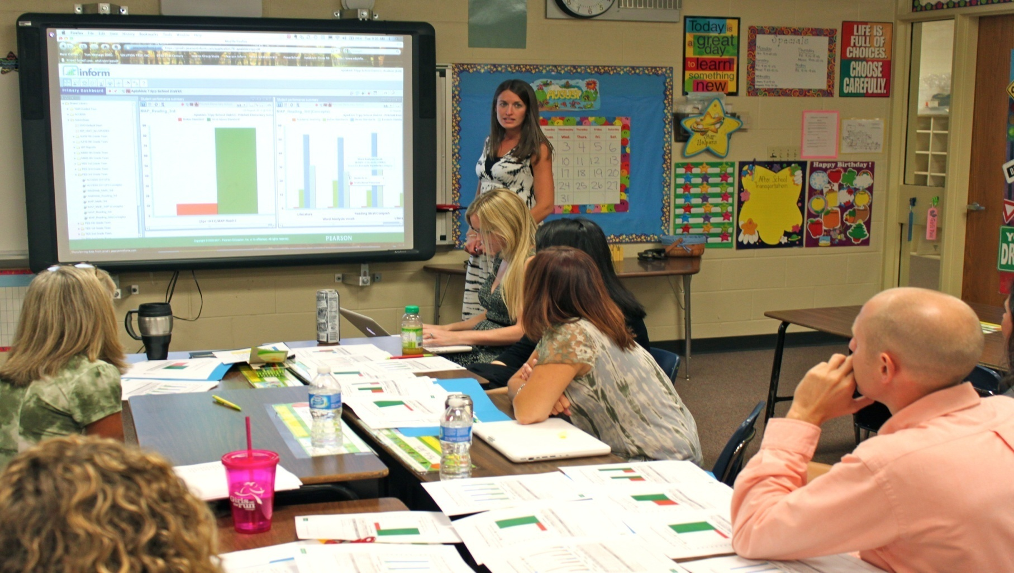
What do you see this PBIS Leadership Team doing?
Notes:
Teams meeting regularly to:
Review their data
Determine if PBIS practices are being used
Determine if PBS practices are being effective
Identify the smallest changes that are likely to produce the largest effects
But focusing on the use of evidence-based practices

Slide 42
Example: Team Meeting Structure
Start with positives!
Review all relevant data
Brainstorm ideas based on data
Discuss, prioritize, make data-based decisions
Gain consensus and implement agreed upon steps
STICK WITH YOUR AGENDA
Notes:
Does this look like your current meeting structure?

Slide 43
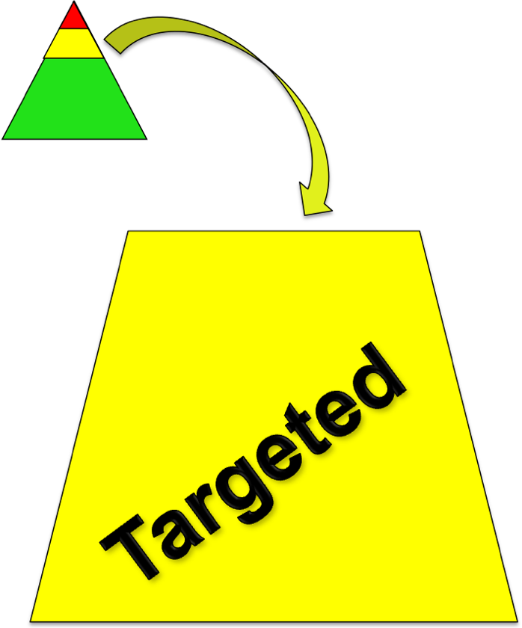
Teaming at the Targeted Level
Two Purposes of Targeted Planning:
Systems level design and accountability
Individual student intervention planning and monitoring
Notes:
Many schools have PBIS teams that focus on the systems needed to be successful that consist of one group of people discussing both targeted and universal systems level issues such as - ODR forms, process for referral, lesson plan development, planning for faculty meetings. Also, this team should look at overall school-wide data to determine the impact of PBIS on behavior, fidelity of implementation. For targeted, review of overall targeted intervention success is a good use of the system’s level team.
This team does not discuss individual students. There is a separate team or conversation about individual students, matching them to interventions, looking at how they are doing, etc.
Either or both of these groups may also be the EST depending on how your EST functions.

Slide 44
Targeted Team and EST Considerations
EST and PBIS Targeted student planning team may be a separate or combined team but should not be duplicative.
Develop your PBIS targeted system to fit within your school’s context.
Goal: “Work smarter, not harder!”

Slide 45
Roles and Responsibilities of Key Members at All Levels
Administrator
Know what the practices look like when implemented with fidelity
Be aware of data using tracking tools; help decide what needs to change
Be active/visible on teams
Troubleshoot systems level issues
Facilitates weekly/monthly meetings
School-based Behavior Coordinator
Active member of implementation team and student planning team
Attend regional coordinator meetings and trainings
Prioritizes students for Team meeting
Prioritizes requests for service
Creates graphs for meetings
Facilitates meetings
Maintains records
Supervisory Union/District Coordinator
Builds capacity to implement effective practices
Focus on student outcomes
Focus on fidelity of implementation of effective practices across District/Supervisory Union.
Align SU/district systems, data and practices.

Slide 46

“Critical to success is the administrator’s active role in supporting the school-based team process.” –Tim Lewis
THANK YOU
Administrators!
Complete Administrator Self-Assessment for continuous improvement!
Notes:
Hand out self-assessment (optional for Admins to complete)

Slide 47
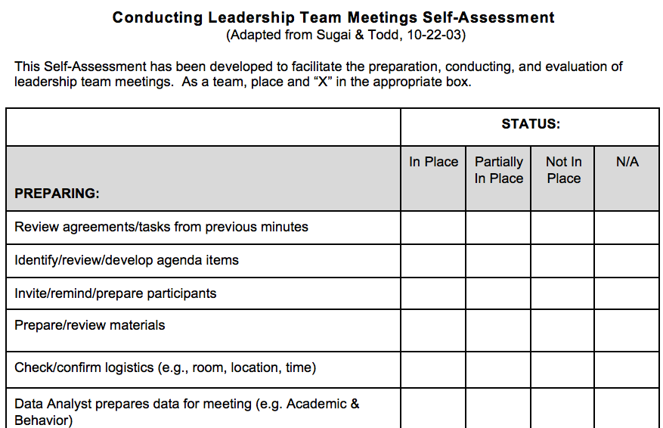
Helpful Tool:
Leadership Team Self-Assessment

Slide 48
Helpful Tool:
Team Profile and Meeting Schedule
Notes:
You also worked on this at the First Steps Module Series.
It’s incredibly important to schedule your yearly meetings in advance. This will increase the likelihood that the meetings take place.
Share your meeting schedule with appropriate folks

Slide 49
Helpful Tool:
“Working Smarter” Team Matrix
Team, Committee or Initiative Related to School Climate & Student Behavior | Purpose ~ Intended Outcomes | Target Group | Staff Involved | What Action Plan goal does this address?
Eliminate all initiatives that do NOT have a defined purpose and outcome measure.
2. Combine initiatives that have the same outcome measure and same target group
3. Combine initiatives that have 75% of the same staff
4. Eliminate initiatives that are not tied to School Improvement Goals.
Notes:
Does this look familiar? This was started at the First Steps Module Series.
It’s important to keep revisiting so you are making sure that you are using the least effort to make the biggest change.
The goal is to make sure you work smarter, not harder by eliminating duplicative efforts

Slide 50
Activity!
  As a leadership team:
    Complete the Leadership Team Meeting Self-Assessment tool (handout).
    Using the Staff Handbook, review and update the “Team Profile and Meeting Schedule,” if needed.
    Using the Staff Handbook, complete/revisit the “Working Smarter, Not Harder Matrix,” if needed.
    Identify and celebrate 2-3 team strengths and 2-3 action steps your Team will take.
Notes:
Approximately 15-20 minutes
Finish during team time….

Slide 51
Team Activities!
Universal Level Activities:
Complete Leadership Team Self-Assessment (handout)
Finalize Team Members & Roles and Schedule Next Year’s Mtgs (Staff Handbook)
Using the Coordinators’ Calendar and PD Calendar, plug in key PBIS activities into your team schedule (handout)
Optional: Revisit/Update your “Working Smarter, Not Harder Matrix” (Staff Handbook)
Targeted/Intensive Activities (optional):
Finalize Targeted/Intensive Team Members & Roles and Schedule Next Year’s Mtgs (handout)

Slide 52
Refresher in PBIS Critical Features

Slide 53
What is School-wide PBIS?
Framework for enhancing adoption & implementation of
Continuum of evidence-based interventions to achieve
Academically & behaviorally important outcomes for
All students

Slide 54
Traditional Approaches Ineffective
School wide Discipline Problems
Reactive
Non-constructive
Poor implementation fidelity
Emphasis on punishment
Limited effects
Notes:
“Drowning Frogs”
“Green to Yellow to Red” Cards
“Full to partial to limited” privileges

Slide 55
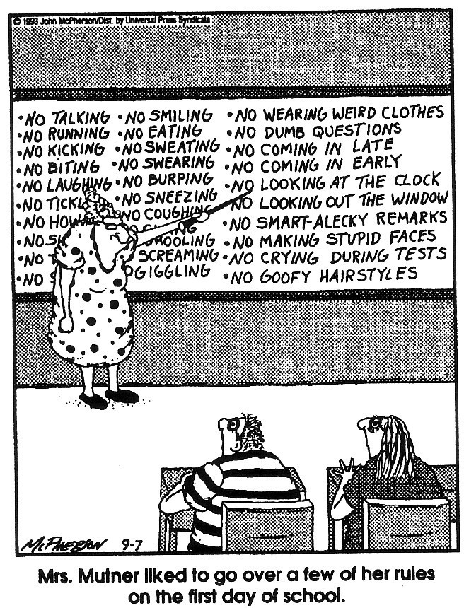
(Close to Home c Reprinted with permission of Universal Press Syndicate. All rights reserved.)

Slide 56
Embracing Person-First Language
Do say…
“students receiving intensive supports”
“students needing targeted interventions”
“student with autism”
“student receiving specialize instruction”
“children with disabilities”
Don’t say…
“red zone kids”
“targeted kids”
“the autistics”
“sped students”
“disabled kids or handicapped kids”

Slide 57
Continuum of Support for “Dylan” within MTSS-B/PBIS & MTSS-A
Universal
Targeted
Intensive
Anger Mgt.
Math
Label Behavior, Not Students!
Science
Adult relationships
Attendance
Reading
Peer Interaction
Notes:
Every student has competencies. Label behavior not STUDENTS. Everyone at one point or another needs targeted or intensive supports. Dylan is doing great in reading but may need more support in Math and with anger management.

Slide 58
PBIS at the Universal Level is about..
Critical Features:
Purpose Statement
Defining behavior expectations
Teaching expected behavior
Acknowledging expected behavior
Discouraging problem behaviors
Creating procedures for record-keeping and decision making
Notes:
Purpose Statement

Slide 59
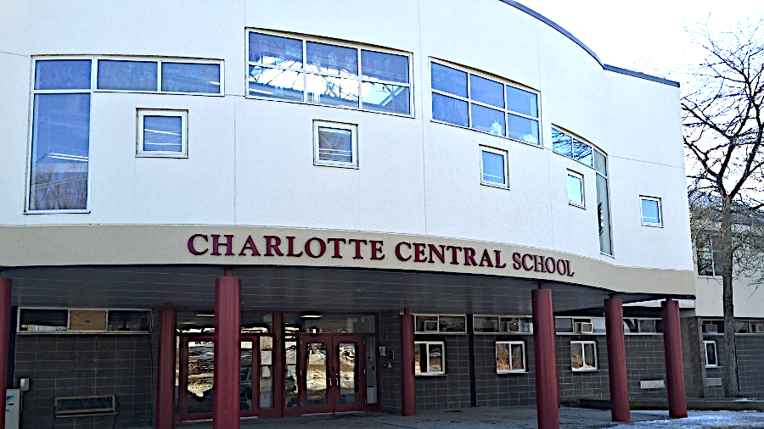
School Presentation
Charlotte Central School
Grades K-8

Slide 60
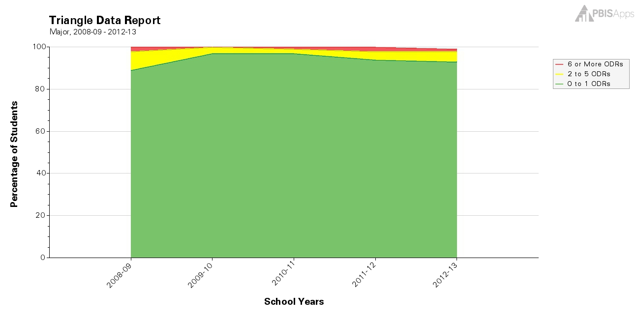
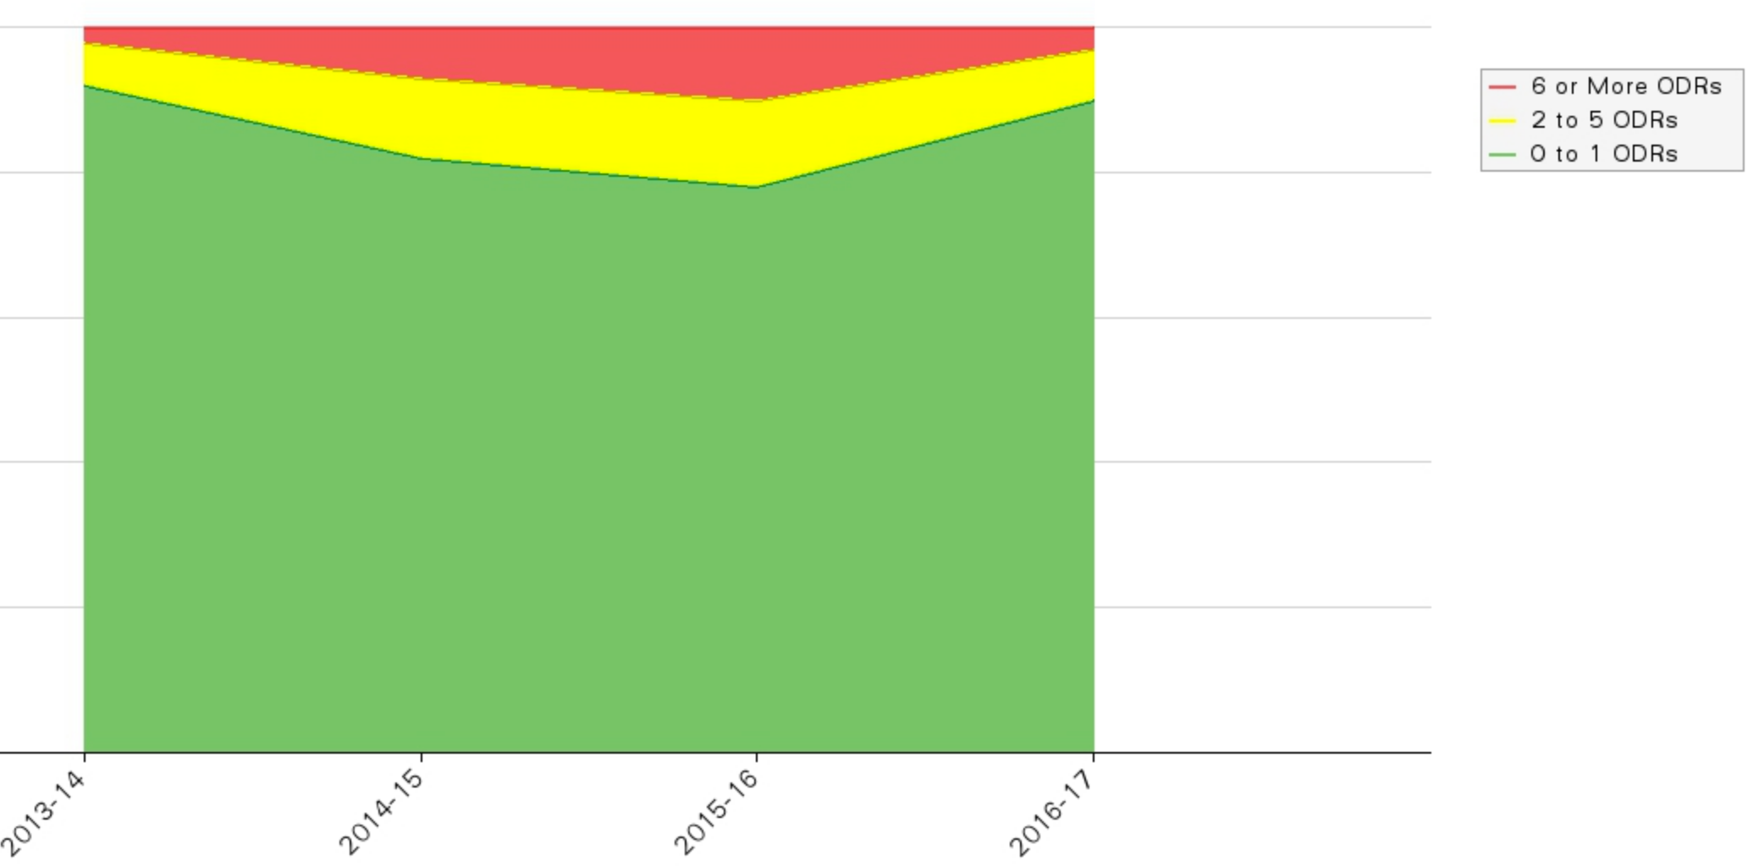
Start with the Data:
What does the data tell us overtime?

Slide 61
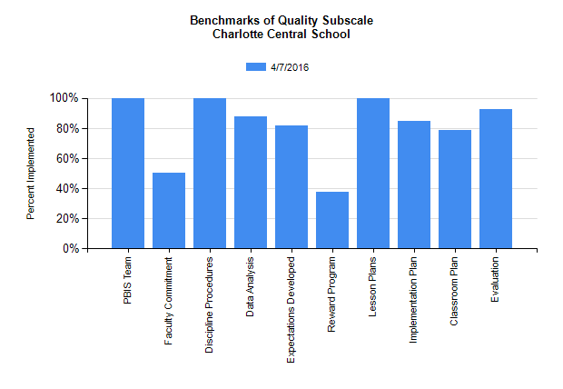
What does the PBIS Team think is in Place?

Slide 62
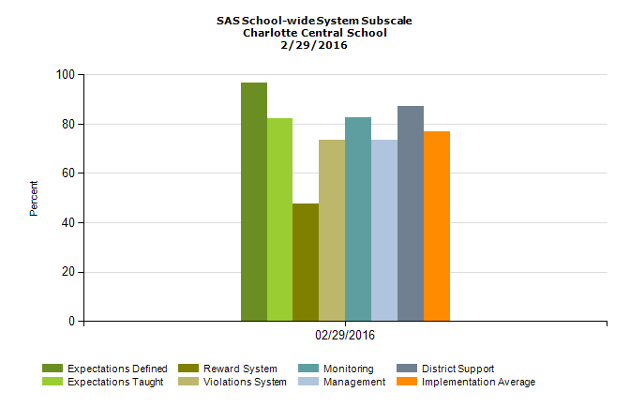
What does CCS Staff think is in Place?

Slide 63
What’s Missing?
PBIS Team
CCS Staff
Acknowledgement System!

Slide 64
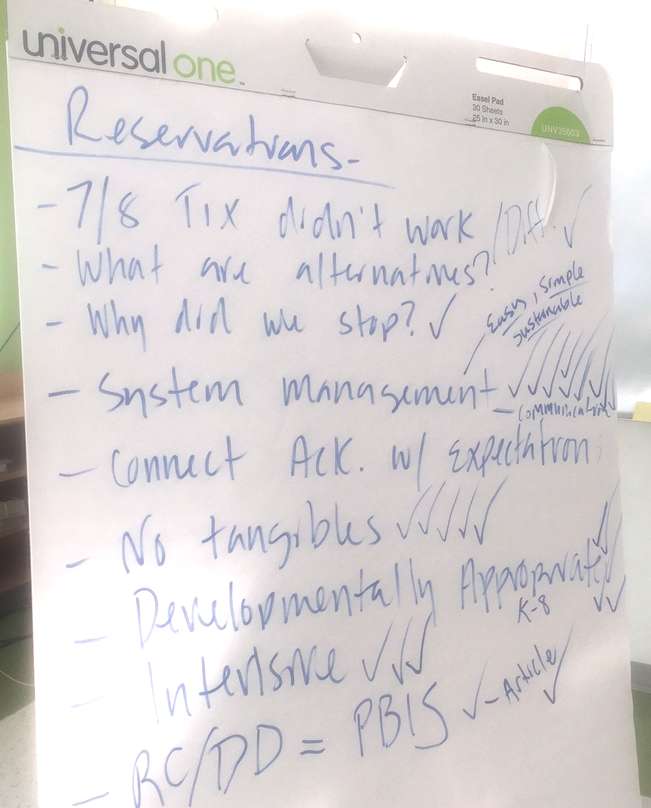
What our Staff told us?
Grades ⅞ -Tickets didn’t work
System Management - Easy, Simple, Sustainable
Connect with School-wide Expectations
No tangibles
Developmentally Appropriate
RC/DD + PBIS = CCS

Slide 65

Our NEW System:
What does it look like?
At CCS, Taking CARE of Ourselves, Taking CARE of Others and Taking CARE of this Place……
Just makes “cents”!

Slide 66
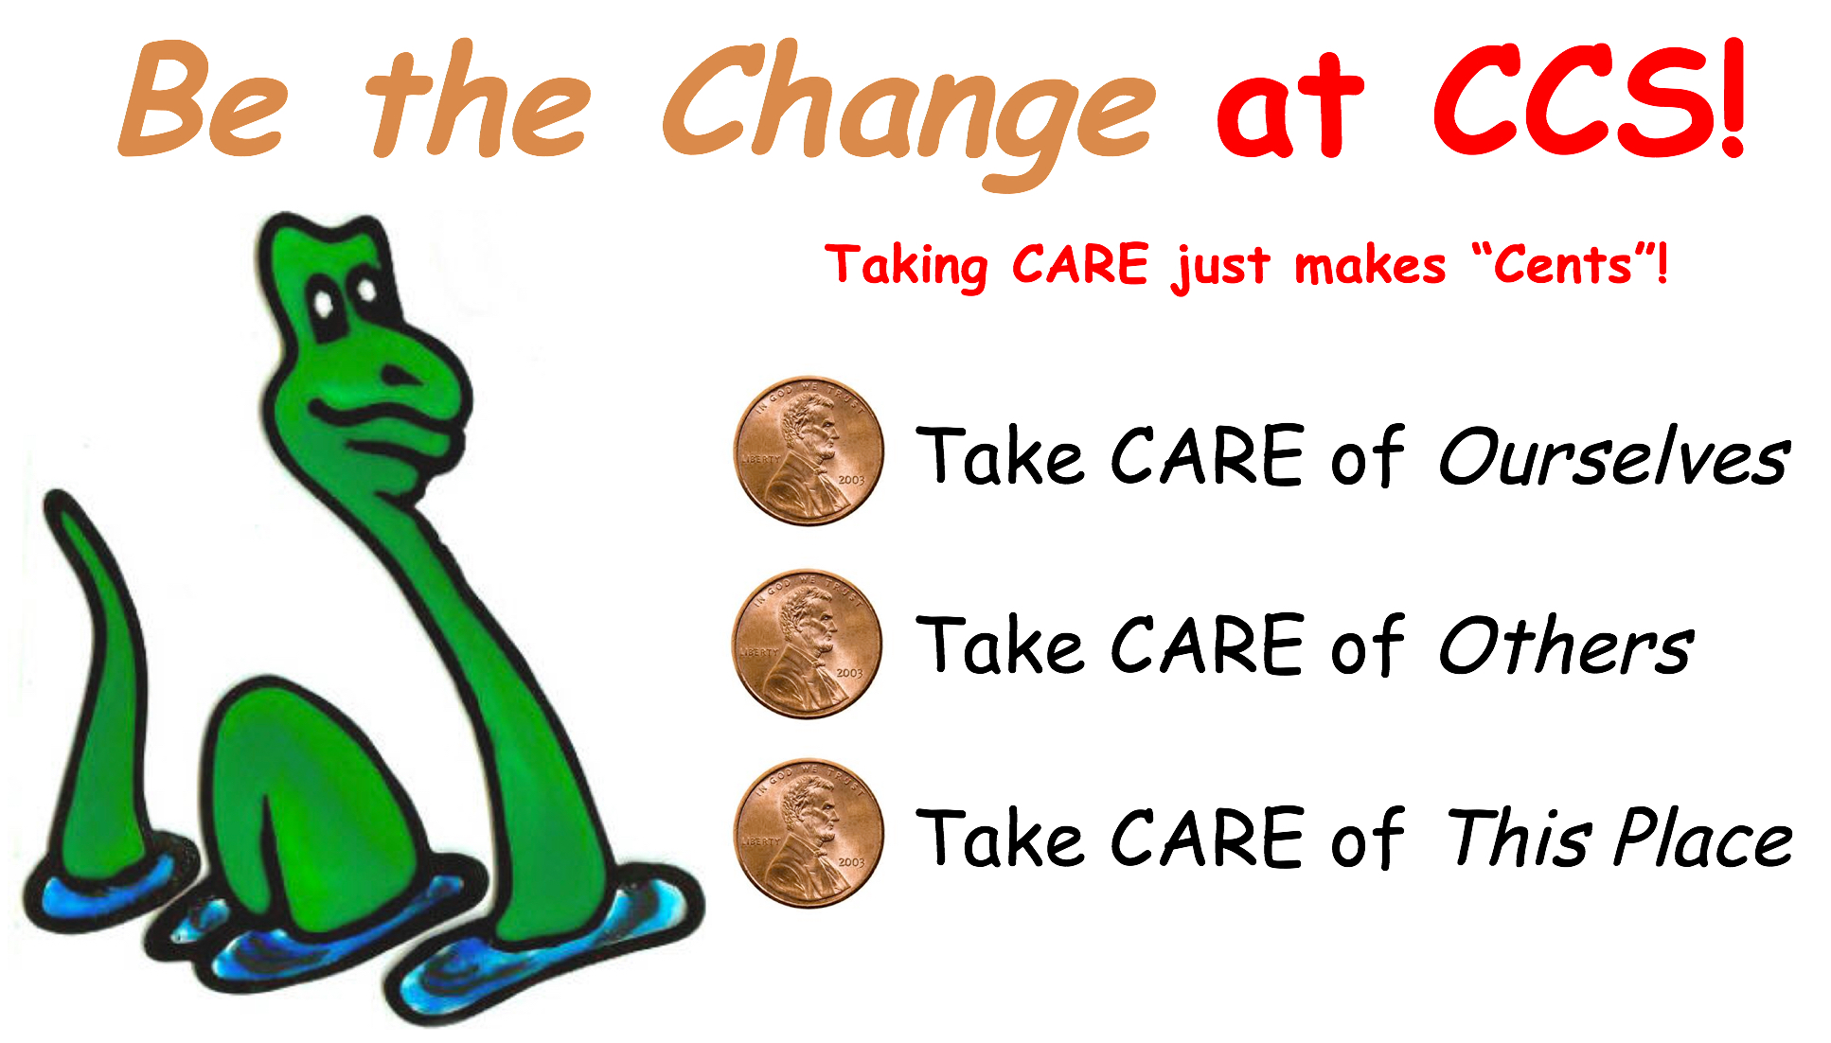
What is it called?
Be the Change!

Slide 67

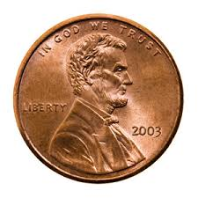
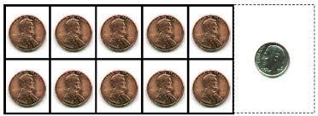

Why the Penny?
Building on CCS’s strong “cents” of community and values, the penny allows CCS to engage in…
Sustainable practices
Educational opportunities
“Paying” it forward

Slide 68
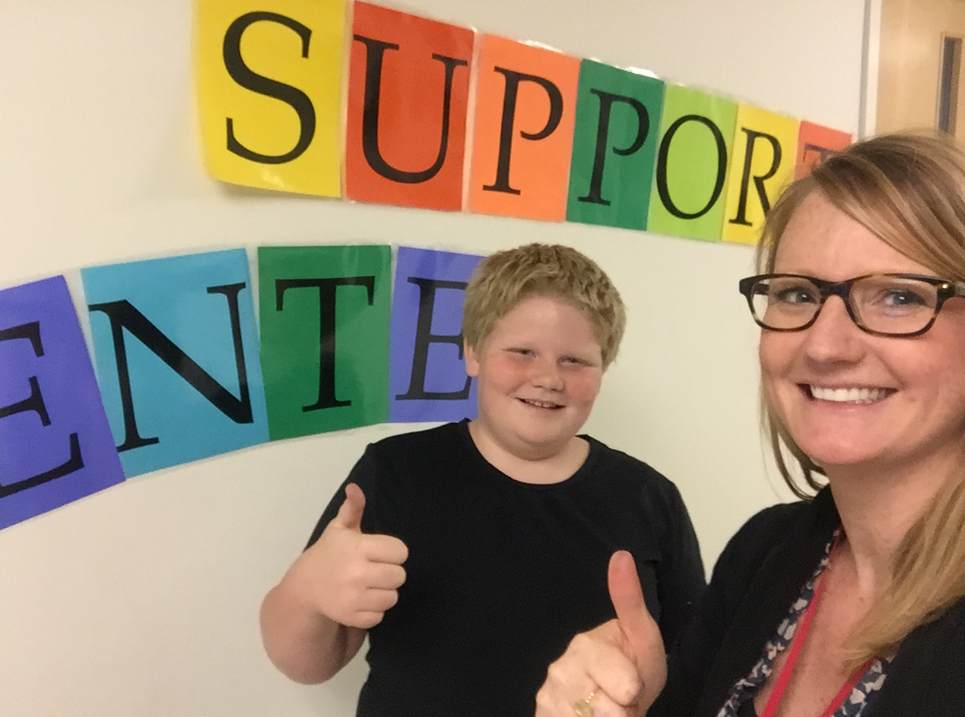
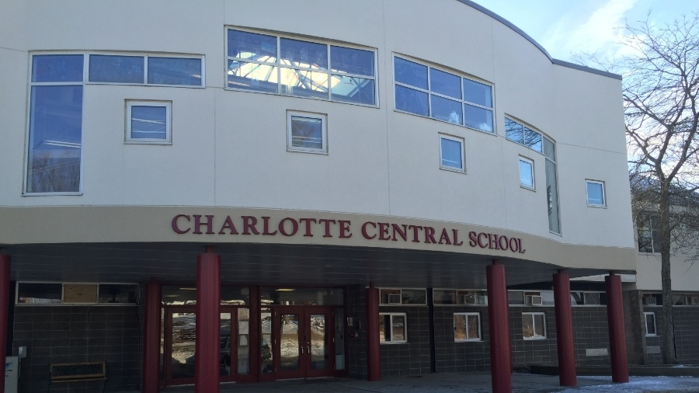

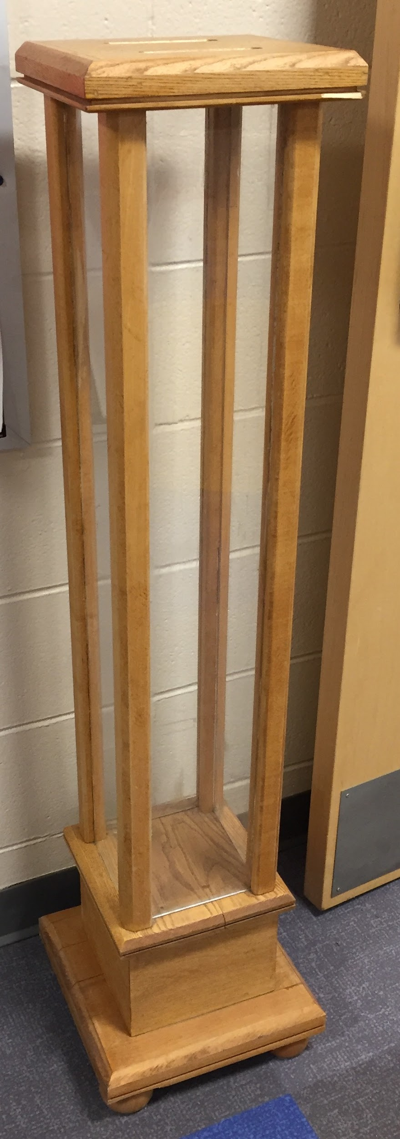
“Paying” it Forward
“Paying” it forward
Individual
School
Community
Local Organization
Lake Champlain Clean-up
Humane Society
VT Organization
Notes:
Students, staff and families will vote to determine the organization CCS will donate too.

Slide 69
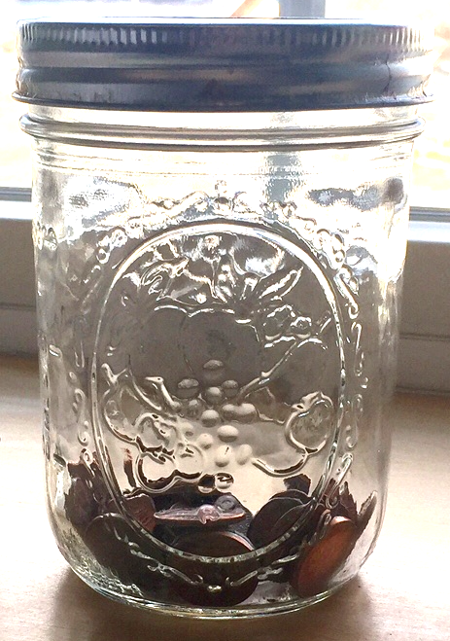
How do Students Get It?
When students demonstrate the school-wide expectations - Take care of ourselves, others and this place:
Give the student specific feedback connected to the expectation and provide them the option to put the penny directly in the school-wide jar or classroom jar

Slide 70

What do Students do with it?
Classroom
School-wide

Slide 71
“Be the Change” in Action!
https://drive.google.com/drive/u/0/folders/0B0R74rPJSuxOenZyTk42b0VqM28

Slide 72

Classroom Celebrations -
Keep it Simple & Have Fun!
You and Your Students Set Goals and Determine Celebration!
PJ Day!
Extra Recess!
Play Games!

Slide 73
Classroom vs. School-wide Celebrations
Celebration should be immediate - something we can live with…
Each classroom has the autonomy to set their own “Class-wide” goal
During every School-wide Assembly, classrooms are invited to deposit their change in the school-wide tube.
Once the tube is full, CCS will donate the pennies to an organization (TBD by the entire school community)

Slide 74

Building a Positive Community….. Starts with Us!
Staff Acknowledgement:
Be (See) the Change!
Note Cards!
Located in the Staff Room & Mailroom

Slide 75
Questions to Consider When Refreshing PBIS…
Why is it important?
What does is look like?
How do we differentiate?

Slide 76
Importance of PBIS Statement of Purpose
Why PBIS?
“The purpose of our PBIS team is to teach and promote positive behaviors through consistent responses, common language, and data driven decisions”
– Allen Brook School
Notes:
Why is this important?

Slide 77
2. Defining Behavior Expectations
Why is it important?
Research indicates that schools should utilize 3 to 5 behavioral expectations that are positively stated and posted throughout the school.
These expectations should be clear and general enough to apply to all school settings (e.g. classroom, hallways, playgrounds).

Slide 78
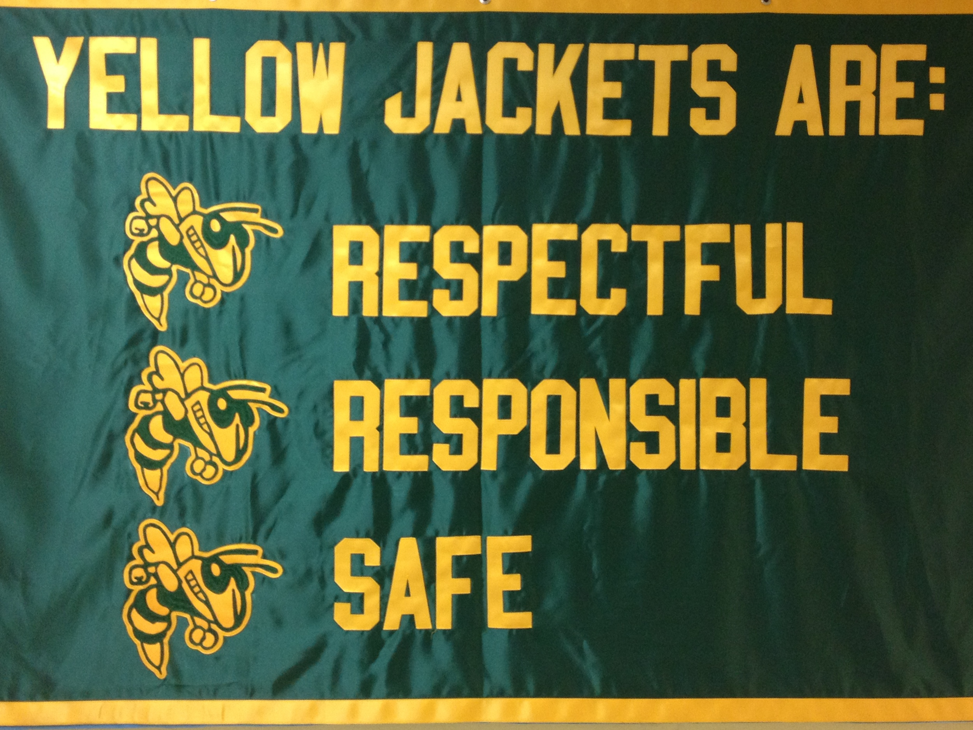
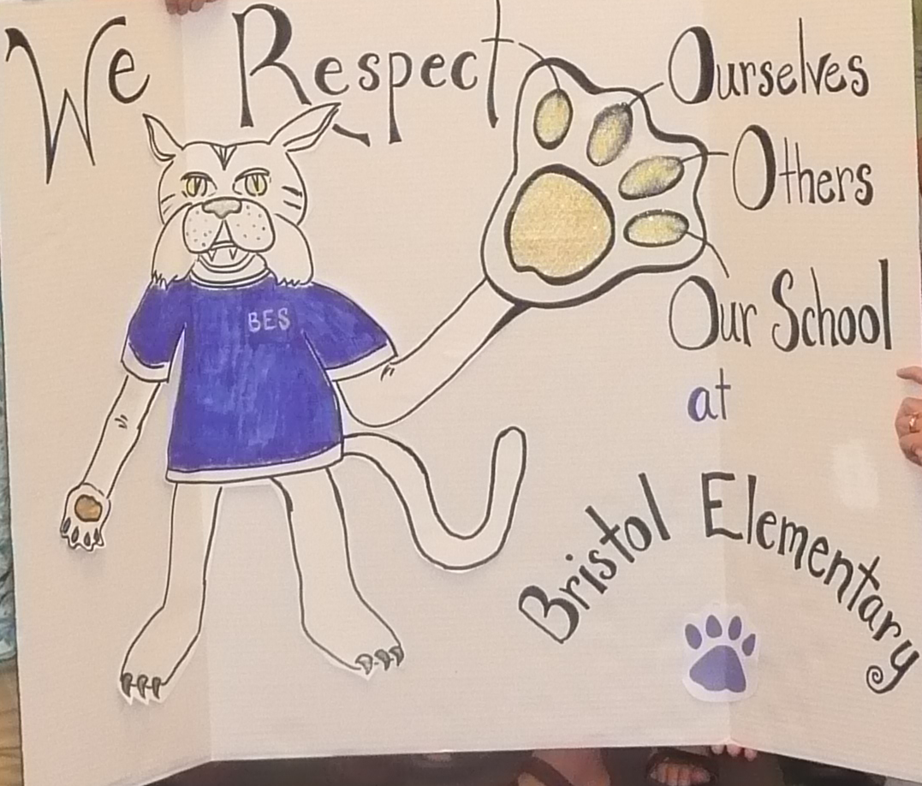
3. Defining Behavior Expectations
What does it look like? Few in number, positively stated, in behavioral terms.
Are your expectations on your website?
Do families know them?
http://www.wsesu.net/wsd-mtss-pbis
Windsor State Street (pre-k – 12)
Bristol Elementary

Slide 79
2. Defining Behavior Expectations
Ideas for keeping expectations visible:
  Posted in classrooms, hallways, computer wallpaper and/or screen saver
  Printed in the school handbook
  Some schools have made videos of the behavior expectations
  Flags hanging in the hallway outside of classrooms
  Staff and/or student lanyards
  Hats, t-shirts, bracelets, bumper stickers
  What else?
  What do you do?

Slide 80
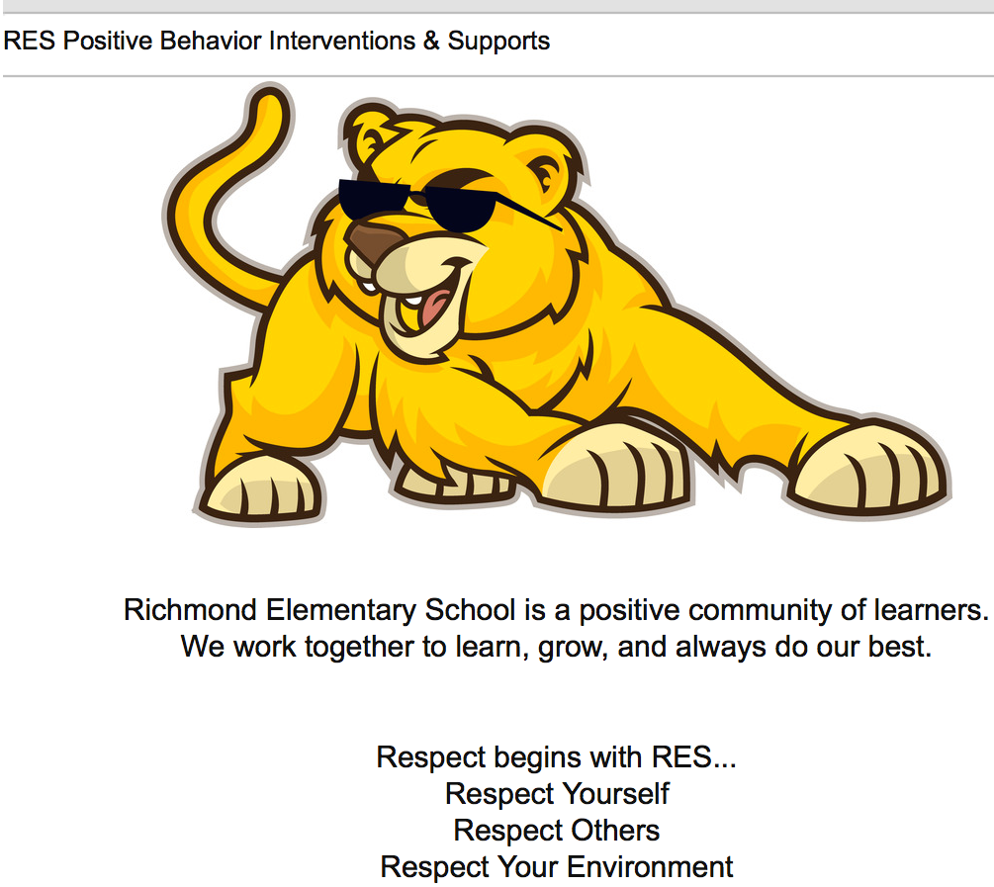
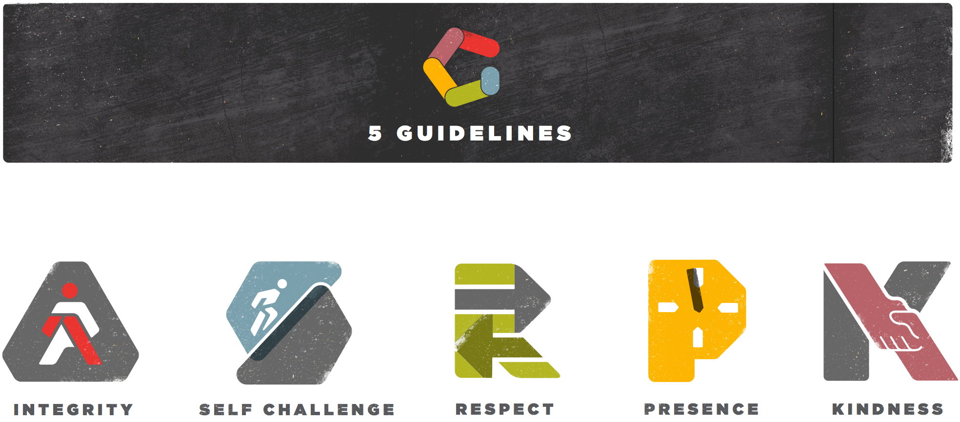
2. Defining Behavior Expectations
Considerations:
Differentiate!
High School vs. Middle vs. Elementary……..
Vergennes High School
Richmond Elementary

Slide 81
3. Teaching Behavior Expectations
Teaching Matrix |  | SETTING
 |  | All Settings | Hallways | Playgrounds | Cafeteria | Library/ Computer Lab | Assembly | Bus
 | Respect Ourselves | Be on task. Give your best effort. Be prepared. | Walk. | Have a plan. | Eat all your food. Select healthy foods. | Study, read, compute. | Sit in one spot. | Watch for your stop.
 | Respect Others | Be kind. Hands/feet to self. Help/share with others. | Use normal voice volume. Walk to right. | Play safe. Include others. Share equipment. | Practice good table manners | Whisper. Return books. | Listen/watch. Use appropriate applause. | Use a quiet voice. Stay in your seat.
 | Respect Property | Recycle. Clean up after self. | Pick up litter. Maintain physical space. | Use equipment properly. Put litter in garbage can. | Replace trays & utensils. Clean up eating area. | Push in chairs. Treat books carefully. | Pick up. Treat chairs appropriately. | Wipe your feet. Sit appropriately.
2. NATURAL CONTEXT
1. SOCIAL SKILL
Expectations
3. BEHAVIOR EXAMPLES
Teaching & Lesson Plans

Slide 82
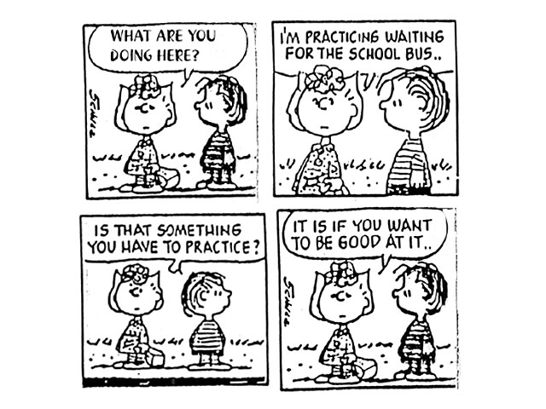

Slide 83
3. Teaching Behavior Expectations
Why is it important?
Behavioral errors more often occur because:
  Acquisition Deficits (can’t do)
  Performance Deficits (won’t do)
  Fluency Deficits (not enough practice)
Repetition is key to learning new skills:
  For a child to learn something new, it needs to be repeated on average of 8 times
  For a child to unlearn an old behavior and replace with a new behavior, the new behavior must be repeated on average 28 times (Harry Wong)
Notes:
At the high school level, older students may take an active role in teaching younger or new students (Bohanon, Borgmeier, Fenning, Flannery, & Malloy, 2009) through an "orientation" process.
Acquisition Deficits
Absence of knowledge for executing skill or failure to discriminate which social behaviors are appropriate in specific situations (can’t do)
Performance Deficits
Skill is present in repertoire, but youth does not perform at acceptable levels (won’t do)
Fluency Deficits
Lack of exposure to sufficient or skilled models of social behavior, insufficient rehearsal/practice or low rates or inconsistent delivery of reinforcement of skilled performances

Slide 84
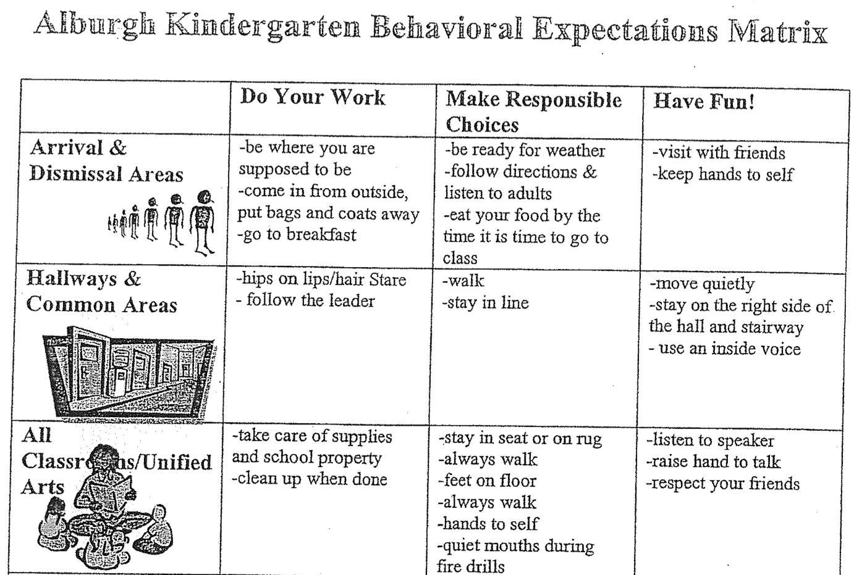
3. Teaching Behavior Expectations
What does it look like?
Use a specific, positive statement
Provide the reason and describe
Model and provide practice
Use prompts and reminders
Give acknowledgement and feedback
Evaluate effectiveness of instruction-redesign instruction if necessary
Define Simply
Model
Practice in Setting
Monitor and Acknowledge
Adjust for Efficiency

Slide 85
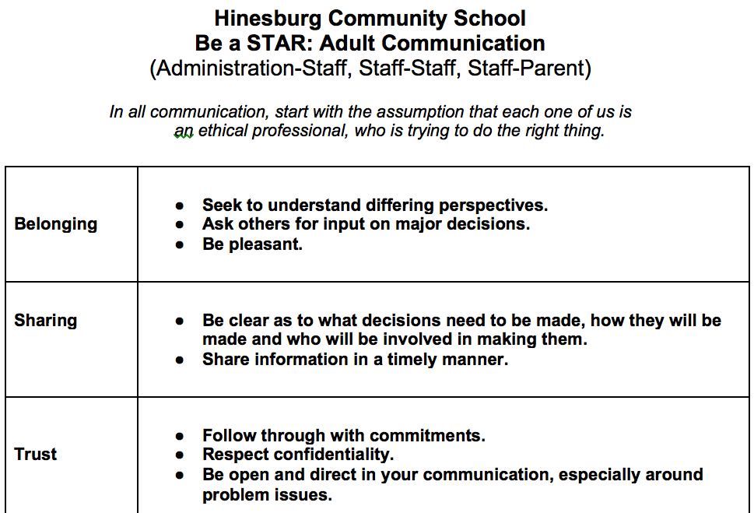
3. Teaching Behavior Expectations
What does it look like?
Matrix for
adults!

Slide 86
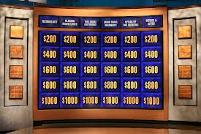
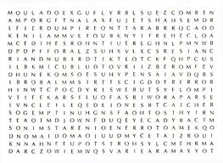

3. Teaching Behavior Expectations
Considerations:
Make it Relevant!
Respect RAP: https://www.youtube.com/watch?v=iGuT9-_Y5J4

Slide 87
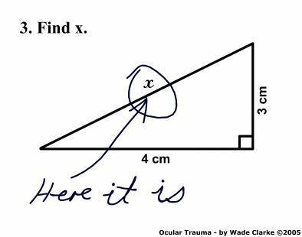
3. Teaching Behavior Expectations
Consideration:
Be Explicit

Slide 88
3. Teaching Behavior Expectations
Considerations Cont’d:
Engage Students through Differentiation
Elementary School: https://www.youtube.com/watch?v=aaweXw03kQI
Middle School: https://www.youtube.com/watch?v=XroJtR9gQc8
High School: https://www.youtube.com/watch?v=26xQHAASMSU
Notes:
Whole brain teaching!

Slide 89
Activity!
Count off by 6 and go to your assigned table
As a new Tribe, discuss the following questions found on your table regarding the Purpose Statement, 3-5 Behavioral Expectations and Teaching Behavior Expectations
Select 1-2 people to record your answers on the Post-it notes at your table and place on designated chart paper on the wall.
Notes:
Create One-pager….

Slide 90
Activity:
Walk around the room to see the ideas on the posters.
Get back into your original Tribe and complete/revise and insert:
  Purpose Statement
  Behavior Expectations
  Teaching Matrix
  Lesson Plans

Slide 91
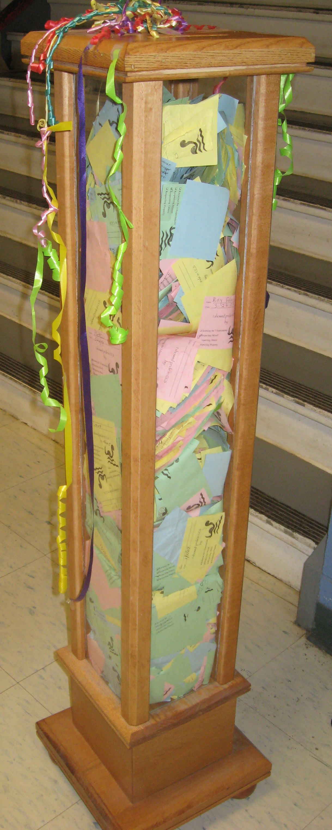
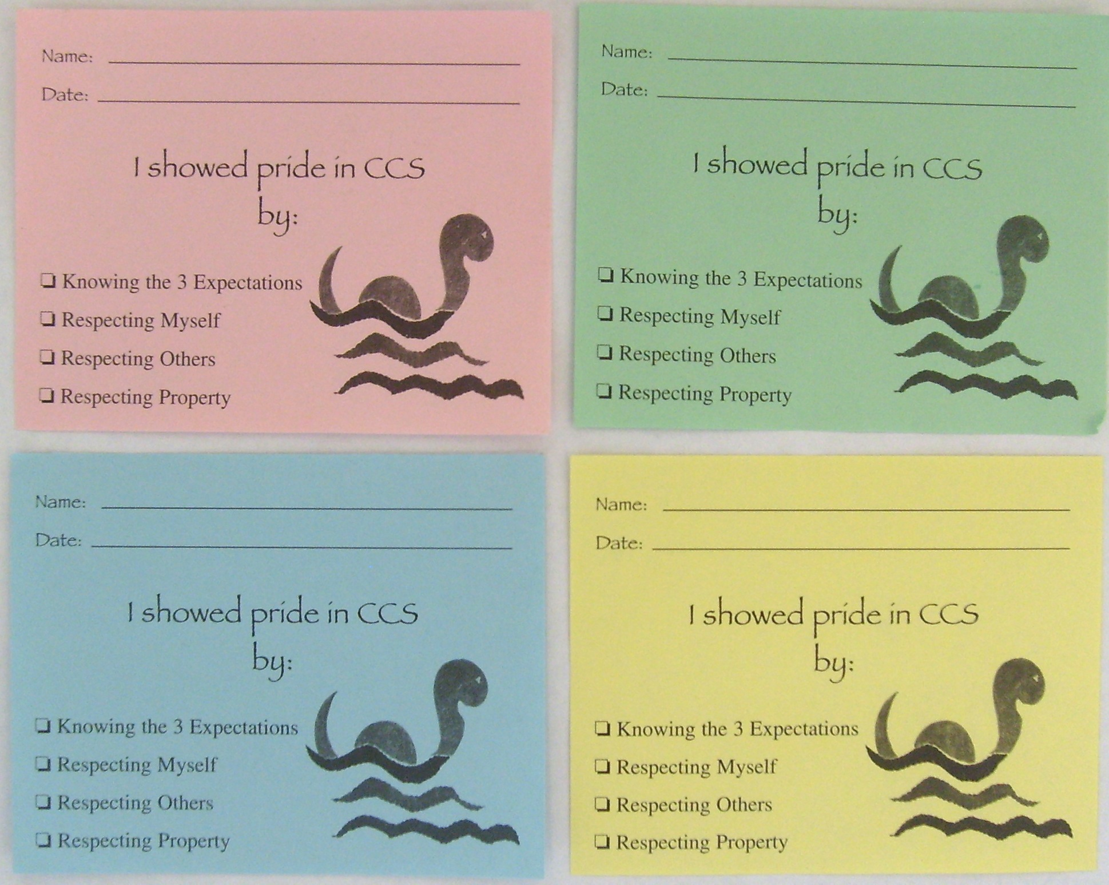
4. Acknowledging Behavior
Providing students feedback to let them know when and how they are meeting expectations (positive acknowledgement)

Slide 92
4. Acknowledging Behavior
Why is it important?
Behavior is learned
Learning is facilitated by guided feedback
Positive feedback has a greater likelihood of shaping behavior than negative feedback

Slide 93
4. Acknowledging Behavior
Why is it important?
Rewards make a difference
    Initial behavior change
    Sustained behavior change (Doolittle, 2006)
Rewards can be used badly
    But they do NOT inhibit intrinsic motivation (Reese, 2005)
Notes:
Rewards are effective when used:
To build new skills or sustain desired skills, with
contingent delivery of rewards for specific behavior, and
gradually faded over time.
Akin-Little, Eckert, Lovett, Little, 2004
“In terms of the overall effects of reward, our meta-analysis indicates no evidence for detrimental effects of reward on measures of intrinsic motivation.”
Cameron, Banko & Pierce, 2001 p.21
“…our research team has conducted a series of reviews and analysis of (the reward) literature; our conclusion is that there is no inherent negative property of reward. Our analyses indicate that the argument against the use of rewards is an overgeneralization based on a narrow set of circumstances.”
Judy Cameron, 2002
Cameron, 2002
Cameron & Pierce, 1994, 2002
Cameron, Banko & Pierce, 2001
“The undermining effect of extrinsic reward on intrinsic motivation remains unproven”
Steven Reiss, 2005

Slide 94
4. Acknowledging Behavior
Considerations:
BIG ideas on Rewarding Behavior:
In order for youth behavior to change, adult behavior must change first
Higher rate of positives than negatives (6-8:1 ratio)
Timely, specific feedback increases learning
Take into account the culture or context
(Gable, Hester, Rock, & Hughes, 2009; Kerr & Nelson, 2006; Nafpaktitis, Mayer, & Butterworth, 1985; Scott, Anderson, & Alter, 2011; Stichter et al., 2009; Walker, Ramsey, & Gresham,2004)
Notes:
Oxygen mask analogy

Slide 95
4. Acknowledging Behavior
Considerations Cont’d:
  Link individual acknowledgement to overall benefit of others
  Dispel myth that rewards are ineffective or detrimental to student “intrinsic motivation”
  Make rewards age and context appropriate

Slide 96
4. Acknowledging Behavior
Considerations Cont’d:
Don’t forget to acknowledge your Staff!
https://youtu.be/Cbk980jV7Ao
Notes:
End at 2:36

Slide 97
Activity!
Using the Acknowledgement Self-Assessment, self monitor your ratio of positive to negative statements for the rest of today, including Team Time.
If 80% of team members have a ratio of 4:1 positives, each person will receive a reward!

Slide 98
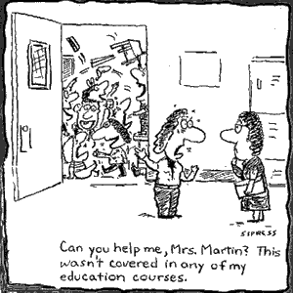
5. Discouraging Problem Behavior
This involves:
  Consistent practices for preventing problem behaviors
  Distinguishing between minor and major behaviors
  Practices for responding to problem behaviors
  Continuum of Procedures for responding to problem behavior

Slide 99
5. Discouraging Problem Behavior
Why is it important?
Problem behavior in non-classroom settings (hallways, cafeteria, playground, common areas) accounts for 50% of all problem behavior in schools. Source: Colvin, Sugai, Good, & Lee (1997)
“Punishing” problem behaviors (without a proactive support system) is associated with increases in (a) aggression, (b) vandalism, (c) truancy, and (d) dropping out. (Mayer, 1995, Mayer & Sulzar-Azaroff, 1991, Skiba & Peterson, 1999)
Students with the most challenging academic and social behavior problems need pro-active comprehensive and consistent systems of support

Slide 100

5. Discouraging Problem Behavior
What does it look like?
  Preventing problem behaviors
Good classroom management – Move, Scan, Interact!
Increase “Opportunities to Respond”!
De-Escalation Techniques:
When a student is Anxious…..Be Supportive!
When a student is Defensive…..Be Directive!
Notes:
De-Escalation Tecniques:
When student shows anxiety….Be supportive!
What does anxiety look like?
What can adults do to be supportive?
When student is defensive…Be directive!
What does defensive behavior look like?
What can adults do to be directive?

Slide 101
Activity!
In your team, discuss the following question:
What strategies should all teachers try before a problem behavior is reported as a minor or major?

Slide 102
5. Discouraging Problem Behavior
What does it look like?
  Calibrate your staff!
    Identify and understand minor vs. major behaviors
DEFINE “Close Confusers!”
The first grade class writes in a journal. The topic focuses on a particular letter each day. During the letter “F” day, Sarah writes an inappropriate word she has learned from some older students on the playground. She shows her journal to all of the students around her.

Slide 103
Activity!
Begin the Discipline Categories Exercise #1
We’ll review answers as a large group!

Slide 104
5. Discouraging Problem Behavior
What does it look like?
  Responding to problem behaviors….
Use scripts to help set limits:
What are you doing? Objectively describes the rule-breaking behavior
What are you supposed to be doing? Clarifies that the student knows what behavior or task is expected.
What are you going to do? The student makes a choice communicated by either words or actions.
You could also say:
“What can I do to help you make a good choice?

Slide 105
5. Discouraging Problem Behavior
Three Simple Evidence-Based Practices:
Behavior-Specific Praise
Behavior Momentum
Choice
Notes:
Handout Article!
Real story experienced by Ken Kramberg to demonstrate Behavior Momentum: A student, (on the autism spectrum) wouldn’t get off the swing at recess when recess was over. The student would have a fit and refused to come in. The team of teachers got together and came up with three things the student says “yes” to………

Slide 106
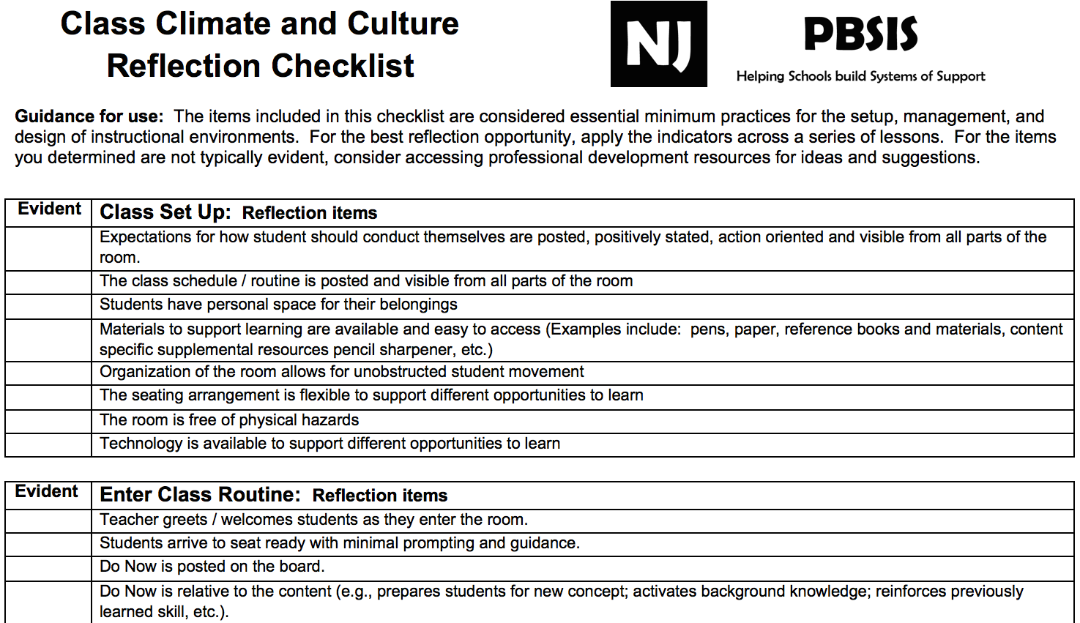
5. Discouraging Problem Behavior
Considerations:
Change the environment not the student!
Redesign of teaching environments…not students!
Notes:
Handout Class Climate Checklist!

Slide 107
Activity!
Count off by 6 and go to your assigned table
As a new Tribe, discuss the following questions found on your table regarding the Acknowledging Behavior, Discouraging Problem Behavior, and Procedures for Record Keeping and Decision-making
Select 1-2 people to record your answers on the Post-it notes at your table and place on designated chart paper on the wall.
Notes:
Create One-pager….

Slide 108
Activity:
Walk around the room to see the ideas on the posters.
Return to your original Tribe and complete practices and procedures for acknowledging positive behavior and discouraging problem behavior.

Slide 109
PBIS Targeted and Intensive Levels

Slide 110
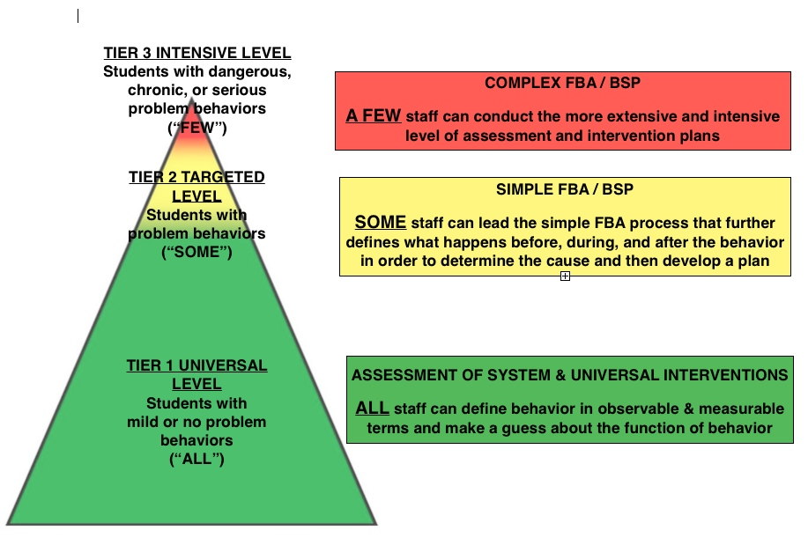
Understanding Function Across the Tiers
Notes:
At the universal level: ALL staff can define behavior in observable and measurable terms and make a guess as to the function of the behavior
Targeted level: SOME staff can lead the simple FBA/BSP process
Intensive level: A FEW staff can do a more extensive and intensive level of assessment

Slide 111
ESTABLISHING CONTINUUM of School-Wide PBIS Support – EXAMPLE
INTENSIVE PREVENTION
INTENSIVE PREVENTION
Function-based support
Wraparound
Person-centered planning
~5%
~15%
TARGETED PREVENTION
TARGETED PREVENTION
Check in/out
Targeted social skills instruction
Peer-based supports
Social skills club
UNIVERSAL PREVENTION
Teach SW expectations
Proactive SW discipline
Positive reinforcement
Effective instruction
Parent engagement
UNIVERSAL PREVENTION
~80% of Students

Slide 112
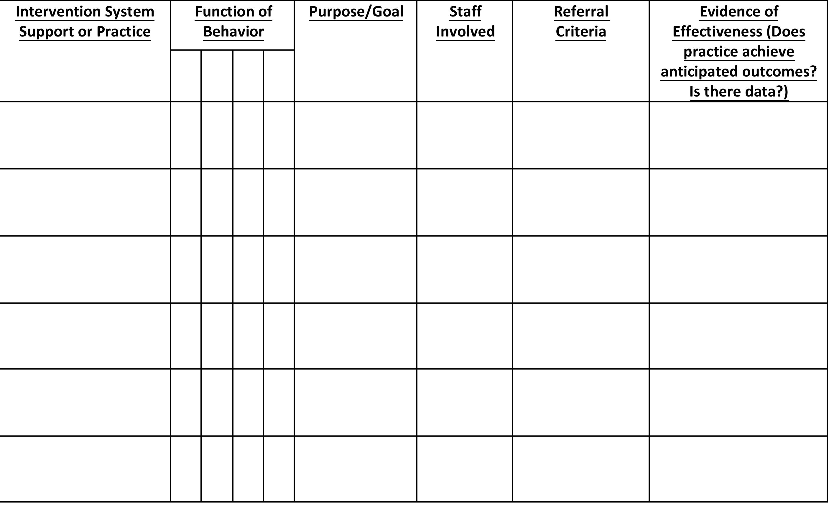
Targeted Inventory of Support

Slide 113
Examples:
Targeted Interventions Based on
Functions of Behavior
Access Adult Attention/Support:
  Check-In/Check-Out
  Adult Mentoring Programs
Access Peer Attention/Support:
  Social Skills Instruction
  Peer Mentoring
  Self-Monitoring with Peer Support (function: academic task escape)
Academic Skills Support
  Organization/Homework planning support
  Homework completion club
  Tutoring

Slide 114



Where to find Evidenced-based Practices
http://www.nrepp.samhsa.gov/
http://www.ojjdp.gov/mpg
http://www.blueprintsprograms.com/programSelector.php

Slide 115
Optional
Finalize your Inventory of Formal and Informal Targeted Systems of Supports (handout)

Slide 116
Homework!
Universal Level Activities:
Continue creating your plan for revitalizing Universal Level components in Staff Handbook
Targeted/Intensive Activities:
Optional: Finalize your Inventory of Formal and Informal Targeted Systems of Supports (handout)
Remember your acknowledgement self-assessment!

Slide 117
Celebration!
Acknowledgements Self-Assessment
If 80% of team members have a ratio of 4:1 positives, each person will receive a reward!
Notes:
Acknowledgement Activity – Positive to Negative Ratio!

Slide 118
VTPBIS Leadership Team Training
Within a Multi-Tiered System of Supports
Refresher – Day 2
Presented by:
VTPBIS Team
March 30-31, 2017
Notes:
CASSANDRA

Slide 119
Questions or Comments?

Slide 120
Agenda
Day 1:
Welcome and Intros
Setting up for Success
Sustainability & Implementation Science
Team Structures
Enhance Fluency in PBIS Features
Targeted & Intensive Features
Day 2:
Identify Strategies for analyzing data
Family Engagement
Finalize Revitalization Plan
Present and Share Ideas!

Slide 121

Using Data to Identify Common Implementation Dips

Slide 122
Activity!
With your neighbor, discuss the following:
What were your successes and challenges in using PBIS data this year? (fidelity and/or student outcome measures)
In a moment, we will ask for a sampling of responses.

Slide 123
Big Ideas About Data…
All data should serve a purpose
Collect data with fidelity
Be prompt about looking at data and acting upon it
Use multiple sources of data to confirm what you see
Use data to support, not punish

Slide 124
Types of Data to Consider
Intensive:
BAT - TFI!
SWIS-ISIS
EST
FBA/BSP
Targeted:
BAT - TFI!
SWIS-CICO
EST
FBA/BSP
Universal:
BoQ – TFI!
SAS
SWIS
Attendance
Grades
Leadership Team Self-Assessment
Notes:
What else?

Slide 125
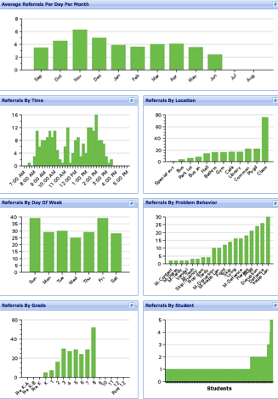
Office Discipline Referrals
Avg. Referrals Per Day Per Month
Time
Location
Day of Week
Problem
Behavior
Grade
Student

Slide 126
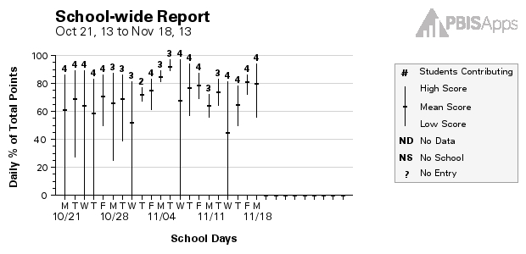
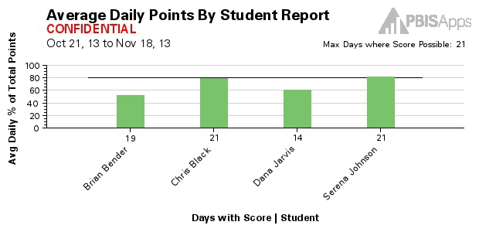
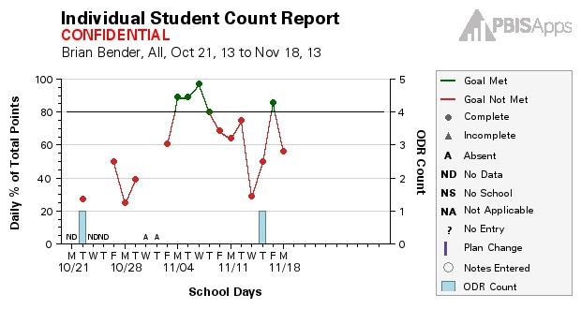
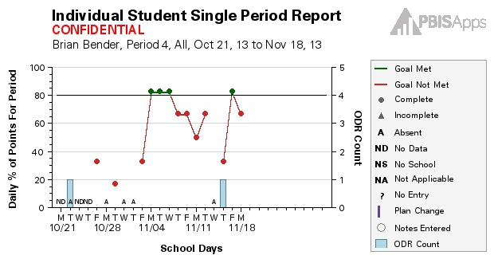
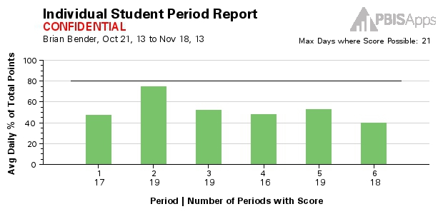
SWIS-CICO
Reports:
School-wide Report
Average Daily Points
Student Count
Student Period
Student Single Period

Slide 127
6. Procedures for record keeping and decision making
Why is it important?
  Identify patterns
  Document pre-referral interventions
  Determine whether a particular teacher needs support
  Communicate with parents and answer questions
  Inform behavior support planning
Moving away from “admiring the problem”

Slide 128
6. Procedures for record keeping and decision making
Considerations:
Track positive behavior
Positive Referrals vs. ODRs:
FG Leary Fine Arts School, Chilliwack, BC

Slide 129
Example: What’s working well!
Notes:
Six schools

Slide 130
Example: Areas in Need of Improvement
Notes:
Six schools

Slide 131
Areas in Need of Improvement
Classroom Plans
Data Analysis
Implementation Plan
Lesson Plans

Slide 132
Activity
In your teams, analyze your school’s BoQ or TFI data using the BoQ or TFI Summary/Planning Tools and identify the following:
  What is your most significant implementation dip? (Area in most need of improvement)
  What are 2-3 areas of strength?
  Identify at least two strategies to overcome identified implementation dips

Slide 133
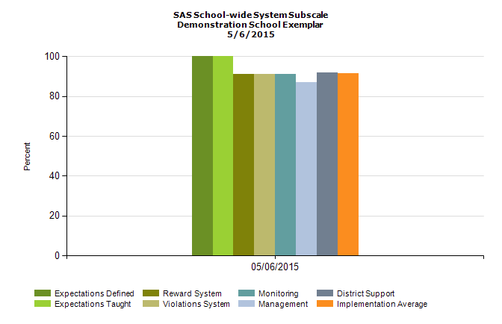
Your SAS Data

Slide 134





Slide 135

SAS Team Summary Tool

Slide 136

Your Student Outcome Data

Slide 137
Sharing data with your staff!
EXAMPLE:
SAS & BoQ Presentation to Staff

Slide 138
PBIS Data Update
THANK YOU ALL!
85% (48) of Staff Members Completed
the Self-Assessment Survey!

Slide 139

This year 85% of our staff completed the SAS. 74% indicated that they think school-wide system is in place compared to 41% last year. 40% of staff still say this is a medium or high priority for improvement.

Slide 140

70% of staff think that non-classroom settings are in place, an increase of 34% since last year. Only 7% say this is still a high priority for improvement.

Slide 141

Overall, staff perception of implementation has improved across all categories!

Slide 142

This year our PBIS team took the BoQ to assess PBIS fidelity across all features of PBIS. This year 85% of PBIS features are in place. Last year, only 48% of features were in place.

Slide 143
Based on your feedback our team has determined the following areas for improvement:
Example:
Focus on maintaining our Universal Efforts
Enroll more students in Targeted Supports
(USE the SAS Summary to help articulate these)

Slide 144
Thanks!
Questions about PBIS?
Contact one of the team members:
Jane Principal
Tom Coordinator
Physical Ed
Sharon Teacher
Johnny Naysayer

Slide 145
Activity
Review your SAS, BoQ, or TFI data and draft priorities using the Summary/Planning Sheets
Using the template provided, create a presentation of your SAS, BoQ, or TFI results, including action steps.
Notes:
The staff presentation ppt will be posted at www.pbisvermont.org. Handouts will also be available.

Slide 146
Looking for a Data Protocol?
Consider Using TIPS:
A process for using data to make decisions:
Formal problem solving steps that a group can use to build and implement solutions.
Access to the right information at the right time in the right format
A structured meeting process
Formal roles (facilitator, recorder, data analyst)
Specific expectations (before, during & after meetings)
Access and use of data
Use of electronic and projected meeting minutes

Slide 148
What, Who, When, Where, and Why?
Team-Initiated Problem Solving (TIPS II) Model
Identify Problem
with
Precision
How do we want the problem to change?
What next?
Make Summative
Evaluation
Decision
Identify
Goal for Change
Collect and Use Data
Has the problem been solved?
Monitor Impact
of Solution and
Compare against Goal
Identify
Solution and
Create
Implementation
Plan with
Contextual Fit
Implement
Solution with
High Integrity
What are we going to do to bring about desired change?
Did we implement with fidelity?
Meeting
Foundations
Notes:
The outer circle ( Problem Solving Meeting Foundations) refer to the process and procedures and team uses to function. Roles are determined and defined, meetings are scheduled for the year, electronic equipment and internet access are available, and an agenda is established.
The inner circles and arrows define a problem-solving model designed to improve the decision-making and problem solving of PBIS Team. This model is called “TIPS,” which stands for “Team-Initiated Problem Solving.” The model uses data for during problem solving and decision making, during meetings. We will also apply a metric for determining if rates of problem behavior at a school or below, at, or above the national average to determine if there is a problem or not. TIPS teaches teams to use their SWIS data to define precision problem statements. Once the problem statement is precise, a variety of solutions are discussed based on prevention, teaching, reward, correction and extinction and teams will determine which solution(s) they want to implement. The TIPS model then moves the team to action planning ,evaluation and measurement determination.

Slide 149
TIPS Problem-Solving “Mantra”
Innovation neutral: Use for Reading, Behavior, Math, School Improvement
Do we have a problem?
(identify)
What is the precise nature of our problem? (define, clarify, confirm/disconfirm inferences)
Why does the problem exist, & what can we do about it? (hypothesis & solution)
What are the actual elements of our plan? (Action Plan)
Is our plan being implemented, & is it working? (evaluate & revise plan)

Slide 150

1. Do we have a problem (identify)?
Look for gaps and trends in your data
Notes:
What data to monitor
ODR per day per month
OSS, ISS, Attendance, Teacher report
Team Checklist/ SET (are we doing what we planned to do?)
What question to answer
Do we have a problem?
What questions to ask of Level, Trend, Peaks
How do our data compare with last year?
How do our data compare with national/regional norms?
How do our data compare with our preferred/expected status?
If a problem is identified, then ask
What are the data we need to make a good decision?

Slide 151

What trend do you notice?

Slide 152

What trend do you notice?

Slide 153

Which location might need attention?

Slide 154
2. What is the precise nature of our problem (define, clarify, confirm/disconfirm inferences)?
Question | SWIS Table/Graph
What problem behaviors are occurring? | Referrals by problem behavior
When are problem behaviors occurring? | Referrals by time
Where are problem behaviors occurring? | Referrals by location
Who is engaging in problem behaviors? | Referrals by student
Why do problem behaviors keep happening? | Referrals by motivation
What is the data we need for a decision?

Slide 155
Precise Problem Statement
Precise Problem Statements include information about the what, when, where, who, when and why
inappropriate behavior is increasing
Inappropriate language and disruptive behavior is increasing in the cafeteria during “first lunch period,” is being done mostly by four 6th grade boys, and seems to be maintained by social praise from the bystander peer group.

Slide 156

3. Why does the problem exist, & what can we do about it? (hypothesis & solution)
Problem Statement: The sixth graders are disruptive & use inappropriate language in the cafeteria between 11:30 AM and 12:00 PM
Hypothesis: We believe they are trying to get attention from their peers.

Slide 157
4. What are the actual elements of our plan?
Prevention | *Maintain current lunch schedule, but shift classes to balance numbers. *Teach behavioral expectations in cafeteria
Teaching
Reward | Establish “Friday Five”: Extra 5 min of lunch on Friday for five good days.
Extinction | Encourage all students to work for “Friday Five”… make reward for problem behavior less likely
Corrective Consequence | Active supervision, and continued early consequence (ODR)
Data Collection | Maintain ODR record and supervisor weekly report

Slide 158

….including logistics:
Notes:
Action Plan Elements:
Who?
By When?
Goal with Timeline
Fidelity of Implementation Measure
Effectiveness of Implementation Measure

Slide 159

5. Is our plan being implemented & is it working? (evaluate & revise plan)
Notes:
Define the goal for solving the problem
What will ‘it’ look like when you say it is not a problem
Define how you will know that the solutions were implemented as planned (with fidelity)?
How often will you conduct a status review?
Define how you will know that the solutions had a positive effect on student achievement, social competence, and/or safety?
How often will you monitor student progress?
What will the data tell you when the problem is solved?
Base on team-established standard
Easier to monitor if quantifiable (“countable”)
Record on meeting minute form for progress monitoring at future meeting(s)

Slide 160
Your Turn!
What is the precise nature of our problem?
Question: | Fill in the information below:
What problem behaviors are occurring?
When are problem behaviors occurring?
Where are problem behaviors occurring?
Who is engaging in problem behaviors?
Why do problem behaviors keep happening?
Notes:
As a team, we need to develop a precise problem statement! This Slide is a handout and we will use this to explore the data is SWIS.

Slide 161
What are the actual elements of our plan?
Precise Problem Statement:
Prevention: Remove/alter “trigger” for problem behavior
Teaching: Define, instruct & model expected behavior
Reward: Expected/alternative behavior when it occurs; prompt as necessary
Extinction: Increase acknowledgement of presence of desired behavior
Corrective Consequence: Use non-rewarding/non-reinforcing responses when problem behavior occurs
Data Collection: Indicate how you know when you have a solution
Notes:
Prevention: *Maintain current lunch schedule, but shift classes to balance numbers.
Teaching: *Teach behavioral expectations in cafeteria
Reward: Establish “Friday Five”: Extra 5 min of lunch on Friday for five good days.
Extinction: Establish “Friday Five”: Extra 5 min of lunch on Friday for five good days.
Corrective Consequence: Active supervision, and continued early consequence (ODR)
Data Collection: Maintain ODR record and supervisor weekly report
Prevention
: How can we avoid the problem context?

Who, When, Where

Schedule change, curriculum change, etc

Teaching:
How can we define, teach, and monitor what we want?

Teach appropriate behavior

Use problem behavior as negative example

Recognition
: How can we build in systematic reward for desired behavior?

Extinction
: How can we prevent problem behavior from being rewarded?

Consequences
: What are efficient, consistent consequences for problem
behavior?

How will we collect and use data to evaluate (a) implementation fidelity, and
(b) impact on student outcomes?

Slide 162
Activity
Part 1:
Using the TIPS Problem Solving Process (handout) as a guide:
  Identify the precise nature of the problem
  What are the elements of your plan?
Part 2:
  Complete a review of your BoQ or TFI and SAS data and prepare a presentation to your staff/board/families/students…

Slide 163

Benefits of Family Engagement
Higher test scores
Better grades
Better attendance
Higher levels of homework completion
More positive student motivation
Improved attitudes about school work
http://www.pbis.org/family/family_partnership.aspx
Darsch, Miao, & Shippen. (2004) A Model for Involving Parents of Children with Learning and Behavior Problems in the Schools: Preventing School Failure 48(3), 24-35
Notes:
The benefits of family-school partnerships have been studied for nearly three decades. Benefits include:…

Slide 164
Student Behavior
When families are involved, students exhibit more positive attitudes and behavior.
When students report feeling support from both home and school, they have more self-confidence, feel school is more important, and they tend to do better in school.
Student at-risk behaviors such as alcohol use, violence, and other anti-social behaviors decrease as parent involvement increases.
  http://www.pbis.org/family/family_partnership.aspx
National PTA, 10/28/2005
Notes:
Positive effects on student behavior…
PBIS is a strengths-based approach…students and families feel more positive which leads to better outcomes not only in school but at home and in the community
There are demonstrated benefits for teachers and schools too including: greater job satisfaction, higher ratings of teaching skills from both parents and principals, higher ratings of school effectiveness, improved classroom behavior through increased knowledge of children’s family, cultural, and community contexts [Adapted from Christenson, 1996]
All things being equal, a student who you have identified for Intensive Level supports will see greater success if a person-centered planning approach is used and the family and other caring adults in that child’s life are fully engaged as equal members of the team.
Children live in families and communities and eventually leave school. I would suggest to you that the measure of overall success is not only how well the child does in school, but how the child can be successful at home and in the community.
Taking a long view when you are faced with the very real challenges of engaging some families may be helpful. I can tell you from working in a family organization, that teachers who have a “never going to give up on the family” attitude are greatly appreciated, even though it may not seem that way some time.
Schools that have a high level of family engagement are rated higher by families. Teachers also report greater job satisfaction and turnover is lower.

Slide 165
Research on Family Engagement
“...lack of full family engagement has been found to be a major impediment to treatment success.”
“Research has shown that outcomes for children’s mental healthcare tend to be better when families are engaged…”
Huey, Henggeler, Brondino, & Pickrel, 2000; Tolan, McKay, Hanish, & Dickey, 2002

Slide 166

Family Engagement Checklist
Muscott & Mann, 2004
Adapted from Epstein (2003) and Fullen (1991)
Five areas & 19 tasks:
Climate (4 tasks)
Parent Involvement in Learning Activities at Home (3 tasks)
Communication with Parents/Families (3 tasks)
Parent/Family Involvement at School (Volunteering, Assisting) (3 tasks)
Parent/Family Involvement in Decision-Making (6 tasks)
Notes:
Use the Family Engagement Checklist to assess how your school is doing and make future plans. The checklist consists of five areas and 19 tasks.
One of the after-webinar activities will be for your team to look at your Checklist. What’s working? What still needs to be done?

Slide 167

Family Engagement Checklist

Slide 168
Family Engagement Modules
Universal Level Family Engagement Module:
https://www.youtube.com/watch?v=lD7BrV11wCA
Targeted Level Family Engagement Module: https://www.youtube.com/watch?v=1w3DDUNJrbM
Intensive Level Family Engagement Module: https://youtu.be/cuZsh9Xd8Ho
Vermont Family Network

Slide 169

NEW Family Engagement Survey and Resources!

Slide 170
Addresses the following questions:
What do families know about PBIS in your school?
How are families’ perceptions about PBIS similar/different from school leadership team perceptions?
What can you do when there is a discrepancy?
What resources are available to help engage families in PBIS?

Slide 171
Activity!
As a team, review the Family Engagement Checklist and the Family Engagement Survey and discuss how you can use these tools.
  Identify 2-3 things you will do to increase family engagement in your school.
  Explore the Family Engagement Resources at http://www.pbisvermont.org/resources/for-families/family-resources
We’ll hear a sampling of responses…….

Slide 172

Activity!
As a team, plan your revitalization roll-out using the Staff Handbook

Slide 173
FINAL ACTIVITY!
As a team, list all tasks & projects that still need to be finished and schedule next meeting date(s).
IMPORTANT!
Turn in a copy of your Staff Handbook before you leave:
    At the registration desk
    Or e-mail it to anne.dubie@uvm.edu

Slide 174

TEAM PRESENTATIONS!

Slide 175

Where do we go from here… thoughts and/or questions…
Notes:
SWIS Trainings
Post Implementation SET
Support Available
Grad Course

Slide 176
Vermont PBIS System of Support
SUPPORT LOOPS
School Level:
School
Coordinators
SU/SD Level:
SU/SD Coordinators
State Level:
TAs
Trainers
Coaches
Leadership Teams at ALL Levels of Support
FEEDBACK LOOPS
Notes:
We’ve learned the importance of identifying a contact at each level of the cascade.
We’ve learned that the beauty of a healthy cascade is that it will continue to sustain if one piece is missing….

Slide 177

Getting ready for next year
Recommended Steps:
  Set aside a time to finish/revise your Staff Handbook and Action Plan - schedule this time now
  Obtain your SWIS License (optional)
    http://www.pbisvermont.org/resources/evaluation-tools/swis
  Consider securing resources for coaching support
  Plan your professional development for next year
    Keep an eye out for the VTPBiS Professional Learning Calendar in June

Slide 178
More Information about Coaching Support
What?
  Support for schools/SUs/SDs in fidelity of PBIS evidence-based practices and development of local implementation capacity
  Goal is to create school/SU/SD capacity for internal coaching
Why?
  Someone with expertise who can bring experience, expertise and an external perspective
How?
  Contract with State Approved VTPBiS Coaches directly!
  SU/SD apply for BEST/Act 230 funds
  More information at: http://www.pbisvermont.org/resources/coaches-a-coordinators/coaches

Slide 179




The elements necessary to sustain PBIS include:
Data
Communicate
Share Information
Participate
Notes:
1) Data: The school completes annual assessments ( SAS and Annual BoQ). The school also collects discipline data and uses it to problem solve and maintains an annual PBIS action plan.
2) Communication: A school initiates at least bi- monthly contact with their Implementation Coach or their State TA. The schools communicates regularly with its Supervisory Union/District Coordinator and/or sends progress reports to the Superintendant at least twice a year.
3) Participation: A school participates in at least three of the four Regional Coordinators Meetings and provides opportunities for all staff to participate in progress updates and problem solving at least three times a year.
4) Training/Information Sharing The school actively works toward fidelity of implementation at all tiers.

Slide 180



Stay Connected!
https://www.facebook.com/groups/PBiSVermont/
https://twitter.com/vtpbis
https://www.pinterest.com/vtpbis/

Slide 181
Questions? Contact a VTPBiS TA
When in doubt, contact Anne Dubie!
(802) 656-5775 or Anne.Dubie@uvm.edu

Slide 182

THANK YOU!
Safe Travels!

