Slide 1
VTPBiS Leadership Team Training
At the Universal Level
Within a Multi-Tiered System of Supports
Presented by:
VTPBiS Trainers
March 2017 – Day 2

Slide 2

Welcome and Questions
Day 2

Slide 3
Day 2 Agenda:
Component 5: Procedures for Discouraging Problem Behavior
  Practices for preventing problem behaviors
  Distinguishing between minor and major behaviors
  Practices for responding to problem behaviors
  Continuum of procedures for responding to problem behavior
Component 6: Procedures for Record-Keeping and Decision Making
Roll-out for staff, students, and families
Team Presentations (1-2 minutes)
Next Steps

Slide 4
Remember, when you see this star…
It indicates that the information/activities on that slide correlate with an item on the TFI (Tiered Fidelity Inventory)
TFI

Slide 5
Activity:
VTPBiS Presentations
(to be completed sometime between now and the final day of training)
Create a product (i.e. poster, skit, song, trifold, PowerPoint, etc.) communicating any part of your VTPBIS Staff Handbook to be used during your school-wide roll-out (1-2 minutes)
Be prepared to share your work at the end of the Universal training
Notes:
Intended to be a useful tool to bring back to your school, to roll-out, etc…

Slide 6
First Steps to Implementation Module Series:
Leadership Team Structure, Norms & Roles, Routines
Component 1: Statement of Purpose
Component 2: Clearly Defined Expected Behavior
Component 3: Procedures for Teaching Expected Behavior
Component 4: Procedures for Encouraging Expected Behavior
Component 5: Procedures for Discouraging Problem Behavior
Component 6: Procedures for Record Keeping & Decision Making

Slide 7
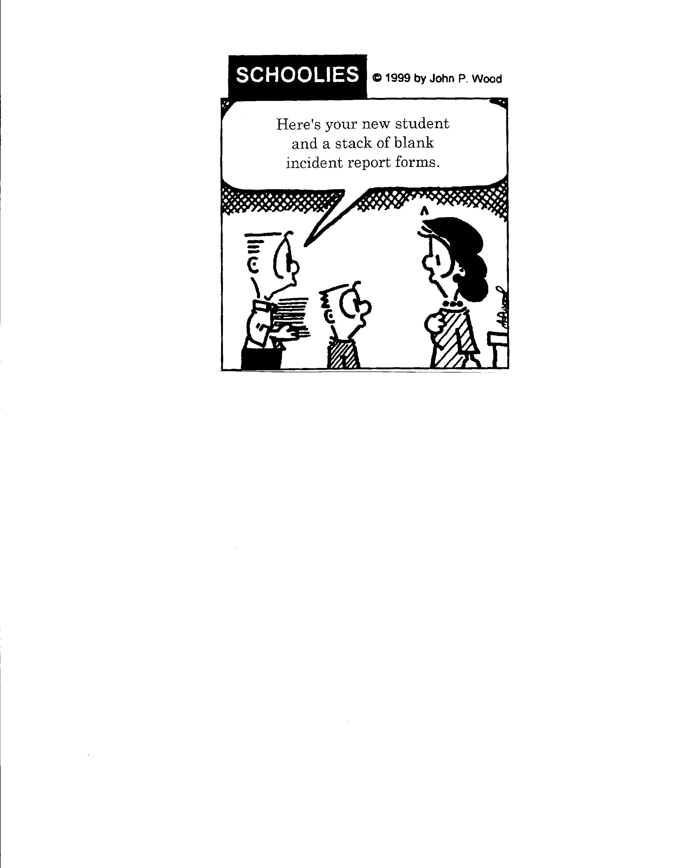

Slide 8

The best way to respond to problem behaviors is to prevent them in the first place!

Slide 9
Classroom Management Defined
Organizing the environmental aspects of the classroom to optimize learning
Notes:
Turn into handout
Hand out Brandi self rating
Classroom Management Practice
Rating
I have arranged my classroom to minimize crowding and distraction
Yes No
I have maximized structure and predictability in my classroom (e.g., explicit classroom routines, specific directions, etc.).
Yes No
I have posted, taught, reviewed, and reinforced 3-5 positively stated expectations (or rules).
Yes No
I provided more frequent acknowledgement for appropriate behaviors than inappropriate behaviors (See top of page).
Yes No
I provided each student with multiple opportunities to respond and participate during instruction.
Yes No
My instruction actively engaged students in observable ways (e.g., writing, verbalizing)
Yes No
I actively supervised my classroom (e.g., moving, scanning) during instruction.
Yes No
I ignored or provided quick, direct, explicit reprimands/redirections in response to inappropriate behavior.
Yes No
I have multiple strategies/systems in place to acknowledge appropriate behavior (e.g., class point systems, praise, etc.).
Yes No
In general, I have provided specific feedback in response to social and academic behavior errors and correct responses.
Yes No
Overall classroom management score:
10-8 “yes” = “Super”
7-5 “yes” = “So-So”
<5 “yes” = “Improvement Needed”
# Yes________

Slide 10
Why Focus on Classroom Management?
Improves classroom climate
Creates shared ownership of the classroom
Develops students’ self-discipline
Decreased disruptive problem behaviors
Decreased teacher redirection
Increased instructional time
Increased academic learning time
Increased academic success

Slide 11
When students can predict the events throughout their school day, they are more likely to be engaged and less likely to display problem behavior. One way to increase predictability in a classroom is to establish routines, particularly early in the school year
(Kern & Clemens, 2007, p. 67).

Slide 12
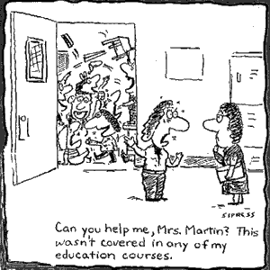
How do you know you are using good prevention practices?
Use Classroom Management Self-Assessment and Non-Classroom Management Self-Assessment Tools to strengthen your practices
See Handout
Notes:
Handout is a great tool for staff to assess their own classroom and non-classroom management strategies.

Slide 13
Evidence Based Practices: Classroom Management
Maximize structure in your classroom.
Establish and teach expectations.
Actively engage students in observable ways.
Establish a continuum of strategies to acknowledge expected behavior.
Establish a continuum of strategies to respond to unexpected behavior.
Use self reflection and behavior data to progress monitor and problem solve
Brandi Simonsen, PhD, UConn

Slide 14
Additional Practices for
Preventing Problem Behavior
  PEP Strategy: Proximity, Eye contact, Privacy
  Differentiate instruction
  Ratio of 5 positive to 1 constructive adult-student interaction
Notes:
Prompt folks to come up with own strategies

Slide 15

Engage your students!
https://www.youtube.com/watch?v=aaweXw03kQI
Notes:
Whole Brain Teaching
Stop video at 2:22 minutes

Slide 16
Non-Classroom Settings
(Mann & Muscott, 2005)
50% of all problem behavior in school
Common Areas
Playground/Recess
Bus
Hallway
Transitions

Slide 17
Non-Classroom Settings
(Mann & Muscott, 2005)
Particular times/places where supervision is emphasized
  Cafeteria, hallways, playgrounds, bathrooms
  Buses & bus loading zones, parking lots
  Study halls, library, “free time”
  Assemblies, sporting events, dances
Where instruction is not typically available
Where ratio of adults to students is typically lower than in classrooms (lightly staffed)
Where supervision is typically shared/staffed by non-certified staff

Slide 18
Activity
Brainstorm “hotspots” where problem behavior occurs in your school
Number off by 1-4 and go to your “hot spot”
As a group, brainstorm existing behavioral challenges and possible preventative solutions/strategies and record on the T Chart on wall
Notes:
Non-classroom Settings Only
20 minutes

Slide 19
Active Supervision by Adults:
(Mann & Muscott, 2005)
Critical, yet under-utilized, skill by adults in non-classroom settings
Sub-skills:
  Scan: Visually examine the entire environment frequently noticing both expected and problem behavior
  Move: Physically move around the entire area in an unpredictable pattern while visiting the problem areas frequently
  Interact: Elicit conversations with most of the students while providing pre-corrections and reminders as well as positive acknowledgements
Notes:
Refer to TIPS!
Refer to Brandi

Slide 20
Defining and Sorting
Problem Behaviors
TFI
Minors
Majors
Behaviors that:
do not require administrator involvement;
handled in the environment in which it occurs*;
do not significantly violate rights of others;
do not put others at risk or harm;
are not chronic.
Behaviors that:
are chronic minors;
may require administrator involvement;
significantly violate rights of others;
put others at risk of harm.
Notes:
This is a conversation you want to have with your entire staff so everyone is on the same page with minors vs. majors.
Foundation of PBIS is keeping students in class available for instruction
*what about buddy classroom or time out

Slide 21
Middle School Example
Major Behaviors:
  Chronic absence/tardy
  Insubordination
  Chronic Minors
  Repeated backtalk (3)
  Directed profanity
  Cutting class/school/detention
  Fighting
  Vandalism
  Verbal/physical intimidation
  Gang representation
  Theft
  Weapons, threats
  Drug violations
  Harassment (incl. sexual)
  Controlled substances
Minor Behaviors:
  Excessive talking
  Attendance/tardy
  Off task (disruptive)
  Gum/Food/Candy/Drinks
  Missing homework
  Not prepared for class
  Name calling
  Dishonesty
  Running in hall
  Passing notes
  Backtalk directed at adults
  Cheating/Plagiarism

Slide 22


Defining “Close Confusers”*
Practice defining major vs. minor behaviors that are “close confusers” to your staff.
VS.
Notes:
Many schools struggle with words such as “dam” or “suck”, hats?

Slide 23
Majors vs. Minors
The first grade class writes in a journal. The topic focuses on a particular letter each day. During the letter “F” day, Sarah writes an inappropriate word she has learned from some older students on the playground. She shows her journal to all of the students around her.
Notes:
Verbal minor – think about intention as well.

Slide 24

Majors vs. Minors
The bus driver hears James call another student a “@#&*%! loud mouth.”
Notes:
Verbal major

Slide 25
Activity:
Developing a Shared Understanding of
Minors and Majors
TFI
Brainstorm a list of 5 problem behaviors and think of different ways to characterize the behaviors (e.g. hat wearing)
Review the SWIS Referral Form Definitions found at: http://www.pbisvermont.org/resources/schools/universal-examples under Component 5 and come to agreement about your list of minor and major behavior problems
Record your agreed upon minors and majors on your T chart found in your Staff Handbook
Identify “close confusers” and plan to operationally define with school staff
Notes:
Insert ODR Form

Slide 26

Behavior Management Defined
The skills and strategies known to prevent and respond to challenging behavior

Slide 27
Practices to Prevent Minor
Problem Behaviors from Escalating
De-Escalation:
When student shows anxiety…Be supportive!
  What does anxiety look like?
  What can adults do to be supportive?
When student is defensive…Be directive!
  What does defensive behavior look like?
  What can adults do to be directive?
Notes:
Similar concepts to those of you who’ve taken CPI.

Slide 28
Practices for Responding to
Minor Problem Behaviors
Signal that expectation has not been met
State the expected behavior
Ask student to show expected behavior
Give positive feedback

Slide 29
More Practices for Responding to
Minor Problem Behaviors
Use scripts to help set limits:
What are you doing? Objectively describes the rule-breaking behavior
What are you supposed to be doing? Clarifies that the student knows what behavior or task is expected.
What are you going to do? The student makes a choice communicated by either words or actions.
You could also say:
“What can I do to help you make a good choice?”
Notes:
Kym bad kid
Richard professor he who professes

Slide 30
Activity
Practices to Prevent and Respond to
Minor Problem Behaviors
TFI
Discuss classroom and school-wide practices that currently exist to prevent and respond to minor problem behaviors
What additional effective practices are needed?
How will you work with your staff to develop these classroom and school-wide practices?
Notes:
10 minutes

Slide 31
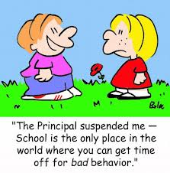
Continuum of Procedures for Responding to Problem Behaviors
TFI

Slide 32
Continuum of Procedures for Responding to Problem Behaviors
TFI
Utilize effective classroom prevention and response practices
If minor problem behavior, document
If major problem behavior, initiate referral out of classroom (to planning room/office)
How might this look different in a non-classroom setting?

Slide 33
Discipline Policies
TFI
Schools policies and procedures should describe and emphasize approaches to student behavior that are:
  Proactive
  Instructive
  Restorative
  Implemented consistently

Slide 34
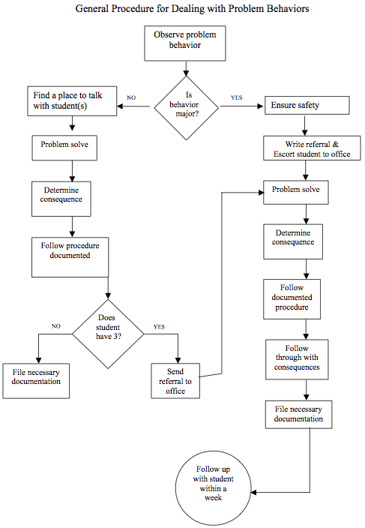
TFI

Slide 35
EXAMPLE 1:
TFI

Slide 36
EXAMPLE 2:
NO
IS THE
INCIDENT
MAJOR?
YES
TFI
Verbal
Warning.
Restate
Expectation/rule
Behavior
ceases.
No further
action
Write Referral
(Attach minor
incident forms if applicable.)
Send the student with the referral
to Room 1.
2nd Offense
(Same behavior)
Complete
Tracking form
Intervention
Behavior
ceases.
No further
action
Administration
determines
course of action
or consequences
3rd Offense
(Same behavior)
Complete
Tracking form
Intervention
Contact Parent
Behavior
ceases.
No further
action
a) Copy of
referral and/or
letter sent to the parent
b) School
retains copies
c) Copy of
referral to (how given to teacher?)
teacher for files
(when?…time frame?)
4th Offense
(Same behavior)
Follow
Referral
Procedure

Slide 37
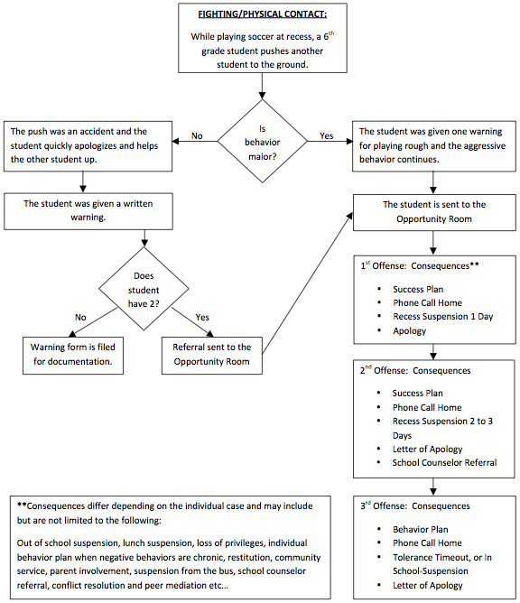
EXAMPLE 3:
TFI

Slide 38
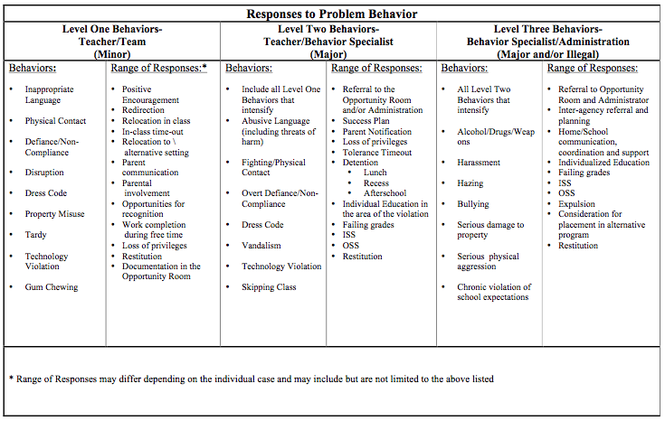
EXAMPLE 4:
TFI

Slide 39

Continuum of Procedures for Responding to a Crisis
https://www.youtube.com/watch?v=NUY2RHhO3rA&feature=youtu.be
“The Vermont School Crisis Planning Team recommends that a simple Crisis Command Placard be prominently placed in all teaching spaces that direct teachers, staff, and students about how to respond to each of the simplified emergency command...”
NEW – 2016!
Notes:
In addition to having consistency around responding to problem behavior, it’s equally important to be consistent on how to respond to a crisis situation. This is also a question on the SET.

Slide 40
Example Placard
Classroom Crisis Commands:
Clear the Halls –
  Go to closest room supervised by an adult. Close door (lock if possible). Students and staff remain away from doors and windows. Turn off lights and shut curtains/blinds on doors and windows (if available). Use classroom intercom or phone only for emergencies.
Secure the School –
  Same as “Clear the Halls.” Go to closest room supervised by an adult. Close door (lock if possible). Students and staff remain away from doors and windows. Turn off lights and shut curtains/blinds on doors and windows (if available). Designated staff secure outside doors. Students outdoors move away from building. Use classroom intercom or phone only for emergencies.
Evacuate the Building –
  (Insert classroom exit directions here.) In an orderly fashion, exit the building with class roster. Teacher takes attendance with assigned students. Move to the __________________ Relocation Site when directed.
Notes:
We recommend that all rooms have something similar posted near the door with the appropriate crisis commands listed.

Slide 41

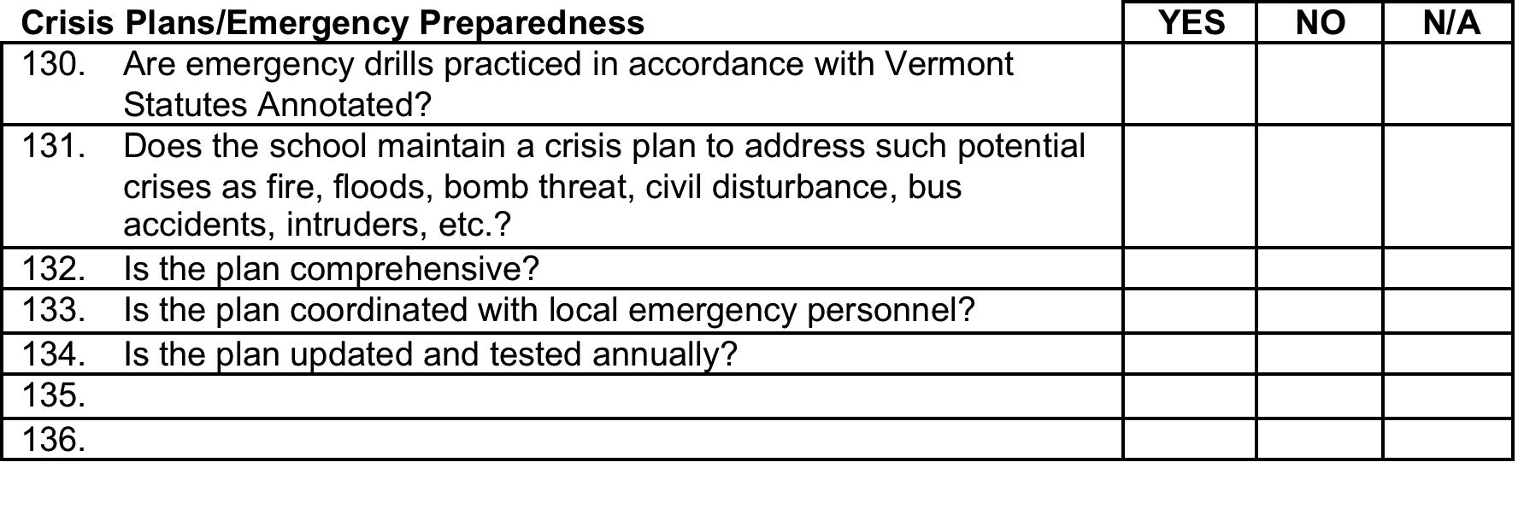
School Safety
Review Checklist
http://education.vermont.gov/new/html/pgm_safeschools/pubs.html#safety_checklist
Notes:
For further information visit the DOE website.

Slide 42
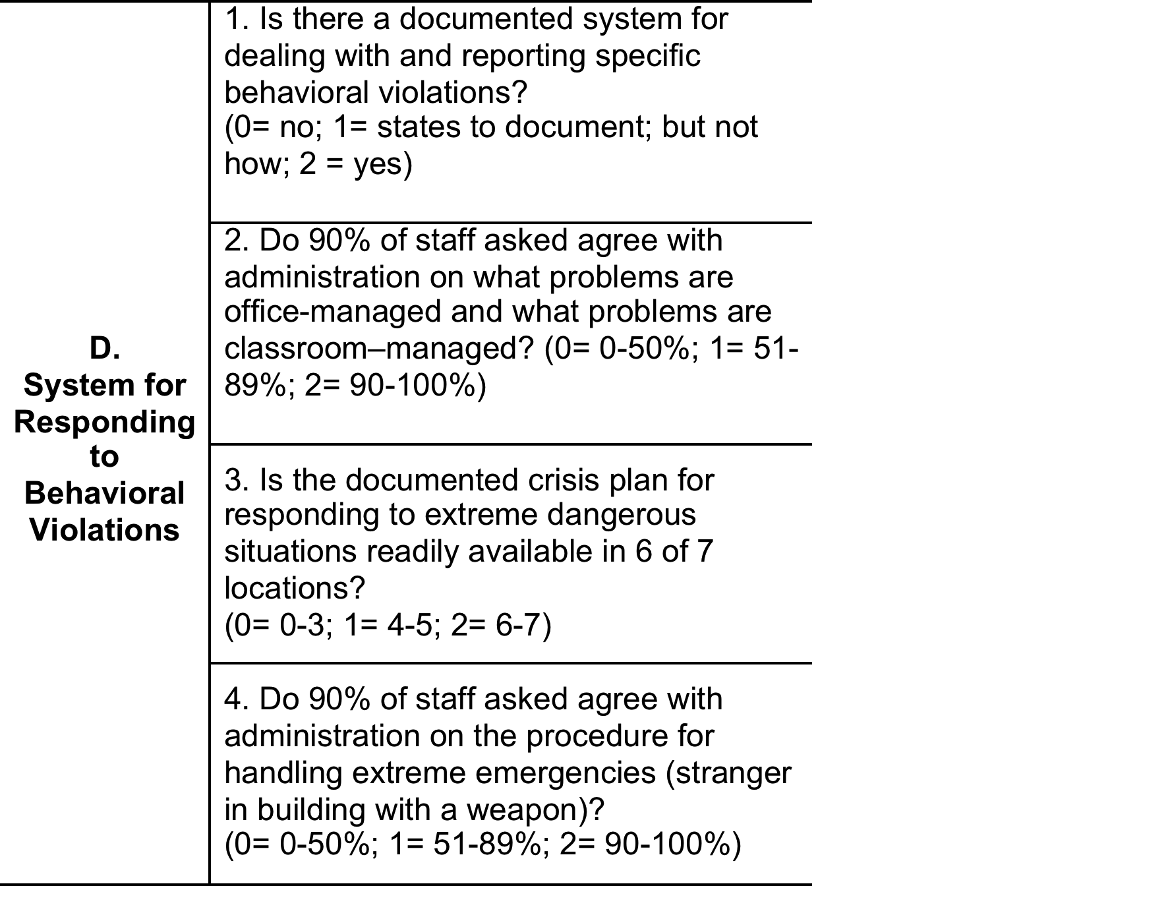
SET Components
Section A: | Expectations Defined
Section B: | Behavioral Expectations Taught
Section C: | On-Going System for Rewarding Behavioral Expectations
Section D | System for Responding to Behavioral Violations
Section E: | Monitoring and Evaluation
Section F: | Leadership

Slide 43
Activity:
Procedures for Discouraging Problem Behaviors
In your team, review the Example Procedural Flow Chart in your Workbook
Create your own procedural flow chart
In your team, discuss your Crisis Plan
Determine next steps, if needed
TFI

Slide 44
Questions?
Status Update?

Slide 45
First Steps to Implementation Module Series:
Leadership Team Structure, Norms & Roles, Routines
Component 1: Statement of Purpose
Component 2: Clearly Defined Expected Behavior
Component 3: Procedures for Teaching Expected Behavior
Component 4: Procedures for Encouraging Expected Behavior
Component 5: Procedures for Discouraging Problem Behavior
Component 6: Procedures for Record Keeping & Decision Making

Slide 46

Recording Problem Behaviors
TFI
Why keep a record?
  to see if there are patterns
  to determine if student’s problem behaviors are habitual
  to document pre-referral interventions
  to determine whether a particular teacher needs support
  to communicate with parents and answer questions
  to inform behavior support planning
  to inform interagency collaboration
  to comply with legal requirements

Slide 47

Recording Problem Behaviors
TFI
It is not:
  For “writing up” a student as a form of punishment
It is:
  A way to collect data for decision making

Slide 48
Information to Record
TFI
Name
Grade
Respondent
Date
Time
Location
Type of behavior
Others involved
Possible motivation/function
Which school-wide behavioral expectation was not met
Notes:
-

Slide 49
Understand Function of Behavior
What does “function of behavior” mean?
  The why of a student’s behavior
Why should you think about it?
  To minimize inadvertent reward of the problem behavior
  Respond in a way that will reduce behavior
  Helps you better understand students’ behavior

Slide 50
Think “Functionally”:
Understand the Why of Behavior
Notes:
In all you do….Think Functionally!
Why is this important to know?

Slide 51
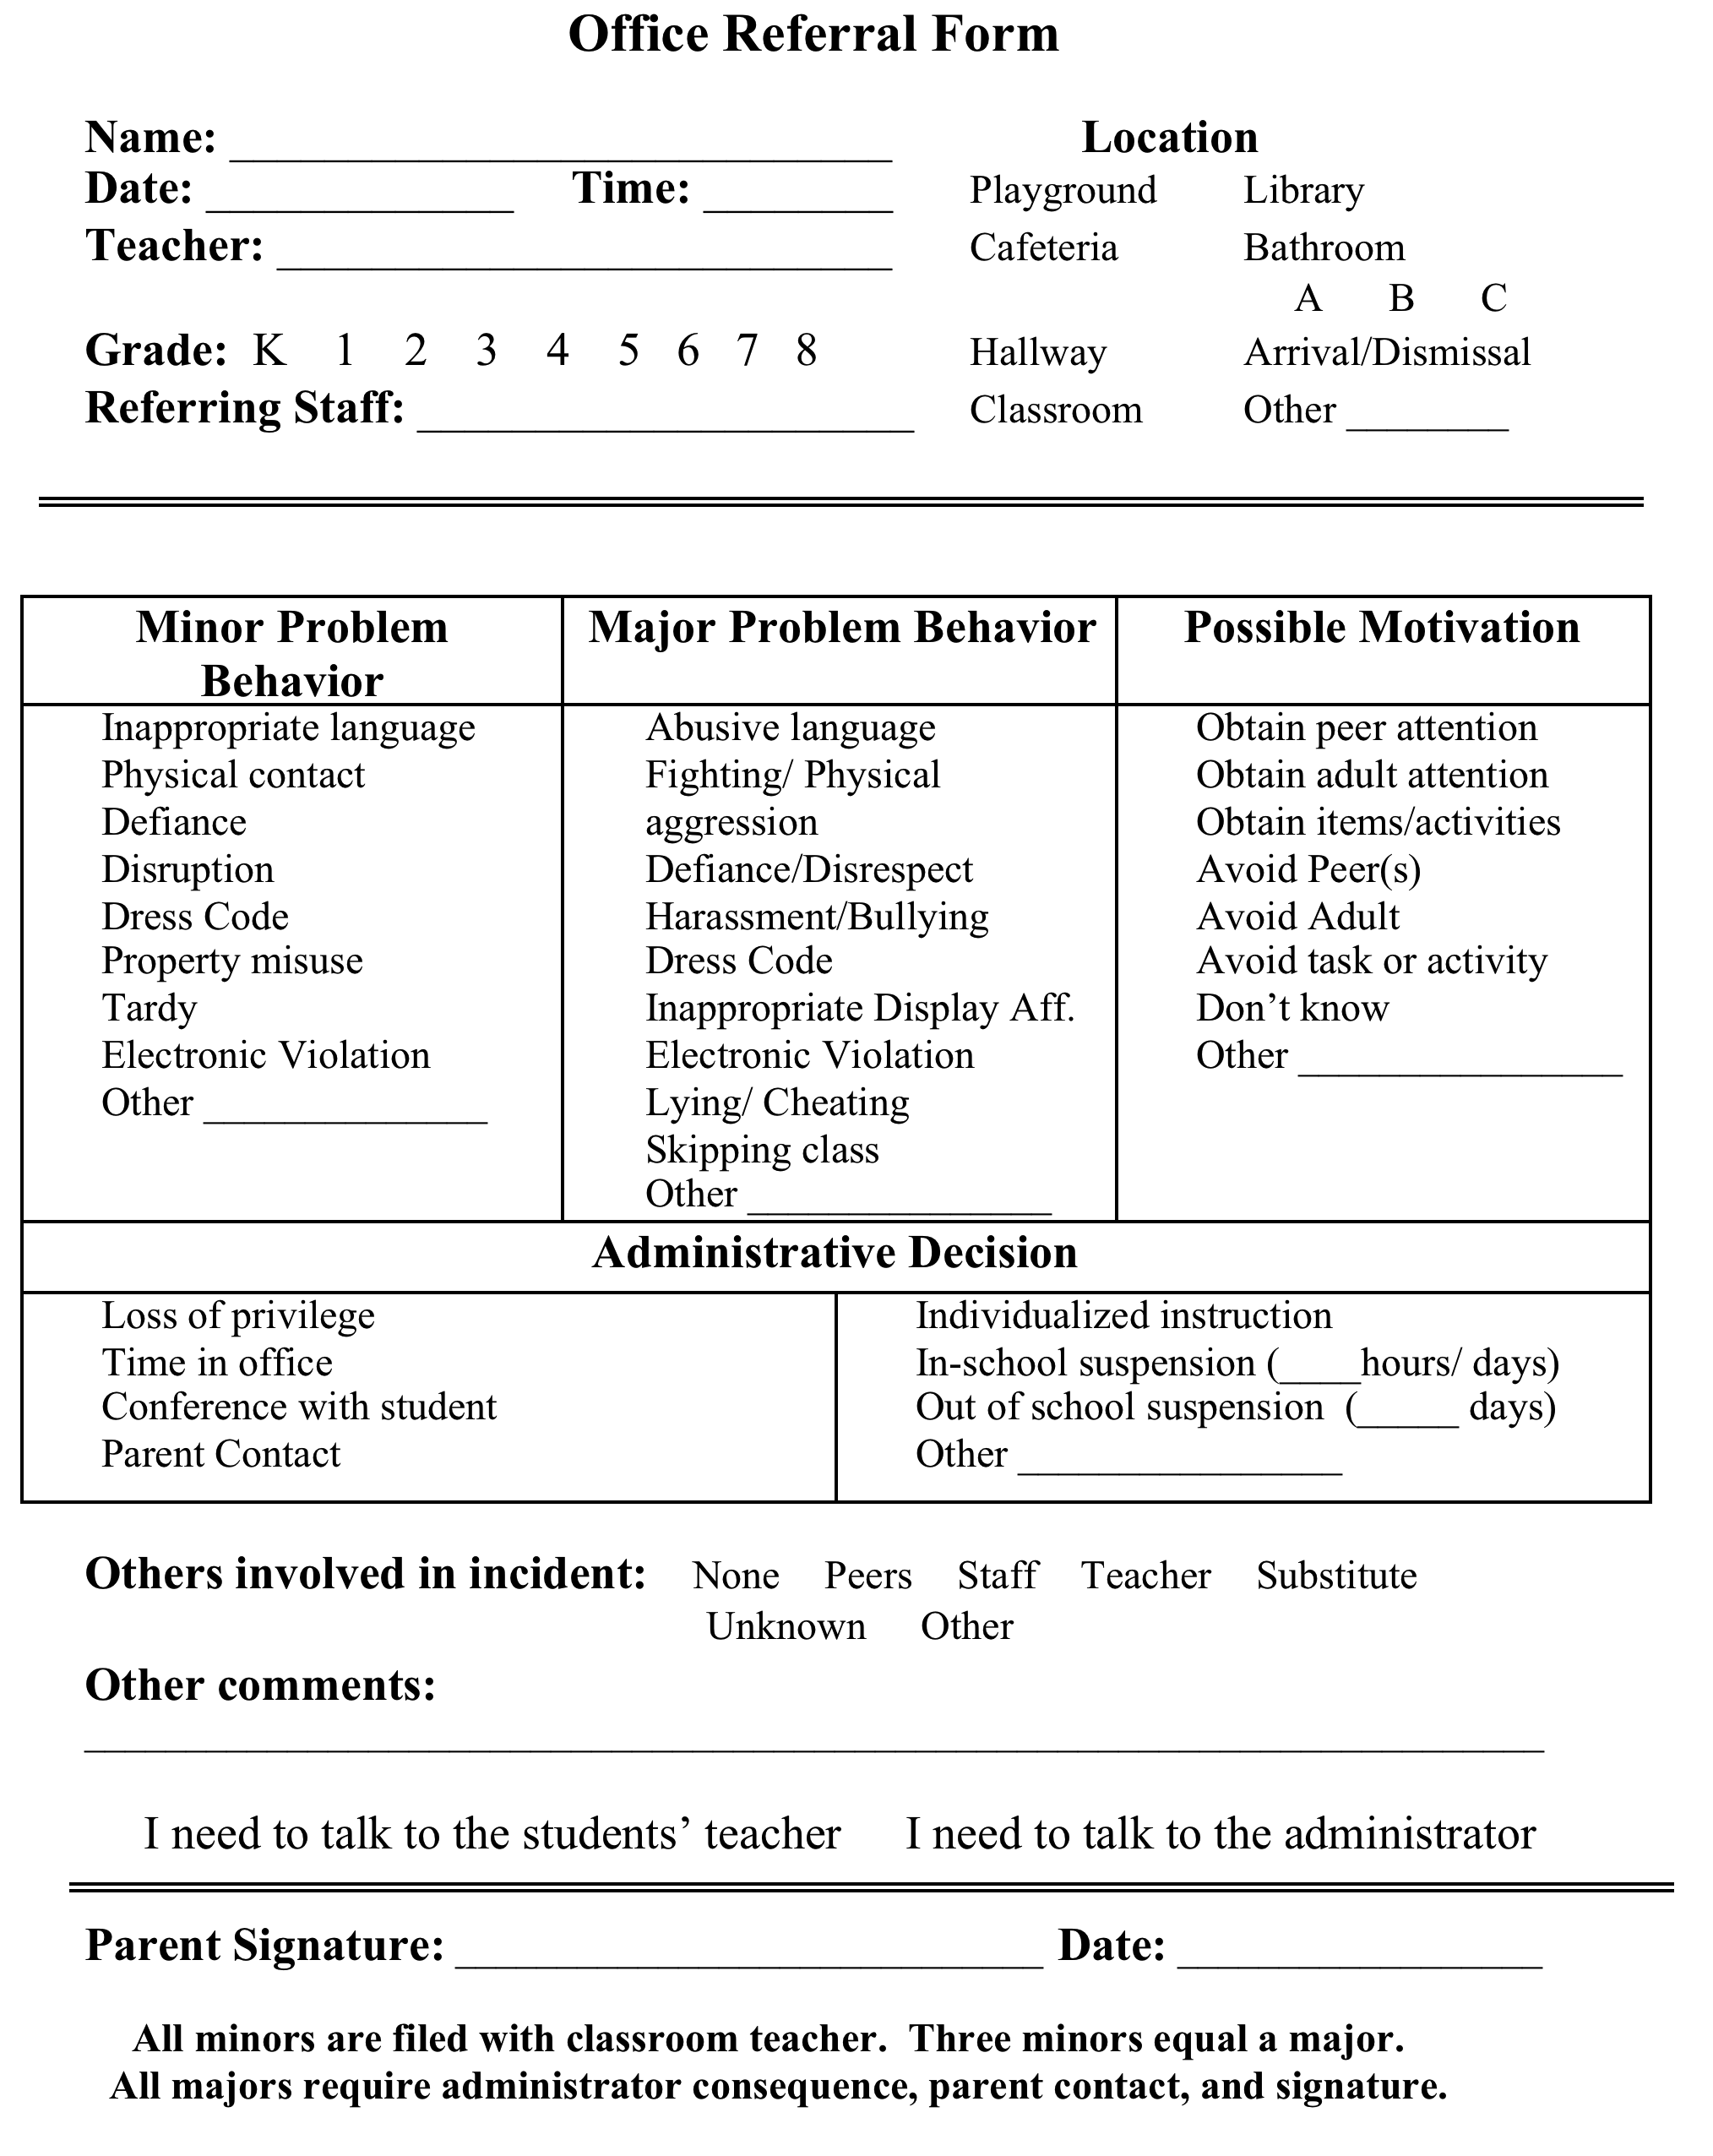
EXAMPLE 1:
TFI

Slide 52
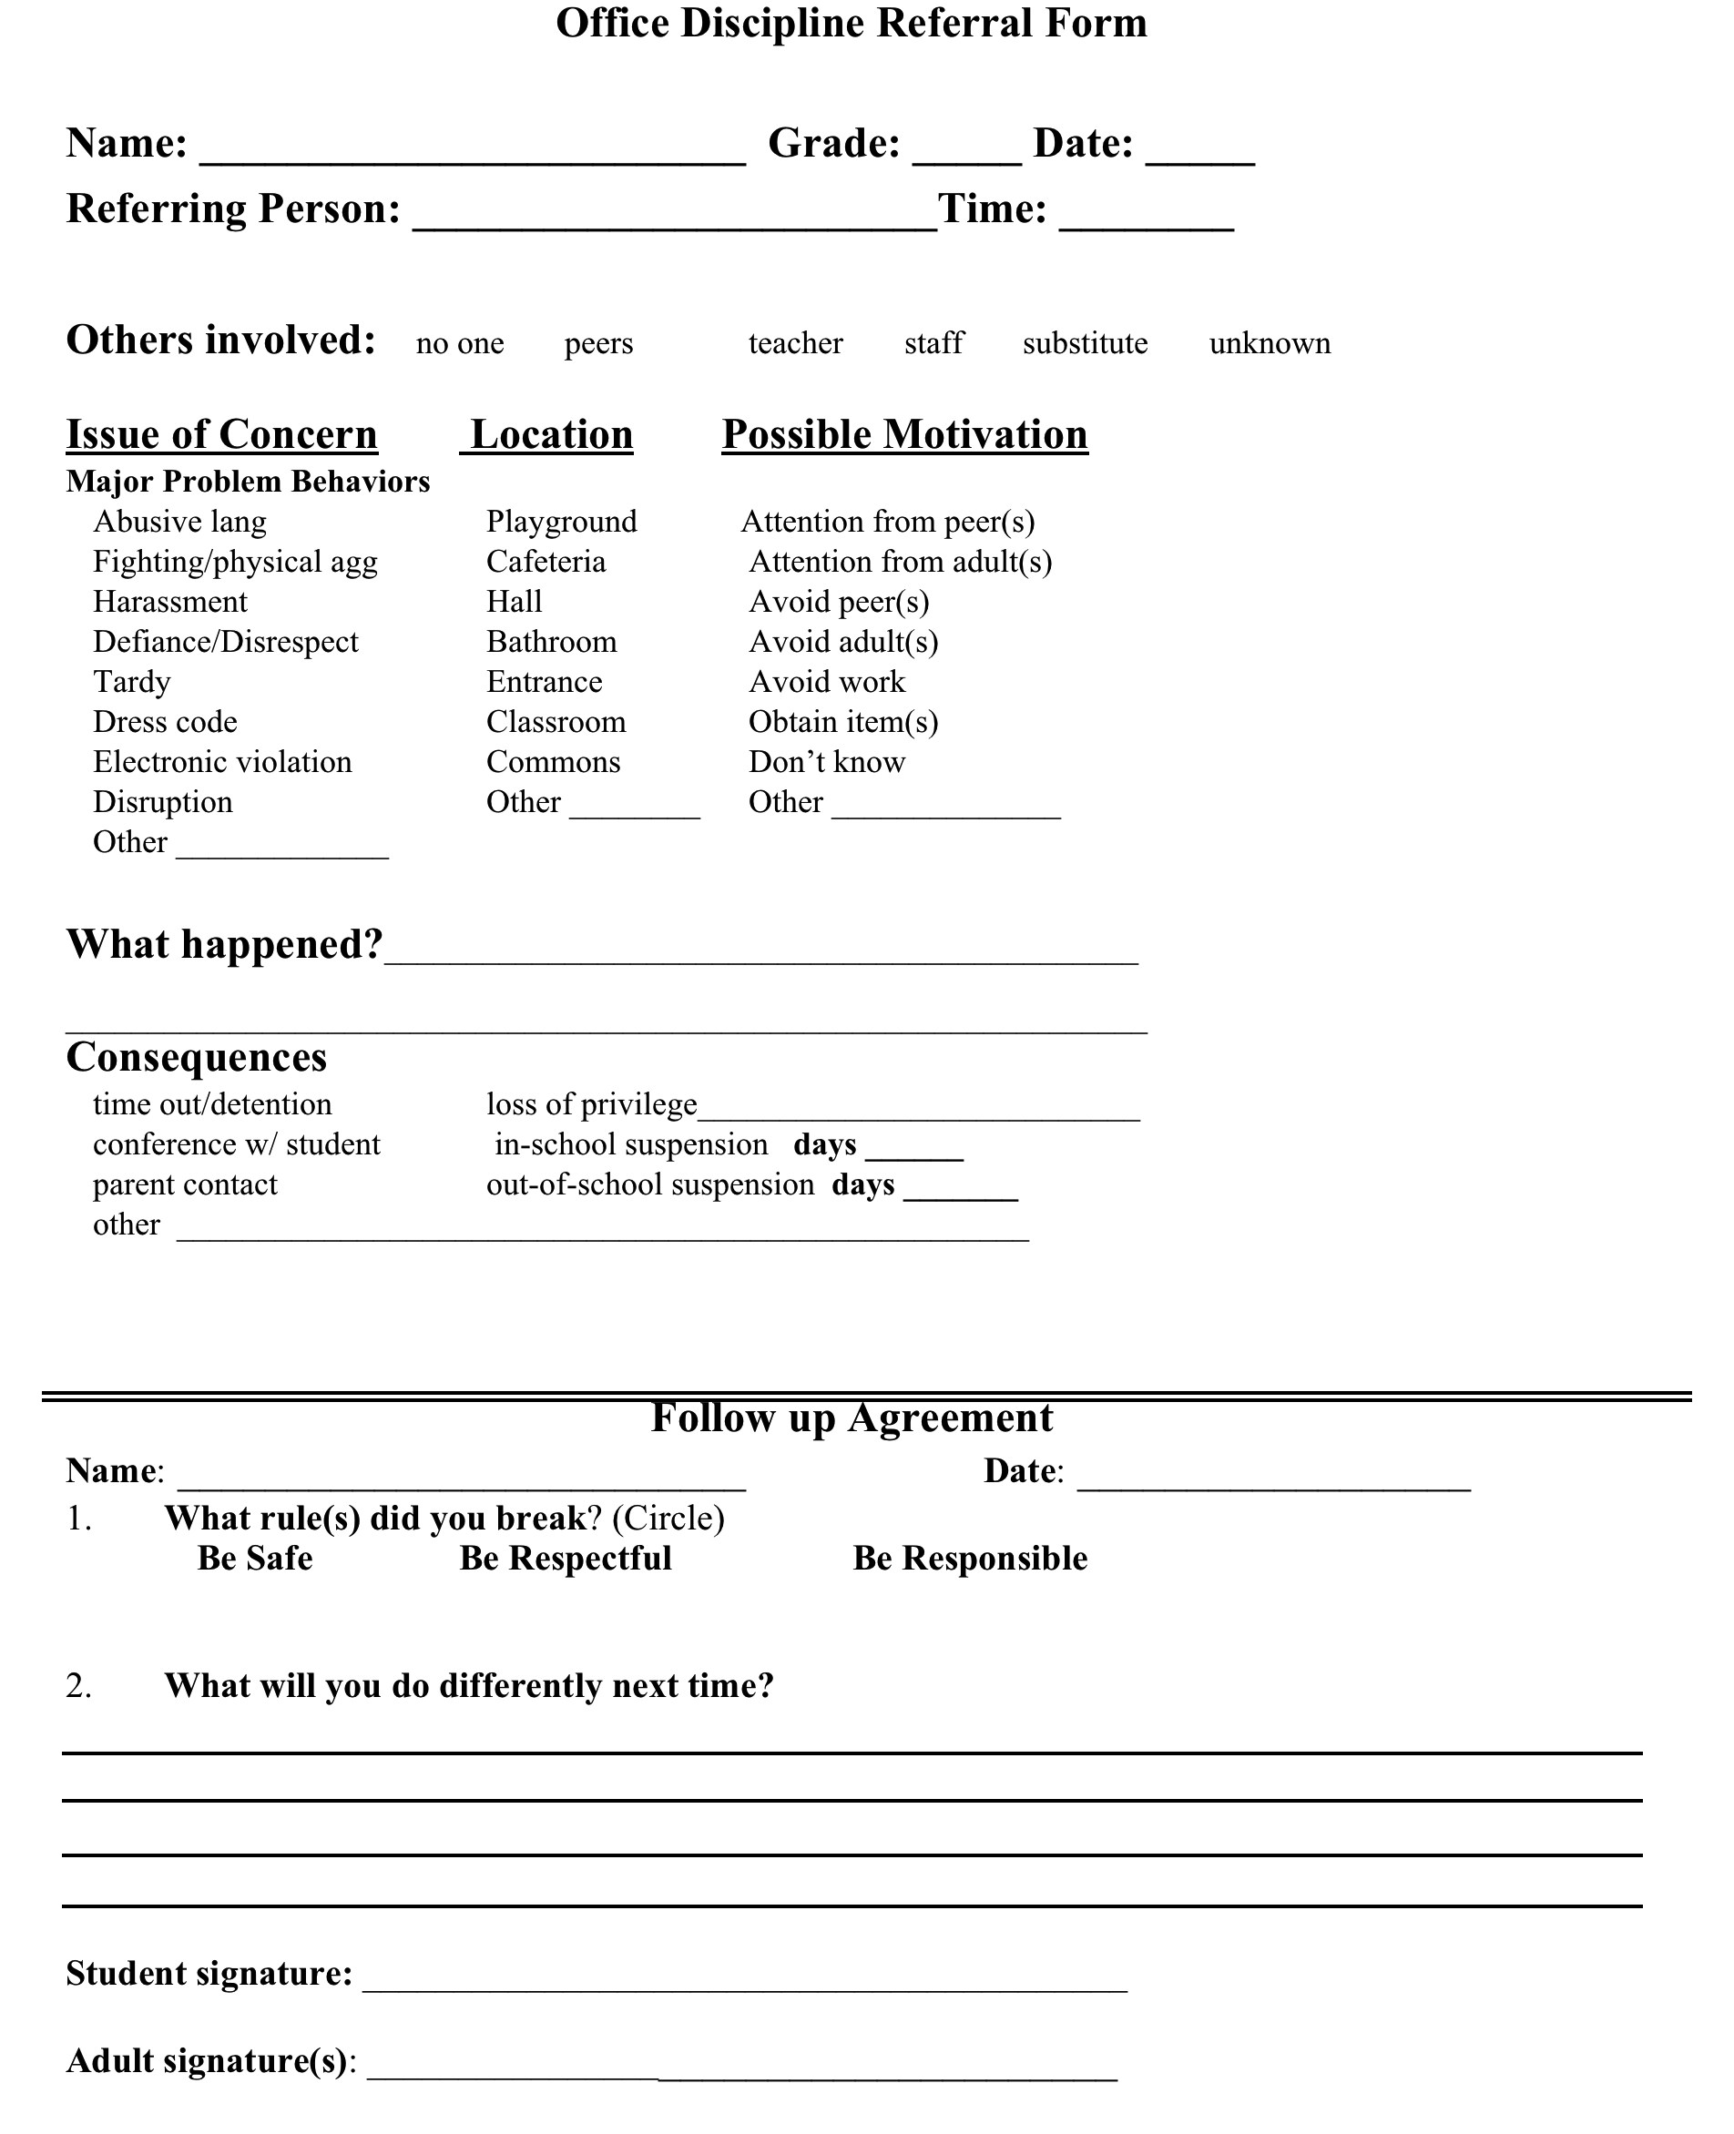
EXAMPLE 2:
TFI
Notes:
Handout CIRS Compatible ODR as another example

Slide 53
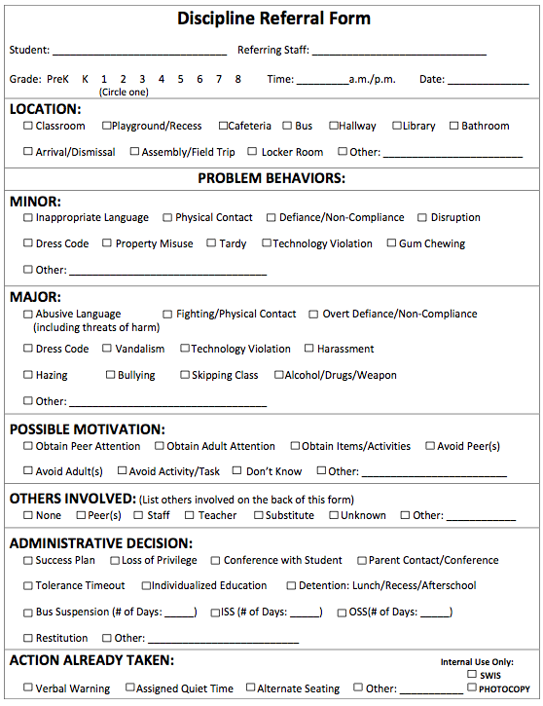
EXAMPLE 3:
TFI
Notes:
Handout CIRS Compatible ODR as another example

Slide 54
SWIS Demo
School-Wide Information System
www.pbisapps.org

Slide 55
Data System
TFI
Whatever data system you choose to use, it should provide you with:
  Instantaneous access to graphed reports summarizing discipline data organized by frequency of problem behavior events by:
    Behavior
    Location
    Time of day
    Individual student

Slide 56
Importance of Data
TFI
Showing staff behavioral data is the number one predictor of whether PBIS will sustain in a school
Staff should be shown the SW data regularly and provide input on universal foundations (e.g. expectations, acknowledgements, definitions, consequences) at least every 12 months

Slide 57
Use of Data
TFI
Teams should review and use discipline and academic outcome data at least monthly for decision making
Your team will also use fidelity assessments (TFI and SAS) annually to action plan

Slide 58
Activity:
Office Discipline Referral (ODR)
TFI
Create your school’s Office Discipline Referral:
Compare your current ODR form with sample ODR forms found in your Staff Handbook
Revise, as needed, or draft a new ODR form
Complete the SWIS compatibility checklist to ensure
inclusion of necessary information found in your Handbook
Complete the SWIS Readiness Checklist found in your Handbook. Verify readiness with State TA and register for SWIS Training
Notes:
HAND OUT SWIS REGISTRATION FLIER!

Slide 59
Questions?
Status Update?

Slide 60
Parallel Processes
Across all Tiers & Problem Behaviors
Action steps to improve problem behavior across school-wide settings, at-risk groups, and individual students follow the same parallel process:
  Prevention by changing setting events
  Teaching replacement skills
  Rewarding replacement skills
  Extinction of problem behavior by reducing reinforcement
  Corrective Consequences(s) for problem behavior
  Data Collection to see if it’s working!

Slide 61
Prevention: Remove/alter “trigger” for problem behavior
Teaching: Define, instruct & model expected behavior
Reward: Expected/alternative behavior when it occurs; prompt as necessary
Extinction: Increase acknowledgement of presence of desired behavior
Corrective Consequence: Use non-rewarding/non-reinforcing responses when problem behavior occurs
Data Collection: Indicate how you know when you have a solution

Slide 62
Example
Prevention: Remove/alter “trigger” for problem behavior | Maintain current lunch schedule, but shift classes to balance numbers.
Teaching: Define, instruct & model expected behavior | Teach behavioral expectations in cafeteria
Reward: Expected/alternative behavior when it occurs; prompt as necessary | Establish “Friday Five”: Extra 5 min of lunch on Friday for five good days.
Extinction: Increase acknowledgement of presence of desired behavior | Encourage all students to work for “Friday Five”… make problem behavior less rewarding than desired behavior
Corrective Consequence: Use non-rewarding/non-reinforcing responses when problem behavior occurs | Active supervision and continued early consequence (ODR)
Data Collection: Indicate how you know when you have a solution | Maintain ODR record and supervisor weekly report

Slide 63
What, Who, When, Where, and Why?
Team-Initiated Problem Solving (TIPS II) Model
Identify Problem
with
Precision
How do we want the problem to change?
What next?
Make Summative
Evaluation
Decision
Identify
Goal for Change
Collect and Use Data
Has the problem been solved?
Monitor Impact
of Solution and
Compare against Goal
Identify
Solution and
Create
Implementation
Plan with
Contextual Fit
Implement
Solution with
High Integrity
What are we going to do to bring about desired change?
Did we implement with fidelity?
Meeting
Foundations
Notes:
The outer circle ( Problem Solving Meeting Foundations) refer to the process and procedures and team uses to function. Roles are determined and defined, meetings are scheduled for the year, electronic equipment and internet access are available, and an agenda is established.
The inner circles and arrows define a problem-solving model designed to improve the decision-making and problem solving of PBIS Team. This model is called “TIPS,” which stands for “Team-Initiated Problem Solving.” The model uses data for during problem solving and decision making, during meetings. We will also apply a metric for determining if rates of problem behavior at a school or below, at, or above the national average to determine if there is a problem or not. TIPS teaches teams to use their SWIS data to define precision problem statements. Once the problem statement is precise, a variety of solutions are discussed based on prevention, teaching, reward, correction and extinction and teams will determine which solution(s) they want to implement. The TIPS model then moves the team to action planning ,evaluation and measurement determination.

Slide 64
Want to learn more?
Two Opportunities:
Recorded Webinar at: https://vimeo.com/user18175786/videos
Anne Todd and Rob Horner’s TIPS Resources: http://tips2info.blogspot.com/
VTPBiS Coaches

Slide 65
Plan for Roll-Out

Slide 66
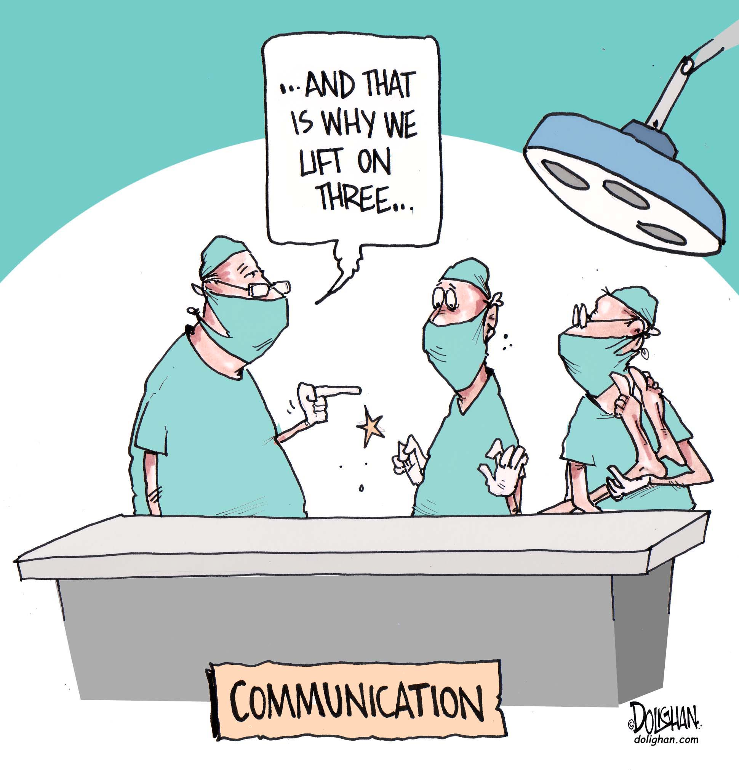
Communication is key!

Slide 67
VTPBiS Roll-Out for Staff
TFI
What is it?
When?
Agenda?
Materials?
Responsible team members?
Notes:
During pre-service if you are planning to roll-out in the fall.
There should be a written process for orienting all faculty/staff on 4 core tier 1 practices: teaching SW expectations, acknowledging appropriate behavior, correcting errors, requesting assistance

Slide 68

VTPBiS Roll-Out for Students
What is it?
When should it take place?
How to prepare for it?
What to cover?
Related activities?
How often to revisit?
Responsible team members?
Notes:
Use technology to spice this up.
Example: One school used Miley Cyrus singing “RESPECT” on Youtube and had this playing in the gym as students entered.

Slide 69

Staff Roll Out Video Example

Slide 70
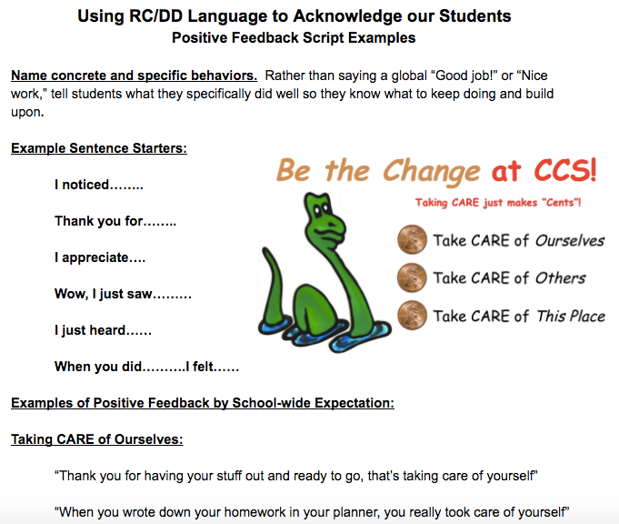
Staff Roll Out Scripts Example

Slide 71
VTPBiS Roll-Out for Families
TFI
Objectives:
Communicate the goals of VTPBiS
Explain how you will use VTPBiS to create social culture
Enlist parents to be partners
Notes:
Examples:
Open House events
Football game that many parents will attend
In the Newsletter

Slide 72


Ways to Communicate VTPBiS to Families
Letter and packet
General presentation at back-to-school event
Review by classroom teachers
Tri-fold brochure
Information on web-site
PTA presentation
Newsletter
Homework assignment for students to teach parents expectations
TFI

Slide 73
Plan for Stakeholder Involvement
TFI
Stakeholders (students, families, and community members) should provide input on universal foundations (e.g. expectations, consequences, acknowledgements) at least every 12 months
How might you accomplish this?

Slide 74
Activity:
Planning Staff Roll-Out
TFI
As a team, design your VTPBiS roll-out for all staff at your school (specials, lunch room, instructional assistants, bus drivers, etc.)
Use Staff Roll-Out Worksheet in your Handbook
Notes:
Roll-out should take place at the beginning of each school and offer various refreshers throughout the year.

Slide 75
Activity:
Planning for Student Roll-Out
TFI
As a team, plan out when, where, and how you will roll-out your VTPBiS program for the students
Include date(s) & format for revisiting the plan with all students
Use Student Roll-Out Worksheet in your Handbook

Slide 76
Activity:
Planning VTPBiS Roll-Out for Families
TFI
As a team, plan out when, where and how you will roll-out your VTPBiS program for parents
Use Roll-Out Worksheet in your Handbook.

Slide 77

Activity:
Completion of VTPBiS Implementation Plan and Finalize Staff Handbook
As a team, list all tasks and projects that still need to be finished
E-mail a copy of your Staff Handbook (it does not need to be complete) before you leave to Anne at Anne.Dubie@uvm.edu

Slide 78
Questions?
Status Update?

Slide 79
Activity:
VTPBiS Presentations
(to be completed sometime between now and the final day of training)
Create a product (i.e. poster, skit, song, trifold, PowerPoint, etc.) communicating any part of your VTPBIS Staff Handbook to be used during your school-wide roll-out (1-2 minutes)
Be prepared to share your work at the end of the Universal training
Notes:
Intended to be a useful tool to bring back to your school, to roll-out, etc…

Slide 80
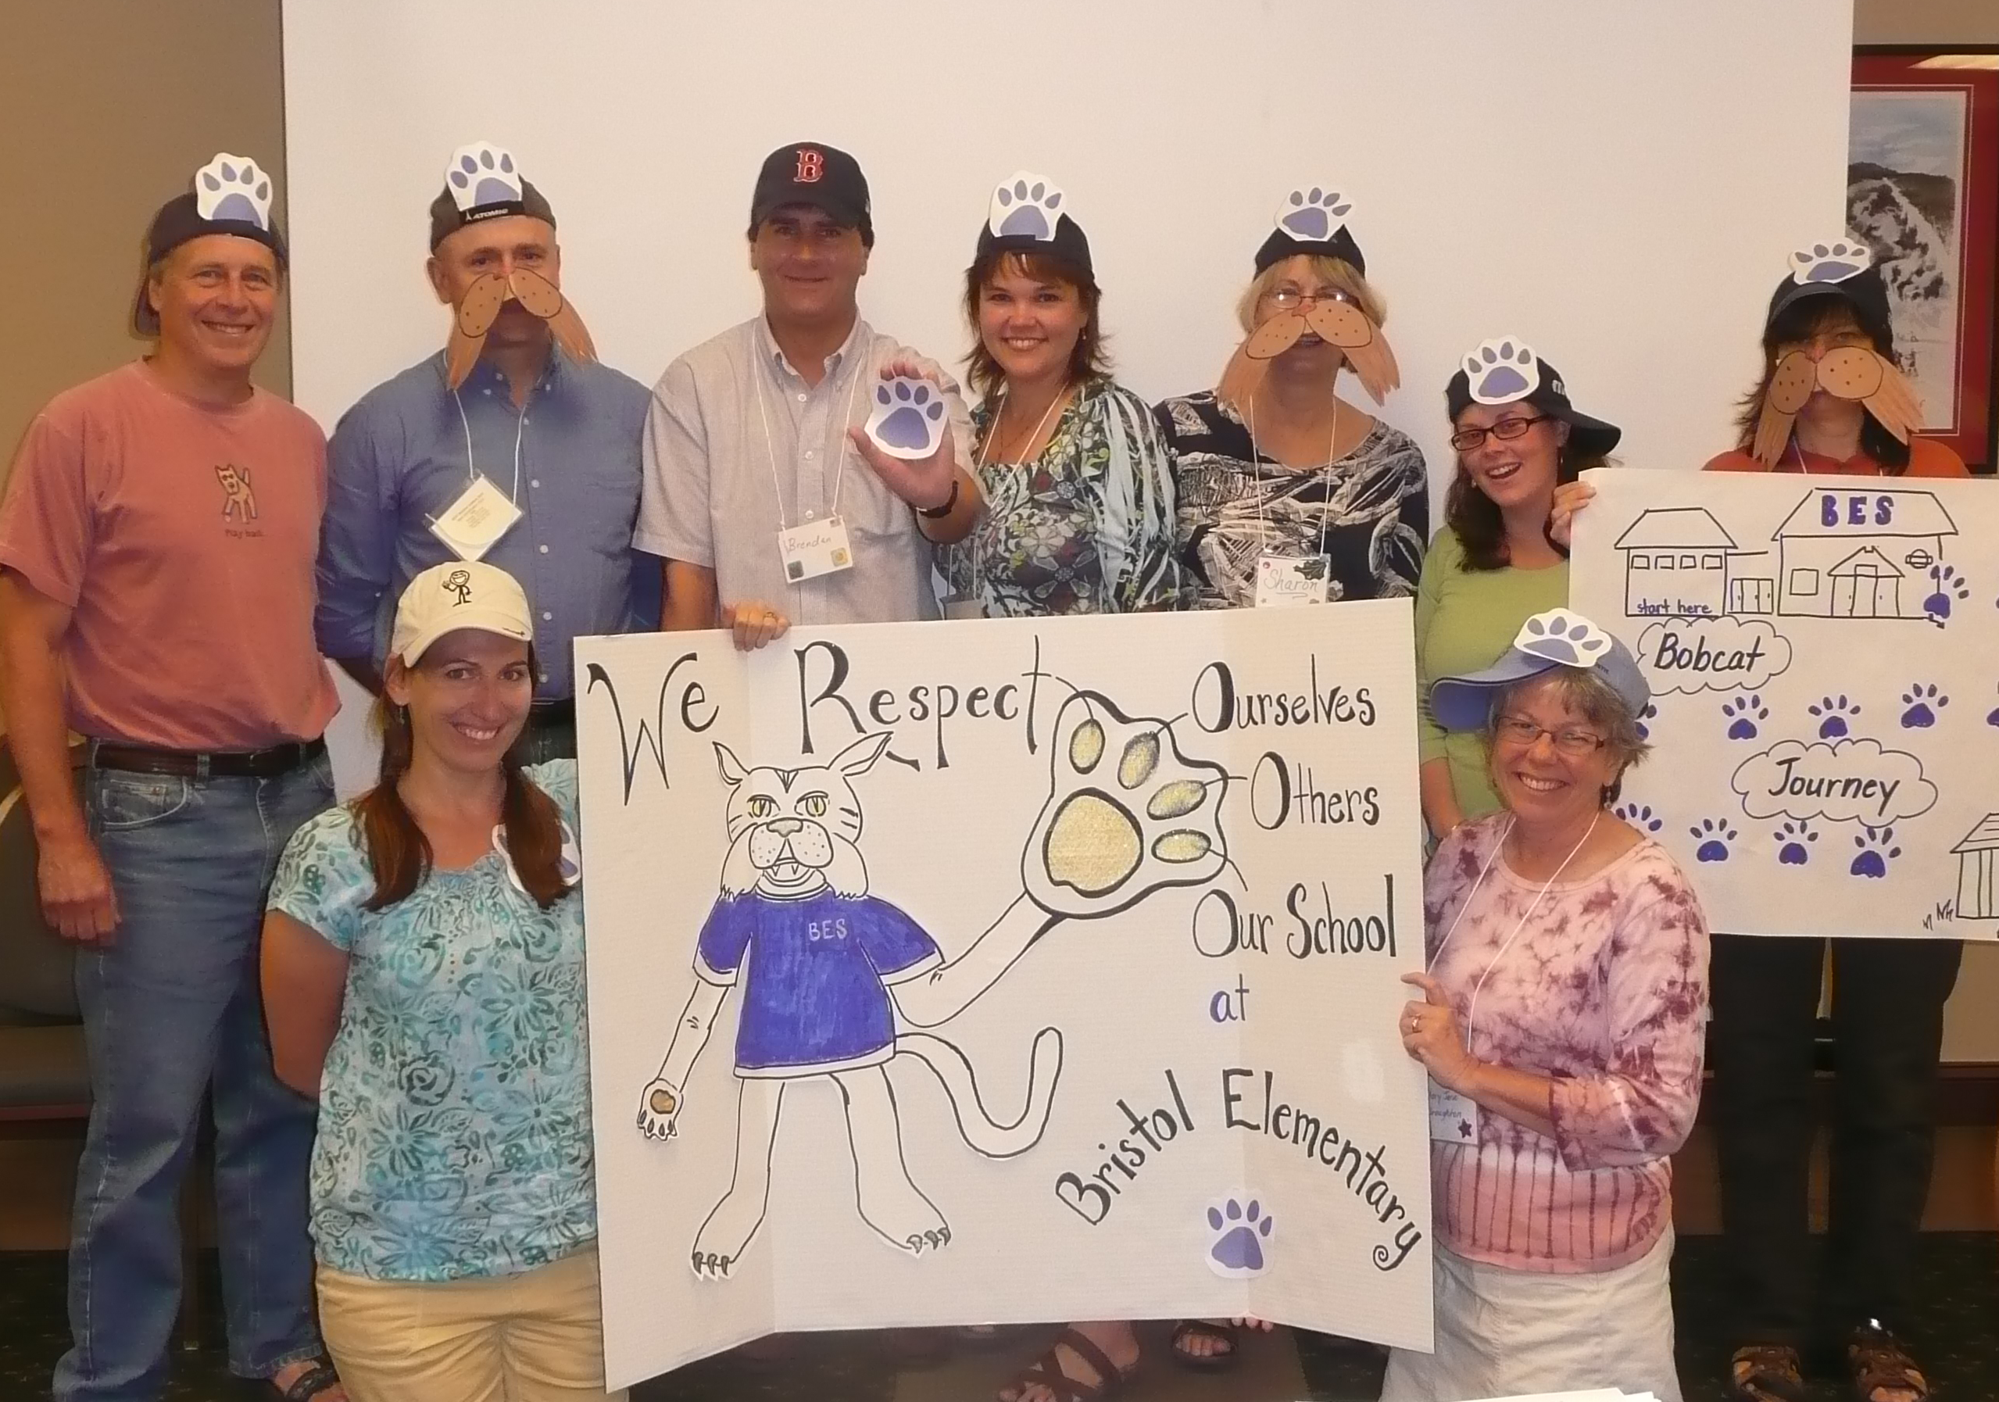
Peer Sharing Activity

Slide 81
Where do we go from here… thoughts and/or questions…
Notes:
SWIS Trainings
Post Implementation SET
Support Available
Grad Course

Slide 82
Vermont PBIS Cascade of Support
SUPPORT LOOPS
School Level:
School
Coordinators
SU/SD Level:
SU/SD Coordinators
State Level:
TAs
Trainers
Coaches
Leadership Teams at ALL Levels of Support
FEEDBACK LOOPS
Notes:
We’ve learned the importance of identifying a contact at each level of the cascade.
We’ve learned that the beauty of a healthy cascade is that it will continue to sustain if one piece is missing….

Slide 83

Getting ready for next year….
Recommended Steps:
  Set aside a time to finish/revise your Staff Handbook and Action Plan - schedule this time now
  Obtain your SWIS License (optional)
    http://www.pbisvermont.org/resources/evaluation-tools/swis
  Consider securing resources for coaching support
  Plan your professional development for next year
    Keep an eye out for the VTPBiS Professional Learning Calendar in June

Slide 84
More information about Coaching Support
What?
  Support for schools/SUs/SDs in fidelity of PBIS evidence-based practices and development of local implementation capacity
  Goal is to create school/SU/SD capacity for internal coaching
Why?
  Someone with expertise who can bring experience, expertise, and an external perspective
How?
  Contract with State Approved VTPBiS Coaches directly!
  SU/SD apply for BEST/Act 230 funds
  More information at: http://www.pbisvermont.org/resources/coaches-a-coordinators/coaches

Slide 85




The elements necessary to sustain PBIS include:
Data
Communication
Sharing Information
Participation
Notes:
1) Data: The school completes annual assessments (SAS and Annual TFI). The school also collects discipline data and uses it to problem solve and maintains an annual PBIS action plan.
2) Communication: A school initiates at least bi- monthly contact with their Implementation Coach or their State TA. The schools communicates regularly with its Supervisory Union/District Coordinator and/or sends progress reports to the Superintendent at least twice a year.
3) Participation: A school participates in at least three of the four Regional Coordinators Meetings and provides opportunities for all staff to participate in progress updates and problem solving at least three times a year.
4) Training/Information Sharing The school actively works toward fidelity of implementation at all tiers.

Slide 86



Stay Connected
https://www.facebook.com/groups/PBiSVermont/
https://twitter.com/vtpbis
https://www.pinterest.com/vtpbis/

Slide 87
Questions? Contact a VTPBiS TA
When in doubt, contact Anne Dubie!
(802) 656-5775 or Anne.Dubie@uvm.edu

Slide 88
THANK YOU!
Safe Travels!

