Slide 1
This Behavior Support
Plan Isn’t Working!
Solutions to Common BSP Implementation Errors
Teri Brooks, Ph.D., BCBA
e-mail: terimbrooks@gmail.com
Cortney Keene, M.Ed., C.A.S., BCBA
email: cortney.keene@uvm.edu
Notes:
Introduce ourselves

Slide 2
Objectives
By the end of this session, you will:
Be able to identify common errors in implementing BSP’s
Be able to offer some solutions to try when a BSP isn’t working
Have problem-solved with presenters and colleagues about ways to improve BSPs in your school (generally or with a specific BSP)
Notes:
Cortney

Slide 3
Activity
At your table, discuss and write down roadblocks and/or problems that folks have encountered about the development and implementation of BSP’s
Notes:
Cortney

Slide 4
Common Roadblocks
The behavior suddenly got worse after we started this plan
We don’t have the staff to implement this plan
The behavior is too severe for us to respond the way the BSP says we should
This student isn’t motivated by anything – there are no rewards that will work
Notes:
Cortney
1= Explain extinction burst – recommend explaining this to BSP teams before implementation
2=The plan has to be easy enough for available staff to implement
3=Include a crisis plan, do not use extinction procedures for severe behavior
4=Try a preference assessment (for more information Google it)

Slide 5
Common Roadblocks, cont…
I don’t have time to implement this BSP
I’m not going to say it out loud, but I don’t think this BSP will work and while I will go through the motions, I’m not going to pretend to like it
This BSP is more than one page long – I don’t have time to read more than one page and even if I did, I won’t be able to remember it all
Notes:
Cortney
1=The BSP procedures must be quick enough for staff to have the time to implement it
2=Staff buy-in is essential to assure before beginning implementation
3=Try to keep your plan succinct but comprehensive, consider including a summary page

Slide 6
… more Common Roadblocks
I have solid knowledge of the plan, but some of the other teachers do it differently than I do
What do I do when _____ ?
How can we reward a student for doing what we expect every other student to do without getting a reward?
We’ve been doing the plan, but we can’t continue to give this student this amount of support and attention.
Notes:
Cortney
1 = Training
2 = Specifically address all contingencies in the BSP
3 = Why we must use reinforcement to meet the student where they are at
4 = Fading support

Slide 7
Activity
On your own or with members of your school team who are here, write a list of roadblocks or problems you would like to get some solutions to in today’s session.
Go to:
https://padlet.com/
cortney_keene/
Notes:
Cortney
padlet.com
login in: cortney.keene@uvm.edu
password: pbisuvm
refresh every once in a while

Slide 8
Types of Implementation Errors
Developing an effective BSP that is not informed by behavior theory (i.e. functional behavior assessment)
Failure to ensure staff buy-in and commitment
Failure to address staff time and availability
Lack of follow through with tasks
i.e. Ordering sensory materials, communicating with staff not present at meetings, finalizing scheduling changes, writing social stories
Notes:
Teri

Slide 9
Types of Implementation Errors
Lack of communication of the plan to involved staff
Lack of adequate training provided to staff
Failing to collect and review data
Failing to set a follow-up meeting date
Failing to use data
Data isn’t collected
Data isn’t summarized
Data isn’t reviewed by the team
Notes:
Teri

Slide 10
Solutions
Rely on Behavior Theory
Do | Don’t
Utilize an FBA process to inform your BSP
Notes:
Teri

Slide 11
Behavior Pathway
Use this for your FBA Hypothesis Statement and include it in your BSP
Setting Events /
Conditions
Antecedent Trigger
Problem Behavior
Maintaining
Consequence
Function
Notes:
‹#›
Teri

Slide 12
Solutions
Rely on Behavior Theory
Do | Don’t
Utilize an FBA process to inform your BSP
Develop a plan based on feelings and subjective impressions
Notes:
Teri

Slide 13
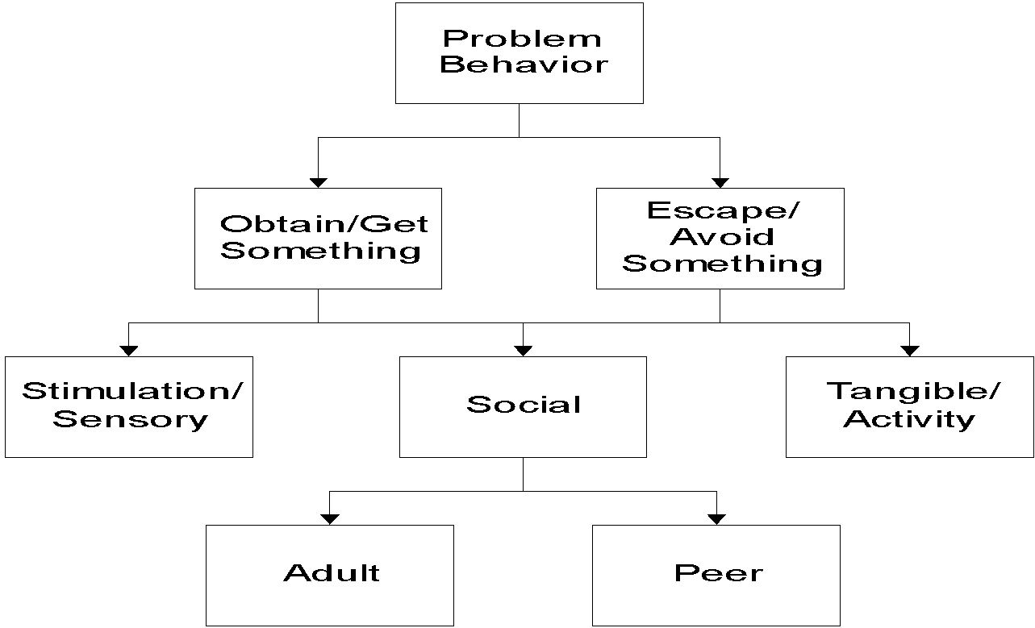
Identify Functions of Behavior
Notes:
‹#›
Teri

Slide 14
Solutions
Rely on Behavior Theory
Do | Don’t
Utilize an FBA process to inform your BSP | Develop a plan based on feelings and subjective impressions
Ensure that staff guiding the development of the BSP have the training and expertise needed
Notes:
Teri

Slide 15
Training Available
Available through the Vermont PBIS Team:
Basic FBA to BSP
Building Better Behavior Support Plans (B3SP)
VTPBiS Leadership Team Training at the Intensive Level
Go to http://www.pbisvermont.org/events/list-of-events/cat.listevents/2016/09/16/- for current trainings offered, or contact a coach for more options
Coming Soon: Tier III E-Consultation!
Notes:
Teri

Slide 16
Solutions
Rely on Behavior Theory
Do | Don’t
Utilize an FBA process to inform your BSP | Develop a plan based on feelings and subjective impressions
Ensure that staff guiding the development of the BSP have the training and expertise needed
Ensure your BSP addresses all stages of the Competing Behavior Pathway
Notes:
Cortney

Slide 17
Competing Behavior Pathway
Desired Behavior
Maintaining
Consequence
Setting Events /
Conditions
Problem Behavior
Antecedent Trigger
Maintaining
Consequence
Function
Replacement Behavior
Notes:
‹#›
Cortney

Slide 18
Checklist of BSP Elements
Interventions in your BSP address each stage of the Competing Behavior Pathway:
Setting Events
Antecedents
Replacement Behavior
Teaching, if needed
Consequences
Rewards for replacement behaviors
Extinguishing rewards for problem behaviors
Punishment for problem behavior
Notes:
Cortney

Slide 19
Consequences
Reinforcement vs. Punishment
Make sure that disciplinary consequences included in your BSP are functioning as punishment and not as reinforcement, based on your Function of Behavior hypothesis
Notes:
Cortney

Slide 20
Replacement Behaviors
Does the replacement behavior fulfill the same function?
Does the replacement behavior need to be taught?
How will the replacement behavior be reinforced?
Is your planned reinforcement of the replacement behavior powerful enough to make it a more desirable choice than the problem behavior?
Notes:
Cortney

Slide 21
Solutions
Ensure Staff Buy-In and Commitment
Do | Don’t
Involve everyone in development of the plan
Hand people a plan that you wrote on your own
Elicit input from key staff, propose ideas, ask questions
Tell them what they should do
Check for staff commitment and buy-in before finalizing your BSP
Assume that just because you talked about it, everyone agrees
Notes:
Teri

Slide 22
Solutions
Ensure Staff Time & Availability
Do | Don’t
Decide who has the time to implement each intervention
Get hung up on thinking you always need to hire a 1:1 to implement a BSP
Decide who will record the data
Notes:
Teri

Slide 23
Solutions
Follow Through with BSP Elements
Do | Don’t
Create a “To Do” list when you develop your BSP as a team. Identify who will do what, and establish deadlines. Include these details in your BSP document for all to review.
Assign tasks without speaking to the person responsible and ensuring they can do it by the established deadline
Send out e-mails to individual staff regarding what they agreed to do and reminding them of the deadline
Be a “helpful nag” by following through to ensure all tasks are completed.
Notes:
Teri
The Team needs to decide who is in charge of ensuring these things get done!

Slide 24
Solutions
Inform & Train All Staff
Do | Don’t
Inform everyone
Forget to inform parents, specials teachers, support staff, or the administrator!
Provide explicit training, including practice to demonstrate they know how to implement the plan
Assume that anyone does not need training in how to implement the BSP correctly
Notes:
Teri

Slide 25
Solutions
Collect and Review Data
Do | Don’t
Ensure you have a data collection process that is easy for staff to adhere to
Forget to look at the data, daily at first, to ensure it is being recorded correctly
Provide positive reinforcement to staff who are doing data collection
Assume staff know they are doing a good job with data collection
Set a meeting date to review the data & plan 1-2 weeks after starting the BSP
Be tempted to wait before scheduling the next meeting
Summarize the data and share with all members of the team, even if they aren’t able to come to the meeting
Avoid sending out the data because it doesn’t look so great – this is a chance to discuss implementation issues
Notes:
Cortney

Slide 26
Solutions
Collect and Review Data
Do | Don’t
 | Let this be the thing you leave out because you didn’t have the time to address it
Include evaluation measures to assess fidelity of implementation in your BSP
Notes:
Cortney

Slide 27
Measuring Fidelity
Adherence | Are minimum components of intervention strategies being implemented? % times teacher provided praise per plan % days Points Sheet was fully completed # of times student received BST
Quality | How well is the plan being implemented? Quality of interaction when teacher completes Points Sheet with student Prompts to use replacement skills using the exact language in the BSP (Careful! We also want to promote generalization of skills by varying the prompts)
Notes:
Cortney

Slide 28
Solutions
Collect and Review Data
Do | Don’t
 | Let this be the thing you leave out because you didn’t have the time to address it
Include evaluation measures to assess fidelity of implementation in your BSP
Use behavioral data along with fidelity of implementation data to assess progress
Make behavioral programming decisions based on “gut feelings” that a student is doing better
Notes:
Cortney

Slide 29
Behavior is improving
Positive behavior change Behavior progress & Good fidelity
Extension
Shaping
Fading
Self-Management
New settings
Delayed gratification
New people
Intermittent schedule
Notes:
Teri

Slide 30
Behavior is NOT improving
Data indicate behavior not improving
Interventions implemented with fidelity
Interventions not implemented w/ fidelity
Hypothesis incorrect
Strategies too difficult or time consuming
Interventions are insufficient
BSP does not fit with ecology of the classroom
Reinforcement for the behavior is insufficient
Teacher experiencing intervention drift
Notes:
Teri
Interventions are insufficient = BSP plan does not address all stages of the Competing Behavior Pathway

Slide 31
How Good Is Your BSP?
TFI (Tiered Fidelity Inventory) Tier III Support Plan Worksheet:
Individualized Team
External Supports/Agencies
Goals/Strengths Identified by Student &/or Family
Relevant medical, academic behavioral assessment data
FBA Hypothesis Statement
7 types of interventions per Competing Behavior Pathway
Action steps
Access to Tier I and Tier II supports
Monthly meetings to review outcome and fidelity data
Online at Vermont PBIS Website->Resources->Evaluation Tools
Notes:
Teri
Provide TFI Tier III Support Plan Worksheet as a resource

Slide 32
Whole Group Discussion
Take out your list of roadblocks or problems you wrote at the beginning of this session.
What roadblocks or problems have we not yet addressed?
Notes:
Cortney
open up padlet again and look at the notes of roadblocks.

Slide 33
Wrap-Up
Questions??
Coaching
Funds are available for coaching support
Visit Vermont PBIS Website or your School Coordinator
Contact us with any questions!
Teri Brooks, Ph.D., BCBA
e-mail: terimbrooks@gmail.com
Cortney Keene, M.Ed., C.A.S., BCBA
email: cortney.keene@uvm.edu
Notes:
Cortney

