Slide 1
School-Wide PBIS Tiered Fidelity Inventory (TFI)
(and a little bit about the Self-Assessment Survey (SAS))
VTPBiS State Team
Notes:
CASSANDRA

Slide 2
Webinar Logistics
Orient to Webinar Screen
2 Ways to Interact:
Raise your hand using the icon on your screen
Type a question into the text box
Intermittently we will provide opportunities to interact.
This webinar will be recorded.
Please note, your microphone will be muted unless otherwise indicated.

Slide 3
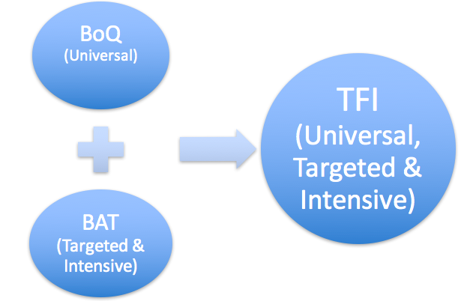
TFI Replaces BOQ + BAT

Slide 4
Why?
To use an efficient and effective validated measure to assess fidelity of core PBIS features at all 3 tiers
To guide and sustain effective implementation of PBIS

Slide 5
What is Sustainability?
Durable implementation of a practice at a level of fidelity that continues to produce valued outcomes (McIntosh et al., 2009)

Slide 6
Guiding Principles of Sustainability
Never stop doing what is already working
Always look for the smallest change that will produce the largest effect
Do not add something new without also defining what you will stop doing
Collect and use data for decision-making

Slide 7
Uses of the TFI
Formative Assessment
Determine current PBIS practices in place and needed prior to launching implementation
Progress Monitoring
Self-assess PBIS practices by tier to guide implementation efforts and assess progress by tier
Build action plan to focus implementation efforts
Annual Self-Assessment
Facilitate sustained implementation of PBIS
State Recognition
Determine schools warranting recognition for their fidelity of PBIS implementation

Slide 8
When?
Expectation is once a year for all schools
Window open January 3rd - March 31st (for TFI and SAS)
Consider completing TFI more than once to monitor/assess progress
Contact Anne Dubie if you would like your window opened
Teams should anticipate 30 minutes to complete each tier’s assessment the first time

Slide 9
Who?
School leadership team responsible for PBIS implementation should complete
Recommended (but not required) that external coach (e.g., VTPBiS SU/SD Coordinator, Coach, TA) be present
Minimally, someone with knowledge about the features of PBIS and who can interpret the meaning of the TFI elements should participate in conducting the TFI with the school leadership team

Slide 10
Before Assessment
Identify which tiers you will assess
All VTPBiS schools are expected to complete the TFI once between January and March for every tier of implementation they have rolled out

Slide 11
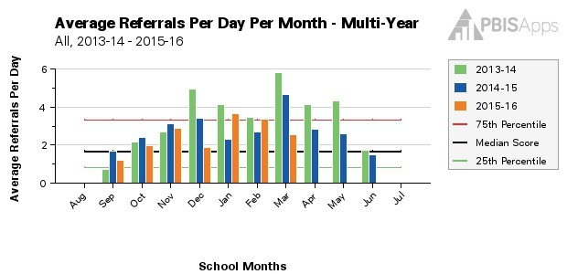
Before Assessment
Gather supporting documentation that will help you to identify an implementation level for various items on the TFI

Slide 12
Tier I: Possible Supporting Documents
VTPBiS Implementation Plan/Staff Handbook
Student Handbook
ODR Data
Staff Professional Development Plan
Team Meeting Minutes
Other…

Slide 13
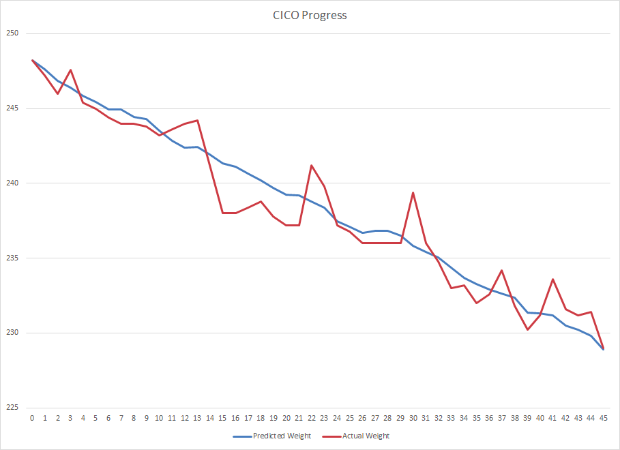
Tier II: Possible Supporting Documents
Tier II team meeting minutes
Rubric for selecting students for Tier II support
Tier II strategy handbooks/procedures
Available Tier II data summaries (if possible for two months)
Most recent fidelity measures for Tier II strategies

Slide 14
Tier III: Possible Supporting Documents
Tier III team meeting notes
Decision rules for selecting students for Tier III
Assessment tools for Tier III (i.e. FBA, mental health, medical records, etc.)
Three randomly selected BSPs
Tier III data summary

Slide 15
Before Assessment
Complete walkthrough (like a mini-SET) (recommended that an external coach do this)

Slide 16
During Assessment
Review item components, main idea, and scoring criteria
Team votes to identify whether the item is not in place, partially in place, or fully in place
Record consensus vote

Slide 17
During Assessment
Each tier has questions on:
Team composition
Note: Teams need people with multiple skills and perspectives to function at a high capacity. However, it is understood that people may wear many hats.
Implementation/Intervention
Evaluation

Slide 18
Number of Questions
Tier I (Universal PBIS) – 15 Questions
Whole School Universal Prevention
Tier II (Targeted PBIS)- 13 Questions
Secondary, Small Group Prevention
Tier III (Intensive PBIS)- 17 Questions
Tertiary, Individual Support Prevention

Slide 19
How?
Go to: https://www.pbisassessment.org/
Enter the email address & password associated with PBIS Assessment account
If you currently have access to SWIS, your login E-mail Address for www.pbisapps.org is the same as your SWIS Login
If you do not have access to SWIS, you were added to your school's PBIS Apps account and should have received an "Welcome to PBIS Assessment" email indicating you had 48 hours to setup your password. If you were unable to setup your password within that time frame, you can setup your password by clicking on PBIS Application Login and "Change Password"
Once logged in, slide over to the left side of the app bar and click on PBIS Assessment to access the PBIS Assessment account dashboard

Slide 20
Find TFI In Open Surveys

Slide 21
How?
To take the TFI, from the Dashboard:
Click the TFI from the Survey's Currently Open section
Locate your school for whom the survey will be submitted and click the Take Survey link
Enter the survey responses for the displayed section
Click the >> to move to the next page
Click the Submit Survey button at the end of the survey to save the responses

Slide 22
After Assessment
Analyze data:
Total score report
Subscale report (broken down by tier)
Sub-sub scale report (broken down by components)
Individual items report

Slide 23
After Assessment
Select a small number of items for implementation action planning (see link for action plan template)
Ask: “What are the smallest changes we can make in the next three months to improve implementation?”
After a few months, use the TFI again to monitor progress

Slide 24
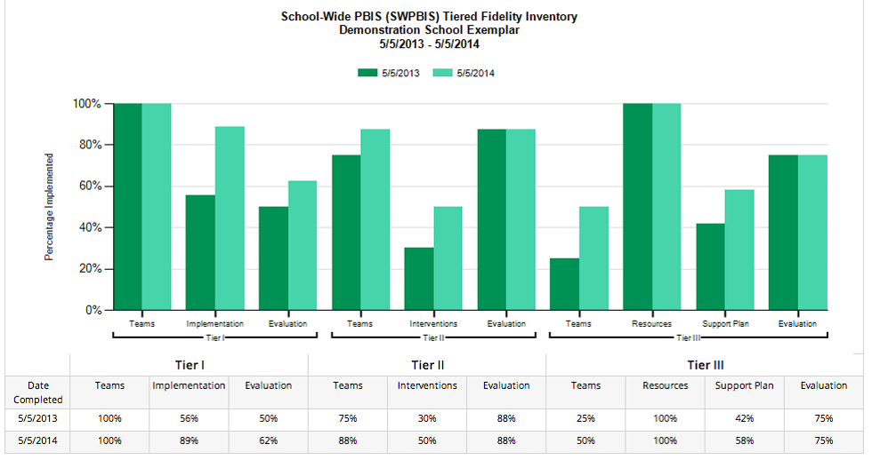
Example Subscale Report

Slide 25
Fidelity
Use the 70% benchmark at each tier to indicate “implementation at criterion”

Slide 26
For More Information
TFI Guide
TFI Slides
TFI Video Walkthrough
*Note: Other fidelity measures (e.g., BOQ, BAT, etc.) will remain on the PBIS Apps website.

Slide 27
Self-Assessment Survey (SAS)
Purpose: | Assess staff perceptions of PBIS practices in place and priority for changes Design annual action plan
Format: | Survey
Completed by: | All staff Manual or on-line scoring, graphing
When? | Annually, preferably in the spring

Slide 28
Two main questions
What systems are in place now?
What systems are most in need of improvement?

Slide 29
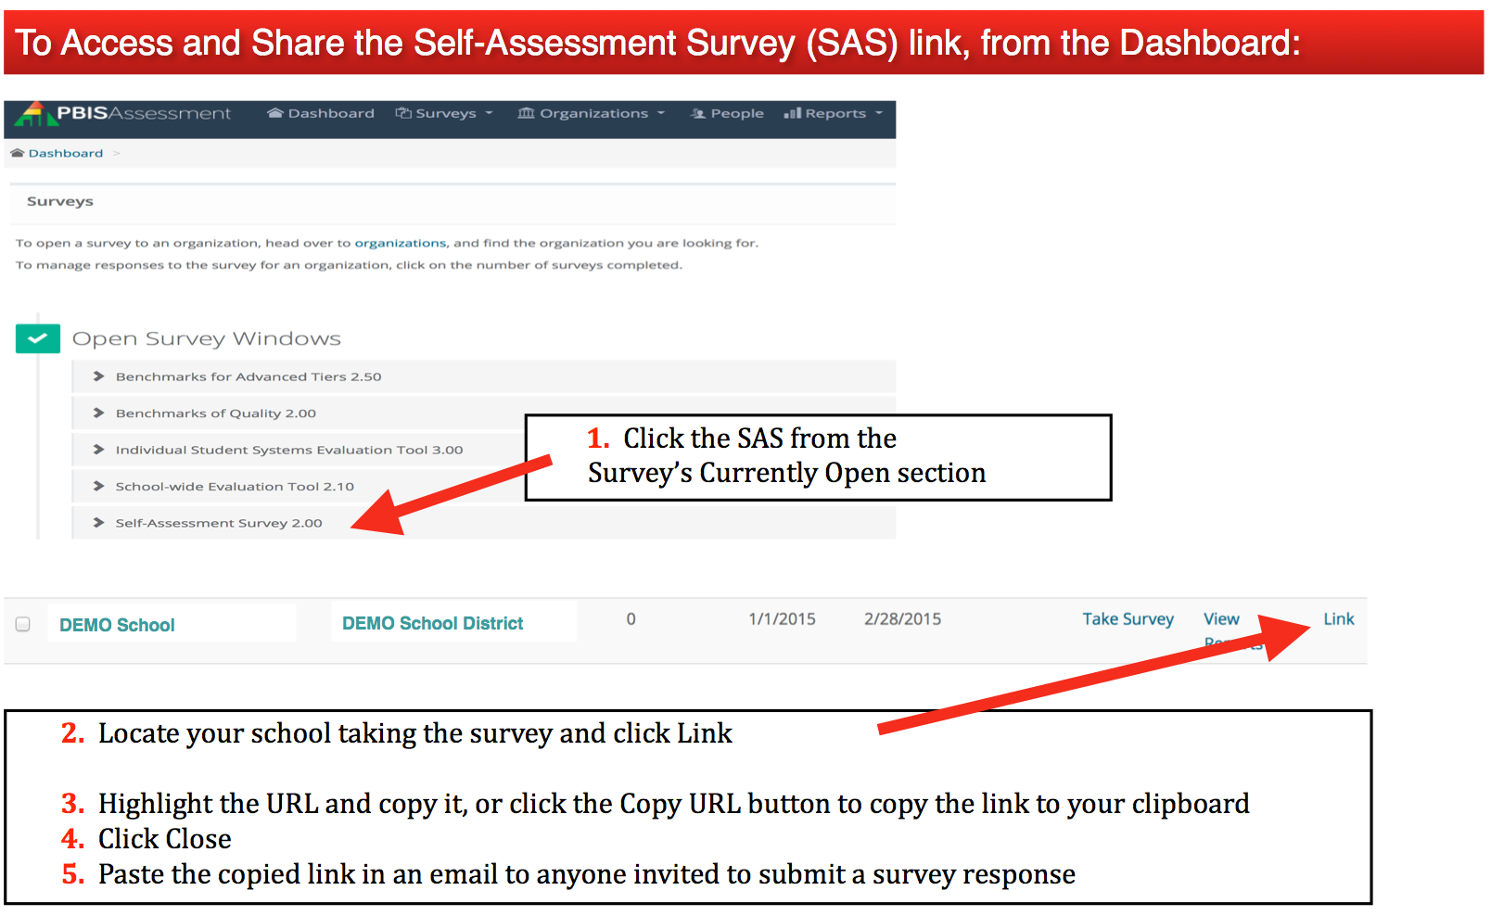
To Take the SAS…

Slide 30
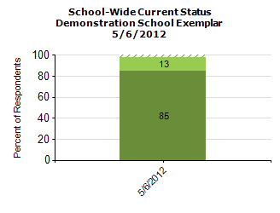
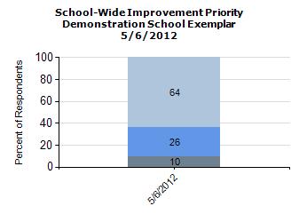
Total Score:

Slide 31
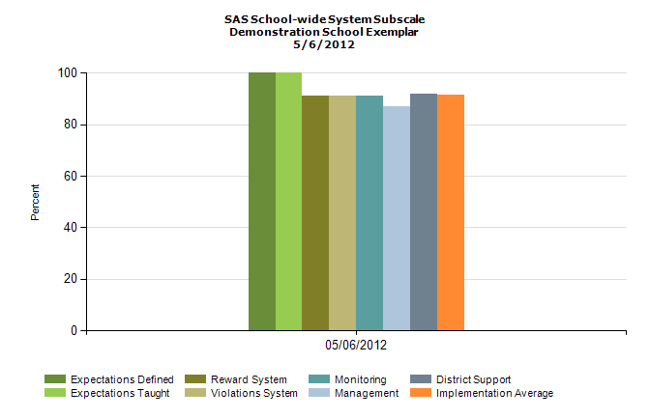
Subscale:

Slide 32
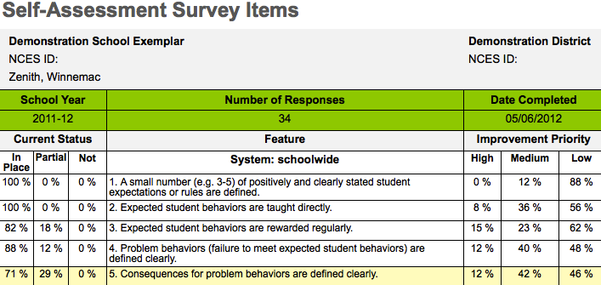
Items:

Slide 33
Any Questions?

