Slide 1
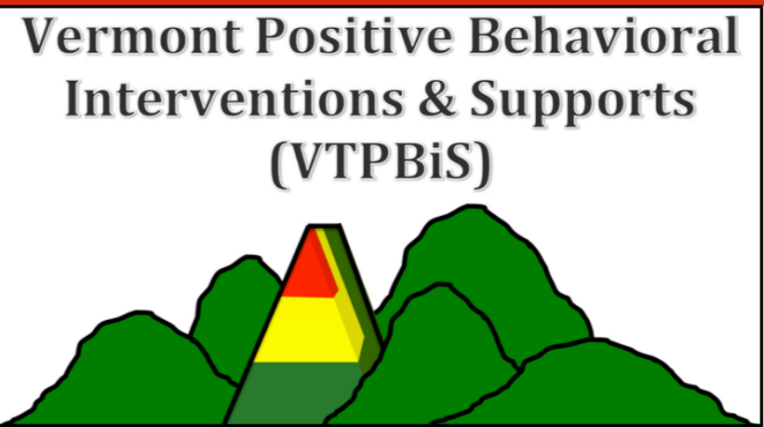
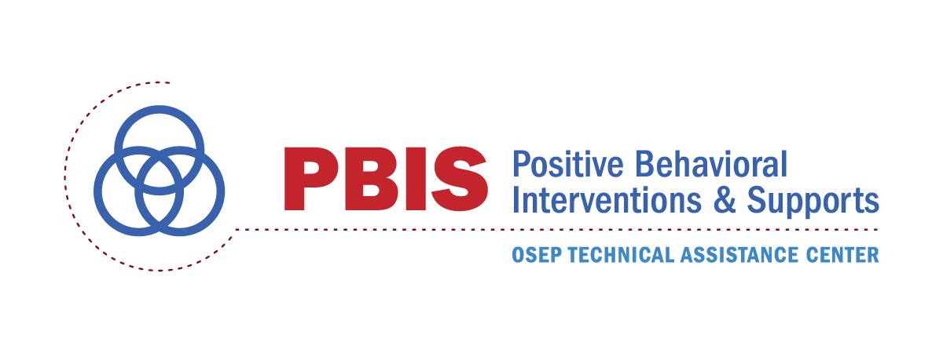
PBIS: Using the PBIS Framework to Implement Effective Practices
Rob Horner
University of Oregon

Slide 2
Goals
Provide update on current status of PBIS in US
Define the “Systems” that support sustained use of PBIS
Training
Coaching
Evaluation
Getting to Tier II and Tier II
Emphasize the critical role of cultural adaptation in PBIS implementation

Slide 3
The Purpose of PBIS
The fundamental purpose of PBIS is to make schools more effective, efficient and equitable learning environments for all students.
Predictable
Positive
Consistent
Safe

Slide 4
Experimental Research on SWPBIS
Bradshaw, C.P., Koth, C.W., Thornton, L.A., & Leaf, P.J. (2009). Altering school climate through school-wide Positive Behavioral Interventions and Supports: Findings from a group-randomized effectiveness trial. Prevention Science, 10(2), 100-115
Bradshaw, C.P., Koth, C.W., Bevans, K.B., Ialongo, N., & Leaf, P.J. (2008). The impact of school-wide Positive Behavioral Interventions and Supports (PBIS) on the organizational health of elementary schools. School Psychology Quarterly, 23(4), 462-473.
Bradshaw, C. P., Mitchell, M. M., & Leaf, P. J. (2010). Examining the effects of School-Wide Positive Behavioral Interventions and Supports on student outcomes: Results from a randomized controlled effectiveness trial in elementary schools. Journal of Positive Behavior Interventions, 12, 133-148.
Bradshaw, C.P., Reinke, W. M., Brown, L. D., Bevans, K.B., & Leaf, P.J. (2008). Implementation of school-wide Positive Behavioral Interventions and Supports (PBIS) in elementary schools: Observations from a randomized trial. Education & Treatment of Children, 31, 1-26.
Bradshaw, C., Waasdorp, T., Leaf. P., (2012 )Effects of School-wide positive behavioral interventions and supports on child behavior problems and adjustment. Pediatrics, 130(5) 1136-1145.
Horner, R., Sugai, G., Smolkowski, K., Eber, L., Nakasato, J., Todd, A., & Esperanza, J., (2009). A randomized, wait-list controlled effectiveness trial assessing school-wide positive behavior support in elementary schools. Journal of Positive Behavior Interventions, 11, 133-145.
Horner, R. H., Sugai, G., & Anderson, C. M. (2010). Examining the evidence base for school-wide positive behavior support. Focus on Exceptionality, 42(8), 1-14.
Ross, S. W., Endrulat, N. R., & Horner, R. H. (2012). Adult outcomes of school-wide positive behavior support. Journal of Positive Behavioral Interventions. 14(2) 118-128.
Waasdorp, T., Bradshaw, C., & Leaf , P., (2012) The Impact of Schoolwide Positive Behavioral Interventions and Supports on Bullying and Peer Rejection: A Randomized Controlled Effectiveness Trial.
Archive of Pediatric Adolescent Medicine. 2012;166(2):149-156
Bradshaw, C. P., Pas, E. T., Goldweber, A., Rosenberg, M., & Leaf, P. (2012). Integrating schoolwide Positive Behavioral Interventions and Supports with tier 2 coaching to student support teams:
The PBISplus Model. Advances in School Mental Health Promotion, 5(3), 177-193. doi:10.1080/1754730x.2012.707429
Freeman, J., Simonsen, B., McCoach D.B., Sugai, G., Lombardi, A., & Horner, ( submitted) Implementation Effects of School-wide Positive Behavior Interventions and Supports on Academic, Attendance,
and Behavior Outcomes in High Schools.
Flannery, B., Fenning, P., Kato, M., & McIntosh, K. (2014). Effect of school-wide positive behavioral interventions and supports and fidelity
of implementation on problem behavior in high schools. School Psychology Quarterly, 29, 111-124.
SWPBIS Experimentally Related to:
Reduction in problem behavior
Increased academic performance
Increased attendance
Improved perception of safety
Reduction in bullying behaviors
Improved organizational efficiency
Reduction in staff turnover
Increased perception of teacher efficacy
Improved Social Emotional competence

Slide 5
Schools Using PBIS Aug, 2016
3138 High Schools

Slide 6
Schools Implementing PBIS by State 2015-16
21 states with over 500 schools Implementing PBIS
Vermont

Slide 7
Proportion of Schools Using PBIS: August, 2016
Vermont

Slide 8
PBIS Tier I Fidelity by State 2015-16
School Using PBIS
13,414 Measured
8,328 Met Tier I Criterion
School Assessing Tier I Fidelity
School Meeting Tier I Fidelity Criterion

Slide 9
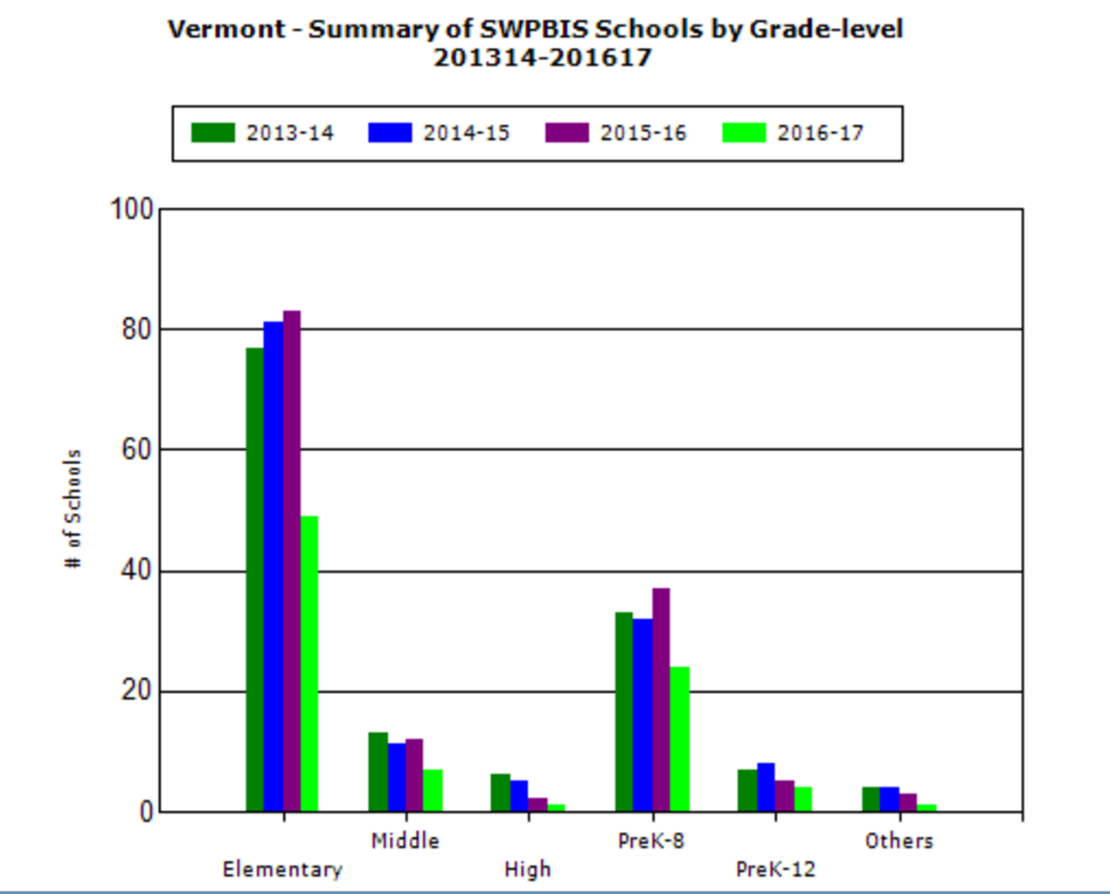
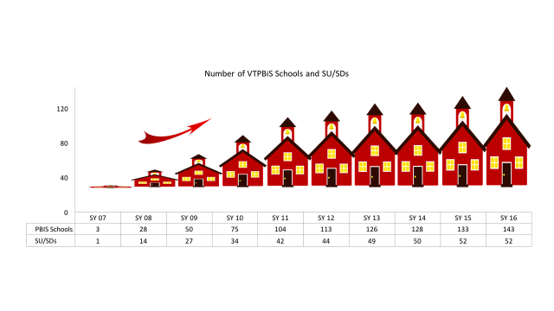

Slide 10
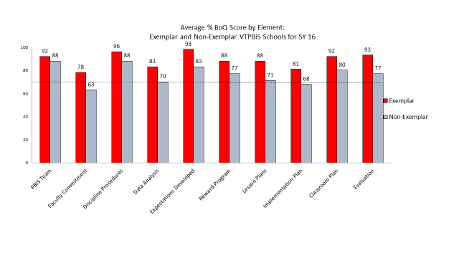
BoQ Scores 2015-16: Vermont

Slide 11
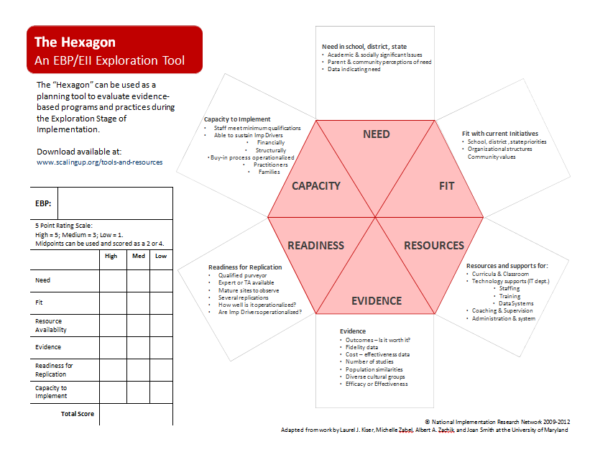

Slide 12
Exploration : Using the Hexagon Tool
Rate features… Select date for presentation and vote
Feature Rating | 1 = low 3 = moderate 5 = high | Most valuable Action
Need Do we need PBIS
Fit Does PBIS fit our culture
Resources Do we have the people/Time/$
Evidence Is there evidence supporting PBIS
Readiness Is this the right time to implement PBIS
Capacity Can we do PBIS given everything else
Local Exemplars Has anyone else done PBIS successfully

Slide 13
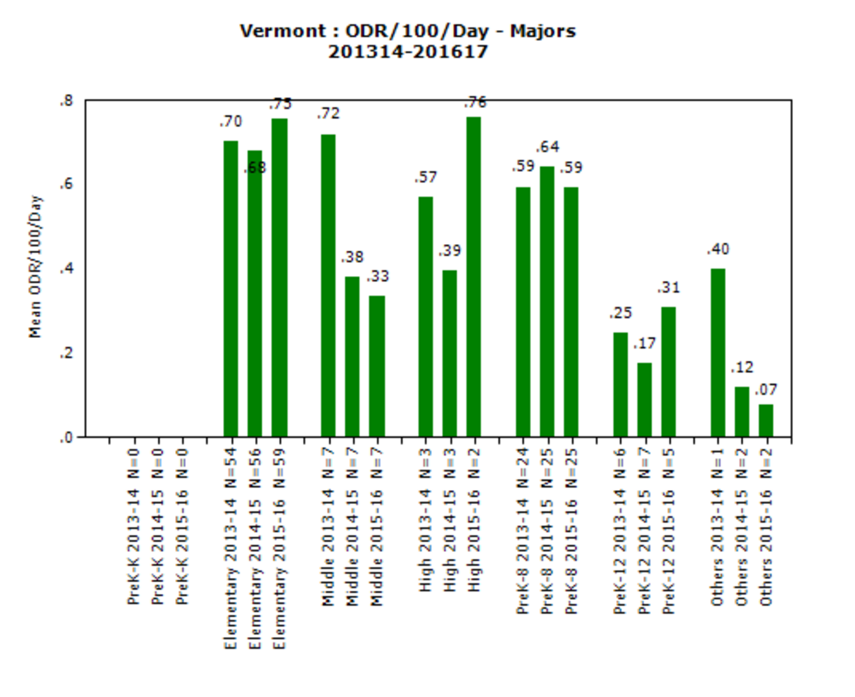

Slide 14
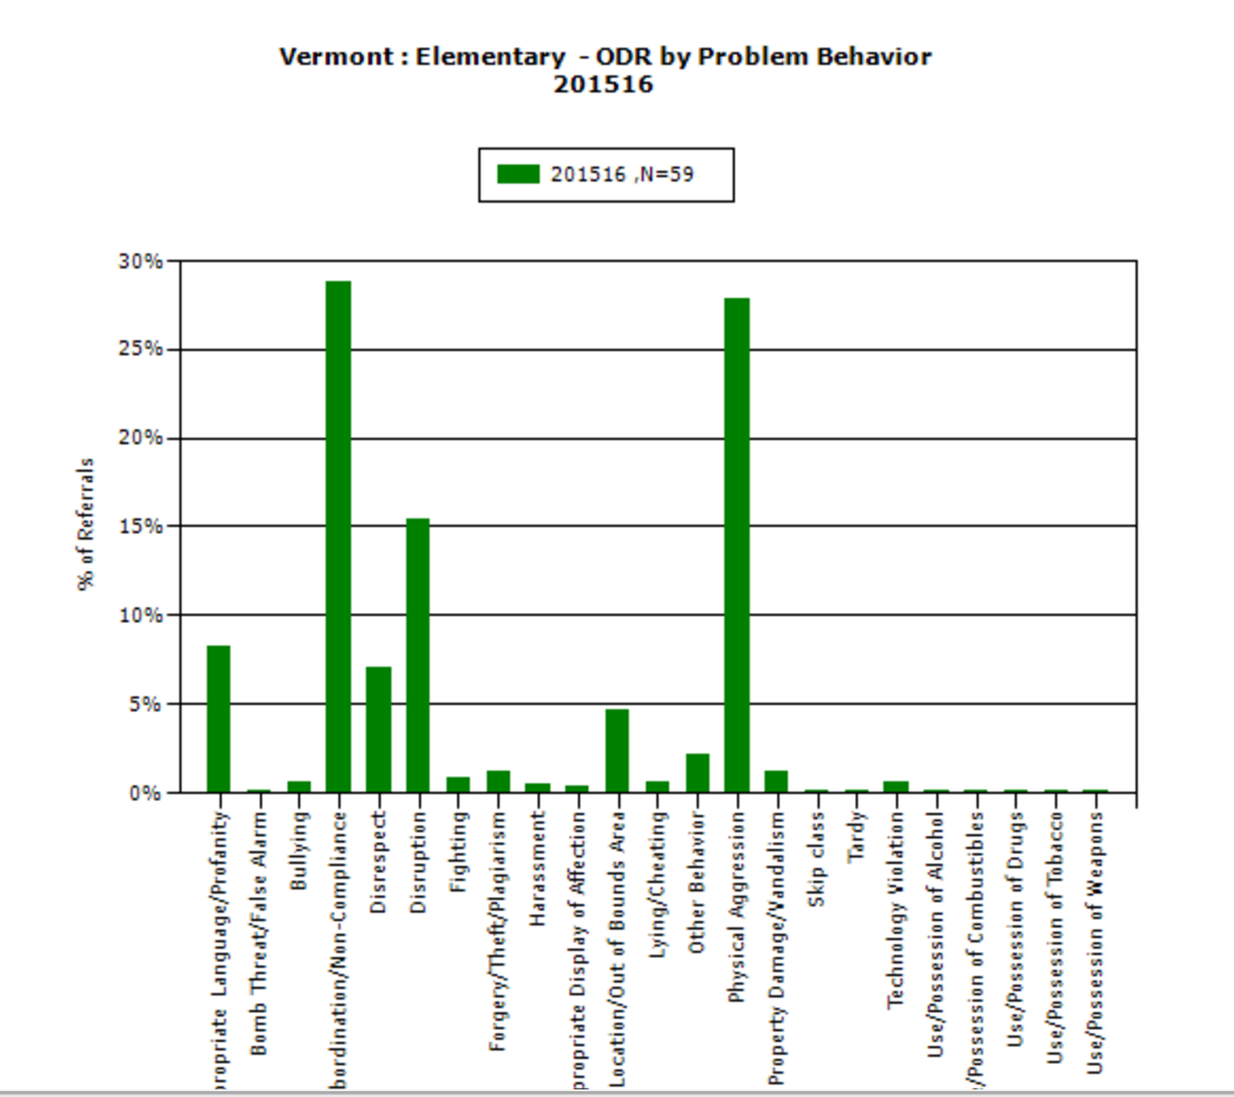

Slide 15
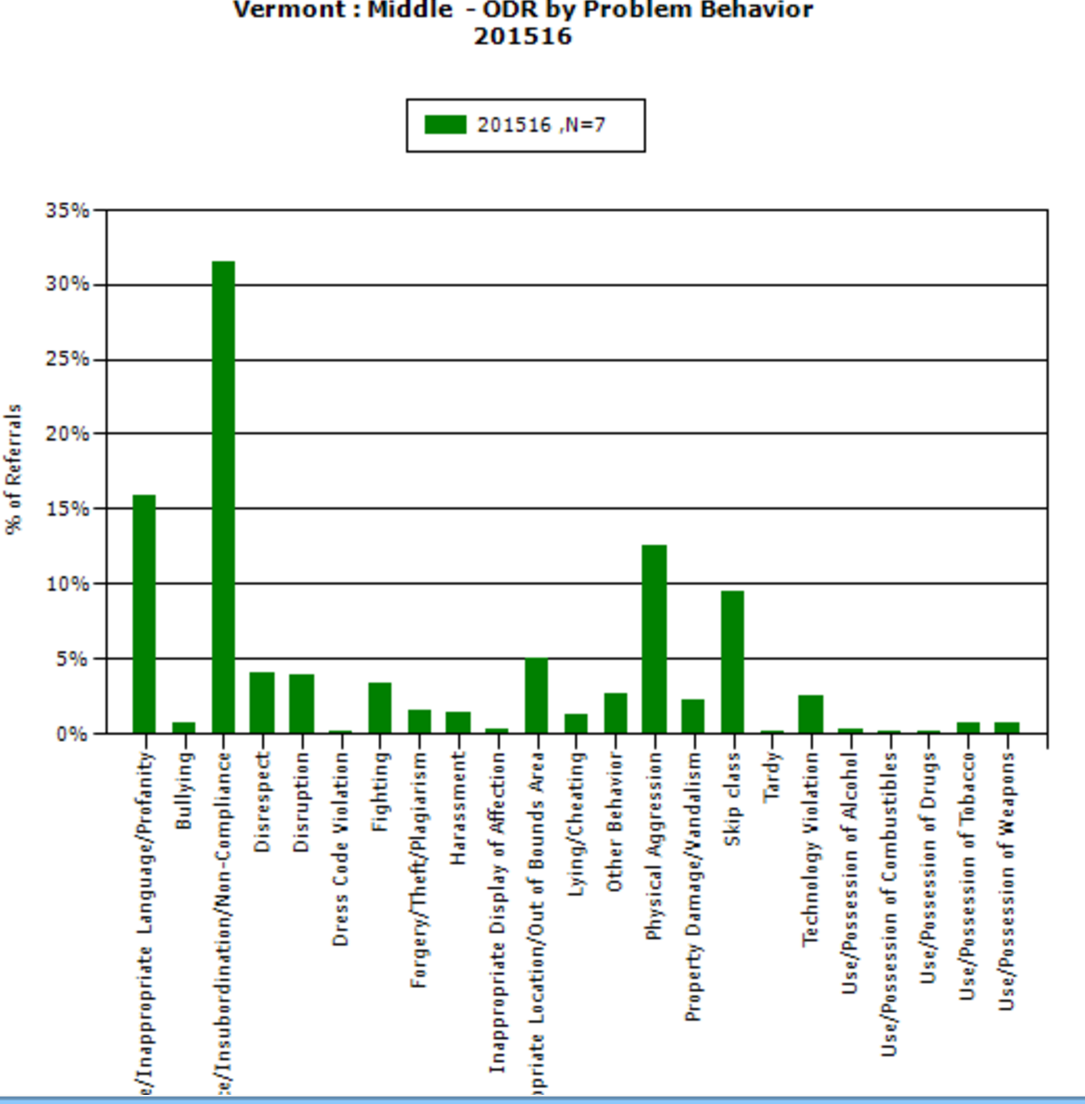

Slide 16
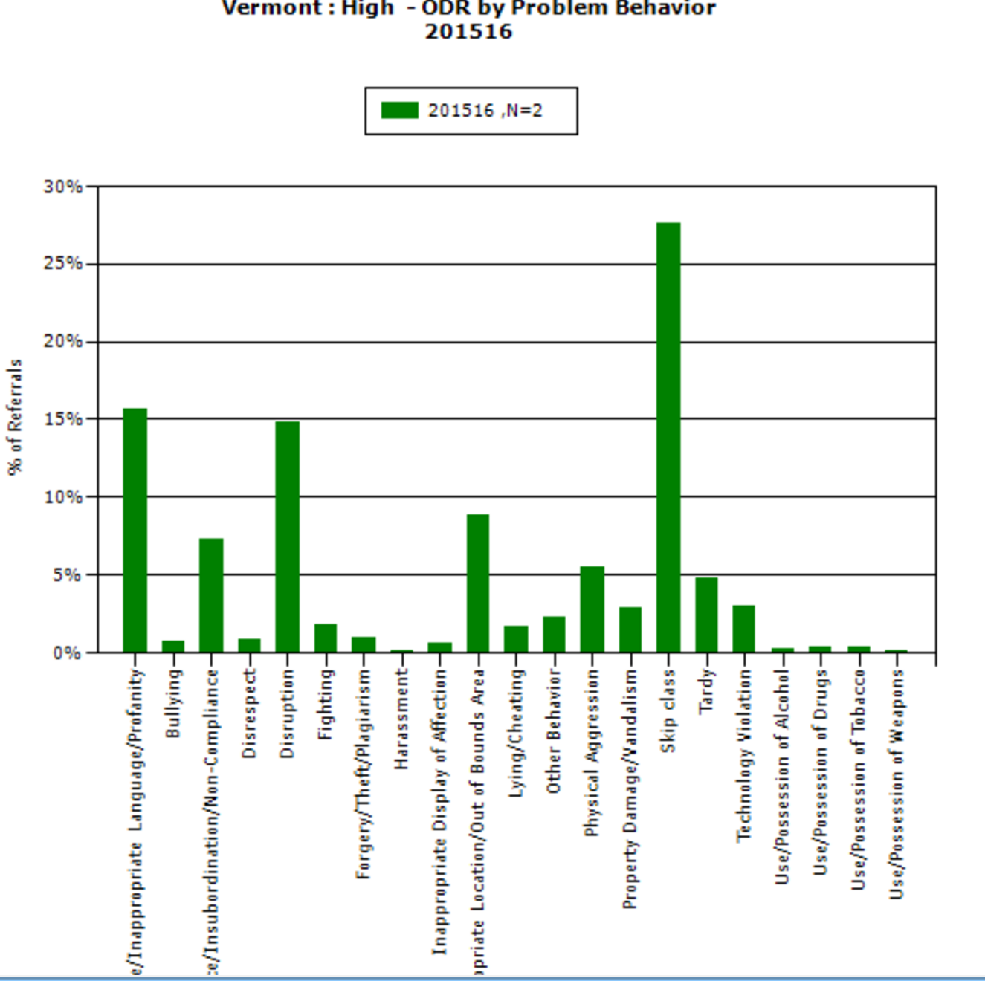

Slide 17
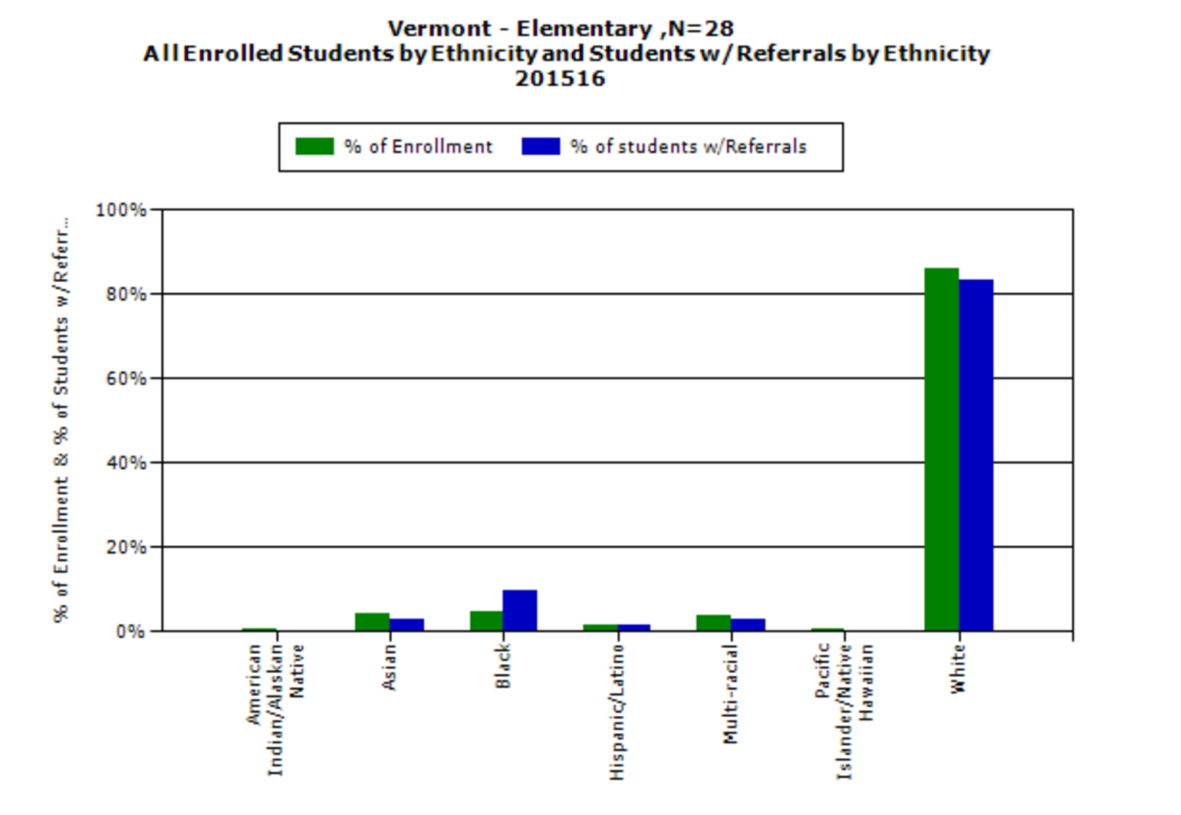

Slide 18
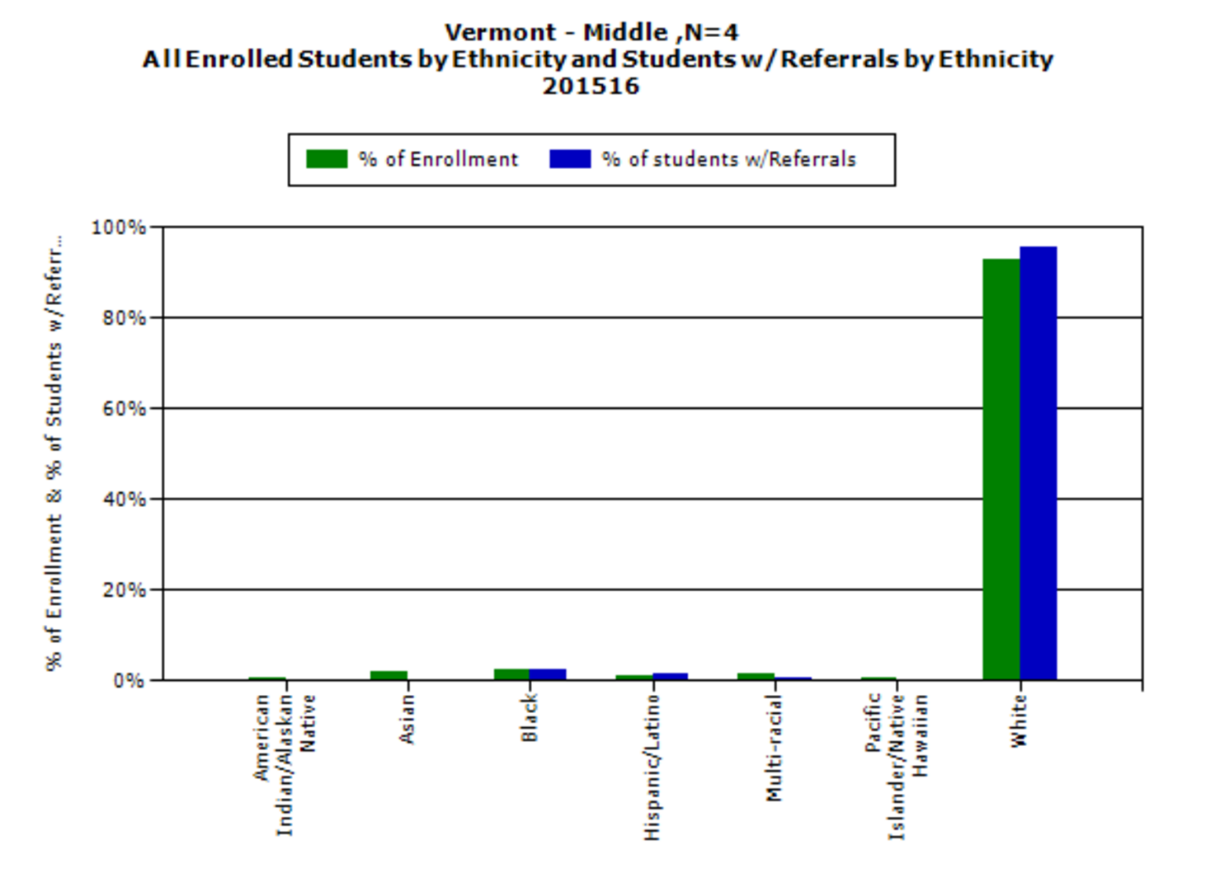

Slide 19
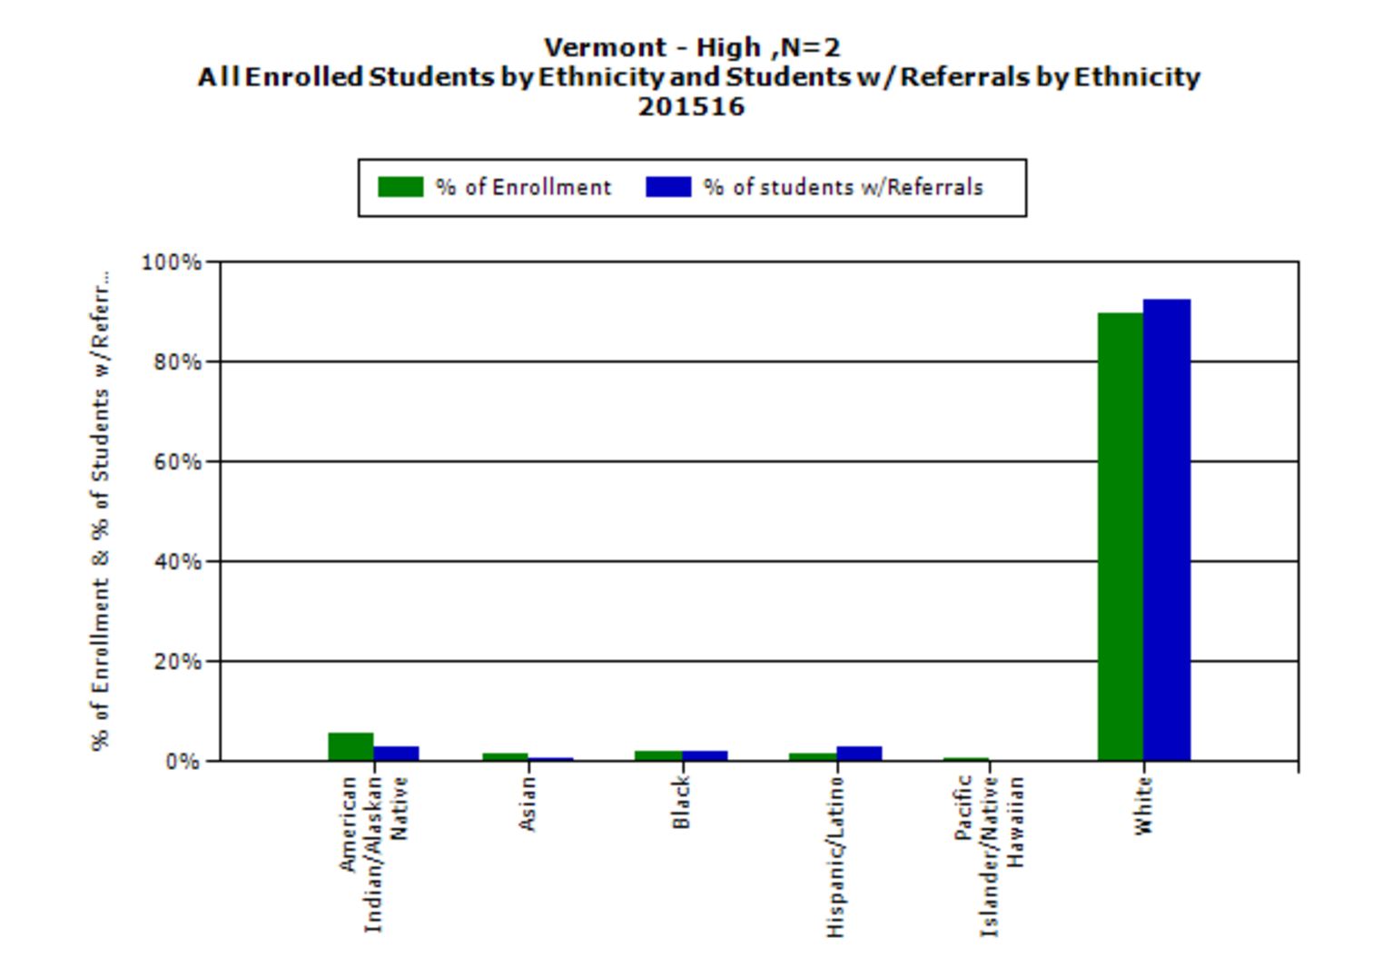

Slide 20
PBIS: Effective Practices + Effective Systems
Effective Practices
Lead Teams
Behavioral Expectations
Acknowledgement
Consequences
Data / Decision System
Effective Systems
Team process
Hiring
Training / Orientation
Coaching
Evaluation
District Data System

Slide 21
Tier I PBIS Core Features
Consequences for Problem Behavior
System to Acknowledge
Behavior
Classroom Systems
Tier I PBIS
Data and Decision System
School-wide Expectations
Bully Prevention
Leadership Team
Family Engagement

Slide 22
Implement SYSTEMS as well as PRACTICES
Expectations
PRACTICES
PRACTICES
Classroom management
Check-in
Check-out

Slide 23
Culturally Equitable Academic &
Social Competence
OUTCOMES
Culturally Relevant
Support for
Student
Behavior
Culturally Valid
Decision
Making
DATA
PRACTICES
SYSTEMS
SYSTEMS
Culturally Knowledgeable
Staff Behavior
Notes:
SWPBS: Four Elements
SWPBS builds from a focus on student Outcomes: academic achievement, social competence, and safety.
SWPBS “Practices” are the behaviors of adults that affect how students perform. These are the daily, classroom, and on-going discipline practices of the school
SWPBS “Systems” are the organizational decisions and structures that support effective STAFF Behavior. A major strength of SWPBS is the emphasis on practices delivered WITH the systems needed to support the practices.
The use of data for decision-making is the single most important system within SWPBS. This element is used both to ensure the SWPBS practices are tailored to the local context/culture, and to benefit the continuous regeneration needed for sustained implementation.

Slide 24
Tier I PBIS systems Features
Professional Development
Orientation
Coaching
Tier I PBIS
Preference given to applicants with demonstrated experience and expertise in implementation of multi-tiered systems of academic and behavior support.
Recruitment and Hiring
Evaluation
District Data Use
Teaming
Shared
Commitment

Slide 25
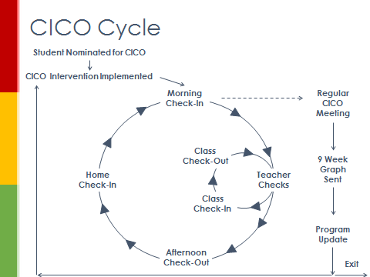
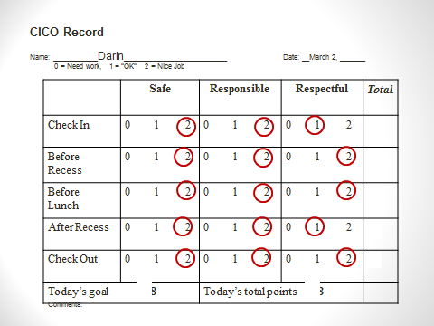
Coaching versus Training
Training is the presentation of material to develop new knowledge and /or skill
Coaching is the on-site support needed to use new knowledge and/or skills under typical conditions.

Slide 26
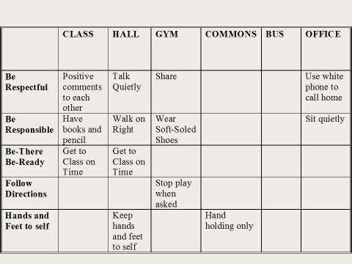
Considerations
Coach versus Coaching
“Actions” rather than “Role”
Coaching versus Training
Coaching Skills /Attributes versus Coaching FUNCTIONS
Knowledge of core content (PBIS Teaching Matrix… general case)
Time
Communication skills
Building professional relationships and trust
Knowledge of organizational context

Slide 27
Coaching Functions
Prompting
Increase use of new skills under typical conditions
Fluency Building
Building speed and easy in use of new skills
Performance Feedback
Reinforcing correct use of new skills, and Increasing precision with which skills are used
Adaptation
Adjusting use of new skills to fit cultural and organizational context, YET retain core features of effective skills

Slide 28
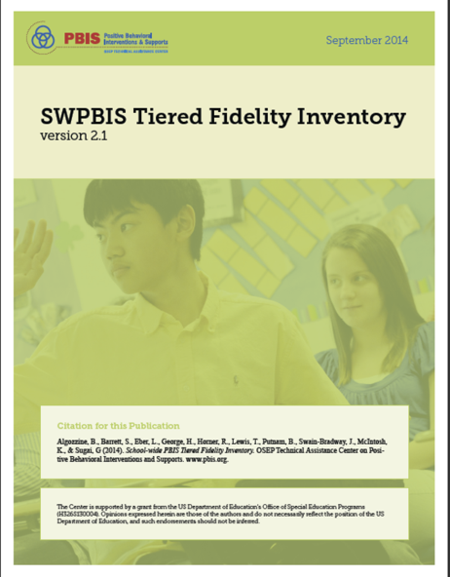
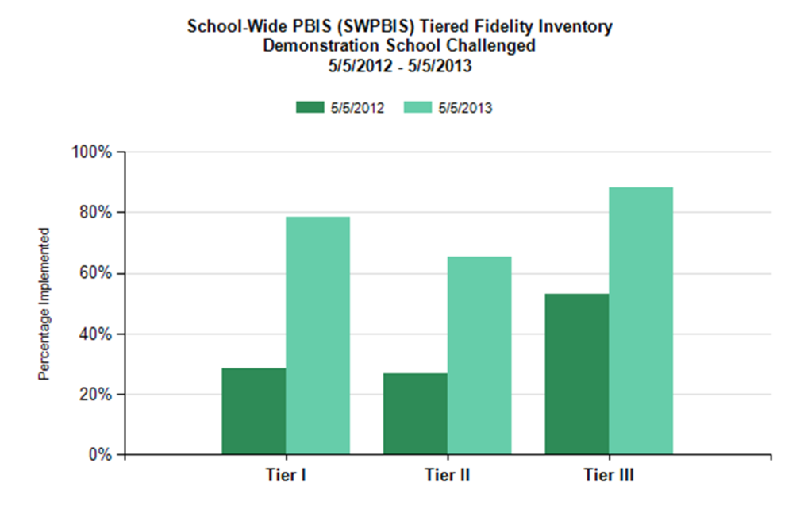
Using Fidelity Data To Guide PBIS Implementation
A defining feature of PBIS is our commitment to implementing with fidelity…and measuring fidelity
Measures of Fidelity
--------------------
SET
TIC
BoQ
SAS
PoI
ISSET
BAT
MATT
TFI

Slide 29
Sub-scale report

Slide 30
Schedule of TFI use
Fidelity Measures affect Implementation only if they are used at least three times a year
--------------------------
Each TFI administration should result in at least 1-3 action items for the next team meeting
Aug- Sept Tier I, Tier II, Tier III
Oct
Nov-Dec Only one Tier
Jan
Feb
Mar-Apr Only one Tier
May
June

Slide 31
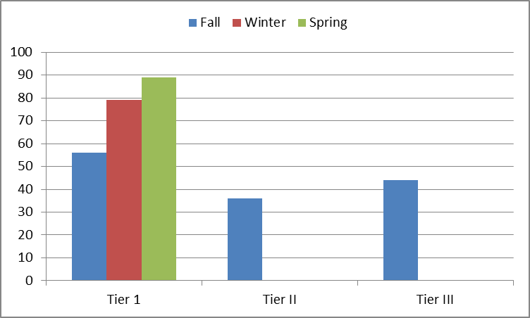
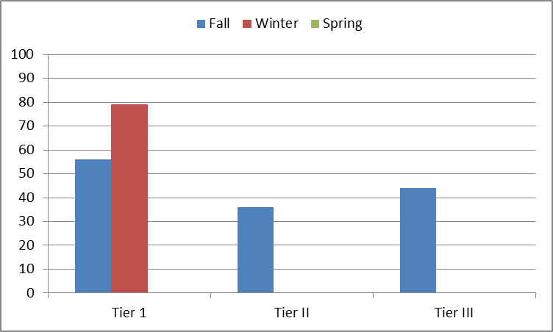
TFI used in Fall, Winter, Spring

Slide 32
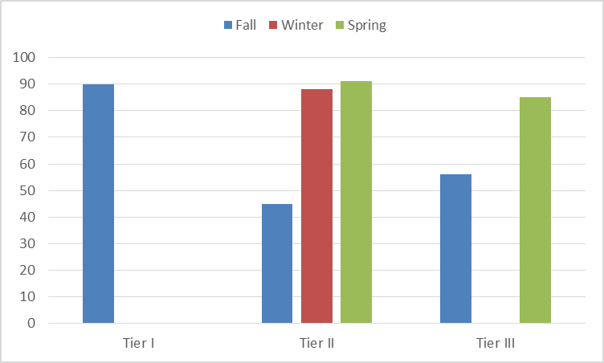
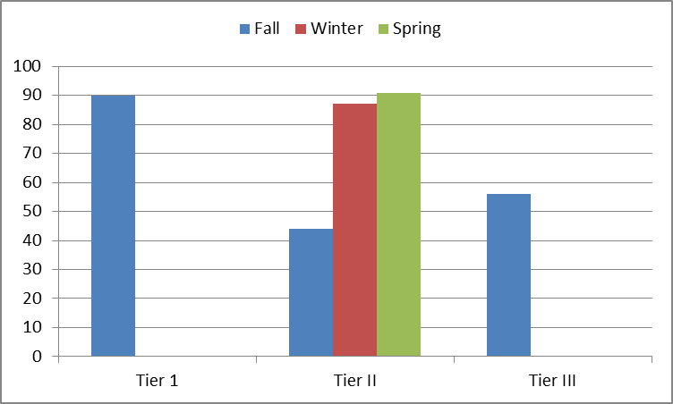
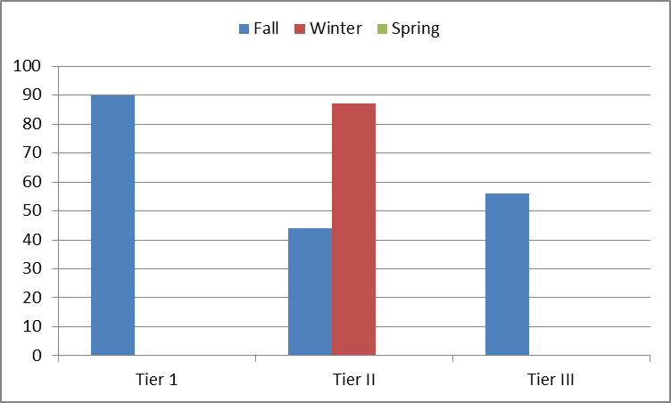
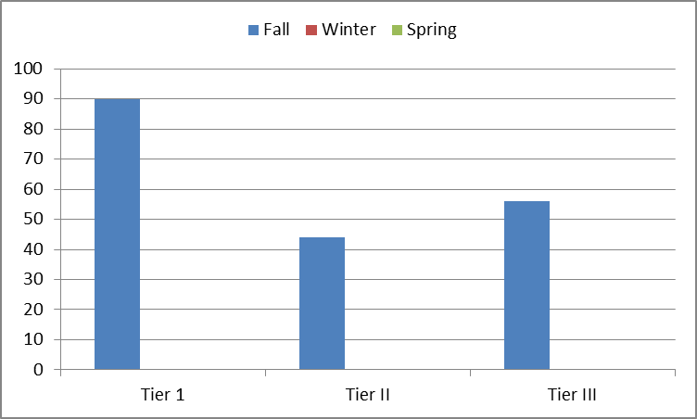
Year 2: TFI used in Fall, Winter, Spring

Slide 33
Action Planning
0
1. Team to propose teaching template and Fall teaching schedule at Feb 16 Faculty meeting.
Alan
Feb 16

Slide 34
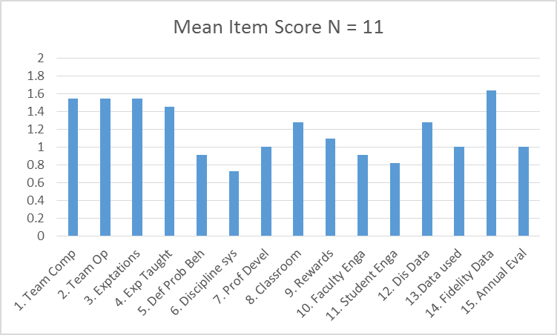
One Example of Using the TFI
Mean TFI Score

Slide 35
Moving to Tier II and tier III Supports

Slide 36
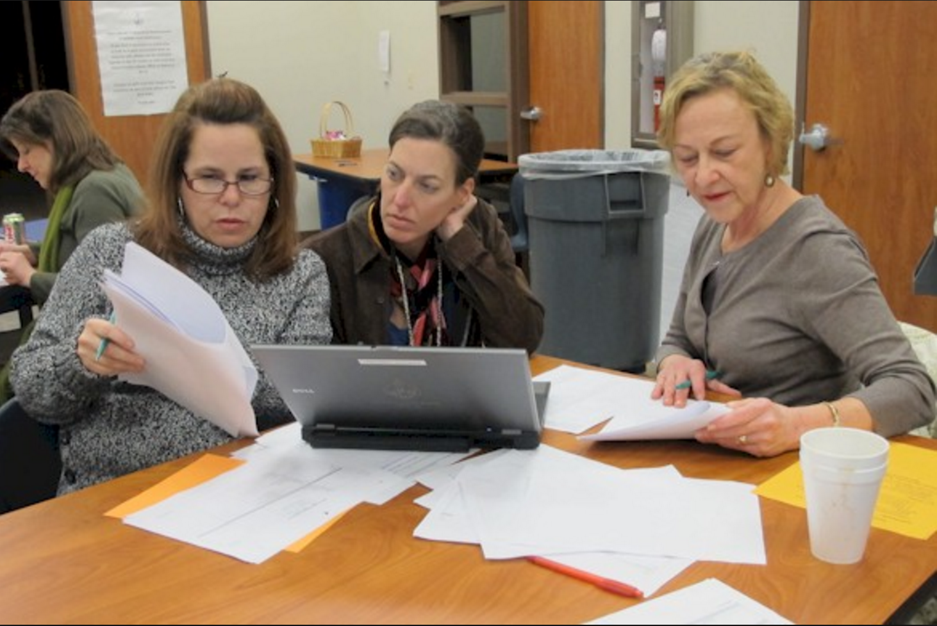
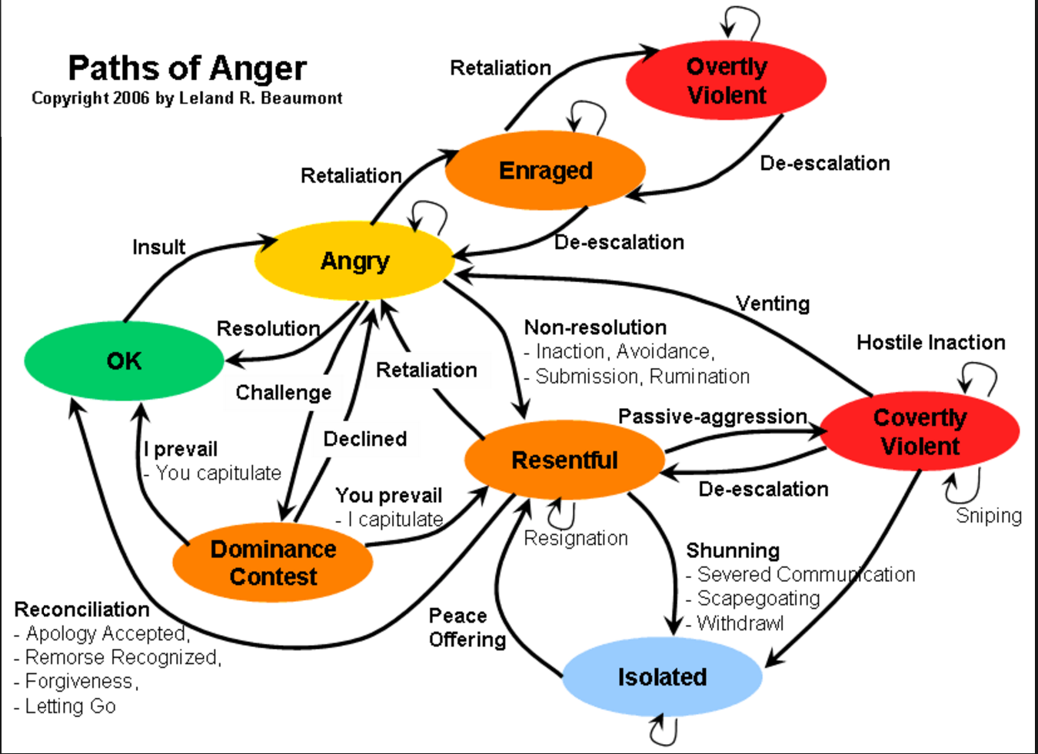
Adapting Behavior Support to Local Culture
Manuel Monzalve, Ph.D. 2016

Slide 37
Contextual Fit
Technically Sound
Contextual Fit
Values
Skills
Resources
Admin
Support

Slide 38
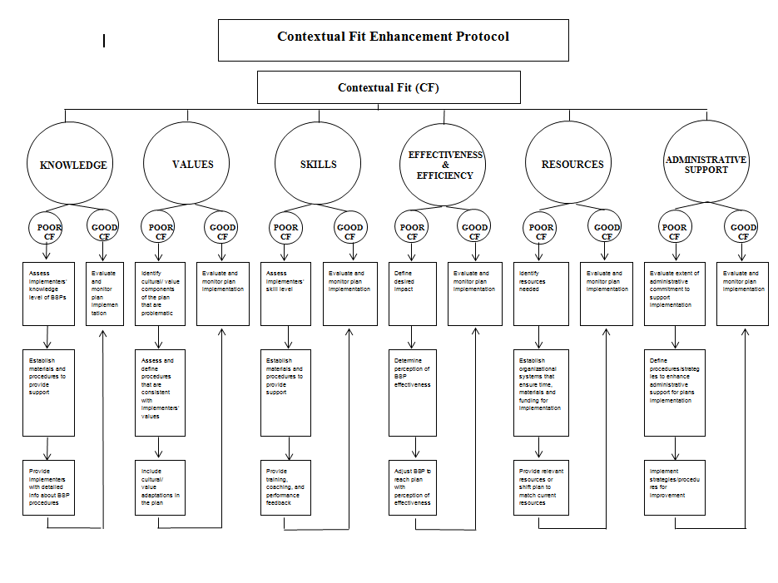

Slide 39
Implementation Fidelity
Use of Contextual Fit Protocol Led to Improved Implementation of Support Plan by teaching staff

Slide 40
Problem Behavior
Improve Use of the Support Plan Led to Improved Student Behavior

Slide 41
Summary
PBIS is doable and effective
Focus on building district capacity
Coaching Support (Four Functions)
Build systems that can adapt to fit the local culture and Expand to Tier II/ Tier III

