Slide 1
Leadership Team Structure, Norms & Roles, Routines

Slide 2
vtMTSS Principle #8
“Effective leadership, including building administrator engagement and distributed leadership, is crucial for guiding and sustaining a multi-tiered system.”

Slide 3
Component 1:
Statement of Purpose

Slide 4
Statement of Purpose
What’s the purpose of VTPBiS within your school’s mission?
How will VTPBiS help your school?
Notes:
This does not replace your school’s mission statement.
The Statement of Purpose should focus on the mission of your leadership team.

Slide 5
Example:
“The purpose of the PBIS Leadership Team is to build the capacity of our school to develop structures for teaching expected behaviors, create student behavioral and academic support systems, and apply data-based decision-making to discipline, academics, and social/emotional learning. Our Team promotes family and community involvement at all levels of implementation.”
Notes:
Look for other examples in the binder
See other examples on the www.pbisvermont.org website

Slide 6
Activity #2:
Statement of Purpose
In your teams:
Finalize your Statement of Purpose (insert into VTPBiS Workbook)
  Positively stated
  2-3 sentences in length
  Supportive academic achievement
  Contextually/culturally appropriate (e.g. age, level, language)
Plan for roll-out (write action steps in VTPBiS Implementation Plan)
  How will this be communicated to stakeholders?
  How will you publicize in written materials/posters/websites?
Notes:
Differentiate

Slide 7
Component 2:
Clearly Defined Expected Behavior
Notes:
KA

Slide 8
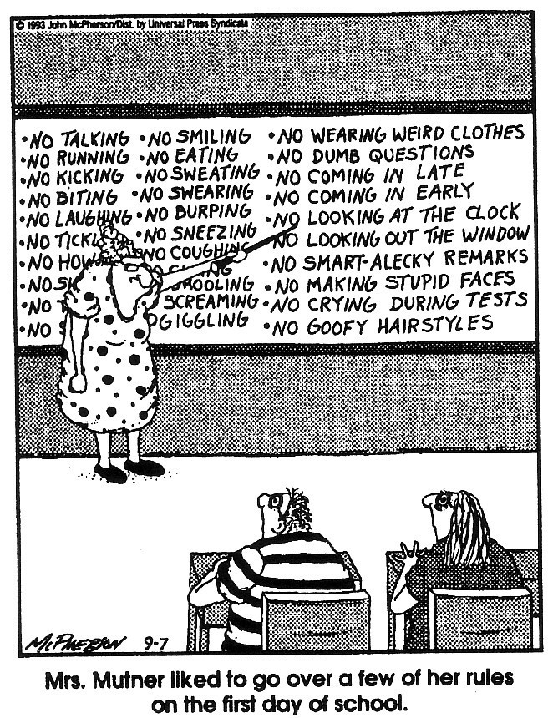
(Close to Home c Reprinted with permission of Universal Press Syndicate. All rights reserved.)
Notes:
This is an example of traditional “rules” and expectations. They were negatively stated and often too many to remember.
PBIS moves away from this by creating 3-5 clearly defined and positively stated expectation.

Slide 9
Defined Behavior Expectations
Few in number
Positively stated
Behavioral terms

Slide 10

St. Albans City School
Notes:
St. Albans City School . They used their school initials.

Slide 11
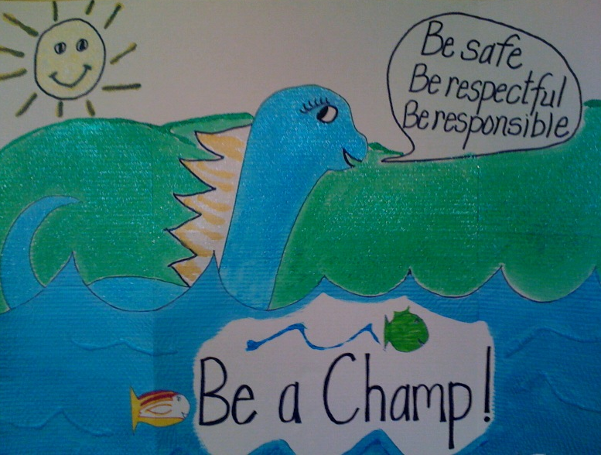
Champlain Elementary
Notes:
Champlain Elementary – they incorporated their mascot.

Slide 12
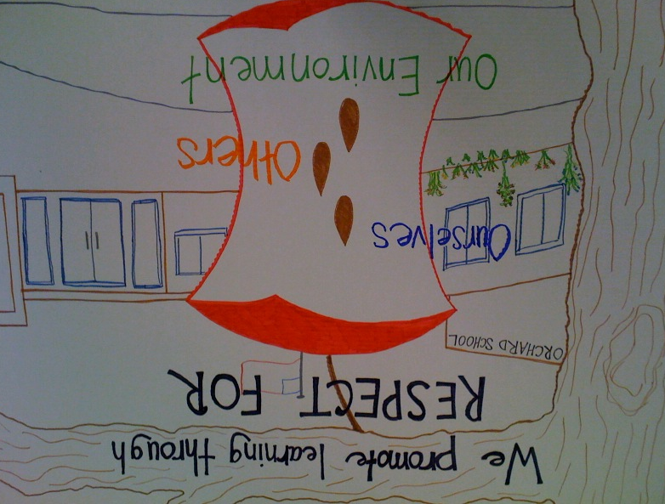
Orchard Elementary
Notes:
Orchard Elementary School- Great example to show that it’s important not to get too stuck on creating an acronym that fits their school. This school, in particular really wanted to use CORE as the acronym for their expectations but they ended up creating meaningless expectations because they were focused on using “CORE”. They decided to say that “Our Core Values are Respect for ourselves, Respect for others and Respect for our environment.”

Slide 13

Stockbridge Central
Notes:
Stockbridge Central School – Each student signed a hand as a sign of committing to the school-wide expectations. This was displayed in the lobby of the school.

Slide 14
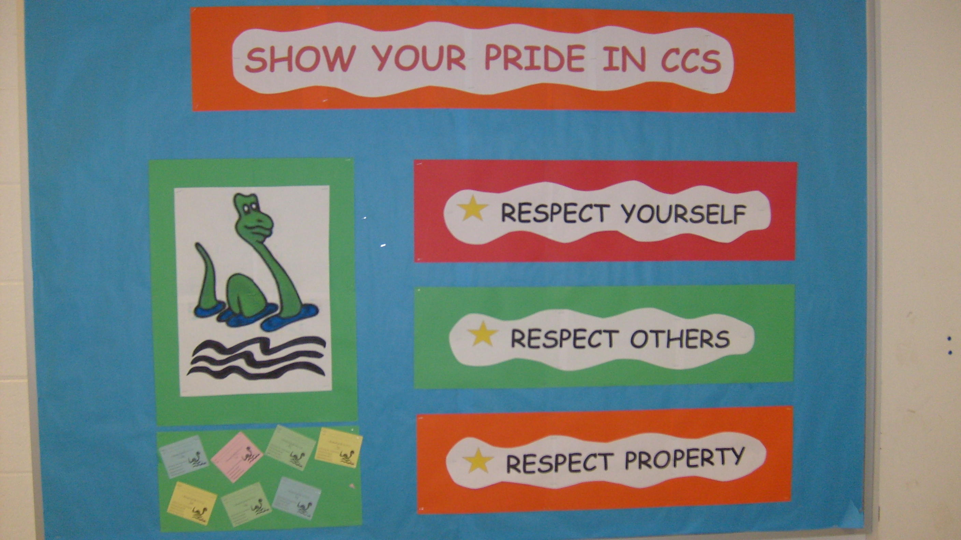
Charlotte Central
Notes:
Charlotte Central School – Again using mascot.

Slide 15

Woodbury Elementary
Notes:
Woodbury Elementary – Use mascot to create character to promote expectations.

Slide 16
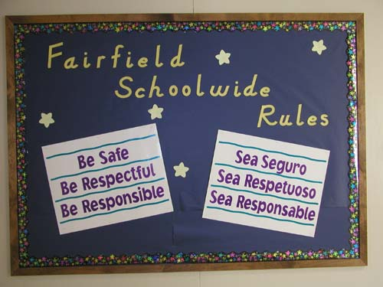
Fairfield in CT
Notes:
This is a school in Texas but a great example of taking into consideration the various cultures within your school. This school, in particular, had several bilingual students.
Mention culture in schools

Slide 17
Activity #3:
Clearly Defined School-wide Expectations
In your teams:
Finalize your Expectations (insert into VTPBiS Workbook)
Plan for roll-out (write next steps into your VTPBiS Implementation Plan found at the back of your Workbook)
Notes:
Roll-out- you want to start thinking about how you are going to get people invested in these expectations
During Team Time – there would be a way to contact a coach for immediate concerns

