Slide 1
PBIS in 60 Minutes!
Webinar
September 27, 2016

Slide 2
Webinar Logistics
Orient to Webinar Screen
2 Ways to Interact:
Raise your hand using the icon on your screen
Type a question into the text box
Intermittently we will provide opportunities to interact.
This webinar will be recorded.
Please note, your microphone will be muted unless otherwise indicated.

Slide 3
Learning Objectives
After this training you will have…
Learned about PBIS within a Multi-tiered Framework
Briefly explored PBIS at the Targeted and Intensive Levels
Next Steps

Slide 4
What is your current knowledge about PBIS?
I know a lot
I know a little bit
I’m just learning
Notes:
Thumbs up, side and down…

Slide 5
What is School-wide PBIS?
Framework for enhancing adoption & implementation of
Continuum of evidence-based interventions to achieve
Academically & behaviorally important outcomes for
All students
Notes:
While this is likely the goal and desire of all schools, PBIS gives you a comprehensive framework for achieving this.
Consistent language and understanding

Slide 6
Traditional Approaches Ineffective
School- wide Discipline Problems
Reactive
Non-constructive
Poor implementation fidelity
Emphasis on punishment
Limited effects
Notes:
Many schools’ paradigms are to assume challenges will arise. PBIS focuses on teaching expectations and providing positive feedback. It is not a punitive approach.
“Drowning Frogs”
“Green to Yellow to Red” Cards expecting challenges rather than acknowledging successes
“Full to partial to limited” privileges

Slide 7
(Close to Home c Reprinted with permission of Universal Press Syndicate. All rights reserved.)
Notes:
Pool story

Slide 8
Who Benefits from PBIS? Everyone!
Intensive individual interventions
5%
Targeted small group, short- term individual interventions
15%
Universal practices ~
in place for 100% of the school population
80%
Notes:
Why – consistent response for students and staff
Clearly articulated plan and framework
Review of data to demonstrate success and challenges

Slide 9
Universal
Targeted
Intensive
Continuum of Support
FEW
SOME
ALL
Notes:
Talk about the differences between the colors

Slide 10
Universal
Targeted
Intensive
Continuum of Support for “Dylan”
Anger Mgt.
Math
Science
Adult relationships
Attendance
Reading
Peer Interaction
Notes:
Don’t reify – every student has competencies.

Slide 11
How does PBIS fit with Vermont Multi-tiered Systems of Support (VT MTSS)?
VT MTSS is a coherent continuum of evidence-based, system-wide practices that support:
proactive preventative core instruction for all;
a rapid response to academic and behavioral challenges;
frequent data-based monitoring; and
instructional decision-making
so that each Vermont student achieves high standards.

Slide 12
IMPACT

Slide 13
PBIS Primary Outcomes
“The number of discipline referrals have been cut in half. We have made steady gains in achievement each year since then. This year 88% of our students were proficient or above in reading and 87% of our students were on or above proficiency in math.” –PBIS Coordinator for St. Albans City School
Increase in
Decrease in
academic performance
on-task behavior
parent, student, and staff satisfaction
staff retention
office referrals
suspensions, detentions
disruptive classroom behavior

Slide 14
PBIS
Supporting
Staff Behavior
Supporting
Decision
Making
SYSTEMS
DATA
MTSS
PRACTICES
Smallest effort
Evidence-based
Biggest, durable effect
Supporting
Student Behavior
Notes:
5 Components of MTSS cuts across Data, Systems and Practices

Slide 15
School-Wide
Leadership team
Behavior purpose statement
Set of positive expectations & behaviors
Procedures for teaching SW & classroom-wide expected behavior
Continuum of procedures for encouraging expected behavior
Continuum of procedures for discouraging rule violations
Procedures for on-going data-based monitoring & evaluation

Slide 16
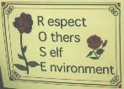
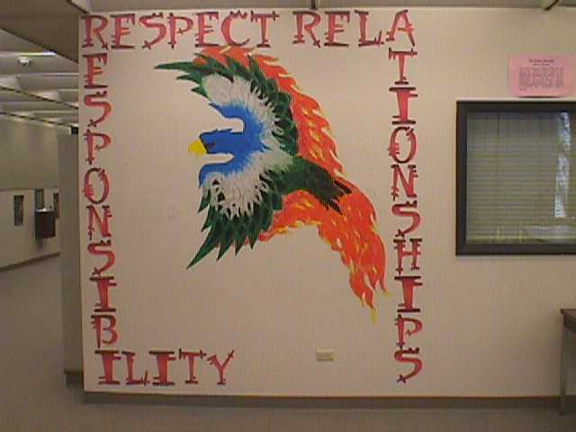
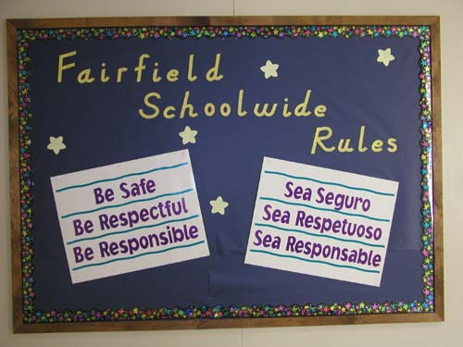
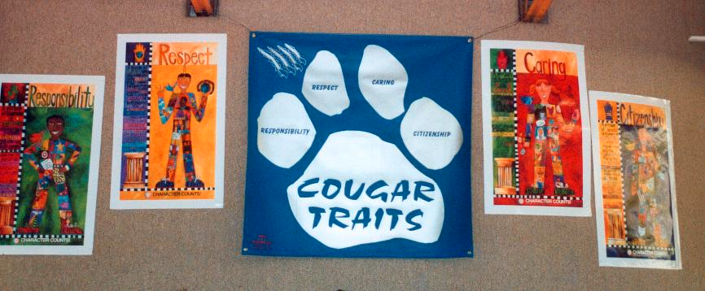
Few positive SW expectations defined, taught, & encouraged

Slide 17
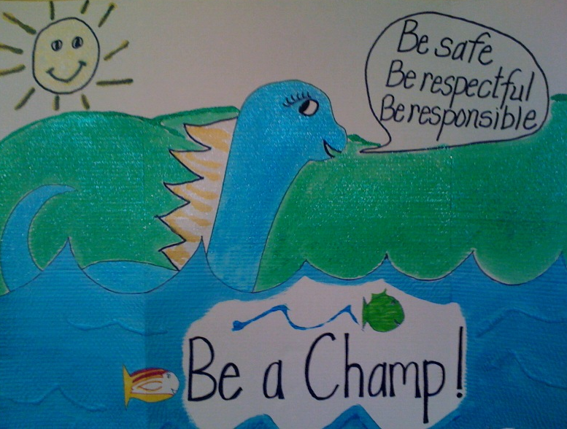
Champlain Elementary
Notes:
Champlain Elementary – they incorporated their mascot.

Slide 18
Proctor Elementary

Slide 19
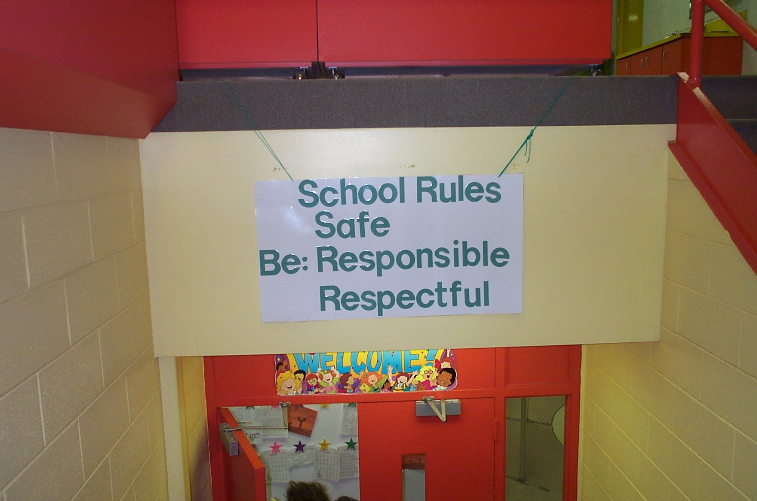
Redesign Learning & Teaching Environment
School Rules
NO Food
NO Weapons
NO Backpacks
NO Drugs/Smoking
NO Bullying

Slide 20
Teaching Behavior Expectations
Teaching Matrix |  | SETTING
 |  | All Settings | Hallways | Playgrounds | Cafeteria | Library/ Computer Lab | Assembly | Bus
 | Respect Ourselves | Be on task. Give your best effort. Be prepared. | Walk. | Have a plan. | Eat all your food. Select healthy foods. | Study, read, compute. | Sit in one spot. | Watch for your stop.
 | Respect Others | Be kind. Hands/feet to self. Help/share with others. | Use normal voice volume. Walk to right. | Play safe. Include others. Share equipment. | Practice good table manners | Whisper. Return books. | Listen/watch. Use appropriate applause. | Use a quiet voice. Stay in your seat.
 | Respect Property | Recycle. Clean up after self. | Pick up litter. Maintain physical space. | Use equipment properly. Put litter in garbage can. | Replace trays & utensils. Clean up eating area. | Push in chairs. Treat books carefully. | Pick up. Treat chairs appropriately. | Wipe your feet. Sit appropriately.
2. NATURAL CONTEXT
1. SOCIAL SKILL
Expectations
3. BEHAVIOR EXAMPLES
Teaching & Lesson Plans
Notes:
Before the next slide, ask audience who here suspends kids for not understanding math?

Slide 21
When a student…..
Doesn’t know how to read – what do we do?
WE TEACH.
Doesn’t know how to add – what do we do?
WE TEACH.
Doesn’t know how to swim – what do we do?
WE TEACH.
Doesn’t know how to drive – what do we do?
WE TEACH.
When a student doesn’t know how to behave – What do we do?
Notes:
21
Let’s read these aloud
Before next slide, ask audience to pair/share and talk about what it means to explicitly teach

Slide 22
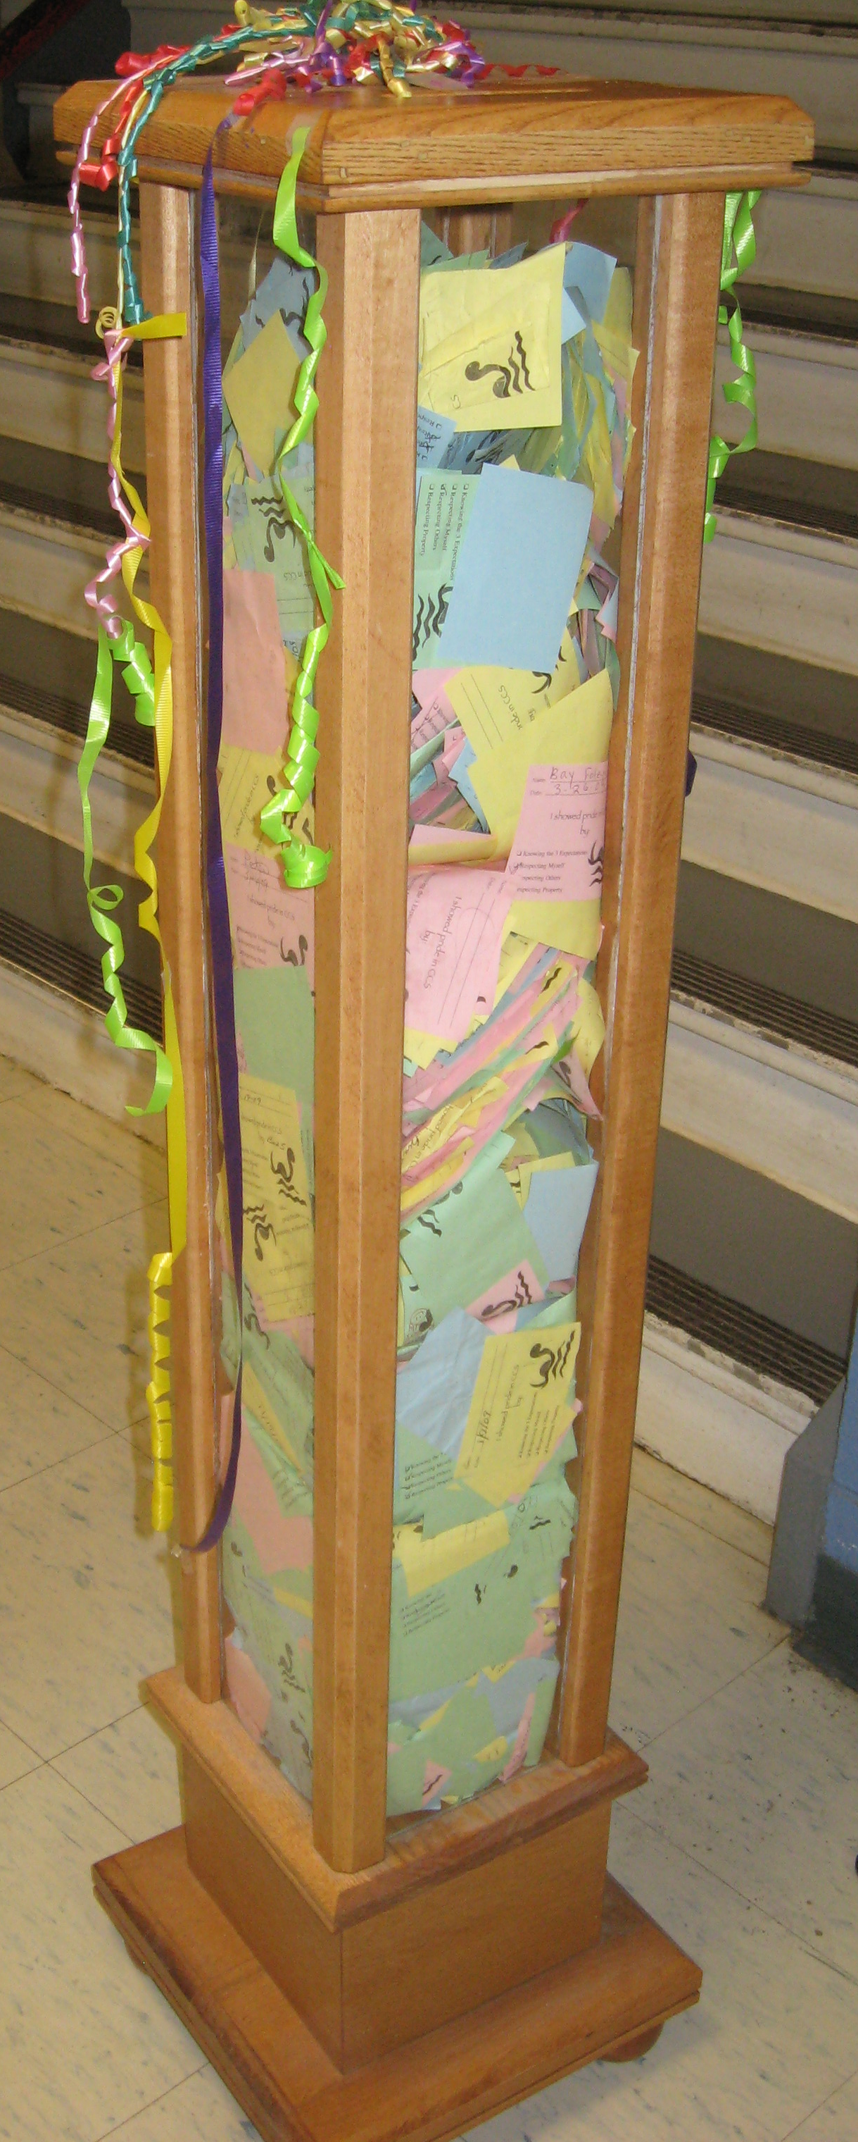
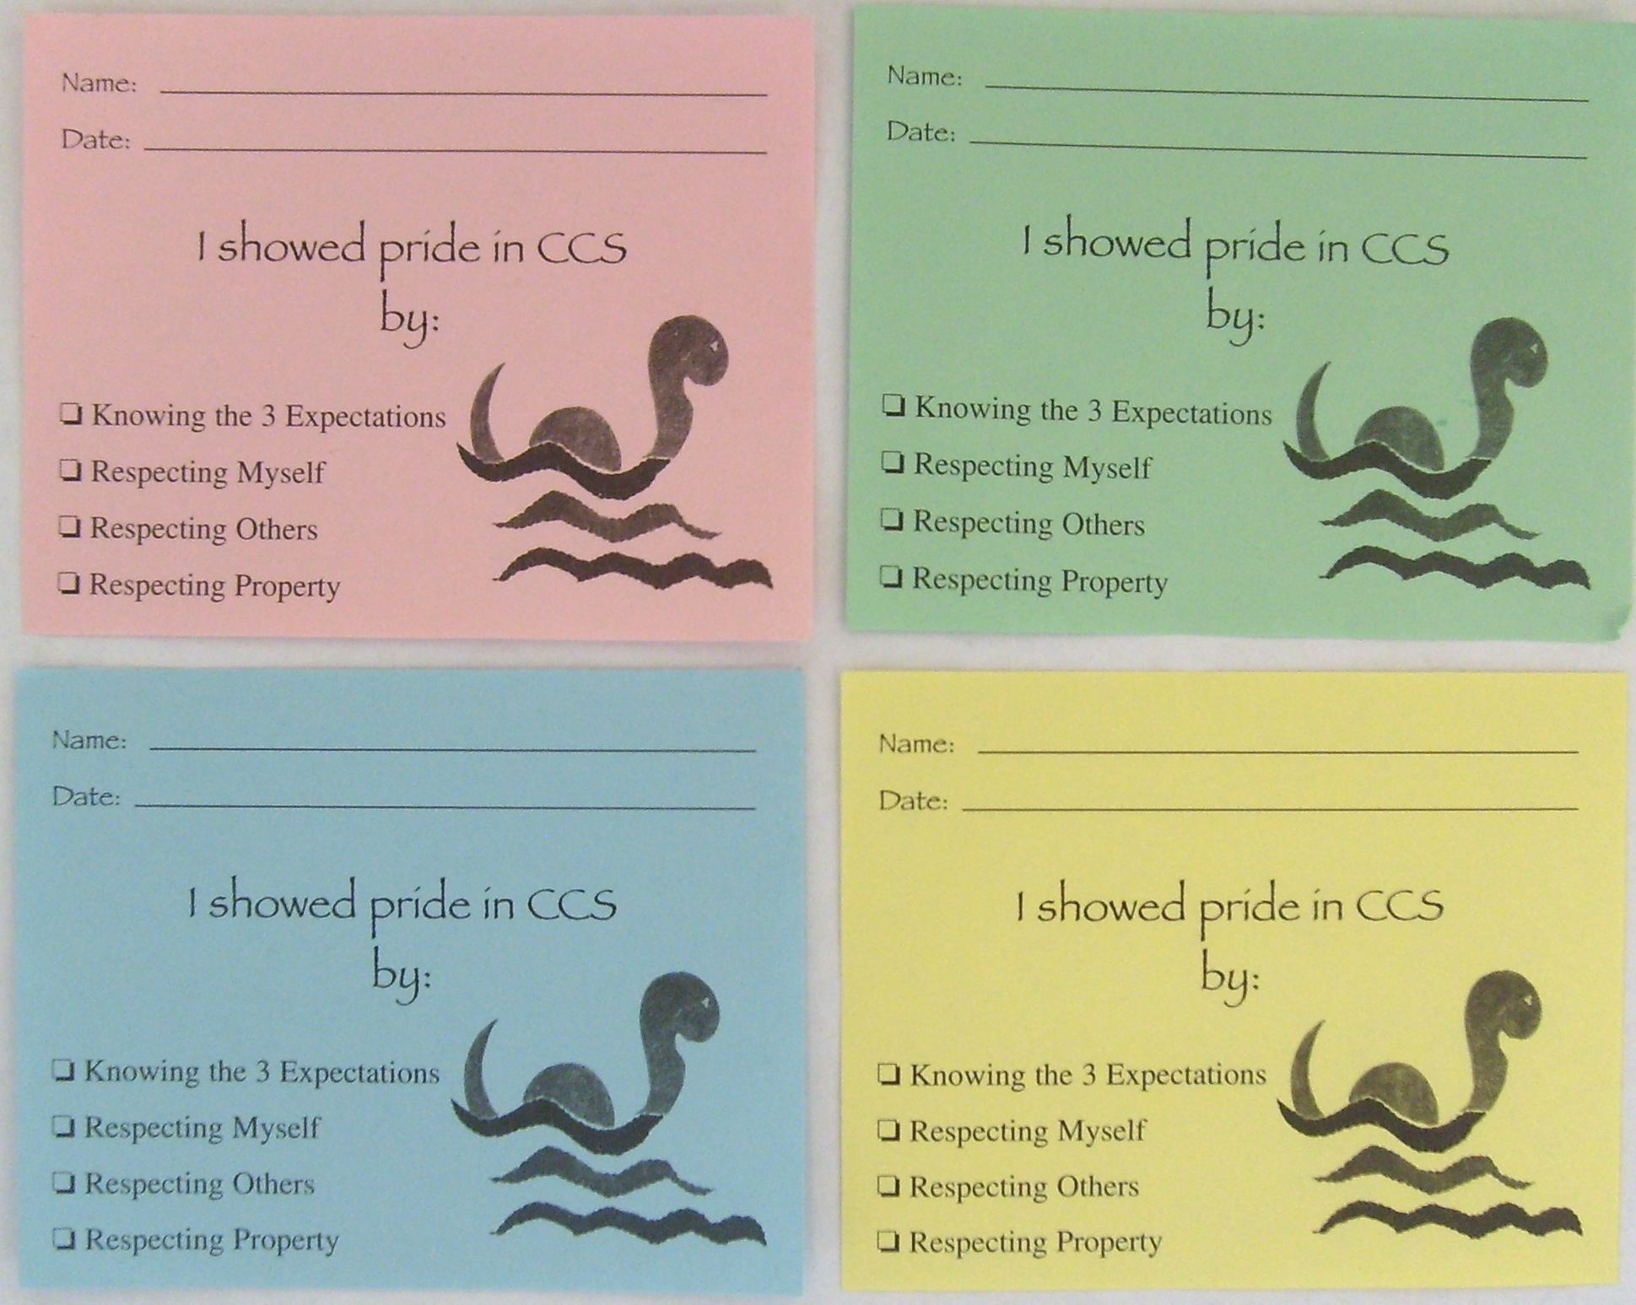
Acknowledging Behavior
Providing students feedback to let them know when and how they are meeting expectations (positive acknowledgement)

Slide 23
Why acknowledge students?
Behavior is learned
Learning is facilitated by guided feedback
Positive feedback has a greater likelihood of shaping behavior than negative feedback
Notes:
A little about the brain? We are hardwired to remember negative experiences because that bx/response keeps us safe.
Cognitive prep, skill acquisition, generalizability

Slide 24
PBIS Big Idea!
PBIS is about changing adult behavior!
We are trying to achieve a ratio of 6-8 positive to 1 negative adult-student interaction

Slide 25
PBIS question
How often do you effectively and regularly use specific acknowledgements for appropriate student behavior?
All the time
Most of the time
Some of the time
Never

Slide 26
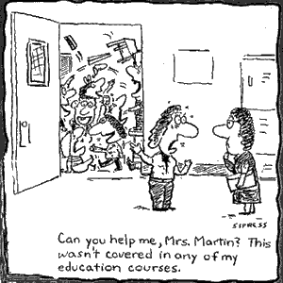
Discouraging Problem Behavior
This involves:
Consistent practices for preventing problem behaviors
Distinguishing between minor and major behaviors
Practices for responding to problem behaviors
Continuum of Procedures for responding to problem behavior

Slide 27
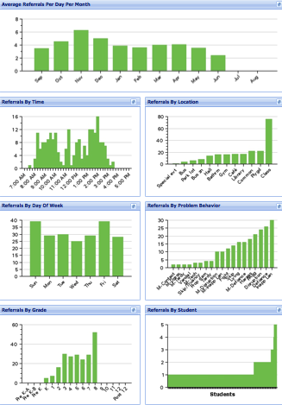
SWIS Big 7: Core Reports
Avg. Referrals Per Day Per Month
Time
Location
Day of Week
Problem
Behavior
Grade
Student

Slide 28
Decision-Making/Problem-Solving Process
Prevention: | Remove/alter “trigger” for problem behavior
Teaching: | Define, instruct & model expected behavior
Reward: | Expected/alternative behavior when it occurs; prompt as necessary
Extinction: | Increase acknowledgement of presence of desired behavior
Corrective Consequence: | Use non-rewarding/non-reinforcing responses when problem behavior occurs
Data Collection: | Indicate how you know when you have a solution
“Data showed a high number of referrals in the cafeteria so we re-taught cafeteria expectations to the staff, students, and cafeteria personnel, posted signs with expectations and referrals decreased markedly.” - PBIS Coordinator, Folsom
Notes:
This slides illustrates how we use
Prevention
Teaching
Rewards
Extinction
Corrective Consequences and
Data Collection to address disruption in the cafeteria

Slide 29
What should you expect to hear/see in a PBIS School (at the Universal level)?
80% of students can tell you the school-wide expectations and can say that they have been rewarded for following them
80% of staff can tell you the school-wide expectations and can say they have acknowledged students for following them
School staff have taught the school-wide expectations to all students
Positive adult-to-student interactions exceed negative
Notes:
School staff agree on which behaviors involve a referral to the office.
The school has a leadership team that is representative of school staff and includes an administrator
Function based behavior support is foundation for addressing problem behavior.
Data & team-based action planning & implementation are operating.

Slide 30
What should you expect to hear/see in a PBIS School?
School staff agree on which behaviors involve a referral to the office
The school has a leadership team that is representative of school staff and includes an administrator
Function-based behavior support is foundation for addressing problem behavior
Data- and team-based action planning & implementation are operating

Slide 31
PBIS Targeted and Intensive Levels

Slide 32
ESTABLISHING CONTINUUM of SWPBS - EXAMPLE
INTENSIVE PREVENTION
INTENSIVE PREVENTION
Function-based support
Wraparound
Person-centered planning
~5%
~15%
TARGETED PREVENTION
TARGETED PREVENTION
Check in/out
Targeted social skills instruction
Peer-based supports
Social skills club
What is your inventory of Supports?
UNIVERSAL PREVENTION
Teach SW expectations
Proactive SW discipline
Positive reinforcement
Effective instruction
Parent engagement
UNIVERSAL PREVENTION
~80% of Students
Notes:
I hid this slide – I don’t think we will have time and I think we talked about hiding it. Correct?

Slide 33
PBIS IN VERMONT

Slide 34
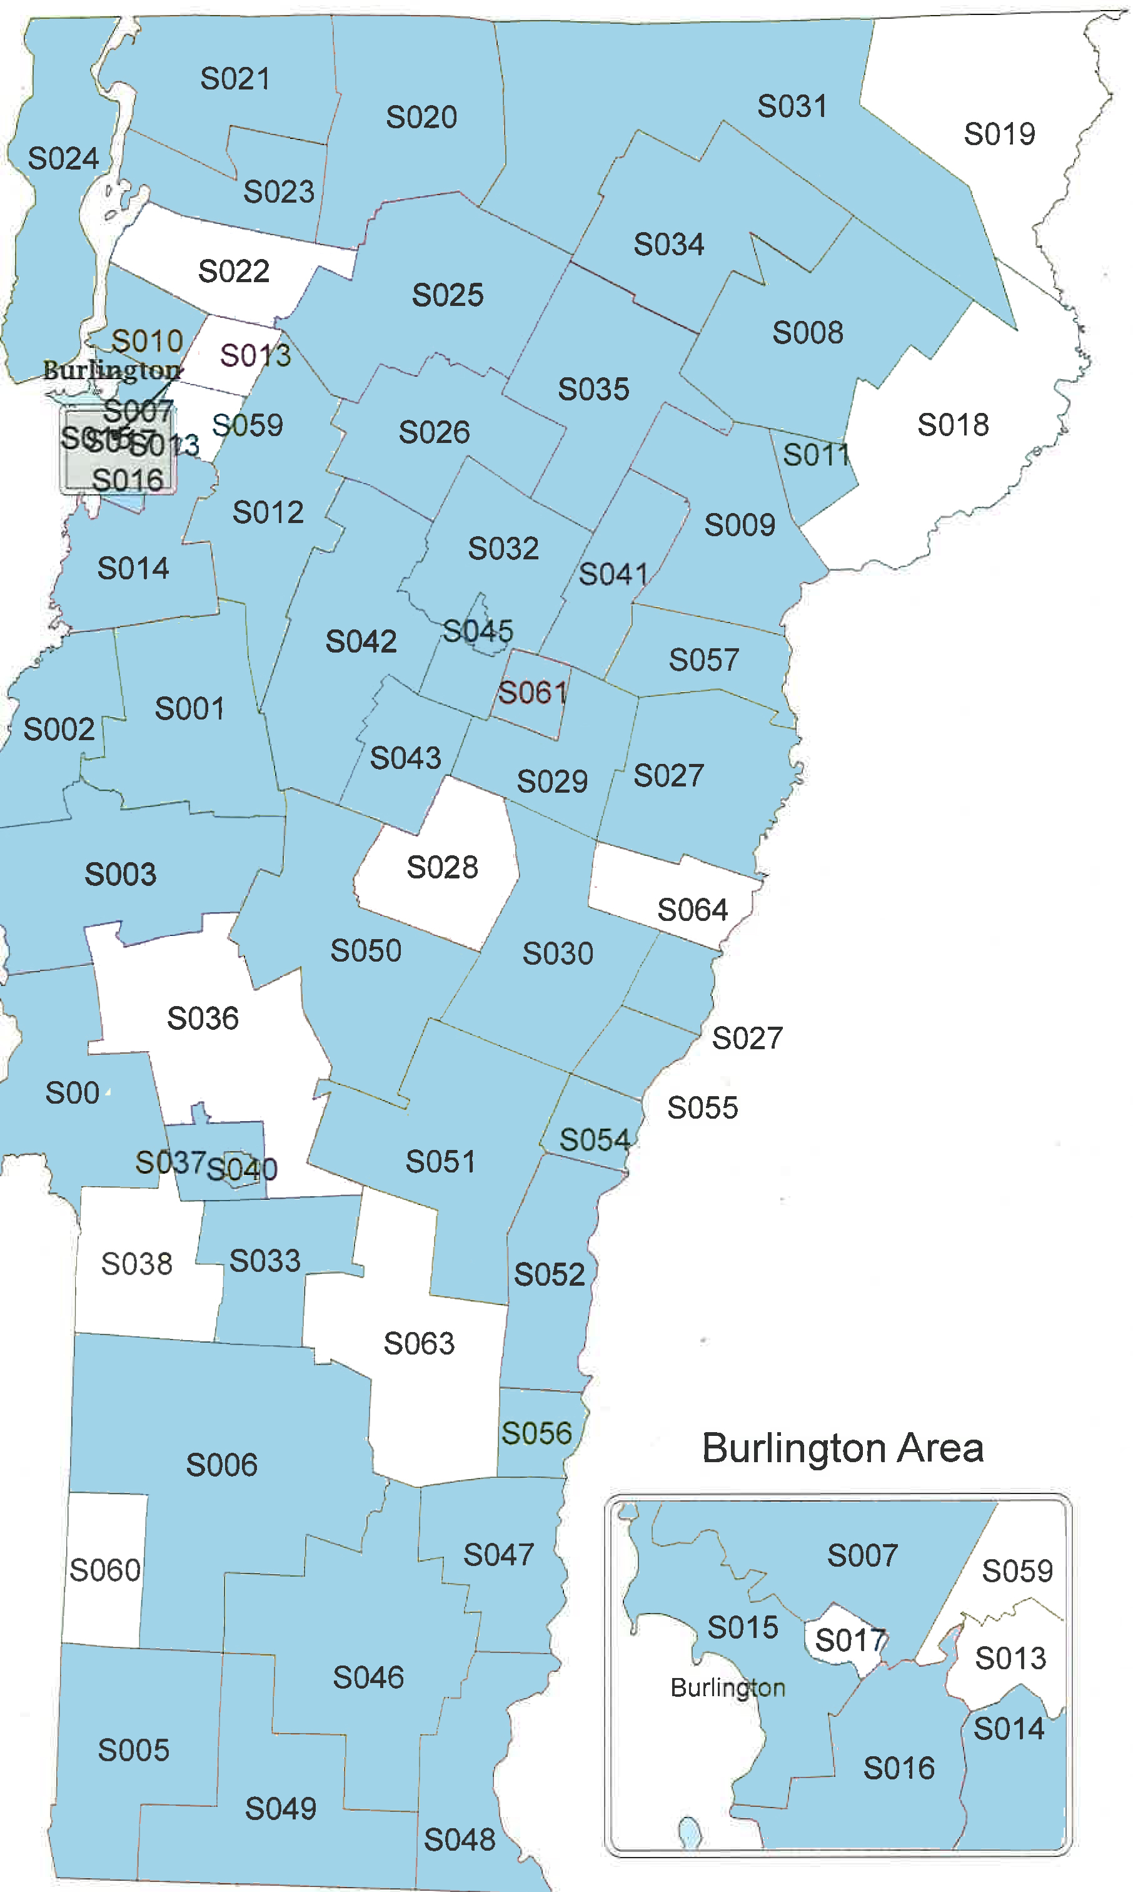
(app.) 22,000 schools in U.S. 143 schools in VT For more information visit: www.pbisvermont.org
52 SUs/SDs with at least one PBIS school
Where is PBIS?
S036
48% of VT Schools

Slide 35
Vermont PBIS Schools Over Time
Notes:
Compared to other states, we have a high proportion of schools doing PBIS

Slide 36
VTPBiS Training Sequence:
www.pbisvermont.org

