Slide 1


VTPBiS
Intensive Level
June 2015

Slide 2
Welcome to Day 2!
Agenda
Day 1
Day 3
Students & Families
Goals
Targeted
Teaming
Specific Interventions
Follow Up
FBA/BSP
Rolling out
Day 2
Day 4
Evaluation

Slide 3

1 Teaming
2 Goals
3 Assessment (FBA)
4 Intervention (BIP)
5 Evaluation (BIP)
Vermont’s Planning Process for Students
Adapted from: Dunlap et al. (2010). Prevent, Teach, Reinforce

Slide 4
Review Yesterday’s Team Time
Team Time Activities:
Complete Student Team Roster (Stage One of Behavior Support Plan)
Complete Goals (Stage Two of Behavior Support Plan)
Assess and strategize around your school’s capacity to conduct an FBA/BSP for students who need intensive supports

Slide 5
Review Yesterday’s Team Time
Team Time Activities:
Revisit the other assessments and inventories presented over the past two days; determine what else you need to do to get your intensive team ready on a systems level
Assign one person to read Chapter Five in your Prevent, Teach, Reinforce book; report back to the team on what this chapter has to offer and one specific strategy that might be pertinent to the student the team is focusing on

Slide 6
Formula for Happiness
Work hard
Succeed
Happy
Notes:
Today we’re going to get into the weeds with developing behavior support plans and measuring success.
Big ideas
- Conventional wisdom holds that if we work hard we will be more successful, and if we are more successful, then we’ll be happy. If we can just find that great job, win that next promotion, lose those five pounds, happiness will follow.
- But often success can be elusive, meaning happiness is rarely achieved despite your hard work

Slide 7

Happiness Advantage
Be positive
Work hard
Succeed
Notes:
- Steve Achor believes we have this formula backwards, and a great deal of research backs him up.
Happiness fuels success, not the other way around.
-When we are positive, our brains become more engaged, creative, motivated, energetic, resilient, and productive at work.

Slide 8

Attitudes & Actions
You maximize student potential when you convey an authentic positive attitude:
“I believe in you. I know you will succeed this year and beyond, and I am absolutely thrilled to be part of your life.”
And then, through your daily actions - show you mean it. - Charlie Appelstein

Slide 9
Selecting Strategies
As you identify unique strategies, use the sticky notes to post strategies on the laminated charts posted around the room:
Setting Event Strategies
Antecedent Strategies
Teaching Strategies
Consequence Strategies

Slide 10
F-BSP Strategy Types
Setting | Antecedent | Behavior | Consequence
Adult attitudes & actions Strengthening relationships Home-school communication Home-to-school reinforcement Engaging families Coordination with community providers Building a trauma-informed school | Providing choices Transition supports Environmental supports Curricular modification Adult verbal behavior Classroom management Increase noncontingent reinforcement Peer support Peer modeling | Replacement behavior Academic skills Problem-solving Coping Social skills Teacher-pleasing behavior Learning skills Self-management Independent responding Increased engaged time | Reinforce replacement behaviors Discontinue reinforcement of problem behavior Group contingencies Increase ratio of + to – responses School-to-home reinforcement Delayed gratification
Notes:
Setting Event Strategies Understanding and addressing precipitating factors (if possible)
Antecedent Strategies Redesigning the learning and environments to prevent problem behaviors
Teaching Strategies defining, modeling, practicing new behaviors
Consequence Strategies implementing specific to generalizable reinforcement
1) Share few examples of really effective strategies
2) Link that to function of problem behavior

Slide 11
Setting Event Strategies
WHAT WE CAN CONTROL
Engaging families
Structure / schedule
Classroom accommodations and modifications
Home/school communication
WHAT WE CANNOT
History of trauma
Medical / physical conditions
Temperament
Sensory profile
Carry-in issues

Slide 12

https://vimeo.com/73172036
https://www.youtube.com/watch?v=E_zaoQFWeLs
Notes:
Difficult to have positive attitude about kids with challenging behaviors. But we know that understanding can build empathy and change attitudes & actions
Husband and wife team became foster parents and decided to make this short film to provide insight on the experiences of children coming from homes of abuse and neglect, and explores the emotion of it all through the child's point of view.
1) What’s your reaction?
2) What strengths did you see that Zoe has?
3) What do you think Zoe’s first foster parents thought of her behavior?
4) What do you guess her teachers think about her behavior?
5) How would they act differently as educators if they could hear her tell her story?
Part 2 is about how to prevent the cycle of abuse and neglect from perpetuating itself in the first place.” She says , “This continuation of Zoe's story will examine how different players in a child's life affect the prospects of his or her future.”

Slide 13
Basic Concepts
Many children with intensive behavior support needs have been victims of trauma and neglect
When staff understand the effects of trauma they often find it easier to manage their own feelings when challenged
Adults who understand the effects of trauma can provide support to help children respond
Notes:
One out of every 4 children attending school has been exposed to a traumatic event that can affect learning and/or behavior. (NCTSN, 2008)
Twice as many have experienced Adverse Childhood Events that can lead to trauma

Slide 14


What is trauma?
Trauma is NOT the stressful event
Trauma is how you experience the event
Unpredictable
Threatening
Overwhelming
Meaningless
Notes:
Trauma is a subjective experience of extreme stress that overwhelms an individual’s ability to cope (Giller, 1999), and is typically characterized by one or more of the following qualities:
Unpredictable – from the victim’s perspective
Overwhelming – individual feels helpless, powerless, voiceless
Threatening – event is perceived as a threat to life, limb, sanity, or integrity of the self
Meaningless – individual is unable to assign meaning to, or understand the event

Slide 15

Elephant Circle
Notes:
When we perceive extreme danger, we enter into freeze-fight-flight mode; our physiology overrides our thinking brain.
Charlie Appelstein uses this metaphor to explain metaphorically what our brains our doing.

Slide 16
Young Children in Custody (0-5)
52% increase in 9 months
Notes:
Latest custody numbers from DCF-FSD. Overall number of children in custody is increasing and if you look at age range there is a bubble of children who will be entering school soon

Slide 17

General Strategies
Relationships
Routines
Warn before changes
Choices
Clear limits
Safe spaces
Anticipate triggers
Answer questions about trauma
Understand link b/w trauma & behavior

Slide 18
When should you refer?
Physical symptoms
Self-regulation difficulties
Inconsistent academic performance
Over or under-reacting to events
Severe reactions
Long duration (more than 1 month)

Slide 19
Effective Mental Health Interventions
Education about trauma
Helping re-establish a sense of safety
Teaching techniques for dealing with overwhelming emotional reactions
An opportunity to talk about and make sense of the traumatic experience in a safe, accepting environment
Involvement, when possible, of primary caregivers in the healing process

Slide 20
Taking Care of Yourself
Recognize signs
Irritability
Difficulty planning & concentrating
Numb
Intensive feeling
Don’t go it alone
Teams
Administrators
Colleagues
Recognize as occupational hazard
“cost of caring”
NOT weakness
Seek help with own trauma
Attend to self care
Eat well
Exercise
Sleep
Laugh & cry
Education
Talk to professional

Slide 21
Handouts
NCTSN Child Trauma Toolkit for Educators (2008)
National Council for Adoption Children of Trauma: What Educators Need to Know (2013)

Slide 22
Activity
Complete the setting event section of your Behavior Support Plan Intervention Checklist
Notes:
Look at hypothesis statement
Look at strategy categories
Choose 1-3
Rank order them
Go to bx support plan
Get specific about the details on how you’ll implement

Slide 23
F-BSP Strategy Types
Setting | Antecedent | Behavior | Consequence
Adult attitudes & actions Strengthening relationships Home-school communication Home-to-school reinforcement Engaging families Coordination with community providers Building a trauma-informed school | Providing choices Transition supports Environmental supports Curricular modification Adult verbal behavior Classroom management Increase noncontingent reinforcement Peer support Peer modeling | Replacement behavior Academic skills Problem-solving Coping Social skills Teacher-pleasing behavior Learning skills Self-management Independent responding Increased engaged time | Reinforce replacement behaviors Discontinue reinforcement of problem behavior Group contingencies Increase ratio of + to – responses School-to-home reinforcement Delayed gratification
Notes:
Setting Event Strategies Understanding and addressing precipitating factors (if possible)
Antecedent Strategies Redesigning the learning and environments to prevent problem behaviors
Teaching Strategies defining, modeling, practicing new behaviors
Consequence Strategies implementing specific to generalizable reinforcement
1) Share few examples of really effective strategies
2) Link that to function of problem behavior

Slide 24
Antecedent Strategies
Antecedents are the events, people or things that immediately precede the problem behavior. Antecedent strategies are created to prevent problem behaviors/increase replacement behaviors
Examples
Eliminate the trigger
Modify task to incorporate student interests
Change task difficulty
Make task more meaningful

Slide 25
De-escalation Strategies
Children who are heard listen
In an emotionally-charged situation, you must deal with the feelings first, and then with the behavior

Slide 26
Activity
Complete the Antecedent section of your Behavior Support Plan Intervention Checklist

Slide 27
F-BSP Strategy Types
Setting | Antecedent | Behavior | Consequence
Adult attitudes & actions Strengthening relationships Home-school communication Home-to-school reinforcement Engaging families Coordination with community providers Building a trauma-informed school | Providing choices Transition supports Environmental supports Curricular modification Adult verbal behavior Classroom management Increase noncontingent reinforcement Peer support Peer modeling | Replacement behavior Academic skills Problem-solving Coping Social skills Teacher-pleasing behavior Learning skills Self-management Independent responding Increased engaged time | Reinforce replacement behaviors Discontinue reinforcement of problem behavior Group contingencies Increase ratio of + to – responses School-to-home reinforcement Delayed gratification
Notes:
Setting Event Strategies Understanding and addressing precipitating factors (if possible)
Antecedent Strategies Redesigning the learning and environments to prevent problem behaviors
Teaching Strategies defining, modeling, practicing new behaviors
Consequence Strategies implementing specific to generalizable reinforcement
1) Share few examples of really effective strategies
2) Link that to function of problem behavior

Slide 28
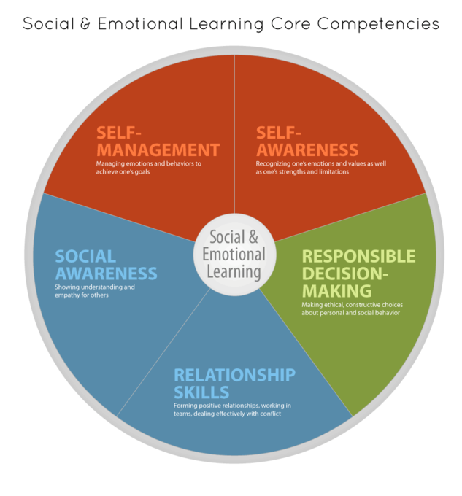
Social Emotional Learning
Notes:
Broad areas of skill sets
From casel.org
Center for academic and social emotional learning

Slide 29
Matching Interventions to types of social skills problems:
Most social skills studies deliver a treatment to children with an almost complete disregard for the types of social skills deficits children may have
(Gresham, 1998)
Notes:
Consider acquisition vs. performance deficits (can’t do vs. won’t do)

Slide 30
Classification of Social Skills
Acquisition Challenges
  Absence of knowledge for executing skill or failure to discriminate which social behaviors are appropriate in specific situations (can’t do)
Performance Challenges
  Skill is present in repertoire, but student fails to perform at acceptable levels (won’t do)
Fluency Challenges
  Lack of exposure to sufficient or skilled models of social behavior, insufficient rehearsal/practice or low rates or inconsistent delivery of reinforcement of skilled performances

Slide 31
Universal screening will help you…
Classify specific types of social skills concerns
Select/target skills and competing problem behaviors for intervention

Slide 32
Social Skills Basics
Social skills curriculum must match the specific need.
An ideal curriculum does not exist.
Basic set of “Preferred Teaching Practices” exists.
Initially, learning how to teach social skills takes time and energy.

Slide 33
Instructional Approach
Tell (coaching)
Show (modeling)
Do (role play)
Practice (behavioral rehearsal)
Monitor Progress (feedback)
Generalize (apply in multiple settings)

Slide 34
Social Skills Instruction at the Intensive Level
Link with functional assessment and behavior planning
Create individualized plans within the context of the Universal (school-wide) social skills instruction
Pre-teach, pre-correct, re-teach
Integrate what the student does well
Evidence of generalization should include school, home and community

Slide 35
Some SEL Examples
Second Step
Social Cognition
Incredible Years
Check and Connect
CASEL: www.casel.org
Parent Toolkit: www.parenttoolkit.com
What do you use?

Slide 36
Activity
Complete the Behavior Teaching section of your Behavior Support Plan Intervention Checklist

Slide 37
F-BSP Strategy Types
Setting | Antecedent | Behavior | Consequence
Adult attitudes & actions Strengthening relationships Home-school communication Home-to-school reinforcement Engaging families Coordination with community providers Building a trauma-informed school | Providing choices Transition supports Environmental supports Curricular modification Adult verbal behavior Classroom management Increase noncontingent reinforcement Peer support Peer modeling | Replacement behavior Academic skills Problem-solving Coping Social skills Teacher-pleasing behavior Learning skills Self-management Independent responding Increased engaged time | Reinforce replacement behaviors Discontinue reinforcement of problem behavior Group contingencies Increase ratio of + to – responses School-to-home reinforcement Delayed gratification
Notes:
Setting Event Strategies Understanding and addressing precipitating factors (if possible)
Antecedent Strategies Redesigning the learning and environments to prevent problem behaviors
Teaching Strategies defining, modeling, practicing new behaviors
Consequence Strategies implementing specific to generalizable reinforcement
1) Share few examples of really effective strategies
2) Link that to function of problem behavior

Slide 38
Consequence Strategies
Consequences strategies: minimize reinforcement for problem behavior, increase reinforcement for desirable behavior, or redirect to alternative behavior. Strategies should be designed in combination with teaching strategies
Examples:
Non-contingent reinforcers
Redirection
Extinction

Slide 39
Supports and Practices
Trauma informed Care
De-escalation and Relationship Building Skills
LSCI trainings
  Breaking The Conflict Cycle (all Staff)
  Turning Down The Heat ( some staff)
  Full LSCI training
Check and Connect
Notes:
11:15-11:25

Slide 40
Life Space Crisis Intervention
Establishing effective positive helping relationships with children
Diagnosing and breaking self defeating patterns of behavior
Notes:
11:15-11:25

Slide 41
Restorative Justice
An alternative to suspension
Notes:
11:15-11:25

Slide 42
Activity
Complete the Consequence section of your Behavior Support Plan Intervention Checklist

Slide 43
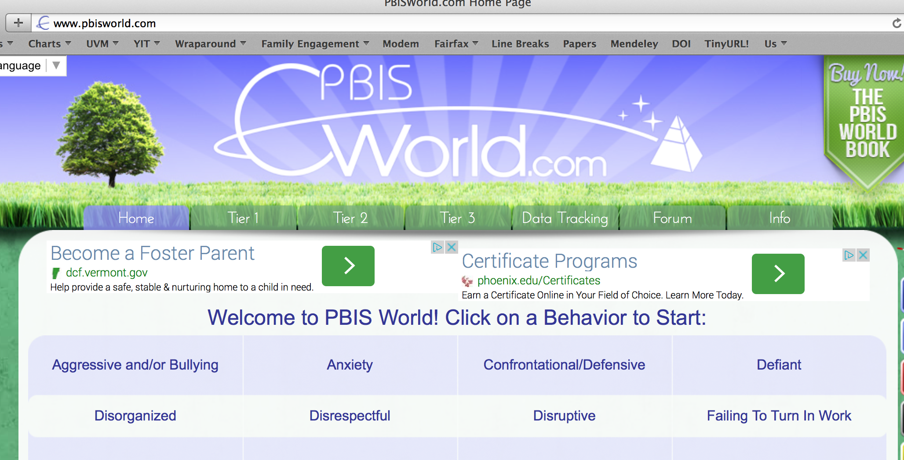
Resources for Interventions
www.pbisworld.com
http://www.cccoe.net/social/skillslist.htm
Notes:
Jean 5

Slide 44
Activity
Find someone you haven’t talked with yet this week.
For all the strategies you’ve talked about, how will you know if they worked?

Slide 45
Team Time
Putting the pieces together … take a critical look at your FBA/BSP
Revise it as needed
Identify parts that need additional work
Make a plan around how you’ll share this process with other teams and team members
Identify specific interventions that you want to know more about, suggest training needs, etc.

