Slide 1


VTPBiS
Intensive Level
June 2015

Slide 2

Tracy Harris
Ken Kramberg

Slide 3

Introductions: Focus on Strengths
As a Team, identify 2-3 big strengths your team is bringing to the strand
Select one person from your team to introduce your team members and list your strengths

Slide 4
Agenda
Day 1
Day 3
Students & Families
Goals
Targeted
Teaming
Specific Interventions
Follow Up
FBA/BSP
Rolling out
Day 2
Day 4
Evaluation
Notes:
Notes about the agenda:
Systems, Practices, Data
Differentiated learning process (maybe insert slide of railroad tracks (next)
This is a “workshop” with the idea that we’ll work together to identify your big needs so you can walk away with a real plan

Slide 5
Objectives
By the end of this training you will have:
Strengthened targeted & built readiness
Explored 5 Steps for Intensive Process
Practiced FBA/BSP
Examined Tier 3 practices
Considered Proactive Crisis Planning
Reviewed data systems at Tier 3
Planned for next steps

Slide 6
Training Logistics
Workbook
Vermont PBIS Behavior Support Plan
Handouts
Flash drives
Website
http://www.pbisvermont.org

Slide 7

BEST Expectations:
Intensive Training Teaching Matrix
BEST Expectation | Training Setting
Be Present | Be On Time Silent cell phones; Eyes and ears in focus
Engage | Take a Team role; Ask questions; Follow along with the Power Point and Activity Sheets.
Strengths Focus | 4:1 positives to negatives; Build on what’s working
Team Solutions | Establish and follow team roles and norms Contribute ideas to Team Planning
Notes:
Teach as you would a teaching matrix in a school. Draw connection to this matrix and ones they have developed. This will be used as part of a simulated CICO activity later in the training.

Slide 8
Activity
Heart of the Matter,
Part 1

Slide 9
SYSTEMS
supporting staff behavior
OUTCOMES
supporting student behavior
PRACTICES
DATA
supporting decision making
Notes:
Systems, Practices, Data
Start with systems

Slide 10
SW-PBIS Supports for All Students
Intensive Supports – Individualized interventions provided to students with most complex emotional and behavioral needs.
Wraparound
Complex FBA/BIP
1-5%
5-15%
80-90%
Simple FBA/BIP
Individualized CICO
Targeted Supports – Provided to students determined to be “at-risk” of emotional and behavioral challenges.
Social/Academic Instructional Groups
Check-in/Check-out
Universal Supports – Supports provided to all students. Expectations are taught, reinforced, and monitored in all settings.
School & Class-wide expectations & supports
Notes:
Need to have a system that builds from the base…
VT had schools with really good individualized systems and schools that do a great job with Universal supports. It’s building the supports in between that has been the challenge. It doesn’t come naturally.
Ken

Slide 11
Check-In/Check-Out (CICO)
Default targeted intervention. WHY?
Most students receive multiple ODRs for peer or adult attention.
Evidence indicates CICO is effective practice for reducing acting out behavior related to attention seeking.
Schools must have strong CICO in place!
Notes:
Jean

Slide 12
All Check In-Check Out programs have:
a positive caring adult
daily positive interactions with teachers & other adults
supervision and monitoring of students
more performance feedback
Notes:
Jean

Slide 13
Statistically Speaking …
Up to 12% of students with chronic problem behaviors act out for adult or peer attention
Why?
Notes:
0 TO 4%

Slide 14
Activity
Do the Math:
Given your enrollment, how many students would benefit from CICO?

Slide 15
Using ODRs for Decision Making
IF | FOCUS ON
Receive 5 or more office referrals (more than 5% of students) | Targeted / classroom supports
10 or more office referrals Continue rate of referrals after receiving targeted group settings Small number of students destabilizing overall functioning of school (Less than 5%) | Intensive supports

Slide 16
Barriers to Implementation
Tendency to individualize
Faculty not marking DPRs
Wanting to continue after goal has been met
Goals set too high
Desire for behavior to change quicker
Inadequate professional development
New staff
Parent buy-in
What else?

Slide 17
Keys to Sustainability
Ongoing professional development
Checking for fidelity
Focus on relationships
What else?
Notes:
17
What successes have you found at targeted level?
Share with each other

Slide 18
Activity
Complete the VTPBiS CICO Self-Assessment
Notes:
In Handbook

Slide 19
Targeted Interventions Based on Functions of Behavior
Access Adult Attention/Support:
Check-In/Check-Out
Adult Mentoring Programs
Access Peer Attention/Support:
Social Skills Instruction
Peer Mentoring
Self-Monitoring with Peer Support (function: academic task escape)
Academic Skills Support
Organization/Homework planning support
Homework completion club
Tutoring
Notes:
Intervention is continuously available
Rapid access to intervention (72 hr.)
Very low effort by teachers
Consistent with school-wide expectations
All staff/faculty in school are involved/have access
Flexible intervention based on descriptive functional assessment
Adequate resources (admin., team)
Continuous monitoring for decision-making

Slide 20
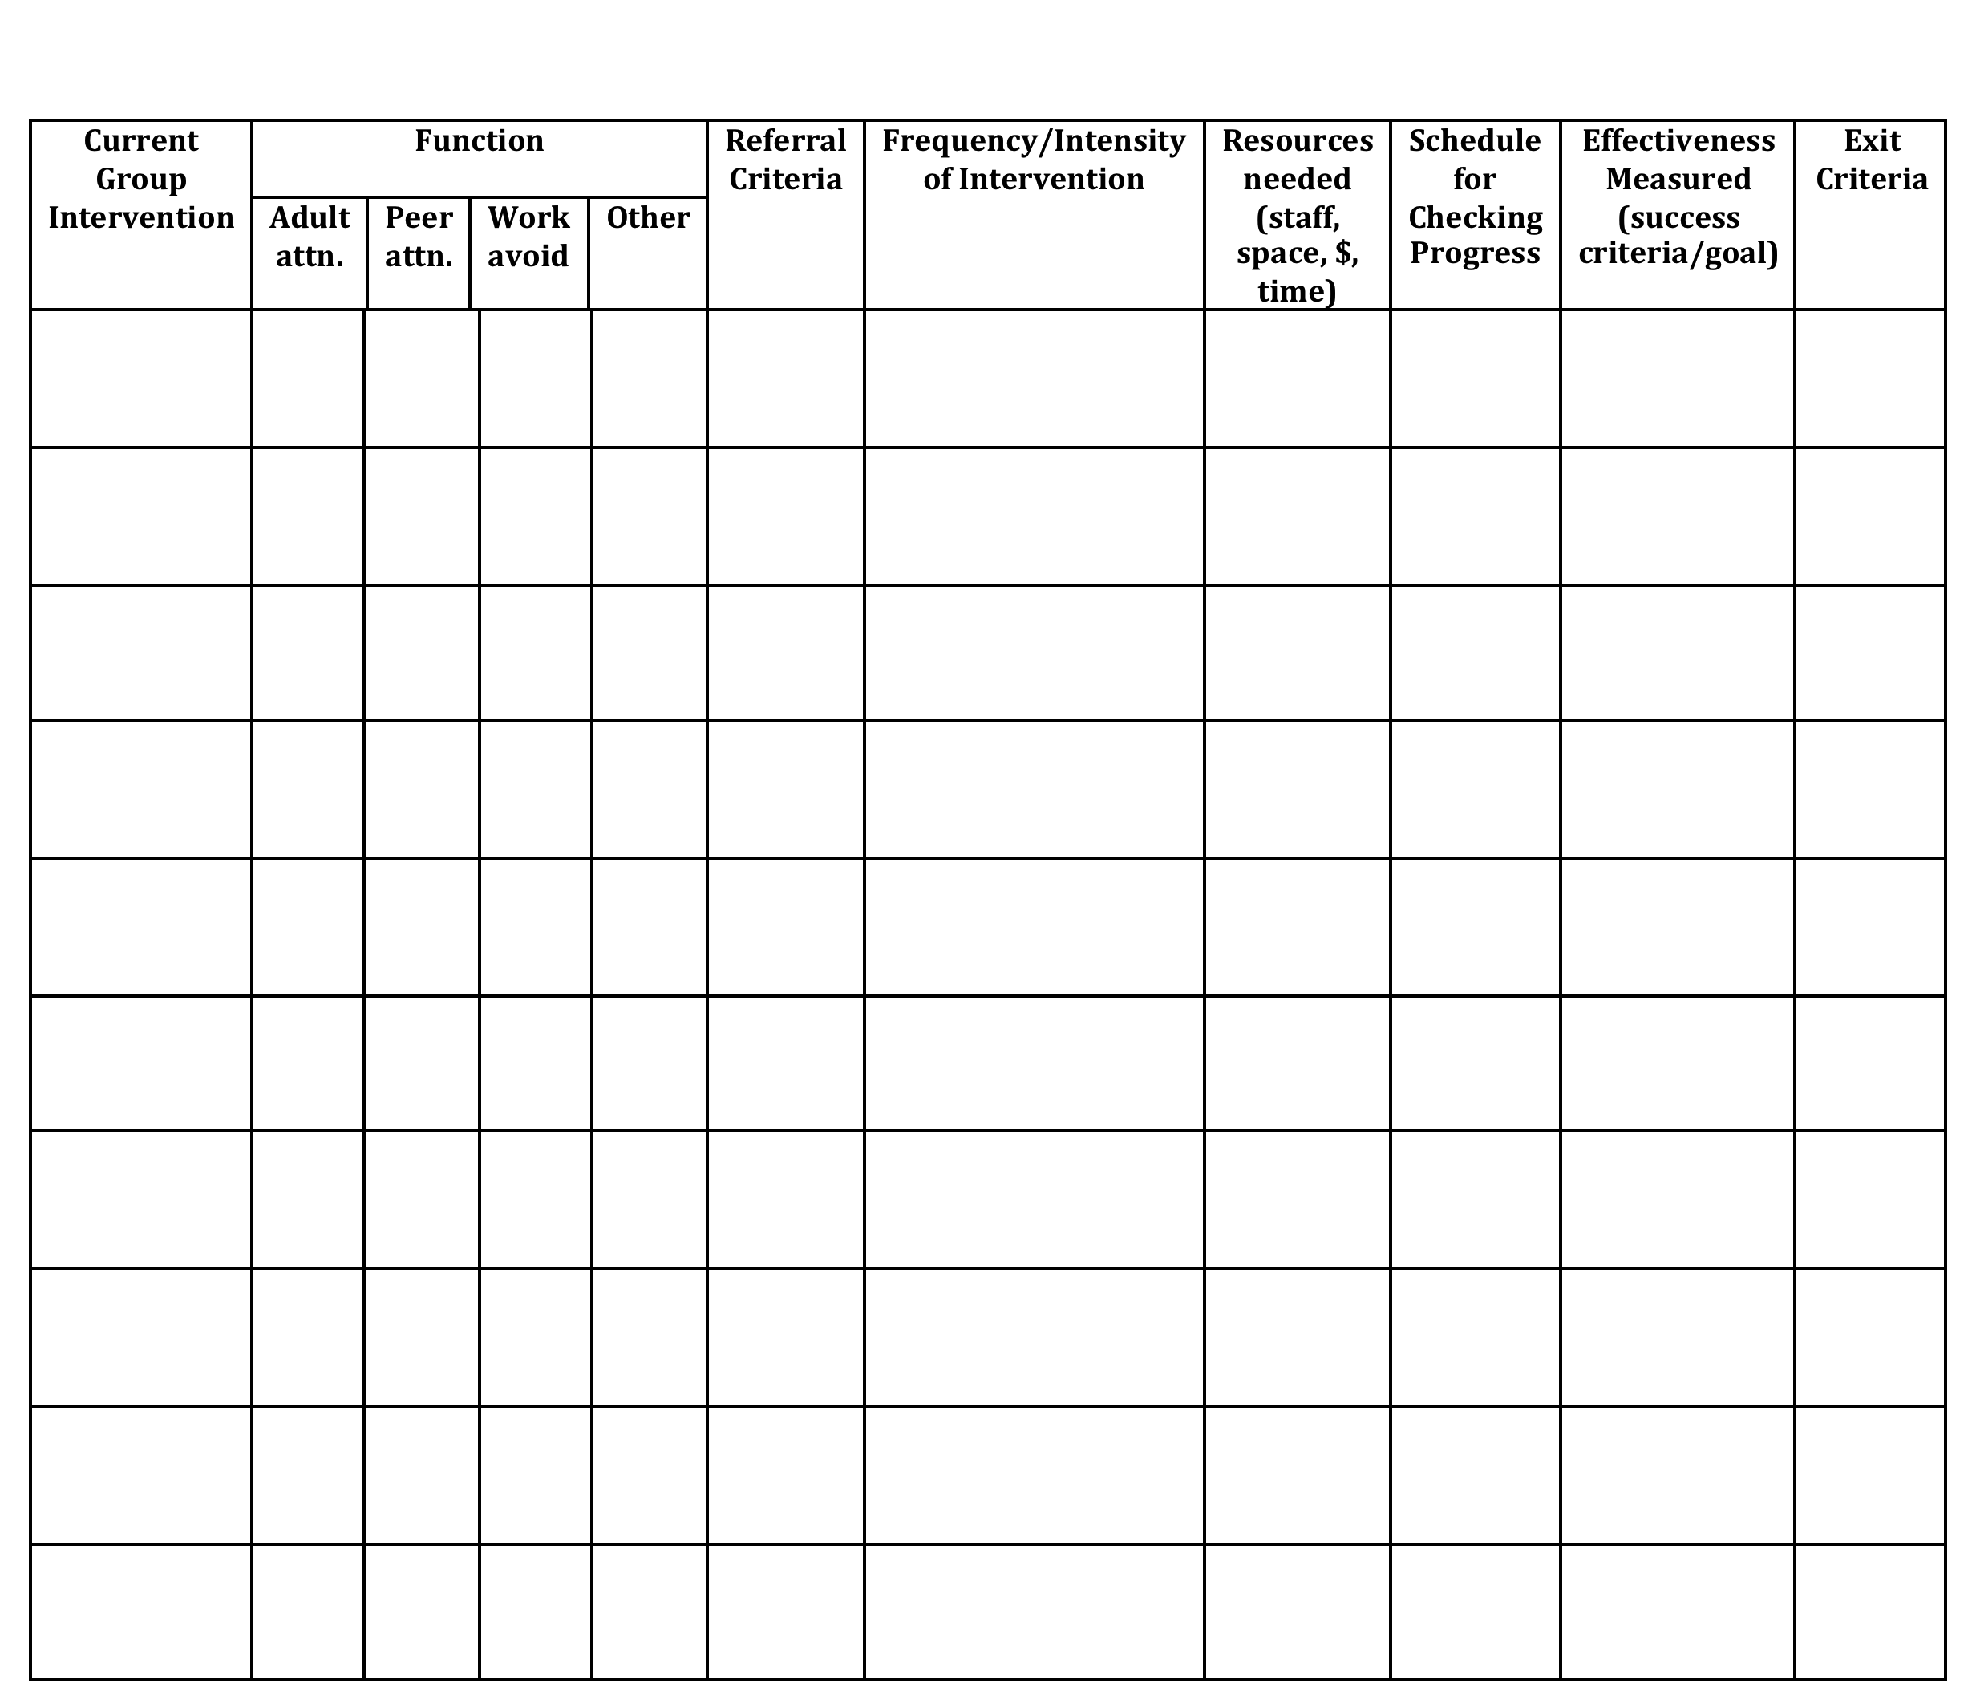
Inventory of Existing Targeted Interventions
Notes:
Direct them to Handbook for this activity, go to next slide

Slide 21
Activity
In school teams, review your Inventory of Targeted Supports
Share two most successful practices with large group
Notes:
In Handbook
Each team shares two most successful practices with large group

Slide 22
Necessary Conversations (Teams)
Tier 1
Tier 2
Tier 3
SU/District Team
•Coordinates implementation
•Ensures access to resources
•Reviews data across schools
SU/District Team – Targeted/Intensive:
•Secures resources
•Focuses on student outcomes
•Focuses on fidelity of practices across the district/SU
SU/District
School Leadership Team
•Plans and implements 6 school components of PBIS
School Systems Level Team – Targeted/Intensive:
•Creates procedures for referral, screening & evaluation
•Communicates with staff and families
School
Student Level Team
•Matches students to interventions
•Evaluates & monitors student progress
Student Level Team
•Completes FBA/BIP
•Evaluate & monitor student progress
Facilitates wraparound
Student
Notes:
You need to figure out where you as the intensive team fit in

Slide 23
Intensive Team: Critical Features
Possess specialized behavioral skills within their membership
Allow and encourage contributions from all their members
Have predictable and efficient procedures for doing business and solving problems
Have regular opportunities to access building staff, families, and community agencies to communicate and solicit information
Notes:
REMEMBER TO FOCUS ON:
Systems Level things vs Individual Students

Slide 24
Intensive Team: Objectives
Manage teacher requests for assistance
Ensure that teachers and students receive support in a timely and meaningful manner
Provide a general forum for discussions and possible solutions for individual student behavioral concerns
Organize a collaborative effort to support the teacher (Todd et. al., 1999)

Slide 25
Role of Administrator
Know what the practices look like when implemented with fidelity;
Access special resources, if needed.
Support team meeting time
Be flexible around school policies/procedures.
Be committed to helping students and LRE.
Be aware of data using tracking tools; help decide what needs to change.
Notes:
This is who the parent will call if there are problems. Administrator needs to know what is happening with all student plans.

Slide 26
Role of School Coordinator
Attend Leadership Team Meetings
Meet with Student Teams weekly to address student referrals, interventions & monitor progress
With leadership team, identify staff to facilitate individual team-based meetings.
Attend regional coordinator meetings
Attend all training events
Help team complete behavior tasks on time
Help with team organization
Data organization and reporting
Notes:
Active knowledge of school’s PBIS efforts
Skilled in function-based assessment, behavior support planning & implementation
Member of the school’s Leadership Team and EST
Role formally endorsed by school principal
Flexibility to complete tasks during the day
Positive rapport with other school staff

Slide 27
Check-In
Who participated in webinar?
Who completed Readiness Checklist as a Team?
Who has had a chance to use the BAT?
Notes:
If not everyone present was part of webinar, readiness, or BAT then bring each other up to date and get additional input from one another in next activity

Slide 28
Activity
Review / Complete Readiness Checklist
Complete Team Profile
Notes:
In Handbook
Pull up your BAT from PBIS apps website … should have completed this as part of pre-institute tasks
Review readiness checklist and BAT
THEN …
Complete Team Profile

Slide 29
Activity
Heart of the Matter,
Part 2

Slide 30


VT Family Support Resources
www.vermontfamilynetwork.org
www.vffcmh.org
Notes:
Do activity two: Power Imbalances today
Do activity one tomorrow: Positions and Interests

Slide 31
Activity
Review Family Engagement
Checklist
Notes:
In Handbook
Should have done this as part of pre-institute task, after having watched the 13-minute webinar

Slide 32
Day One Homework
Complete Activities started in strand today:
  VTPBiS CICO Self-Assessment
  Inventory of Targeted Supports
  VTPBiS Intensive Level Readiness Checklist with relevant sections of the BAT
  Complete Team Profile
  Family Engagement Checklist

Slide 33

1 Teaming
2 Goals
3 Assessment (FBA)
4 Intervention (BIP)
5 Evaluation (BIP)
Vermont’s Planning Process for Students
Adapted from: Dunlap et al. (2010). Prevent, Teach, Reinforce
Notes:
We’ve focused today on systems.
We’re going to move for the rest of the week to focusing on intensive supports for students
Hand out books

