Slide 1
Be a STAR @ HCS
Our PBIS Implementation Road Trip

Slide 2
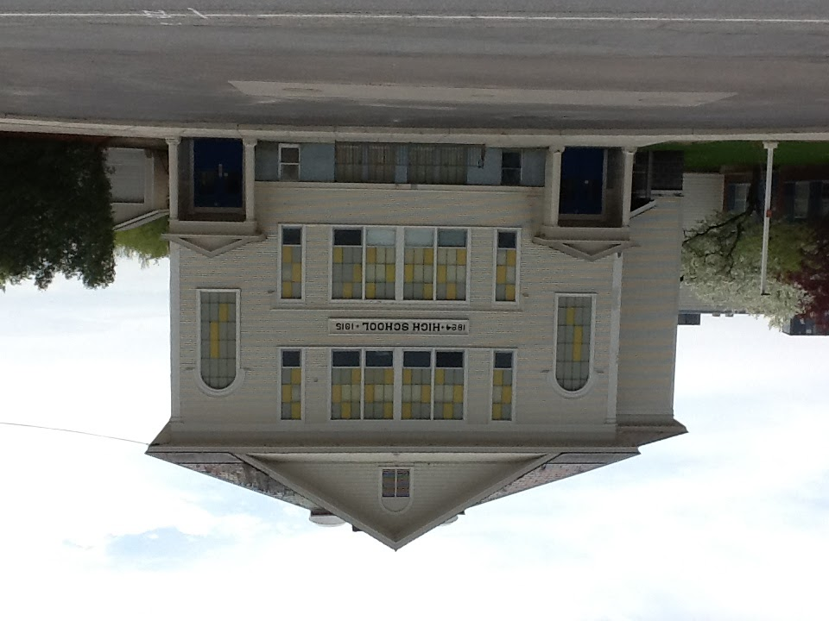
Point of Departure: Hinesburg Community School
Located in Hinesburg, VT
PreK-Grade 8
Over 500 students
(23% free/reduced lunch)
Rural community with
growing village center
9th year of implementation

Slide 3
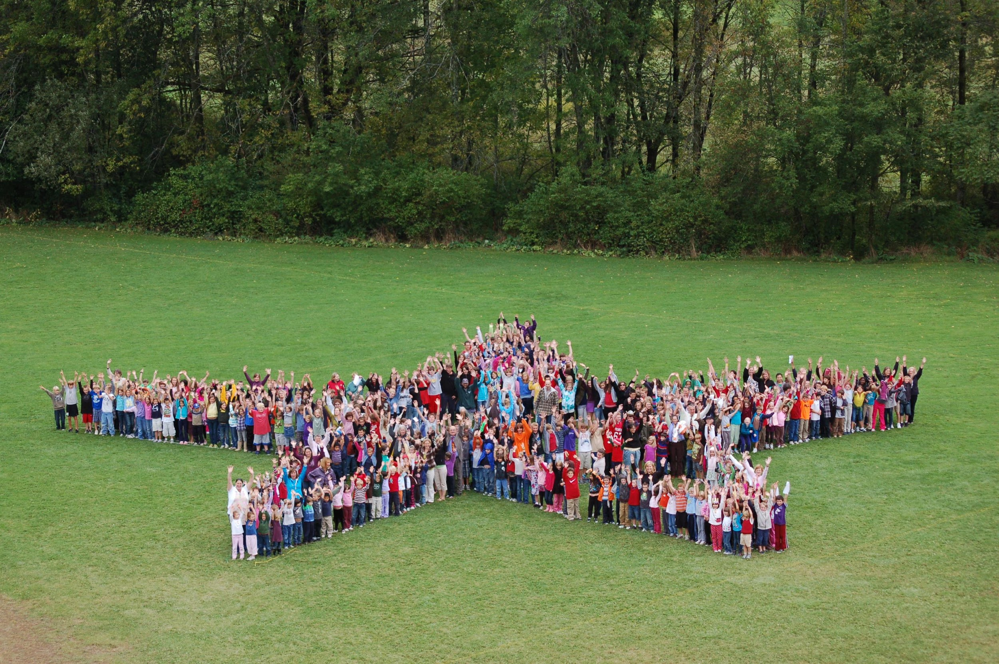
Stop #1: Our Schoolwide Expectations
Welcome to HCS, where you can Be a STAR
Belonging
Sharing
Trust
Accepting Responsibility
Respect

Slide 4
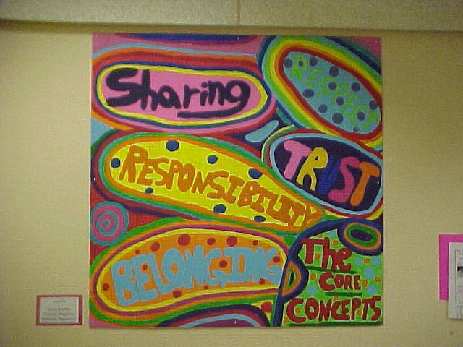
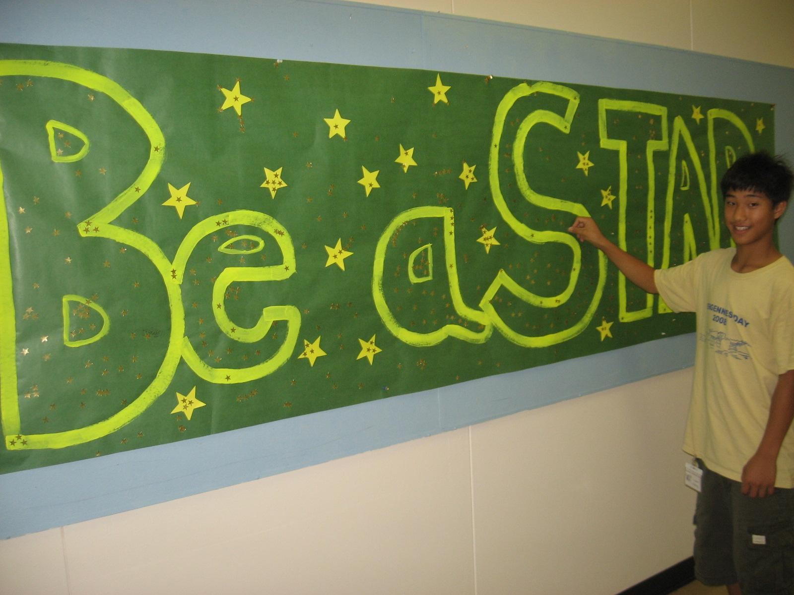
Moving From “Core Values” to Schoolwide Expectations

Slide 5
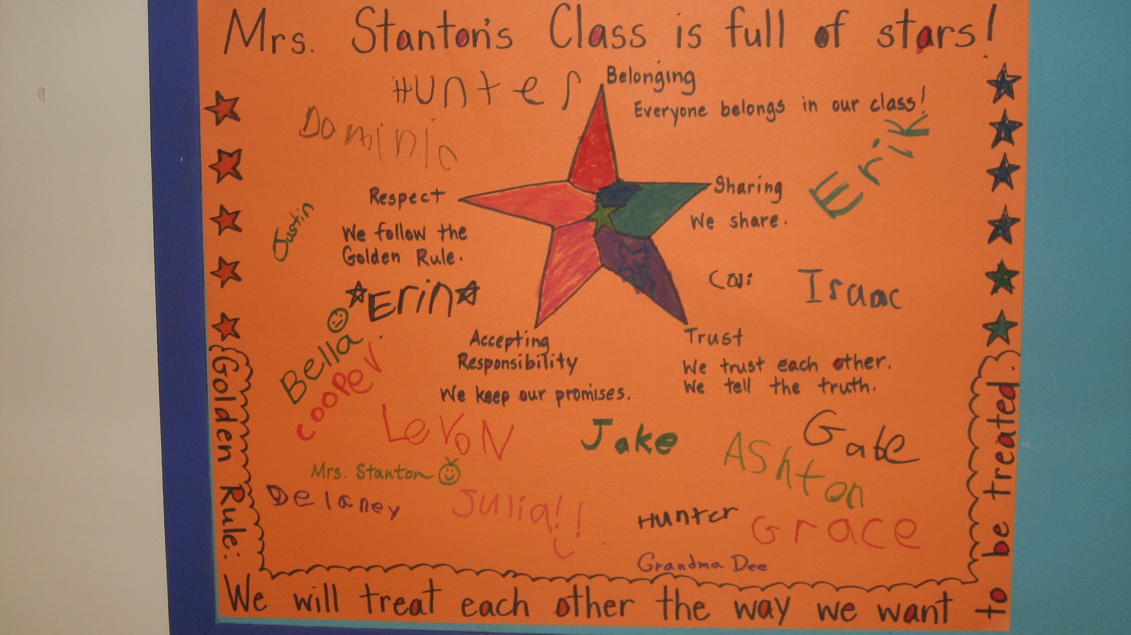
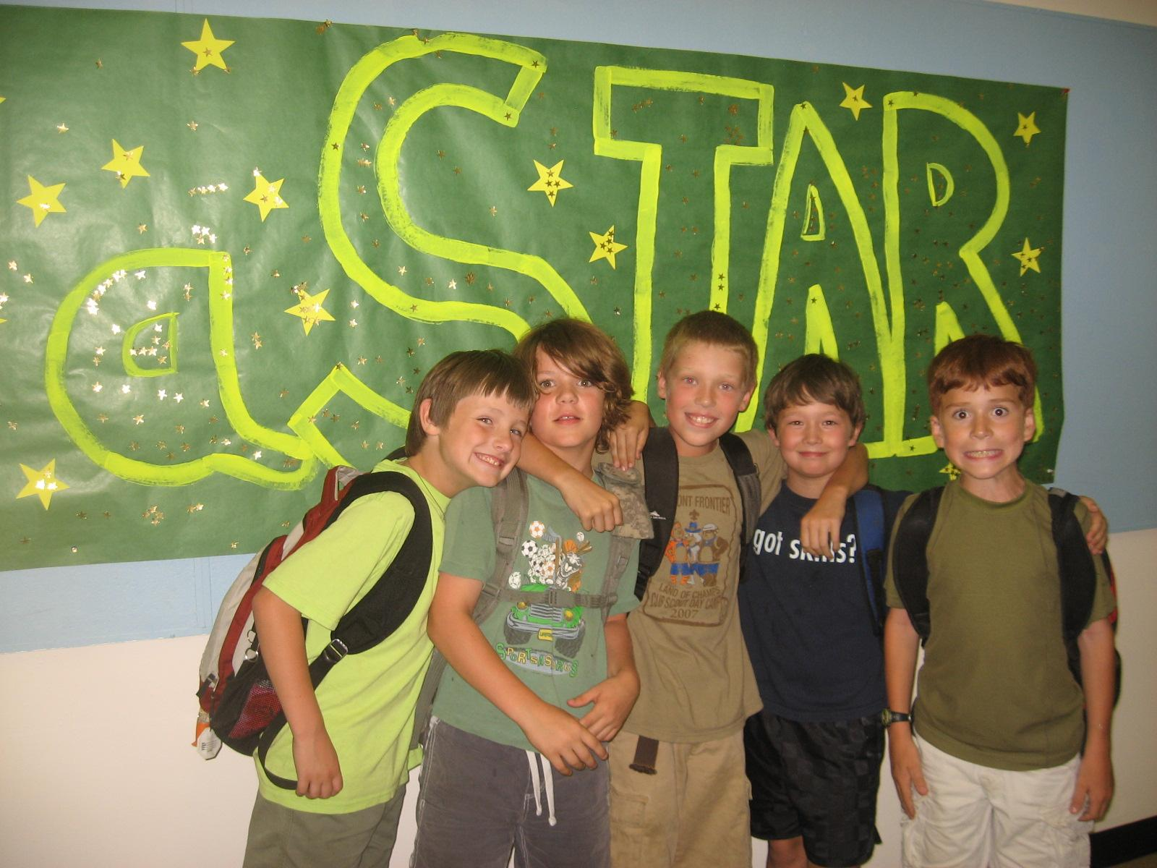
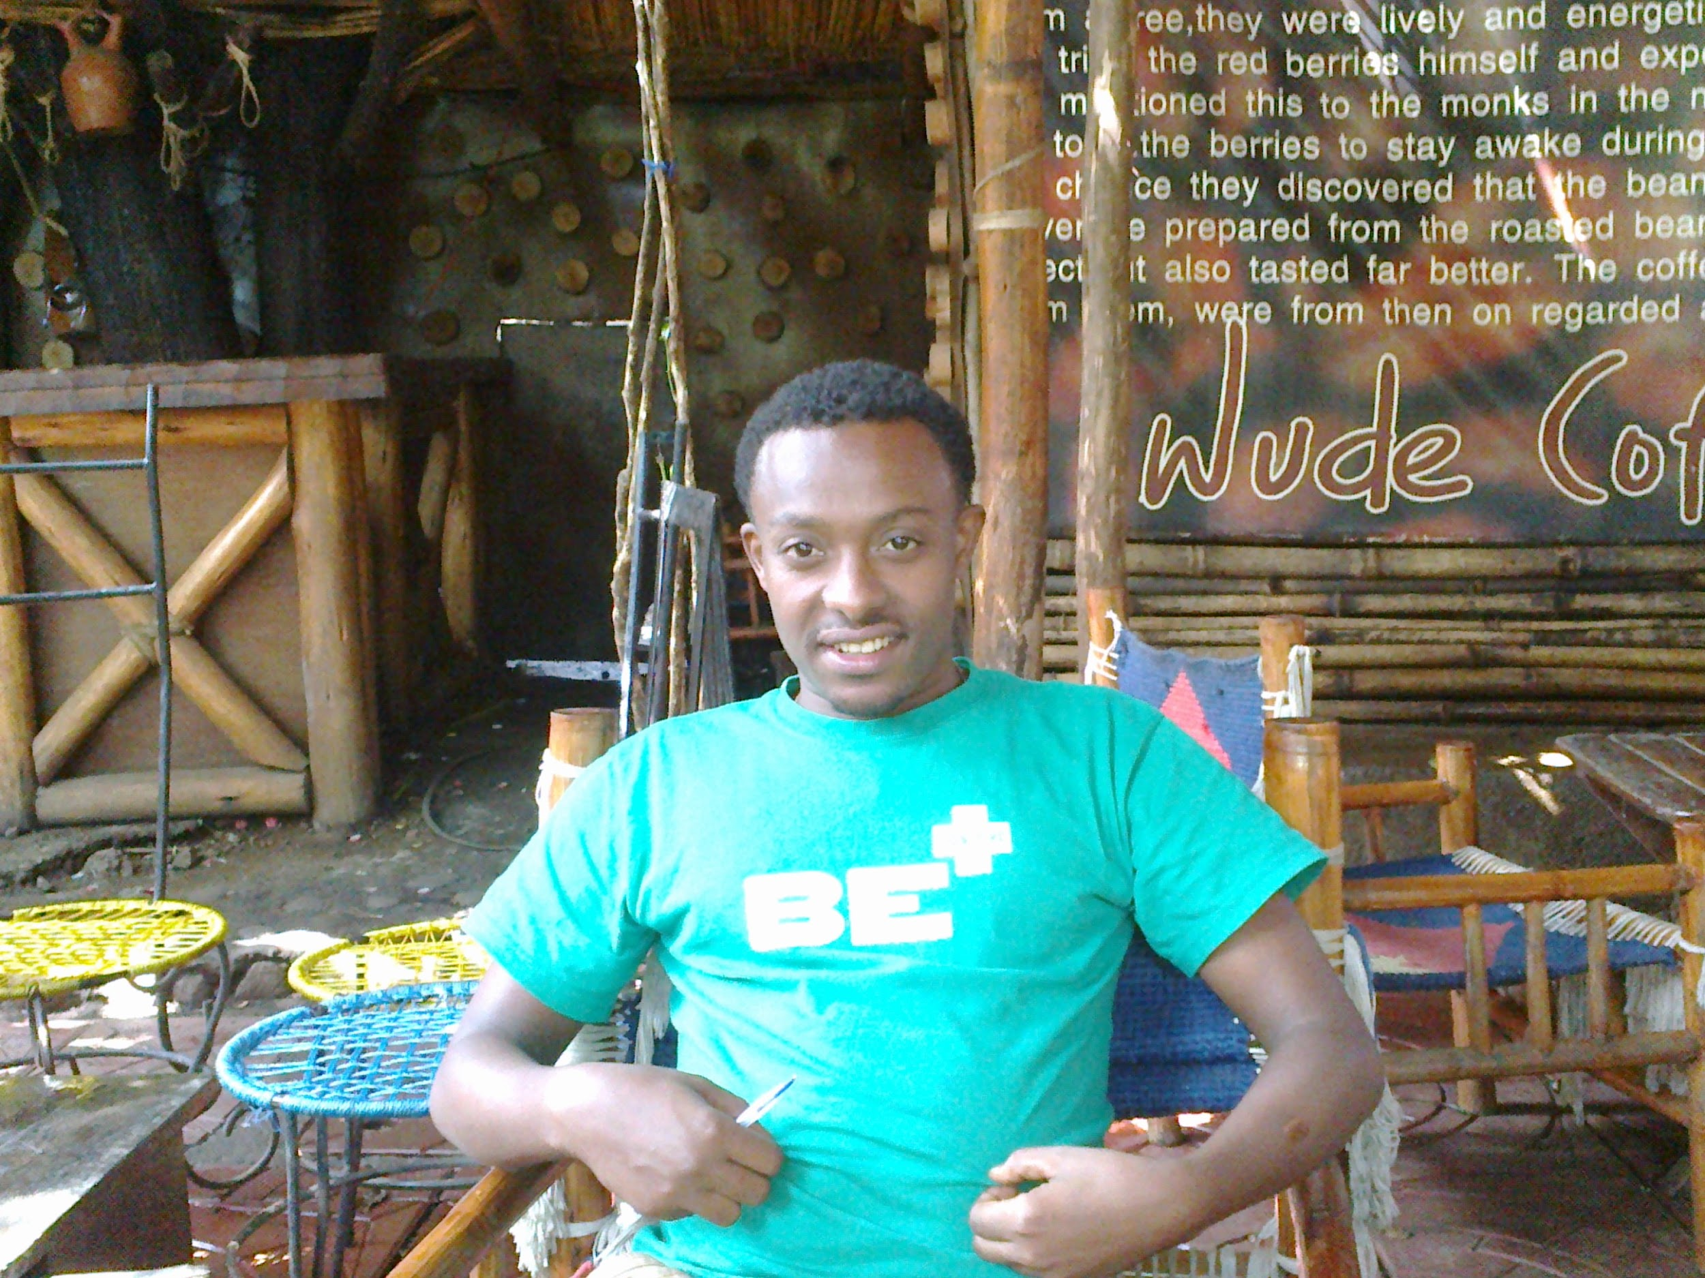
Traveling from School to Classroom to Community

Slide 6
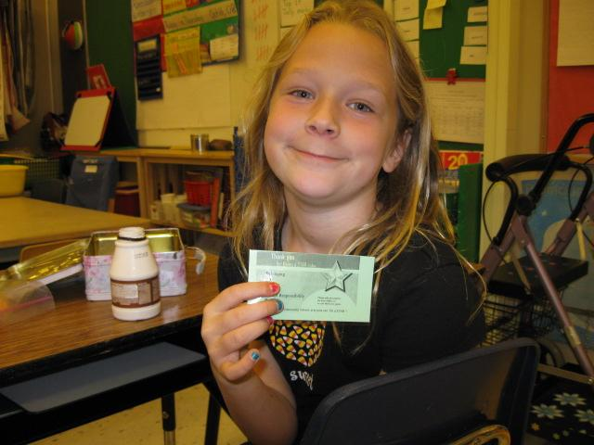
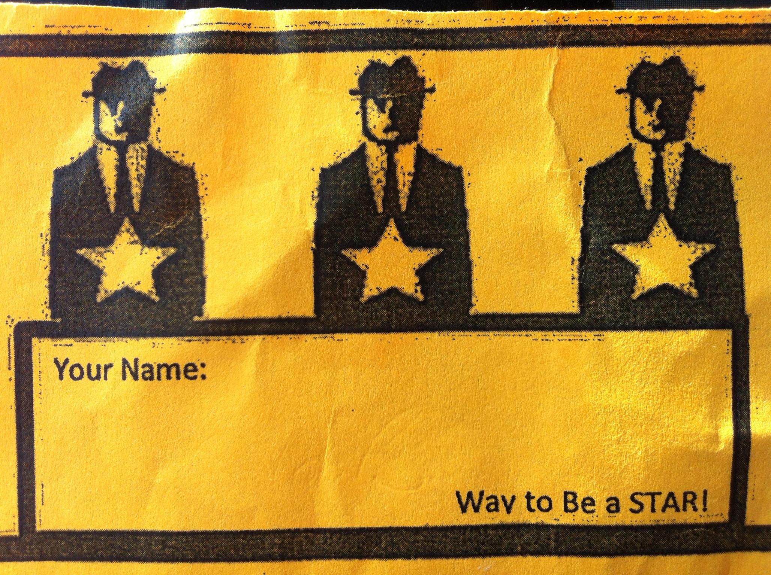
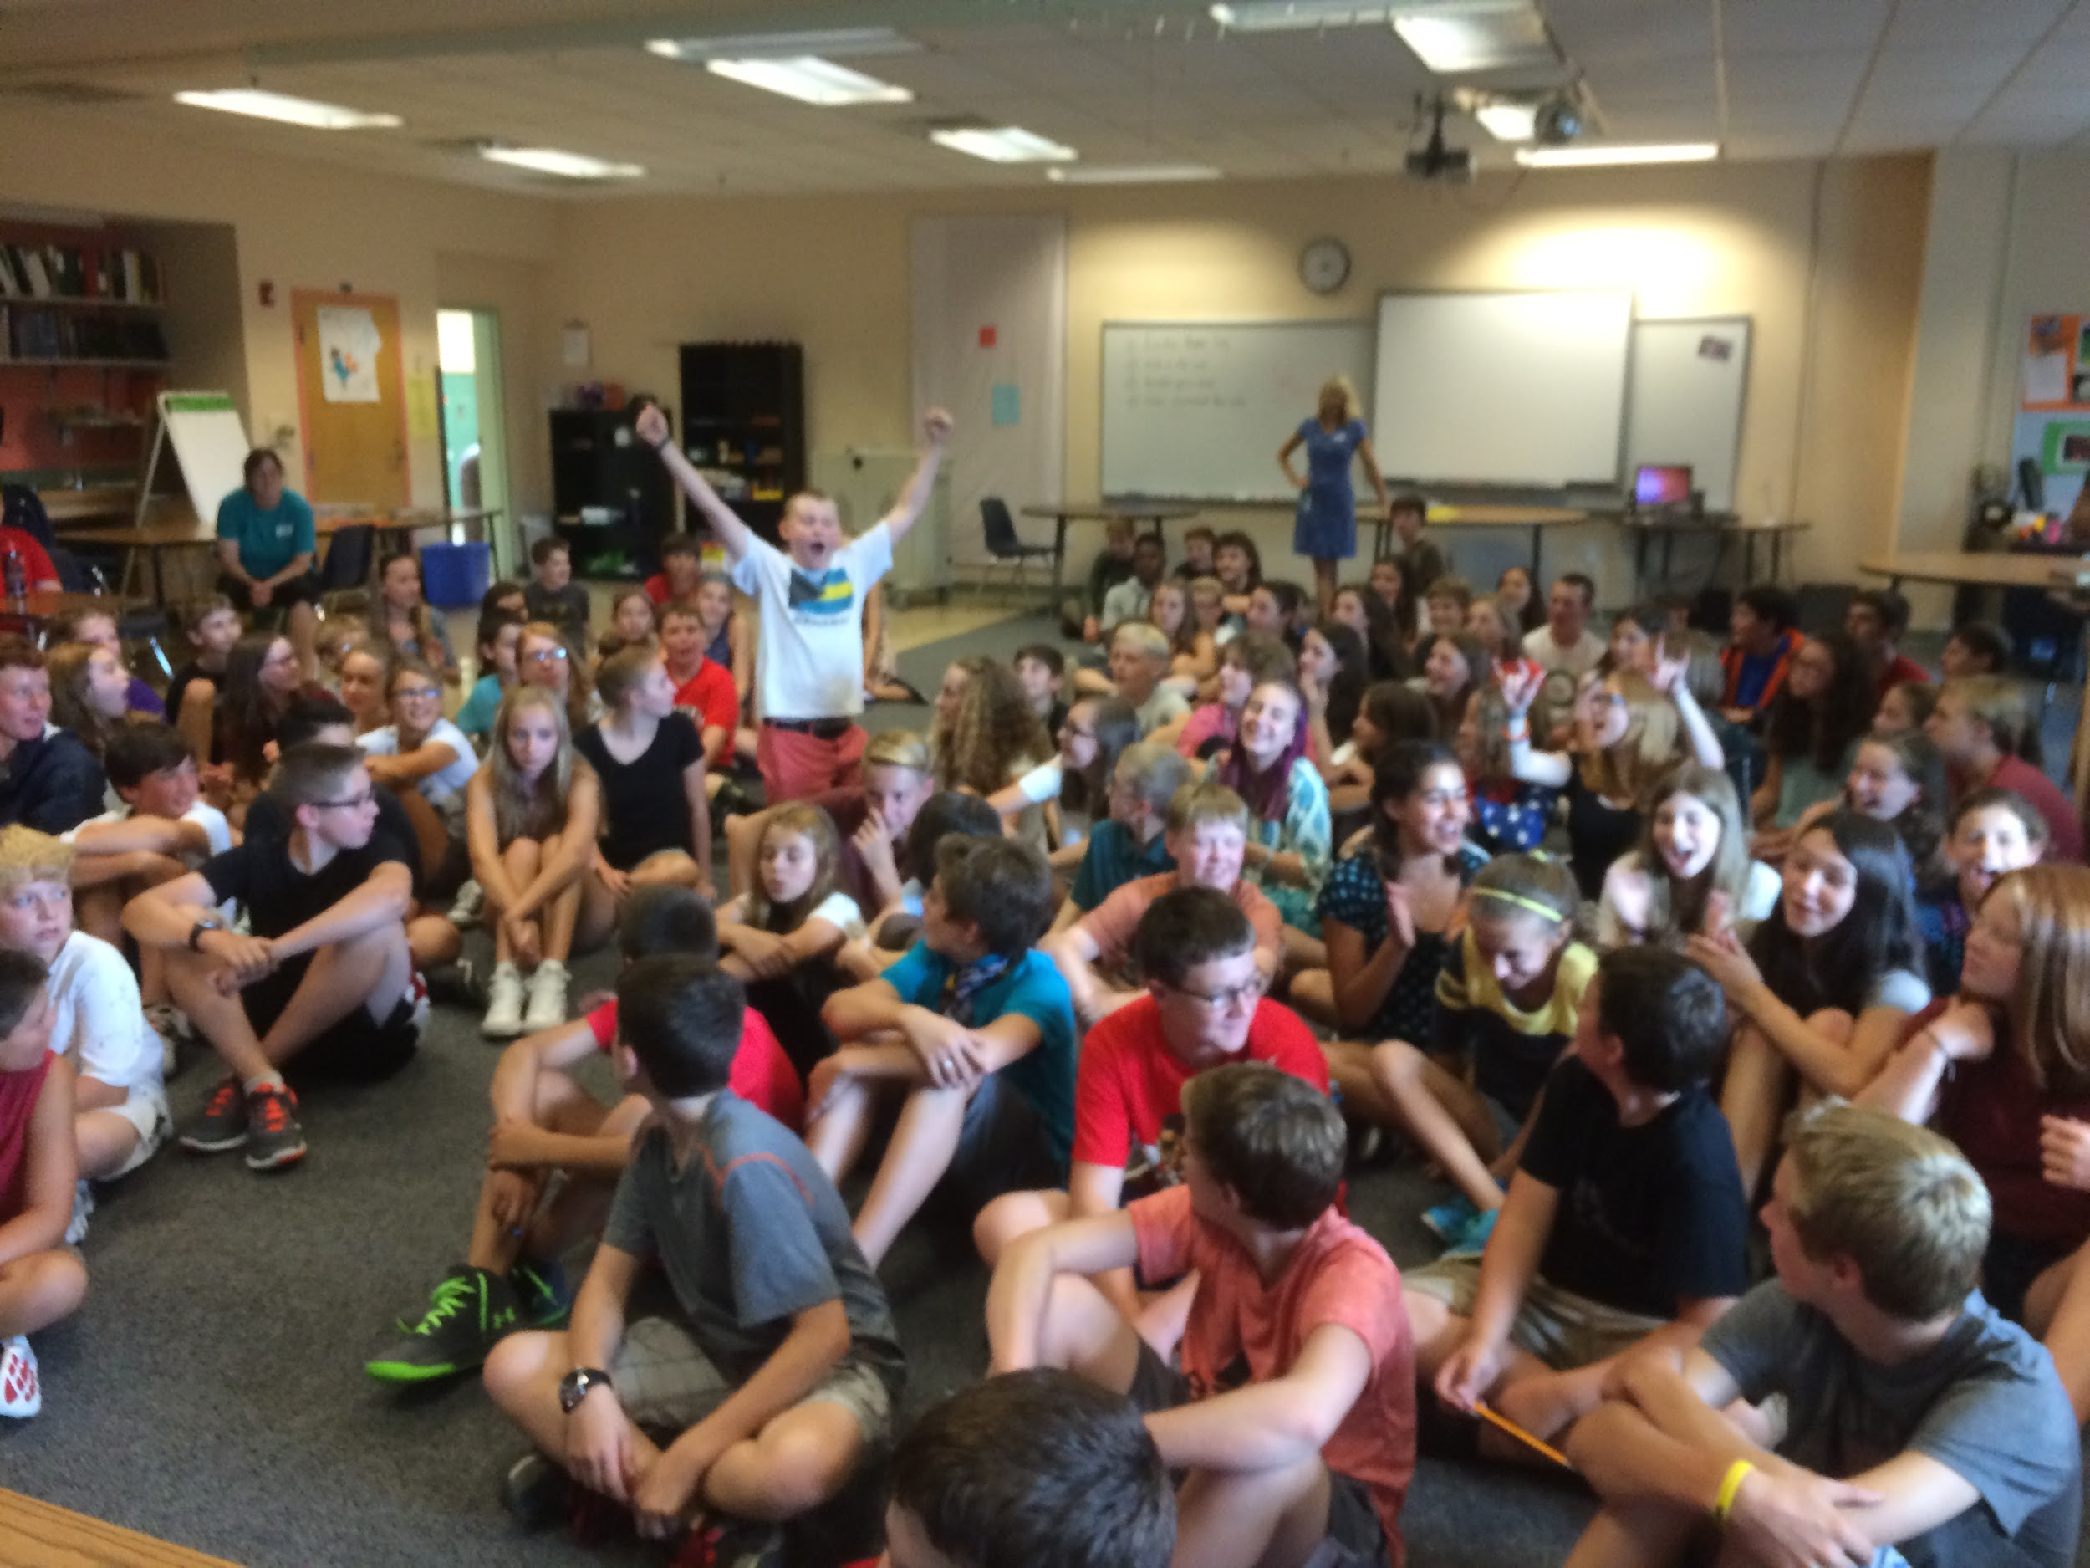
Stop #2: Our Acknowledgement System
Teachers thank students for demonstrating our core values with both a specific, verbal recognition and a paper star.
These stars are tallied for students in our younger grades (PK-2) and are pooled together by team for students in grades 3-8.
Celebrations are both Individual and Collective

Slide 7
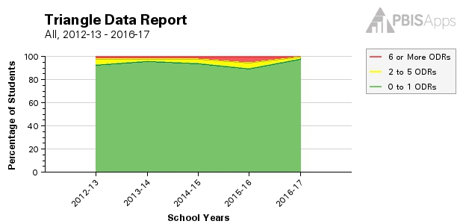
Stop #3: Our Data over Time

Slide 8
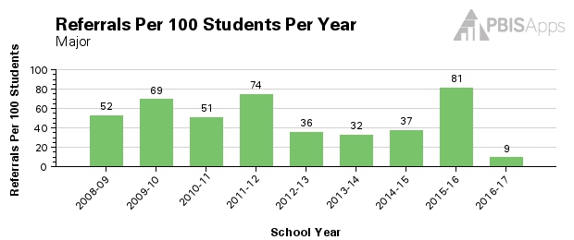
The Need for Tune-Ups

Slide 9
Detours over Time (& why we didn’t buy a new car)
Administrative Support became Involvement (Year 2)
Emphasized team-based celebrations over individual recognition (Year 2+)
Spotlight on adult impact on school culture (Year 4)
Redefined Majors and the decision not to track minors (Year 5)
Added second behavior specialist (Year 7)
What happened in year 8? Using data to inform decisions

Slide 10
The Rest of the Trip: Our Next Steps
Shift to a more proactive system with high visibility and increased communication, with emphasis on keeping students in class
Study/Implement Restorative Justice as Tier 1 strategy (part of our monthly professional development calendar)
Continue quest to provide meaningful data (e.g. by grade level) to staff
Considering tracking minors as useful data

Slide 11
Roadside Assistance
Time for Questions
Jen Bradford, Special Educator jbradford@cssu.org
Kate Myhre, Behavior Coordinator kmyhre@cssu.org

