Slide 1

VTPBIS Tier 2 & Tier 3 Networking
Presented by: Nicole Grenier & Kym Asam
WiFi Information:
Grand Guest
Find all materials at:
www.pbisvermont.org

Slide 2
Maximizing Your Session Participation
Consider these questions:
Where are we in our implementation?
What do I hope to learn?
What did I learn?
What will I do with what I learned? By when?
Use the Learning Reflection Sheet

Slide 3
Where are you in the implementation process?
Adapted from Fixsen & Blase, 2005
Exploration & Adoption
Installation
Initial Implementation
We think we know what we need so we are planning to move forward (evidence-based)
Let’s make sure we’re ready to implement (capacity infrastructure)
Let’s give it a try & evaluate (demonstration)
Full Implementation
That worked, let’s do it for real and implement all tiers across all schools (investment)
Let’s make it our way of doing business & sustain implementation (institutionalized use)

Slide 4

BEST Expectations
Be present
Engage with others
Strengths-based
Team solutions
Notes:
Sherry
Remind of our expectations –
Be present – cell phones off, throw out task list, etc.
Engage – show respect by listening and using effect team skills
Use rule of brainstorming= no idea is a bad idea
Team solutions – work together toward consensus

Slide 5
Learning Outcomes
Understand the Purpose of School Wide-PBIS Tiered Fidelity Inventory (TFI)
Explore Strategies for enhancing the Core Features of Teaming, Interventions & Evaluation
Use TFI while networking with peers to generate improvement
Hear from schools who are exemplars in their implementation at Tier 2/Tier 3

Slide 6
Agenda
Introductions
TFI Overview
TFI Action Plan “Big Ideas”
Panel Discussion with Exemplars
Networking Activity Based on TFI

Slide 7
The Tiered Fidelity Inventory (TFI)
Will Help you Get to Outcomes
Notes:
Amy

Slide 8
Tiered Fidelity Inventory (TFI)
What? An efficient and effective validated measure to self-assess fidelity of core PBIS features at all 3 tiers (Teams, Implementation and Evaluation)
Why? To guide and sustain effective implementation of PBIS at all 3 tiers
Notes:
Amy

Slide 9
When?
Expectation is once a year for all schools
  Window open January 3rd - March 31st (for TFI and SAS)
Consider completing TFI more than once to monitor/assess progress
  Contact Anne Dubie if you would like your window opened
Teams should anticipate 30 minutes to complete each tier’s assessment the first time
Notes:
Amy

Slide 10

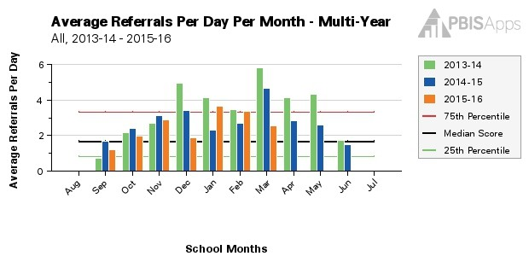
How? (Before Assessment)
Identify which tiers you will assess
Gather supporting documentation that will help you to identify an implementation level for various items on the TFI
Notes:
Amy

Slide 11
How? (During Assessment)
As a team, review item components, main idea, and scoring criteria
Team votes to identify whether the item is not in place, partially in place, or fully in place
Record consensus vote
Shouldn’t be an extensive conversation
Save Action Planning for later
Notes:
Amy

Slide 12
How? (After Assessment)
Analyze data:
  Total score report
  Subscale report (broken down by tier)
  Sub-sub scale report (broken down by components)
  Individual items report
Celebrate your 2’s, examine your 0’s and 1’s
Notes:
Amy

Slide 13
How? (After Assessment)
Select a small number of items (1-3) for implementation action planning
Ask: “What are the smallest changes we can make in the next three months to improve implementation?”
After a few months, use the TFI again to monitor progress
Share results with stakeholders
Notes:
Amy

Slide 14
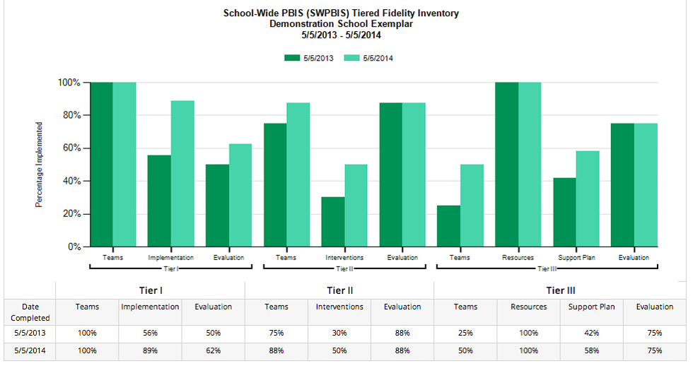
Example Subscale Report
Notes:
Amy

Slide 15
What’s the Big Idea?
Teams | Tier 2 | Tier 3
 | 2.1 Team Composition Tier 2 teams needs individuals with specific skills and perspectives to effectively provide and implement Tier 2 supports. | 3.1 Team Composition Tier 3 teams need individuals with specific skills and perspectives to effectively provide and implement Tier 3 supports.
 | 2.2 Team Operating Procedures Tier 2 teams need meeting foundations in order to operate efficiently and to implement effective supports. | 3.2 Team Operating Procedures Tier 3 teams need meeting foundations in order to operate efficiently and to implement effective supports.
 | 2.3 Screening Timely selection of students for Tier 2 supports improves the effectiveness of Tier 2 implementation. | 3.3 Screening Timely selection of students for Tier 3 supports improves the effectiveness of Tier 3 implementation.
 | 2.4 Request for Assistance Faculty, staff, families should have a highly predictable, and low-effort strategy for requesting behavior assistance. | 3.4 Student Support Team Each student receiving Tier 3 supports benefits from having an individualized team comprised of relevant stakeholders.
Notes:
Note that the first 3 Features of the Subscale related to Teaming, (Team Composition, Team Operating Procedures and Screening), are the same for both Tiers 2 & 3.
The only difference is in the last Feature:
Request for Assistance at Tier 2 vs. the Student Support Team at Tier 3.
Since Team Composition is the very first feature for both Tiers, let’s look at this more closely before moving ahead.

Slide 16
Team Composition
Team Composition could include:
Coordinator
Behavioral expertise
Administrative authority
Coaching expertise
Knowledge about academic/behavior outcomes
Knowledge about school operations
Family/Student perspective included
Do you have these perspectives represented?
What are some strategies for improvement?
Notes:
Let’s here some examples your Team Compositions
What works well?
What are some challenges?

Slide 17
Interventions | Tier 2 | Resources | Tier 3
 | 2.5 Options for Tier II Interventions A wide array of intervention options increases the likelihood that student needs are met and done so in a timely way. |  | 3.5 Staffing
 |  |  | 3.6 Student/Family/Community Involvement
 |  |  | 3.7 Professional Development Effective implementation of Tier 3 supports requires that relevant staff have the knowledge base necessary for success.
 | 2.6 Tier II Critical Features
 | 2.7 Practices Matched to Student Need Tier 2 support strategies are evidence-based, and designed with preliminary assessment information (or assumptions) about student need.
 | 2.8 Access to Tier I Supports Tier 2 supports are more effective when layered within Tier 1. | Support Plans | 3.8 Quality of Life Indicators
 |  |  | 3.9 Academic, Social, and Physical Indicators
 |  |  | 3.10 Hypothesis Statement
 | 2.9 Professional Development Effective Tier 2 supports require participation of many adults in the school.
 |  |  | 3.11 Comprehensive Support
 |  |  | 3.12 Formal and Natural Supports
 |  |  | 3.13 Access to Tier I and Tier II Supports Tier 3 supports are more effective when layered within Tiers 1 and 2.
Notes:
As we move from Teaming into the next sections of the TFI, we now notice the Features changing across Tier 2 and Tier 3
For sake of time, we ask that you continue to make yourselves familiar with the Big Ideas for each of the Features for your Tier of Implementation, but let’s look at where there the similarities are:
Access to Tier 1 supports must continue to be layered and serve as the foundation for both Tier 2 and Tier 3
Having access to a wide array of Tier 2 Interventions that are well-matched to student needs is ALSO CRITICAL at Tier 2 and Tier 3
The right amount of adults in the school MUST have the right kind of information and enough time + support to participate in a meaningful way

Slide 18
Evaluation | Tier 2 | Tier 3
 | 2.10 Level of Use Tier 2 supports that are used by too few students (e.g. 1% of enrollment) or by too many students (e.g. 20% of enrollment) are not sustainable. | 3.14 Data System
 | 2.11 Student Performance Data | 3.15 Data-based Decision Making
 | 2.12 Fidelity Data | 3.16 Level of Use Tier 3 supports that are used with too few students (e.g. fewer than1% of enrollment) or by too many students (e.g. more than 5% of enrollment) are not sustainable.
 | 2.13 Annual Evaluation Any strategy or procedure needs to be reviewed at least annually and revised to remain current and match changes in the school. | 3.17 Annual Evaluation Any strategy or procedure needs to be reviewed at least annually and revised to remain current and match changes in the school.
Notes:
In the last Subscale addressing Evaluation, we again see similar Big Ideas across Tiers:
Level of Use
Systems to Collect, Analyze and USE your Data to Make Decisions
Annual Evaluation

Slide 19
Tier 2 and Tier 3: Evaluation
Big Ideas:
Teams need the right information at the right time to make effective decisions.
Measuring fidelity data is essential for maintaining effective implementation of PBIS.
Implementation of Tier 2 and 3 is likely more sustainable if the Team self-assesses at least annually AND reports this data to key stakeholders.

Slide 20
Tier 2 and Tier 3: Evaluation
Data collection and problem-solving includes:
  Access to both academic and behavior data that is
  reviewed monthly
  Completion of Fidelity Assessments
  Tying data findings into Action Planning
  Reporting data to all stakeholders
What works for you?
What are strategies for improvement?
Notes:
Sherry

Slide 21
Welcome Caroline Comley and Johanna Davis from Floodbrook!

Slide 22

TFI Activities
Generate great ideas as a group
Problem solve any challenges
Record the strategies you like on TFI Action Plan template
Notes:
Sherry

Slide 23
Tier 2/Tier 3 Networking Activity
Break into groups to discuss Tier 2 or Tier 3 Implementation
Introduce yourselves and assign a facilitator, recorder(s), and timekeeper
As a group, discuss the following questions found on your table regarding Tier 2 or Tier 3 Implementation.
Select 1-2 people to record your answers on the Post-it notes at your table and place on designated chart paper on the wall.
Notes:
Sherry

Slide 24
TFI Activity Debrief
Walk around the room to see the recordings from each group.
We’ll hear a sampling of responses.
Notes:
Sherry

Slide 25
Guiding Principles for Sustainability
Never stop doing what is already working
Always look for the smallest change that will produce the largest effect
Do not add something new without also defining what you will stop doing
Collect and use data for decision-making
Notes:
Sherry

Slide 26
How to Obtain a
VTPBIS State-Approved Coach
Contact your VTPBIS State TA to review the needs of your SU/SD/School
Review the VTPBIS Coach Fees: $62.50/hour, $250/half day or $500/day plus mileage
Coordinate with your central office Grants Coordinator to use local funds or to apply for BEST/Act 230 funds: http://education.vermont.gov/sites/aoe/files/documents/edu-integrated-frameworks-best-act-230-innovation-grant-instructions.pdf.
Contact a VTPBIS State-Approved Coach: http://www.pbisvermont.org/resources/coaches-a-coordinators/coaches.

Slide 27

Explore the PD Calendar

Slide 28
Questions? Contact a VTPBIS TA
When in doubt, contact Anne Dubie!
(802) 656-5775 or Anne.Dubie@uvm.edu

Slide 29


Stay Connected
https://www.facebook.com/groups/PBISVermont/
https://twitter.com/vtpbis
Please share all of the awesome things you are doing by using #VTPBIS or @VTPBIS

