Slide 1
Supporting our Most Vulnerable Students with PBIS
VTPBIS Leadership Forum
Keynote
October 2017
Lucille Eber Ed.D
Email: lucille.eber@midwestpbis.org
Midwest PBIS Network
www.midwestpbis.org
National PBIS TA Center Partner
www.pbis.org

Slide 2
Session Description
Supporting students with intensive behavior/mental health/academic needs requires strong foundational systems.
This session will share multi-tiered system features needed to ensure effective interventions are implemented accurately and effectively.
Descriptions and examples of interventions for students with complex needs within a school-wide system of PBIS will be shared.

Slide 3
Your Opportunities to Respond
A BIG idea I “get” and can maybe share?
A BIG idea I am still “circling”?
A BIG idea I can take back and we can DO?

Slide 4
Confusion about what constitutes effective support?
Exclusion (or placements) seen as “intervention”
Confuse label as “intervention”
Confuse paperwork with intervention
Confuse people with interventions
Not so great interventions
Not so great fidelity
Resources not allocated commensurate with needs
Notes:
Who do we “blame’?

Slide 5
Did Henry “need” a restrictive placement?

Slide 6
Henry’s Daily Point Data for Behavioral Goals

Slide 7
Did Henry “need” a restrictive placement?
Or effective interventions?

Slide 8
Every Student Succeeds Act
Why School Climate Should Be One of Your Indicators
Read the Center for Positive Behavioral Interventions and Supports Technical Brief
www.pbis.org/training/technical-guide

Slide 9
Every Student Succeeds Act
Why School Climate Should Be One of Your Indicators
What is the purpose?
An important emphasis of ESSA is school climate and safety, which are integrally linked to academic achievement, active student and teacher engagement, and tiered systems of support for all students; but especially our most vulnerable students (e.g., students with disabilities English language learners, students from disadvantaged and diverse backgrounds and environments).

Slide 10
Every Student Succeeds Act
Why School Climate Should Be One of Your Indicators
What is school climate?
Generally, school climate represents the shared norms, beliefs, attitudes, experiences, and behaviors that shape interactions between and among students, teachers, and administrators.
www.pbis.org/training/technical-guide

Slide 11
Every Student Succeeds Act
Why School Climate Should Be One of Your Indicators
Organizing/Aligning School Climate:
Rather than addressing each behavior issue…
Bullying behaviors, tardiness, aggressive acts, substance abuse, trauma exposure
…or climate condition…
Safety, respect, discrimination, mental health, civility
…as separate initiatives…
Restorative practices, classroom bully-proofing, character education, life skills training, trauma informed care
…related interventions, practices, personnel and programs…
School mental health, special education, nursing, school psychology and counseling
…must be organized around common need or outcome.
Resource at www.pbis.org:
“Technical Guide for Alignment of Initiatives, Programs, Practices in School Districts”

Slide 12
Advantages of PBIS/MTSS Framework
Promotes effective decision making
Improves climate & learning environment
Changes adult behavior
Reduces punitive approaches
Reduces OSS and ODRs
Improves student academic performance
Notes:
A well tested framework for ensuring effectiveness;

Slide 13
Experimental Research on SWPBIS
Bradshaw, C.P., Koth, C.W., Thornton, L.A., & Leaf, P.J. (2009). Altering school climate through school-wide Positive Behavioral Interventions and Supports: Findings from a group-randomized effectiveness trial. Prevention Science, 10(2), 100-115
Bradshaw, C.P., Koth, C.W., Bevans, K.B., Ialongo, N., & Leaf, P.J. (2008). The impact of school-wide Positive Behavioral Interventions and Supports (PBIS) on the organizational health of elementary schools. School Psychology Quarterly, 23(4), 462-473.
Bradshaw, C. P., Mitchell, M. M., & Leaf, P. J. (2010). Examining the effects of School-Wide Positive Behavioral Interventions and Supports on student outcomes: Results from a randomized controlled effectiveness trial in elementary schools. Journal of Positive Behavior Interventions, 12, 133-148.
Bradshaw, C.P., Reinke, W. M., Brown, L. D., Bevans, K.B., & Leaf, P.J. (2008). Implementation of school-wide Positive Behavioral Interventions and Supports (PBIS) in elementary schools: Observations from a randomized trial. Education & Treatment of Children, 31, 1-26.
Bradshaw, C., Waasdorp, T., Leaf. P., (2012 )Effects of School-wide positive behavioral interventions and supports on child behavior problems and adjustment. Pediatrics, 130(5) 1136-1145.
Horner, R., Sugai, G., Smolkowski, K., Eber, L., Nakasato, J., Todd, A., & Esperanza, J., (2009). A randomized, wait-list controlled effectiveness trial assessing school-wide positive behavior support in elementary schools. Journal of Positive Behavior Interventions, 11, 133-145.
Horner, R. H., Sugai, G., & Anderson, C. M. (2010). Examining the evidence base for school-wide positive behavior support. Focus on Exceptionality, 42(8), 1-14.
Ross, S. W., Endrulat, N. R., & Horner, R. H. (2012). Adult outcomes of school-wide positive behavior support.
Journal of Positive Behavioral Interventions. 14(2) 118-128.
Waasdorp, T., Bradshaw, C., & Leaf , P., (2012) The Impact of Schoolwide Positive Behavioral Interventions and
Supports on Bullying and Peer Rejection: A Randomized Controlled Effectiveness Trial. Archive of
Pediatric Adolescent Medicine. 2012;166(2):149-156
Bradshaw, C. P., Pas, E. T., Goldweber, A., Rosenberg, M., & Leaf, P. (2012). Integrating schoolwide Positive Behavioral Interventions and
Supports with tier 2 coaching to student support teams: The PBISplus Model. Advances in School Mental Health Promotion, 5(3),
177-193. doi:10.1080/1754730x.2012.707429
Freeman, J., Simonsen, B., McCoach D.B., Sugai, G., Lombardi, A., & Horner, ( submitted) Implementation Effects of School-wide
Positive Behavior Interventions and Supports on Academic, Attendance, and Behavior Outcomes in High Schools.
SWPBIS Experimentally Related to:
Reduction in problem behavior
Increased academic performance
Increased attendance
Improved perception of safety
Reduction in bullying behaviors
Improved organizational efficiency
Reduction in staff turnover
Increased perception of teacher efficacy
Improved Social Emotional competence

Slide 14
We know the practices that work for students with significant mental needs…
Proactive, strength-based; “set kids up” to experience success
High rates of consistent, supported instruction; teach/practice/reinforce
Predictable and consistent environments
Know unique “why?” for each student/problem
Contextual fit: Strategic use of natural supports, and settings
Careful monitoring of data over time with ongoing revisions to guide incremental improvements in quality of life

Slide 15
It Takes a System…
… that builds system capacity for advanced tiers

Slide 16
٭
Positive
Behavior
Support
Social Competence &
Academic Achievement
OUTCOMES
Supporting
Decision
Making
Supporting
Staff Behavior
SYSTEMS
DATA
PRACTICES
Adapted from “What is a systems Approach in school-wide PBS?”OSEP Technical Assistance on Positive Behavioral Interventions and Supports. Accessed at http://www.Pbis.org/schoolwide.htm
Supporting
Student Behavior
Notes:
16
2 types of data: Individual Student outcome data and process data

Slide 17
EBP = Teaching Skills (same for social/emotional as for academics)
Define simply
Model/demonstrate w/ range of examples
Practice in range of natural settings
Monitor & provide positive feedback & reinforcement
Based on data, adjust instruction & reteach

Slide 18
Core features of MTSS framework:
Teams
Data-based decision making
Continuum of linked EBPs
Screening
Progress monitoring
Ongoing PD/coaching
Are these features in place (or partially/in progress) in your district?
Notes:
DBD: both fidelity and outcomes; much mor specific..link presenting problem to outcome data…Focused Family: WrapAround/FBA?BIP//Family/teacher and youth perspective
Screening: integrate what PBIS AND SMH have historically done into one stronger model (John Crocker);

Slide 19
Tertiary Prevention:
Specialized
Individualized
Systems for Students with High-Risk Behavior
SCHOOL-WIDE
POSITIVE BEHAVIOR
SUPPORT
~5%
Secondary Prevention:
Specialized Group
Systems for Students with At-Risk Behavior
~15%
Primary Prevention:
School-/Classroom-
Wide Systems for
All Students,
Staff, & Settings
~80% of Students
Notes:
Focus on layering of S on U and T on S

Slide 20
Consider features of SWPBIS w/regards to youth with significant social/emotional needs
Module 1: PBIS Team
Module 2: Faculty Commitment
Module 3: Expectations and Rules
Module 4: Lesson Plans
Module 5: Acknowledgement
Module 6: Discipline Procedures
Module 7: Data Entry and Analysis
Module 8: Classroom Behavior Systems
Module 9: Evaluation
Module 10: Implementation Plan

Slide 21
How Can We Differentiate Instruction?
ALL Means ALL!
Kick-off events
Teaching staff, students, and families the expectations and rules
On-going direct instruction
Data-driven and scheduled designed lessons
Pre-correction
Re-teaching immediately after behavioral errors
Embedding into curriculum
Booster trainings
Scheduled and data-driven
Continued visibility
Visual displays – posters, agenda covers
Daily announcements
Newsletters
More Visual Cues?
Extra Practice/Rehearsal?
Peer supports?
Buddies?
Peer Leaders?
Other? (think: Same as academics!)
Notes:
Knowledge V. Deficit

Slide 22
Tier I Acknowledgements Guidelines
School-wide reinforcements are for every student
Acknowledge the behavior
Include ALL students in identifying possible recognitions
Recognize students other than your own in common areas
Recognition closely follows the desired behavior
Keep it novel
Effective & Efficient
Notes:
22
Always have a plan for reducing the effort
Acknowledge frequently in the beginning
Acknowledge contingent on desired behavior
Refrain from threatening the loss of reinforcer as a strategy for motivating desired behaviors
Refrain from taking earned items or activities away from a student
Students should be eligible to earn acknowledgement throughout the day contingent upon appropriate behavior

Slide 23
Why aren’t we doing “it”?
What do we know from the empirical literature?
Teachers typically receive little pre- or in-service training in classroom management
Begeny & Martens, 2006; Freeman, Simonsen, Briere, & MacSuga, in press; Markow, Moessner, & Horowitz, 2006; Special Education Elementary Longitudinal Study, 2001, 2002, 2004; Wei, Darling-Hammond, & Adomson, 2010)
Multi-component training packages (didactic training + coaching + performance feedback + etc.) result in desired behavior change, especially when trained skills are effective
Abbott et al., 1998; Hiralall & Martens, 1998; Madsen, Becker, & Thomas, 1968; Freeman et al., in preparation; The Metropolitan Area Child Study Research Group & Gorman-Smith, 2003; Rollins et al., 1974
(Simonsen, B., PBIS Conference Keynote, 2016)

Slide 24
Tier 1 Integrates Positive Behavioral Classroom Supports
8 Positive Behavioral Classroom Supports
Arrange orderly physical environment
Define, Teach, Acknowledge Rules and Expectations (T1 Modules 1.3, 1.4, 1.9)
Define, Teach Classroom Routines (T1 Modules 1.3, 1.4)
Employ Active Supervision
Provide Specific Praise for Behavior (T1 Module 1.9)
Continuum of Response Strategies for Inappropriate Behaviors (T1 Module 1.5-1.6)
Class-Wide Group Contingency
Provide Multiple Opportunities to Respond
Adapted from MO Classroom PBIS
Notes:
Trainer Notes: We want your teachers to have effective strategies that they are all using consistently. Tier I features are implemented within classrooms and are consistent with school-wide systems.
(The classroom is a critical aspect of Tier I training and includes 8 key components. These strategies maximize classroom management to allow for instructional time and less teacher stress!
**Components 1 & 4 are about setting up the physical environment to minimize distractions for students, to use the physical space of the classroom as an assistant in managing student bodies and behaviors, and also how we can have a positive impact on students engagement by moving around the classroom and having brief interactions with students.
**Components 2, 3, 5, 7 are about efficient teaching of those common classroom routines, how to do it efficiently and not over and over again, and how to provide feedback to encourage students follow those routines. Praise connected to specific behaviors is more powerful than generic praise. Group feedback, and rewards can be powerful motivators too.
**Components #7 and 8 are about providing adequate level of practice for the behaviors you want to see, and how to effectively, quickly redirect these misbehaviors so they are less likely to turn into bigger behaviors.)

Slide 25
Teaching Matrix |  | INCORPORATE Coping Strategies for Managing Stress
 |  | All Settings | Halls | Playgrounds | Lunch | Library/ Computer Lab | Assembly | Bus
 | Respectful | Be on task. Give your best effort. Be prepared. | Walk. | Have a plan. |  | Study, read, compute. | Sit in one spot. | Watch for your stop.
 | Achieving & Organized | Be kind. Hands/feet to self. Help/share with others. | Use normal voice volume. Walk to right. | Share equipment. Include others. |  | Whisper. Return books. | Listen/watch. Use appropriate applause. | Use a quiet voice. Stay in your seat.
 | Responsible | Recycle. Clean up after self. | Pick up litter. Maintain physical space. | Use equipment properly. Put litter in garbage can. |  | Push in chairs. Treat books carefully. | Pick up. Treat chairs carefully. | Wipe your feet.
1. Expectations
2. NATURAL CONTEXT (Locations)
Invite those sitting alone to join in
Have a lunch plan and choose quiet or social lunch area
Invite friends to join me
Expectations
3. Rules or Specific Behaviors
Use my breathing technique
Listen to my signals
Notes:
Replacement behaviors- very important that we anchor in our teaching matrix as this is our core social emotional curriculum- the common language and script we use to teach, acknowledge, pre-correct – all staff are using same approach for teaching and supporting throughout the year across the school day. We get what we pay attention to and this helps provide the common language/consistent approach- our values for our school
When dealing with stress and anxiety became major priority in school, it would be a matter of teaching skills to students so they developed strategies and skills and incorporated into their social curriculum – the matrix is the delivery mechanism to get skills out ALL !!!

Slide 26
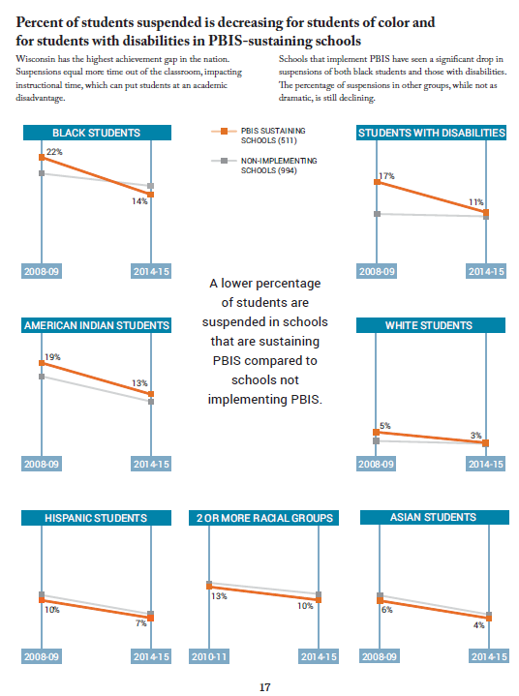
Data Highlights – 2015-16 Annual Report
Decrease in suspensions in every group
Significant decrease in suspensions for Black students and Students with Disabilities
Outcomes for ALL

Slide 27
Schools at fidelity/full implementation for the last 2-3 years have seen a GREATER DECREASE in suspension rates for STUDENTS WITH DISABILITIES than the state and schools with no record of implementing.
Outcomes for ALL

Slide 28
Notes:
Comparison of PBS v. Non-PBS schools on Missouri State Assessment

Slide 29
Notes:
Comparison of PBS v. Non-PBS schools on Missouri State Assessment

Slide 30
A Multi-tiered Continuum of Behavioral Support
Tier 1/Universal
School-Wide Assessment
School-Wide Prevention Systems
ODRs,Credits, Attendance, Tardies, Grades, DIBELS, etc.
Tier 2/ Secondary
Tier 3/
Tertiary
Check-in Check-out (CICO)
Assessment
Intervention
Social/Academic Instructional Groups (SAIG)
Daily Progress Report (DPR) (Behavior and Academic Goals)
Group Intervention with Individualized Feature
Competing Behavior Pathway, Functional Assessment Interview, Scatter Plots, etc.
Brief Functional Behavior Assessment/
Behavior Intervention Planning (FBA/BIP)
Individual Student
Information System (ISIS)
Complex or Multiple-domain FBA/BIP
USDOE-OSEP Tertiary Demo Project
#H326M0060010
SIMEO Tools: HSC-T, RD-T, EI-T
Wraparound

Slide 31
Tier 2/Tier 3 Changing Existing Systems
Harder than starting from scratch
Schools think they are “already doing it”
Need to “deconstruct” some existing teaming approaches and practices
Data not being used except to justify placements

Slide 32
Examples of Ineffective Secondary/Tertiary Structures
Referrals to Sp. Ed. seen as the “intervention”
FBA seen as required “paperwork” vs. a needed part of designing an intervention
Interventions the system is familiar with vs. ones likely to produce an effect
(ex: student sent for insight-based counseling at point of misbehavior)

Slide 33
IL Tertiary Demo School Reduces ODRs & Increases Simple Secondary Interventions
*CICO = Check in, Check Out

Slide 34
Example of change that may be needed
“Groups” that are not evidence-based
Clinicians “seeing” students w/o clarity of intervention and data to determine effectiveness
Re-install FBA/BIP process with focus on effectiveness vs compliance

Slide 35
Social Skills/Academic Instructional Groups:
Selection into groups based on youths’ reaction to life circumstance not existence of life circumstances
ex. fighting with peers, not family divorce
Goals for improvement common across youth in same group
ex. use your words
Data used to measure if skills are being USED in natural settings (vs. in counseling sessions)
transference of skills to classroom, café etc.
Stakeholders (teachers, family etc.) have input into success of intervention
ex. Daily Progress Report
Notes:
35
35
35

Slide 36
Daily Progress Report (DPR) Sample
NAME:______________________ DATE:__________________
Teachers please indicate YES (2), SO-SO (1), or NO (0) regarding the student’s achievement in relation to the following sets of expectations/behaviors.
EXPECTATIONS | 1st block | 2nd block | 3rd block | 4th block
Be Safe | 2 1 0 | 2 1 0 | 2 1 0 | 2 1 0
Be Respectful | 2 1 0 | 2 1 0 | 2 1 0 | 2 1 0
Be Responsible | 2 1 0 | 2 1 0 | 2 1 0 | 2 1 0
Total Points
Teacher Initials
Adapted from Grant Middle School STAR CLUB
Adapted from Responding to Problem Behavior in Schools: The Behavior Education Program by Crone, Horner, and Hawken
Notes:
36

Slide 37
Trauma-Informed
Tier 2 Group
Daily Progress Report (DPR) Sample
NAME:______________________ DATE:__________________
Teachers please indicate YES (2), SO-SO (1), or NO (0) regarding the student’s achievement in relation to the following sets of expectations/behaviors.
EXPECTATIONS | 1st block | 2nd block | 3rd block | 4th block
Be Safe | 2 1 0 | 2 1 0 | 2 1 0 | 2 1 0
Be Respectful | 2 1 0 | 2 1 0 | 2 1 0 | 2 1 0
Be Responsible | 2 1 0 | 2 1 0 | 2 1 0 | 2 1 0
Total Points
Teacher Initials
Self-Check
Use calming strategy
Use your words
Use safe hands
Ask for help
Connect with safe person
Adapted from Grant Middle School STAR CLUB
Adapted from Responding to Problem Behavior in Schools: The Behavior Education Program by Crone, Horner, and Hawken
Notes:
37

Slide 38
“Tier 3 Plan with Trauma-Informed Strategy”
Daily Progress Report (DPR) Sample
NAME:______________________ DATE:__________________
Teachers please indicate YES (2), SO-SO (1), or NO (0) regarding the student’s achievement in relation to the following sets of expectations/behaviors.
EXPECTATIONS | 1st block | 2nd block | 3rd block | 4th block
Be Safe | 2 1 0 | 2 1 0 | 2 1 0 | 2 1 0
Be Respectful | 2 1 0 | 2 1 0 | 2 1 0 | 2 1 0
Be Responsible | 2 1 0 | 2 1 0 | 2 1 0 | 2 1 0
Total Points
Teacher Initials
SOS (slow down, orient, self-check)
Use mindfulness
Distract & Self-Soothe
Let ‘M Go
Make A Link
Make Meaning
Adapted from Grant Middle School STAR CLUB
Adapted from Responding to Problem Behavior in Schools: The Behavior Education Program by Crone, Horner, and Hawken
Notes:
38

Slide 39
Daily Progress Report (DPR) Sample
NAME:______________________ DATE:__________________
Teachers please indicate YES (2), SO-SO (1), or NO (0) regarding the student’s achievement in relation to the following sets of expectations/behaviors.
Individualized Student Card (FBA/BIP)
EXPECTATIONS | 1st block | 2nd block | 3rd block | 4th block
Be Safe | 2 1 0 | 2 1 0 | 2 1 0 | 2 1 0
Be Respectful | 2 1 0 | 2 1 0 | 2 1 0 | 2 1 0
Be Responsible | 2 1 0 | 2 1 0 | 2 1 0 | 2 1 0
Total Points
Teacher Initials
Use your words
Use deep breathing
Keep arm’s distance
Use #2 voice level when upset
Ask for breaks
Self-monitor with DPR
Adapted from Grant Middle School STAR CLUB
Adapted from Responding to Problem Behavior in Schools: The Behavior Education Program by Crone, Horner, and Hawken
Notes:
39

Slide 40
We know the practices that work…
Proactive, strength-based; “set kids up” to experience success
High rates of consistent, supported instruction; teach/practice/reinforce
Predictable and consistent environments
Know unique “why?” for each student/problem
Contextual fit: Strategic use of natural supports, and settings
Careful monitoring of data over time with ongoing revisions to guide incremental improvements in quality of life

Slide 41
We Know the System Features Needed to Support the Effective Practices…
A Team unique to each individual child & family
Blend the family/natural supports with the school representatives who know the child best
A defined Meeting Process
Meet frequently and use data
Develop, implement, review range of interventions
Facilitator Role
Bringing team together
Blending perspectives; guiding consensus
Systematic use of data (strengths and needs)

Slide 42
Behavior support is the redesign of environments, not the redesign of individuals.
Positive behavior support plans define changes in the behavior of those who will implement the plan. A behavior support plan describes what we will do differently.
Do ALL staff understand the context for effective
behavior interventions?

Slide 43
Interventions…
Ownership & Voice: A Key to Intervention Design
The person who is supposed to implement the strategy needs to be actively involved in designing it, or it probably won’t work!

Slide 44
Tier 3 Interventions
Person-centered (voice and choice)
Highly individualized (unique team per student)
Multiple data sources (add Tier 3 data - Perception data)
Complex function-based behavior plans
Wraparound/RENEW/Family-Focused Plans

Slide 46
Competing Behavior Pathway
Behavior Intervention Plan
Setting Event Strategies
Antecedent Strategies
Teaching/ Instructional Strategies
Consequence Strategies
Neutralize/
eliminate
setting
events
Add relevant
& remove
irrelevant
triggers
Teach
alternative
that is more
efficient
Add effective &
& remove
ineffective
reinforcers

Slide 47
Behavioral Pathway
Setting Event
Days with Gym
Antecedent
Less structured activities that involve competition
Problem Behavior
Negative comments about activity and to peers leading to physical contact
Consequence
Sent out of P.E. class
Function
To escape setting

Slide 48
Brief Function-based Interventions
Setting Event Strategies
Add check-in before gym
Antecedent Strategies
Behavior Lessons for all students about using respectful language with self and others and how to be a good sport
. More frequent activities with less focus on competition (parachute, 4-square, etc...)
Pre-correct
Teaching Strategies
Teach social skills (getting along with others, friendship, problem solving, sportsmanship)
Teach how to approach gym teacher to ask for a drink of water to leave setting.
Teach student how to re-enter and continue with activity
Consequence Strategies Acknowledging/rewarding student when uses new skills (asking for a drink of water to leave, using respectful language with peers, being a good sport, etc..)

Slide 49
Ben’s Story
September 2014 - CICO started
Mid October, 40%
November - community-based mentor assigned
December - Ben request to return to “psych” hospital saying, “I can’t control myself” (has had three prior admissions)
December 5 - Tier 3 team met. Recommended referral to wraparound based on following:
CICO average of 50%
30 Office Disciplinary Referrals
3 Out of School Suspensions
At risk for alternative school placement
At risk for out-of-home placement
December 15 - Wraparound started with Ben and Barb

Slide 50
Family Strengths Example
Love & like each other
Friendly, kind-hearted
Likes to cook gourmet meals
Likes math, reading, writing
Neat, well-groomed
Organized, good w/ detail
Attends schools regularly
Smart, capable of doing the work
Has had academic success
Hard worker, reliable, dependable
Creative, enjoys drawing cartoons
Likes playing video games
Likes Rob
Supportive boyfriend (Rob)
Hard worker, employed
Stable housing
Active w/ Ben…cooking, games, videos,
Values family concept, Invested in Ben’s success
Attends all meetings, appointments
Strong Christian faith
Support from relatives, boyfriend
Not afraid to ask for help
Open to feedback/good follow up on suggestions
Unconditional, loving, commitment
Involved in church activities
Values education

Slide 51
Family Needs/Concerns Example
Trust the “System”, Wrap Facilitator & wrap process*
Information from school w/ open lines of communication*
Get along without fighting and arguing*
“Act his age” (be more responsible & independent)
Graduate from Middle school*
Follow rules at school*
A “break”, overwhelmed, tired (respite)
Support with making/implementing changes
Identified Needs/Concerns that led to Big Needs
Feels guilty over divorce/single mother
“I need help doing it at home”
Structure at home & within the classroom
Friends to do “stuff” with at home and school
Positive attention from mom*
Wants to be more successful at school
Consistency with giving med’s
Depression, Childhood trauma
Doesn’t trust Doctor, Therapist

Slide 52
Big Needs
Barb and Ben want to have a healthy and positive relationship
Ben needs to feel happy about being at school
Ben needs to feel support with completing his school work

Slide 53
First Child & Family Meeting
Initial steps as a result of the first child & family team meeting:
Continued CICO
Continued mentoring
Continued MH services
Continue communication with MH
FBA to be completed
Family access to YMCA (schedule present at LANS for funding)

Slide 54
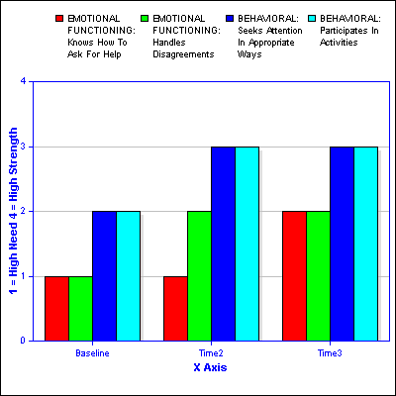
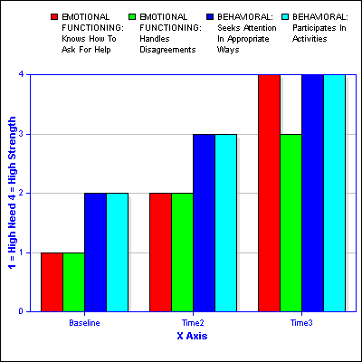
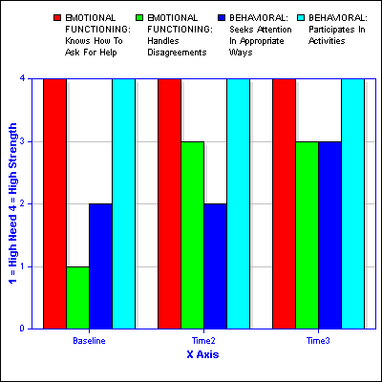
Home School Community Tool
HOME SCHOOL COMMUNITY
Knows how to ask for help
Handles disagreements
Seeks attention in appropriate ways
Participates in activities

Slide 55
Tertiary Level “Coaches” Have to Help Establish Capacity (Fidelity) for Wraparound
Commitment of time
Commitment to “stay at table”
Willingness to regroup and be solution-focused
No judging or blaming
Time for listening to stories
Time for venting, validating
Establishing consensus
Voice of student/family in prioritizing
Establishing ownership

Slide 56
Commitments for Success
Examples of District/Building Tier 2/3 Commitments:
Tier 2/3 Coaching FTE
Position Personnel to Facilitate Tertiary Intervention Teams for 3-5% of Students
Comprehensive Training and “Practice” (coaching) to fluency
Data-based decision-making is part of all practices
Tertiary District Leadership Team
Review Special Education and Disproportionality Data
Review District Policies
http://www.istac.net/resources/illinois-pbis-network-resources/PBIS-Trainings/tier-2-3-readiness

Slide 57
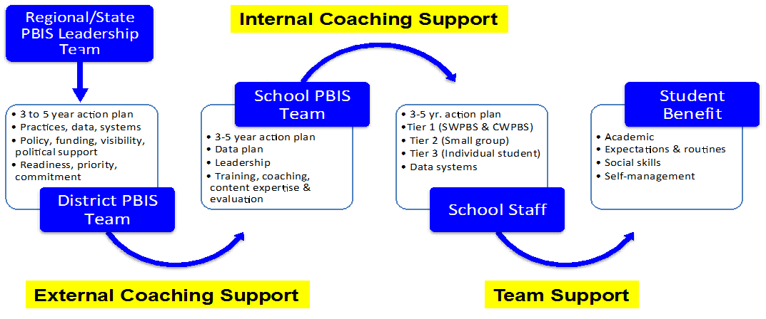
Supporting Implementation:
Alignment and Integration, Implementation Coordination

Slide 58
District-wide Tertiary Implementation Process
District meeting quarterly
District outcomes
Capacity/sustainability
Other schools/staff
Building meeting monthly
Check on all levels
Cross-planning with all levels
Effectiveness of practices (FBA/Wrap)
Tertiary Coaching Capacity
Facilitators for complex FBA/BIP and wraparound teams

Slide 59
What is the current culture of professionalism in the building?
Host environment that supports a culture of coaching, self-reflection
Support vs evaluation
Practices will probably be the same
Separate system
SW PBIS Team includes administrator
Hold balcony view
Responsible for resource allocation
Notes:
Admin sets the tone and culture to set up a system of support for all staff- not eval-support

Slide 60
Failed Interventions are Not Neutral
They leave a residual effect…

Slide 61
How Did You Do?
A BIG idea I “get” and can maybe share?
A BIG idea I am still “circling”?
A BIG idea I can take back and we can DO?

