Slide 1

Intro to FBA Thinking (FBT)
Cortney Keene, M.Ed., C.A.S., BCBA
email: cortney.keene@uvm.edu
Teri Brooks, Ph.D., BCBA
e-mail: terimbrooks@gmail.com
WiFi: Grand Guest
Notes:
Introduce ourselves

Slide 2
Maximizing Your Session Participation
Consider these questions:
Where are we in our implementation?
What do I hope to learn?
What did I learn?
What will I do with what I learned? By when?
Use the Learning Reflection Sheet!

Slide 3

BEST Expectations
Be present
Engage with others
Strengths-based
Team solutions
Notes:
Sherry
Remind of our expectations –
Be present – cell phones off, throw out task list, etc.
Engage – show respect by listening and using effect team skills
Use rule of brainstorming= no idea is a bad idea
Team solutions – work together toward consensus

Slide 4
FBA Thinking (FBT)
What does that mean?
FBA = Functional Behavior Assessment
Simple FBA vs. Complex FBA = It’s a continuum!
Simply put, FBA Thinking is figuring out why a student engaged in a negative behavior
Notes:
Teri

Slide 5
The Continuum of FBA
 | FBA Thinking (FBT) | SIMPLE | COMPLEX
FOR | On the spot decision-making about effective responses (i.e. consequences) to student’s challenging behaviors | High frequency behaviors that are not dangerous or only mildly to moderately disruptive, may occur in only 1-2 settings | Dangerous behaviors or highly disruptive behaviors that persistently occur in 3 or more school settings
WHAT | A way of thinking about why a student is engaging in a challenging behavior, and how you can respond in a way that will effectively reduce the behavior | Relatively simple and efficient process to gather data to hypothesize about the function of behavior and use this information to guide behavior support planning | Time-intensive process involving gathering information from multiple sources, a written FBA and BSP, emergency planning, family-centered planning, and collaboration with outside agencies
BY WHOM | You! | Team of school-based personnel (ex: teachers, special educator, counselor, administrator, behavior support personnel) | School-based team, including professionals trained to develop and implement intensive interventions for students with severe problem behaviors (i.e. behavior specialist)
Notes:
Teri

Slide 6
FBA and FBT
Although Functional Behavioral Assessments (FBAs) are widely recommended for problem behaviors, this is not occurring in general education
However, core elements of FBAs that promote function-based thinking (FBT) can serve as an efficient strategy.

Slide 7
Problems with FBAs
A limited number of school-based professionals are trained in the complexities of FBA.
Resource and time constraints on classroom teachers
Concern about quality and effectiveness of FBA/BSPs due to overwhelmed, budget-constrained, insufficiently trained personnel

Slide 8
Function-Based Thinking
A model for thinking and a systematic process for defining problem behaviors and selecting interventions that match the function of behavior.

Slide 9
Why FBT?
More effective disciplinary responses
Earlier intervention can stop new onset behaviors from becoming entrenched
Time savings for teachers and administrators due to reduced problem behaviors
Using FBT as a precursor to FBA can make FBA process more efficient and accurate

Slide 10
Objectives
By the end of this session, you will:
Have some idea of how to determine the “function” of a student’s challenging behavior
Have increased confidence in your ability to choose an effective response to a student’s challenging behavior, based on the function
Know when to ask for more help
Notes:
Teri

Slide 11
Objectives
AND:
You will be able to bring this power-point back to
present at your school to help other staff get on board with FBA Thinking!
Notes:
Teri

Slide 12
3 Steps to a FBT Intervention
1. Gather information
2. Develop a plan
3. Assess if the plan is working
This can be a written or an “in-your-head” process!

Slide 13
Step 1: Gather Information
Data comes in many forms=
Already existing data:
  * ODRs * Minors * Attendance/Tardies
  * Nurse’s visits * Work completion
Collect new data:
  * Time sampling * Frequency counts * Scatterplot
  * Set-backs * Subjective ratings scale * A-B-C Charts
  Let the data help you define the problem behavior and develop a hypothesis re: function of behavior

Slide 14
Step 1: FBA Hypothesis
Setting
Antecedent
Behavior
Consequence
Typically on days when John has worked alone for 30 min…
when given math worksheets & other assignments…
he doesn’t do his work and uses profanity.
The teacher gives the rest of the class a task to do then sits with John to give him support and help him do the work.
Notes:
Cortney

Slide 15
2-Minute Talk
Turn to the person sitting next to you and discuss the “consequence” of sitting with John to give him support and help him do the work.
Will this encourage or discourage
the behavior?
The Effect of Consequences
Notes:
Cortney

Slide 16
FBA Hypothesis
Setting
Antecedent
Behavior
Consequence
Typically on days when John has worked alone for 30 min…
when given math worksheets & other assignments…
he doesn’t do his work and uses profanity.
The teacher gives the rest of the class a task to do then sits with John to give him support and help him do the work.
Function of the Behavior = Teacher Attention
Encourage or discourage behavior?
Notes:
Cortney

Slide 17
FBA Hypothesis
Setting
Antecedent
Behavior
Consequence
Typically on days when Sarah comes in late because she overslept
when given math worksheets & other assignments…
she doesn’t do her work and uses profanity.
Sarah is sent out of the classroom.
Notes:
COrtney

Slide 18
2-Minute Talk
Turn to the person sitting next to you and discuss the “consequence” of sending Sarah out of the classroom.
Will this encourage or discourage
the behavior?,
The Effect of Consequences
Notes:
Cortney

Slide 19
FBA Hypothesis
Setting
Antecedent
Behavior
Consequence
Typically on days when Sarah comes in late because she over-slept
when given math work sheets & other assignments…
she doesn’t do her work and uses profanity.
Sarah is sent out of the classroom.
Function of the Behavior = Avoids work
Encourage or discourage behavior?
Notes:
Cortney

Slide 20
Behavior Pathway
Setting Events /
Conditions
Antecedent Trigger
Problem Behavior
Maintaining
Consequence
Function
Notes:
20
Cortney
Function can be determined once a pattern is established. You can hypothesize once you have the beginning of a pattern.

Slide 21
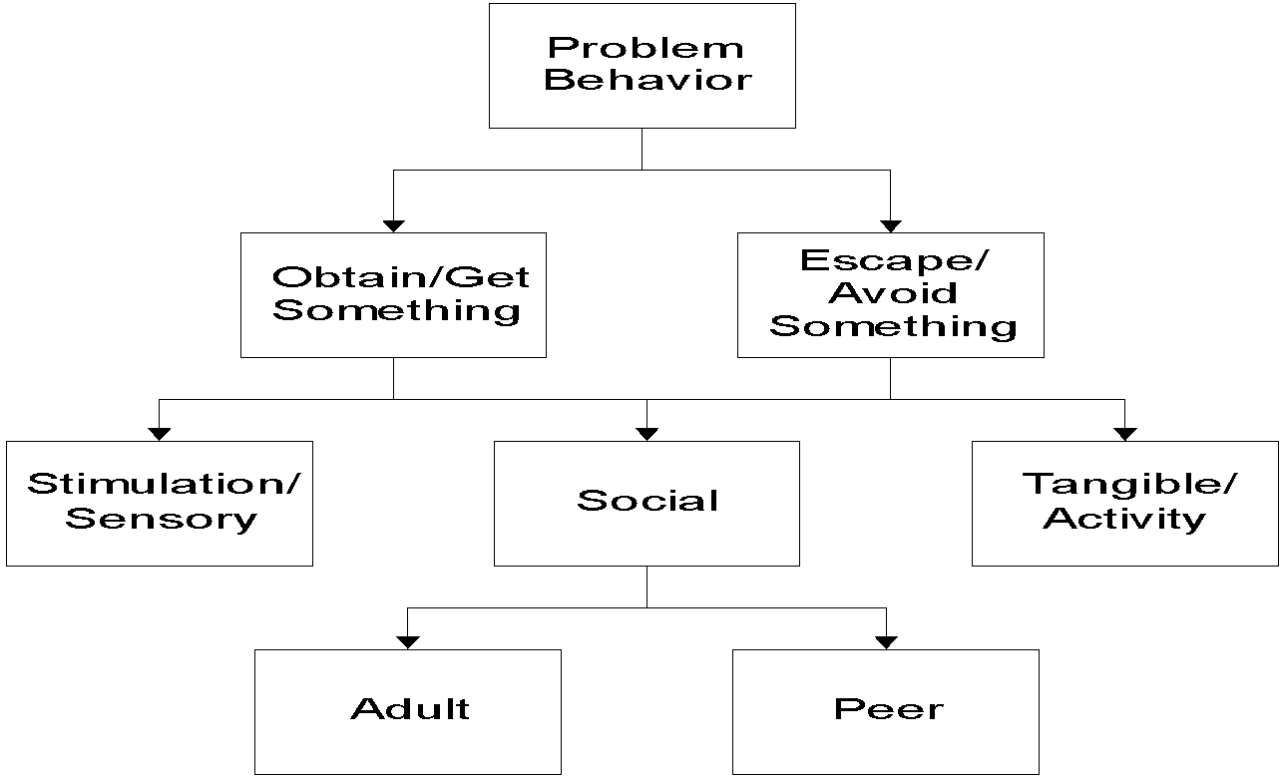
Functions of Behavior
Notes:
COrtney

Slide 22
Most Common Functions of Behavior
To Obtain/ Get :
Peer attention
Adult attention
Desired activity
Desired object/ items
Sensory stimulation: auditory, tactile, etc.
To Avoid/ Escape:
Difficult Task
Boring Task
Physical demand
Non-preferred activity
Peer attention
Staff attention
Reprimands
Notes:
COrtney

Slide 23
Examples of Function in School
Obtain/Get Reinforcers
  I yell and others look at me
  I fight and others listen to me
  I wander and people talk to me
  I hit in order to get toys from other kids
Escape/Avoid Aversives
  I cry when work gets hard and the teacher tells me to take a time out
  I throw a book during math class and the teacher will send me out of class
  I stand against the wall in PE so my classmates do not throw the ball at me
Notes:
COrtney

Slide 24
Your Case Study: Step 1
Write down an example of a challenging behavior, along with
your hypothesis about function.
Include data, if you have it!
Think-about Question =
Is the typical consequence for the behavior going to encourage or discourage the behavior?
The Effect of Consequences
Notes:
Cortney
Base whole group vs. table discussion on whole group size
Record examples of challenging behavior to use later in punishment activity

Slide 25
Consequences
Definition: Anything that happens after a behavior.
Consequences can either:
Encourage or reinforce (increase the frequency of) behavior,
or
Discourage or “punish” (decrease the future frequency of)
behavior
The consequences the student has experienced in the past determines the function of the current behavior
Notes:
Teri

Slide 26
Consequences: Reinforcement +
Definition: Anything that happens after a behavior that increases the probability that the behavior will be repeated again in the future.
Positive: Anything desirable that the student gets, contingent upon the behavior (i.e. time with a preferred activity, a token, praise, or a candy treat)
Example: John gets the teacher’s attention when he blurts out in class. Important - John LIKES teacher attention!
Notes:
Teri

Slide 27
Consequences: Reinforcement -
Definition: Anything that happens after a behavior that increases the probability that the behavior will be repeated again in the future.
Negative: Anything that is aversive that the student avoids by engaging in a behavior (i.e. disrupting class to get kicked out so that work is avoided, or avoiding a reprimand by raising one’s hand)
Example: Sarah avoids work when she refuses to do it, and is even more successful when the teacher sends her out of the classroom as a result of her refusal.
Notes:
Teri

Slide 28
Consequences: Punishment +
Definition: Anything that happens after a behavior that decreases the probability that the behavior will happen again. Punishment is the second type of consequence.
Positive: Something aversive happens contingent on the behavior
Example: Sarah refuses to do her work but she does care about her grades. When she gets an “F”, she is upset.
Notes:
Teri

Slide 29
Consequences: Punishment -
Definition: Anything that happens after a behavior that decreases the probability that the behavior will happen again. Punishment is the second type of consequence.
Negative: Something desirable is taken away
Example: Sarah has to stay in from recess to do her work (provided she really likes recess)
Other examples include: Re-Set, Time-Out, Loss of Privileges
Notes:
Teri

Slide 30
Disciplinary Consequences
Reinforcement or Punishment?
Send student out of the room for refusing to complete a task
Verbally re-direct a student who continually calls out to get your attention
You may not know whether a consequence is reinforcement or punishment until future behavior increases, stays the same, or decreases
Notes:
Teri

Slide 31
Behavior Pathway
Setting Events /
Conditions
Antecedent Trigger
Problem Behavior
Maintaining
Consequence
Function
Notes:
31
Cortney
Function can be determined once a pattern is established. You can hypothesize once you have the beginning of a pattern.

Slide 32
Step 2: Develop a Plan
Identify how you will respond to the problem behavior in a way that does not reinforce the behavior (i.e. fulfill the function)

Slide 33
Your Case Study: Step 2
With a partner, review the example of a challenging behavior that you came up with earlier and determine an appropriate disciplinary response that will effectively discourage the behavior (i.e. serve as an effective “punishment”)
Notes:
Teri

Slide 34
Step 2: Develop a Plan
Identify a replacement behavior that fulfills the same function as the problem behavior
  Does the behavior need to be taught?
  How will the behavior be taught? By whom?
  How will the behavior be reinforced?
Match with your style, comfort level, and class-wide acknowledgements system

Slide 35
Step 2: Develop a Plan
Avoidance
  To avoid a task
  To avoid a person/interaction
What to do
  Premack – No fun until it’s done!
  Build in breaks
  Permit escape for a specified time

Slide 36
Step 2: Develop a Plan
Access (Attention-Seeking)
  Engages in behavior to satisfy need for attention
    Chronic blurting out, excessive helplessness, tattling, minor disruptions
What to do:
  Be careful about reinforcing the “problem behavior”
  Planned ignoring
  Provide attention to and reinforce positive behavior
  Teach an alternate way to access attention

Slide 37
Competing Behavior Pathway
Desired Behavior
Maintaining
Consequence
Setting Events /
Conditions
Problem Behavior
Antecedent Trigger
Maintaining
Consequence
Function
Replacement Behavior
Notes:
37
Cortney

Slide 38
Case Study Pathway: Sarah
Complete math task
Maintaining
Consequence
Routine: Math Class
Function
Student didn’t get much sleep last night
Avoids math task
Asked to do a math task
Gets sent out of class
Sits silently
Write name on paper
Notes:
38
Cortney

Slide 39
Your Case Study: Step 2
With your partner, using the same challenging behavior example, decide on an intervention that could result in the student choosing a more acceptable replacement behavior that meets the same function as the challenging behavior. Decide if/how you would
teach and reinforce the
replacement behavior.
Notes:
Cortney

Slide 40
Step 3: Assess if plan is working
Assess if the plan is working
- Collect more data
- Compare pre- and post-intervention
- Adjust your plan per the data
or
- Refer for more help, if needed, using the data you collected to
support your referral and to jumpstart next steps

Slide 41
Your Case Study: Step 3
With your partner, decide what data you would collect to determine if your intervention is working.
Notes:
Cortney

Slide 42
Congratulations!
You have successfully engaged in FBA Thinking!
By doing a mini FBA you can respond in a way that will:
Not accidentally reinforce challenging behavior
Effectively discourage (and not encourage) behavior
And you can reinforce an acceptable replacement behavior instead!
Notes:
Teri

Slide 43
Next Steps?
With a partner, discuss how you plan to use the information shared in this presentation.
Will you be presenting this to your staff?
If so, when? Do you need any additional assistance from us?
Notes:
Teri
Ask some people to share their plans

Slide 44
Training Available
Available through the Vermont PBIS Team:
    Basic FBA to BSP
    Building Better Behavior Support Plans (B3SP)
    VTPBiS Leadership Team Training at the Intensive Level
See Vermont PBIS website for current trainings offered, or contact a coach for more options
Notes:
Teri

Slide 45

Explore the PD Calendar

Slide 46
To get a VTPBIS State-Approved Coach:
Contact your VTPBIS State TA to review the needs of your SU/SD/School
Review the VTPBIS Coach Fees: $62.50/hour, $250/half day or $500/day plus mileage
Coordinate with your central office Grants Coordinator to use local funds or to apply for BEST/Act 230 funds: http://education.vermont.gov/sites/aoe/files/documents/edu-integrated-frameworks-best-act-230-innovation-grant-instructions.pdf.
Contact a VTPBIS State-Approved Coach: http://www.pbisvermont.org/resources/coaches-a-coordinators/coaches.

Slide 47
VTPBIS TA’s are a great resource
When in doubt, contact Anne Dubie!
at
(802) 656-5775 or
Anne.Dubie@uvm.edu

Slide 48


Stay Connected
https://www.facebook.com/groups/PBISVermont/
https://twitter.com/vtpbis
Please share all of the awesome things you are doing by using #VTPBIS or @VTPBIS

Slide 49
Wrap-Up
Contact us with any questions!
Cortney Keene, M.Ed., C.A.S., BCBA
email: cortney.keene@uvm.edu
Teri Brooks, Ph.D., BCBA
e-mail: terimbrooks@gmail.com
Notes:
Cortney

