Slide 1

The Interconnected Systems Framework (ISF) for Integrating Mental Health in Schools
VT PBIS Conference
October 2017
Lucille Eber, Midwest PBIS Network
National PBIS TA Center
With: Michaela Martin and Jamie Kinnarney of ONSU
And Tiffiny Hubbard of WCMHS
www.midwestpbis.org
www.pbis.org
Notes:
Integration of Mental Health within PBIS: Action Planning and Coaching

Slide 2
Key Questions
Can we expand the effectiveness of the school-based continuum if we include a broader group of stakeholders within one integrated behavioral health system (school/community mental health providers, family)?
Can we, using local data, enhance the continuum with a greater array of EBPs to meet the needs of more students with greater effectiveness?
Can we increase the # of students with data-based improvements in social/emotional functioning (beyond "clinician judgment”)?

Slide 3
Big Ideas
Rationale/need for interconnected systems
How PBIS can serve as a framework for an expanded continuum of school mental health interventions
How changing roles of clinicians, cross-training, and shared decision making can lead to an expanded system of behavioral health support
How tools can guide the development and implementation of an ISF

Slide 4

Advancing Education Effectiveness: Interconnecting School Mental Health and
School-Wide Positive Behavior Support
  Editors: Susan Barrett,
  Lucille Eber, and Mark Weist
  pbis.org
  csmh.umaryland
  IDEA Partnership NASDSE

Slide 5
ISF National Leadership Team
Susan Barrett, Director, Mid-Atlantic PBIS
sbarrett@midatlanticpbis.org
Lucille Eber, Director, Midwest PBIS
lucille.eber@midwestpbis.org
Bob Putnam, Executive Vice President of PBIS and Consultation, May Institute
bputnam@mayinstitute.org
Kelly Perales, Director of Training and Technical Assistance PBIS/MH Integration, Midwest PBIS Network
kelly.perales@midwestpbis.org
Mark Weist, Professor, Clinical-Community and School Psychology, U South Carolina
weist@mailbox.sc.edu
Sharon Stephan, Co-Director, CSMH
sstephan@psych.umaryland.edu
Nancy Lever, Co-Director, CSMH
nlever@psych.umaryland.edu
Joni Splett, Assistant Professor, University of Florida
splett@coe.ufl.edu
Ashley Quell, University of South Carolina
quell@mailbox.sc.edu

Slide 6
ISF Defined
  Structure and process for education and mental health systems to interact in most effective and efficient way
  Guided by key stakeholders in education and mental health/community systems
  Who have the authority to reallocate resources, change role and function of staff, and change policy

Slide 7
MTSS/ISF Core Features
  Effective teams that include community mental health providers
  Data-based decision making
  Formal processes for the selection & implementation of evidence-based practices (EBP)
  Early access through use of comprehensive screening
  Rigorous progress-monitoring for both fidelity & effectiveness
  Ongoing coaching at both the systems & practices level
Notes:
Same as PBIS RTI MTSS (labels not as important as ensuring core features needed for installing EBPs)

Slide 8
What Does it Mean to Integrate?
Change in routines and procedures?
(e.g. who needs to be available to participate in team meetings?)
Change in how interventions are selected and monitored?
(e.g. team review of data/research vs. individual clinician choice?)
Change in language we use?
(e.g. identifying specific interventions vs. generic terms such as “counseling” or “supports”?)
Changes in roles/functions of staff?
(e.g. clinicians coordinating/overseeing some interventions that non-clinicians deliver?)

Slide 9
ISF Key Messages
2. Access is NOT enough
3. Mental Health is for ALL
4. MTSS essential to install SMH
1. Single System of Delivery
Notes:
SOC
SMH
MTSS/PBIS

Slide 10
1. Single System of Delivery
One committed and functional team with authority guides the work, using data at three tiers of intervention
MH participates across ALL Tiers
Evidence-Based Practices/Programs integrated at each tier
Symmetry (of process) at District- and Building-level
  District has a plan to integrate MH at all buildings
  Plan is based on community and school data
Plan to build “social emotional” capacity across staff
  Training and coaching in place for ALL staff (community and school employed)
  Staff are competent and confident in identifying, intervening, and/or referring

Slide 11
Traditional
MH counselor “sees” student at appointments
Clinicians only do “mental health”
An Interconnected Systems Framework
MH person on teams at all tiers. Interventions are defined (core features, dosage, frequency, outcomes)
MH is everyone’s job. Clinicians contribute to integrated plan
Case management notes
Fidelity AND outcome data determined before delivery; data monitored continuously by teams

Slide 12
School Data → Community Data
Student and System level
Academic (Benchmark, GPA, Credit accrual etc)
Discipline
Attendance
Climate/Perception
Visits to Nurse, Social Worker, Counselor, etc.
Screening from one view
Community Demographics
Food Pantry Visits
Protective and Risk Factors
Calls to crisis centers, hospital visits
Screening from multiple views
Notes:
How can we start to screen from multiple views? Here are some data to consider

Slide 13
Coaching ISF
Are Community Mental Health providers members on the Tier 1 team and looking at data with the Tier 1 Team?
Have teams and Community MH providers used community data to determine Tier 1 strategies (moving beyond simply being aware of the data)?
Have school teams integrated “SEL lessons” (i.e. related to Trauma) into Tier 1 matrix?

Slide 14
2. Access is NOT enough
All work is focused on ensuring positive outcomes for ALL children and youth and their families.
Interventions are matched to presenting problem using data, monitored for fidelity and outcome
Teams and staff are explicit about types of interventions students and youth receive (e.g. from “student receives counseling” to “student receives 4 coping skills group sessions)
Skills acquired during sessions are supported by ALL staff (e.g. staff are aware that student is working on developing coping skills and provides prompts, pre-corrects, acknowledges across school day)

Slide 15
Daily Progress Report (DPR) Sample
NAME:______________________ DATE:__________________
Teachers please indicate YES (2), SO-SO (1), or NO (0) regarding the student’s achievement
in relation to the following sets of expectations/behaviors.
EXPECTATIONS | 1 st block | 2 nd block | 3 rd block | 4 th block
Be Safe | 2 1 0 | 2 1 0 | 2 1 0 | 2 1 0
Be Respectful | 2 1 0 | 2 1 0 | 2 1 0 | 2 1 0
Be Responsible | 2 1 0 | 2 1 0 | 2 1 0 | 2 1 0
Total Points
Teacher Initials
Adapted from Grant Middle School STAR CLUB
Adapted from Responding to Problem Behavior in Schools: The Behavior Education Program by Crone, Horner, and Hawken
Notes:
15
Layered DPR examples

Slide 16
Trauma-Informed
Tier 2 Group
Daily Progress Report (DPR) Sample
NAME:______________________ DATE:__________________
Teachers please indicate YES (2), SO-SO (1), or NO (0) regarding the student’s achievement
in relation to the following sets of expectations/behaviors.
EXPECTATIONS | 1 st block | 2 nd block | 3 rd block | 4 th block
Be Safe | 2 1 0 | 2 1 0 | 2 1 0 | 2 1 0
Be Respectful | 2 1 0 | 2 1 0 | 2 1 0 | 2 1 0
Be Responsible | 2 1 0 | 2 1 0 | 2 1 0 | 2 1 0
Total Points
Teacher Initials
Self-Check
Use calming strategy
Use your words
Use safe hands
Ask for help
Connect with safe person
Adapted from Grant Middle School STAR CLUB
Adapted from Responding to Problem Behavior in Schools: The Behavior Education Program by Crone, Horner, and Hawken
Notes:
16

Slide 17
Trauma-Informed
Tier 2 Group
Daily Progress Report (DPR) Sample
NAME:______________________ DATE:__________________
Teachers please indicate YES (2), SO-SO (1), or NO (0) regarding the student’s achievement
in relation to the following sets of expectations/behaviors.
EXPECTATIONS | 1 st block | 2 nd block | 3 rd block | 4 th block
Be Safe | 2 1 0 | 2 1 0 | 2 1 0 | 2 1 0
Be Respectful | 2 1 0 | 2 1 0 | 2 1 0 | 2 1 0
Be Responsible | 2 1 0 | 2 1 0 | 2 1 0 | 2 1 0
Total Points
Teacher Initials
SOS (slow down, orient, self-check)
Use mindfulness
Distract & Self-Soothe
Let ‘M Go
Make A Link
Make Meaning
Adapted from Grant Middle School STAR CLUB
Adapted from Responding to Problem Behavior in Schools: The Behavior Education Program by Crone, Horner, and Hawken
Notes:
17

Slide 18
3. Mental Health is for ALL
Positive school climate and culture serves as protective factor
Social/emotional/behavioral health addressed with same level of attention and concern as is our children’s academic and cognitive achievement
Social behavior skills taught and reinforced by ALL staff across ALL settings and embedded in ALL curriculum
Behavior examples used to explicitly teach what behaviors look like and sound like across school settings

Slide 19
EBP = Teaching Skills
(same for social/emotional as for academics)
Define simply
Model/demonstrate w/ range of examples
Practice in range of natural settings
Monitor & provide positive feedback & reinforcement
Based on data, adjust instruction & reteach

Slide 20
Teaching Matrix |  | INCORPORATE Coping Strategies for Managing Stress
 |  | All Settings | Halls | Playgrounds | Lunch | Library/ Computer Lab | Assembly | Bus
 | Respectful | Be on task. Give your best effort. Be prepared. | Walk. | Have a plan. |  | Study, read, compute. | Sit in one spot. | Watch for your stop.
 | Achieving & Organized | Be kind. Hands/feet to self. Help/share with others. | Use normal voice volume. Walk to right. | Share equipment. Include others. |  | Whisper. Return books. | Listen/watch. Use appropriate applause. | Use a quiet voice. Stay in your seat.
 | Responsible | Recycle. Clean up after self. | Pick up litter. Maintain physical space. | Use equipment properly. Put litter in garbage can. |  | Push in chairs. Treat books carefully. | Pick up. Treat chairs carefully. | Wipe your feet.
1. Expectations
2. NATURAL CONTEXT (Locations)
Invite those sitting alone to join in
Have a lunch plan and choose quiet or social lunch area
Invite friends to join me
Expectations
3. Rules or Specific Behaviors
Use my breathing technique
Listen to my signals
Notes:
Replacement behaviors- very important that we anchor in our teaching matrix as this is our core social emotional curriculum- the common language and script we use to teach, acknowledge, pre-correct – all staff are using same approach for teaching and supporting throughout the year across the school day. We get what we pay attention to and this helps provide the common language/consistent approach- our values for our school
When dealing with stress and anxiety became major priority in school, it would be a matter of teaching skills to students so they developed strategies and skills and incorporated into their social curriculum – the matrix is the delivery mechanism to get skills out ALL !!!

Slide 21
4. Installed and aligned with core features of MTSS framework
Teams
Data-based decision-making
Continuum of linked EBPs
Screening
Progress monitoring
Ongoing PD/coaching
Are these features in place (or partially/in progress) in your district?
Notes:
DBD: both fidelity and outcomes; much mor specific..link presenting problem to outcome data…Focused Family: WrapAround/FBA?BIP//Family/teacher and youth perspective
Screening: integrate what PBIS AND SMH have historically done into one stronger model (John Crocker);

Slide 22
Multiple Evidence-Based Interventions of Varying Intensity
Install foundational interventions school-wide
Ensure identification, monitoring, and selection process are in place
Identify additional interventions that might be needed such as:
  Trauma-informed interventions
  Coping Cat
  Check and Connect

Slide 23
MTSS: A Continuum of Evidence-Based Practices (EBPs) Linked Across Tiers
A formal process for selecting and implementing evidence-based practices
Team process (not individual clinicians)
Interventions linked across tiers with dosage and specificity of interventions increasing from lower to higher tiers
Consumer Guide to Selecting Evidence-based Practices

Slide 24
Example:
Behavior
A small (15) group of students who were asking to go to the office on a daily basis or were frequently absent
  Most behaviors were internalizing: anxiety, withdrawal, avoidance of others
  These were students who performed academically, not special education eligible
School psychologist researched small group interventions for these students
Found Coping Cat
Access to Skills
Coping CAT is a Cognitive Behavioral Intervention
that helps students recognize & analyze feelings related to stress & develop strategies to cope with stress provoking situations. It is an 8-week group intervention that meets on a weekly basis for 45 minutes.
Notes:
An Example
What can you draw from this example?

Slide 25
Modified Coping Cat
Generalize to Context
Coping Cat small groups (6 students) are co-facilitated by a Community Mental Health Counselor and a school counselor. Student responsibilities include participating in weekly group sessions, completing homework assignments (using coping strategies), & self-monitoring progress.
Teacher responsibilities include prompting students to use their coping strategies & a willingness to participate in professional development regarding stress management &/or anxiety. Coping Cat instructor responsibilities include implementing the Coping Cat curriculum with fidelity & monitoring student progress (Office Visit Requests and Attendance Rate) with students & teachers.
Pre-post measure: Screen for Child Anxiety Related Disorders (SCARED). Birmaher, Khetarpal, Cully, Brent, & McKenzie,1995.
Outcome
Outcome
Resource: Recorded webinar
Installing ISF-Local Experiences Integrating SOC & Education
A review of the core components of the ISF and experiences from SOC/Education efforts in New Hampshire.
https://theinstitute.adobeconnect.com/p5sh4fur2al/
Notes:
Is this an EBP?

Slide 26
Pre/Post Coping Cat
Students Report on the SCARED (n=18)
Notes:
April 2015 ISF webinar series located at www.midwestpbis.org; “Installing ISF : Local Experiences Integrating Systems of Care and Education”, Barrett, Eber and Malloy.

Slide 27
Average Number of Absences per Student (Full Days)
Pre (7 weeks prior to group); During (8 school weeks of intervention);
Post (7 weeks after group)
Notes:
April 2015 ISF webinar series located at www.midwestpbis.org; “Installing ISF : Local Experiences Integrating Systems of Care and Education”, Barrett, Eber and Malloy.

Slide 28
Average Number of Visits to the Nurse (per week)
Pre (7 weeks prior to group); During (8 school weeks of intervention);
Post (7 weeks after group)
Notes:
April 2015 ISF webinar series located at www.midwestpbis.org; “Installing ISF : Local Experiences Integrating Systems of Care and Education”, Barrett, Eber and Malloy.

Slide 29
Integrated Action Plan
School-employed and community-employed staff share responsibilities and resources
Uses framework of PBIS and blends in SMH across tiers to provide full continuum of prevention and intervention based on data and use of EBPs

Slide 30
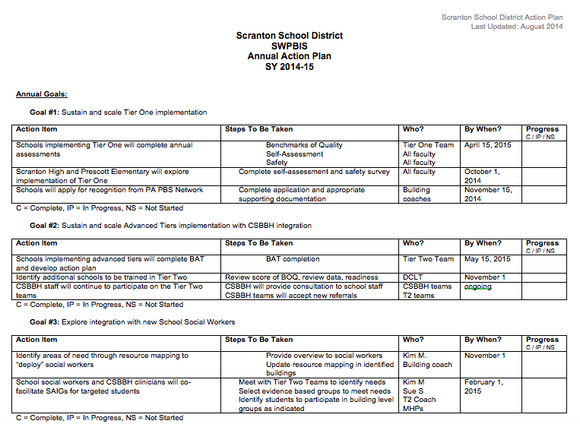
CSBBH clinicians will continue participating
on Tier 2 systems teams
School Social workers and CSBBH clinicians
will co-facilitate social skills groups

Slide 31
Examples of Coaching ISF
Are Community MH providers members on the Tier 2 team?
Are interventions provided by community providers determined as part of the overall system (All Tiers)?
Are interventions provided by Community MH providers progress monitored through Tier 2 team?

Slide 32
Interconnected Systems Framework
Action Planning Companion Guide
SW-PBIS Tiered Fidelity Inventory

Slide 33
ISF Action Planning Companion Guide to SWPBIS TFI
The purpose is to guide action planning for integration of Mental Health into PBIS
Not for use in scoring the TFI
  At this point, the ISF enhancements do not impact PBIS fidelity measures
  To measure ISF fidelity, consider piloting the ISF II

Slide 34
1.3 Behavioral Expectations
Subscale | Tiered Fidelity Inventory: Tier I Features
Implementation | 1.3 Behavioral Expectations: School has five or fewer positively stated behavioral expectations and examples by setting/location for student and staff behaviors (e.g., school teaching matrix) defined and in place.
 | PBIS Big Idea: School-wide expectations are a brief, memorable set of positively-stated expectations that create a school culture that is clear, positive, and consistent. ISF Big Idea: School-wide expectations foster skill building, positive relationships, and focus on teaching social and emotional competencies.
ISF Enhancements | Families, students and community participate in development of the expectations
 | All elements of the social emotional curriculum including community enhancements are linked the behavioral expectations

Slide 35
Teaching Matrix |  | INCORPORATE Trauma-Informed Strategies
 |  | All Settings | Halls | Playgrounds | Classroom | Library/ Computer Lab | Assembly | Bus
 | Respectful | Be on task. Give your best effort. Be prepared. | Walk. | Have a plan. |  | Study, read, compute. | Sit in one spot. | Watch for your stop.
 | Safe | Be kind. Hands/feet to self. Help/share with others. | Use normal voice volume. Walk to right. | Share equipment. Include others. |  | Whisper. Return books. | Listen/watch. Use appropriate applause. | Use a quiet voice. Stay in your seat.
 | Responsible | Recycle. Clean up after self. | Pick up litter. Maintain physical space. | Use equipment properly. Put litter in garbage can. |  | Push in chairs. Treat books carefully. | Pick up. Treat chairs carefully. | Wipe your feet.
2. NATURAL CONTEXT (Locations)
1. Expectations
Use your words
Use safe hands
Self Check
Use Calming Strategy
Expectations
3. Rules or Specific Behaviors
Ask for help
Connect with Safe Person
Notes:
Replacement behaviors- very important that we anchor in our teaching matrix as this is our core social emotional curriculum- the common language and script we use to teach, acknowledge, pre-correct – all staff are using same approach for teaching and supporting throughout the year across the school day. We get what we pay attention to and this helps provide the common language/consistent approach- our values for our school
When dealing with stress and anxiety became major priority in school, it would be a matter of teaching skills to students so they developed strategies and skills and incorporated into their social curriculum – the matrix is the delivery mechanism to get skills out ALL !!!

Slide 36
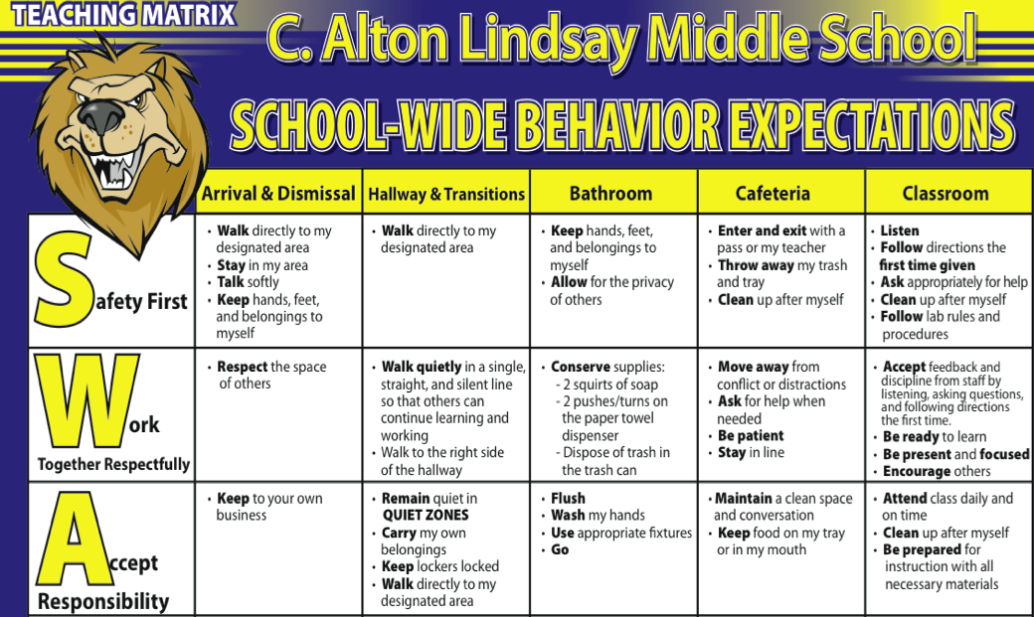

Notes:
Example from VA middle school- feedback from students leveraged this enhancement

Slide 37
PBIS Matrix for Home
I am respectful Listen to my parents
Be truthful to my parents
Play cooperatively
Speak nicely to others
I am responsible Put away my toys, bike, and equipment
Help with jobs at home
Follow my parents’ directions
Share Thursday folder with parents
I am safe Play safely with others
Stay in designated areas
Stay away from strangers
Wear bike helmet and equipment
I am prepared Finish homework and share with parent
Pack backpack at night for school the next day
Go to bed on time
Get up and get ready for school when called
Notes:
Home example- how do we provide examples that represent our community and the values of our families-

Slide 38

Notes:
Forest Park community example:
the community-wide team came together and decided to use same behavioral expectations as the schools. The icons of each agency/organization are on the community pbis logo

Slide 39
1.5 Problem Behavior Definitions
Subscale | Tiered Fidelity Inventory: Tier I Features
Implementation | 1.5 Problem Behavior Definitions: School has clear definitions for behaviors that interfere with academic and social success and a clear policy/procedure (e.g., flowchart) for addressing office-managed versus staff-managed problems.
 | PBIS Big Idea: Explicit definitions of acceptable versus unacceptable behavior provides clarity to both students and staff and is a critical component of identifying clear procedures for staff to respond to inappropriate behavior objectively. ISF Big Idea:. Community, family/student input to the definitions of acceptable vs unacceptable behaviors expands the view of behavioral definitions and increases likelihood of cultural relevancy and student engagement.
ISF Enhancements | The school team develops a clearly documented and predictable system for managing disruptive behavior that represent community family/student values and culture.
 | Referral procedures include ways to track students leaving their instructional environment (e.g., visits to the nurse or school counselor) so the needs of youth with internalizing as well as externalizing challenges inform the behavior definition process.
Notes:
What is our current system? Can we improve and enhance?

Slide 40




Broaden Use of Data:
Focus on Internalizing Issues

Slide 41
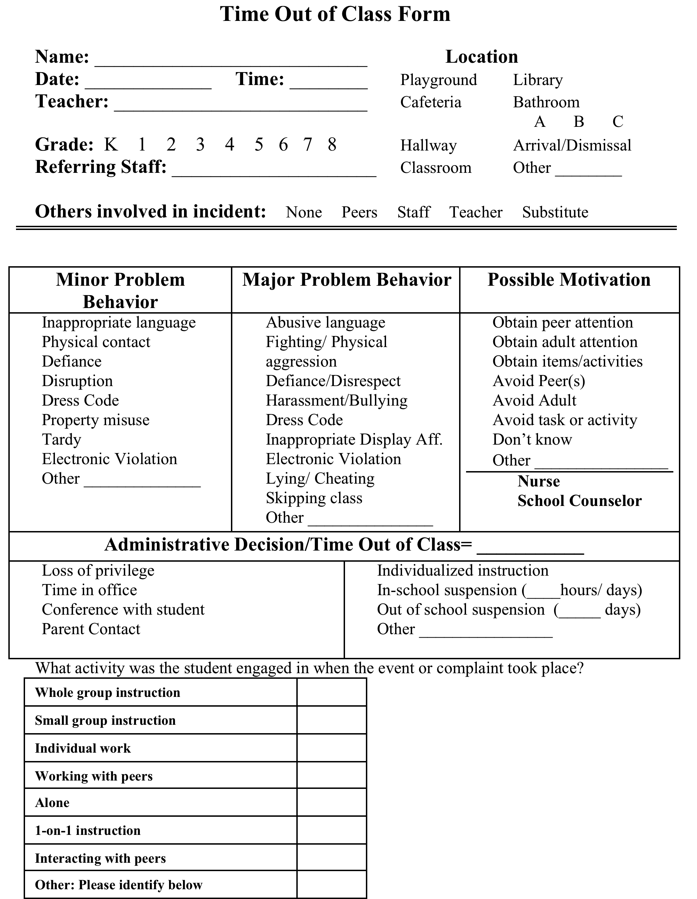
Notes:
If installing a screener seems like a long term goal you can Start small by documenting out of class time for students who are seeking support a the nurse, school counselor, social worker etc

Slide 42
2.3 Screening
Subscale | Tiered Fidelity Inventory: Tier II Features
Teams | 2.3 Screening: Tier II team uses decision rules and multiple sources of data (e.g., ODRs, academic progress, screening tools, attendance, teacher/family/student nominations) to identify students who require Tier II supports.
 | PBIS Big Idea: Quick access to additional supports increases the likelihood of student success. ISF Big Idea: Screening for social, emotional, and behavioral concerns; both internalizing and externalizing; allows students to be identified early and linked to the appropriate intervention.
ISF Enhancements | School-wide screening protocol includes a process to identify both internalizers and externalizers.
 | Data from screening and Tier II decision rules are used to select appropriate evidence-based intervention (e.g., if a small group of students are experiencing anxiety, an intervention specifically aligned to teach coping skills is selected).

Slide 43
Integration of Positive Family Support into PBIS & RTI (Tom Dishon and Kevin Moore)
Individualized Supports
Functional Behavioral
Assessments
Indicated
Family Check-Up
Parenting Support Sessions
Parent Management Training
Community Referrals
Specialized Supports
Check-In/Check-Out
Selected
Parent Integration CICO
Attendance & Homework Support
Home-School Beh Change Plans
Email and Text messages
Universal
School Rules & Expectations
Positive Reinforcement
Student Needs Screening
Family Resource Center
Parenting Materials
(Brochures/Videos/Handouts)
Positive Family Outreach
Student Needs Parent Screening
(http://fcu.cfc.uoregon.edu/)
Notes:
Positive Family Support: A tiered model for evidenced-based parental engagement. Tom Dishion, University of Oregon
(http://fcu.cfc.uoregon.edu/)

Slide 44


John Crocker
Methuen Public Schools
Methuen, MA
John Crocker
Session E8
National PBIS Leadership Forum
October 28, 2016
Comprehensive School Mental Health System
National Quality Initiative Summit
April 26, 2016
Notes:
Thank you for being willing to provide a brief description of your team’s use of the National SMH performance measures. Please complete the following slides (additional instructions in the notes of each slide). Feel free to email/call if you have any questions! jbohnenk@psych.umaryland.edu, 443-255-2480. Please return by 2/20.

Slide 45
Example –
Screening for Internalizing Problems
Two large scale screenings at Methuen High School
  GAD-7 anxiety screener (January)
  PHQ-9 depression screener (April)
Electronic screening using Google forms
Parent notification and opt-out process in advance
100% of students who required follow-up received it within 7 days of the screening
Notes:
Provide a brief description of one of your PDSAs in the domain you have been focusing on.

Slide 46
Methuen HS, cont.
The two screenings yielded the following data:
  GAD-7 (January)
    840 responses (approx. 45% of the high school pop.)
    85 students scored in the severe range (10.1% of respondents)
    104 students scored in the moderate range (12.4% of respondents)
  PHQ-9 (April)
    853 responses (approx. 45% of the high school pop.)
    69 students scored in the severe range (8.1% of respondents)
    102 students scored in the moderate range (12.0% of respondents)
  8.1% of students scored in the moderate or severe range on both screeners
  2.3% of students scored in the severe range on both screeners

Slide 47
Mental Health Partnership in
Vermont
Orange North SU and WCMH’s Partnership
VT PBIS Leadership Forum

Slide 48
ONSU/WSSU- Central Vermont SU
Orange/Washington School District
Orange Center School
Washington Village
Central Vermont Unified Union School District
Williamstown
Northfield

Slide 49
Setting the Context
K-8 school with 100 students
No school-wide approach to behavior
Six 1:1 Behavior Interventionists (contracted from local mental health agency)
Chronic office referrals with no attention to data
Ineffective leadership

Slide 50
Vision for a
Partnership with Mental Health
Implement PBIS within MTSS
To Partner with local mental health agency in creating SU-wide approach
that is
proactive, that benefits all students, and that enriches the school’s climate
Reactive to Proactive

Slide 51
ONSU MTSS
ONSU MTSS

Slide 52
How did we do this?
In 2011, all schools began the professional learning in implementation of the principles of PBIS.
Orange Center School drastically reduced its need for one on one behavior support with the implementation of PBIS at the Targeted & Intensive levels.
They quickly realized that students coming off intensive supports still needed the support of a resource that had expertise in behavior and could help provide wrap around supports for the child and family.
The PBIS Analyst was created in spring of 2012 after financial resources were reallocated.

Slide 53
ONSU PBIS Analyst Model
Is…
Proactive
Expertise
Support
Professional Learning
For all students’ benefit
Part of a team approach
Part of a MTSS system

Slide 54
ONSU PBIS Analyst Model
Is NOT …
Responsive
Behavior Intervention
Discipline
Outside consultant
For only a few students
Silo
Dumping Ground

Slide 55
Roles & Responsibilities
  Case-manages 8 to 10 students with targeted plans
  Provided social/emotional intervention to students on targeted plans
  Conducted Functional Behavior Assessments
  Created/monitored/exited behavior support plans
  Collaborated with SpEd on behavior plans for students with intensive needs
  Coordinated interagency support
  Coached Check in Check Out
  Supported staff in universal social/emotional strategies
  Member of PBIS Universal & Targeted Intensive Teams

Slide 56
So what now what?
2012-2013
Expanded to Washington Village School & Williamstown Middle/High School.
2013-2014
Expanded to Williamstown Elementary which eliminated the planning room model.
2017-2018
Expanded to Northfield Elementary & Northfield Middle School which maintains a planning room model.
PBIS Analyst Model is in 18 schools in Vermont!

Slide 57
Lessons WE learned along the way!
There must be a solid universal system as a foundation BEFORE developing this type of partnership.
There must be strong leadership with strong commitment to being proactive and persevering for student success.
There must be structures developed that support clear and continual communication between the principal, analyst and other team members.
SU-systemic approach for sustainability.

Slide 58
Summarizing
Questions
Dialogue
Possible Next Steps

Slide 59

ISF Resources available at: www.midwestpbis.org

Slide 60
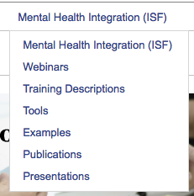
Several Pages are Available

Slide 61
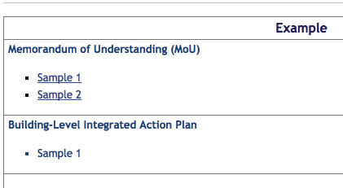
Sharing Examples from Sites

Slide 62
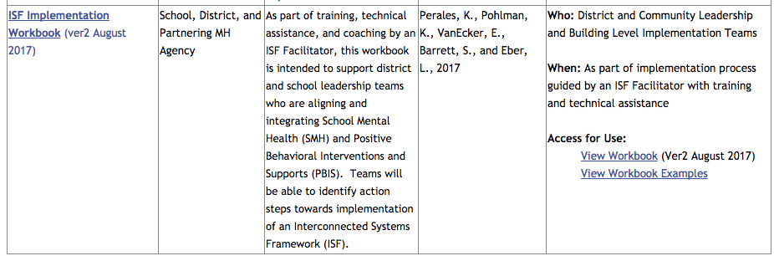
New Workbook with Hyperlinks

Slide 63
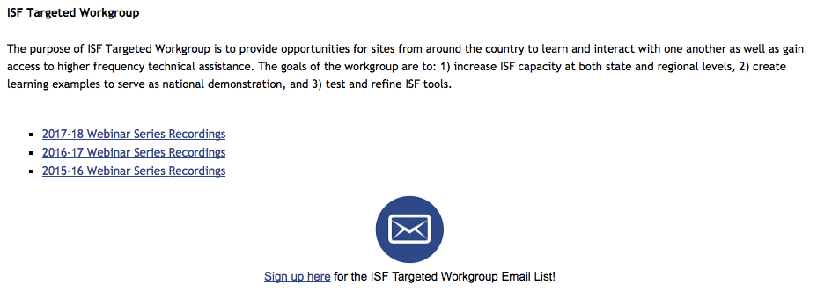
Join the Targeted Workgroup Webinars

