Slide 1

Engaging Families
Presented by:
Kym Asam, LICSW
Bonnie Poe
Wifi Information:
Grand Guest
Find all materials at: pbisvermont.org

Slide 2
Maximizing Your Session Participation
Consider these questions:
Where are we in our implementation?
What do I hope to learn?
What did I learn?
What will I do with what I learned? By when?
Use the Learning Reflection Sheet

Slide 3
Where are you in the implementation process?
Adapted from Fixsen & Blase, 2005
Exploration & Adoption
Installation
Initial Implementation
We think we know what we need so we are planning to move forward (evidence-based)
Let’s make sure we’re ready to implement (capacity infrastructure)
Let’s give it a try & evaluate (demonstration)
Full Implementation
That worked, let’s do it for real and implement all tiers across all schools (investment)
Let’s make it our way of doing business & sustain implementation (institutionalized use)
Notes:
Think about implementation for any initiative, framework, practice you do

Slide 4

BEST Expectations
Be present
Engage with others
Strengths-based
Team solutions
Notes:
Remind of our expectations –
Be present – cell phones off, throw out task list, etc.
Engage – show respect by listening and using effect team skills
Use rule of brainstorming= no idea is a bad idea
Team solutions – work together toward consensus

Slide 5
Learning Outcomes
Explore current strategies for engaging families
Examine family engagement opportunities across tiers
Examine barriers to family engagement across the tiers
Enhance strategies for strengthening relationships with families
Share tools and resources for engaging families

Slide 6

Reflections
Think of a time when you felt really engaged with a parent.
  What were the circumstances?
  What was the forum?
  What strategies did you use?
  What qualities did the parent have?
Notes:
If you are in a team, talk amongst your team.
If not, pair/share

Slide 7
So, what do we know?

Slide 8
Parent and Family Collaboration: Improving Student Outcomes
Several decades of research suggests…
Strong partnerships between families, schools, and communities
Building a caring community
Dynamic, positive and productive collaboration
Notes:
When parents, teachers, students and others view one another as partners in education, a caring community forms around students – this can be hard when there is conflict between student and teacher
among students, families, and professionals…is the foundation for effective problem solving and instructional decision-making.
Ask audience to shout out the qualities of effective collaboration
Cormer, J. 2005, the rewards of parent participation
Epstein and Selinas, 2004, Partnering with Families and Communities
Henderson and Mapp (2002), A new wave of evidence: The impact of school, family, and community connections on student achievement
Kreider, H, Caspe, M, Kennedy, S., & Weiss, H. B (2007), Family involvement in middle and high school students’ education
NICHCY )2009), Questions and answers about parent participation
Weiss, H.B., Bouffard, S. M., Bridglass, B. L., & Gordon, E. W. (2009), Reframing family involvement in education: Supporting families to support educational equity

Slide 9
Engaging Families: What really works?
Positive expectations = 15%
  Generation of hope
  Expectation of change
  Provider confidence
Personality, warmth, empathy = 15%
Client’s strengths and access to resources = 40%
Notes:
It is not so much about modality as it is about interpersonal connection
“Several meta-analyses estimate that between 5 and 13 percent of variance in outcomes is the result of therapeutic techniques such as cognitive behavioral treatment, motivational interviewing or other techniques. The same analyses suggested that positive client outcomes are due to the expectance of change, generation of hope and provider confidence in an intervention (15 percent), provider effects such as personality, warmth, empathy (15 percent) and client strengths, and access to resources (40 percent).

Slide 10

Three Key Strategies for
Family Involvement
Awareness
Involvement
Supports
Deceptively simple, but…
Notes:
According to aligning and integrating family engagement in PBIS, the 3 key strategies for family involvement are…

Slide 11
What Do We Want to Do?

Slide 12
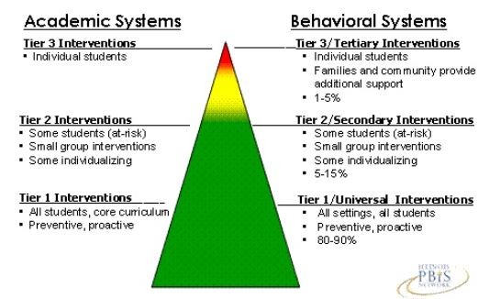
Parents Involvement At Every Tier
Family involvement, school and home support and awareness
Family involvement, invitation, and practice
Building awareness, involvement
Notes:
We want to engage families at every tier of support
Tier 2 – invite families in, ask them to practice at home
Tier 3 – surround families with support in implementing strategies

Slide 13
Natural Opportunities
What are the current forums/opportunities families have for being a part of the school community?
Notes:
Ask audience to call out
Scribe on flip chart

Slide 14
Family Engagement Measures
Tiered Fidelity Inventory (TFI)
School-Wide Assessment Survey (SAS)
Family Engagement Checklist (Muscott and Mann)
Family Engagement Survey (PBIS website)
Others?
Notes:
6 separate questions about family involvement on the TFI
Team involvement
Feedback
Annual evaluation
Planning participation
Quality of life – academic, social, attendance, etc.
Natural supports

Slide 15
Universal
Parent newsletter
Parent representative
Celebration support/participation
PTO money
Breaks and PBIS
Notes:
What are other tools you are using at the universal level?
What are some other roles you think parents/caregivers can have to be involved in the school community? Scribe…
Advocates
Monitors
Decision-makers
Fund-raisers
Volunteers
Paraeducators
Home teachers
Homework helpers

Slide 16
Universal Resources
Beyond the Bake Sale: The Essential Guide to Family- School Partnerships (Henderson, Mapp, Johnson, Davies)
Packed with tips from principals and teachers, checklists, and an invaluable resource section
Shows how to form essential partnerships and how to make them work
Notes:
bonnie

Slide 17
Beyond the Bake Sale
Study Guide 1
https://moodle.cpsd.us/moodle/pluginfile.php/34759/mod_resource/content/2/Beyond the Bake Sale Study Guide.pdf
Notes:
bonnie

Slide 18

Too Much Information
Oh yeah – I got the manual…
Notes:
Story of getting HS student handbook
How are we translating the information to families? How are we ensuring families, from all the choices and ideas we have offered, they feel membership in deciding which one to use and that it is something they can also practice at home?

Slide 19
Targeted
Yikes, my kid is struggling
Relentless teaching of academics
Homework
5:1 positives – who is calling home?
Menu of choices
Share progress monitoring
Strengths-based lens
  How am I communicating to the child and caregiver?
Notes:
Script – we are not being as successful at teaching the expectations to your child so we would like to try…
How do you nominate and invite families into the process.
If the function of behavior is adult attention, can a parent be identified as a mentor for a child?
Don’t make the process perfunctory.
Would you like it if your child’s challenges and a plan was made without your involvement?
What are some choices you offer families when you agree there providing targeted supports would be helpful? What is on your menu of choices in and out of the school?
Before next slide – raise your hand if you have ever been overwhelmed with the amount of resources you are asked to explore?

Slide 20
Targeted Resource
Vermont MTSS Field Guide to Engaging Families
Aligning and Integrating Family Engagement in Positive Behavioral Interventions and Supports
  Chapter 3 and 7
Notes:
We just want to name the irony of us talking about being overwhelmed with resources and then identifying several more you can access…

Slide 21
Intensive
Now we are tired
Competence and confidence
External locus of control
Barriers
Ancillary supports
Who has the relationship?
How do you frame the supports?
Notes:
When you feel as you have implemented tier 1 and 2 with fidelity you can confidently identify a student who would benefit from tier 3 supports. However, at this point, here are some additional considerations.

Slide 22
Barriers to Family Involvement
Institutional
  Access, proximity, transportation, time, mandates, safety
Impersonal
  Benign neglect, cultural considerations, literacy level, technology
Personal
  Triggers, belief systems, conflict, membership
Notes:
How do parents get to school?
Time limits – educational mandates – how could I possibly find the time to truly connect with a parent?
2. Talking but not doing, family vs. school culture, access to computers
3. I don’t like them, defensiveness, don’t believe it is important, conflict leads to teaming handout, feeling connected.

Slide 23
Safety and Security
Changing adult behavior by changing adult behavior…
…starts with changing our assumptions --
Is the environment really safe ?
Notes:
If we want parents to take risks in coming to school, we must be sure it is a safe place for them to visit. How do I feel? What is my body language? What do I really want to get out of this meeting?

Slide 24
Creating Sanctuary
“The community has a responsibility to parents to provide the social conditions that makes good parenting possible an to supply whatever education is necessary to improve parenting skills.”
How can I help?
Hurt people hurt people
Notes:
If we think of caregivers as injured vs. bad or sick we shift our perspective. Injured people we want to help.

Slide 25
Changing the Paradigm and Assumptions
Blaming the victim
Demanding
Manipulative
Attention-seeking
Needy
Oppositional
Why?
What purpose do these symptoms serve that could be adaptive?
What do these behaviors tell us about the tragedy of their lives?

Slide 26
It Really Does Take a Village
“Once a problem becomes a social problem, and not just the problem of an individual perpetrator, then we are all engaged, we must all participate in solving the problems.”
Notes:
If we assume everyone at the table has role to play in improving the outcome for the student, then we are truly collaborating and partnering for change.

Slide 27
What We Don’t Know…

Slide 28
What Comes Into the Room?
Setting events
Antecedents
Past trauma
Triggers
Notes:
How do we remain curious and interested in the challenges that may be present for the caregivers?

Slide 29
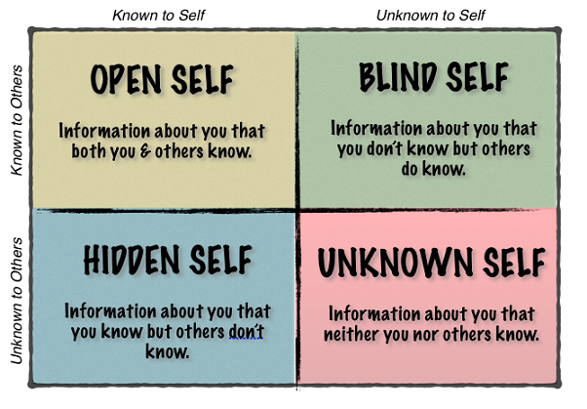
The Johari Window
Notes:
Preconceptions and presuppositions go in both directions.
Do activity around this.

Slide 30
A Few Ideas
Loaf of bread and house plants
Same challenges, same skill set
5 Positives to every negative!
Notes:
Next time you pick up the phone to talk about the challenges of the child, think if you have called at least 5 other times with positive feedback?

Slide 31
Empathy and Attunement
  What has happened to you in the past?
  Is it affecting you today?
  How can I help?
Notes:
35% reduction in doctor office visits
11% reduction in ER visits

Slide 32
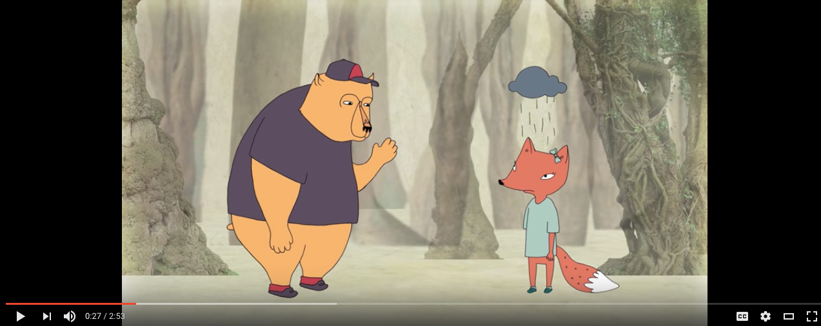
Brene Brown on Empathy
Being with not doing for
Notes:
Can you think of a time in your personal or professional life when you were prone to doing for (at least) vs. being with?

Slide 33
Resources
http://www.swiftschools.org/
Family and Community
SWIFT Guide: Trusting Family Partnerships
http://www.pbisvermont.org/resources/for-families/family-resources

Slide 34
Resources, con’t
School, Family, and Community Partnerships: Your Handbook for Action by Epstein and Associates
Comprehensive handbook that:
Addresses 6 types of partnerships
Challenges
Expected outcomes
Evaluation tools
Middle and High School partnerships

Slide 35
How to Obtain a
VTPBIS State-Approved Coach
Contact your VTPBIS State TA to review the needs of your SU/SD/School
Review the VTPBIS Coach Fees: $62.50/hour, $250/half day or $500/day plus mileage
Coordinate with your central office Grants Coordinator to use local funds or to apply for BEST/Act 230 funds: http://education.vermont.gov/sites/aoe/files/documents/edu-integrated-frameworks-best-act-230-innovation-grant-instructions.pdf.
Contact a VTPBIS State-Approved Coach: http://www.pbisvermont.org/resources/coaches-a-coordinators/coaches.

Slide 36

Explore the PD Calendar

Slide 37
Questions? Contact a VTPBIS TA
When in doubt, contact Anne Dubie!
(802) 656-5775 or Anne.Dubie@uvm.edu

Slide 38


Stay Connected
https://www.facebook.com/groups/PBISVermont/
https://twitter.com/vtpbis
Please share all of the awesome things you are doing by using #VTPBIS or @VTPBIS

