Slide 1

Classroom Behavior
Practice Coaching (CBPC)
Cohort 1 Meeting
Amy Wheeler-Sutton
Brandi Simonsen
Notes:
Amy

Slide 2
Agenda
Brief overview of where we’ve been
Status check
Report out on:
  Summer work
  In-service training
  Coaching
Next steps
Feedback to Inform Cohort 2
Notes:
Amy

Slide 3
Where We’ve Been
Notes:
Amy

Slide 4
Our Goal
To help schools build their capacity to support teachers' implementation of evidence-based classroom management practices (e.g., behavior specific praise, opportunities to respond, etc.)
Notes:
Amy

Slide 5
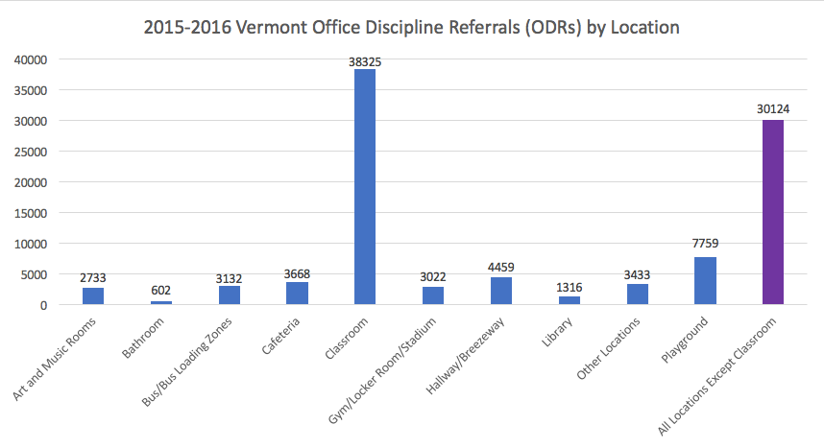
Notes:
Amy

Slide 6
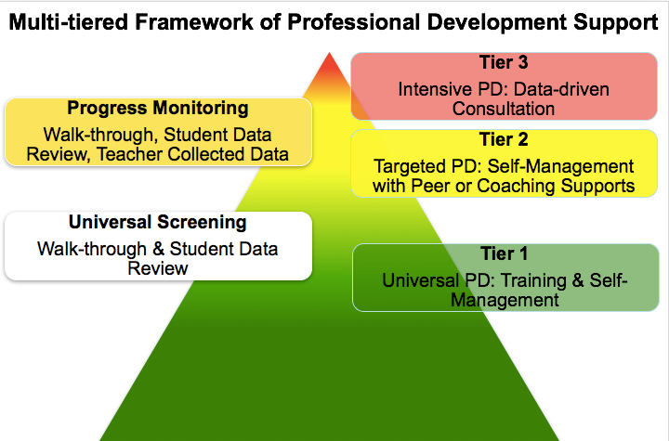
(adapted from Simonsen, MasSuga, Briere, Freeman, Myers, Scott, & Sugai, 2013)
Notes:
Brandi

Slide 7
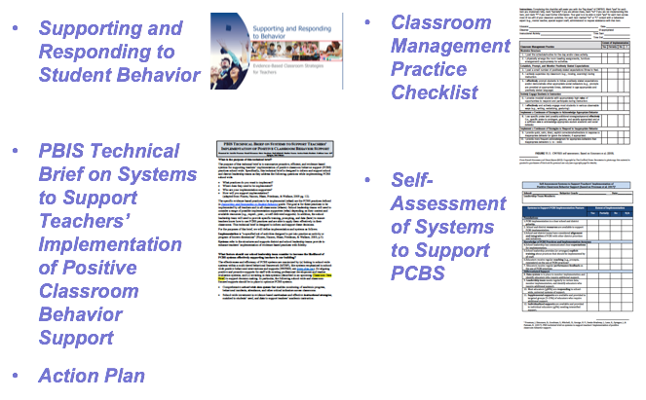
Materials Used
Notes:
Brandi

Slide 8
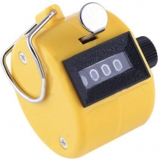

Skills
OUTCOMES
VT PBIS BEST Team
Consider these elements at each level.
-VT PBIS Team
-CBPC and School Team
supports
SYSTEMS
DATA
Classroom Behavior Practice Coaches
who
support
PRACTICES
Teachers within School(s)
Train-the-trainer, coach-the-coach, or turn-key approach to building capacity.
Notes:
Brandi

Slide 9
Evaluation Tools
DATA
Existing Data
  Classroom Office Discipline Referrals (ODR)
  Classroom Item on Tiered Fidelity Inventory (TFI)
Checklists During Training
  Classroom Management Assessment (CMA)
  Classroom Systems Assessment (CSA)
Possible Additional Sources of Data
  School Climate Survey
  Direct Observations (by self, peer, coach, etc.)
Notes:
Brandi

Slide 10

Training in Practices
PRACTICES
Notes:
Brandi

Slide 11
Interactive Map of Core Features
Hyperlink
Notes:
Brandi

Slide 12
Tables with Definitions, Examples, Non-Examples, and Resources
Notes:
Brandi

Slide 13
Decision Making Chart
Notes:
Brandi

Slide 14
PCBS Practices Decision-making Guide: 3 Key ?s
Are the foundations of effective PCBS in place?
Effectively design the physical environment of the classroom
+
Develop & teach predictable classroom routines.
+
Post, define, & teach 3-5 positive classroom expectations.
Are proactive and positive PCBS practices implemented consistently?
Provide high rates of varied opportunities to respond.
+
Use prompts and active supervision.
+
Acknowledge behavior with specific praise & other strategies.
Do data indicate that students are still engaging in problem behavior?
Notes:
Brandi

Slide 15
Are students still engaging in problem behavior?
Are behaviors minor or major expectation violations?
Well done! Monitor outcomes and adjust as needed
Use brief, specific error correction & other strategies
How many students are involved (many or few)?
Review, adjust & intensify CWPBIS. Ask for help!
Request additional (tier 2 & 3) support for students.
Yes
No
Minor
Major
Do data indicate that students are still engaging in problem behavior?
Many
Few
Notes:
Brandi

Slide 16
On-Going Coaching & Performance Feedback
SYSTEMS
PBIS Technical Brief on Systems to Support Teachers’ Implementation of Positive Classroom Behavior Support
Notes:
Brandi

Slide 17
Hyperlink
Guiding Questions
Notes:
Brandi

Slide 18
Tables with Details
Notes:
Brandi

Slide 19
School-Level Scenario
Notes:
Brandi

Slide 20
PCBS Systems Action Planning Guide:
3 Key Questions
Are the foundational systems in place to support PCBS practice implementation by all staff?
PCPS implementation is a clear school and district priority
+
School and district resources are available to support PCBS implementation
+
School and district teams have considered alignment and integration of PCBS with other district priorities and initiatives
Do all staff know what PCBS practices to implement and if they’re doing it accurately?
Clear expectations and explicit training about practices that should be implemented by all staff
+
Coaching and/or regularly available performance feedback on the use of PCBS practices
Do data indicate that staff are implementing PCBS practices effectively?
Notes:
Brandi

Slide 21
Are staff implementing PCBS with fidelity?
Determine the number of classrooms needing support (many or a few)
Review and adjust universal support
Determine type and severity of implementation changes (minor or major)
Provide supplemental support to small groups of staff needing support
Consider individualized supports and other strategies for staff members needing intensified support.
Well done! Monitor outcomes and adjust as needed
Yes
No
Minor
Major
Many
Few
Do data indicate that staff are implementing PCBS practices effectively?
Notes:
Brandi

Slide 22
Action Plan
1st page sets norms and aligns this action plan with PBIS action plan for school.
2nd page prompts foundations, explicit training, and coaching.
3rd page prompts performance feedback, data, and differentiation.
Notes:
Brandi

Slide 23
Status Check
Notes:
Amy

Slide 24
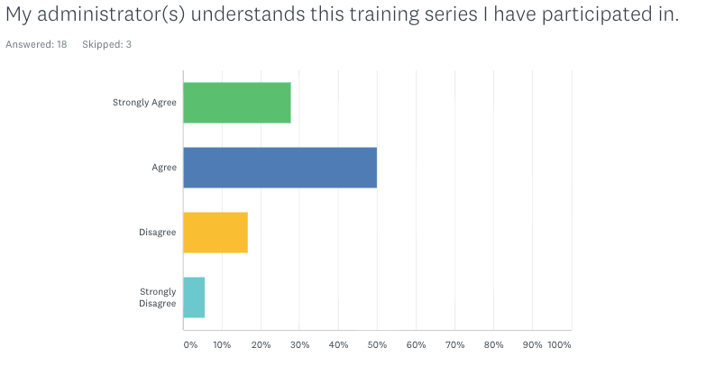
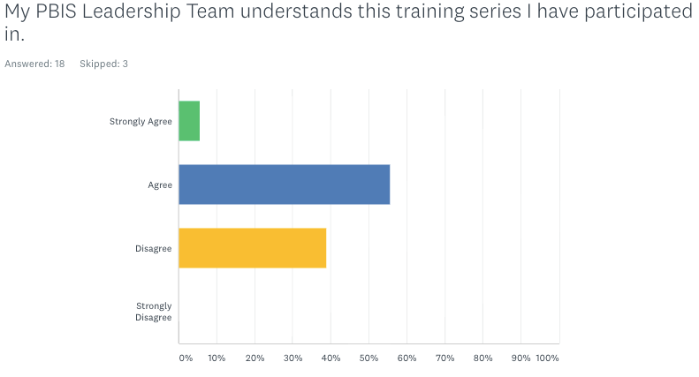
This is where you were in June… where are you now?
Notes:
Amy

Slide 25
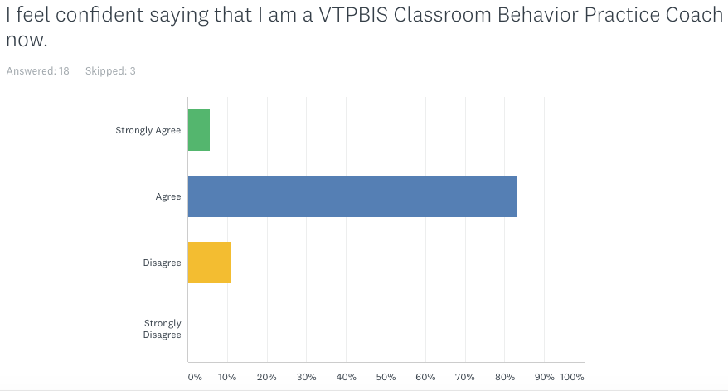
This is where you were in June… where are you now?
Notes:
Amy

Slide 26
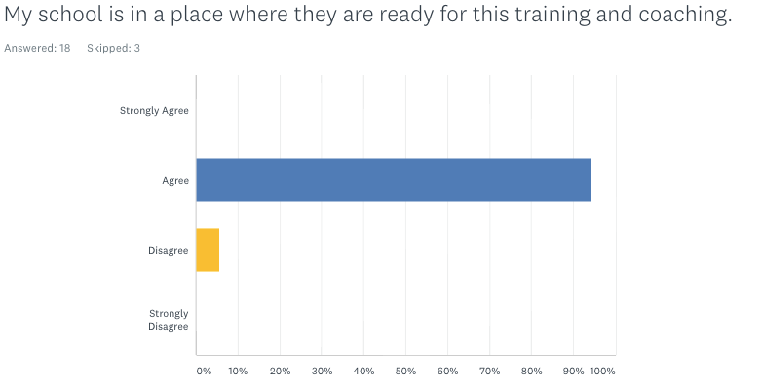
This is where you were in June… where are you now?
Notes:
Amy

Slide 27
Report Out On:
Summer work
In-service training
Coaching
Notes:
Amy

Slide 28
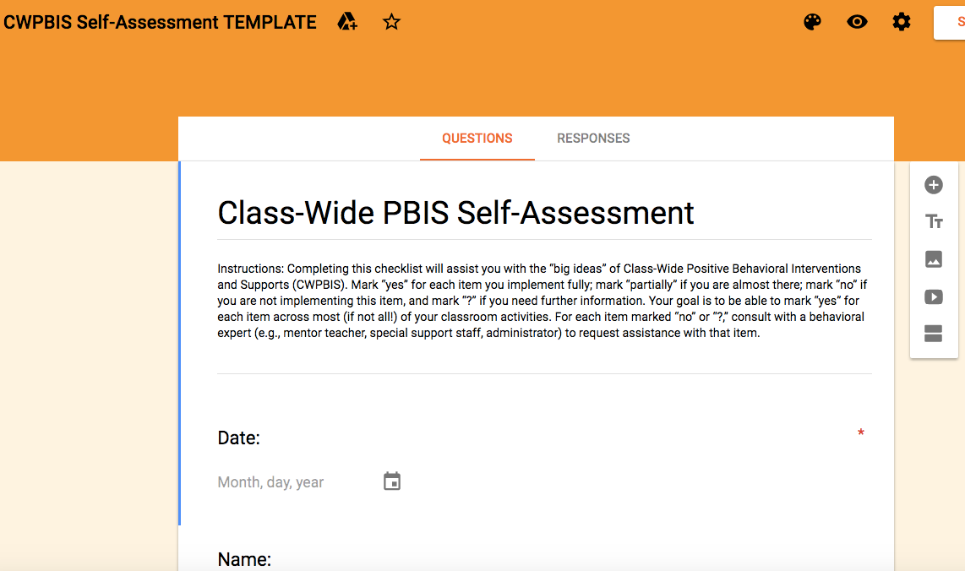
Example
Charlotte - CW PBIS Self-Assessment
Notes:
Amy

Slide 29
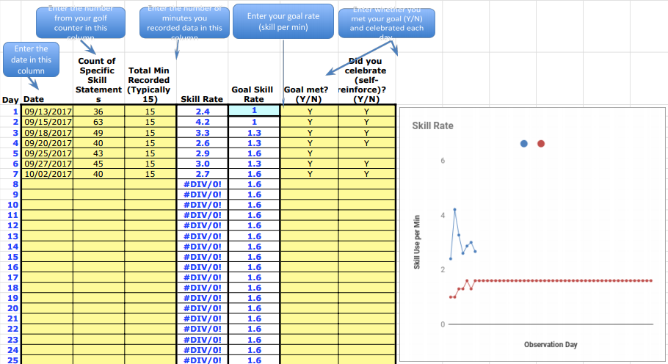
Example
Jericho – Self-Monitoring of Skills
Notes:
Amy

Slide 30
What struggles have you encountered?
What are you proud of?
Summer work
In-service training
Coaching
Notes:
Amy

Slide 31
Next Steps
Notes:
Amy

Slide 32
What’s Next?
Continued full staff PD?
Coaching?
  Coach – teacher
  Peer coaching
  Self-monitoring
Notes:
Amy

Slide 33
What’s Next?
Post-implementation assessments:
  Walkthroughs
  Self-Assessments
Share baseline and post-implementation results to staff in the aggregate at a staff meeting and celebrate growth!
Update Action Plan
Notes:
Amy

Slide 34
Opportunity to Connect
Option to connect with Brandi during Cohort 2’s webinars (last half hour)
Will keep you posted on dates
Notes:
Amy

Slide 35
Data Collection
VTPBIS State Team will analyze overall classroom ODRs (this year vs. last year)
Survey to CPBCs 2x/year
  Training data
  Coaching data
  Classroom ODR rates for specified teachers
Notes:
Amy

Slide 36
Feedback to Inform Cohort 2
Notes:
Amy

Slide 37
Resources Reminders
Calendar of Activities: https://docs.google.com/document/d/1AV6mavGxHlJ08KyRTPl7apMsuTuBzoeJL6X2h1SX-4A/edit
NE PBIS Website: http://neswpbs.org/VT-Area
Each other!
Brandi, Amy, and Sherry
Notes:
Amy

Slide 38
Questions?
Notes:
Amy

