Slide 1
Refresher in VTPBiS Features
Presented by
VTPBiS State Team
Notes:
This is just a taste of what is needed for a full refresher.

Slide 2
This is a VTPBiS sampler of a full course Refresher Training

Slide 3
WorkshopOutcomes
By the end of our time together, you will have:
Enhanced Fluency in PBIS Features
Examined strategies for sustainability
Shared new ideas for moving forward
Learned about supports and resources
Notes:
Talk about pace and differentiation activities

Slide 4
Review for VTPBiS Fluency
As a table group, complete the VTPBiS questions seen on the PowerPoint. Use any sheet of paper to answer the questions.
We will review as a large group.
If 80% of the Teams answer 80% of the questions correctly, the entire group will receive a reward!

Slide 5
VTPBiS Review
How does VTPBiS help prevent problem behaviors?
What is the purpose of having an administrator on the VTPBiS Leadership team? Why is it important?
Why do we spend so much time focusing only on Universal Level to begin with?
What is the purpose of completing the VTPBiS Self-Assessment Survey (SAS) and the Benchmarks of Quality (BoQ) annually in the spring?
What PBIS activities should you do prior to the start of school every fall?
Who do you roll-out PBIS to?
Bonus ? Complete this sentence: When implementing PBIS, label ___ not ____.

Slide 6
Universal
Targeted
Intensive
BONUS ?
Anger Mgt.
Math
BEHAVIOR
LABEL__________
NOT
_______________
Science
Adult relationships
STUDENTS!
Attendance
Reading
Peer Interaction
Notes:
LABEL BEHAVIOR
NOT
STUDENTS!

Slide 7
PBIS
Supporting
Staff Behavior
Supporting
Decision
Making
SYSTEMS
DATA
PRACTICES
Supporting
Student Behavior
Notes:
5 Components of MTSS cuts across Data, Systems and Practices

Slide 8
PBIS at the Universal Level is about..
Essential Features:
Purpose Statement
Defining behavior expectations
Teaching expected behavior
Acknowledging expected behavior
Discouraging problem behaviors
Creating procedures for record-keeping and decision making.
Notes:
Purpose Statement

Slide 9
1. Importance of PBIS Statement of Purpose
“The purpose of our PBIS team is to teach and promote positive behaviors through consistent responses, common language, and data driven decisions”
– Allen Brook School
Notes:
Why is this important?

Slide 10
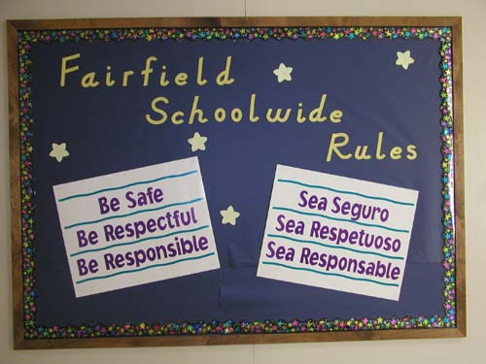
2. Defining Behavior Expectations Why is this important?
Research indicates that schools should utilize 3 to 5 behavioral expectations that are positively stated and posted throughout the school.
These expectations should be clear and general enough to apply to all school settings (e.g. classroom, hallways, playgrounds).

Slide 11
2. Defining Behavior Expectations
Ideas for keeping expectations visible:
Posted in classrooms, hallways, computer wallpaper and/or screen saver
Printed in the school handbook and websites
Some schools have made videos of the behavior expectations
Flags hanging in the hallway outside of classrooms
Staff and/or student lanyards
Hats, t-shirts, bracelets, bumper stickers
What do you do?

Slide 12
3. Teaching Behavior Expectations
Why is it important?
Behavioral errors more often occur because:
Acquisition Deficits (can’t do)
Performance Deficits (won’t do)
Fluency Deficits (not enough practice)
Repetition is key to learning new skills:
For a child to learn something new, it needs to be repeated on average of 8 times
For a child to unlearn an old behavior and replace with a new behavior, the new behavior must be repeated on average 28 times (Harry Wong)
Notes:
At the high school level, older students may take an active role in teaching younger or new students (Bohanon, Borgmeier, Fenning, Flannery, & Malloy, 2009) through an "orientation" process.
Acquisition Deficits
Absence of knowledge for executing skill or failure to discriminate which social behaviors are appropriate in specific situations (can’t do)
Performance Deficits
Skill is present in repertoire, but youth does not perform at acceptable levels (won’t do)
Fluency Deficits
Lack of exposure to sufficient or skilled models of social behavior, insufficient rehearsal/practice or low rates or inconsistent delivery of reinforcement of skilled performances

Slide 13
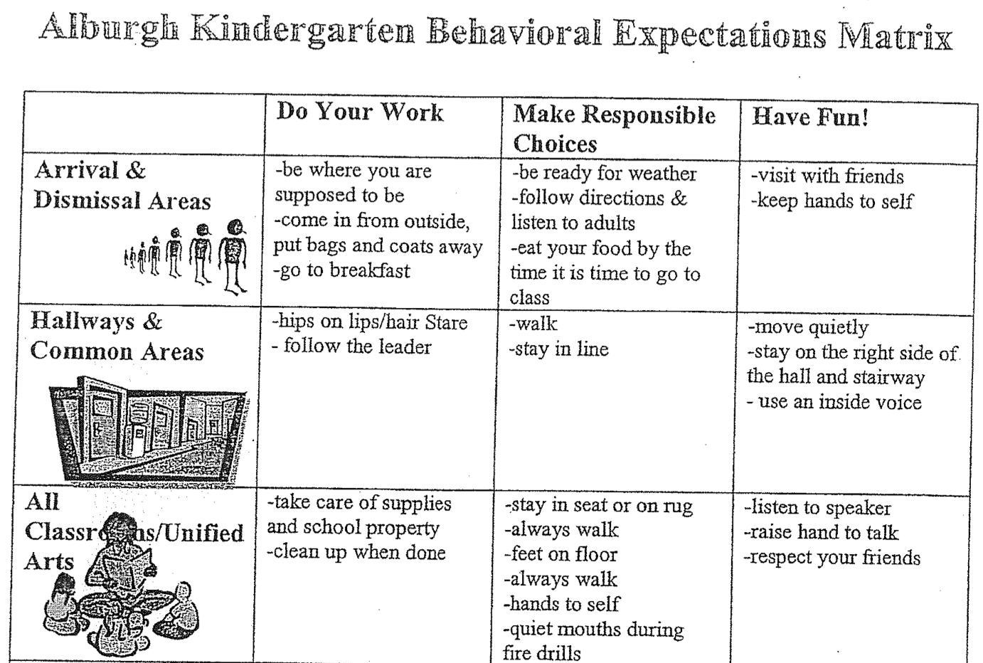
3. Teaching Behavior Expectations
What does it look like?
Define Simply
Model
Practice in Setting
Monitor and Acknowledge
Adjust for Efficiency
What do you do?

Slide 14
4. Acknowledging Behavior
Why is it important?
Behavior is learned
Learning is facilitated by guided feedback
Positive feedback has a greater likelihood of shaping behavior than negative feedback

Slide 15
4. Acknowledging Behavior
BIG ideas on Rewarding Behavior:
In order for youth behavior to change, adult behavior must change first
Higher rate of positives than negatives (6-8:1 ratio)
Timely, specific feedback increases learning
Take into account the culture or context
Link individual acknowledgement to overall benefit of others
Dispel myth that rewards are ineffective or detrimental to student “intrinsic motivation.”
What do you do?
(Gable, Hester, Rock, & Hughes, 2009; Kerr & Nelson, 2006; Nafpaktitis, Mayer, & Butterworth, 1985; Scott, Anderson, & Alter, 2011; Stichter et al., 2009; Walker, Ramsey, & Gresham,2004)
Notes:
Oxygen mask analogy

Slide 16
5. Discouraging Problem Behavior
Why is it important?
Problem behavior in non-classroom settings (hallways, cafeteria, playground, common areas) accounts for 50% of all problem behavior in schools. Source: Colvin, Sugai, Good, & Lee (1997)
“Punishing” problem behaviors (without a proactive support system) is associated with increases in (a) aggression, (b) vandalism, (c) truancy, and (d) dropping out. (Mayer, 1995, Mayer & Sulzar-Azaroff, 1991, Skiba & Peterson, 1999)
Students with the most challenging academic and social behavior problems need pro-active comprehensive and consistent systems of support

Slide 17
5. Discouraging Problem Behavior
What does it look like?
Preventing problem behaviors
Responding to minor problem behaviors
Responding to major problem behaviors
What do you do?
Notes:
De-Escalation Tecniques:
When student shows anxiety….Be supportive!
What does anxiety look like?
What can adults do to be supportive?
When student is defensive…Be directive!
What does defensive behavior look like?
What can adults do to be directive?

Slide 18
PBIS
Supporting
Staff Behavior
Supporting
Decision
Making
SYSTEMS
DATA
PRACTICES
Supporting
Student Behavior
Notes:
5 Components of MTSS cuts across Data, Systems and Practices

Slide 19
What do you see this PBIS Leadership Team doing?
Notes:
Teams meeting regularly to:
Review their data
Determine if PBIS practices are being used
Determine if PBS practices are being effective
Identify the smallest changes that are likely to produce the largest effects
But focusing on the use of evidence-based practices

Slide 20
TIPS Problem-Solving “Mantra” Innovation neutral: Use for Reading, Behavior, Math, School Improvement
Do we have a problem? (identify)
What is the precise nature of our problem? (define, clarify, confirm/disconfirm inferences)
Why does the problem exist, & what can we do about it? (hypothesis & solution)
What are the actual elements of our plan? (Action Plan)
Is our plan being implemented, & is it working? (evaluate & revise plan)

Slide 21
Types of Data to Consider
Intensive:
BAT
SWIS-ISIS
EST
FBA/BSP
Targeted:
BAT
SWIS-CICO
EST
FBA/BSP
Universal:
BoQ
SAS
ODRs
Attendance
Grades
Leadership Team Self-Assessment
Notes:
What else?

Slide 22
Big Ideas About Data…
All data should serve a purpose
Collect data with fidelity
Be prompt about looking at data and acting upon it
Use multiple sources of data to confirm what you see
Use data to support, not punish

Slide 23
PBIS
Supporting
Staff Behavior
Supporting
Decision
Making
SYSTEMS
DATA
PRACTICES
Supporting
Student Behavior
Notes:
5 Components of MTSS cuts across Data, Systems and Practices

Slide 24
How do we break through barriers, implement with fidelity so we can sustain PBIS?

Slide 25
What is Sustainability?
Definition:
Durable implementation of a practice at a level of fidelity that continues to produce valued outcomes (McIntosh et al., 2009)
Notes:
Named one of the top ten jargoniest words by advertising age magazine

Slide 26
What is the strongest predictor of PBIS sustainability?
Kent McIntosh, University of Oregon - 2014 OSEP PD Conference
School Priority Administrator support, staff support, perceived effectiveness, perceived efficiency, integration into new initiatives
Team Use of Data School team/staff skill, functioning, regular meetings, data collection, use of data for decision making, presenting data to staff and community
District Priority District support, state support, funding, district policy, promoted to external organizations
Capacity Building Access to district coaching, yearly professional development, connection to a community of practice

Slide 27
What is more important to sustainability?
Kent McIntosh, University of Oregon - 2014 OSEP PD Conference
Having a supportive administrator?
Having a strong PBIS team?

Slide 28
Both!
PBIS is most sustainable with a supportive administrator and a strong team
If administrators take too much of a lead, sustainability can suffer
School teams can benefit from training in running meetings and using data
District systems (coaching, training) enable both admins and teams implement and sustain

Slide 29
Factors that Help or Hinder Sustainability
Continuous Teaching and Reinforcement
Team Effectiveness
Staff Ownership
Administrator Involvement
Use of Data
Community of Practice
Access to External Expertise
Maintaining PBIS as a Priority
Staff Turnover
Conflict with or Mistaken Personal Beliefs
Andreou, T., McIntosh, K., Ross, S., & Kahn, J. (2014)
Notes:
Handout “Implementation Dip Self-Assessment”

Slide 30
Activity
Review the handout on Factors that Help or Hinder PBIS Sustainability.
Prioritize three factors to discuss at your table.
What strategies can you implement to enhance sustainability?
We’ll hear a sampling from the group.

Slide 31
Guiding Principles for Sustainability:
Never stop doing what is already working
Always look for the smallest change that will produce the largest effect
Do not add something new without also defining what you will stop doing
Collect and use data for decision-making

Slide 32
Vermont PBIS System of Support
SCHOOL LEVEL
School Coordinators
REGIONAL
LEVEL
Implementation
Coaches
STATE
LEVEL
Trainers/
State TA’s
SU/SD
LEVEL
SU/SD Coordinators
Notes:
To assess your leadership team for continuous improvement
To assess your fidelity of implementation for identifying needed systems changes
To problem-solve around school-wide and individual outcome data
To garner staff perceptions about status of PBIS and their priorities for improvement
To communicate outcomes to staff, students, families, community, etc.

Slide 33
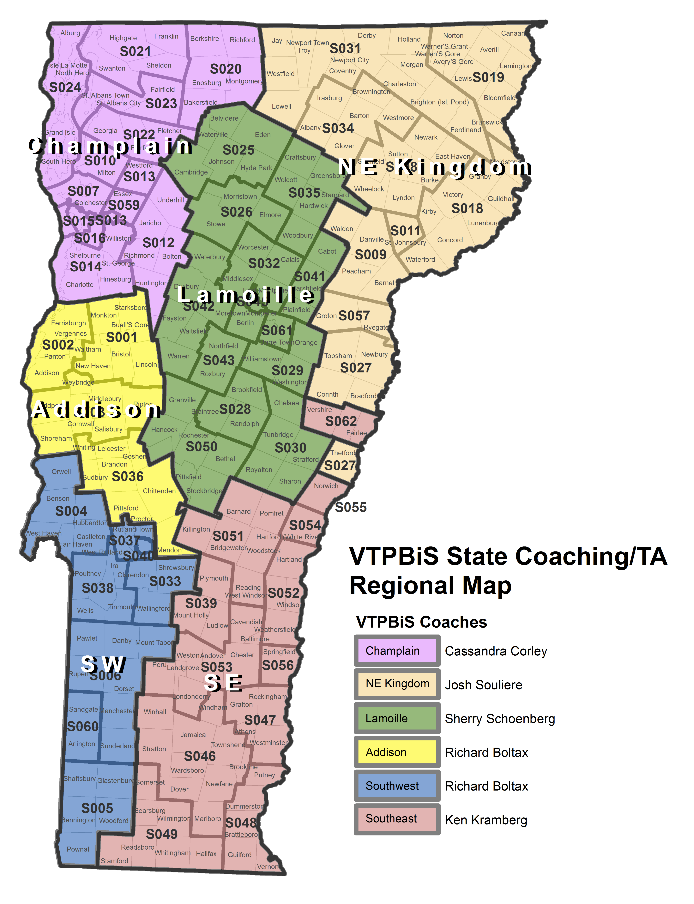
Insert TA map
Notes:
Makes

Slide 34
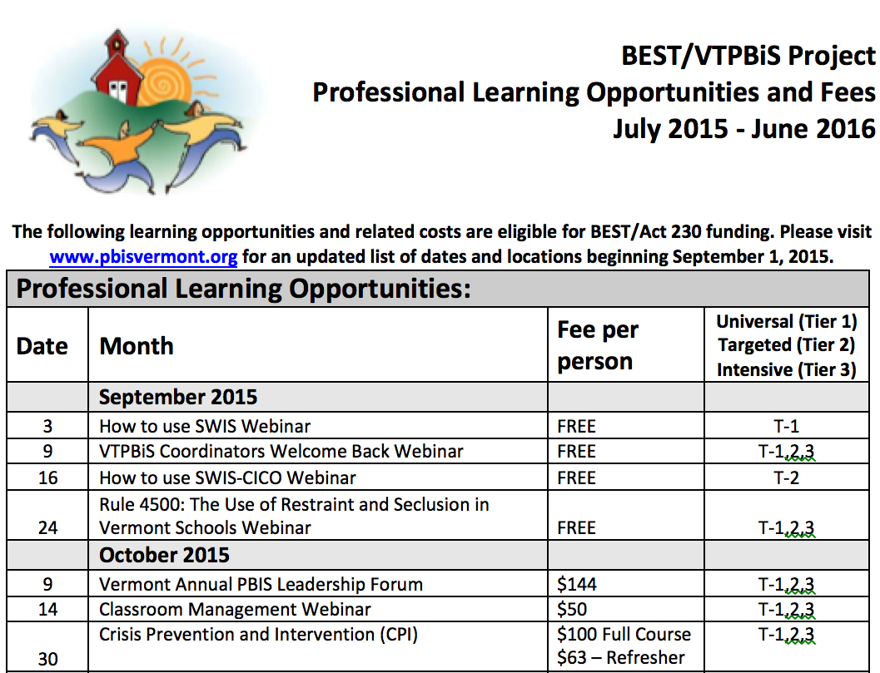
Calendars
School/SU/SD Coordinators Calendar
VTPBiS Professional Learning Calendar

