Slide 1
Enhancing PBiS through
Social Media + Technology
Sarah Schoolcraft
Williston Central School

Slide 2
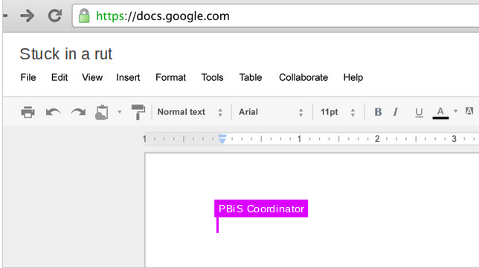
Notes:
what is a rut you have been in? what has helped you get out of it?

Slide 3
Agenda
About our School
Google Tools
Capturing Celebrations
Public Relations
Ideas Forum

Slide 4
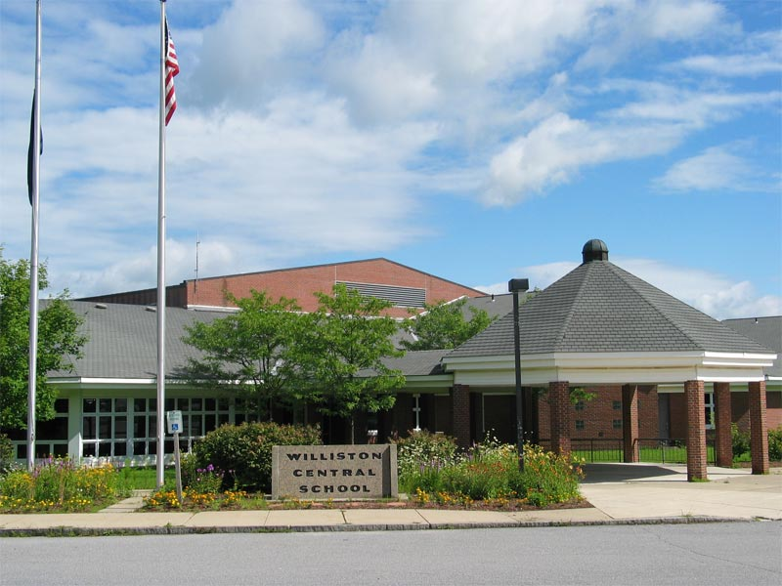
Williston Central School
Located in Williston, VT
Grades 3-8
Nearly 500 students
(14% free/reduced lunch)
Suburban community with growing village center

Slide 5
Google Tools
Collaborative planning documents
Rolling Agendas
Google Slides for meeting presentations and sharing of information
Google Forms for data collection/surveys (adults and students)
Google Sites for accessible shared resources

Slide 6
Intentionally Shared documents
Share features in Drive allow for privacy and a high level of collaboration and accountability
House Matrices
Universal Screener - Student Risk Screening Scale:
(SRSS: Drummond, 1994)
Rolling Agendas

Slide 7
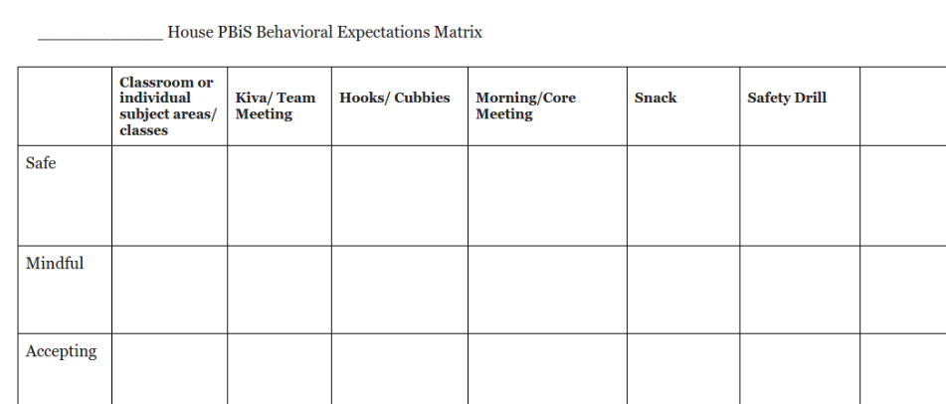
House Matrix

Slide 8
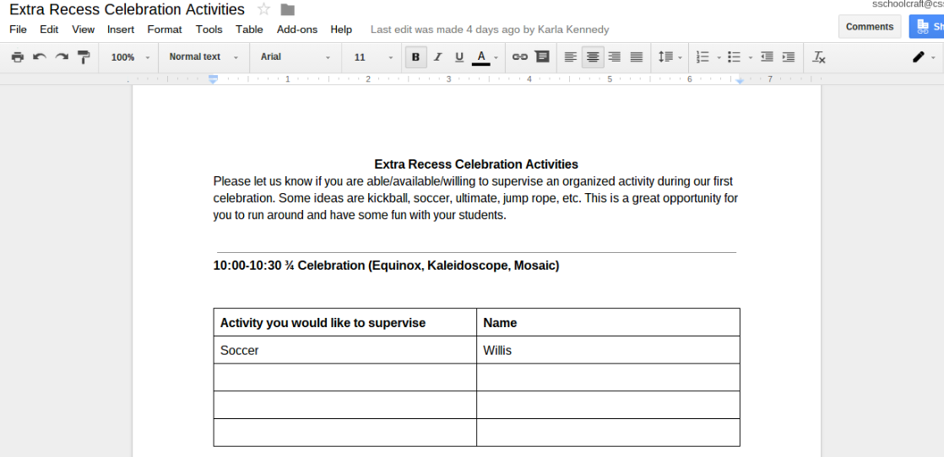
Collaborative Planning Documents

Slide 9
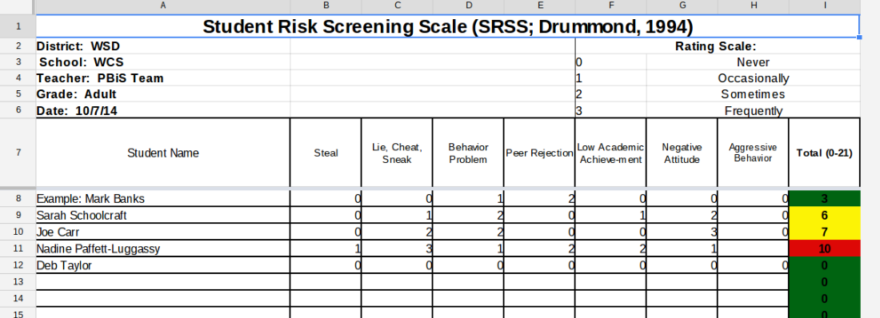
Universal Screener - SRSS

Slide 10
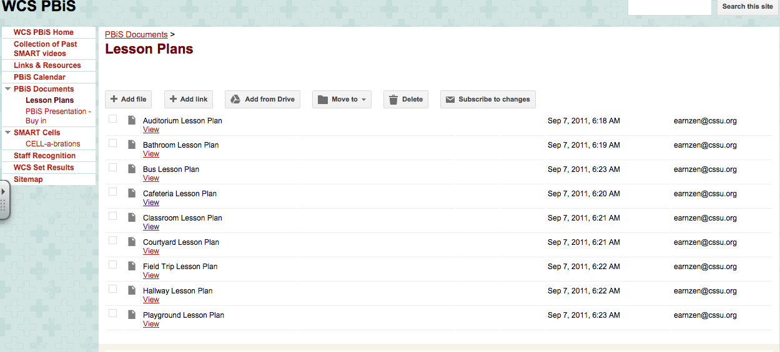
Lesson Plans are organized by location and posted
on a Google Site which is accessible to all adults.
Google Sites

Slide 11
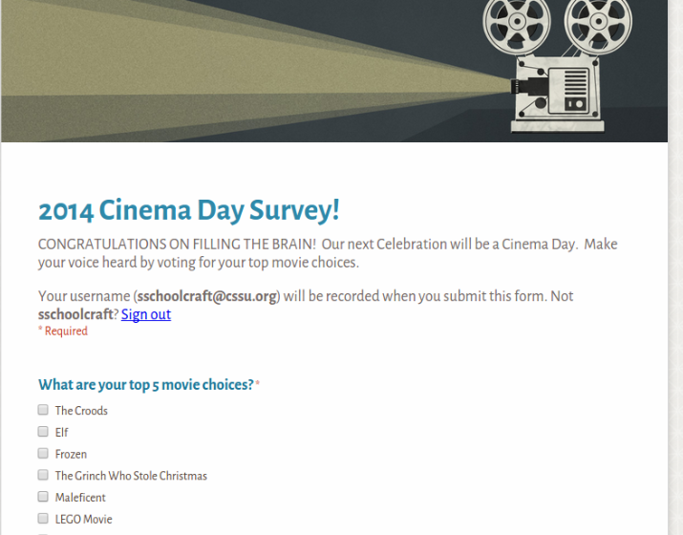
Collecting Data from Students - For Celebration Planning

Slide 12
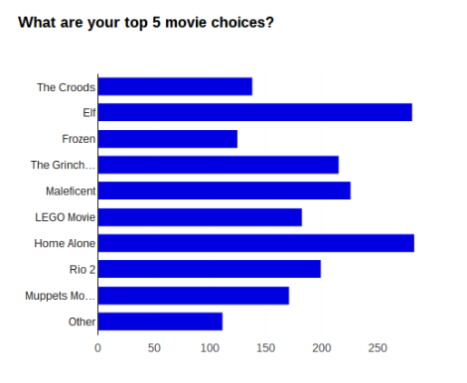
Notes:
student voting for Cinema Day

Slide 13
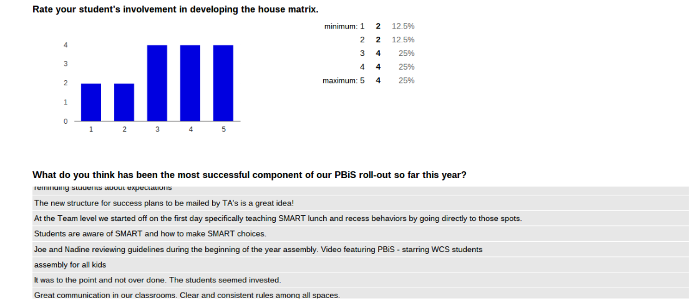
Faculty & Staff Feedback

Slide 14
Capturing Cell-a-Brations and Important Moments
Notes:
faculty roll-out for year 1

Slide 15
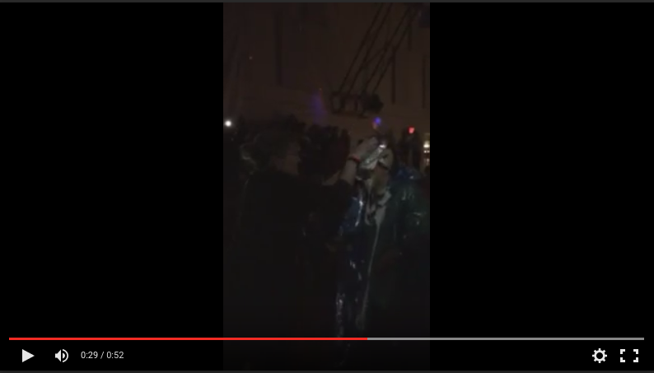
PBiS Sponsored Dance -
fundraising opportunity/giving back to the community

Slide 16
Teaching Expected Behaviors
Notes:
Exploratory students w/Shari Carr - teaching PSA

Slide 17
Cell-A-Bration: Extra Recess

Slide 18
PSA to introduce Following Directions Booster

Slide 19
Welcome BAck Music Video w/VideoStar App

Slide 20
Public Relations
Courtesy of Thatcher Brook Primary School

Slide 21
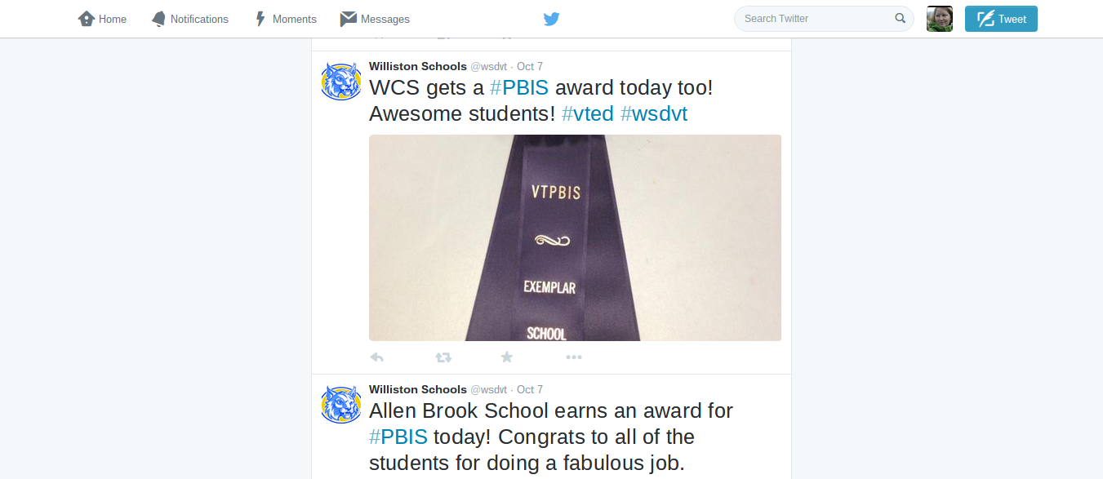
@wsdvt

Slide 22
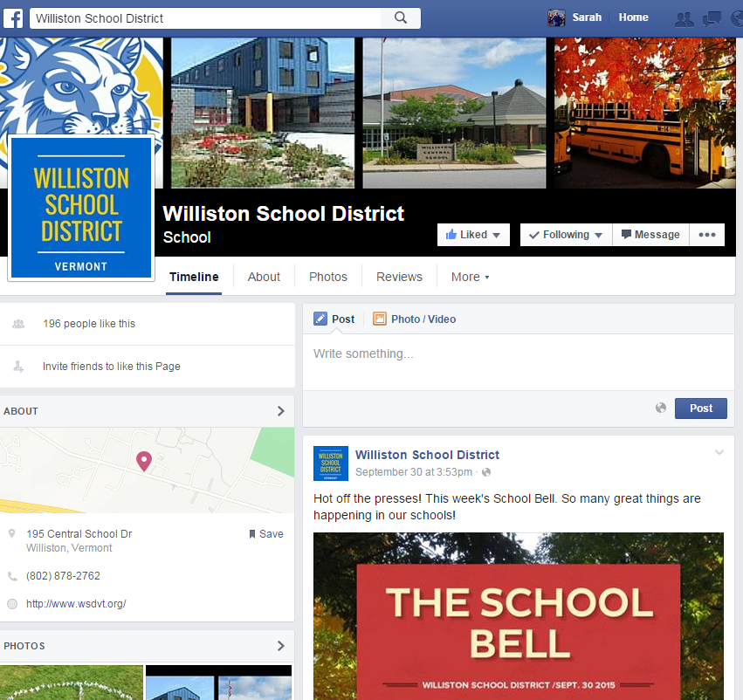
Facebook

Slide 23
So...What do YOU do?

