Slide 1
A Function Based Approach to Addressing Challenging Behaviors
Ken Kramberg
Cortney Keene

Slide 2
AGENDA
Overview and basics of Applied Behavior Analysis (ABA)
Components of a Functional Behavior Assessment (FBA) and an effective Behavior Support Plan (BSP)
Environmental and Sensory Considerations
De-escalation and Relationship Skills

Slide 3
What is ABA?
Applied behavior analysis focuses on objectively defined, observable behaviors of social significance. It seeks to improve the behavior under study, while demonstrating a reliable relationship between the procedures employed, through the use of the methods of science: description, quantification and analysis.
(Cooper, Heron, and Heward, 1987)
So, what does that all mean?
Learning is controlled by events that situations that occur immediately before and immediately after a behavior.
Learning can be broken down scientifically using the ABC’s of behavior

Slide 4
ABC’s of Behavior
Behavior is maintained by both the antecedent and the consequence to the behavior.
Antecedent - occurs immediately before a behavior
Behavior - described in observable and measureable terms, exactly what they are DOING
Consequence - occurs immediately after a behavior (determine if behavior will increase, maintain, or decrease)

Slide 5
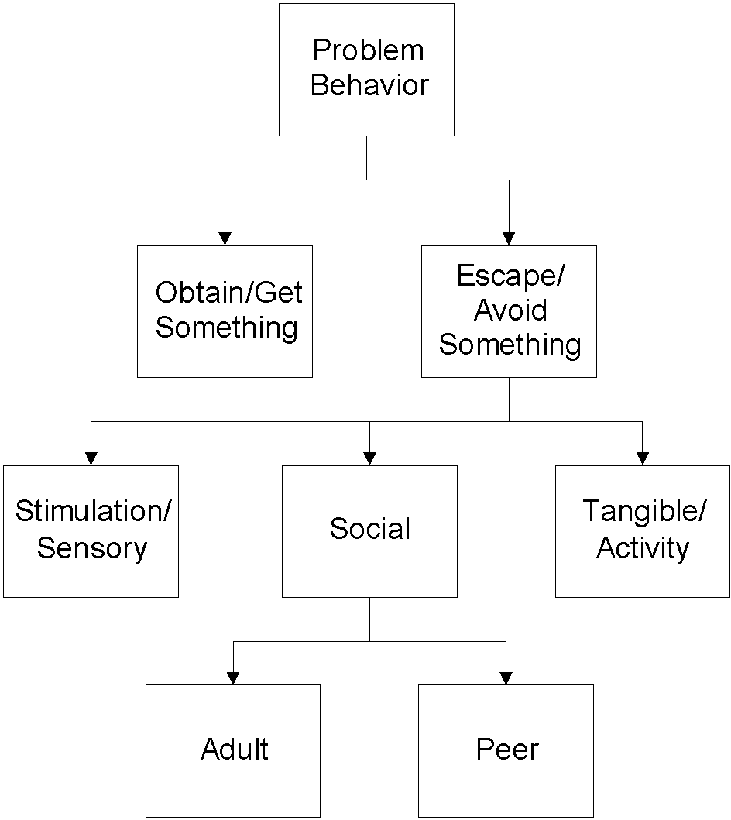
Only Two Basic Functions
Positive
Reinforcement
Negative
Reinforcement
from Horner & Sugai at www.pbis.org
Notes:
For example-
Many students use off topic comments/inappropriate language to obtain
attention from peers through their reactions and to escape the task at hand.
In this example, social reinforcement is obtained from the peers and the
adult.
Remember reinforcement is positive and negative.
NOTE:
When control is offered as a possible function- think about what is underlying that perception.
Control can be a way:
To hide skill deficits; therefore escaping/avoiding a task
To hide fears around social acceptance; therefore escaping/avoiding a situation
For an individual to assert themselves; therefore gaining/obtaining the attention of peers/adults

Slide 6
Function Based Approach
A process that focuses on
changing environmental factors
instead of
fixing the person.
It’s about what we as adults will do differently!

Slide 7
FBA Team Process Steps
Collect information.
Develop testable hypothesis or summary statement.
Collect direct observation data to confirm summary statement.
Develop “competing pathways” summary statement.
Develop BIP.
Develop details & routines for full implementation of BSP.
Develop strategies for monitoring & evaluating implementation of BSP.

Slide 8
Build a Competing Behavior Pathway
Maintaining
Consequence
Desired
Behavior
Setting Event
Triggering
Antecedent
Problem
Behavior
Maintaining
Consequence
Replacement
Behavior
Adapted from Crone, D.A. and Horner,R.H., 2003

Slide 9
Behavior Intervention Program (BIP)
Two Goals:
Reduce problem behaviors
Increase appropriate behaviors
Make behaviors:
Irrelevant
Inefficient
ineffective

Slide 10
Making it Work
(“The Devil Is In The Detail”)
Environmental Factors
Sensory Factors
Relationship Factors

Slide 11
The Environmental Factor
Often One of the Simplest and Easiest Tools To Manipulate to Effect Positive Behavior Change
What Environmental Factors Do You Control That Can Help Effect Positive Change?

Slide 12
The Sensory Factor
Always Consider The Childs Sensory Needs First
What are good examples of sensory needs and sensory diet which we can address?

Slide 13
The Relationship Factor
Well designed interventions often succeed or fail based on the quality of the relationship the child has with the helping adult

