Slide 1
Data-based Decision Making and Problem Solving in PBIS Schools
Resources

Slide 2
Questions to Ask…..
(TIPS Problem-Solving “Mantra”)
Do we have a problem? (identify)
What is the precise nature of our problem? (define, clarify, confirm/disconfirm inferences)
Why does the problem exist, & what can we do about it? (hypothesis & solution)
What are the actual elements of our plan? (Action Plan)
Is our plan being implemented, & is it working? (evaluate & revise plan)
Innovation neutral: Use for Reading, Behavior, Math, School Improvement

Slide 3
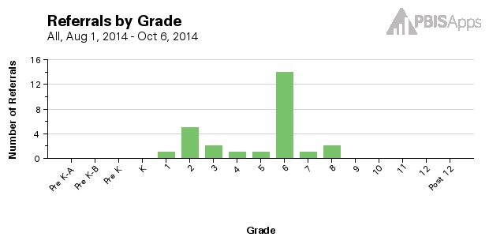
Who?

Slide 4
What?

Slide 5
Where?

Slide 6
When?

Slide 7
Our Precise Problem Statement….
Students in ______ grade are _______________
(Grade/s) (Problem Behavior/s)
in the ________________between
(Location/s)
________and _________.
(Start Time) (End Time)
We need to take it one step further……Why is this happening?

Slide 8
Why?

Slide 9
What is the precise nature of our problem (define, clarify, confirm/disconfirm inferences)?
Question: | Fill in the information below:
What problem behaviors are occurring?
When are problem behaviors occurring?
Where are problem behaviors occurring?
Who is engaging in problem behaviors?
Why do problem behaviors keep happening?
Notes:
As a team, we need to develop a precise problem statement! This Slide is a handout and we will use this to explore the data is SWIS.

Slide 10
What are the actual elements of our plan?
Precise Problem Statement:
Prevention: Remove/alter “trigger” for problem behavior
Teaching: Define, instruct & model expected behavior
Reward: Expected/alternative behavior when it occurs; prompt as necessary
Extinction: Increase acknowledgement of presence of desired behavior
Corrective Consequence: Use non-rewarding/non-reinforcing responses when problem behavior occurs
Data Collection: Indicate how you know when you have a solution
Notes:
Prevention: *Maintain current lunch schedule, but shift classes to balance numbers.
Teaching: *Teach behavioral expectations in cafeteria
Reward: Establish “Friday Five”: Extra 5 min of lunch on Friday for five good days.
Extinction: Establish “Friday Five”: Extra 5 min of lunch on Friday for five good days.
Corrective Consequence: Active supervision, and continued early consequence (ODR)
Data Collection: Maintain ODR record and supervisor weekly report
Prevention
: How can we avoid the problem context?

Who, When, Where

Schedule change, curriculum change, etc

Teaching:
How can we define, teach, and monitor what we want?

Teach appropriate behavior

Use problem behavior as negative example

Recognition
: How can we build in systematic reward for desired behavior?

Extinction
: How can we prevent problem behavior from being rewarded?

Consequences
: What are efficient, consistent consequences for problem
behavior?

How will we collect and use data to evaluate (a) implementation fidelity, and
(b) impact on student outcomes?

Slide 11
What are the actual elements of our plan?
EXAMPLE
Precise Problem Statement:
The sixth graders are disruptive & use inappropriate language in the cafeteria between 11:30 AM and 12:00 PM to get peer attention.
Prevention: Remove/alter “trigger” for problem behavior | Maintain current lunch schedule, but shift classes to balance numbers. Teach behavioral expectations in cafeteria
Teaching: Define, instruct & model expected behavior
Reward: Expected/alternative behavior when it occurs; prompt as necessary | Establish “Friday Five”: Extra 5 min of lunch on Friday for five good days.
Extinction: Increase acknowledgement of presence of desired behavior | Encourage all students to work for “Friday Five”… make problem behavior less rewarding than desired behavior
Corrective Consequence: Use non-rewarding/non-reinforcing responses when problem behavior occurs | Active supervision and continued early consequence (ODR)
Data Collection: Indicate how you know when you have a solution | Maintain ODR record and supervisor weekly report
Notes:
Prevention: *Maintain current lunch schedule, but shift classes to balance numbers.
Teaching: *Teach behavioral expectations in cafeteria
Reward: Establish “Friday Five”: Extra 5 min of lunch on Friday for five good days.
Extinction: Establish “Friday Five”: Extra 5 min of lunch on Friday for five good days.
Corrective Consequence: Active supervision, and continued early consequence (ODR)
Data Collection: Maintain ODR record and supervisor weekly report
Prevention
: How can we avoid the problem context?

Who, When, Where

Schedule change, curriculum change, etc

Teaching:
How can we define, teach, and monitor what we want?

Teach appropriate behavior

Use problem behavior as negative example

Recognition
: How can we build in systematic reward for desired behavior?

Extinction
: How can we prevent problem behavior from being rewarded?

Consequences
: What are efficient, consistent consequences for problem
behavior?

How will we collect and use data to evaluate (a) implementation fidelity, and
(b) impact on student outcomes?

