Slide 1
Intro to FBA Thinking
Teri Brooks, Ph.D., BCBA
e-mail: terimbrooks@gmail.com
Cortney Keene, M.Ed., C.A.S., BCBA
email: cortney.keene@uvm.edu
Notes:
Introduce ourselves

Slide 2
Want to follow along?
Go to pbisvermont.org
Click on Resources
Click on Training Presentation & Materials
Click on Special Topics
http://www.uvm.edu/~cdci/best/pbswebsite/FBAandBIP.htm
Notes:
Teri

Slide 3
Objectives
By the end of this session, you will:
Have some idea of how to determine the “function” of a student’s challenging behavior
Have increased confidence in your ability to choose an effective response to a student’s challenging behavior, based on the function
Know when to ask for more help
Notes:
Teri

Slide 4
Objectives
AND:
You will be able to bring this power-point back to
present at your school to help other staff get on board with FBA Thinking!
Notes:
Teri

Slide 5
FBA Thinking
What does that mean?
FBA = Functional Behavior Assessment
Simple FBA vs. Complex FBA = It’s a continuum!
Simply put, FBA Thinking is figuring out why a student engaged in a negative behavior
Notes:
Teri

Slide 6
The Continuum of FBA
 | FBA Thinking | SIMPLE | COMPLEX
FOR | On the spot decision-making about effective responses (i.e. consequences) to student’s challenging behaviors | High frequency behaviors that are not dangerous or only mildly to moderately disruptive, may occur in only 1-2 settings | Dangerous behaviors or highly disruptive behaviors that persistently occur in 3 or more school settings
WHAT | A way of thinking about why a student is engaging in a challenging behavior, and how you can respond in a way that will effectively reduce the behavior | Relatively simple and efficient process to gather data to hypothesize about the function of behavior and use this information to guide behavior support planning | Time-intensive process involving gathering information from multiple sources, a written FBA and BSP, emergency planning, family-centered planning, and collaboration with outside agencies
BY WHOM | You! | Team of school-based personnel (ex: teachers, special educator, counselor, administrator, behavior support personnel) | School-based team, including professionals trained to develop and implement intensive interventions for students with severe problem behaviors (i.e. behavior specialist)
Notes:
Teri

Slide 7
Behavior Pathway
Setting Events /
Conditions
Antecedent Trigger
Problem Behavior
Maintaining
Consequence
Function
Notes:
‹#›
Cortney
Function can be determined once a pattern is established. You can hypothesize once you have the beginning of a pattern.

Slide 8
FBA Hypothesis
Setting
Antecedent
Behavior
Consequence
Typically on days when John has worked alone for 30 min…
when given math worksheets & other assignments…
he doesn’t do his work and uses profanity.
The teacher gives the rest of the class a task to do then sits with John to give him support and help him do the work.
Notes:
Cortney

Slide 9
2-Minute Talk
Turn to the person sitting next to you and discuss the “consequence” of sitting with John to give him support and help him do the work.
Is this “punishment”,
reinforcement,
or something else?
Rewards
and
Punishments
Notes:
Cortney

Slide 10
FBA Hypothesis
Setting
Antecedent
Behavior
Consequence
Typically on days when John has worked alone for 30 min…
when given math worksheets & other assignments…
he doesn’t do his work and uses profanity.
The teacher gives the rest of the class a task to do then sits with John to give him support and help him do the work.
Function of the Behavior = Teacher Attention
Reinforcement or Punishment?
Notes:
Cortney

Slide 11
FBA Hypothesis
Setting
Antecedent
Behavior
Consequence
Typically on days when Sarah comes in late because she overslept
when given math worksheets & other assignments…
she doesn’t do her work and uses profanity.
Sarah is sent out of the classroom.
Notes:
COrtney

Slide 12
2-Minute Talk
Turn to the person sitting next to you and discuss the “consequence” of sending Sarah out of the classroom.
Is this “punishment”,
reinforcement,
or something else?
Rewards
and
Punishments
Notes:
Cortney

Slide 13
FBA Hypothesis
Setting
Antecedent
Behavior
Consequence
Typically on days when Sarah comes in late because she over-slept
when given math work sheets & other assignments…
she doesn’t do her work and uses profanity.
Sarah is sent out of the classroom.
Function of the Behavior = Avoids work
Reinforcement or Punishment?
Notes:
Cortney

Slide 14
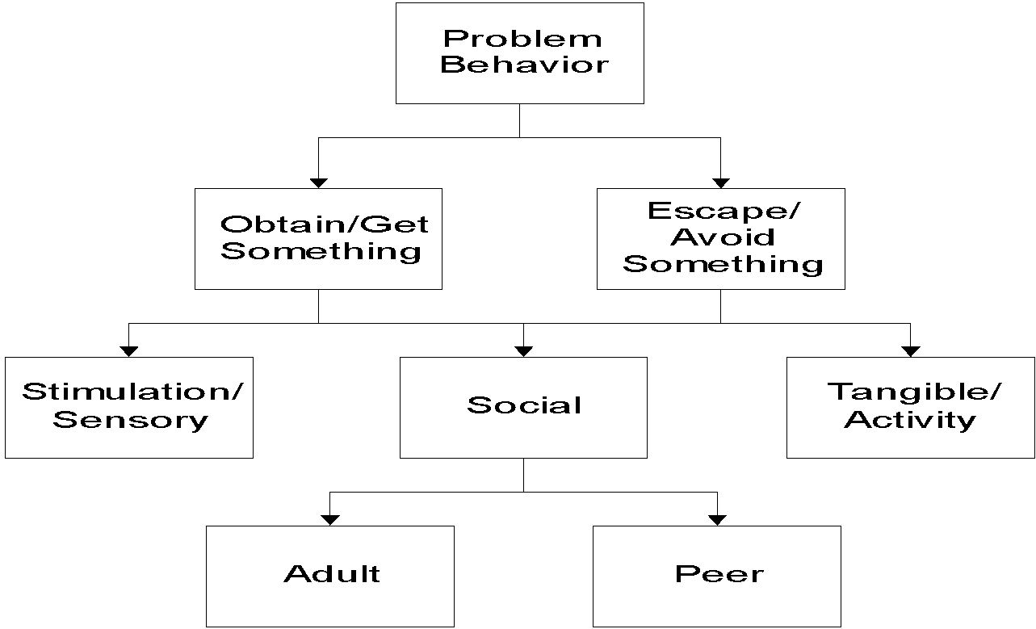
Functions of Behavior
Notes:
COrtney

Slide 15
Most Common Functions of Behavior
To Obtain/ Get :
Peer attention
Adult attention
Desired activity
Desired object/ items
Sensory stimulation: auditory, tactile, etc.
To Avoid/ Escape:
Difficult Task
Boring Task
Physical demand
Non-preferred activity
Peer attention
Staff attention
Reprimands
Notes:
COrtney

Slide 16
Examples of Function in School
Obtain/Get Reinforcers
I yell and others look at me
I fight and others listen to me
I wander and people talk to me
I hit in order to get toys from other kids
Escape/Avoid Aversives
I cry when work gets hard and the teacher tells me to take a time out
I throw a book during math class and the teacher will send me out of class
I stand against the wall in PE so my classmates do not throw the ball at me
Notes:
COrtney

Slide 17
Whole Group Discussion
Write down an example of a challenging behavior.
Share with the group so that we can hypothesize the function of behavior together.
Thinkabout Question =
Is the typical consequence for the behavior reinforcement or punishment?
Notes:
Cortney
Base whole group vs. table discussion on whole group size
Record examples of challenging behavior to use later in punishment activity

Slide 18
Consequences
Definition: Anything that happens after a behavior.
Consequences can either:
reinforce (increase the frequency of) behavior,
or
“punish” (decrease the future frequency of)
behavior
The consequences the student has experienced in the past determines the function of the current behavior
Notes:
Teri

Slide 19
Consequences: Reinforcement +
Definition: Anything that happens after a behavior that increases the probability that the behavior will be repeated again in the future.
Positive: Anything desirable that the student gets, contingent upon the behavior (i.e. time with a preferred activity, a token, praise, or a candy treat)
Example: John gets the teacher’s attention when he blurts out in class. Important - John LIKES teacher attention!
Notes:
Teri

Slide 20
Consequences: Reinforcement -
Definition: Anything that happens after a behavior that increases the probability that the behavior will be repeated again in the future.
Negative: Anything that is aversive that the student avoids by engaging in a behavior (i.e. disrupting class to get kicked out so that work is avoided, or avoiding a reprimand by raising one’s hand)
Example: Sarah avoids work when she refuses to do it, and is even more successful when the teacher sends her out of the classroom as a result of her refusal.
Notes:
Teri

Slide 21
Consequences: Punishment +
Definition: Anything that happens after a behavior that decreases the probability that the behavior will happen again. Punishment is the second type of consequence.
Positive: Something aversive happens contingent on the behavior
Example: Sarah refuses to do her work but she does care about her grades. When she gets an “F”, she is upset.
Notes:
Teri

Slide 22
Consequences: Punishment -
Definition: Anything that happens after a behavior that decreases the probability that the behavior will happen again. Punishment is the second type of consequence.
Negative: Something desirable is taken away
Example: Sarah has to stay in from recess to do her work (provided she really likes recess)
Other examples include: Re-Set, Time-Out, Loss of Privileges
Notes:
Teri

Slide 23
Disciplinary Consequences
Reinforcement or Punishment?
Send student out of the room for refusing to complete a task
Verbally re-direct a student who continually calls out to get your attention
You may not know whether a consequence is reinforcement or punishment until future behavior increases, stays the same, or decreases
Notes:
Teri

Slide 24
Activity – Part One
With a partner, review the example of a challenging behavior that you came up with earlier and determine an appropriate disciplinary response that will serve as an effective “punishment.”
Notes:
Teri

Slide 25
Competing Behavior Pathway
Desired Behavior
Maintaining
Consequence
Setting Events /
Conditions
Problem Behavior
Antecedent Trigger
Maintaining
Consequence
Function
Replacement Behavior
Notes:
‹#›
Cortney

Slide 26
Replacement Behaviors
Does the replacement behavior fulfill the same function?
Does the behavior need to be taught?
How will the behavior be reinforced?
Notes:
Cortney

Slide 27
Case Study Pathway: Sarah
Complete math task
Maintaining
Consequence
Routine: Math Class
Function
Student didn’t get much sleep last night
Avoids math task
Asked to do a math task
Gets sent out of class
Sits silently
Write name on paper
Notes:
‹#›
Cortney

Slide 28
Activity – Part Two
With your partner, using the same challenging behavior example, decide on an intervention that could result in the student choosing a more acceptable replacement behavior that meets the same function as the challenging behavior.
Notes:
Cortney

Slide 29
Congratulations!
You have successfully engaged in FBA Thinking!
By doing a mini FBA-in-your-head you can ensure that your disciplinary responses will:
Not accidentally reinforce challenging behavior
Serve as effective punishment
Reinforce an acceptable replacement behavior
Notes:
Teri

Slide 30
Next Steps?
With a partner, discuss how you plan to use the information shared in this presentation.
Will you be presenting this to your staff?
If so, when? Do you need any additional assistance from us?
Notes:
Teri
Ask some people to share their plans

Slide 31
Wrap-Up
Questions??
Coaching
Funds are available for coaching support
Visit Vermont PBIS Website or your School Coordinator
Contact us with any questions!
Teri Brooks, Ph.D., BCBA
terimbrooks@gmail.com
Cortney Keene, M.Ed., C.A.S., BCBA
cortney.keene@uvm.edu
Notes:
Teri

