Slide 1
VTPBiS Leadership Team Training
At the Intensive Level
Within a Multi-Tiered System of Supports
Presented by:
VTPBiS Trainers
June 2016

Slide 2


About Us
Cortney Keene
Ken Kramberg

Slide 3

BEST Expectations:
Teaching Matrix
BEST Expectation | All Settings
Be Respectful | Empathic responses to presenters and colleagues Silence cell phones Be present and wait for breaks
Engage | Take a Team role Ask clarifying questions
Strengths-based | Use positive statements and re-statements Remember, four positives to one negative
Team Solutions | Establish and follow team roles and norms Consider all ideas of team members

Slide 4
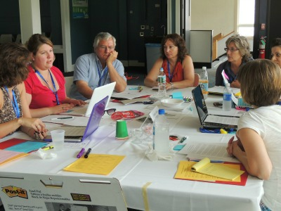
Principles of Adult Learning
Immediacy
Respect
Relevance
Safety
Engagement
Inclusion
Notes:
Connect Expectations with our goal of providing a training that takes into account the 6 principles of Adult Education……..As trainers we will be focusing on these principles so please let us know how this is working for you……….
6 Core Principles of Adult Learning:
Immediacy – Show usefulness of content
Respect – Invite participants to share
Relevant – Connect content to context
Safety – Ensure all feel comfortable
Engagement – Variety of activities
Inclusion – Be mindful of power dynamics

Slide 5
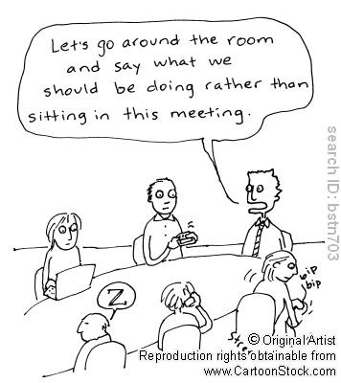
Importance of Roles and Norms
Effective collaboration
Accountability
Efficient and focused meetings
http://www.schoolimprovementcoach.org/manual/7%20Norms%20and%20Roles.pdf
Notes:
As we come together as learners and team members, it’s really important that we use our time during this training wisely so that we are most efficient. Setting up norms and roles during this training is critically important because………..Read SLIDE. In a few…… as leadership teams, you will spend some time creating your meeting norms and roles……that will be used throughout the training…….
Norms help make collaboration more effective by guiding team behavior
Norms enable team members to hold each other accountable
Roles and responsibilities help team build internal capacity for holding effective and focused meetings

Slide 6
Activity
As a team, develop your matrix of team norms.
Notes:
Have team do norm matrix

Slide 7


VTPBiS Targeted Training Materials
USB & Website
USB Includes:
PowerPoint
Workbook
Materials
www.pbisvermont.org
Notes:
Hand out Drives now! Explain what’s on them. They can’t keep the USB Drives but they can drag and drop materials, if needed.
PowerPoint
Workbook
Materials

Slide 8
Who Benefits from PBIS/MTSS-B? Everyone!
1-5% of Students may need Intensive Supports
Few
10-15% of Students may need Targeted Supports
Some
ALL Students!
Universal Practices in place for 100% of students
80% of Students should be successful when accessing Universal Supports
Notes:
Why – consistent response for students and staff
Clearly articulated plan and framework
Review of data to demonstrate success and challenges

Slide 9
Person First Language
Do say…
“students receiving intensive supports”
“students needing targeted interventions”
“student with autism”
“student receiving specialize instruction”
“children with disabilities”
Don’t say…
“red zone kids”
“targeted kids”
“the autistics”
“sped students”
“disabled kids or handicapped kids”

Slide 10

Differentiate based on your experience
Foundations:
Think about how you plan to accomplish the work.
Full Implementation:
Think about how to make it easy, better, more effective.
Sustainability:
Think about how to continue the practice and ensure sustainability.
Notes:
This is to convey that teams are all in different phases of implementation. There is always work to be accomplished in each part of the training. If you are a team that is just starting out, you will need to make your plan. If you have already completed some of these actions, how will you make them more effective. If you are fully implemented, the work is to make it part of your school culture as deeply as possible. Teams may want to focus on - How do you reach out to families? Mental heatlh? Other community resources?

Slide 11
Objectives
By the end of this training you will have:
Strengthened targeted & built readiness
Explored 5 Steps for Intensive Process
Revisited FBA/BSP skills and capacity
Examined Tier 3 practices
Considered Proactive Crisis Planning
Reviewed data systems at Tier 3
Planned for next steps

Slide 12
Agenda
Focus on Strengths
Targeted Review
Teaming
Engaging Families
Setting Goals
FBA
Day 1 & 2
Day 3 & 4
        BSP Interventions
        Evaluation
        Crisis Plan
        Roll Out Plan
        Follow Up
Center on Disability and Community
Inclusion

Slide 13

Introductions:
Focus on Strengths
As a Team, identify 2-3 big strengths your team is bringing to this training
Select one person from your team to introduce your team members and list your team’s strengths

Slide 14

https://vimeo.com/73172036
Notes:
Focus on this student’s strengths

Slide 15
Activity
Heart of the Matter, Part 1
List student strengths in
Student Profile Section
of F-BSP
Notes:
Not in workbook

Slide 16
SYSTEMS
supporting staff behavior
OUTCOMES
supporting student behavior
PRACTICES
DATA
supporting decision making
Notes:
Systems, Practices, Data
Start with systems

Slide 17
SW-PBIS Supports for All Students
Intensive Supports – Individualized interventions provided to students with most complex emotional and behavioral needs.
Wraparound
1-5%
5-15%
80-90%
Complex FBA/BIP
Simple FBA/BIP
Individualized CICO
Targeted Supports – Provided to students determined to be “at-risk” of emotional and behavioral challenges.
Social/Academic
Instructional Groups
Check-in/Check-out
Universal Supports – Supports provided to all students. Expectations are taught, reinforced, and monitored in all settings.
School & Class-wide expectations & supports
Notes:
Need to have a system that builds from the base…
VT had schools with really good individualized systems and schools that do a great job with Universal supports. It’s building the supports in between that has been the challenge. It doesn’t come naturally.
Ken

Slide 18
Ensure Check-In/Check-Out (CICO) supports are in place
Default targeted intervention. WHY?
Most students receive multiple ODRs for peer or adult attention.
Evidence indicates CICO is effective practice for reducing acting out behavior related to attention seeking.
Schools must have strong CICO in place!
Notes:
Jean

Slide 19
All Check In-Check Out programs have:
a positive caring adult
daily positive interactions with teachers & other adults
supervision and monitoring of students
more performance feedback
Notes:
Jean

Slide 20
Statistically Speaking …
Up to 12% of students with chronic problem behaviors act out for adult or peer attention
Why?
Notes:
0 TO 4%

Slide 21
Activity
Do the Math:
Given your enrollment, how many students would benefit from CICO? Write this in Plan to Sustain the Targeted Level of workbook
Notes:
First item in workbooks

Slide 22
Keys to Sustainability for CICO
Ongoing professional development
Checking for fidelity
Focus on relationships
What else?
Notes:
22
What successes have you found at targeted level?
Share with each other

Slide 23
Activity
Complete the VTPBiS CICO Self-Assessment
Notes:
In Handbook

Slide 24
Barriers to Implementation of CICO
Tendency to individualize
Faculty not marking DPRs
Wanting to continue after goal has been met
Goals set too high
Desire for behavior to change quicker
Inadequate professional development
New staff
Parent buy-in
What else?
Notes:
Action Plan for Completion of Start-Up Activities appears here in workbook – is there an activity around this?

Slide 25
Targeted Interventions Based on Functions of Behavior
Access Adult Attention/Support:
Check-In/Check-Out
Adult Mentoring Programs
Access Peer Attention/Support:
Social Skills Instruction
Peer Mentoring
Self-Monitoring with Peer Support (function: academic task escape)
Academic Skills Support
Organization/Homework planning support
Homework completion club
Tutoring
Notes:
Intervention is continuously available
Rapid access to intervention (72 hr.)
Very low effort by teachers
Consistent with school-wide expectations
All staff/faculty in school are involved/have access
Flexible intervention based on descriptive functional assessment
Adequate resources (admin., team)
Continuous monitoring for decision-making

Slide 26
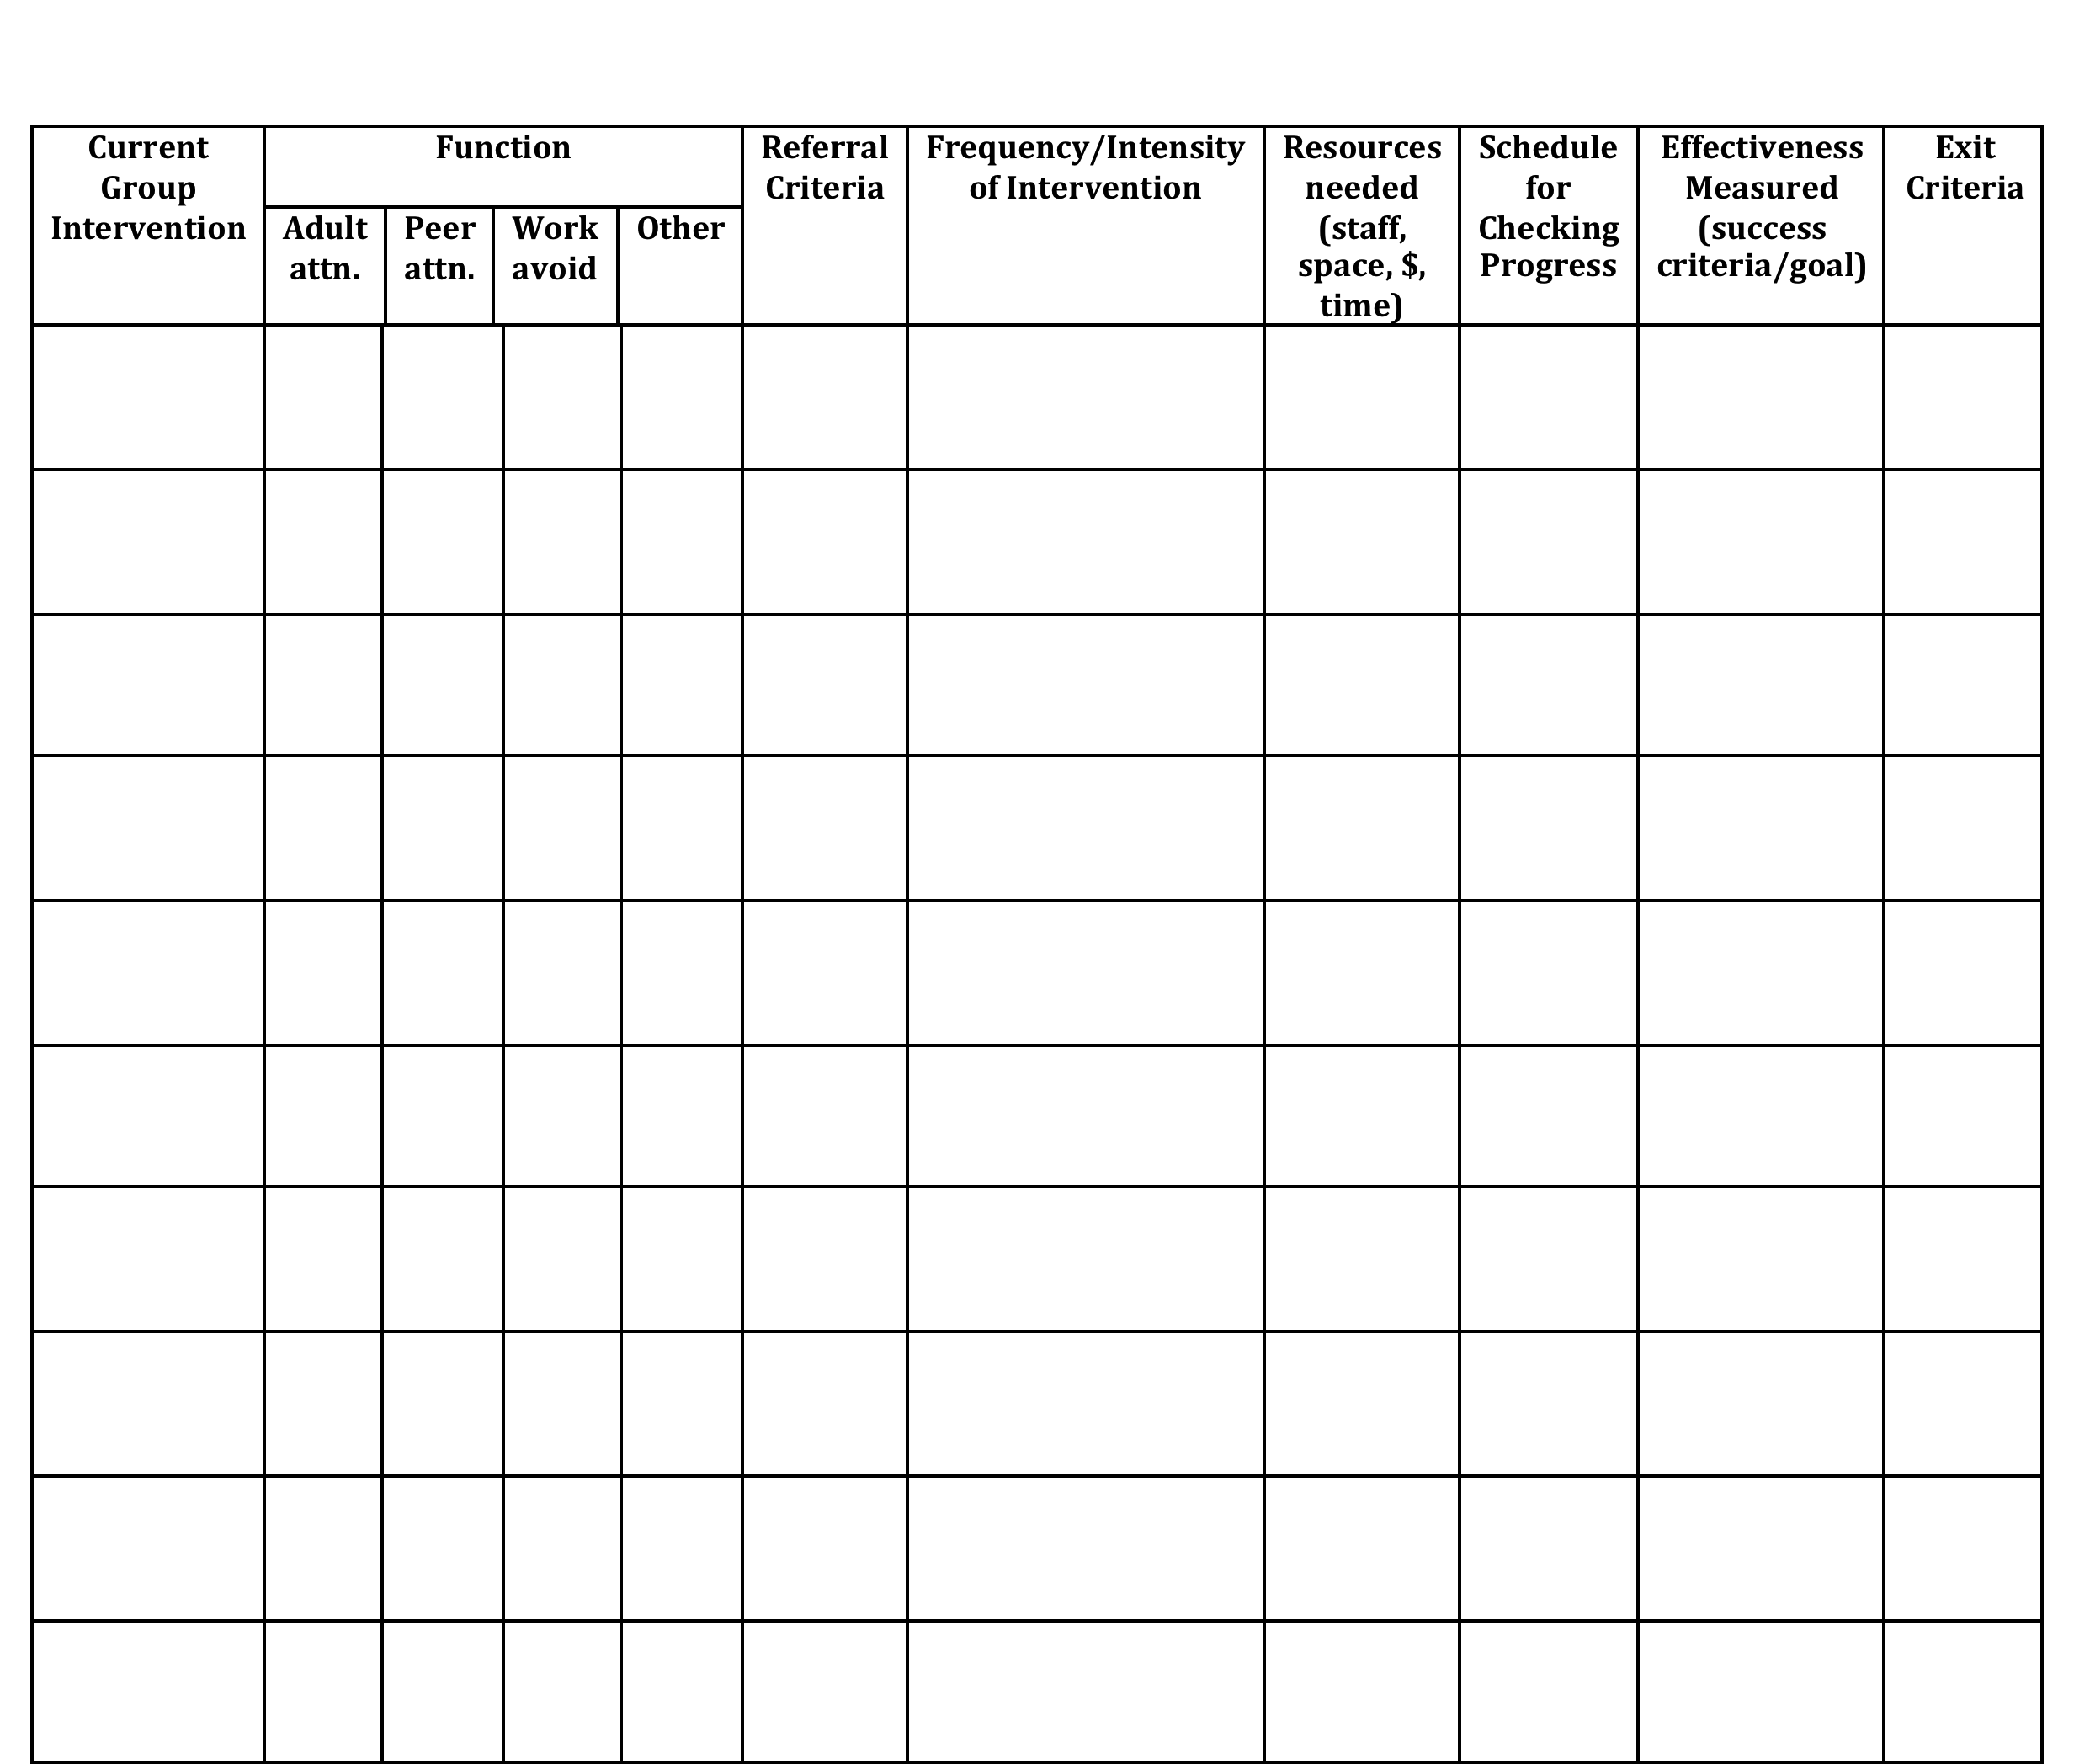
Inventory of Existing Targeted Interventions
Notes:
Direct them to Handbook for this activity, go to next slide

Slide 27
Activity
In school teams, review your Inventory of Targeted Supports
Share two most successful supports or practices with large group
Notes:
In Handbook
Each team shares two most successful practices with large group

Slide 28
Activity
Take one of your targeted interventions from your inventory and plan how you can adapt it and incorporate it in an individual support plan

Slide 29
Check-In
Who participated in webinar?
Who completed Readiness Checklist as a Team?
Who has had a chance to use the BAT?
Notes:
If not everyone present was part of webinar, readiness, or BAT then bring each other up to date and get additional input from one another in next activity

Slide 30
Necessary Conversations (Teams)
Tier 1
Tier 2
Tier 3
SU/District Team
•Coordinates implementation
•Ensures access to resources
•Reviews data across schools
SU/District Team – Targeted/Intensive:
•Secures resources
•Focuses on student outcomes
•Focuses on fidelity of practices across the district/SU
SU/District
School Leadership Team
•Plans and implements 6 school components of PBIS
School Systems Level Team – Targeted/Intensive:
•Creates procedures for referral, screening & evaluation
•Communicates with staff and families
School
Student Level Team
•Matches students to interventions
•Evaluates & monitors student progress
Student Level Team
•Completes FBA/BIP
•Evaluate & monitor student progress
Facilitates wraparound
Student
Notes:
You need to figure out where you as the intensive team fit in

Slide 31
Intensive Team: Critical Features
Possess specialized behavioral skills within their membership
Allow and encourage contributions from all their members
Have predictable and efficient procedures for doing business and solving problems
Have regular opportunities to access building staff, families, and community agencies to communicate and solicit information

Slide 32
Intensive Team: Objectives
Manage teacher requests for assistance
Ensure that teachers and students receive support in a timely and meaningful manner
Provide a general forum for discussions and possible solutions for individual student behavioral concerns
Organize a collaborative effort to support the teacher (Todd et. al., 1999)

Slide 33
Role of Administrator
Know what the practices look like when implemented with fidelity;
Access special resources, if needed.
Support team meeting time
Be flexible around school policies/procedures.
Be committed to helping students and LRE.
Be aware of data using tracking tools; help decide what needs to change.
Notes:
This is who the parent will call if there are problems. Administrator needs to know what is happening with all student plans.

Slide 34
Role of Intensive Team Coordinator
Attend Leadership Team Meetings
With leadership team, identify staff to facilitate individual team-based meetings.
Help team complete behavior tasks on time
Data organization and reporting
Meet with student teams weekly
Notes:
Active knowledge of school’s PBIS efforts
Skilled in function-based assessment, behavior support planning & implementation
Member of the school’s Leadership Team and EST
Role formally endorsed by school principal
Flexibility to complete tasks during the day
Positive rapport with other school staff

Slide 35
Check-In
Who participated in webinar?
Who completed Readiness Checklist as a Team?
Who has had a chance to use the BAT?
Notes:
If not everyone present was part of webinar, readiness, or BAT then bring each other up to date and get additional input from one another in next activity

Slide 36
Activity
Review / Complete Readiness Checklist
Complete Team Profile
Notes:
In Handbook
Pull up your BAT from PBIS apps website … should have completed this as part of pre-institute tasks
Review readiness checklist and BAT
THEN …
Complete Team Profile for ???both Systems Level and Individual Student Level???

Slide 37
Day One Homework
Complete Activities started in strand today:
  VTPBiS CICO Self-Assessment
  Inventory of Targeted Supports
  VTPBiS Intensive Level Readiness Checklist with relevant sections of the BAT
  Complete Team Profile

Slide 38
Welcome to Day 2: Agenda
Focus on Strengths
Targeted Review
Teaming
Engaging Families
Setting Goals
FBA
Day 1 & 2
Day 3 & 4
        BSP Interventions
        Evaluation
        Crisis Plan
        Roll Out Plan
        Follow Up
Center on Disability and Community
Inclusion

Slide 39

1 Teaming
2 Goals
3 Assessment (FBA)
4 Intervention (BSP)
5 Evaluation (BSP)
Vermont’s Planning Process for Students
Adapted from: Dunlap et al. (2010). Prevent, Teach, Reinforce
Notes:
We’ve focused today on systems.
We’re going to move for the rest of the week to focusing on intensive supports for students
Hand out books

Slide 40

Step 1 for Referral to Intensive: Individual Student Teams
Notes:
Individual student team will look different than your intensive SYSTEMS team!
Who are the essential people to have on your individual student teams?

Slide 41
Think about a student team…
What was positive or successful about the team experience?
What strengths did you bring to the team experience?
Notes:
Think about a student you know who received individualized / intensive level supports
Write down one thing of those things on post-its and put up on newsprint.
Share with a neighbor
Pick someone on your team to introduce your team after we’re done.
[TRAINER: Point out one or two themes. We’re going to use them during the day.]

Slide 42
Recommended Team Members
Teacher
Parent
Behavior expert
Resource expert
Student
Others?
People who are actively involved with the student and invested in the student’s success
Notes:
Emphasize ACTIVELY INVOLVED and INVESTED
This is exactly how the Behavior Support Plan is organized

Slide 43
Engaging Team Members
Dedicated time
Creative problem solving
Organized team process
Handling conflict
Notes:
Not necessarily an easy thing to do; need to invest more effort to make them run well

Slide 44
Activity
Heart of the Matter,
Part 2

Slide 45


VT Family Support Resources
www.vermontfamilynetwork.org
www.vffcmh.org
Notes:
Do activity two: Power Imbalances today
Do activity one tomorrow: Positions and Interests

Slide 46
Activity
Review Family Engagement
Checklist
Notes:
In Handbook
Should have done this as part of pre-institute task, after having watched the 13-minute webinar

Slide 47
Example: Team Meeting Structure
Start with positives!
Review all relevant data
Brainstorm ideas based on data
Discuss, prioritize, make data-based decisions
Gain consensus and implement agreed upon steps
STICK WITH YOUR AGENDA
Notes:
All the most successful individual interventions are built on student’s strengths, not on remediating their weaknesses
Don’t just mention the positives, but truly celebrate them
Hold up Bx Support Plan and direct their attention to where this sample agenda is built in

Slide 48
ONSU Team
http://www.wcax.com/story/28128871/vt-school-tackles-behavior-intervention-strategies

Slide 49
Activity
Choose one of your students who needs intensive supports.
Complete: Clarifying Roles and Goals of Team Members in workbook for that Student Team
Notes:
In Workbook

Slide 50

Step 2: Setting Goals
Broad goals identified by team at the start
Includes positive behaviors to increase and problem behaviors to decrease
Team has conversation to reach consensus
Notes:
Who are the essential people to have on your individual student teams?
Goals to support child AS WELL AS the adults providing primary interventions with child.

Slide 51
Broad Goal Example
Jesse will follow instructions by teachers, staff, and other adults.

Slide 52
Positive & Problem Behaviors
Increase the number of times he responds appropriately by responding to adult requests quickly and respectfully
Decrease number of times he runs away from adults following adult requests.

Slide 53
Steps 3 & 4 Assessment & Intervention
Assessment=Functional Behavior Assessment (FBA)
Intervention = Behavior Support Plan (BSP)
School should have personnel ready to provide simple & complex FBA / BSP
Trigger
Behavior
Consequence
Function
Notes:
Do you have people identified?
Do they feel competent and confident?
And are they doing them?

Slide 54
Simple vs. Complex FBA
 | SIMPLE | COMPLEX
FOR | Students with high frequency behaviors (not dangerous), received interventions that did not improve behavior, show behaviors in only 1-2 settings | Students that demonstrate dangerous behaviors or show behaviors that occur in 3 or more school settings
WHAT | Relatively simple and efficient process to guide behavior support planning | Time-intensive process involves emergency planning, family-centered planning, & collaboration outside agencies
WHO | Team of school-based personnel (ex: teachers, special educator, counselor, administrator, behavior support personnel) | School-based team with professionals trained to implement interventions for students with severe problem behaviors (ex: behavior specialist or school psychologist)
Notes:
You should have in-house capacity for simple FBAs
This looks like a dichotomy, but is really on a continuum
Know when to call in an “expert” or outside consultant

Slide 55
FBA = D.A.S.H. (Loman Training)
Define behavior in observable and measurable terms
Ask about behavior by interviewing staff and student
specify routines where & when behavior occurs
summarize where, when, and why behavior occurs
See the behavior
observe the behavior during routines specified
observe to verify summary from interviews
Hypothesize
a final summary of where, when, and why behaviors occur

Slide 56
Functional Behavior Support Plan
An interview tool for collecting information about problem behaviors
For staff, parents, and students
The F-BSP then leads the team to create a competing behavior pathway and behavior support plan

Slide 57
Activity
Complete the Goal-Setting Form from p. 2 of Intensive Level Behavior Support Plan (F-BSP) for your student
Notes:
Emphasize that they’re thinking about a real student but this is just practice bc you don’t have all the proper team members with you today

Slide 58
Competing Behavior Pathway
Desired Behavior
MaintainingConsequence
Setting Condition
Antecedent Trigger
Problem Behavior
Maintaining Consequence
Function
Replacement Behavior
Notes:
58

Slide 59
FBA Hypothesis
Setting
Antecedent
Behavior
Consequence
Typically on days when he has worked alone for 30 min…
when given math work sheets & other assignments…
he doesn’t do his work and uses profanity.
His work doesn’t get completed and he avoids teacher requests.

Slide 60
Hypothesis Summary
When given math worksheets & other assignments, Caesar does not do his work, uses profanity, & disrupts lessons, especially, when he has worked alone for 30 minutes without peer contact. His work does not get completed, & he avoids teachers requests.

Slide 61
These student FBAs, plans, & strategies are for practice only.
You will need to further refine them at school, involving the whole student team.
Notes:
Jesse

Slide 62
Activity
Choose ONE behavior for your student
Complete competing behavior pathway for your student using F-BSP
Develop hypothesis for function of the behavior
Notes:
Jesse 15 minutes 10:35-10:50
NOW BREAK

Slide 63
Homework
Team Time Activities:
Complete Student Team Roster (Stage One of Behavior
Support Plan)
Complete Goals (Stage Two of Behavior Support Plan)
Assess and strategize around your school’s capacity to
conduct an FBA/BSP for students who need intensive
supports (in workbook)

Slide 64
Homework Continued
Team Time Activities:
Assign one person to read Chapter Five in your Prevent, Teach, Reinforce book
Report back to the team on what this chapter has to offer and one specific strategy that might be pertinent to the student the team is focusing on

