Slide 1

VTPBiS Intensive Level Wraparound
Webinar
Presented by: Jesse Suter
February 4, 2015

Slide 2
Webinar Logistics
Two ways to ask questions:
  Raise your hand using the icon on your screen
  Type a question into the text box for
We will also be asking you questions
This webinar will be recorded.
Please note, your microphone will be muted unless otherwise indicated.

Slide 3


“Here comes the really hard part!”
Notes:
Disconnect major challenge. We will ask you to think of ways to connect students at Tier 3 with 1 & 2,
Counter intuitive then to emphasize the tip.
ASK THEM: So why the heck are we doing it?
My belief is that principles and values of wraparound are not just an effective basis for team planning around a small number of students in your school, but when you introduce the wraparound process into a school’s PBIS system there’s the opportunity for the values to improve the supports that ALL students receive.

Slide 4
What is intensive level wraparound?
Is my school ready for the training?
Trainings
Practices
Data
Systems
Next Steps
Notes:
Agenda

Slide 5
Tier 2/3 Training Sequence
Tier 2 School Leadership Training
Tier 3 School Leadership Training
Tier 3 SU/SD Wraparound Overview
Universal Screening
Tier 2 Trainings
Tier 3 Wraparound Facilitator Training
FBA/BSP
Trauma

Slide 6
SYSTEMS
supporting staff behavior
OUTCOMES
supporting student behavior
PRACTICES
DATA
supporting decision making

Slide 7
Supports for All Students
Intensive Supports – Individualized interventions provided to students with most complex emotional and behavioral needs.
WRAPAROUND
Complex FBA/BIP
1-5%
5-15%
80-90%
Brief FBA/BIP
Individualized CICO
Targeted Supports – Provided to students determined to be “at-risk” of emotional and behavioral challenges.
Social/Academic Instructional Groups
Check-in/Check-out
Universal Supports – Supports provided to all students. Expectations are taught, reinforced, and monitored in all settings.
School & Class-wide expectations & supports

Slide 8
What is Tier 3 intensive?
For students with serious and challenging behaviors that require individualized interventions
Collection of data to determine function of behavior and positive behavior plan to address function
Coordination of home, school, community interventions

Slide 9
Question #1
What is your knowledge about or experience with wraparound?

Slide 10
What is wraparound?
Wraparound is a family-driven, team-based process for planning and implementing services and supports.
Plans meet unique needs & strengths of students with complex needs and their families.
Team members meet regularly to implement and monitor the plan to ensure success.

Slide 11
Wraparound Principles
Voice & choice
Community-based
Individualized
Strengths-based
Unconditional
Outcomes-based
Natural supports
Collaboration
Culturally Competent
Team-based
Notes:
The more your team is following these principles, the closer you are to true wraparound.
So to start things out with the right emphasis and keeping our focus solidly on POSITIVE Behavior Interventions and Supports.
We’re going to start with an activity identifying the strengths of one of your students.
Now I know that you’re here because you probably recognize and use the strengths in your students naturally.
The goal of integrating wraparound within PBIS however, is to help schools do this more systematically and intentionally.
One measure of success that I have for this strand is if you’re able to return to your schools, and model this strengths-based approach so it becomes part of the culture for all students, not just those in Tier 3

Slide 12
Four Phases of Wraparound
1. Engagement & Team Preparation
2. Planning
3. Implementation
4. Transition
Orient family, stabilize crises, assess strengths & needs, form vision, identify team members
Hold initial meeting(s), orient team, create plan focusing on “Big Needs”, identify services & supports
Hold regular meeting, implement plan, review progress, revise plan
Define when vision / goals have been met, “unwrap” celebration, follow up with family

Slide 13

1 Teaming
2 Goals
3 Assessment (FBA)
4 Intervention (BSP)
5 Evaluation (BSP)
Adapted from: Dunlap et al. (2010). Prevent, Teach, Reinforce
Vermont’s Planning Process for Students

Slide 14
Comparison Tiers 2, 3, & Wrap
Student Teams
Tier 2 | Tier 3 | Tier 3 Wraparound
Small behavior planning team reviewing students who need more than Tier 1 interventions | Student-specific team members (student, parent, peer, administrator, teacher, behavioral staff member, etc.) | Student and family identify team members which may include peers and professionals outside of school

Slide 15
Comparison Tiers 2, 3, & Wrap
Goals
Tier 2 | Tier 3 | Tier 3 Wraparound
Similar goals for all students: in class, on task, responding successfully to Tier 1 supports | Individualized school-based goals to address 1-2 specific problem behaviors | Student and family choose goals focused on addressing BIG needs occurring in the home, school, community

Slide 16
Comparison Tiers 2, 3, & Wrap
Interventions
Tier 2 | Tier 3 | Tier 3 Wraparound
Tiers 1 and 2 interventions with individualized components to Tier 2 interventions if needed | Tiers 1 and 2 interventions and Behavior Support Plan (BSP) including Safety Plan | Same as Tiers 1, 2 and 3; Crisis/safety plan; Community services, as needed

Slide 17
Wraparound isn’t…
A set of services
A one or two time meeting
A special education evaluation
Individual counselor who meets family or student
Only for families and students we judge as “workable”
The presence of flexible funds

Slide 18

Who benefits from wraparound?
Youth with needs in home, school, and community
Youth with needs in multiple domains
Families not engaged
Staff through coordination
Schools through climate change

Slide 19
Your Questions
?

Slide 20
Question #2
How is wraparound similar and different from typical individualized service delivery in your school?

Slide 21
Supports for All Students
Intensive Supports – Individualized interventions provided to students with most complex emotional and behavioral needs.
WRAPAROUND
Complex FBA/BIP
1-5%
5-15%
80-90%
Brief FBA/BIP
Individualized CICO
Targeted Supports – Provided to students determined to be “at-risk” of emotional and behavioral challenges.
Social/Academic Instructional Groups
Check-in/Check-out
Universal Supports – Supports provided to all students. Expectations are taught, reinforced, and monitored in all settings.
School & Class-wide expectations & supports

Slide 22
Readiness check
My school is currently implementing PBIS at the Universal & Targeted levels:
Yes, No, Don’t Know

Slide 23
Readiness check
Targeted / Intensive: Have school personnel who can complete simple FBA and access to people who can complete full FBA.
Yes, No, Don’t Know

Slide 24
Appropriate Intensive Practice
FBA/BSP
No wraparound criteria present
Brief FBA/BSP not successful
Wraparound
Adults not engaged
Risk of placement change
Multiple needs
Focus on 1-2 behaviors

Slide 25

All Hinges on the Facilitator
Has experience working with children with complex needs
Able to engage families
Collaborates with natural supports & professionals
Follows wraparound process & principles
Uses data

Slide 26
Question #3
Who are candidates to become wraparound facilitators for your school?

Slide 27
SYSTEMS
supporting staff behavior
OUTCOMES
supporting student behavior
PRACTICES
DATA
supporting decision making

Slide 28


Data: Student & System Levels
Behavior
Academic
Strengths
Needs
Readiness
Implemen-tation
Fidelity
Progress Monitoring
Screening

Slide 29
Using ODRs for Decision Making
IF | FOCUS ON
More than 5% of students receive 5 or more office referrals | Targeted / classroom supports
Less than 5% students with 10 or more office referrals Less than 5% students continue rate of referrals after receiving targeted group settings Small number of students destabilizing overall functioning of school | Intensive supports

Slide 30
Question #4
How does your school identify students needing individualized or intensive level supports?

Slide 31
1 Teaming
2 Goals
3 Assessment (FBA)
4 Intervention (BIP)
5 Evaluation (BIP)
Adapted from: Dunlap et al. (2010). Prevent, Teach, Reinforce
Vermont’s Planning Process for Students

Slide 32
Comparison Tiers 2, 3, & Wrap
Assessment
Tier 2 | Tier 3 | Tier 3 Wraparound
Practical Functional Behavior Assessment (FBA) of problem behavior | FBA including observations and interviews | More comprehensive measures assessing strengths & needs in home, school and community

Slide 33
Comparison Tiers 2, 3, & Wrap
Evaluation
Tier 2 | Tier 3 | Tier 3 Wraparound
Office discipline referrals, Check-in/Check out data attendance, nurse visits, other | Same as Tier 2, and SWIS Student Support Information System (ISIS) | Same as Tier 3,and other data tools

Slide 34
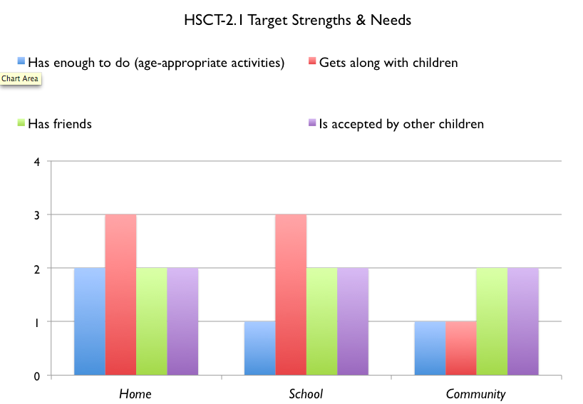

Slide 35
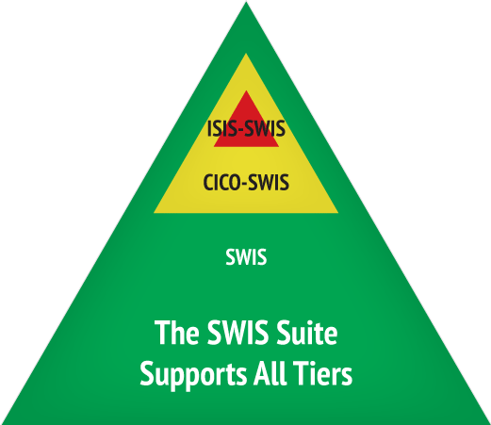
Evaluation: ISIS Demonstration
https://www.pbisapps.org/

Slide 36
Progress Monitoring

Slide 37
Question #5
How does your school track student progress receiving individualized supports?

Slide 38
SYSTEMS
supporting staff behavior
OUTCOMES
supporting student behavior
PRACTICES
DATA
supporting decision making

Slide 39

Lessons Learned
PBIS Intensive level interventions require system of support at both the school and SU/District.
New interventions (innovations) require changes in system structures.
Success at any level of the pyramid is dependent on fidelity of implementation at all levels of the pyramid.
Notes:
From review of schools in Illinois PBIS
Innovative practices do not fare well in old organizational structures and systems
Organizational and system changes are essential to successful use of innovations
Expect it
Plan for it

Slide 40
Stages of Implementation
Implementation of an “innovation” (PBIS Wraparound) occurs in stages
Exploration
Installation
Initial Implementation
Full Implementation
Innovation
Sustainability
2-4 years
Fixsen, Naoom, Blase, Friedman, & Wallace, 2005

Slide 41
Necessary Conversations (Teams)
SU/SD
Secure resources
Track fidelity & outcomes
School
Referral, screening, & evaluation
Engage with families
Student
Teaming, Goals, Assessment, Intervention, Evaluation
Facilitate wraparound
Coordinate with mental health

Slide 42
Old Approach
New Approach
Each school works out their own plan with Mental Health (MH) agency;
A MH counselor is housed in a school building 1 day a week to “see” students;
No data to decide on or monitor interventions;
“Hoping” that interventions are working; but not sure.
District has a plan for integrating MH at all buildings;
MH person participates in teams at all 3 levels;
MH person leads small groups based on data;
MH person co-facilitates FBA/BIP or wrap individual teams for students.

Slide 43
Your Questions
?

Slide 44
Readiness check
Do you have a leadership team of SU/District and school personnel including:
SU admin, SU Intensive coordinator, family member, behavior specialist / clinician, mental health agency rep, regular education teacher
All, most, few, none, don’t know

Slide 45
Data: Student & System Levels
Behavior
Academic
Strengths
Needs
Readiness
Implemen-tation
Fidelity
Progress Monitoring
Screening

Slide 46
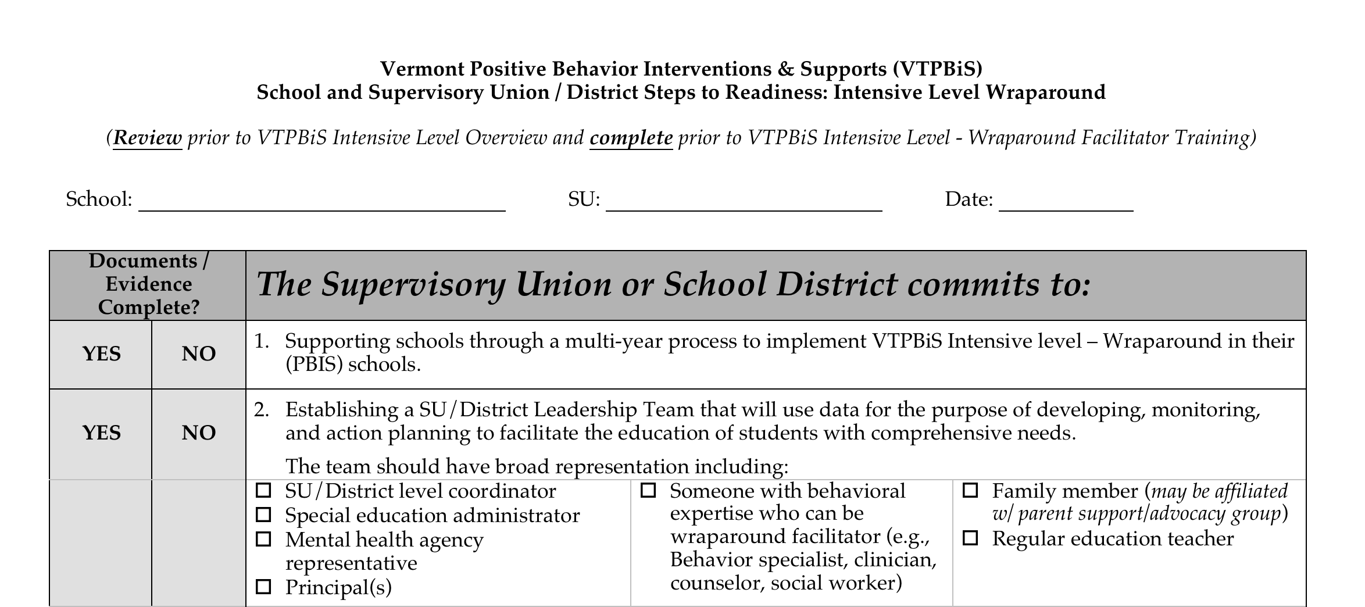
Readiness Checklist

Slide 47
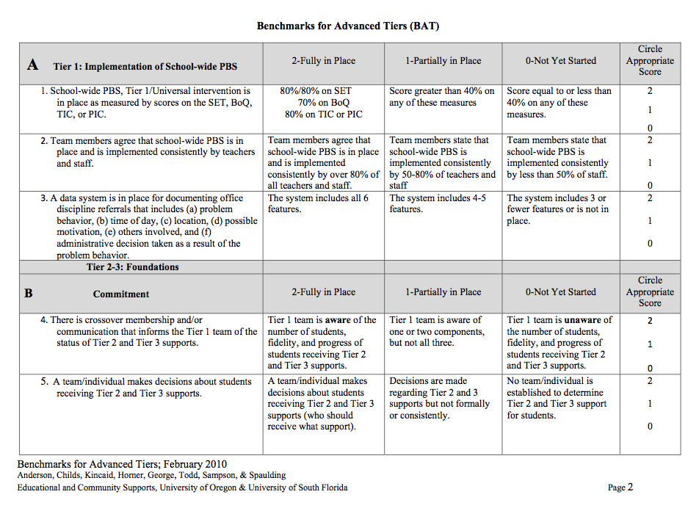
Benchmarks for Advanced Tiers (BAT)
Notes:
Self-assessment of Targeted & Intensive practices, systems, & data
Schools should review before the overview day and we will complete it that day.

Slide 48
Planning for next steps

Slide 49
Tier 2/3 Training Sequence
Tier 2 School Leadership Training
Tier 3 School Leadership Training
Tier 3 SU/SD Wraparound Overview
Universal Screening
Tier 2 Trainings
Tier 3 Wraparound Facilitator Training
FBA/BSP
Trauma

Slide 50
Steps for Adopting Intensive Level
Steps for Tier 3 Wraparound
Tier 3 Wraparound Webinar February 4
Tier 3 SU/SD Wraparound Overview
Complete BAT & Readiness Checklist
Follow-Up Coaching / Data System Training
Tier 3 Wraparound Facilitator Training
June
FBA/BSP Training
Feb 5 & 12
Tier 3 Leadership Training
March or June
Understanding Trauma
March 6
Building Better Behavior Support Plans
April 7

Slide 51
Most Important Steps:
Complete the BAT
School & SU/SD team
Talk to VTPBiS TA and Jesse
Steps, Resources, & Tools at: www.pbisvermont.org

Slide 52
Your Questions
?

Slide 53
Resources
Jesse Suter: 802-656-1130, jesse.suter@uvm.edu
Vermont PBIS: www.pbisvermont.org
National Wraparound Initiative www.nwi.pdx.edu
PBIS Apps www.pbisapps.org
Illinois PBIS: www.pbisillinois.org
New Hampshire PBIS: http://www.nhcebis.seresc.net/pbis_nh

