Slide 1



Basic FBA to BSP
Using Functional Behavioral Assessment (FBA) to Develop Function-Based Behavior Support Plans (BSP)
Adapted from Sheldon Loman and others
Day Two

Slide 2
Welcome Back!!!

Slide 3
What’s the function of the behavior that brought you here today?
A. Get access to learning new skills
B. Avoid being back at school
C. Get a free lunch
D. All of the above
E. None of the above

Slide 4
Learning Objectives
Day Two:
Review learning from last week
Develop a BSP for selected student
Plan for installation of practice back at school

Slide 5
Activity 1: Homework Review
As a team, debrief the additional information you gained as a result of interviewing team members back at school and conducting observations.
Discuss the things you found useful and the questions that arose as a result of using the F-BSP Protocol.
Finalize your hypothesis statement

Slide 6
Group Share:
Tell us about your student!
What is the:
  Observable behavior?
  Antecedent?
  Setting Event?
  Consequences?
  Hypothesis of Function of Behavior?

Slide 7

Notes:
Vignette Part 2

Slide 8

Notes:
Segment 1

Slide 9
What do we do with this Information?
Simple FBA
If the team does not have confidence in the hypothesis
If the team has confidence in the hypothesis
Develop/Implement a Behavior Support Plan
Gather More Information

Slide 10
Critical Components of
Behavior Support Plans
1: Competing Behavior Pathway
2: Function-Based Behavior Support Strategies
3: Implementation Plan
4: Evaluation Plan

Slide 11
Behavior Support Plan (BSP)
Two Goals
1. Reduce Problem Behaviors
make them irrelevant, inefficient, and ineffective
2. Increase Appropriate Behaviors

Slide 12
FBA: Summary of Behavior
Targeted Routine: ____________
FUNCTION
is where student behavior intersects with the environment
Function = Learning
Student Learns that when (A), if I (B), then (C) …
Function = how I benefit so I keep doing B
Maintaining Consequence & Function
Antecedent
Problem Behavior

Slide 13
Competing Behavior Pathway
Routine:
Desi
Desired Behavior
Consequence/Function
Setting Event
Antecedent
Problem Behavior
Consequence/Function
Alternative Behavior
But… start with the Alternative Behavior.
Why can’t we go right to the Desired Behavior?

Slide 14
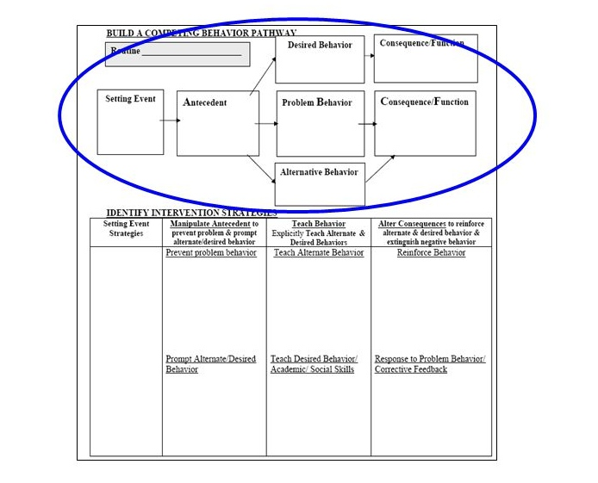
Competing Behavior Pathway

Slide 15
Why the Replacement Behavior?
3. Look how different this is from what’s happening now
Why not go straight to the Desired Behavior?
4. The student is going to need to gain numeracy skills before being able to do this like peers
Routine: Math Class
1. This is what we’re asking the student to do.
Complete math assignment
Success, teacher acknowledgment
Poor grades in math class
Given double-digit addition problems
Crying, pushing papers off desk
Sent to hall to ‘calm down’ Function: escape task
Raise hand & ask for break
5. So… in the meantime we use the Alternative behavior
2. This is what the student is currently obtaining.
Notes:
15

Slide 16
Essential Characteristics of Alternative Behaviors
Serves the same function as the problem behavior
Is easier to do and more efficient than the problem behavior
Socially acceptable
Notes:
requires less physical effort and provide quicker, more reliable access to the pay-off than the problem behavior did
Replacement Behaviors
an immediate attempt to reduce disruption and potentially dangerous behavior in the classroom
(take some of the pressure off the teacher)
actively begin breaking down student’s habit of using problem behavior to meet their needs, by replacing it with a more acceptable replacement behavior

Slide 17
Which of the Following are
Appropriate Alternative Behaviors?
Leslie is 12, has severe intellectual disabilities, does not use words, and screams during independent work times in the Life Skills classroom. Screaming is maintained by adult attention.
Which is the best Alternative Behavior
  Put head down on her desk and sit quietly
  Sign “more” to another student
  Take completed work up to show the teacher
  Move to sit by another student
  Use picture communication system to request teacher help
1. Serve same Function? Does it provide adult attn?
2. Is Behavior easier to do than problem behavior?
3. Is Behavior Socially Acceptable?
Notes:
17

Slide 18
Which of the Following are Appropriate Alternative Behaviors?
Jason is nine and cries when asked to do difficult tasks. The crying is maintained by avoiding or escaping difficult tasks.
Possible Alternative Behaviors:
  More rewards for doing tasks
  Ask for an easier task/ worksheet
  Ask to play w/ his Gameboy
  Appropriately request adult attention
  Ask to have soda after tasks are done
2. Is behavior easier to do than problem behavior?
1. Serve same Function? Does it provide escape from difficult task?
3. Is Behavior socially acceptable?
Notes:
18

Slide 19
Activity 2
Identify the desired behavior you ultimately want your student to demonstrate
Identify an alternative behavior that …
  serves the same function as the problem behavior
  is easier to do and more efficient than the problem behavior
  is socially acceptable
Record your student’s behavior pathway below. Assign one team member to use the sticky notes to post the competing pathway on the laminated chart. Prepare to present your student’s competing pathway to others.

Slide 20
Behavior Support Plan (BSP)
Setting Event Strategies
Antecedent Strategies
Teaching Strategies
Consequence Strategies

Slide 21
Setting Event Strategies
These are structural changes made to the students
day or classroom
Alternative Schedule
Sitting Near the Teacher
Lunch in the support room
Student Check In
Early or late entry to class/activity
Notes:
One step removed from what is triggering the behavior
Example: Monday morning- student staying at parents house
Red Flag- precipitating factors

Slide 22

Notes:
Segment 6

Slide 23
Activity 3
Identify any setting event strategies or structural changes that could be made to your student’s day or to the classroom
Record in your workbook

Slide 24
Behavior Support Plan (BSP)
Setting Event Strategies
Antecedent Strategies
Teaching Strategies
Consequence Strategies

Slide 25
Antecedent Strategies
Antecedent strategies are designed to make problem behavior irrelevant by:
1. Eliminating or Modifying antecedents that “trigger” the behavior
AND
2. Prompting alternative/Desired behavior (pre-correction)
Setting Event Strategies | Manipulate Antecedent | Teach Behavior | Alter Consequences
Eliminate or Neutralize Setting Events | Prevent/Modify “Triggers” Prompts for Alt/Des Behavior | Teach Alternate Behavior Teach Desired Behavior/ Academic/ Social Skills | Reinforce Alt/Des Behavior Response to Problem Behavior/ Corrective Feedback

Slide 26
Identifying Antecedent Strategies
When asked to read independently at his seat, Ronnie makes inappropriate noises and makes faces at peers. Based on the FBA data collected, the team agreed that the function of Ronnie’s behavior is to obtain peer attention.
Which is the best antecedent modifying strategy?
  Provide student with an easier reading assignment
  Remind student of expectations related to respectful behavior
  Allow student to wear headphones during independent reading
  Ask student to work quietly 1:1 with a ‘reading buddy’
  Have student check in with the teacher at the beginning of class
Addresses:
1.Antecedent? Function?

Slide 27
Identifying Antecedent Strategies
When Pam is asked to work on long-division problems in math class, she argues, refuses to work, and uses profanity to avoid/escape the difficult task.
Which is the best antecedent modifying strategy to prevent problem behavior? Why or Why Not?
  Move student’s seat closer to the teacher
  Give student more time to complete the difficult tasks
  Give student an easier math assignment she can be successful with
  Warn student she will be sent to office for using profanity
  Allow student to practice long-division on the computer

Slide 28

Notes:
Segment 7

Slide 29
Activity 4
Identify and describe a few antecedent strategies for your student that will:
  prevent or modify the “triggers” and
  prompt the alternative/desired behaviors

Slide 30
Behavior Support Plan (BSP)
Setting Event Strategies
Antecedent Strategies
Teaching Strategies
Consequence Strategies

Slide 31
Teaching Alternative Behavior
Identify skill(s) to teach
dual focus on both alternative and desired behavior
First teach the alternative behavior
teaching = review and practice regularly
Then teach the desired behavior
may be something to focus on immediately, or only after the student is fluent with the alternative
behavior

Slide 32
Teaching Alternative Behavior Cont.
Don’t assume that the student already has the alternative behavior in his/her skill set
Develop an observable definition of behavior
identify examples & non-examples
Teach, Model and Reinforce
Schedule review and practice of the skill/behavior regularly

Slide 33
Teaching Strategies
These are the skills the student will need to be taught to do
*How to ask for a break using break card
*How to monitor his/her progress with a point sheet
*How to engage in appropriate conversations with peers during small group counseling

Slide 34

Notes:
Segment 5

Slide 35
Activity 5
Summarize how you will teach, practice, and prompt alternative and desired behaviors for your student. Consider the following …
  observable definition of behavior
  examples and non-examples
  Teach, Model and Reinforce
  schedule review and practice of the skill/behavior regularly

Slide 36
Behavior Support Plan (BSP)
Setting Event Strategies
Antecedent Strategies
Teaching Strategies
Consequence Strategies

Slide 37
Consequence Strategies
Consequence strategies help make problem behavior ineffective by:
Reinforcing appropriate behaviors
Minimizing reinforcement for problem behaviors
Setting Event Strategies | Manipulate Antecedent Prevent problem & prompt alternate / desired behaviors | Teach Behavior Explicitly teach alternate and desired behaviors | Alter Consequences Reinforce alternate & desired behavior Extinguish negative behavior
Eliminate or Neutralize Setting Events | Modify or Prevent “Triggers” Prompt Alternative/Desired Behaviors | Teach Alternate Behavior Teach Desired Behavior / Academic Skill / Social Skill | Reinforce Alternative/Desired Behaviors Respond to Problem Behavior with Redirection or Extinction

Slide 38
Only Two Basic Functions
Positive
Reinforcement
Negative
Reinforcement
from Horner & Sugai at www.pbis.org
Notes:
What response immediately follows the behavior can either stop the problem behavior from continuing or maintain it to continue to happen

Slide 39
Reinforcing Alternative and Desired Behavior

Slide 40
Consequences: Reinforcing the Alternative Behavior
It is extremely important that the alternative behavior is reinforced:
  Immediately
  Consistently
  and…
  Results in the same type of reinforcement as the problem behavior (serves the same function)
This is necessary for the alternative behavior to successfully compete with the problem behavior.
In other words, the problem behavior cannot happen if the student is exhibiting the desired behavior…they can’t happen at the same time!

Slide 41
Considerations for Reinforcing Desired Behavior
Reasonable goals and expectations
Reasonable timeframes
Valued reinforcers

Slide 42
Considerations for Reinforcing Desired Behavior
The goals and expectations for desired behavior must be reasonable
example: on a daily basis, the student is out of his seat and off task the entire period and has turned in no work this term
  not reasonable to expect student to stay seated the whole class period and turn in each assignment
  more reasonable to expect student to be on task and trying to complete work 15 minutes each period and turning work in 50% completed
  start small and build on success

Slide 43
Considerations for Reinforcing Desired Behavior
The timeframe for goals for desired behavior must be reasonable
in the beginning, try to reinforce every occurrence or approximation
probably not a reasonable timeframe to expect a student to turn in every assignment during week one to earn an extra recess on Friday
a more reasonable timeframe would be to expect the student to complete five problems on a worksheet in order to be able to cross off three problems on that same worksheet

Slide 44
Considerations for Reinforcing Desired Behavior
The reinforcer must be valued by the student
the function of behavior is a good place to start when identifying valued reinforcers
if the function of behavior is to gain peer attention, then the reinforcer should give access to peer attention
if the function of behavior is to avoid a difficult task, a reasonable reinforcer could be a no homework pass

Slide 45
Identifying Consequence Strategies: Reinforcing Alternative/Desired Behavior
During independent seatwork, Ronnie makes inappropriate noises and makes faces at peers. The function of Ronnie’s behavior is to obtain peer attention.
Function?
Reasonable expectations?
Which are the best reinforcement strategies?
  Student is allowed to sit by a preferred peer for 15 minutes, if he is quiet and on task during seatwork every day for a week
  Student will receive a “free homework pass” if he has no problem behavior during independent seatwork
  When student is on task with no problem behavior for 15 minutes, he will be allowed to sit at back table and read with a peer
  Student receives frequent teacher praise for staying on task
  Student is allowed to work with a peer when asks appropriately

Slide 46
Identifying Consequence Strategies: Reinforcing Alternative/Desired Behavior
During independent reading time in language arts, Audrey makes noises, talks out, and walks around the room. The FBA has shown that this behavior is maintained by adult attention.
Which are the best reinforcement strategies? Why or Why Not?
  Student can play a game with the teacher if she works quietly (no more than 2 talk-outs) during independent reading
  Student is allowed to work with a peer when she has been quiet for 15 minutes
  Student receives help from teacher if asks appropriately
  Student can eat lunch with the teacher if no talk-outs for one month
  Student earns a homework pass for on-task behavior

Slide 47

Notes:
Segment 8

Slide 48
Consequences: Responding to Problem Behavior
Responses to Problem Behavior should focus on two things:
  #1. Redirecting to the Alternative Behavior
  #2. Extinction of the Problem Behavior

Slide 49
Responding to Problem Behavior: Redirection
At the earliest signs of problem behavior, quickly redirect to the alternative behavior
Example:
During independent work, Annie often talks out to get teacher attention. If ignored, Annie will begin yelling and knocking materials off her desk.
  When Annie first starts talking out, her teacher will immediately remind her how to appropriately get adult attention and will praise Annie’s use of the alternative behavior.

Slide 50
Responding to Problem Behavior: Extinction
Do NOT allow the problem behavior to “work” or “pay off” for the student.
Eliminate/minimize the amount of missed instructional time or work provided to a student for engaging in problem behavior
  But… make sure student is capable of doing work… or provide support/instruction so student can complete the work
Eliminate/minimize the amount of attention for engaging in problem behavior
  Limit verbal interactions/explanations
  Create a signal to cue the student to use the alternative behavior instead

Slide 51
Responding to Problem Behavior: Extinction
** Note: extinction should ALWAYS be combined with frequent reinforcers for alternative/desired behavior.
Example:
Darci engages in problem behavior that results in peer attention.
  Darci’s peers will receive “Panther Paws” for ignoring her inappropriate behavior.
Darci will also be learning how to interact (and provided frequent opportunities to practice interacting) with peers appropriately and will earn time with peers for alternative/desired behavior.

Slide 52

Notes:
Segment Nine

Slide 53
Activity 6
Identify and describe the consequence strategies for your student that will …
  reinforce alternative and desired behaviors according to function, and
  minimize reinforcement of problem behaviors through redirection or extinction

Slide 54
Activity 7
Using post-it notes, consolidate the setting event, antecedent, teaching and consequence strategies for your student.
Place your notes on the corresponding posters around the room
Gallery Walk!

Slide 55
Critical Components of
Behavior Support Plans
1: Competing Behavior Pathway
2: Function-Based Behavior Support Strategies
3: Implementation Plan
4: Evaluation Plan

Slide 56
Measuring and Monitoring the BIP
Select Initial; Intervention Strategies:
  Define tasks and who’s going to do them by when.
Evaluation Plan:
  Create Goal Statements
  Develop Evaluation Procedures and data sheets
    Use a data sheet that is set up to take data efficiently and clearly - checklists/tallies- with correct measurement that aligns with the language of the goal/objectives

Slide 57
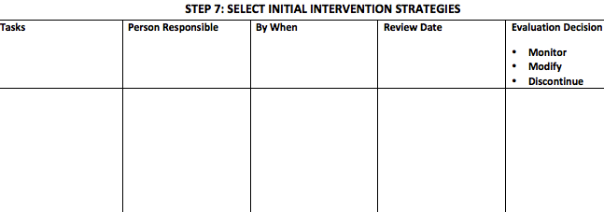
Step 7 in your F-BSP Protocol
Notes:
15 minutes

Slide 58
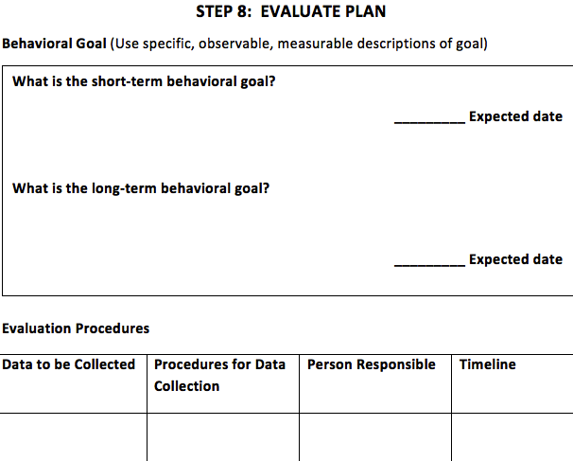
Step 8 in your F-BSP Protocol

Slide 59
Evaluation Planning
The team leader will ensure that the BSP includes an evaluation plan with:
  A short-term goal that is reasonable based on current performance
  A long-term goal focused on increasing desired behavior
  Specific activities/procedures that will be used to evaluate progress
  A specified date when the team will next meet to review progress

Slide 60
Use Competing Behavior Pathway to Identify Goals
Long-term goal
Desired Behavior
Typical Consequence
Routine:
Setting Event
Antecedent
Problem Behavior
Maintaining Consequence
Alternate Behavior
Short-term goal
Notes:
60

Slide 61
Evaluation Planning: How Will We Measure Progress??
EVALUATION PLAN
Behavioral Goal (Use specific, observable, measurable descriptions of goal)
The team identifies:
Short-term goal
Long-term goal
Specific evaluation procedures
Date to meet and evaluate the effectiveness of the plan
What is the short-term behavioral goal?
_________ Expected date
What is the long-term behavioral goal?
_________ Expected date
Evaluation Procedures
Data to be Collected | Procedures for Data Collection | Person Responsible | Timeline
Is Plan Being Implemented?
Is Plan Making a Difference?
Plan date for review meeting (suggested within 2 weeks) ________________

Slide 62
Evaluation Planning: Short- and Long-term Goals
Short-term goal
  Focus on increasing student’s use of the identified Alternative behavior & reductions in problem behavior
    Use baseline data to develop a REASONABLE initial goal that student will be able to achieve
    Short term goal will CONTINUOUSLY be revised as student moves closer to achieving the long-term goal
Long-term goal
  Focus on desired behavior & sustained reductions in problem behavior
    Begin by reinforcing approximations of desired behavior
Notes:
62

Slide 63
Developing Goals
Both short and long-term goals should:
  A. Be written in observable, measureable terms
    What specific behaviors will you increase/decrease?
      Increase use of Alternative Behavior
      Reduce Problem Behavior
      Increase APPROXIMATIONS of the desired behavior
  B. Include specific mastery criteria
    How will you know when the student has met the goal?

Slide 64
Sample Short-Term Goal for Dexter
Increase use of Alternative Behavior
Decrease Problem Behavior
Increase Approximations of Desired Behavior
Mastery Criteria
64
Short-term: Dexter will:
a) appropriately ask to work with a peer (or work independently) in Writing,
b) stay on task without leaving his seat or talking to peers about unrelated topics for at least 75% of independent work time, and
c) complete at least 25% of his daily writing assignments
for 4 out of 5 days across 2 consecutive weeks.

Slide 65
Example Goals for Leroy
During Writing class, Leroy is currently engaging in problem behavior (throwing materials and cursing) to escape difficult tasks in Math approximately 4 days per week. On average, he is completing only 25-30% of his work in class.
Behavioral Goals ( Always include mastery criteria )
What is the short-term behavioral goal?
During Writing, Leroy will ask appropriately for an easier task or for a “break” from difficult tasks without throwing materials or cursing at least 75% of the time as measured by a daily point card for 2 consecutive weeks.
What is the long-term behavioral goal?
Leroy will complete at least 80% of his assigned work in his math class with no more than 3 incidences of problem behavior (throwing materials, cursing) for 3 consecutive weeks.
__5/1____ Expected date
Short-term goal
Increase Alt. Behavior & Reduce Problem Behavior
+ Approximation toward Desired Behavior
Long-term goal
Increase Desired Behavior & Reduce Problem Behavior

Slide 66
Intermediate Goals: Approximations
Leroy’s Short-Term Goal
Leroy will ask appropriately for an easier task or for a “break” from difficult tasks without throwing materials or cursing at least 75% of the time as measured by a daily point card for 2 consecutive weeks.
Leroy will ask appropriately for an easier task or for a “break” no more than 3 times during Math block with no more than 2 problem behavior incidents for 4 consecutive days .
Leroy will ask appropriately to cross off up to 60% of difficult math problems and will have no more than 3 problem behavior incidents for 2 consecutive weeks.
Leroy’s Long-Term Goal
Leroy will complete at least 80% of his assigned work in his math class with no more than 3 incidences of problem behavior (throwing materials, cursing) for one month.

Slide 67
Evaluation Planning: How Will We MEASURE Progress?
In addition to long- and short-term goals, the evaluation plan includes the specific data that will be collected to assess:
Is the plan being implemented as designed (with fidelity)?
Is the plan making an impact on student behavior?

Slide 68
Fidelity Measures
Considerations:
1. Is the plan being implemented?
    Did I implement the plan? vs. Did I check in with student and provide specific praise when she entered class?
2. How to measure fidelity?
    Example: Staff will strive for 80% fidelity of implementation as measured weekly on a scale of 1-5

Slide 69
Example: Sheldon
Desired Behavior
Sitting appropriately and responding with group during circle time
Consequence
Feeling of success, adult praise for appropriate behavior
Routine: Circle Time on Carpet
Setting Event
None Identified
Antecedent
Teacher teaching to whole class or praising another student
Problem Behavior
Making noises with mouth or hands, leaning on or grabbing others or materials, out of seat
Consequence/Function
Teacher reprimands, teacher takes to time-out
Access Teacher / Adult Attention
Alternative Behav.
Raise hand for adult attention or to answer a question
Setting Events | Manipulate Antecedent | Teach Behavior | Alter Consequences
Eliminate/Neutralize Setting Events N/A | Eliminate/Modify Antecedents - Sheldon will sit in front of teacher / tape outline on carpet marking his spot Weighted vest Frequent adult attention/ stickers for appropriate behavior (at least 1 x per min) Prompt Alt/Des Behavior - Pre-teach on the way to circle time (model raising hand, “safe body”) | Teach Replacement Behavior Teach Sheldon to raise hand for attention Teach what it means to have a “listening ears” Teach Desired Behavior/Skills Teach appropriate sitting on carpet (use examples/non-examples; teach outside of circle time routine) | Rewards Sheldon will earn stickers and teacher praise for sitting appropriately (5 stickers will = teacher recognition in front of class) Teacher will quickly respond to and praise hand raising Response to Problem At first sign of problem behavior, remind Sheldon to raise his hand using visual cue only (minimize adult attention to problem behavior) Time out (no longer than 3 min), praise and bring back after several seconds of approp behv

Slide 70
Is the Plan Making a Difference?
FAQ: I see the student every day, why do I need to collect data?
Answer: Data help us to
    Document what has occurred and the variables responsible
    Predict future performance
    Be accountable for our own behavior
    Determine when program modifications are needed

Slide 71
Measures for Tracking Student Behavior
Considerations:
  Does the measure capture the specific tasks/target behaviors of interest?
    Was it a “good” or “bad” day? vs. How many talk-outs occurred during Spanish class today?
  Is the measure sensitive enough to show change?
    Metric examples: duration, frequency, intensity, points earned, correct words per minute, steps completed in task analysis

Slide 72
Consider SWIS - ISIS
ISIS-SWIS is an application within the SWIS Suite designed to coordinate and monitor individualized student support.
ISIS-SWIS allows teams to:
Set up, collect, and monitor a student’s outcome data on
individualized goals based on team agreements.
Set up, collect, and monitor fidelity data about the
implementation of the support plan.
Upload and store critical student plan documents needed
for planning and decision making.
Summarize outcome and fidelity data for problem solving and
decision making.

Slide 73
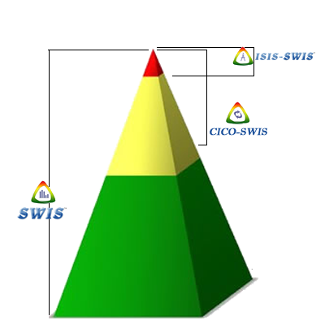
Where does ISIS-SWIS fit?
ISIS-SWIS is a decision system for students requiring more intensive and individualized supports for academic social or mental health services.
CICO-SWIS is a decision system for targeted or group-based interventions for students needing additional support beyond the Universal or Tier 1 system.
The School-Wide Information System (SWIS) is a web-based decision system designed to help school personnel to use office referral data to monitor progress of school-wide and individual student interventions.
Notes:
ISIS-SWIS is the third application in the SWIS Suite. Each of the three SWIS applications (SWIS; CICO-SWIS and ISIS-SWIS) is designed to assist school personnel to make effective and efficient decisions, and together the three applications follow the multi-tiered prevention model advocated within PBIS and RtI efforts.
Tier 1: The School-Wide Information System (SWIS) is a web-based decision system designed to help school personnel to use office referral data to monitor progress of school-wide and individual student interventions.
Tier 2: CICO-SWIS is a decision system for targeted or group-based interventions for students needing additional support beyond the Universal or Tier 1 system.
Tier III: ISIS-SWIS is a decision system for students requiring more intensive and individualized supports in academics, social or mental health services.
* Note that this approach assumes that support at one level builds upon additional tiers of support. Students needing Tier III support are receiving all 3 tiers (not just individualized).

Slide 74
SWIS ISIS Demo
www.pbisapps.org

Slide 75
Activity 8
Select your Initial Intervention Strategies:
  Define tasks and who’s going to do them by when.
Develop your Evaluation Plan:
  Create Goal Statements
  Develop Evaluation Procedures and data sheets

Slide 76
Next Steps: Student
You may need to collect more data:
  Teacher/Parent/Student Interviews
  More Behavior Observations
  File Review
  Office Discipline Referrals
  Grades
  Test Scores
Read and use Sheldon Loman’s Module 7
Schedule additional meetings back at your school
Notes:
What if the behavior intervention plan did not work?

Slide 77
Next Steps: Continued PD
Think about coaching needs back at school
Arrange for at least one on-site coaching visit with one of us and your team at school during an actual FBA/BSP
Building Better Behavior Support Plans – April 7, 2015 at the Commodore Inn in Stowe

Slide 78
Questions?
THANK YOU!
www.pbisvermont.org

