Slide 1
VTPBiS Coordinators as Coaches Learning and Networking Workshop
Presented by
VTPBiS State Team
Notes:
Describe transition from Region Mtgs to Coordinators as Coaches

Slide 2
Acknowledgements
National PBIS TA Center
George Sugai
Rob Horner
Susan Barrett
Northeast PBIS Network
Brandi Simonson
Jen Freeman
Other PBIS Super Stars
Terry Scott
Kent McIntosh
VTPBiS
Julie Erdeyli
Rebecca Lallier
Ken Kramberg

Slide 3
Agenda
Why Coordinators as Coaches?
What you told us!
Topic: Social/Emotional/Behavioral Learning Across the Tiers
Annual Report Review and SY 16 Goals
Fidelity & Impact
VTPBiS Updates
What else?

Slide 4
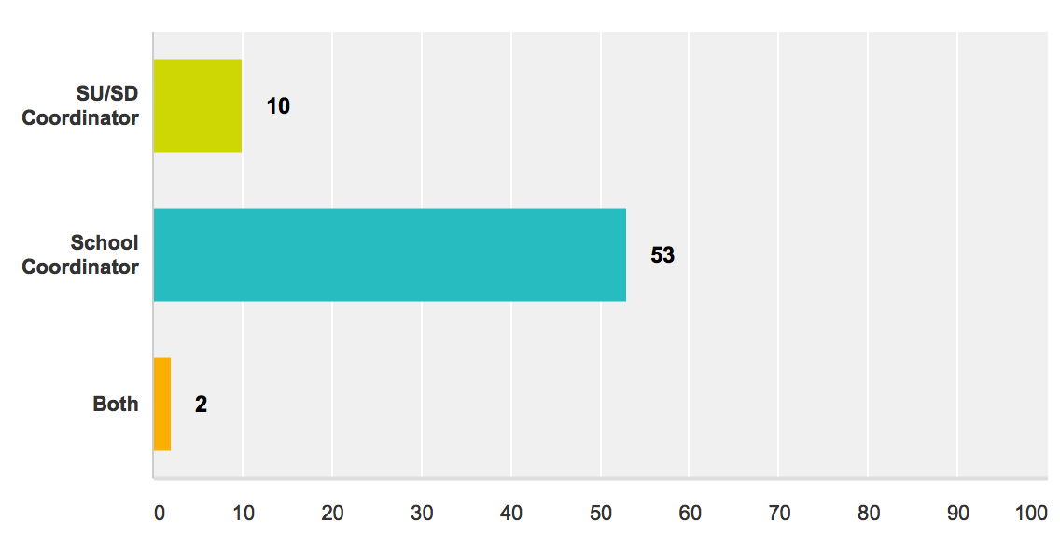
Who’s Here and Introductions!
Notes:
If large group, have the attendees introduce themselves to their table mates. If small group, they may be able to quickly introduce themselves to the large group.

Slide 5
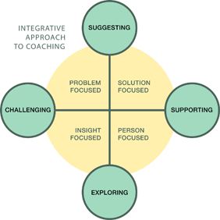
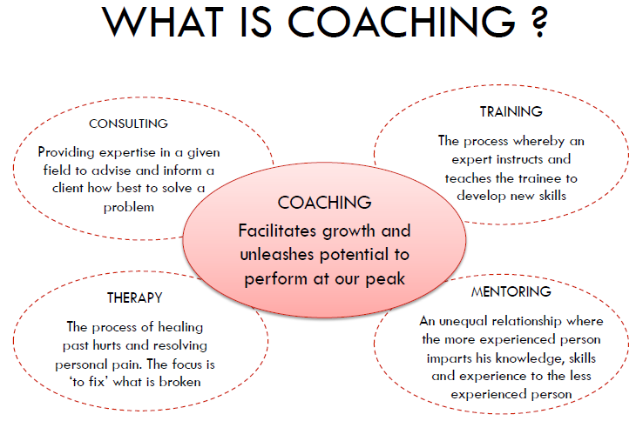
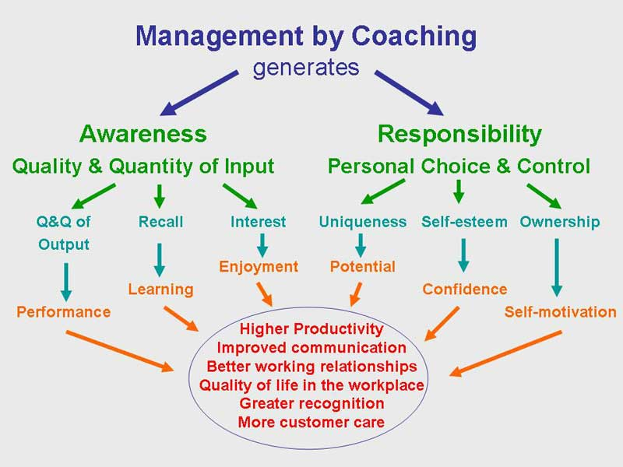
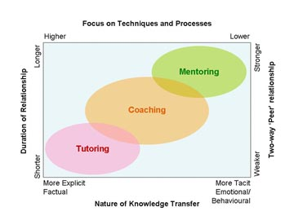
Why Coordinators as Coaches?
Notes:
Coaching is key to sustainability and coaching at the building level helps to build internal capacity. Many of the functions you are currently doing are “coaching” activities.
Ask if folks attended coaching at Leadership Forum
Role similar to Literacy Coach or Math Coach – depends on SU/SD/School Structure

Slide 6
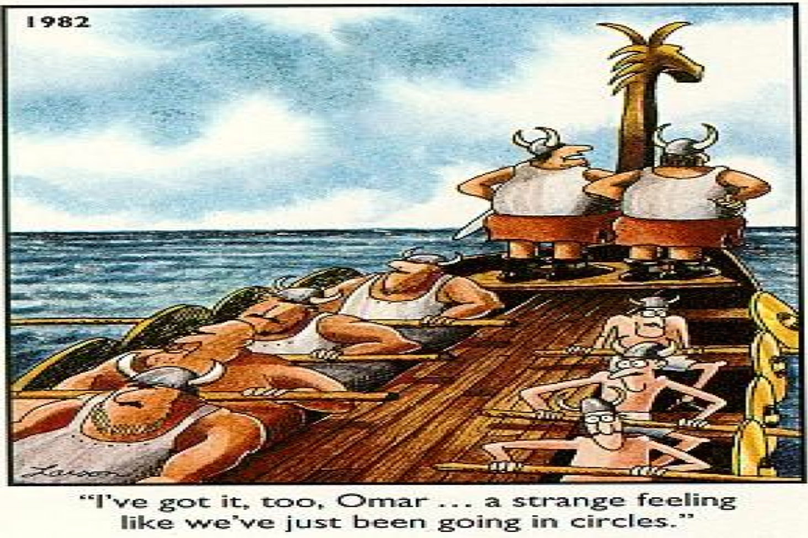
Why Coaching is Important?
Notes:
Pre-correction, provide resources……Next few slides discuss this further. We want to avoid doing the same thing over and over again and getting the same results.

Slide 7
Why is Coaching Important?
Why is Coaching Important?
Training Outcomes Related to Training Components
 | Training Outcomes
Training Components | Knowledge of Content | Skill Implementation | Classroom Application
Presentation/ Lecture
Plus Demonstration
Plus Practice
Plus Coaching/ Admin Support Data Feedback
10% 5% 0%
30% 20% 0%
60% 60% 5%
95% 95% 95%
Joyce & Showers, 2002

Slide 8
What is a Coach?
Notes:
Transition Slide – Many ways and words to describe coaching.

Slide 9
Features of Coaching (see Coordinator Self-Assessment)
Coaching Function
Facilitator
Share Content Knowledge
Communicator
Action Planning
Faculty training
PBIS/MTSS-B
Team meetings
PBIS knowledge
MTSS
Behavioral competence
Link to resources
Data tools
Faculty
Administrator
SU/SD Coordinator
Families and
Community
George & Barrett (2011)
Notes:
As we move into this new intentional use of Coach in your roles, let’s talk about some of the features of coaching.
Coordinators Self-Assessment

Slide 10
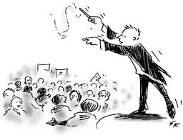
Coach as ‘Facilitator’
Facilitator
George & Barrett (2011)
Notes:
Creates a positive, supportive environment
Creates and helps ensure structure within team meetings
Helps identify team member roles and responsibilities
Ensures team consensus
Guides the development of the Team Action Plan
Facilitates the problem solving process
Guides and ensures implementation fidelity of the PBS/MTSS-B process

Slide 11
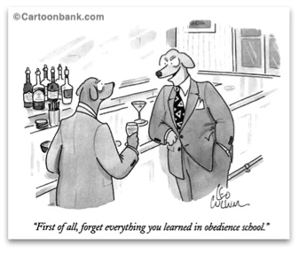
Coach: Content Knowledge
Content Knowledge
George & Barrett (2011)
Notes:
Weakest area of coaching – Other coaching roles in literacy or math have already been established – Our hope is to, with your expertise and knowledge in PBIS, to support you and your own content knowledge so you can best support your school. Is to Increase knowledge of coach at local school building level
Fluent in PBS principles (features, practices, and systems across the tiers)
Knowledgeable of PBIS/MTSS-B principles (i.e. triangle or continuum of supports)
Understands basic behavioral principles
Familiar with the components and operation of a proactive school-wide behavior discipline system
Aware of the application of school-based data management and data-based decision making
Able to evaluate date and make data-based decisions

Slide 12
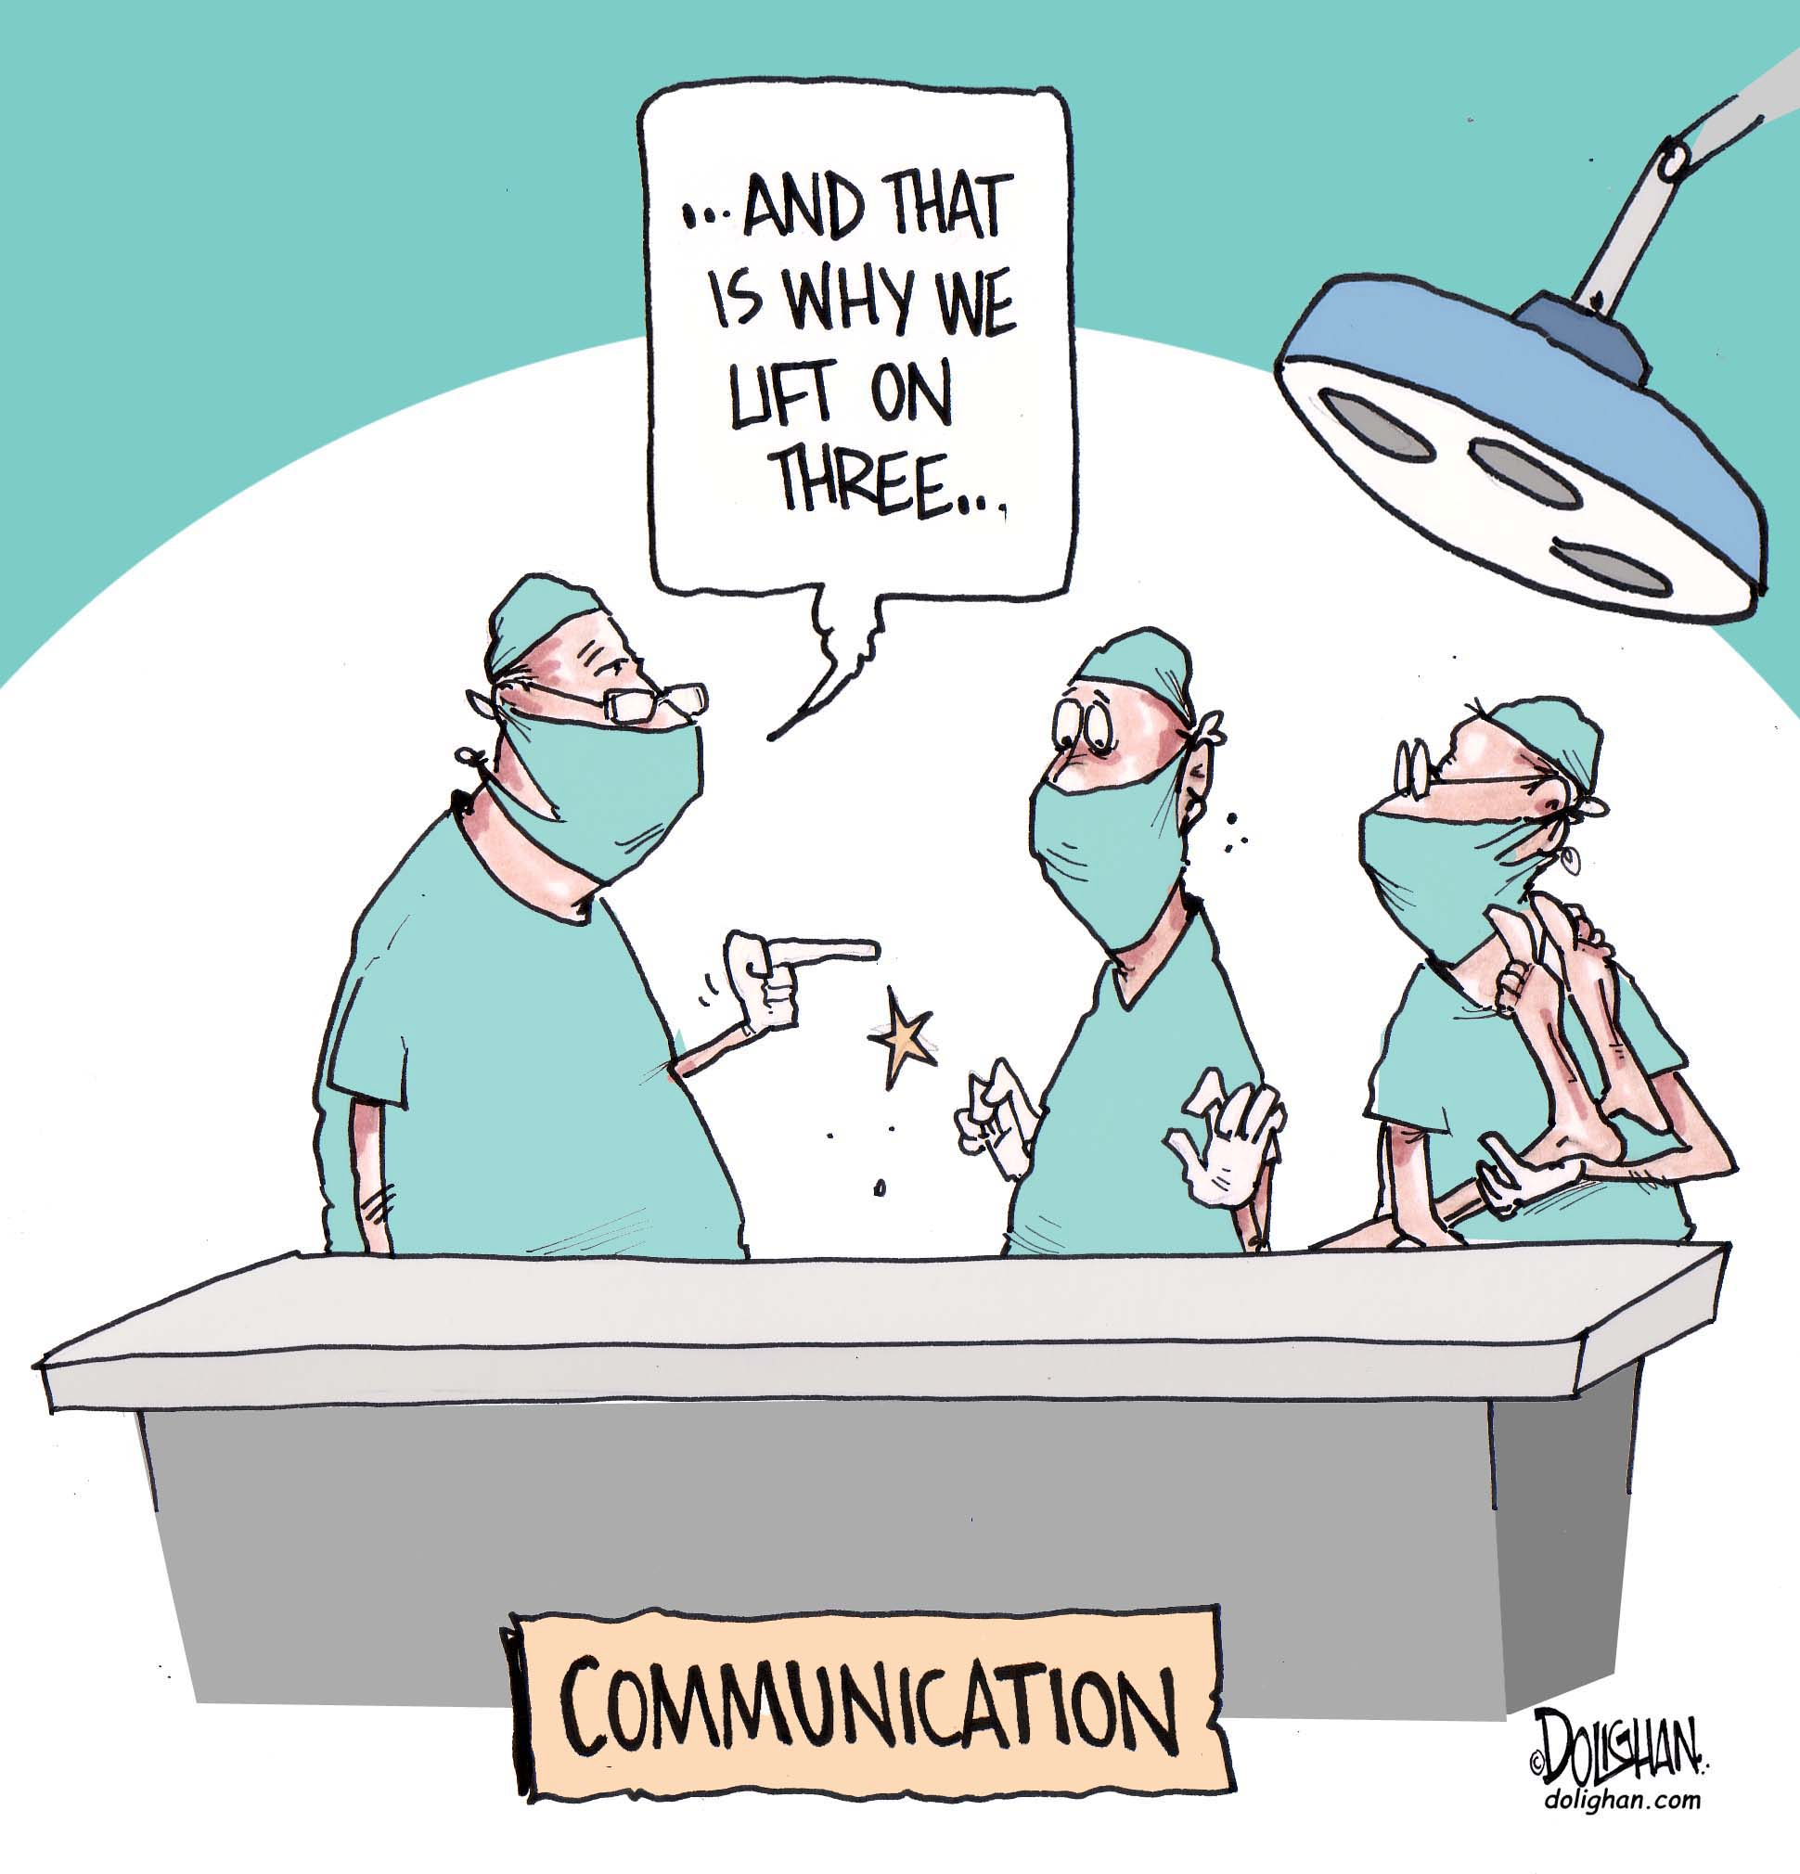
Coach as ‘Communicator’
Communicator
Notes:
Have folks share what they may have experienced since seeing this ppt at the leadership forum

Slide 13
Activity
Review and complete the PBIS Coordinator Self-Assessment or the SU/SD Coordinator Checklist
With a partner identify the coaching activities you currently do.
Identify three goals and discuss strategies for how you can accomplish these goals.
Notes:
20 Minutes – Handout Coordinator Self-Assessment to School Coordinators and the SU/SD Coordinator Checklist to the SU/SD Coordinators.

Slide 14
Coordinator/Coaching Functions at the Different Tiers
Intensive:
Ensure FBA/BSP capacity
Liaison with student teams & systems teams
Targeted:
Meet with student team
Facilitate progress monitoring
Liaison with systems teams
Use CICO data
Universal:
Facilitate monthly meetings
Support implementation
Organize materials
Liaison with SU/SD/State
Complete assessments
Use student outcome data
Notes:
What else?

Slide 15
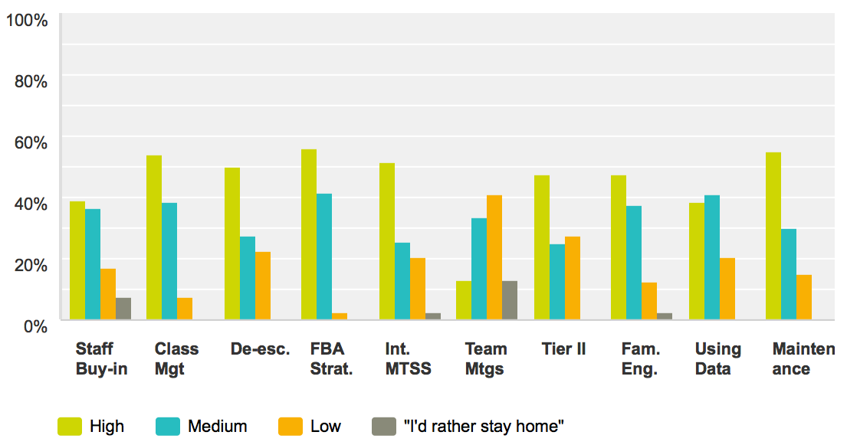
What you told us!
Topics of most interest to you for future trainings:
Notes:
Thank you to those of you who completed the Coordinator Survey.

Slide 16
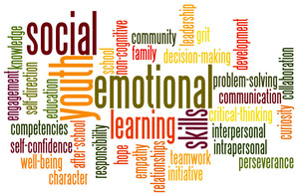
Topic-Based Learning Session
Social/Emotional/Behavioral
Practices in VTPBiS Schools
Notes:
SEBL part of PBIS – dispel myth that it’s two different things

Slide 17
The children of today are too much in love with living. They have terrible manners, mock authority, and have no respect for their elders. . . . I can only fear what kind of awful creatures they will become.
Socrates 369 B.C.
Notes:
It appears that we have not changed—each generation thinks the next is inferior. Introducing Social Skills is important for all children….

Slide 18
Why is Teaching of Social Skills Important?
Research Links SEL to Higher Student Success
23% gain in SE skills
9% gain in attitudes about self/others/school
9% gain in pro-social behavior
11% gain on academic performance via
standardized tests (math and reading)
And Reduced Risks for Failure
9% difference in problem behaviors
10% difference in emotional distress
Source: Durlak, J.A., Weissberg, R.P., Dymnicki, A.B., Taylor, R.D., and Schellinger, K. (2011).
The Impact of Enhancing Students’ Social and Emotional Learning: A Meta-Analysis of School-Based Universal Interventions. Child Development, 82, 405-432.
Notes:
18
Research supports using best practices.

Slide 19
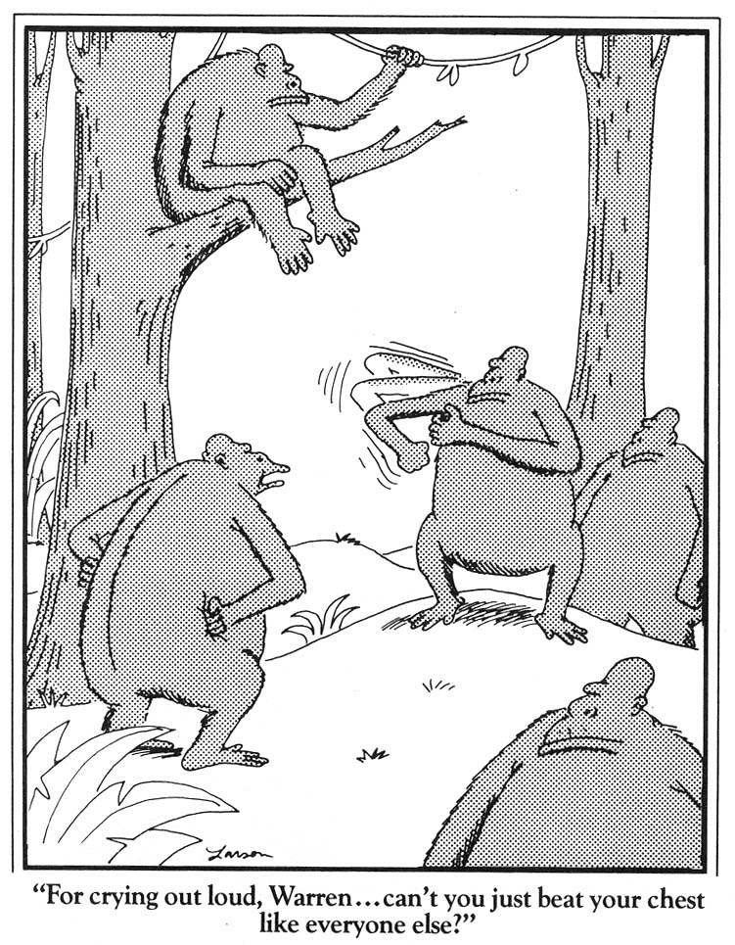

Slide 20
Social skills curriculum must match the specific need
Acquisition Deficits
Absence of knowledge for executing skill or failure to discriminate which social behaviors are appropriate in specific situations (can’t do)
Performance Deficits
Skill is present in repertoire, but student fails to perform at acceptable levels (won’t do)
Fluency Deficits
Lack of exposure to sufficient or skilled models of social behavior, insufficient rehearsal/practice or low rates or inconsistent delivery of reinforcement of skilled performances
Notes:
Can’t Do
Won’t Do
Lack of Practice

Slide 21
Understanding Social, Emotional, Behavioral Learning (SEBL)……
Social skills curriculum must match the specific need.
An ideal curriculum does not exist.
Basic set of “Preferred Teaching Practices” exists.
Initially, learning how to teach social skills takes time and energy.
Notes:
What does social skills mean to you?
Matching Interventions to types of
social skills problems:
Most social skills studies deliver a treatment to children with an almost complete disregard for the types of social skills deficits children may have (Gresham, 1998)

Slide 22
Social Skills Instruction at the Universal Level
Generally taught by classroom teacher
Considered part of the curriculum
Built into the weekly schedule
Often starts with the teaching of school-wide expectations and progresses to issues of concern based on data i.e., bullying, harassment, other risk behaviors
Acknowledgement system should be linked to demonstration of skills covered in social skills instruction

Slide 23
School-wide Promotion of SEBL!
Your role as coach at the:
School-wide Level
Know evidence-based practices
Share resources and information with Teachers
Learn about and promote PD in this area

Slide 24
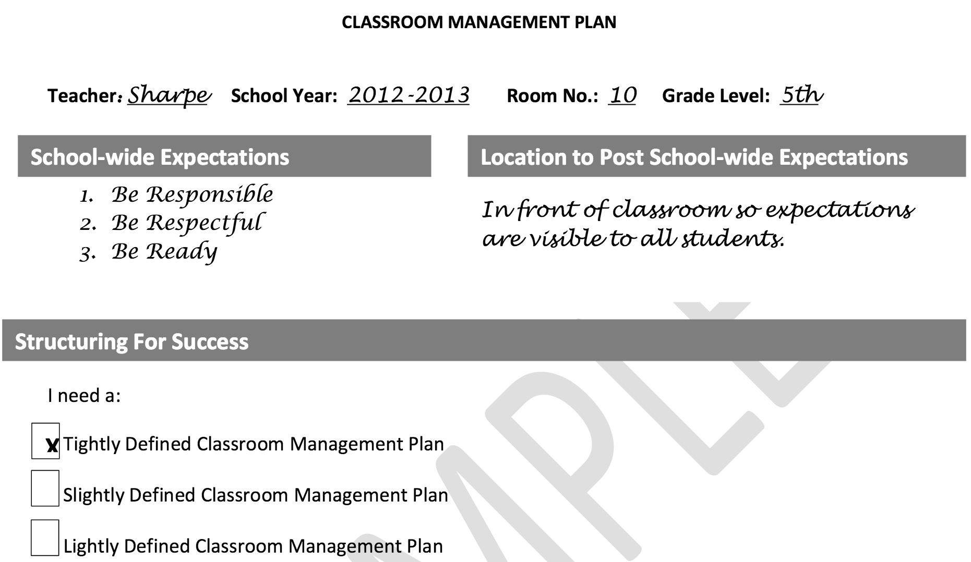
Start with Classroom Management
From MiBliSi: http://miblsi.cenmi.org/LinkClick.aspx?fileticket=GEW-lBx5QYA%3D&tabid=2372
Notes:
Get your house in order……..Important strategy to prevent problem behaviors – create an organized classroom environment. This is a great resource to know about and share with your staff.
Classroom Management Plan (MiBLISI).
Handout Sample Plan and Blank Template

Slide 25
Activity: Getting your Classroom in Order
Please read “What the Research Says” (2 pages).
Review the Classroom Management Plan (4 pages)
As a group, discuss the following:
In your role as coach, how can you provide support to teachers in completing this plan?
How can the Principal help to ensure there is time for this to happen?
Notes:
Handouts

Slide 26
Second Step
SEBL Best Practices Across Tiers
Posters
K & G1 Puppets
Listening Rules and Skills for Learning Cards
Lesson Cards
DVD
Teaching Materials Binder
Online Resources
Unit Cards
Song CD

Slide 27
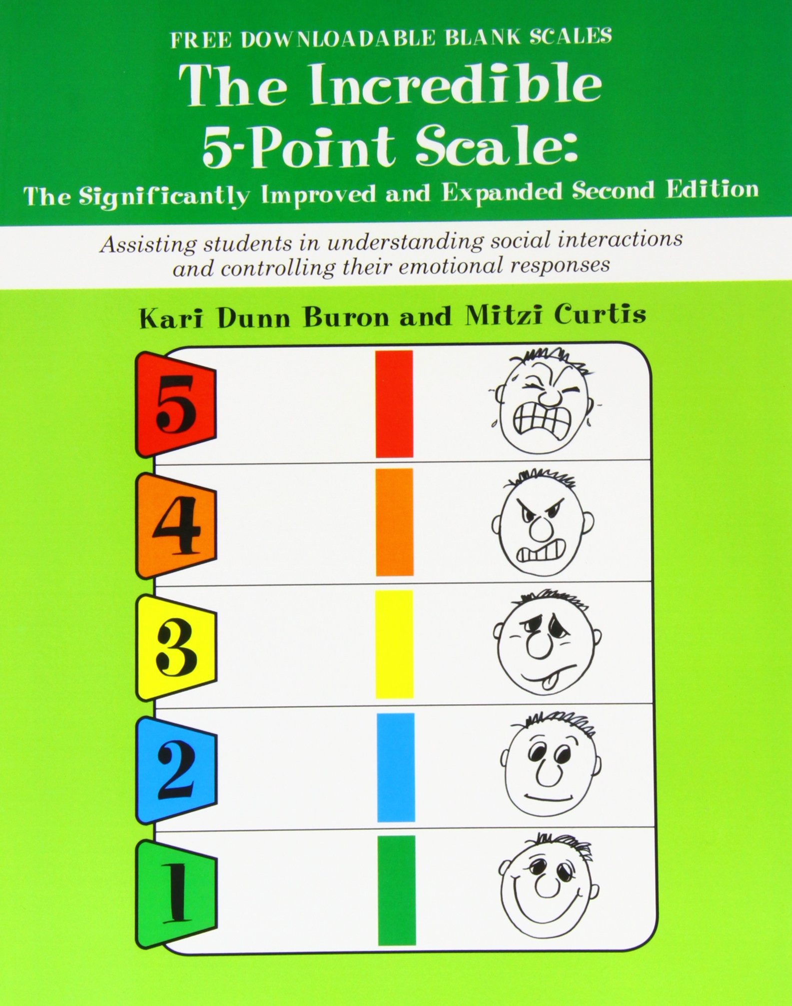
SEBL Best Practices
http://www.5pointscale.com/

Slide 28
SBEL Best Practices
“The Zones is a systematic, cognitive behavior approach used to teach self-regulation by categorizing all the different ways we feel and states of alertness we experience into four concrete zones. The Zones curriculum provides strategies to teach students to become more aware of, and independent in controlling their emotions and impulses, managing their sensory needs, and improving their ability to problem solve conflicts.”
http://www.zonesofregulation.com/

Slide 29
Social Skills Instruction at the Targeted Level
Pre-corrections, prompts and acknowledgments linked to universal social skill instruction with greater frequency
Linked to a school’s check in/check out strategies
Social skills group pre-teach skills introduced in the universal curriculum and provides extra opportunities for practice and feedback
Targeted lessons presented as game-based instruction can ameliorate behavior challenges in the small group

Slide 30
SEBL at the Targeted/Intensive Level!
Your role as coach at the:
Targeted/Intensive Level -
Establish Targeted Team or have Targeted conversations.
Know evidence-based Tier II practices
Share resources and information with Teachers and Tier II Team
Understand FBA/BSP process
Know community resources available and evidence-based Tier III practices

Slide 31
Inventory of Targeted Supports
EXAMPLE

Slide 32
Social Skills Instruction at the Intensive Level
Link with functional assessment and behavior planning
Create individualized plans within the context of the Universal (school-wide) social skills instruction.
Integrate what the student does well
Evidence of generalization should include school, home and community

Slide 33
Activity: What are you using?
As a group:
Discuss what SEBL practices you are using in your school across the tiers.
What are your successes and challenges implementing SEBL?
How do you know your SEBL practices are effective?
Prepare to share your ideas with the large group

Slide 34
Change begins with us!
How we respond can escalate or de-escalate our students….
Rational Detachment
Remain Calm & Respond Right When a Student Challenges – Article
Notes:
Remain Calm & Respond Right When a Student Challenges – Article – Handout
CPI Training
LSCI Training

Slide 35
Honing our own SEBL Skills…
Children Who Are Heard, Listen
Children want to tell their story
Adapted from Ken Kramberg
Notes:
35

Slide 36
Activity: Active Listening
In pairs, follow the instructions on the cards in front of you.
We’ll process as a large group…..
Notes:
Hand out the “Speaker” card to one of the partners and hand the “listener” card to the other partner. Make sure they don’t show each other their specific instructions. Ask them to read their cards and begin the activity. The presenter should read the cards as well so they know when to prompt the activity.

Slide 37
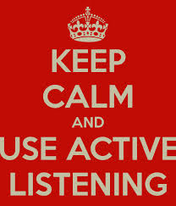
Active Listening
Identifies and validates feelings
^{Reduces defensiveness}
^{Promotes change}
Communicates that we care and understand
Is an effective co-regulation strategy
Helps young people “talk out rather than act out”

Slide 38
Understanding Responses
^{Reflective Responses:}
“You feel uncomfortable when your friends talk about school.”
“You are angry about your visit being cancelled. I’d be upset, too.”
^{Summarization:}
“Here is what I hear you saying, you felt good at first, but now....”

Slide 39
Adults can help children by…
Seeing the incident from the child’s perspective
Helping children see the connection between feelings and behaviors
Encouraging children to be responsible for their actions

Slide 40
The “Script” Activity
In pairs, using the scenarios found at your table, practice using the following script:
Acknowledge the feelings
Affirmation: Make 2-3 affirming statements
Get the child’s perspective and restate
Set limits, giving choices as needed
Adapted from Ken Kramberg
Notes:
Practice with Scenario……Willy or Sarah – One person is the student the other is the teacher/adult. The adult should practice using the script outlined in the slide as the student uses the scenario.

Slide 41
More information on SEBL:
http://www.casel.org/social-and-emotional-learning/outcomes/
http://www.edutopia.org/keys-social-emotional-learning-video
http://www.5pointscale.com/
http://www.zonesofregulation.com/
http://www.cfchildren.org/second-step

Slide 42
VTPBiS Coordinators Meeting
Logistics, Updates, Q & A and Networking

Slide 43
Agenda
Model for Sharing Data: VTPBiS Annual Report
BoQ & SAS
Tiered Fidelity Inventory (TFI)
Ongoing communication?
Wikis
FB
Blogs
Next Meeting: MAY 5th – Best Western
VTPBiS & Suspension/Expulsion Questionnaire

Slide 44
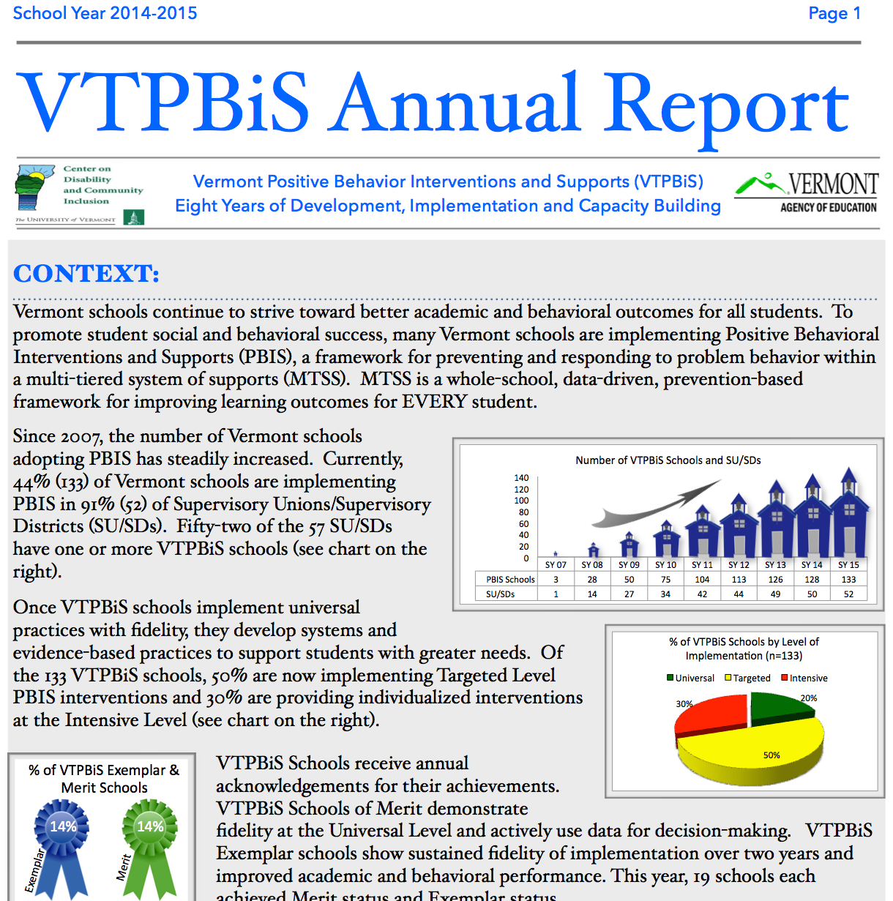
VTPBiS Annual Report Review

Slide 45
How are we doing as a state?
Notes:
Hot off the press VTPBiS Annual Report is on your tables for you to review the details. But here are some highlights.

Slide 46
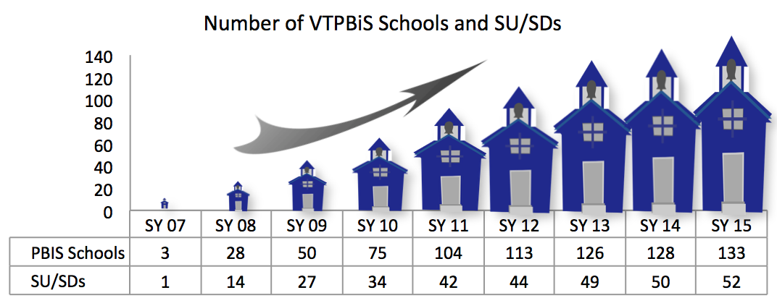
CONTEXT
Notes:
First, we have a lot to celebrate about how fast PBIS has scaled up in VT. From 3 schools in 2007 to 133 in 52 Sus/SDs today! 44% of our schools are implementing. We are one of thirteen states out of 42 states that implement PBIS that have over 40% schools implementing PBIS. As you can see, PBIS is he

Slide 47
CONTEXT
Notes:
This pie chart shows the level of PBIS implementation in VT. You can see that 80% schools have moved on from Tier one and are now implementing Tier 2 and Tier 3 interventions and supports as well as Tier 1.

Slide 48
INPUT

Slide 49
FIDELITY
Notes:
This graph shows fidelity of implementation at the Universal Level based on a national PBIS self-assessment called the Benchmarks of Quality (or BoQ). The BoQ looks at 10 elements of implementation such as discipline procedures, lesson plans, evaluation and data analysis. This graph represents the average scores of 92 schools that completed the BoQ. A score of 70% indicates fidelity of implementation. You can see on this graph that most of the scores are above the 70% which is the dotted line. In 2014-15, 79%of schools that completed this assessment achieved fidelity., VTPBiS schools scored higher than 70% on eight out of ten BoQ elements, with “Faculty Commitment” and “Implementation Plan” falling slightly lower than 70%.

Slide 50
IMPACT
Notes:
So, how are we doing?
Due to the switch from NECAP to Smarter Balanced Assessments, we are unable to show statewide correlations between academic achievement and decreased discipline referrals. However, in looking at office discipline referrals by grade levels, we can see that average office displine referrals per day per hundred students have gone down in middle school, high school, pre-k through 12. With a very slight increase in elementary grades. This is an important indicator for learning because, when a students remain in class, they have greater access to instruction. Our goal is in class and on task.

Slide 51
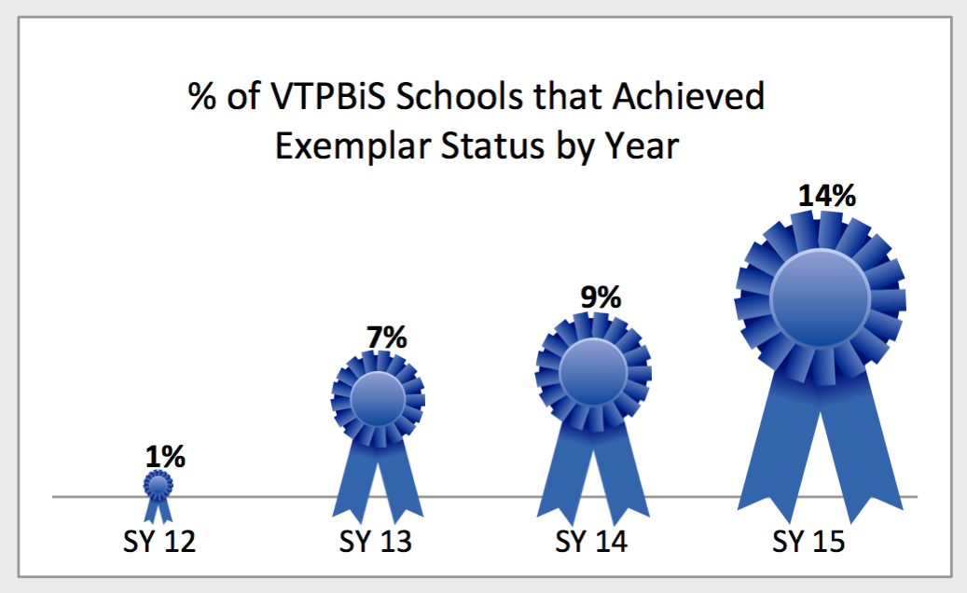
IMPACT
Notes:
This year also saw a significant increase in the number of schools that met VTPBiS exemplar status which means they can show two years of fidelity of implementation as well as a decrease in ODRs and an increase in academic achievement. We’ll hear more about that at the lunchtime celebration!

Slide 52
IMPACT
Notes:
One thing we know from implementation science is that sustaining an innovation like PBIS involves significant attention to the systems data and practices over time. While Dean Fixsen and others have found that sustained implementation of educational initiatives is a rare phenomenon, in the eight years of Vermont PBIS, 97% of our schools are still implementing!

Slide 53
VTPBiS SY ‘16 Goals:
Fidelity:
Increase the number of schools that complete the PBIS fidelity assessments
Maintain a statewide minimum average score of 70% on the Benchmarks of Quality
Use the Benchmarks of Advanced Tiers assessment to identify supports needed at Tier II and Tier III
Impact:
Use the Smarter Balanced Assessment scores to track improved academic achievement in VTPBiS Exemplar schools.
Decrease ODRs, Suspension and Expulsion
Notes:
Big applause to the Coordinators – tie back to the value of their role as coaches

Slide 54
Activity: Planning to Improve PBIS Fidelity and Impact
Use your school’s data to determine whether you need a plan to improve PBIS Fidelity and Impact.
Follow the data-based decision-making process (next 2 slides) in preparation for sharing with your leadership team or entire school staff.
As a small group, talk about any questions you have and brainstorm solutions.
Notes:
Handout Template

Slide 55
VTPBiS Problem Solving Process: Fidelity
Do we have a problem? (No data; BoQ scores below 70%; Some features are low)
What is the precise nature of our problem? (Which features are low?)
Why does the problem exist, & what can we do about it?
What are the actual elements of our plan? (Action Plan)
Is our plan being implemented, & is it working? (how will you evaluate & revise plan)

Slide 56
VTPBiS Problem Solving Process: Impact
Do we have a problem? (identify – ODRs and OSS Data overtime)
What is the precise nature of our problem? (SWIS: ODRs big 7 and custom graphs)
Why does the problem exist, & what can we do about it? (hypothesis and solution)
What are the actual elements of our plan? (Action Plan)
Is our plan being implemented, & is it working? (how will you evaluate & revise plan)

Slide 57
VTPBiS Problem Solving Process: Fidelity
Question: | Fill in the information below:
Do we have a problem? (No data; BoQ scores below 70%; Some features are low)
What is the precise nature of our problem? (Which features are low?)
Why does the problem exist, & what can we do about it?
What are the actual elements of our plan? (Action Plan)
Is our plan being implemented, & is it working? (how will you evaluate & revise plan)

Slide 58
VTPBiS Problem Solving Process: Impact
Question: | Fill in the information below:
Do we have a problem? (identify – ODRs and OSS Data overtime)
What is the precise nature of our problem? (SWIS: ODRs big 7 and custom graphs)
Why does the problem exist, & what can we do about it?
What are the actual elements of our plan? (Action Plan)
Is our plan being implemented, & is it working? (how will you evaluate & revise plan)

Slide 59
SAS and BoQ Reminder!
The SAS Window is currently open! It closes on February 28th!
The BoQ Window is currently open! It closes on close on March 31st!
Notes:
SAS REMINDER: The window to complete the SAS is now open and will close on March 31, 2016. It is an expectation that all PBIS schools participate in this important annual assessment. If you haven’t already done so, please schedule at time for your staff to complete this survey. The SAS is a great tool for identifying staff priorities and evaluating staff buy-in!
BoQ REMINDER: On April 1st the window to complete your annual Benchmarks of Quality (BoQ) assessment will open for two months. The window will close on May 31st. It is an expectation that school leadership teams complete this assessment. The BoQ helps schools identify areas of success and areas of improvement for the implementation of the Universal components of PBIS. The features include: PBIS Team, Faculty Commitment, Discipline Procedures, Data Entry & Analysis, Expectation, Recognition, Teaching, Implementation Plan, Classroom Systems and Evaluation.

Slide 60
How to Access & Complete Annual Assessments www.pbisapps.org

Slide 61
To Take the BoQ…

Slide 62
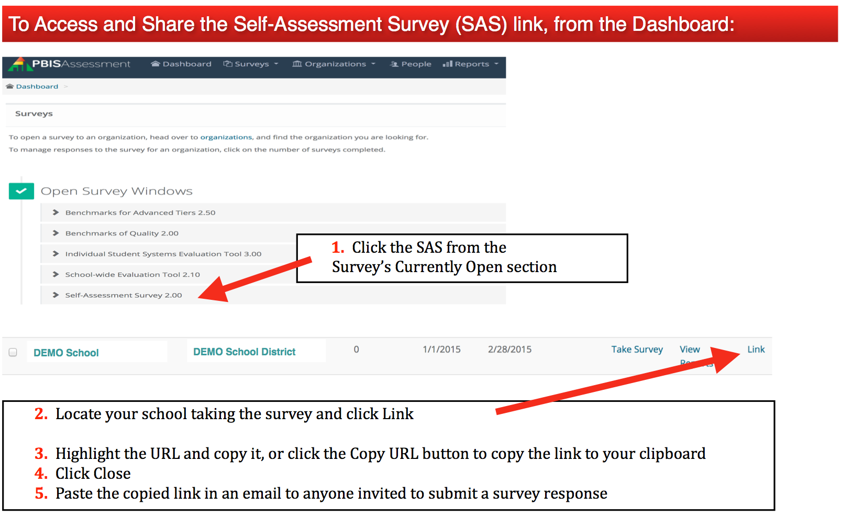
To Take the SAS…

Slide 63
VTPBiS Updates
Tiered Fidelity Inventory (TFI)
Ongoing Communication?
Wikis
Facebook
Blogs
Coordinators Handbook
Next Meeting: MAY 5th – Best Western – NORTH
MAY 6th – Franklin Center - SOUTH
VTPBiS & Suspension/Expulsion Questionnaire
Interested in Presenting at future trainings
Notes:
TFI – We’re currently piloting this “all in one” assessment. Plan to roll-out next year and will take the place of the BoQ.
Ongoing Communication – how can we connect more frequently as a learning community? What are your thoughts? Stay tuned for a survey eliciting ideas…..
Handbook is on our webstie for Coordinators to print. Pass around a couple of copies to show attendees what’s in it.

Slide 64
Networking and Q & A

Slide 65
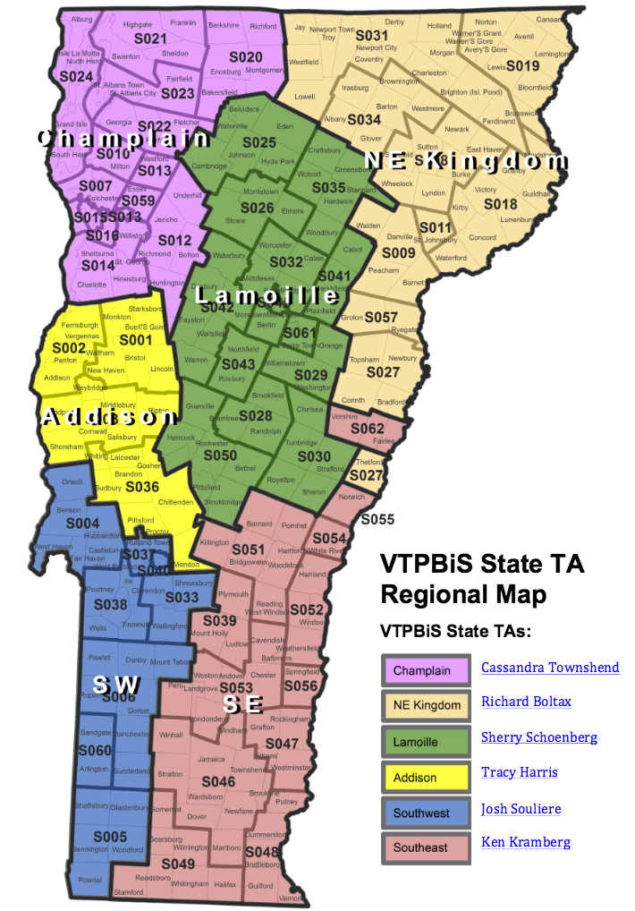
Additional Questions? Contact your State Technical Assistance Provider
www.pbisvermont.org

