Slide 1
VTPBiS Coordinators as Coaches Learning and Networking Meeting
May, 2016
Notes:
Describe transition from Region Mtgs to Coordinators as Coaches

Slide 2
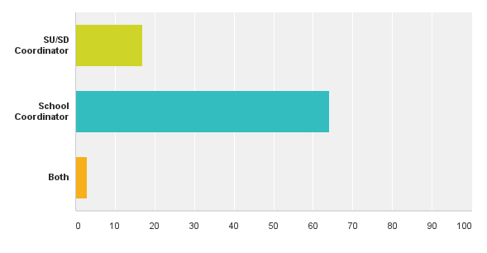
Who’s Here and Introductions!
17
64
3
Notes:
If large group, have the attendees introduce themselves to their table mates. If small group, they may be able to quickly introduce themselves to the large group.

Slide 3
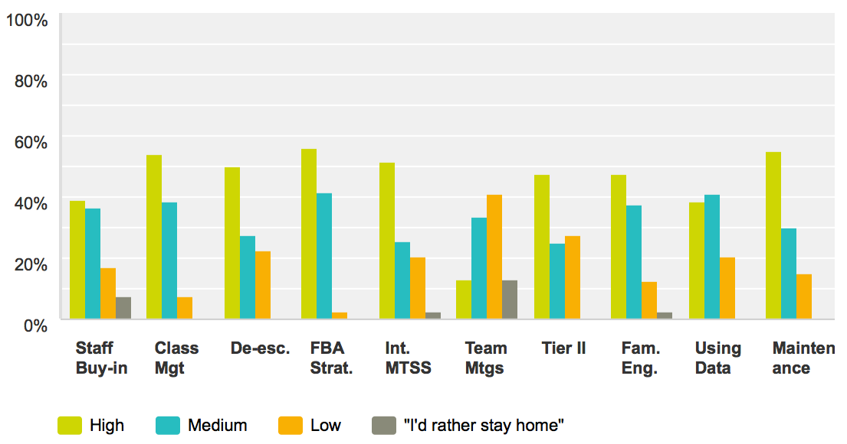
What you told us!
Topics of most interest to you for future trainings:
Notes:
Thank you to those of you who completed the Coordinator Survey.

Slide 4
Agenda
Celebrate VTPBiS Assessments!!!!
Statewide BoQ and SAS Results are IN!!
Plan for Presenting your Own Data
What’s New?
Hear About the Latest and Greatest
Explore Exciting New Resources
Get Ready for Next Year!
Small Group Networking Sessions:
Select topics of interest and gather in small groups
Other Agenda Items?

Slide 5
How are we doing as a state? BoQ and SAS Results!
Notes:
Hot off the press VTPBiS Annual Report is on your tables for you to review the details. But here are some highlights.

Slide 6
BoQ and SAS Completion Rates!
SAS
BoQ
85%
86%
Notes:
Data updated on 4-27-16

Slide 7
Fidelity of Implementation - BOQ
Notes:
This graph shows fidelity of implementation at the Universal Level based on a national PBIS self-assessment called the Benchmarks of Quality (or BoQ). The BoQ looks at 10 elements of implementation such as discipline procedures, lesson plans, evaluation and data analysis. This graph represents the average scores of 92 schools that completed the BoQ. A score of 70% indicates fidelity of implementation. You can see on this graph that most of the scores are above the 70% which is the dotted line. In 2014-15, 79%of schools that completed this assessment achieved fidelity., VTPBiS schools scored higher than 70% on eight out of ten BoQ elements, with “Faculty Commitment” and “Implementation Plan” falling slightly lower than 70%.

Slide 8
Fidelity of Implementation - SAS

Slide 9
Process for Analyzing Data and Sharing Data with Staff…
Recommended Steps:
Review BoQ and SAS Data with PBIS Team
Use the BoQ Summary Sheet to identify the following:
Areas of Strength
Areas in Need of Improvement
Action Items
Use the SAS Summary Sheet to identify the following:
Areas of Strength
Areas of priority for improvement
Create Staff Presentation using the template provided and share data with your staff!

Slide 10
Why share data?
Sharing SAS results shows that you honor staff input and changes will be made as a result
Assessment summaries highlight strengths and weaknesses so you can celebrate what's working and make changes when needed
Results can be shared with board, community, families and students. Great PR/Visibility!
Data is used for statewide reports that can be tied to future resources

Slide 11
1. Review BoQ and SAS Data with PBIS

Slide 12
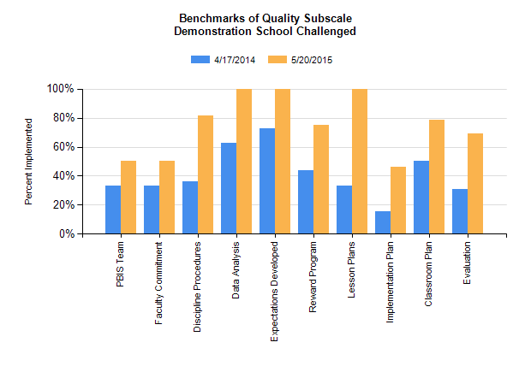
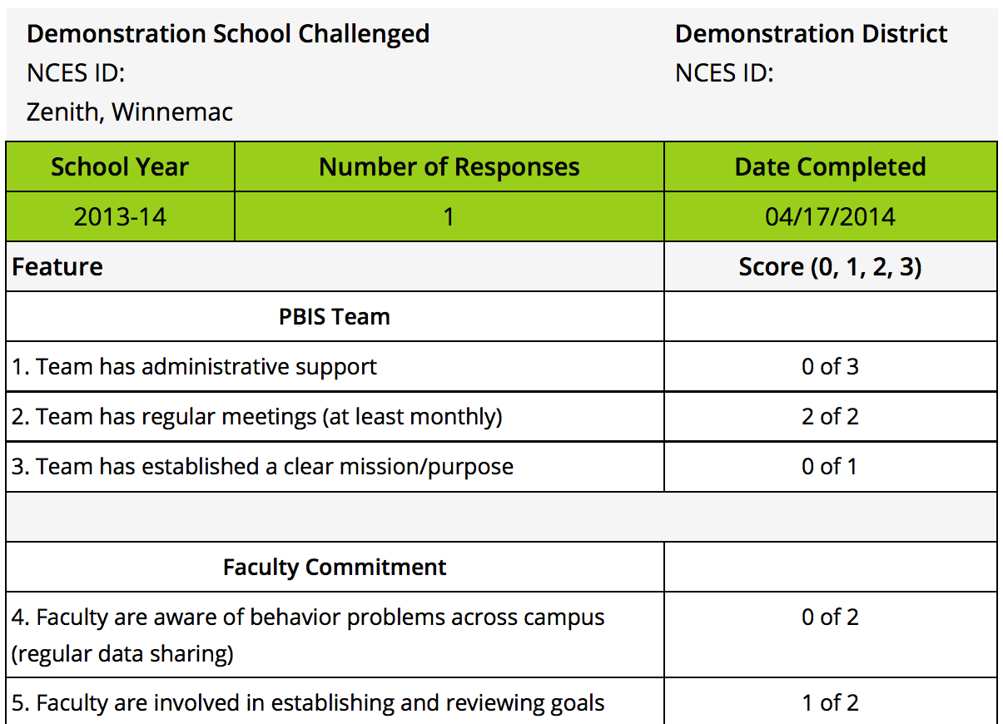
BoQ Data
Total Score
Subscale
Items

Slide 13
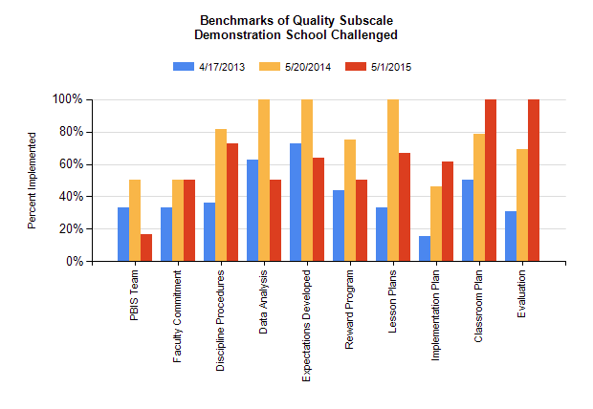
BoQ Data Over time
Subscale – Multi-year

Slide 14
BoQ Summary Sheet
Strengths HERE
Areas in Need of
Development HERE
Actions Items HERE
Notes:
This is the Team Summary page of the BoQ. This is where you choose the top areas of strength and top areas in need of development. The team may have more than space allows, just use your best judgment in selecting which items to include. Also, the excel spreadsheet should expand giving you more space if needed.

Slide 15
Areas in Need of Development
PBIS Team
Data Analysis
Reward Program

Slide 16
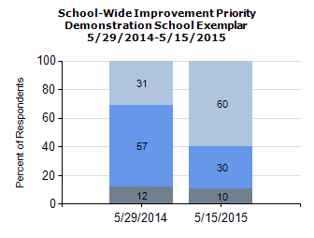
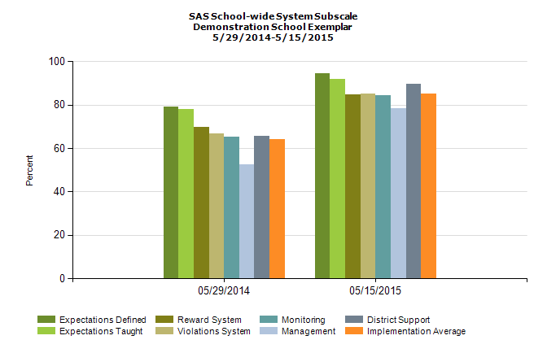
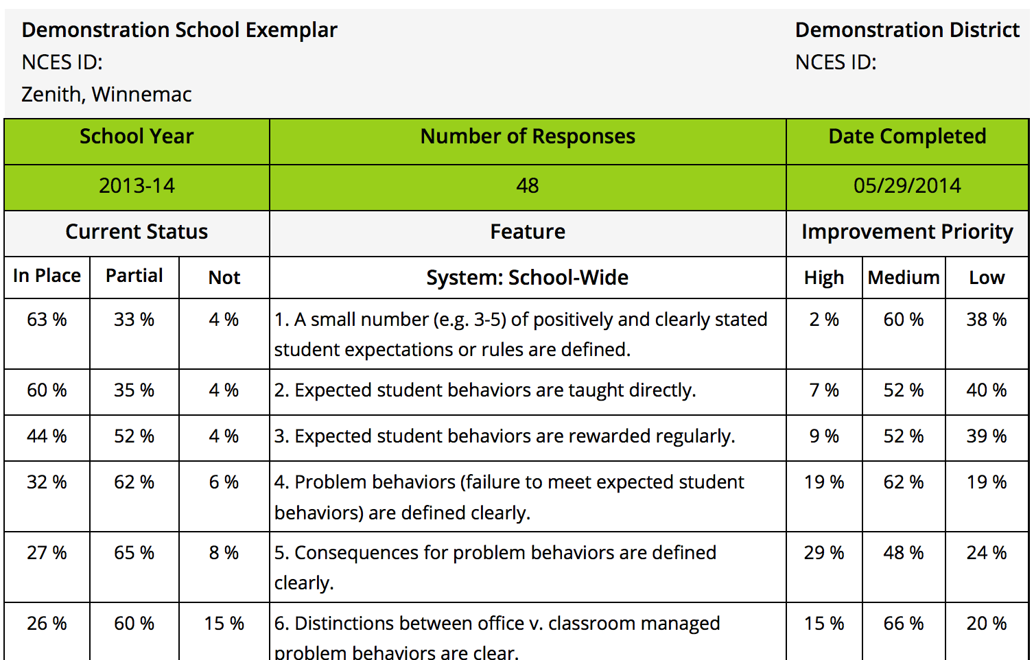
SAS Data
Total Score
Subscale
Items

Slide 17
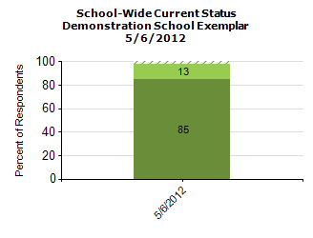
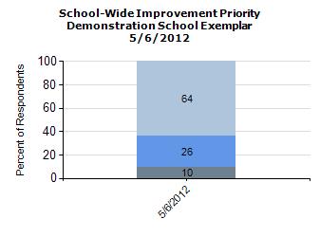
SAS Data
Total Score

Slide 18
SAS Data
Item

Slide 19
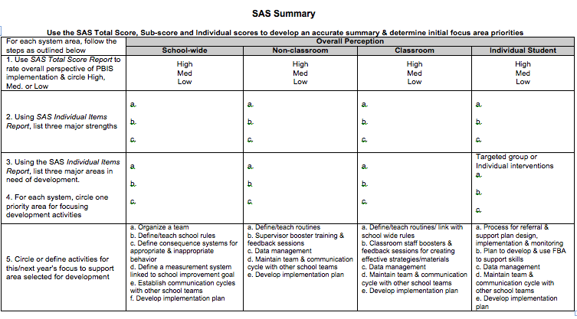
SAS Summary Tool
Strengths HERE
Expectations in Place
Areas in Need of
Development HERE
Expectations are taught
Clearly Defined Behaviors
Classroom Managed vs. Admin.
Actions Items HERE

Slide 20
Areas in Need of Development
Clearly Defined Behaviors
Classroom Managed vs. Admin.
Clearly Defined Behaviors
Classroom Managed vs. Admin.

Slide 21
SAS Data Over Time
SAS Data
Subscale – Multi-year

Slide 22
2. Sharing data with your staff!
EXAMPLE: SAS & BoQ Presentation to Staff

Slide 23
PBIS Data Update!
THANK YOU ALL!
85% (48) of Staff Members Completed
the Self-Assessment Survey!

Slide 24
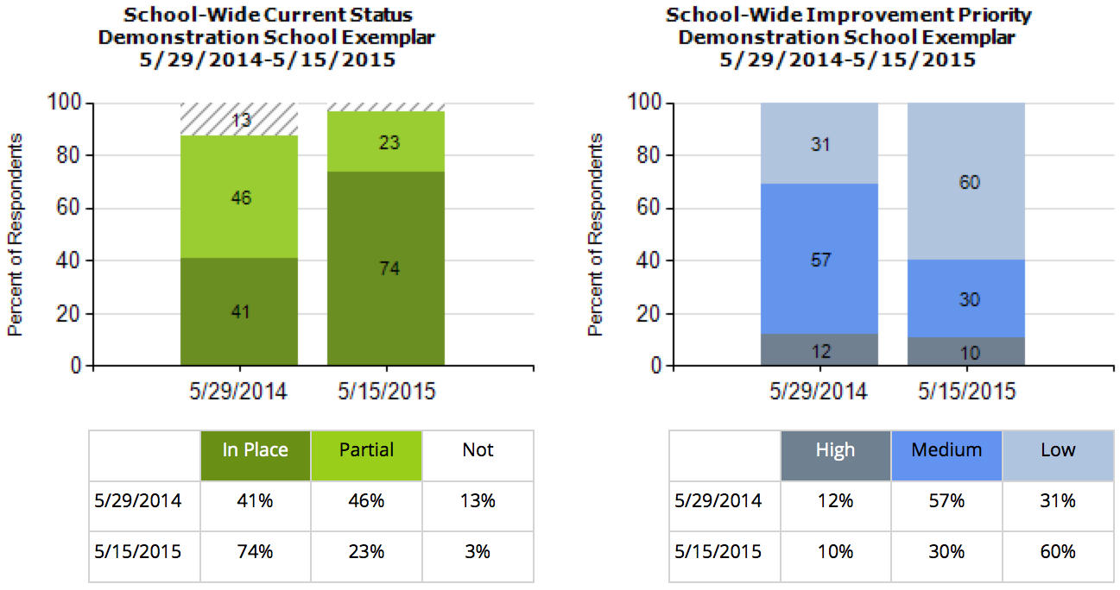
This year 85% of our staff completed the SAS. 74% indicated that they think school-wide system is in place compared to 41% last year. 40% of staff still say this is a medium or high priority for improvement.

Slide 25
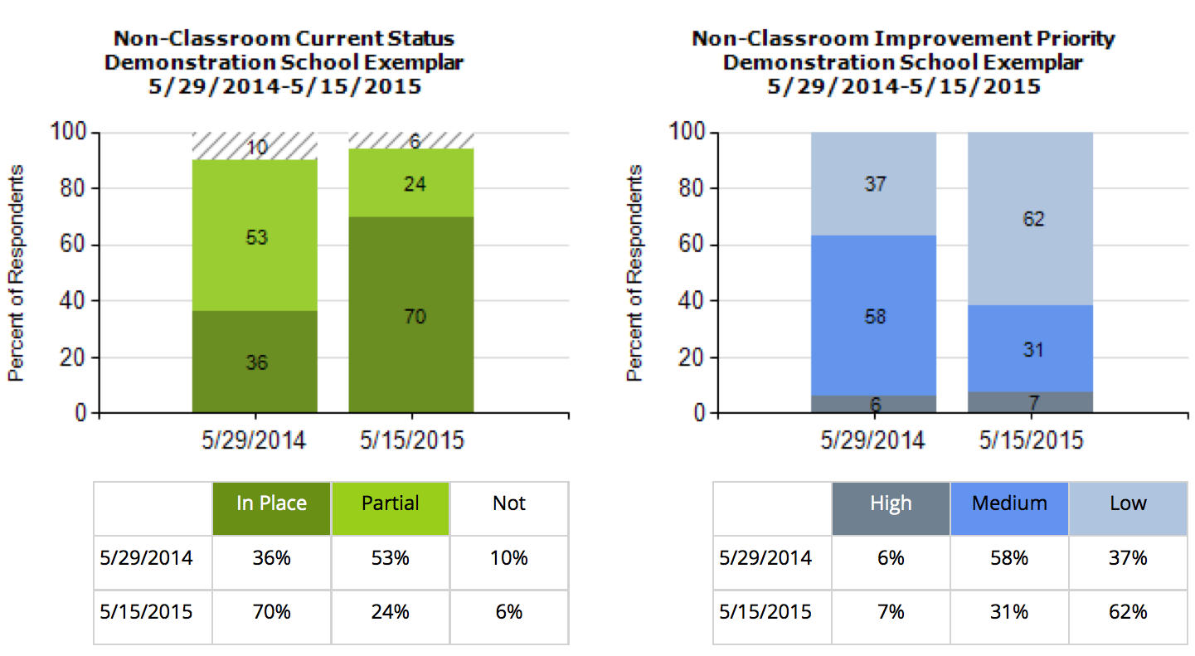
70% of staff think that non-classroom settings are in place, an increase of 34% since last year. Only 7% say this is still a high priority for improvement.

Slide 26
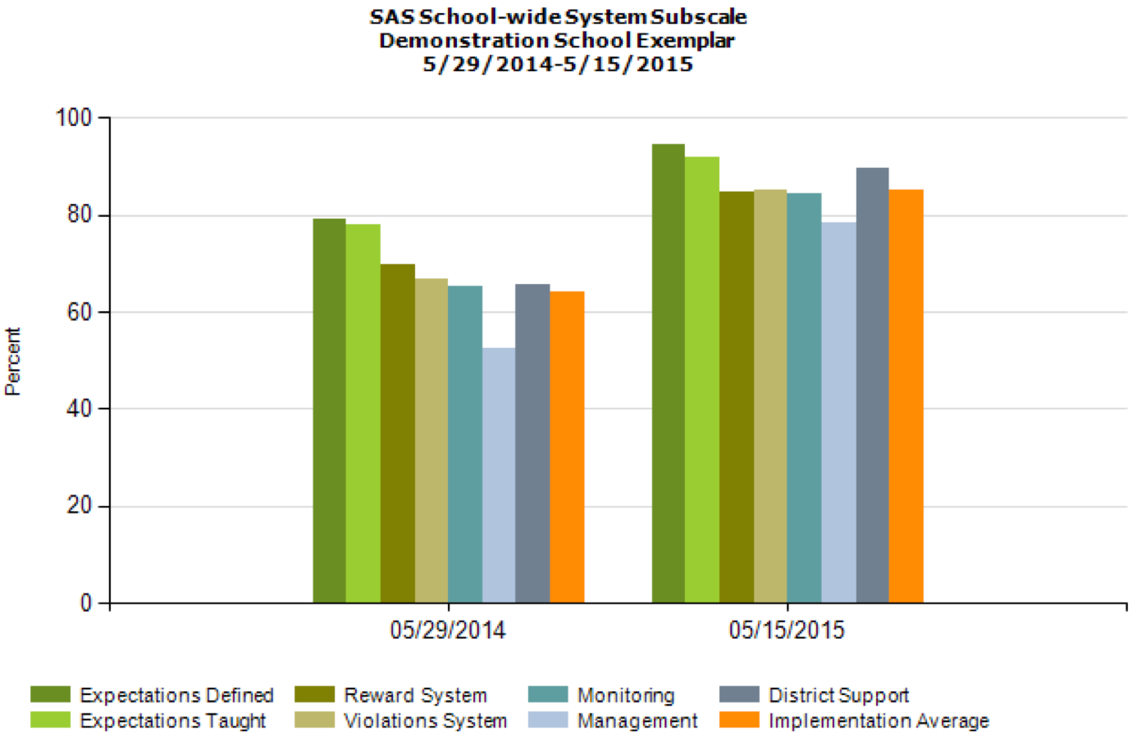
Overall, staff perception of implementation has improved across all categories!

Slide 27
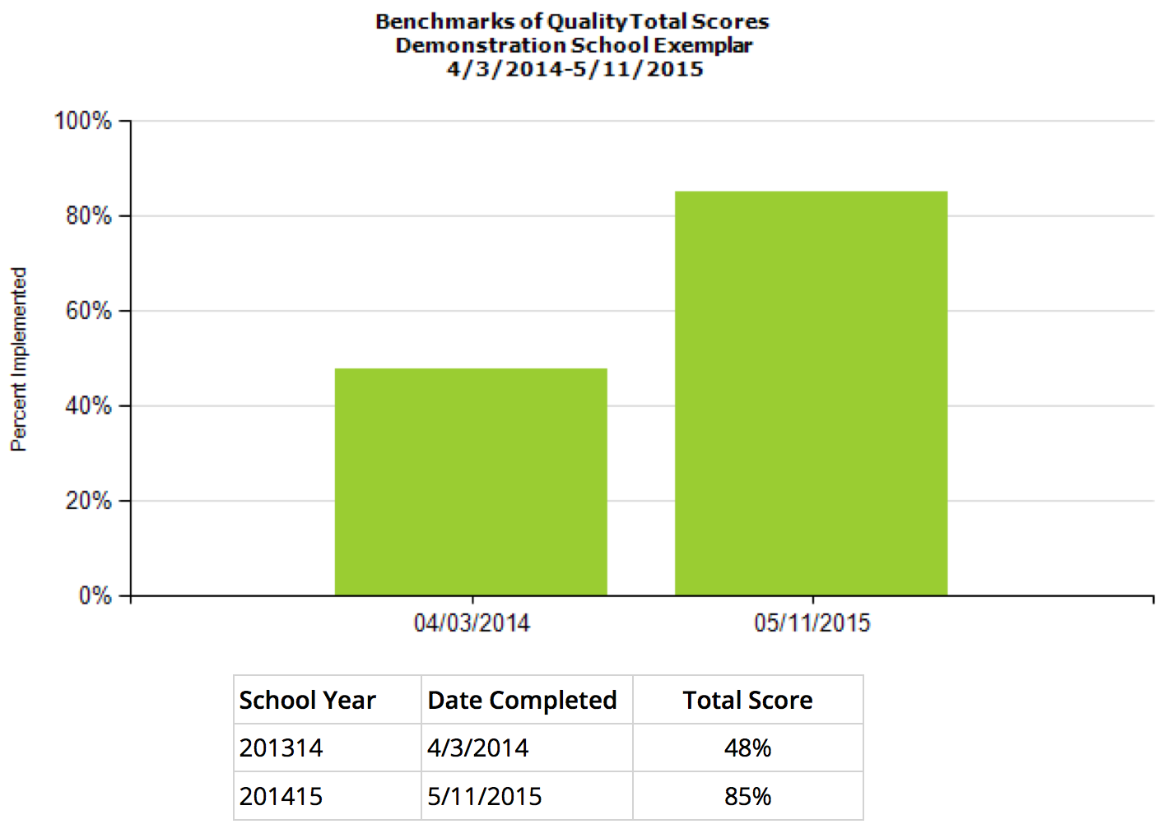
This year our PBIS team took the BoQ to assess PBIS fidelity across all features of PBIS. This year 85% of PBIS features are in Place. Last year, only 48% of features were in place.

Slide 28
Based on your feedback our team has determined the following areas for improvement:
Example:
Focus on maintaining our Universal Efforts
Enroll more students in Targeted Supports
(USE the SAS Summary to help articulate these)

Slide 29
Thanks!
Questions about PBIS?
Contact one of the team members:
Jane Principal
Tom Coordinator
Physical Ed
Sharon Teacher
Johnny Naysayer

Slide 30
Activity
Review your SAS or BoQ data and draft priorities using the Summary Sheets
Using the template provided, work in pairs to help each other create a presentation of your SAS and/or BoQ results, including action steps
Notes:
The staff presentation ppt will be posted at www.pbisvermont.org. Handouts will also be available.

Slide 31
What’s New?

Slide 32
New PBIS Acronym (and Fidelity Instrument)!!!
Introducing the TFI!
aka
Tiered Fidelity Inventory

Slide 33
Purpose of the PBIS Tiered Fidelity Inventory
The purpose of the School-wide PBIS Tiered Fidelity Inventory is to provide an efficient and valid index of the extent to which PBIS core features are in place within a school.
Tier I (Universal PBIS) – 15 Questions
Whole School Universal Prevention
Tier II (Targeted PBIS)- 13 Questions
Secondary, Small Group Prevention
Tier III (Intensive PBIS)- 17 Questions
Tertiary, Individual Support Prevention
About 30 minutes per Tier – at first

Slide 34
Uses of the SWPBIS Tiered Fidelity Inventory
Formative Assessment
Determine current PBIS practices in place and needed prior to launching implementation
Progress monitoring
Self-assess PBIS practices by tier to guide implementation efforts, and assess progress by tier
Build action plan to focus implementation efforts
Annual Self-Assessment
Self-assess annually to facilitate sustained implementation of PBIS
State Recognition
Determine schools warranting recognition for their fidelity of PBIS implementation.

Slide 35
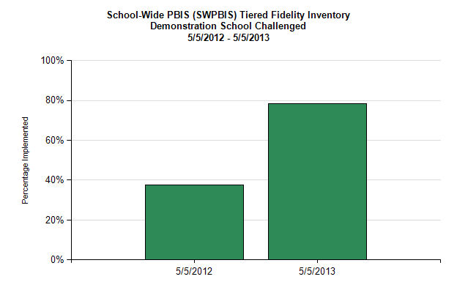
Total Score Report (Fidelity > 80%)

Slide 36
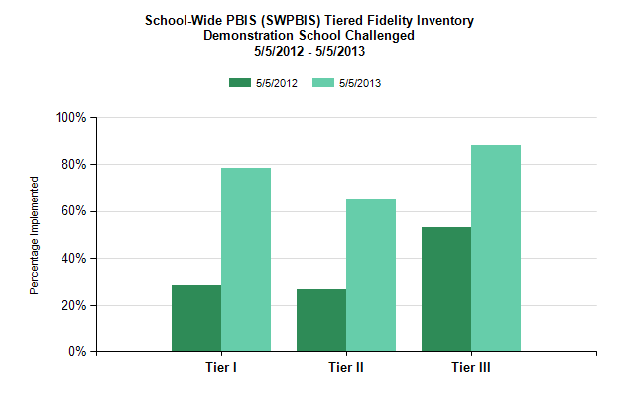
Sub-scale Report

Slide 37
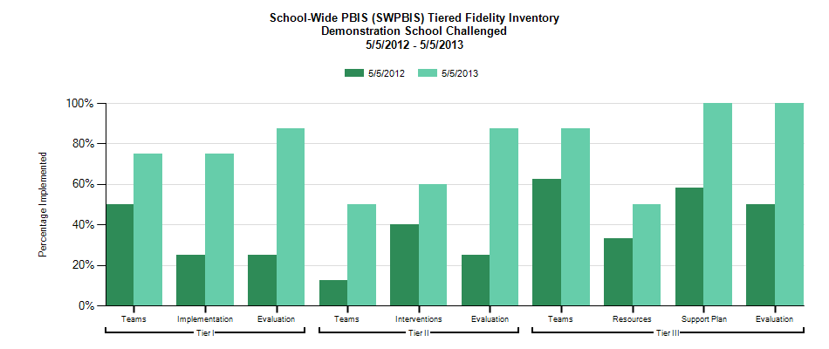
Sub sub-scale Report
Tier III
Teams
Resources
Support plan
Evaluation
Tier II
Teams
Interventions
Evaluation
Tier I
Teams
Implementation
Evaluation

Slide 38
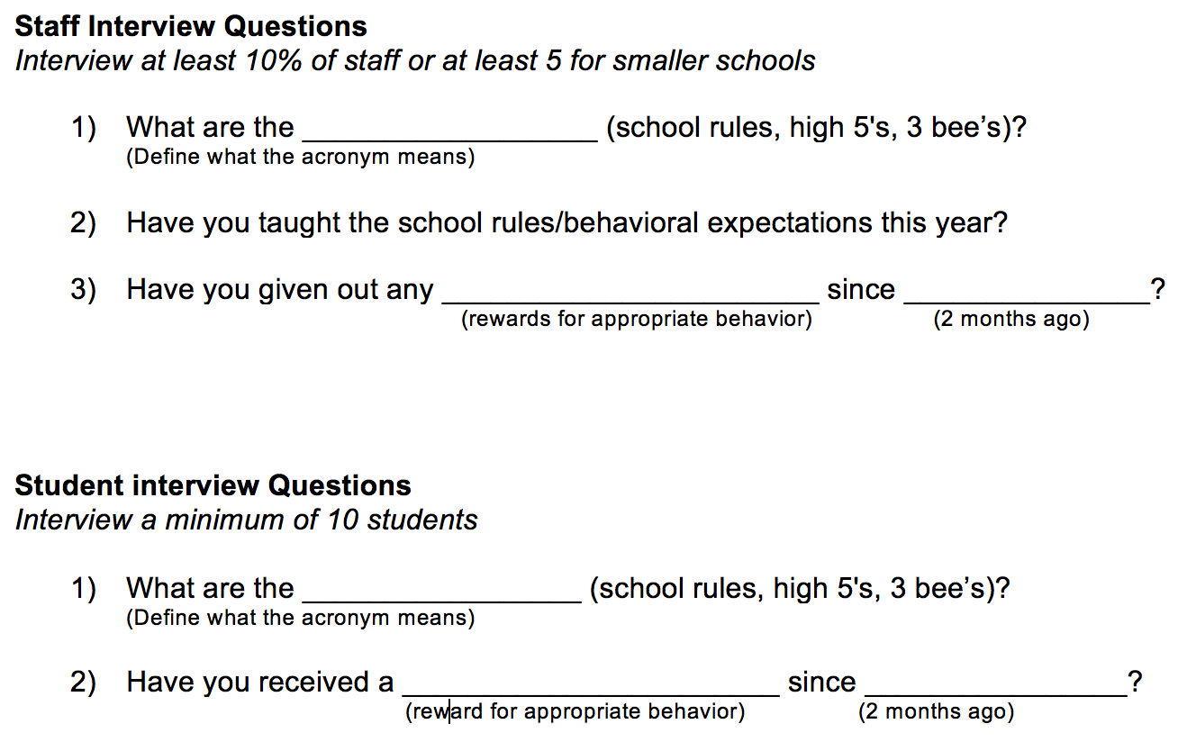
TFI Walkthrough Tool (optional)
Notes:
Completed prior to the Team Taking this Self-Assessment

Slide 39
Next Steps:
The VTPBiS Team will be in touch in the Fall!

Slide 40
NEW Family Engagement Survey and Resources!

Slide 41
Addresses the following questions:
What do families know about PBIS in your school?
How are families’ perceptions about PBIS similar/different from school leadership team perceptions?
What can you do when there is a discrepancy?
What resources are available to help engage families in PBIS?

Slide 42
Activity
Review the VTPBiS Family Engagement Survey and accompanying Materials
Discuss how you can use this survey to improve family engagement and PBIS at your school
Explore the Family Engagement Resources at http://www.pbisvermont.org/resources/for-families/family-resources
Prioritize one thing you will do back at your school

Slide 43
Get Connected!
https://www.facebook.com/groups/PBiSVermont/
https://twitter.com/vtpbis

Slide 44
Get Ready for Next Year!

Slide 45
Getting ready for next year
Recommended Steps:
Review VTPBiS Sustainability Action Plan and complete with your team
Consider securing resources for coaching support
Review VTPBiS Professional Learning Calendar and prioritize activities for next year
Use the VTPBiS Coordinators Handbook to understand your role for next year
Summer Homework: Consider creating/revising your Staff Handbook

Slide 46
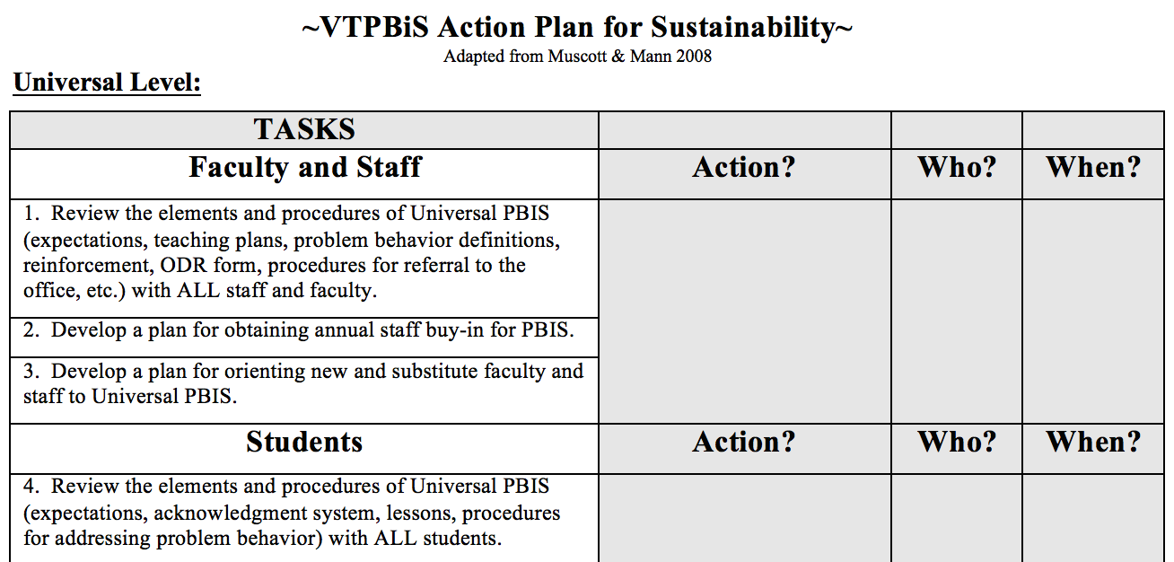
1. Review VTPBiS Sustainability Action Plan and complete with your team
Notes:
Resource – encourage teams to complete at final team meeting or sometime before school starts

Slide 47
2. Consider securing resources for coaching support
What?
Support for schools/SUs/SDs in fidelity of PBIS evidence-based practices and development of local implementation capacity
Goal is to create school/SU/SD capacity for internal coaching
Why?
Someone with expertise who can bring experience, expertise and an external perspective
How?
VTPBiS Request for Assistance process
Local funding – can use BEST/Act 230 funds
This year, 29 VTPBiS schools accessed support from VTPBiS coaches

Slide 48
3. Review VTPBiS Professional Learning Calendar and prioritize activities
Notes:
Handout Draft PD Calendar

Slide 49
Activity
Turn and Talk:
What (if any) external supports do you or your team need to help you develop internal capacity for PBIS implementation and sustainability?
How would you use this support, if available?
Review the draft Professional learning Calendar
Prioritize learning opportunities for next year
Plan next steps

Slide 50
4. Use the VTPBiS Coordinators Handbook to understand your role

Slide 51
5. Summer Homework: Consider creating/revising your Staff Handbook

Slide 52
Networking and Professional Development

Slide 53
Topical Networking Carousel :
Session 1:
Alignment
Non-Classroom Settings
Tier II/III
Social Media
Celebrations
Family Engagement
Anything Goes!
Session 2:
Alignment
Non-Classroom Settings
Tier II/III
Social Media
Celebrations
Family Engagement
Anything Goes!
Session 3:
Alignment
Non-Classroom Settings
Tier II/III
Social Media
Celebrations
Family Engagement
Anything Goes!
Notes:
VFN will sit at the Family Engagement Table and share knowledge of Family Engagement Survey and field questions.
Tier II/III will have a BEST Team or Coaches talk about the TFI supplemental tools and VTPBiS Behavior Support plan.
30 minutes are each table – depends on time!

Slide 54
Networking Guidelines
7 Topics, 7 Tables, 7 Unique Conversations……..
Select a topic and find corresponding table
Select a facilitator
Allow everyone a turn to speak
Reflect on the following:
What are strengths and challenges?
What does it look like when done well?
Record ideas and questions on poster paper

Slide 55
Upcoming Reminders:
Please nominate your school for an VTPBiS Annual Acknowledgement!
BEST/Act 230 – Know who your SU/SD Grants Manager is!
QUESTIONS? IDEAS?
Other THOUGHTS?

