Slide 1
Beyond Check-In/Check- Out (CICO): Expanding Your Inventory of Supports
Mandy Couturier, Thatcher Brook Primary School
Sarah Schoolcraft, Williston Central School

Slide 2
Goals
We will practice identifying causes of challenging behavior (function).
We will explore and share function-based supports for tier 2 student behaviors.

Slide 3
Function
All behavior has a function
take a minute and think about this…
Why do you _______?
Behavior is learned
Behavior is communication
Behavior is patterned, stable, predictable, and functional
Behavior that is positively reinforced is more likely to continue/repeat
Behavior can be maladaptive

Slide 4
Function
Pure behaviorists will says that all behavior is to obtain or avoid something.
Why do you go to work everyday?
Why do you wear your seat belt?
Why might a student call out in class?
Why might a student do his/her homework?
Why might a student go get a drink 5 times during a 40 minute class?

Slide 5
Data...It Helps us know why
What kind of data do you currently take?
What other kinds are there?
How can it help?

Slide 6
how often are they happening?
How much of a problem are they really?
How much of my day am i spending on this?
Notes:
Data is not an intervention, but rather a way to tell if an intervention is working-

Slide 7
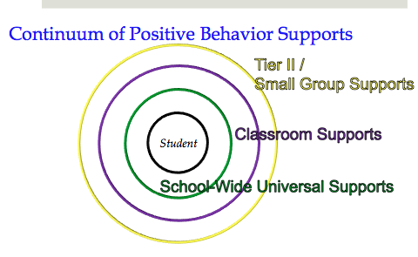

Slide 8
Basic Steps
School-wide, including classroom, universals in place
Identify students who need additional supports
3. Identify what support student needs
Environment
Intervention
4. Monitor and evaluate progress

Slide 9
Let’s look at challenging behaviors:
Attempts to control others
Tattling
Stealing
hitting/punching
Kicking
Self-harm
Bribing
Drug use
Cutting
Lying
Food behaviors
Dress code infractions
Running/bolting/hiding
Screaming/yelling
Swearing
Encouraging of other’s behavior
Bullying/harassment
Refusals
Fighting
Name calling
Distractions
Throwing objects
Interrupting/blurting
Threatening
Destruction of property

Slide 11
Framework to follow
Focus on what you want student to do instead (replacement behavior)
Look for patterns of behavior that suggest “functional relationships”
Teach replacement behavior and provide multiple opportunities to practice
Deliver high rates of positive feedback/same similar outcome as problem behavior when students display replacement behavior
Tim Lewis, Ph. D.

Slide 12
Short-term vs. Long-term interventions
Short-term
Consequences
priming/reminders
Setting modifications
Seat change
Teacher proximity
Long-term
Behavior plans
Skills groups
Teaching/reteaching

Slide 13
Meeting needs
Finding the function of student behavior is important for 2 major reasons:
To determine the need for intervention(s)
To determine the effectiveness of intervention(s)
For example, if you feel that the function of a student’s misbehavior is adult attention and then s/he is matched with an intervention that does not involve adult attention, the intervention will most likely not work to change the challenging behavior

Slide 14
Small group & targeted interventions
When universal level is not sufficient to impact behavior
When students display chronic patterns
When concerns arise regarding students’ behavior
Tim Lewis, Ph. D.
University of Missouri

Slide 15
“If a response solves a problem for a child, then they will repeat that response if provided with a similar situation” – Ashford, Lecroy & Lortie, 2001

Slide 16
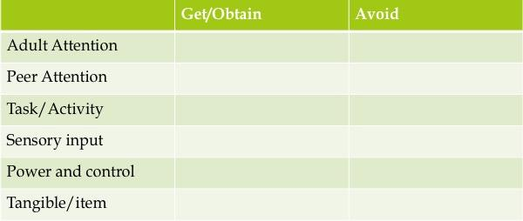
Quick break down of common functions in a school setting:

Slide 17
Function-based Interventions
Check in/check out
Mentoring
Lunch dates
Everyone Wins
Social Skills groups
Peer Mentoring
What else?

Slide 18
Your Turn!
On the Post-it’s at your table, write down (one per post-it) the interventions that you have available at your school/setting
Discuss the function that this intervention will match
Place the post-it on the matching chart paper
Try to do at least 5 interventions

Slide 19
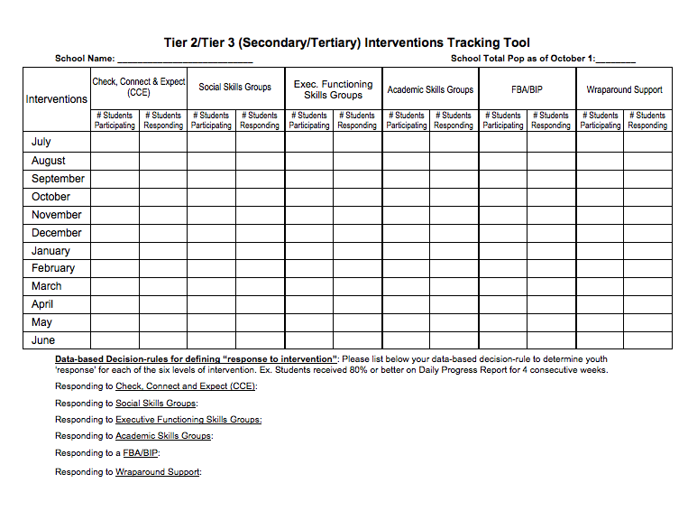
How will
you know
if it’s
working?

Slide 20
What if it’s NOT working?
Analyze the following:
Are Tier One Supports being implemented with fidelity?
How do you know?
Are Tier Two systems implemented with fidelity?
How do you know?
Are “Components of a Successful Classroom” in place?
How do you know?
Analyze Tier Two data and make adjustments
Consider Function of Intervention. Does it match?
* If all options have been tried, consider a move to Tier 3.

Slide 21
Next Steps:
Using the Group Intervention Grid…
Review the interventions that your school currently has, and the “wish list” of interventions you would like to implement.
List each intervention
Decide what the function of these interventions are.

Slide 22
Feel Free To contact us:
Mandy Couturier
mcouturier@wwsu.org
Sarah schoolcraft
sschoolcraft@cssu.org

