Slide 1
Welcome!
Building Better Behavior Support Plans
With others from your school, identify a student who requires an individualized F-BSP
There may be more than one student and team identified for the same school
This afternoon, you will be working with this team to build a better BSP for that student - so your team may want to sit together

Slide 2
Building Better Behavior Support Plans (B3SP)
Teri Brooks, Ph.D., BCBA
e-mail: terimbrooks@gmail.com
Cortney Keene, M.Ed., C.A.S., BCBA
e-mail: cortney.keene@uvm.edu
Notes:
Welcome: Introductions

Slide 3
BEST
Notes:
Cortney

Slide 4
Notes:
Cortney

Slide 5
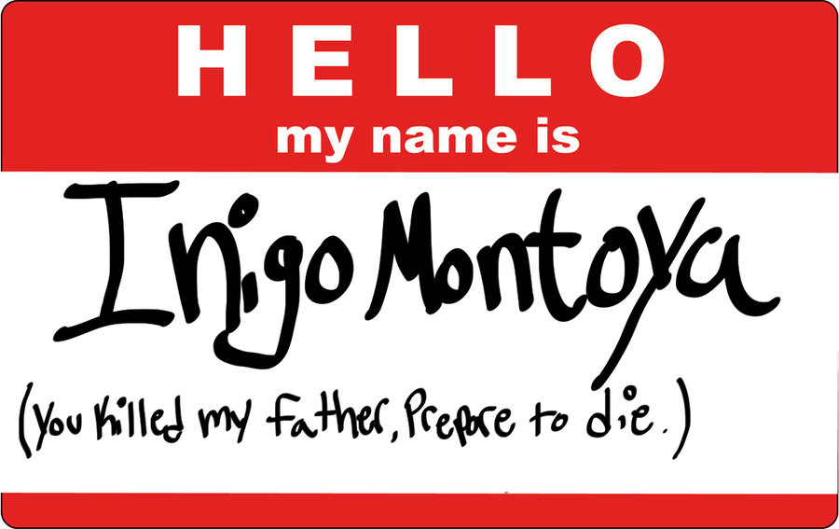
Introductions
1. Find someone with the same color shirt as you
2. Say “Hello” and introduce yourself
if you don’t know the person
3. Share your role & your strengths
with respect to building F-BSP’s
4. Introduce your partner to the group,
explain what their role is, and one of their strengths
Notes:
Cortney

Slide 6
Agenda
Competing Behavior Pathway Case Studies
ABA Concepts and Examples
Build your better BSP
Setting Events
Antecedents
Behavior Teaching
Consequences
Evaluation, Data, and Decision-Making
Notes:
Cortney: Today’s presentation will build on a foundational knowledge of the 5 stages of the F-BSP process, focusing primarily on building skills to complete Stage 4 (Interventions)

Slide 7
Competing Behavior Pathway
Desired Behavior
MaintainingConsequence
Setting Events/
Conditions
Antecedent Trigger
Problem Behavior
MaintainingConsequence
Function
Replacement Behavior
Notes:
7
Teri
fix slide

Slide 8
Case-Study Pathway John
Routine: Classroom Discussion
Raise hand
at Expected Frequency
Teacher
calls on
John
Group Discussion on high preference topic
Teacher responds
to John
FunctionAdult Attention
Teacher asks a question
On-topic blurting
Raise Hand
at High Frequency
Teacher calls on John
Other Factors:
Little parental attention available at home
Notes:
Teri

Slide 9
Case Study Pathway: Sarah
MaintainingConsequence
?
Function?
Routine: Math Class
Complete math task
Student didn’t get much sleep last night
Asked to do a math task
Sits silently
Avoids math task
Gets sent out of class
Write name on paper
Notes:
9
Teri
fix slide

Slide 10
2-Minute Talk
Turn to the person sitting next to you and discuss the “consequence” of sending a Sarah out of the classroom for blurting out.
Is this “punishment”,
reinforcement,
or something else?
Rewards
and
Punishments
Notes:
Teri

Slide 11
Reinforcement
Definition: Anything that happens after a behavior that increases the probability that the behavior will be repeated again in the future. Reinforcement is a type of consequence.
Positive: Anything desirable that the student gets, contingent upon the behavior (i.e. time with a preferred activity, a token, praise, or a candy treat)
Example: John gets the teacher’s attention when he blurts out in class. Important - John LIKES teacher attention!
Notes:
Teri

Slide 12
Reinforcement
Definition: Anything that happens after a behavior that increases the probability that the behavior will be repeated again in the future. Reinforcement is a type of consequence.
Negative: Anything that is aversive that the student avoids by engaging in a behavior (i.e. disrupting class to get kicked out so that work is avoided, or avoiding a reprimand by raising one’s hand)
Example: Sarah avoids work when she refuses to do it (note that the response effort to get this reward is very low, making it difficult to come up with a good replacement behavior with a low enough response effort and big enough reward.
Notes:
Teri

Slide 13
Punishment
Definition: Anything that happens after a behavior that decreases the probability that the behavior will happen again. Punishment is the second type of consequence.
Positive: Something aversive happens contingent on the behavior
Example: Sarah gets an “F”
Notes:
Teri

Slide 14
Punishment
Definition: Anything that happens after a behavior that decreases the probability that the behavior will happen again. Punishment is the second type of consequence.
Negative: Something desirable is taken away
Example: Sarah has to stay in from recess to do her work (provided she really likes recess)
Other examples include: Re-Set, Time-Out, Loss of Privileges
Notes:
Teri

Slide 15
Reinforcement Schedules
Definition: How frequently reinforcement is provided
Example: When implementing the new Behavior Support Plan, Ms. Keene will call on John every single time he raises his hand. Later, she will “thin” this schedule to every other time he raises his hand, and so on.
With new skills, we often have to provide reinforcement every time to get the behavior established
The most effective schedule of reinforcement is intermittent -
?Why can this be a really big problem?
Notes:
Teri

Slide 16
2-Minute Talk
Turn to the person sitting next to you and discuss when you have reinforced problem behavior on an intermittent reinforcement schedule
Rewards
and
Punishments
Notes:
Teri

Slide 17
Motivating Operation
Definition: Something that changes the value of a consequence, i.e. makes a reinforcer or a punishment more powerful or less effective
Example: Ms. Brooks starts praising John every minute or two during classroom discussion. Because she is providing John with frequent attention (which functions as positive reinforcement for him), he is no longer motivated to blurt out in order to get her attention.
Notes:
Teri:
If I gave you all a big bag of chocolate when you walked in this morning, how effective would my chocolate candy be as a reinforcer throughout today’s training?

Slide 18
Extinction & Differential Reinforcement
Definition: When reinforcement is no longer provided, and the behavior goes away, this is called “extinction”.
When a replacement behavior differentially gets rewarded instead of the problem behavior, this is called Differential Reinforcement.
Example: Ms. Brooks calls on John every single time he raises his hand, but never when he blurts out.
Notes:
Teri

Slide 19
Extinction Burst
Definition: A short-lived increase in frequency or intensity of problem behavior because reinforcement is suddenly being withheld.
Example: The first day Ms. Brooks tries differential reinforcement, John blurts out 28 times during Morning Meeting, twice as much as usual (data collected indicated an average of 14 blurts in Morning Meeting). On the second day, he blurts out only twice.
Notes:
Teri -

Slide 20
Extinction Burst Warning!
Remember to warn your teams that withholding reinforcement may spark an extinction burst.
It is important to consider whether this will be something the team can live with (or not), considering the nature and/or severity of the behavior. A crisis plan may be needed.
Notes:
Teri

Slide 21
Response Effort &
Matching Law
Definitions: Response Effort is the amount of effort required to engage in a behavior. The Matching Law refers to the need to ensure your reinforcement is big enough to make the effort worth it.
Example: When John raises his hand instead of blurting out for a whole week, he gets to eat one M&M. The Team is wondering why his behavior isn’t improving. The Behavioral Specialist who consults with the Team tells them that one of the reasons is that the reward isn’t big enough in relation to the amount of effort needed to get it.
Notes:
Teri - What’s another reason this reward might not work? IT DOESN’T MEET THE FUNCTION OF THE BEHAVIOR

Slide 22
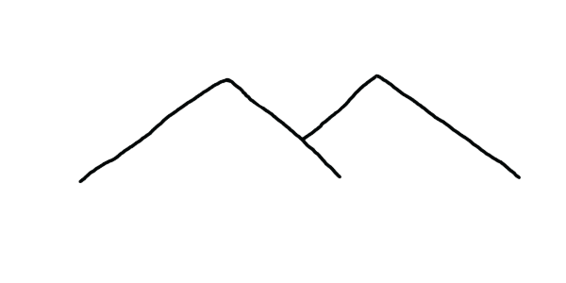
Matching Law
Why bother?
I can do that! Yay me!
Notes:
Teri

Slide 23
Preference Assessment
Definition: A simple assessment to determine what a student might like to get as a reinforcer.
Example: Asking John what he might like to earn (open-ended or from a list) for raising his hand in the classroom without blurting.
Notes:
Cortney

Slide 24
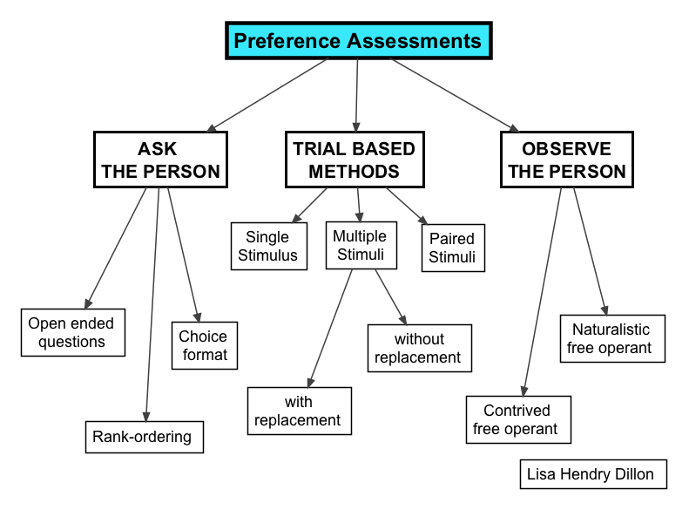
Scientific

Slide 25
Activity
Complete Preference Assessment
Notes:
Cortney
Open-Ended Questions
Paper/pencil Preference Assessment
Present options on a tray and have a participant pick via Multiple Stimulus With Substitution and another participant without

Slide 26
Secondary Reinforcers
Definition: A primary reinforcer is something that a student enjoys getting or doing. A secondary reinforcer “buys” a primary reinforcer. This can become reinforcing once paired with something a child enjoys.
Example: E.g. Tokens, Money, marbles
Notes:
Cortney
Start using “Good for You” tokens that participants can trade in for small candies or treats

Slide 27
Instructional Control
Definition: A positive working relationship where the adult is seen as “the giver of good things.” The learner responds consistently when presented with a task or demand.
Example: The student does what the adult asks them to do.
Notes:
Cortney

Slide 28
Discriminative Stimulus
Definition: A discriminative stimulus is a cue to a student that reinforcement or punishment may occur (we call this an “SD”)
Example: Ms. Brooks responds to John for blurting out, but Ms. Keene ignores. John talks out in Ms. Brooks’ class but not Ms. Keene’s.
Ms. Brooks is a discriminative stimulus for ______?
What is an example of an SD for punishment?
Notes:
Cortney: In this case, Ms. Brooks is a discriminative stimulus for ?????
Example for punishment: In group discussion, Sub Sarah harshly tells Jimmy that his answer was wrong. Next time she subs at the school, Jimmy refuses to participate, even though he usually participates very actively with his regular teacher.

Slide 29
Non-Contingent Positive Reinforcement (NCR)
Definition: Providing access to a known reinforcer frequently so that problem behavior is no longer necessary to access it. Reinforcement is NOT contingent on a specific behavior occurring beforehand.
Example: John blurts out 5 times in an hour in order to get adult attention. NCR in the form of adult attention is provided 10 times an hour at random intervals. Blurting is significantly reduced.
Notes:
Providers of NCR may withdraw Positive Reinforcement for a short period of time following problem behavior to avoid any inadvertent reinforcement of that behavior.

Slide 30
2-Minute Talk
Discuss how NCR could possibly
eliminate the need for a student
to engage in the problem behavior.
What about your student?

Slide 31
Prompts
Definition: A prompt is used when the student has not yet learned how she is expected to respond to a particular stimulus (i.e. she doesn’t recognize the stimulus as an SD for reinforcement, or naturally-occurring cues are not yet recognized). Prompts are often necessary to teach a new behavior, but they should be faded as soon as possible
Example: Sarah is shown cards with sight words and told, “find the word house”. Sarah does not select “house” so the teacher gestures to the correct response by pointing.

Slide 32
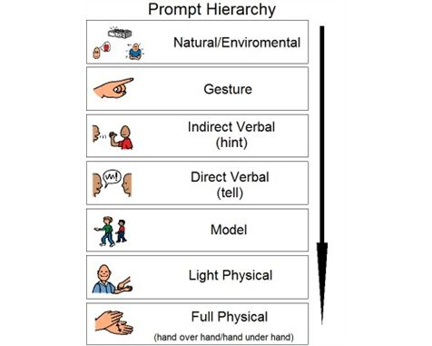
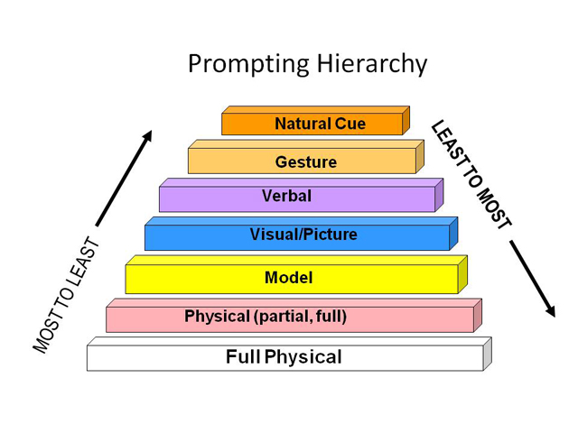
Notes:
Cortney

Slide 33
2-Minute Talk
If a student requires a verbal prompt
in order to perform a skill, is it
independent?
In your opinion, how well do we
do at fading prompts in school?
Notes:
Para-professionals and fading prompts - a BIG problem!

Slide 34
Planning for Generalization
Definition: A skill is taught under one set of conditions and the child is able to apply the same skill with different people, in new places, using other materials.
Examples:
Across People: Sally is taught to say hi to her teacher and she says hi to other people as well
Across Settings: Sally is taught to wash her hands before a meal at school and she washes her hands before meals at home.
Across Behaviors: Sally is taught to add an “s” onto the end of “tree” and “car” and she adds an “s” to the end of all nouns.
Notes:
Cortney

Slide 35
1 Teaming
Adapted from: Dunlap et al. (2010). Prevent, Teach, Reinforce
5 Evaluation (BIP)
Vermont’s Planning Process for Students
2 Goals
4 Intervention (BIP)
3 Assessment (FBA)
Notes:
Teri

Slide 36
F-BSP Process
Stage 1: Teaming
Stage 2: Goals
Stage 3: FBA
Stage 4: BSP
Stage 5: Evaluation
Notes:
Teri

Slide 37
Recommended Team Members
Teacher
People who are actively involved with the student and invested in the student’s success
Others?
Admin?
Parent
Student
Resource expert
Behavior expert
Notes:
Teri
Link to characteristics just discussed - who are the essential people to include on a student team?

Slide 38
Today, we will come up with interventions to add to an existing BSP.
You will need to bring these ideas back to the student’s team for approval.
Notes:
Teri

Slide 39
Setting Goals
Stage 2 of F-BSP
Broad goals identified in the referral - use data!
Initial ideas about positive behaviors to increase and problem behaviors to decrease
Notes:
Teri
Talk about different types of data used to make a referral for a F-BSP and how to use this data to set initial goals

Slide 40
Broad Goal
Javier will follow instructions by teachers, staff, and other adults.
Notes:
Teri

Slide 41
Positive & Problem Behaviors
Increase the number of times he responds appropriately by responding to adult requests quickly and respectfully
Decrease number of times he runs away from adults following adult requests.
Notes:
Teri

Slide 42
Examples
Task Engagement: amount of time Johnny remains in his seat with eyes focused on the teacher and/or work materials during independent academic work.
Tantrums: number of times Johnny engages in (1) screaming, (2) kicking furniture or people, and (3) throwing objects.
Notes:
Teri

Slide 43
Activity
Review page 2 of the VTPBiS Intensive Level BSP and complete Stage 2: Goals
Notes:
Teri

Slide 44
Reminder: FBA Hypothesis
Setting
Antecedent
Behavior
Consequence
Typically on days when he has worked alone for 30 min…
when given math work sheets & other assignments…
he doesn’t do his work and uses profanity.
His work doesn’t get completed and he avoids teacher requests.
Notes:
Cortney

Slide 45
Activity
Complete a competing behavior pathway for your student
Note: This is the end result of Stage 3, Assessment, which is your FBA
Notes:
Cortney

Slide 46
BSP Strategies Based on FBA
Setting Event Strategies
Understanding and addressing precipitating factors (if possible)
Antecedent Strategies
Redesigning the learning and environments to prevent problem behaviors
Teaching Strategies
defining, modeling, practicing new behaviors
Consequence Strategies
implementing specific to generalizable reinforcement
teaching
Notes:
Cortney
Could look different in each school. The idea is to have a group of people that address the effectiveness and processes of the targeted interventions as they relate to the SW-PBIS efforts, not to review individual students. This could be a subset of the universal team or an overlapping group of the universal team, targeted team, EST, etc.

Slide 47
F-BSP Strategy Types
Setting | Antecedent | Behavior | Consequence
Adult attitudes & actions Strengthening relationships Home-school communication Home-to-school reinforcement Engaging families Coordination with community providers Building a trauma-informed school | Providing choices Transition supports Environmental supports Curricular modification Adult verbal behavior Classroom management Increase noncontingent reinforcement Peer support Peer modeling | Replacement behavior Academic skills Problem-solving Coping Social skills Teacher-pleasing behavior Learning skills Self-management Independent responding Increased engaged time | Reinforce replacement behaviors Discontinue reinforcement of problem behavior Group contingencies Increase ratio of + to – responses School-to-home reinforcement Delayed gratification
Notes:
Cortney
Setting Event Strategies Understanding and addressing precipitating factors (if possible)
Antecedent Strategies Redesigning the learning and environments to prevent problem behaviors
Teaching Strategies defining, modeling, practicing new behaviors
Consequence Strategies implementing specific to generalizable reinforcement
1) Share few examples of really effective strategies
2) Link that to function of problem behavior

Slide 48
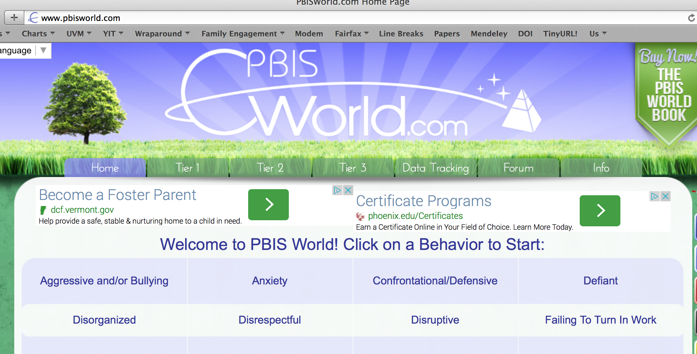
Resource for Interventions
www.pbisworld.com
Notes:
Cortney

Slide 49
Setting Event Strategies
Setting events are aspects of environment or routine that do not happen immediately before or after problem behaviors, but still have an effect.
Setting event strategies are designed to reduce their influence.
Examples: Home-school communication, sleep, meals, medication
Notes:
Cortney

Slide 50
Setting Event Strategies
WHAT WE CAN CONTROL
Engaging families
Structure / schedule
Classroom accommodations and modifications
Home/school communication
WHAT WE CANNOT
History of trauma
Medical / physical conditions
Temperament
Sensory profile
Carry-in issues
Notes:
Cortney

Slide 51
Activity
Identify one setting event strategy to add to your student’s BSP
Consider:
Relationship with teacher/para
Motivating operations
in play
Notes:
Cortney

Slide 52
Antecedent Strategies
Antecedents are the events, people or things that immediately precede the problem behavior.
Antecedent strategies are created to prevent problem behaviors/increase replacement behaviors
Examples: Eliminate the trigger, Modify task to incorporate student interests, Change task difficulty, Make task more meaningful
Notes:
Teri

Slide 53
Activity
Identify one antecedent strategy to add to your student’s BSP
Consider:
Discriminative Stimuli
Prompts & Prompt Fading
Instructional Control
Notes:
Teri

Slide 54
Teaching Strategies
Teaching strategies are created to increase the student’s skill and/or performance in carrying out replacement and desired behaviors.
Examples
Social skills training, teaching self-regulation & coping skills, identifying motivators for better performance
Notes:
Teri

Slide 55
Behavioral Skills Training
Tell (coaching)
Show (modeling)
Do (role play)
Practice (behavioral rehearsal)
Monitor Progress (feedback)
Generalize (apply in multiple settings)
CenterDisability and Community
Inclusion
Notes:
Teri

Slide 56
Activity
Identify one teaching strategy to add to your student’s BSP
Consider:
Response Effort
Instructional Control
Motivating Operations
Planning for Generalization
Notes:
Teri

Slide 57
Consequence Strategies
Consequences strategies: minimize reinforcement for problem behavior, increase reinforcement for desirable behavior, or redirect to alternative behavior. Strategies should be designed in combination with teaching strategies.
Examples:
Reinforcement, Non-contingent reinforcers, Re-direction, Extinction
Notes:
Teri

Slide 58
Activity
Identify one consequence strategy to add to your student’s BSP
Consider:
Reinforcement/Punishment
Preference Assessment
Secondary Reinforcers
Extinction Burst
Notes:
Teri

Slide 59
Crisis Prevention/Intervention Plan -
* if needed
Triggers/stressors
Red Flag behaviors & correct staff response
What is considered a crisis
Who is called
Where student should go
What to do or say to student
What not to do or say to student
Training needed for key support people
Coordinated Services Plan Proactive Crisis Plan format
Notes:
Teri

Slide 60
Evaluation
Create measurable goals
Assess fidelity of implementation
Assess progress toward goals
Make data-based decisions
Notes:
Cortney

Slide 61
Collecting Baseline Data
For short-term goals teams must:
Define them as measurable and observable
Determine best method for measuring
Choose anchor points for recording change
Baseline data is used to inform the FBA Hypothesis
Notes:
Cortney

Slide 62
Measuring Progress on Goals
Frequency
Duration
Intensity
Likert-type scale
Perception
Notes:
Cortney

Slide 63
Setting Anchor Points: Positive
5
Pro-social behavior goal
> 10 minutes
> 12 times/day
4
8-10 minutes
10-12 times/day
3
5-7 minutes
7-9 times/day
2
Typical day
2-4 minutes
4-6 times/day
1
Very challenging day
< 2 minutes
< 4 times/day
Notes:
Cortney

Slide 64
Measuring Fidelity
Adherence | Are minimum components of intervention strategies being implemented? % times teacher provided praise per plan % days Points Sheet was fully completed # of times student received BST
Quality | How well is the plan being implemented? Quality of interaction when teacher completes Points Sheet with student Prompts to use replacement skills using the exact language in the BSP (Careful! We also want to promote generalization of skills by varying the prompts)
Notes:
Cortney

Slide 65
Activity
Add to the Evaluation section of your BSP:
Measurement of behavioral goals
Adherence to plan
Quality of implementation
Notes:
Cortney

Slide 66
Behavior is improving
Positive behavior change Behavior progress & Good fidelity
Extension
Shaping
Fading
Self-Management
New settings
Delayed gratification
New people
Intermittent schedule
Notes:
Teri

Slide 67
Behavior is NOT improving
Data indicate behavior not improving
Interventions implemented with fidelity
Interventions not implemented w/ fidelity
Hypothesis incorrect
Strategies too difficult or time consuming
Interventions are insufficient
BSP does not match teacher context
Teacher experiencing intervention drift
Notes:
Teri

Slide 68
Activity
In your BSP, note the date of your next follow-up meeting
Identify who will collect and summarize data indicated in the Evaluation section of your BSP
Notes:
Teri

Slide 69
How Good Is Your BSP?
TFI (Tiered Fidelity Inventory) Tier III Support Plan Worksheet:
Individualized Team
External Supports/Agencies
Goals/Strengths Identified by Student &/or Family
Relevant medical, academic behavioral assessment data
FBA Hypothesis Statement
7 types of interventions per Competing Behavior Pathway
Action steps
Access to Tier I and Tier II supports
Monthly meetings to review outcome and fidelity data
Notes:
Teri

Slide 70
Activity
Assess your BSP using the TFI Tier III Support Plan Worksheet
Complete your to-do list to
take away from this training
Notes:
Teri

Slide 71
Wrap-Up
Questions??
Coaching
Funds are available for coaching support
Visit Vermont PBIS Website or your School Coordinator
Contact us with any questions!
Teri Brooks, Ph.D., BCBA
terimbrooks@gmail.com
Cortney Keene, M.Ed., C.A.S., BCBA
cortney.keene@uvm.edu
Notes:
Teri

