Slide 1
Spatial Autocorrelation Basics NR 245 Austin Troy University of Vermont

Slide 2
SA basics
Lack of independence for nearby obs
Negative vs. positive vs. random
Induced vs inherent spatial autocorrelation
First order (gradient) vs. second order (patchiness)
Within patch vs between patch
Directional patterns: anisotropy
Measured based on point pairs

Slide 3
Spatial lags
Source: ESRI, ArcGIS help

Slide 4
Statistical ramifications
Spatial version of redundancy/ pseudo-replication
OLS estimator biased and confidence intervals too narrow.
fewer number of independent observations than degrees of freedom indicate
Estimate of the standard errors will be too low. Type 1 errors
Systematic bias towards variables that are correlated in space

Slide 5
Tests
Null hypothesis: observed spatial pattern of values is equally likely as any other spatial pattern
Test if values observed at a location do not depend on values observed at neighboring locations

Slide 6
Moran’s I
Ratio of two expressions: similarity of pairs adjusted for number of items, over variance
Similarity based on difference from global mean
See http://www.spatialanalysisonline.com/output/html/MoranIandGearyC.html#_ref177275168 for more detail

Slide 7
Moran’s I
Where N is the number of cases Xi is the variable value at a particular location Xj is the variable value at another location is the mean of the variable Wij is a weight applied to the comparison between location i and location j
See http://www.spatialanalysisonline.com/output/html/MoranIandGearyC.html#_ref177275168 for more detail

Slide 8
Moran’s I
Deviation from global mean for j
W_{ij} is a contiguity matrix. Can be:
Adjacency based
Inverse distance-based (1/d_{ij})
Or can use both
# of connections
In matrix
See http://www.spatialanalysisonline.com/output/html/MoranIandGearyC.html#_ref177275168 for more detail

Slide 9
Moran’s I
“Cross product”: deviations from mean of all neighboring features, multiplied together and summed
When values of pair are either both larger than mean or both smaller, cross-product positive. When one is smaller than the mean and other larger than mean, the cross-product negative. The larger the deviation from the mean, the larger the cross-product result.
See http://www.spatialanalysisonline.com/output/html/MoranIandGearyC.html#_ref177275168 for more detail

Slide 10
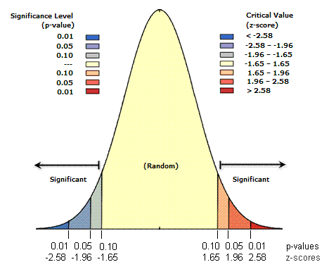
Moran’s I
Varies between –1.0 and + 1.0
When autocorrelation is high, the coefficient is high
A high I value indicates positive autocorrelation
Zero indicates negative and positive cross products balance each other out, so no correlation
Significance tested with Z statistic
Z scores are standard deviations from normal dist
Source: ESRI ArcGIS help

Slide 11
Geary’s C
One prob with Moran’s I is that it’s based on global averages so easily biased by skewed distribution with outliers.
Geary’s C deals with this because:
Interaction is not the cross-product of the deviations from the mean like Moran, but the deviations in intensities of each observation location with one another

Slide 12
Geary’s C
Value typically range between 0 and 2
C=1: spatial randomness
C< 1: positive SA
C>1: negative SA
Inversely related to Moran’s I
Emphasizes diff in values between pairs of observations, rather than the covariation between the pairs.
Moran more global indicator, whereas the Geary coefficient is more sensitive to differences in small neighborhoods.

Slide 13
Scale effects
Can measure I or C at different spatial lags to see scale dependency with spatial correlogram
Source:http://iussp2005.princeton.edu/download.aspx?submissionId=51529

Slide 14
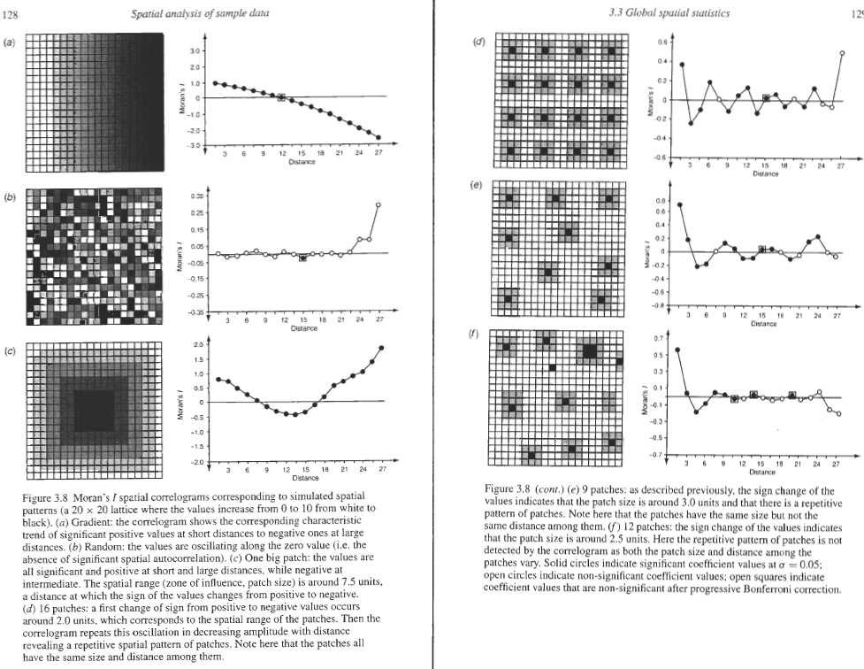
Source: Fortin and Dale, Spatial Analysis

Slide 15
LISA
Local version of Moran: maps individual covariance components of global Moran
Require some adjustment: standardize row total in weight matrix (number of neighbors) to sum to 1—allows for weighted averaging of neighbors’ influence
Also use n-1 instead of n as multiplier
Usually standardized with z-scores
+/- 1.96 is usually a critical threshold value for Z
Displays HH vs LL vs HL vs LH
And expected value
where

Slide 16
Local Getis-Ord Statistic (High/low Clustering)
Indicates both clustering and whether clustered values are high or low
Appropriate when fairly even distribution of values and looking for spatial spikes of high values. When both the high and low values spike, they tend to cancel each other out
For a chosen critical distance d,
where xi is the value of ith point, w(d) is the weight for point i and j for distance d. Only difference between numerator and denominator is weighting. Hence, w/ binary weights, range is from 0 to 1.

Slide 17
Median House Price

Slide 18
Local Moran: polygon adjacency

Slide 19
Local Moran: inverse distance

Slide 20
Local Moran: inverse distance
+ 2000 m threshold

Slide 21
Local Moran: inverse distance z values

Slide 22
Local Moran: inverse distance: p values

Slide 23
Local Getis: inverse distance: Z score

