Slide 1
"Eugenic" Sterilizations in the United States in the 20th Century: A Comparative Analysis
Presentation at the 2012 annual conference of the Social Science History Association, Vancouver
Please do not quote or cite without permission by the author
Lutz Kaelber
Assoc. Professor of Sociology
University of Vermont
Email: LKAELBER@uvm.edu

Slide 2
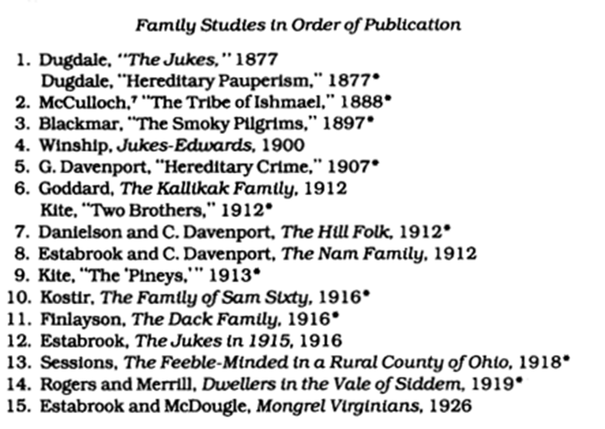
“Eugenically” motivated family studies ca. 1875 – ca. 1925
Notes:
Source: Rafter, Nicole H, ed. 1988. White Trash: The Eugenic Family Studies, 1877-1919. Boston: Northeastern University Press, S. 4

Slide 3
Biological – eugenic model of intergenerational transmission of disability and deviance
Negative Conditions
Poverty
Sexual Deviance
Criminal Behavior
“Feeblemindedness”
Other Disabilities
Next Generation
Biological Causes
Biological-social Manifestations
Biological Transmission
Notes:
Quelle: Autor.

Slide 4
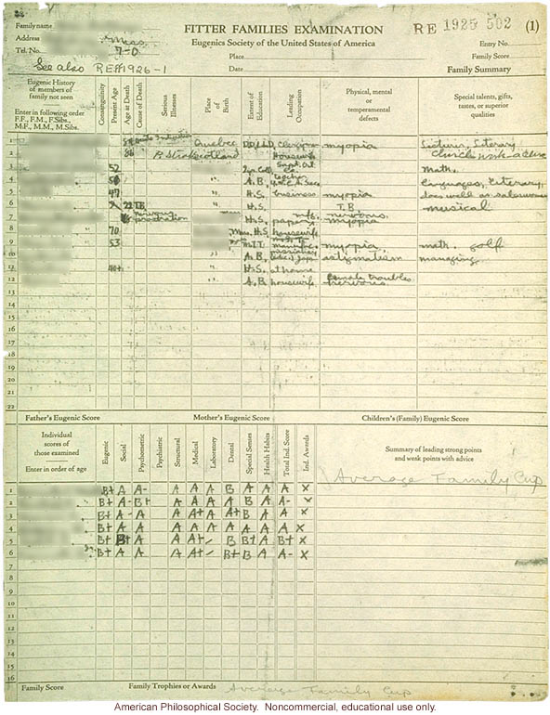
“Positive Eugenics” here: winner, “fitter families” contest
1925
Illnesses, “defects”
Worth based on eugenic score of father, mother, children
Notes:
Source: Eugenics archive. http://www.eugenicsarchive.org/eugenics/view_image.pl?id=168

Slide 5
 | U.S. (and Canada) | Nazi Germany
Period | 1907-late 1970s | 1934-1945
Total | 70,000+ (3,000) | 350,000 (= approx. 1% of adult population of childbearing age)
Disproportionately targeted | Disabled; also disenfranchised, poor, women, minorities | Same
Law | State | Federal
Compulsion | Typically formally voluntary (required formal consent) | Compulsory
Reach | Mostly only institutionalized (in a few cases, “extra mural”) | Everyone
Text of the law | Varied across states; basic elements similar | Similar to H. Laughlin’s model sterilization law
Adjudication | Typically eugenics boards; proceedings public; victims could challenge in civil court | Special “hereditary health courts”; non-public; appeal only to superior health courts
Denunciation by general public (information to commence sterilization proceedings) | No | Yes
Authorities’ access to medical and other records of kin groups | Could be extensive | Extensive

Slide 6
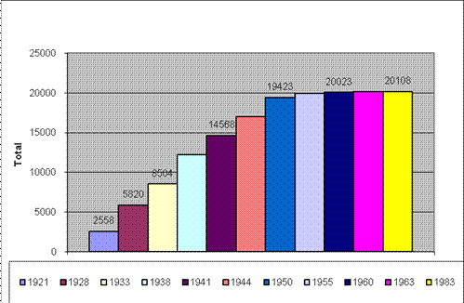
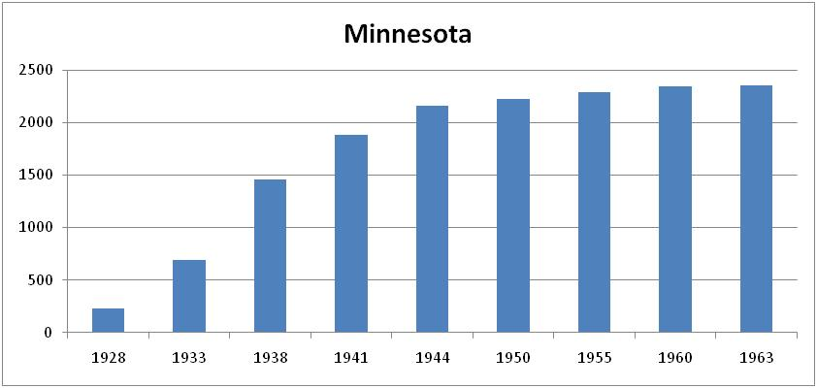
Eugenics sterilizations in California and Minnesota
CA

Slide 7
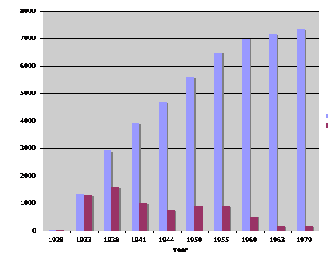
Virginia
cumulative
per period

Slide 8
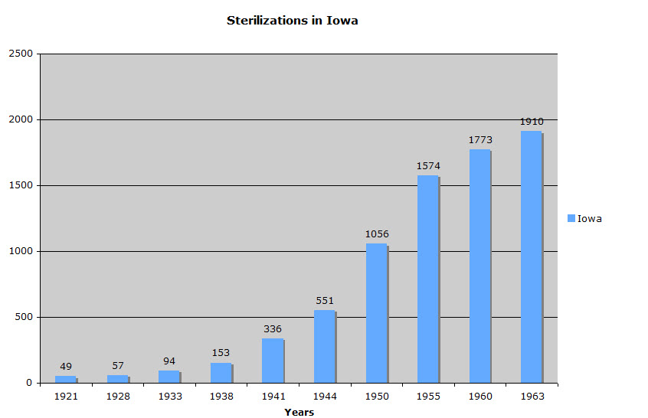
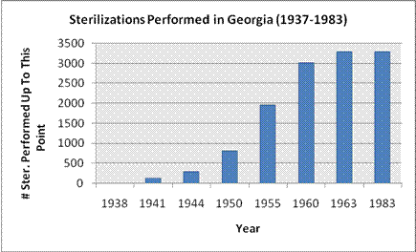
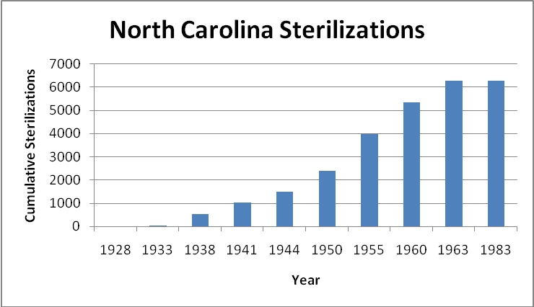
Iowa, Georgia, North Carolina

Slide 9
 | % female victims | % mentally ill | % intellectually disabled | total | victims per year/ 100,000 pop. in peak period | sterilization period (length of time)
National | 61% | 44% | 52% | Est. 70,000+ |  | 1907-earl.1980s (75 years)
CA | 49% | 58% | 37% | 20,000 | 13 | 1909-60s (55 years)
MN | 78% | 18% | 82% | 2,300 | 5 | 1925-earl.1960s (35 years)
VA | 61% | 49% | 48% | 7,300 | 13 | 1924-1979s (50 years)
IA | 71% | 44% | 50% | 1,910 | 6 | 1915-earl.1960s (35 years)
GA | 55% | 77% | 22% | 3,200 | 9 | 1937-1963 (25 years)
NC | 83% | 25% | 70% | 6,300 | 7 | 1929-1974 (45 years)

Slide 10
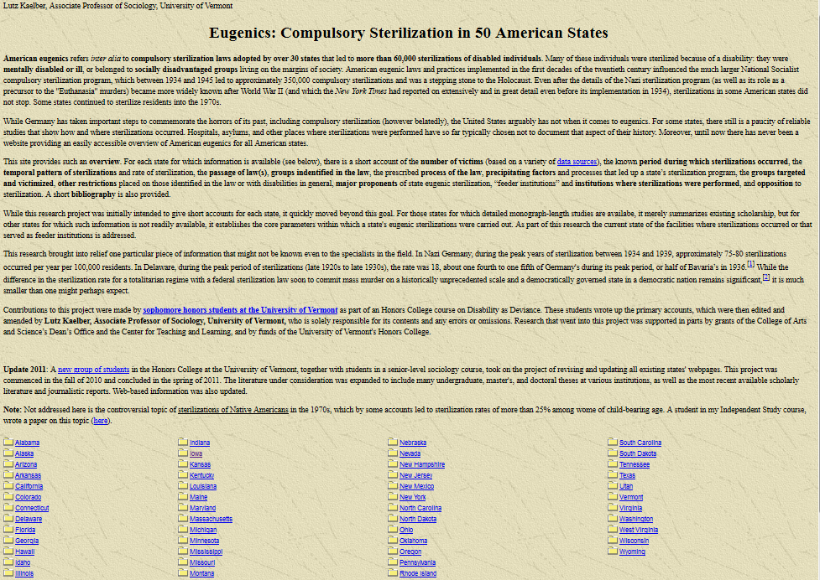

Slide 11
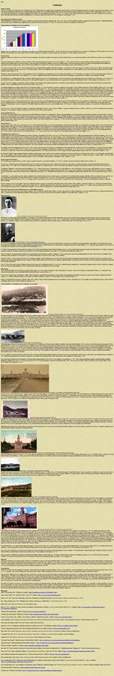
http://www.uvm.edu/~lkaelber/eugenics/CA/CA.html
Number of victims
Temporal pattern of sterilizations
Passage of Laws / Groups identified in the law / process of the law
Precipitating factors and processes
Groups targeted and victimized
Other restrictions on targeted populations
Major proponents of eugenics
“Feeder institutions” and institutions where sterilizations were performed
Opposition
Commemoration
Bibliography

Slide 12
 | % female victims | % mentally ill | % intellectually disabled
NC | 83% | 25% | 70%
NC targeted “black welfare queens” in 1950s and 1960s; sterilization law had “extra-mural” component and allowed sterilization of populations not in state institutions
 | % female victims | % mentally ill | % intellectually disabled
MN | 78% | 18% | 82%
MN: strength of social progressivism with a focus on ‘helping’ intellectually disabled females; sterilization of insane required at least 6 months of continuous institutionalization and consent by individual and next of kin

Slide 13
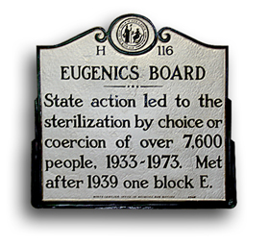
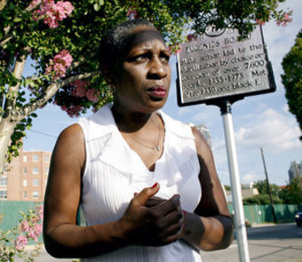
Memorialization of events and commemoration of victims
Inscribed memory
Incorporated memory
Notes:
Sources: North Carolina Dept. of Cultural Resources, at http://news.ncdcr.gov/news/wp-content/uploads/eugenics-board-marker.jpg; http://3.bp.blogspot.com/-h0D2hCu9MAc/TgSUXedGnBI/AAAAAAAACt0/E9goepD-xDo/s1600/elaine-riddick-sterilization-north-carolina-eugenics.jpg

