Slide 1
Fitness propaganda
https://www.youtube.com/watch?v=2W0FfkaIEXE&t=32s

Slide 2
The Situation
What- The fitness industry has been marketing gimmicks to sell the idea of an easier way to get into shape targeting people who want a shortcut to getting into shape
Where- Devices and ideas such as the shake weight, the bow flex, the thigh master, and the vibrating belt etc. have been advertised across all media platforms predominantly in magazines and on television and the radio
When- has paralleled the rise of media in the last century and will continued to be a major part of advertising
Who and How- Companies looking to take advantage of people by targeting their desires for instant gratification, for example, “Use this product and you will grow bigger muscles now”

Slide 3
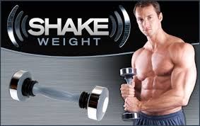
The shake weight
Advertisement: Just hold and gain muscle fast!
According to WebMD experts- For a muscle to be fully stimulated, resistance must be applied through a full range of motion. The Shake Weight does not deliver this and will not result in the same muscular activity as traditional dumbbell exercise, despite what the company claims. Also, you cannot add additional weight to the device and it offers limited exercises. A muscle improves when it is continually challenged with increased resistance and targeted with a variety of exercises. Therefore, very little (if any) results should be expected with the Shake Weight.

Slide 4
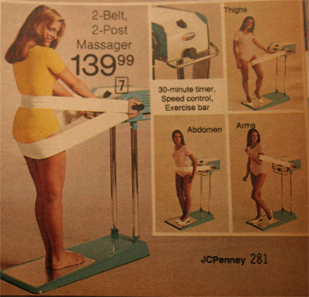
The vibrating belt
Simply stand and lean against the belt as the machine does all the work! Those fat cells can’t help but be loosened and whisked away!
According to WebMD: "I've seen some remarkable results in terms of bone density -- working better than conventional exercise -- plus good effects on circulation and muscle stimulation for those who can't do conventional exercise," says Quist. "But I don't think it can help you lose weight or impact cellulite. There is really no solid medical evidence backing up these or other health claims."

Slide 5
Main Propaganda Techniques used in Advertisements
Testimonials- advertisement of a muscular athlete using a product
Plain Folks- Showing a before and after picture of a regular person who got into shape by using the product
Bandwagon- Everyone is using this product, if you want to be in shape, you should to
Fear- Advertisement of an out of shape person eating chips on the couch… “Don’t be this guy!”

Slide 6
Success
This type of propaganda has been very successful in terms of companies making money off of people who are less educated in fitness and want shortcuts or easier ways to get into shape
This propaganda is less successful for educating people on proper fitness which takes dedicated, consistent effort over a period of time to gain results. Relying on gimmicks or short cuts to get fit will leave you with less money and frustration

Slide 7
Thank you!

