Slide 1
Breitbart News Network
Sam Wiehe

Slide 2
“They are certainly a much more conservative paper, to put it mildly, than the New York Times. But Breitbart really is a news organization that has become quite successful. It’s got readers, and it does cover subjects on the right, but it covers subjects on the left also. It’s a pretty big thing.”
Why is this an important quote?

Slide 3
Preview
About the company
Classification
Ownership
Politics
Money
Source: Breitbart

Slide 4
What do they do/what is their mission?
Breitbart is a far-right/alt-right news website, which provides commentary, news, and opinion pieces.
Breitbart.com launched in 2005 as a news aggregator site to link to other news sites, and became its own independent entity in 2007.
Founder Andrew Breitbart wanted to start a conservative website that was “unapologetically pro-freedom.”
The site is notable for publishing many falsehoods, sensationalized stories, and wild conspiracy theories - More on that in a minute!
Size: Breitbart is the 34th most popular site in the United States. They rank 235th globally.

Slide 5
Classification
Breitbart News would most likely fit under the banner of the journalism of affirmation. Because of their extreme right-wing bias and alt-right publishings, Breitbart has a reputation for catering to its conservative audience and reaffirming their already-held beliefs. They are known for cherry-picking facts, exaggerating claims, and having lopsided, ill-informed op-ed pieces about our current political climate.

Slide 6
Some examples of Breitbart content
Full disclosure: While these are undoubtedly some of their more out-there headlines, I feel that these are still representative of Breitbart’s mission statement and tonal quality. Keep in mind, this is the 34th most popular site in this country, and is not satirical or comedic.
“Birth control makes women unattractive and crazy” - Posted 12/8/17
“Racist, Pro-Nazi Roots of Planned Parenthood Revealed” - Posted 7/14/15
“Hoist It High and Proud: The Confederate Flag Proclaims a Glorious Heritage” - Posted 7/1/15
“The Solution to Online ‘Harassment’ is Simple: Women Should Log Off - Posted 7/5/16

Slide 7
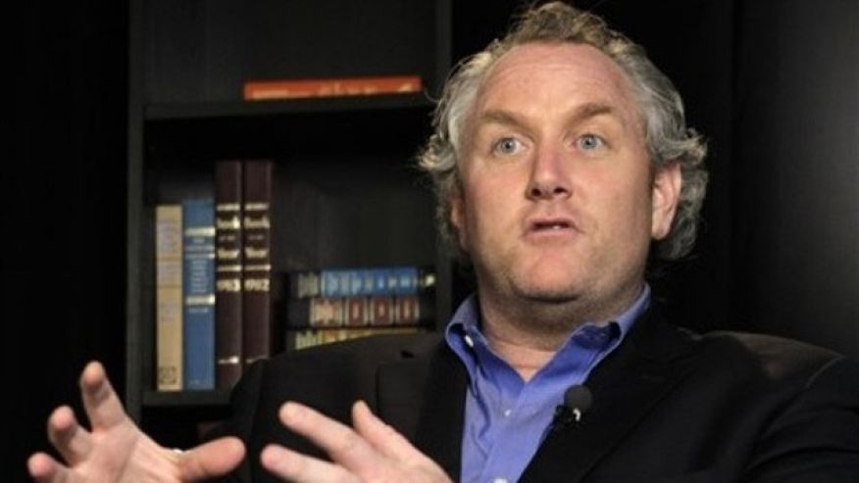
Ownership
Breitbart News is owned by Breitbart News Network, LLC.
The current CEO of the company is Larry Solov, co-founder and co-creator. Former CEO Andrew Breitbart passed away in 2012.
Very little is known about the corporate structure of the company, but Breitbart News appears to be the only product of the parent company.
Left: Andrew Breitbart
Right: Larry Solov
Source: Fox News
Source: Los Angeles Business Journal

Slide 8
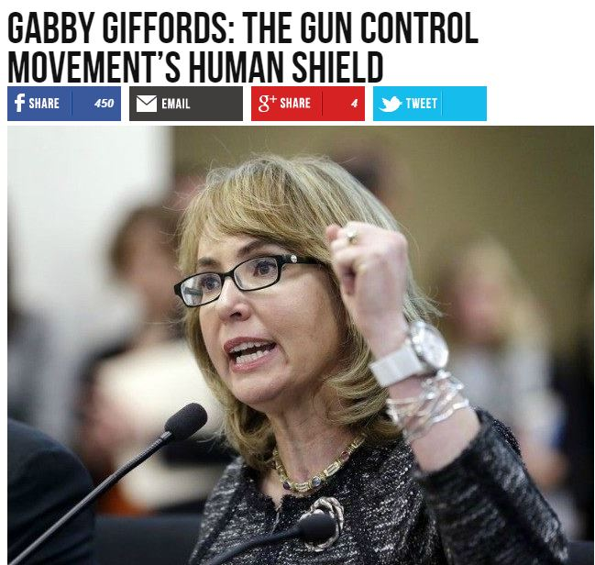
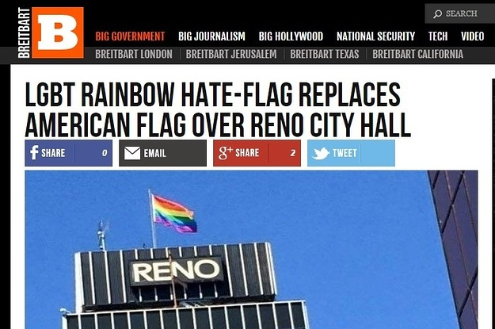
Political leanings
As mentioned previously, Breitbart caters to alt-right, conservative beliefs exclusively.
You will be incredibly hard-pressed to find anything on the site that speaks to liberal, or even moderate political beliefs. The company is a strong supporter of the Trump Administration, and has posted several hundred positive op-ed pieces about the work they’ve been doing.
Former executive Steve Bannon is currently Trump’s Chief Strategist, a source of huge controversy - More on that in a minute!
Source: Media Matters
Source: BuzzFeed

Slide 9
Structure/sales
There doesn’t appear to be any publicly available information regarding the corporate structure of Breitbart. As far as making money is concerned, it could be inferred that they make money from advertising revenue. Being a highly-trafficked site, it’s clear that they must be making a considerable amount of money from banner ads and affiliate programs. The company is not publicly traded, but there appears to be a board of directors. The company is private, and does not have any information available regarding sales figures or revenue.

Slide 10
Issues/controversy
Breitbart has been consistently accused of being peddlers of fake news, and for publishing content that is racist, xenophobic, misogynistic, and sensational.
Controversial employee Milo Yiannopoulous resigned in February 2017 after making comments endorsing pedophilia.
Former executive Steve Bannon is a very high-ranking member of Trump’s administration. This has sparked controversy because of Bannon’s anti-media agenda, incendiary remarks, and affiliation with Breitbart’s offensive content. Breitbart is one of the few media outlets granted full access to White House press briefings.
Breitbart was one of the key figures in the controversy regarding Obama’s birthplace, which turned out to be a complete fabrication and conspiracy theory.
Most recently, Breitbart published a story claiming that the Obama administration wiretapped Trump Towers. Incredibly coincidentally, just hours after the publishing of this story, Trump went public with this accusation.

Slide 11
Summary
Breitbart News is a controversial company, with a history of publishing offensive, factually untrue content.
This in mind, the key players of Breitbart have real-world influence.
Steve Bannon has a great deal of influence in the White House, Milo has been the cause of riots and protests.
While little is known about the corporate structure, we know that Breitbart is an incredibly popular website and is growing fast.
Questions for you folks to consider: What are the implications of this site’s popularity? What do you think of Breitbart? Do you know people that enjoy the site?

