Slide 1
Gardening & Nutrition
Faith Nazarene Primary School
Esci 375
Applications to Sustainable Development
Team Members:
Deborah Cal
Raymond Edwards
Travis Garvais
Margaret Fitzgerald
Margaret Stone
Elida Tuyud

Slide 2
Overview
Background
Project Goals
Methods
Results
Recommendations
Conclusion
Acknowledgements

Slide 3
Background
Nutrition Issues in Belize
Education
Gardening and Nutrition at Faith Nazarene

Slide 4
Project Goals
To teach nutrition in a way that serves students needs and at the same time is engaging and interesting to them
Create a garden that children can work and learn in
Provide Faith Nazarene the foundation to teach future students about the importance and maintenance of gardening

Slide 5
Methods
Lessons
  Health and Fitness
  Circulatory System
  The Environmental Problems and The 3 R’s
  Ecosystems and The Food Chain
  Ecosystem Protection
Gardening
  Garden Journal
  Watering Cans
  Jobs
  Signs
  Work

Slide 6
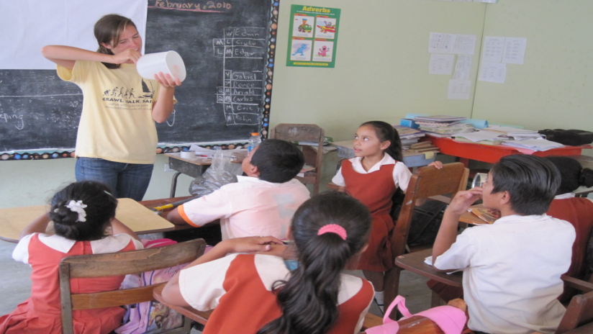
Lesson Plans
Margaret teaching the students how to make watering cans.

Slide 7
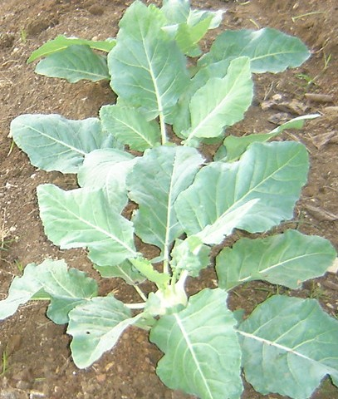
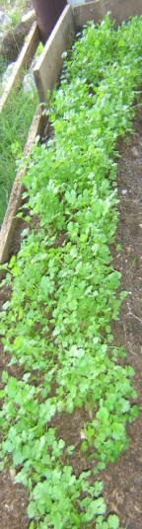
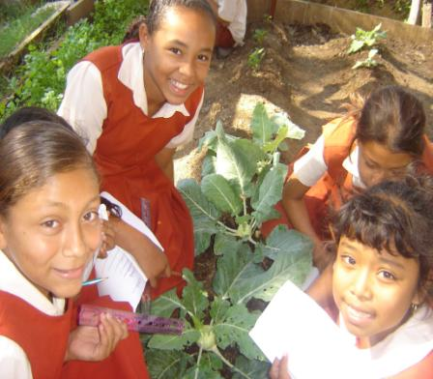
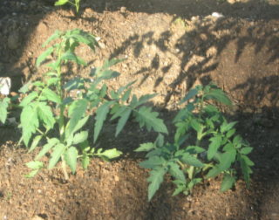
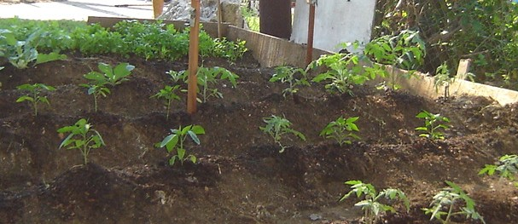
Final Results

Slide 8
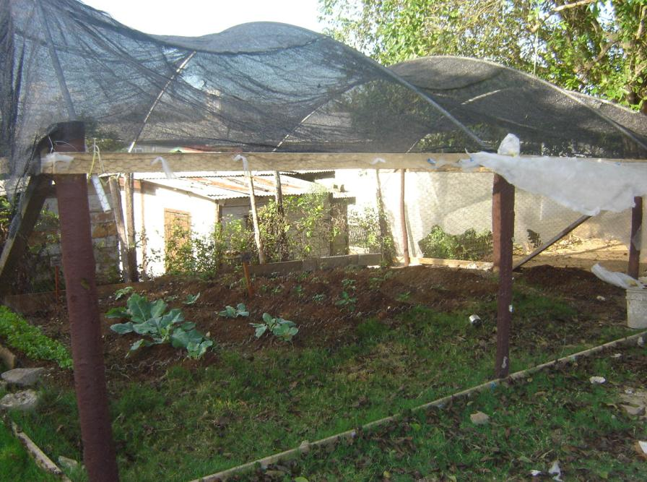

Slide 9
Recommendations
Nutrition and Gardening vs. Curriculum
Student Chores
Primary School Calendar
Communication
Garden Area

Slide 10
Conclusion
Followed the Curriculum

Slide 11
Acknowledgements
Joni Miller
Mr.Urbina
Mr. Valasquez
Mr.Brandon
Mr.Tuyud
4-H organization
Ms.Flowers
Mr. Loague

