Slide 1
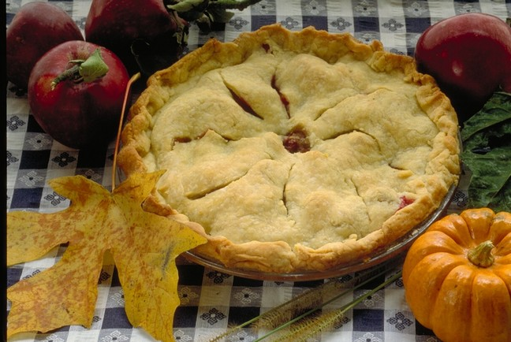
As American as…
PBIO 006
March 25, 2014

Slide 2
Lecture Outline As American as …
The morphology and natural and cultural history of several familiar fruits in the:
Rose family (Rosaceae)
Heath family (Ericaceae)
Squash family (Cucurbitaceae)
Bean family (Fabaceae)

Slide 3
Thanksgiving Dinner … what’s on the table?
Turkey and stuffing
Squash
Green beans
Mashed potatoes
Cranberry sauce
Apple, blueberry, and pumpkin pie

Slide 4
Thanksgiving Dinner … what’s on the table?
Turkey and stuffing
Squash
Green beans
Mashed potatoes
Cranberry sauce
Apple, blueberry, and pumpkin pie

Slide 5
Thanksgiving Dinner … what’s on the table?
Turkey and stuffing
Squash
Green beans
Mashed potatoes
Cranberry sauce
Apple, blueberry, and pumpkin pie

Slide 6
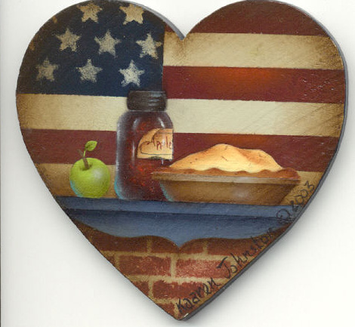
As American as Apple Pie
But just how American is apple pie?

Slide 7
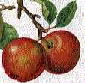
Apple
(Malus domestica)
Rosaceae

Slide 8
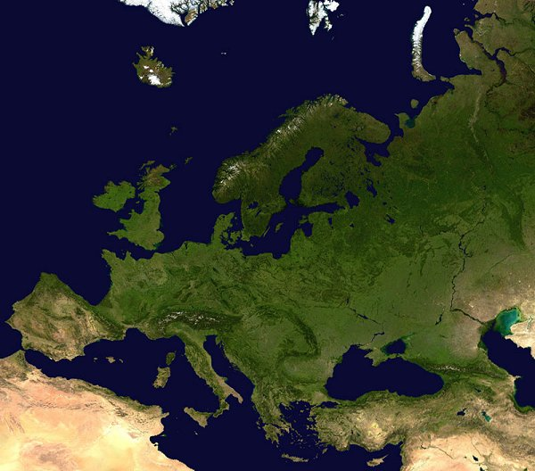
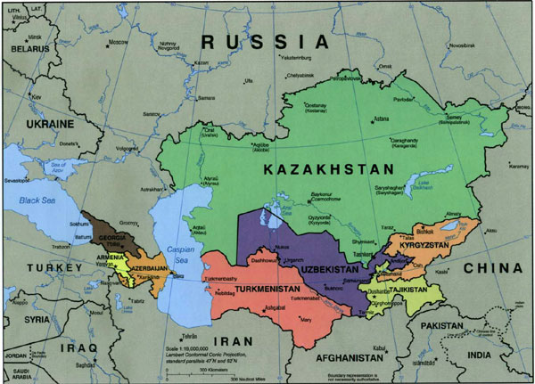
Apples are native to the mountains of central Asia …
Kazakhstan
Caspian Sea
Black Sea

Slide 9
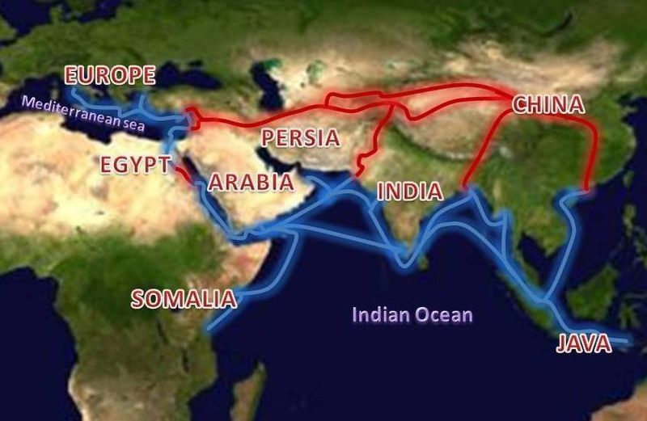
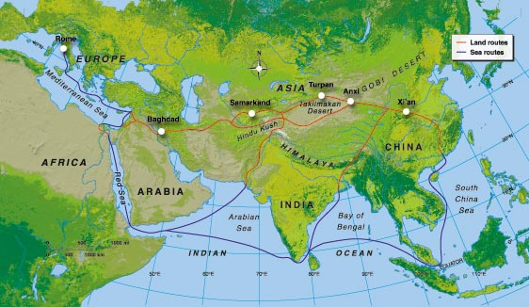
Apples spread west with traders along the Silk Road

Slide 10
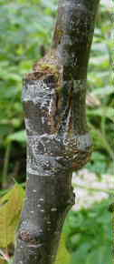
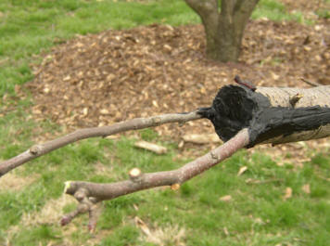
Roman horticulturalists established consistent
varieties by grafting.

Slide 11
So what is American about apples?

Slide 12
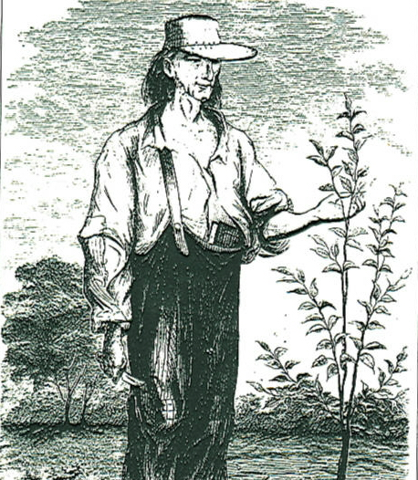
John Chapman and the
Americanization of apples
John Chapman
1774-1845

Slide 13
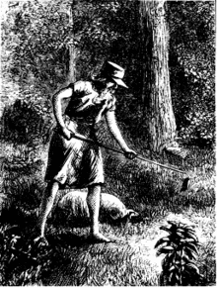
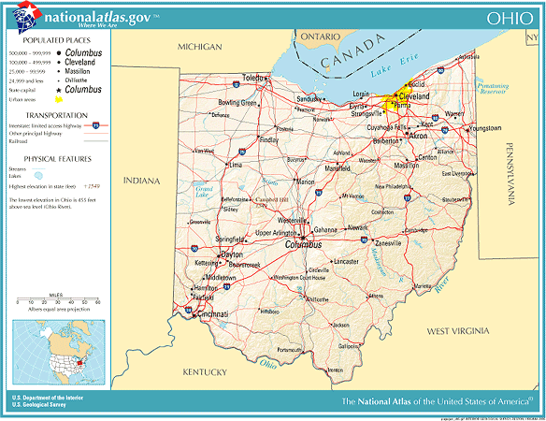
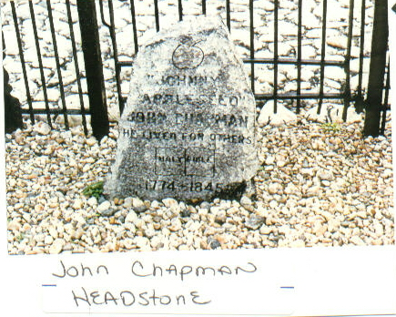

Slide 14
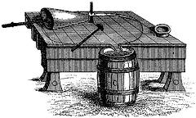
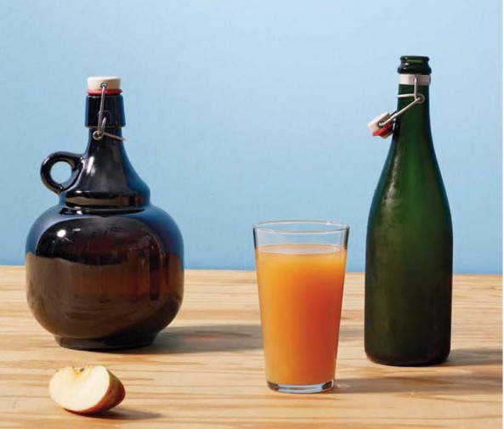
What were John Chapman’s
apples used for?
Applejack, the drink of choice on the American frontier!

Slide 15
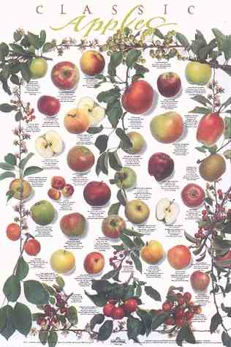
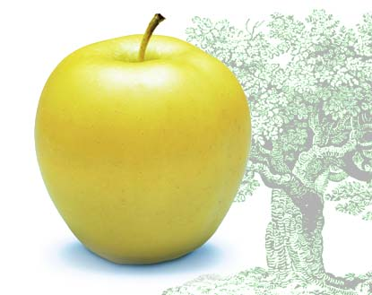
Golden Delicious

Slide 16
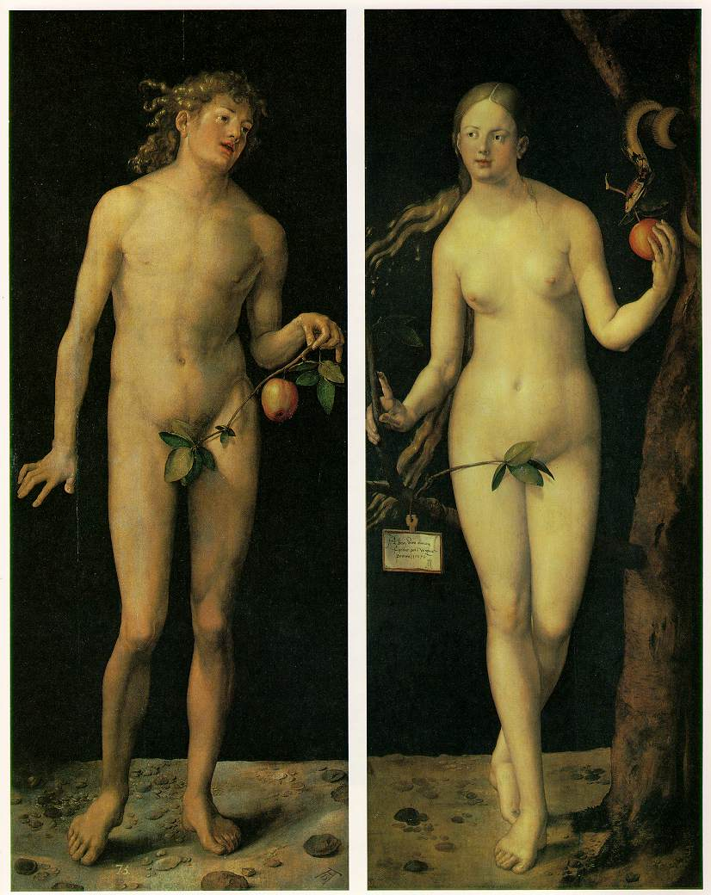
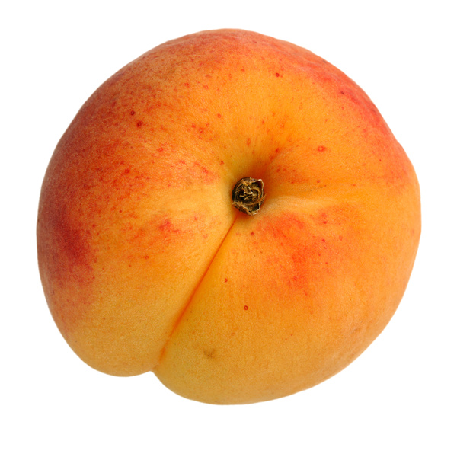
The Apple in History and Folklore
History’s most famous apple
eaters …
μήλο:
mālum (evil) or
malus (apple)?
Adam and Eve
Albrecht Durer 1507

Slide 17
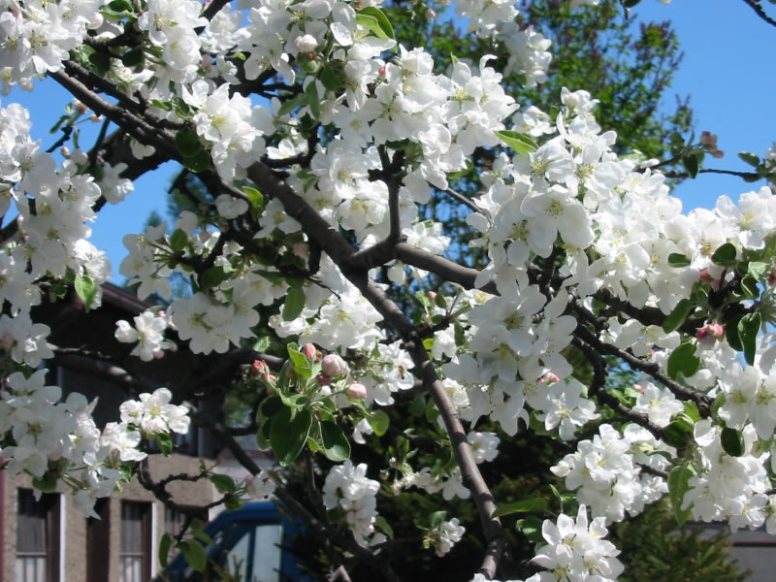
Flower and Fruit Structure

Slide 18
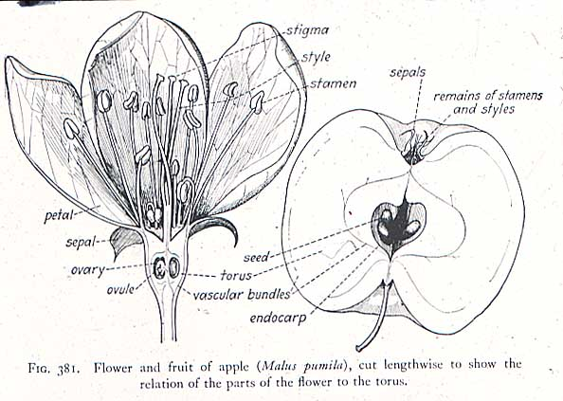
The apple is the product of an inferior ovary…

Slide 19
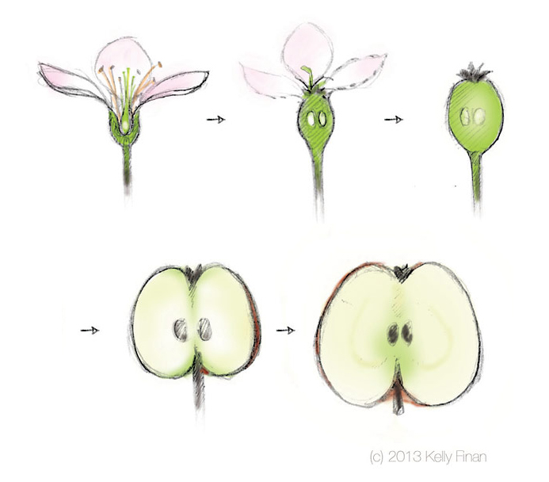

Slide 20
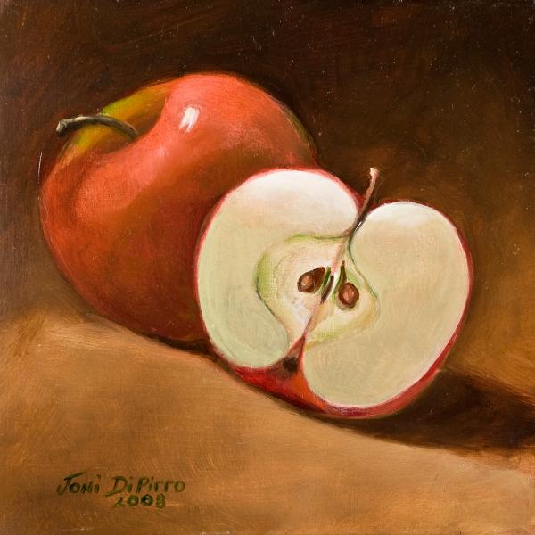
The apple, a simple, fleshy, accessory fruit
In this longitudinal section of the apple fruit, the green line delineates
the ovary wall (core) from the accessory tissue (the tasty part!)

Slide 21
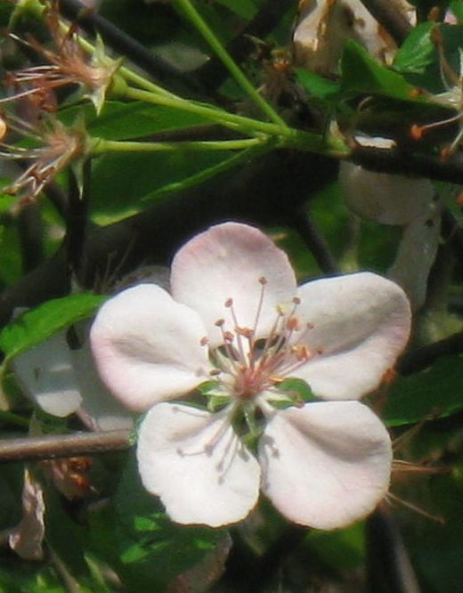
Rose Family (Rosaceae)
Leaves are alternate
Flowers are radially symmetrical,
with 5 petals and many stamens
Fruits various, including drupes
(cherries, peaches), achenes
(roses), aggregate fruits
(raspberries), & pomes (apples)
The Rose family is the third most
economically important plant family

Slide 22
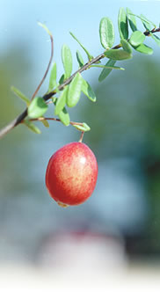
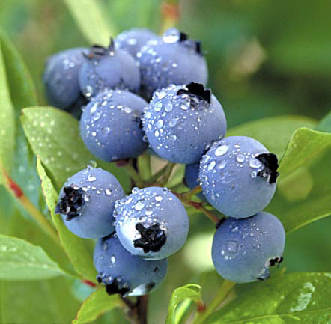
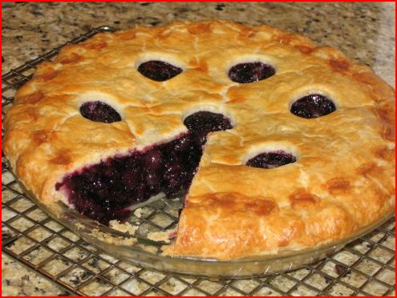
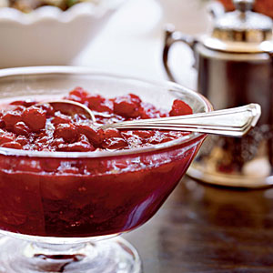
Truly American fruits:
the cranberry and the blueberry
Both were domesticated within the last 200 years.

Slide 23
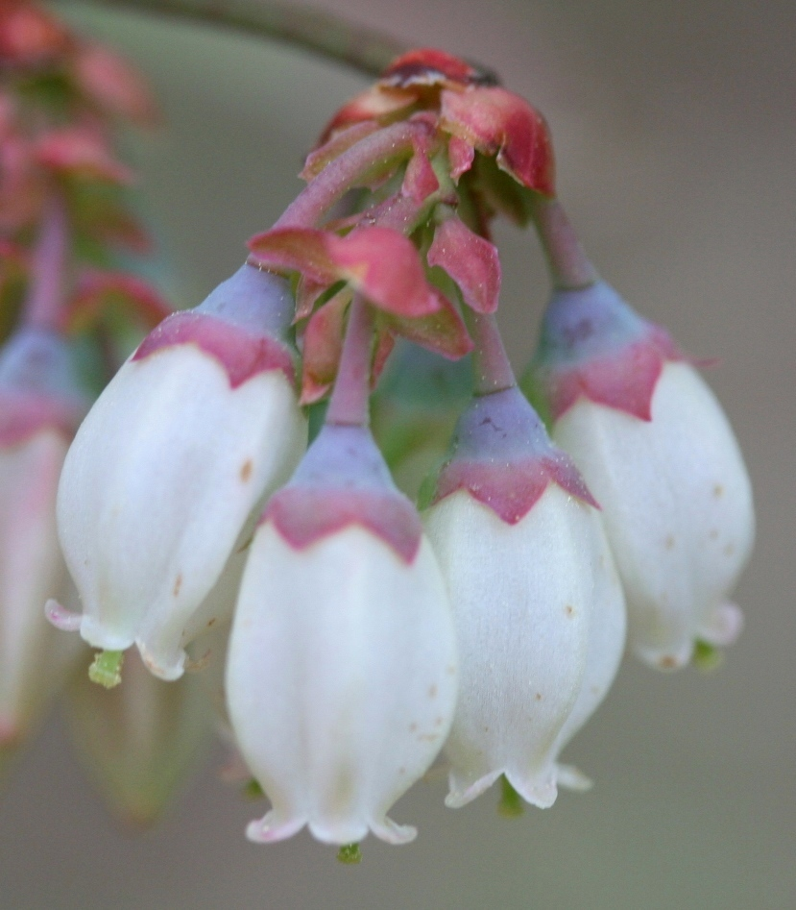
Heath Family (Ericaceae)
Leaves are alternate, often leathery and evergreen
Often shrubs
Flowers are often urn-shaped,
with 4 or 5 fused petals
Fruit is a berry (blueberry,
cranberry) or a capsule (rhododendron, azalea)

Slide 24
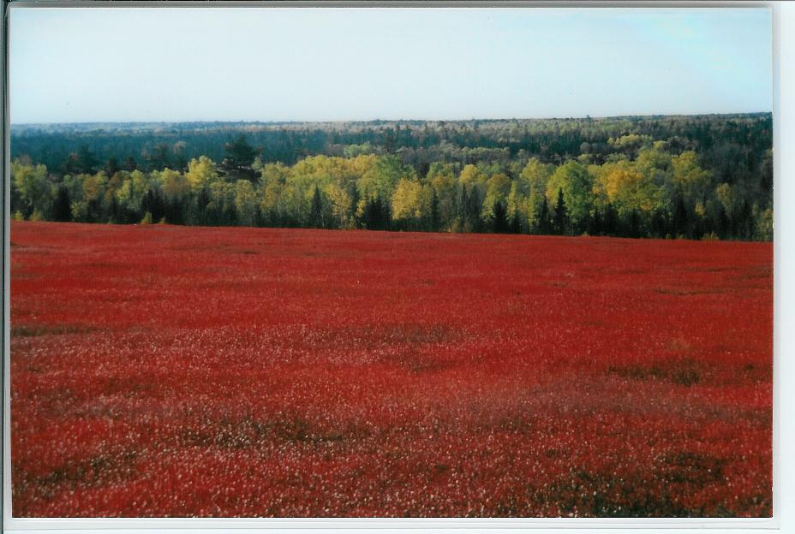
Blueberry barrens in autumn, Washington Co., Maine
Members of the heath family thrive in bogs and acid soils.

Slide 25
Cranberry: native to northeastern North America

Slide 26
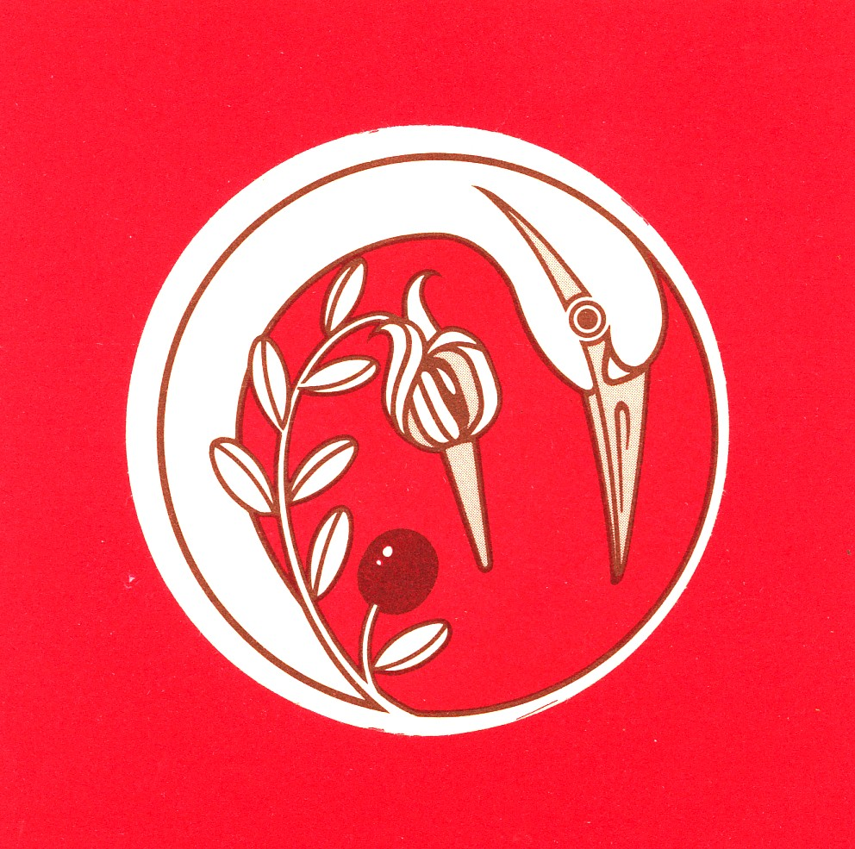
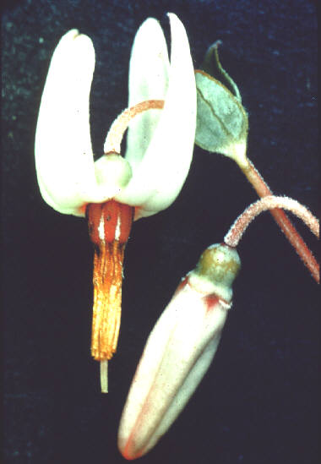
The name cranberry comes from the early Dutch and German settlers, who nicknamed it “craneberry” after the shape of the blossoms.

Slide 27
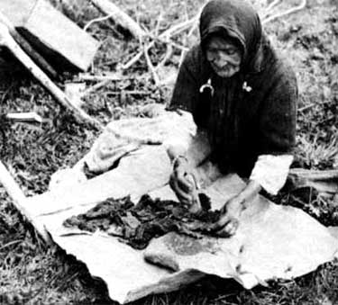
Native Americans
mixed crushed
cranberries with dried,
shredded strips of
deer meat and fat
to produce pemmican,
a high-energy journey
food.

Slide 28
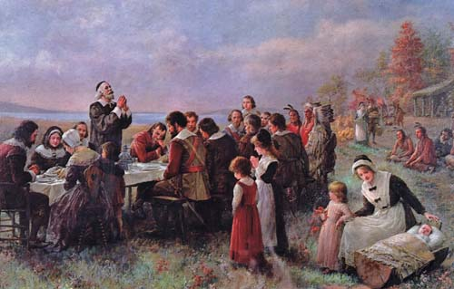
Legend has it that the Pilgrims, having learned of their use from the Wampanoag, served cranberries at the first Thanksgiving

Slide 29
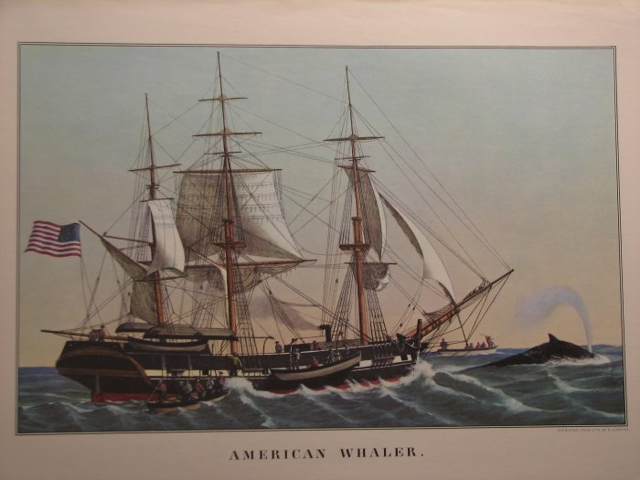
American whaling ships carried cranberries, rich in vitamin C, to prevent scurvy

Slide 30
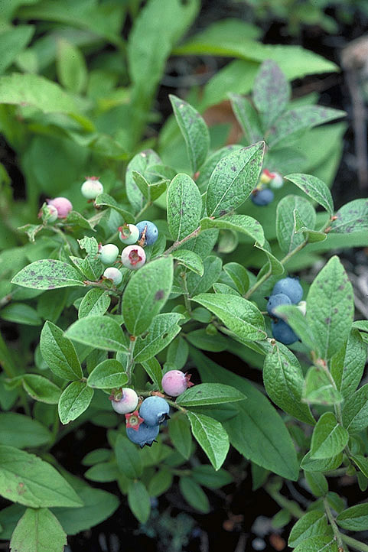
Blueberries

Slide 31
Blueberry: also native to northeastern North America

Slide 32
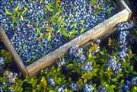
Blueberries are rich in antioxidants:
Research shows that blueberries are # 1 in antioxidant capacity per serving, compared with more than 20 other fruits, including cranberries, strawberries, plums, and raspberries. Antioxidants are associated with reducing the risk of many chronic diseases.
Journal of Agricultural and Food Chemistry, 2004, 52: 4026-4037

Slide 33
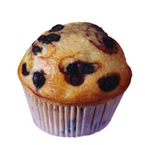
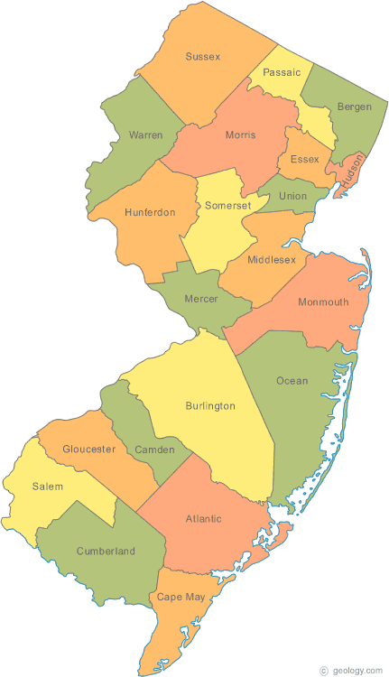
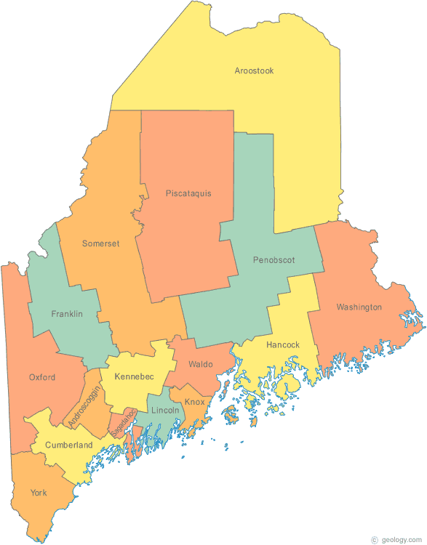
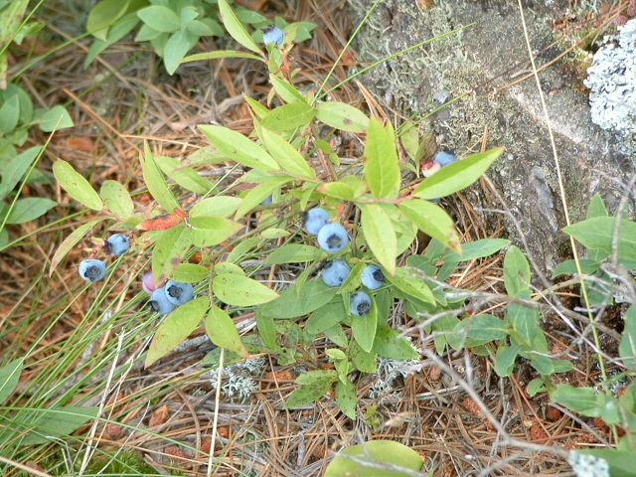
Commercially important blueberries
Lowbush blueberry
Vaccinium angustifolium
Highbush blueberry
Vaccinium corymbosum

Slide 34
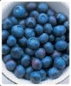
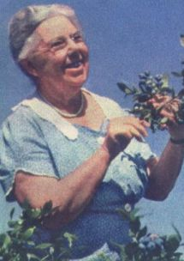
Elizabeth Coleman White,
developer of the commercial
New Jersey blueberry

Slide 35
Squashes and Pumpkins

Slide 36
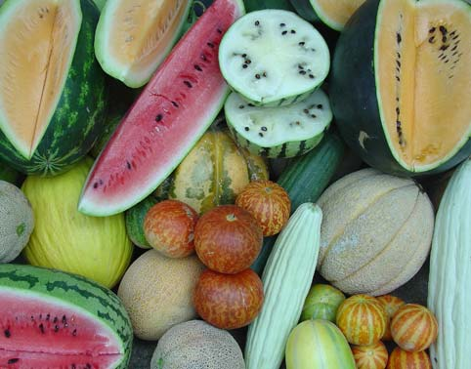
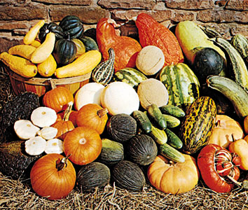
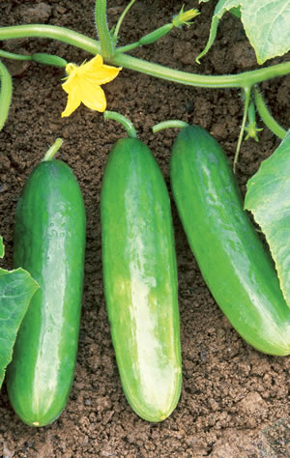
melons
The Squash Family
Pumpkins, squashes, and gourds
New World Origin
cucumbers
Old World Origin

Slide 37
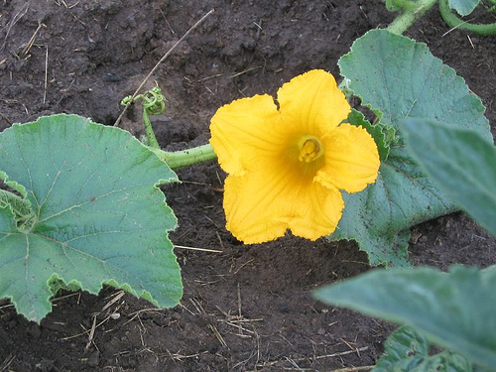
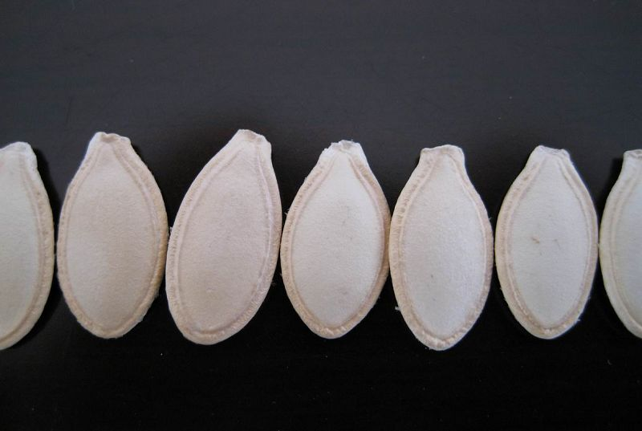
Cucurbitaceae
The Squash Family
Herbaceous vines with tendrils
Flowers unisexual, radially symmetrical,
often yellow or orange
Ovary inferior
Fruit a pepo
Seeds flat, tear-drop shaped

Slide 38
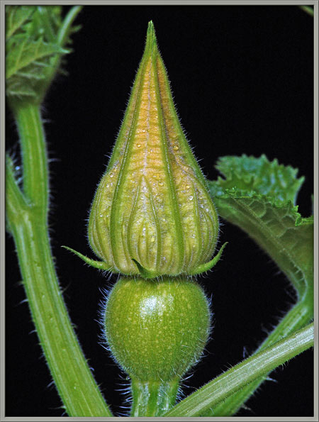
Pumpkin: inferior ovary will develop
into the fruit after
pollination and
fertilization.

Slide 39
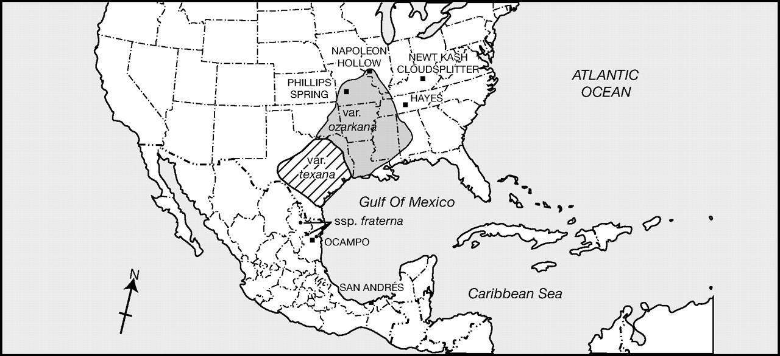
Cucurbita pepo was independently domesticated twice. Cucurbita pepo subsp. pepo (pumpkins) was developed ca. 10, 000 years ago in Mexico. Cucurbita pepo subsp. ovifera (acorn squashes), was domesticated about 5000 years ago in eastern North America.
Smith B D PNAS 2006;103:12223-12228
©2006 by National Academy of Sciences
Notes:
Location of archaeological sites discussed in the text and the present-day geographical range of the three wild Cucurbita gourds identified as potential progenitors of pepo squash (Cucurbita pepo ssp. ovifera).

Slide 40
Green Beans (Phaseolus vulgaris)
Fabaceae

Slide 41
Fabaceae Pea Family
Vegetative Features
Leaves alternate, compound
Some species are twining vines
Nodules present on the
roots

Slide 42
Fabaceae, Reproductive Features
Flowers bilaterally symmetrical
Androecium of 9 fused stamens and one free stamen
Pistil simple
Fruit a legume

Slide 43
Economic Importance
The second-most economically important family of flowering plants and the third largest
Source of peas, beans, alfalfa, clover
Nitrogen fixation
Source of indigo dye

Slide 44
Rhizobium bacteria
dwelling in the root
nodules fix atmospheric
nitrogen and make it
available to the plants
Notes:
Ended here on Tuesday, March 20.

Slide 45
Green beans (Phaseolus vulgaris; Fabaceae), domesticated in
Mesoamerica by 7000 years ago

Slide 46
The Three Sisters:
Maize, green beans,
and squash, planted
together by Native
Americans. The
cornstalk would serve
as a trellis for the beans
to climb while the beans
would fix nitrogen
for the corn. The viney
squash plants serve as a
ground cover, minimizing
the growth of weeds
beneath the trio.
2009 Sacagawea dollar coin

Slide 47
Lecture Review: As American as …
Trace the history of the apple, from the mountains of central Asia to the American frontier.
Explain apple flower and fruit structure.
Name two fruits that are native to northeastern North America. Discuss their uses, both historically and in the present time.
Describe the squash family, both botanically and with respect to human uses. Where were pumpkins first domesticated? Acorn squashes?
What is a legume? Why are they so nutritious?
What are the Three Sisters? Why do these crops compliment one another so effectively?

