Slide 1
Directions: Take one yellow jelly bean and two
red jelly beans. DO NOT EAT!!

Slide 2
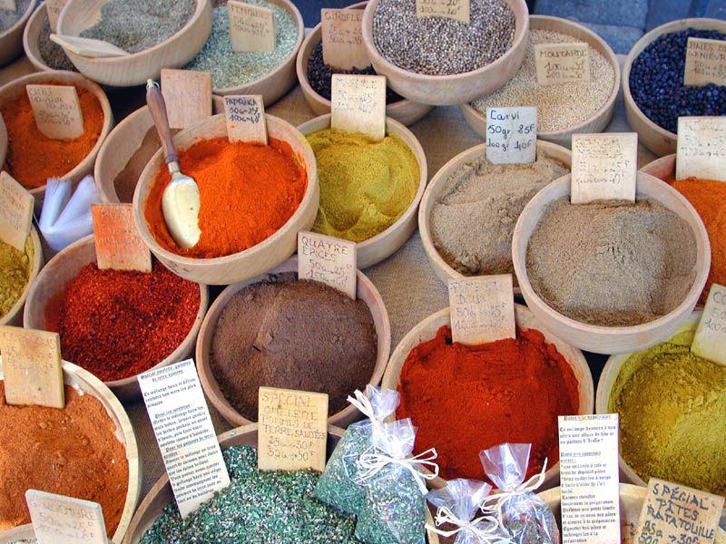
Spices, Herbs, and Perfumes
PBIO 006
Spring 2014
Chapter 17

Slide 3
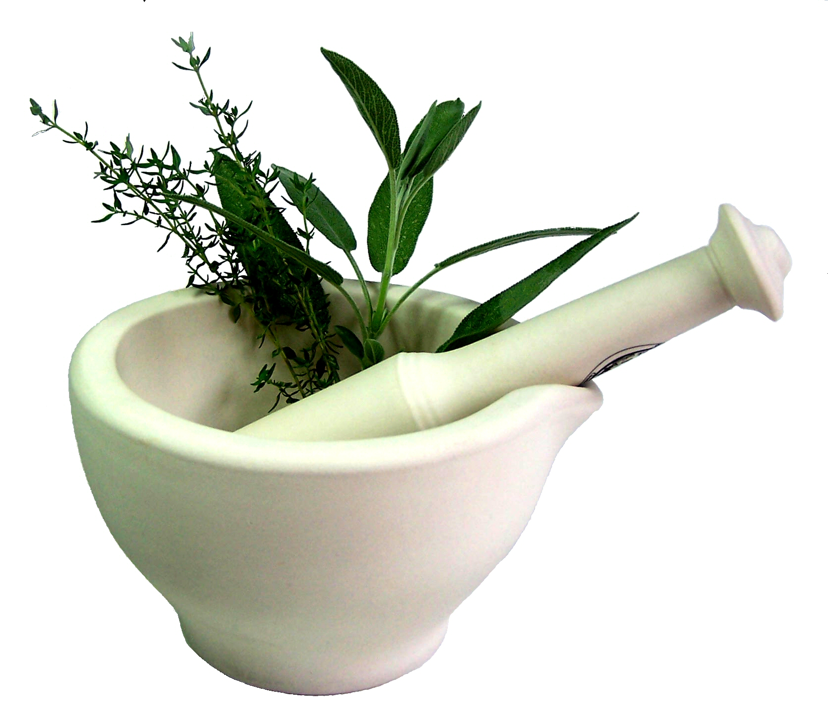
Spices, Herbs, and Perfumes
Lecture Outline:
I. Differences between herbs and spices
II. Why did ancient cultures use spices?
III. Terpenoids/essential oils
IV. The biology of taste and smell
V. Ancient trade of spices
VI. Spices of the Old World tropics: cinnamon, clove, nutmeg and mace, ginger, and turmeric
VII. Spices of the New World tropics: capsicum peppers and vanilla
VIII. Herbs of the mint, parsley, and mustard families
IX. Perfumes: patchouli, frankincense, and lavender

Slide 4
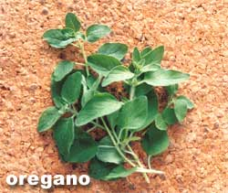
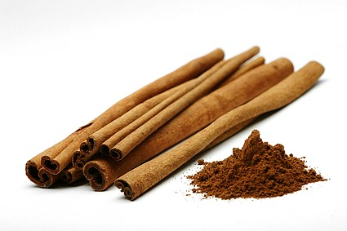
Herbs: aromatic leaves; temperate origin
Example: oregano
Spices: aromatic bark, buds, flowers, seeds; tropical origin
Example: cinnamon

Slide 5
The characteristic scent of aromatic plants is due to the presence of essential oils, volatile substances occurring in specialized glands in the leaves, flowers, and fruits.

Slide 6
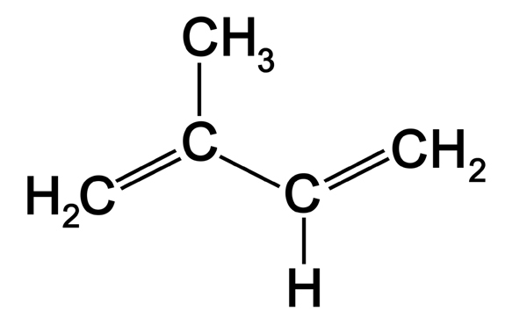
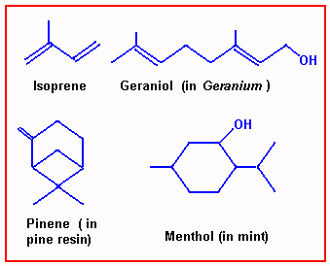
Most essential oils contain terpenes, a large group of
hydrocarbons with a common building block of C₅H₈
Notes:
Most essential oils contain terpenes, a large group of (unsaturated) hydrocarbons with a common building block of C₅H₈
Role of essential oils unknown. In flowers, probably serve to attract pollinators. (Many moth pollinated flowers have heavy scents, for example: jasmine, gardenia) Maybe they discourage herbivores or inhibit bacterial and fungal pathogens.

Slide 7
Why have spices been used?
Food preservation may have been the initial function. Many herbs and spices have been shown to inhibit food borne bacteria. Onions, garlic, allspice, and oregano are especially effective in this respect.
Notes:
Antimicrobial properties related to the history of their use: many herbs and spices have been shown to inhibit food-borne bacteria. Onions, garlic, allspice, and oregano especially effective.

Slide 8
A matter of taste …

Slide 9
The yellow jelly bean tastes like …
Clicker Question
Lemonade
Grapefruit
Pear
Banana
Sweet but non-descript

Slide 10
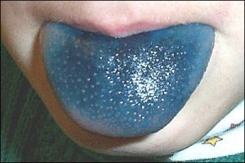
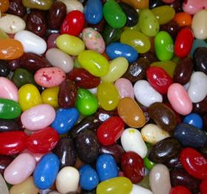
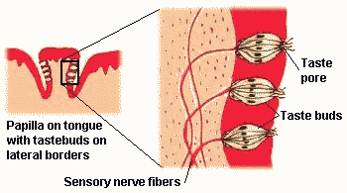
sour
salt
umami
sweet
bitter

Slide 11
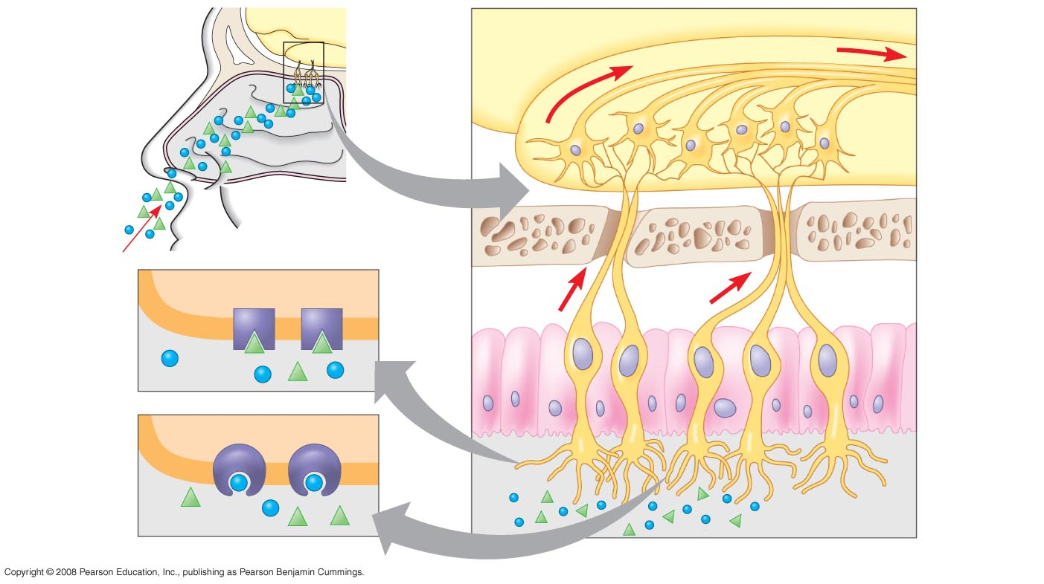
How do we smell?
Oops, wrong photo!
Brain
Olfactory bulb
Odorants
Nasal cavity
Bone
Odorant receptors
Smell receptor
Plasma membrane
Odorants

Slide 12
The senses of smell and taste together contribute to flavor.
Tongue - distinguishes only among five tastes
Nose - distinguishes among hundreds of sub- stances, even in minute quantities

Slide 13
The red jelly bean tastes like …
Clicker Question
Apple
Cherry
Raspberry
Cinnamon
Other

Slide 14
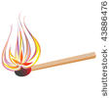
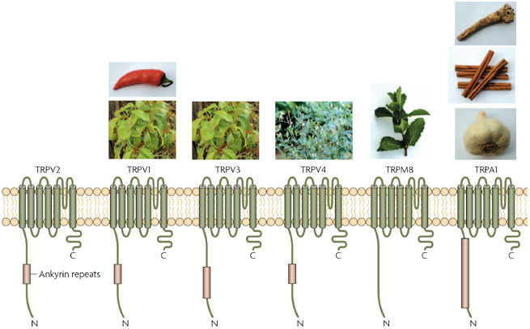
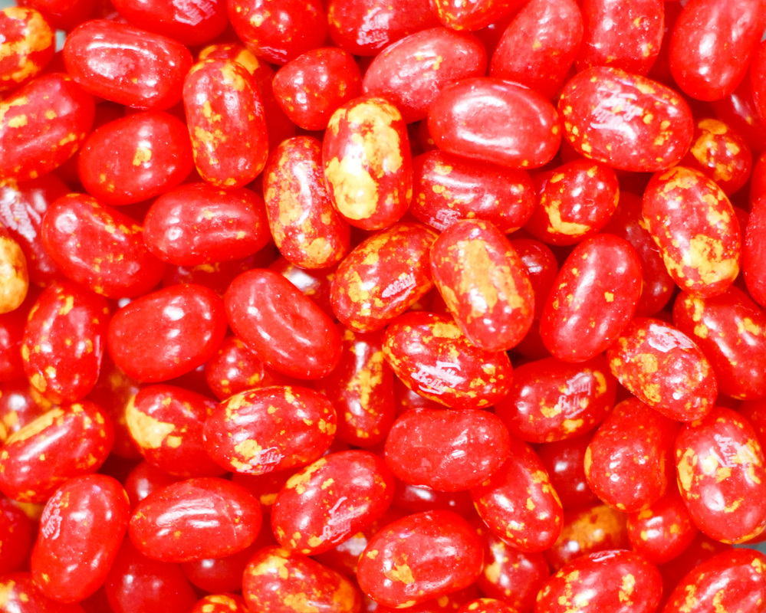
Capsaicin and painful heat both activate sensory nerves through the same ion channel, which explains why our mouths feel hot when we eat chili peppers and other spicy foods.

Slide 15
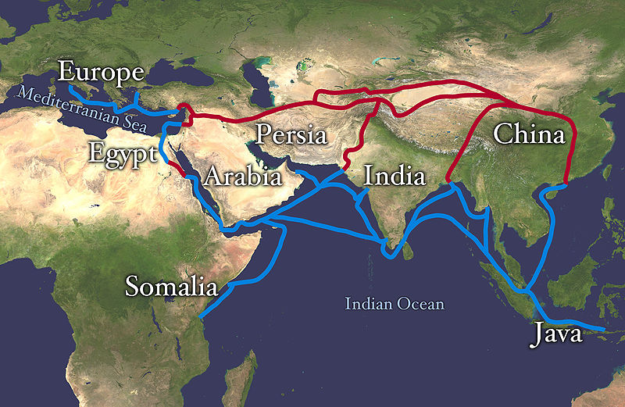
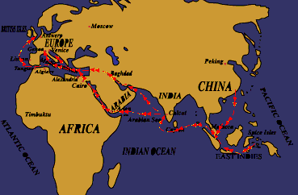
A Brief History of the Spice Trade

Slide 16
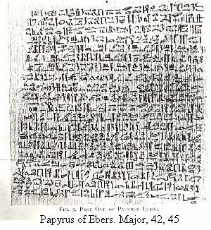
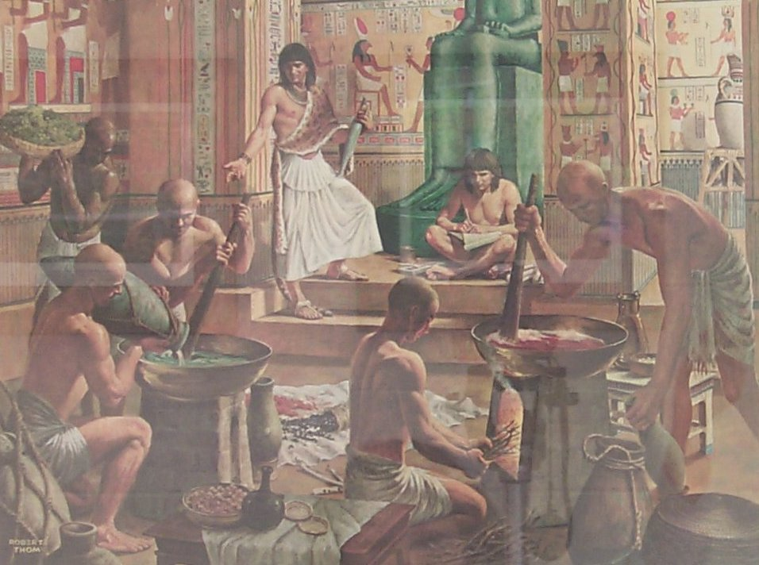
Ancient Egyptians used spices
in medicine, cooking, in
embalming, and for perfume.
Ebers Payrus,
ca. 3500 ybp
Notes:
The Ebers Papyrus, written ca 3500 years bp, is a scroll that lists the medical uses of many plants. On it are anise, caraway, mustard, saffron, etc. Cinnamon and cassia, native to SE Asia, are also mentioned in Egyptian writings, showing that trade in spices was underway even then.

Slide 17
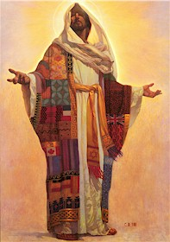
Joseph, of the coat of
many colors, was sold to
spice traders bound for
Egypt.
Notes:
"And behold, a company of Ishmaelites came from Gilead (present-day Jordan) with their camels bearing spicery and balm and myrrh, going to carry it down to Egypt."

Slide 18
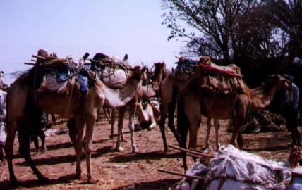
The route from Gilead to Egypt was part of the "golden road to Samarkand" traveled for hundreds, almost thousands of years, bringing pepper and cloves from India, cinnamon and nutmeg from the Spice Islands (or Moluccas), ginger from China.
Notes:
The route from Gilead to Egypt was part of the "golden road to Samarkand" traveled for hundreds, almost thousands of years, bringing pepper and cloves from India, cinnamon and nutmeg from the Spice Islands (or Moluccas), ginger from China.� ASTA website

Slide 19
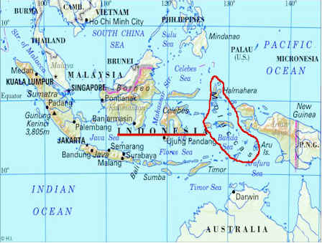
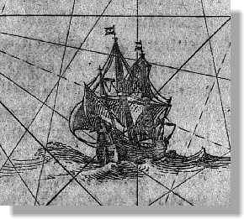
Moluccas - the Spice Islands

Slide 20
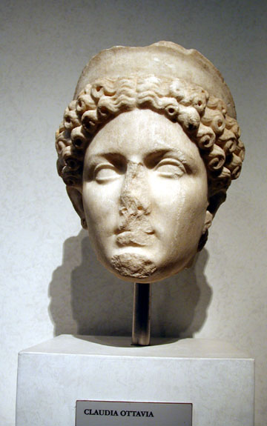
1st century A.D. - The use of herbs and spices spread
throughout Europe with Roman civilization. When Nero’s wife died in 65 A.D., a year’s supply of cinnamon was burned at her funeral.
Notes:
Use of herbs and spices spread through Europe with the Roman civilization. Their use in cuisine expanded, as well as for luxuries such as bath oils, lotions, and perfumes. When Nero’s wife died in Rome in 65 AD, a year’s supply of cinnamon, the most precious commodity in the imperial storehouse, was burned at her funeral.
In the West, trade collapsed with the fall of Rome in the fifth century AD. Little happened in the Dark Ages. (Medicinal herbs cultivated in monastery gardens.)

Slide 21
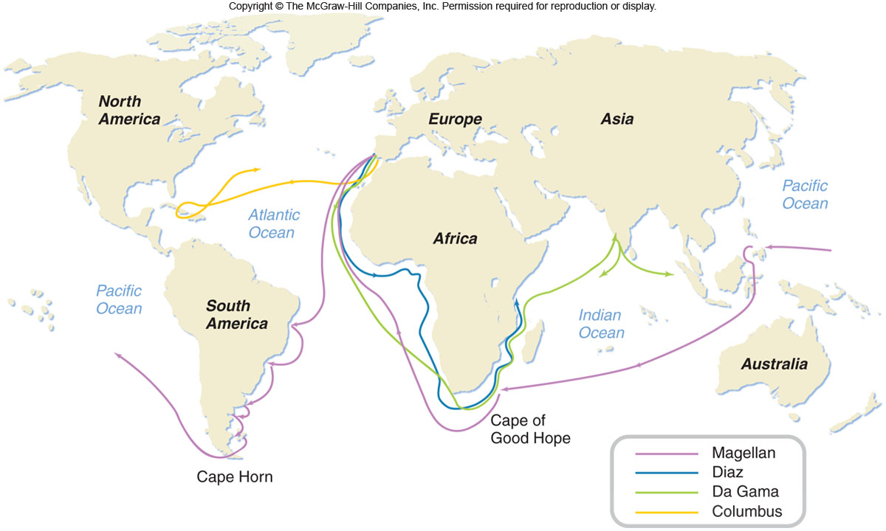
European explorations for exotic spices

Slide 22
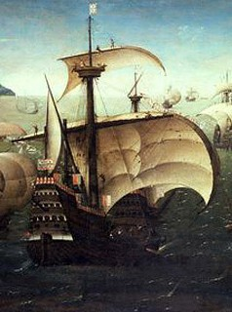
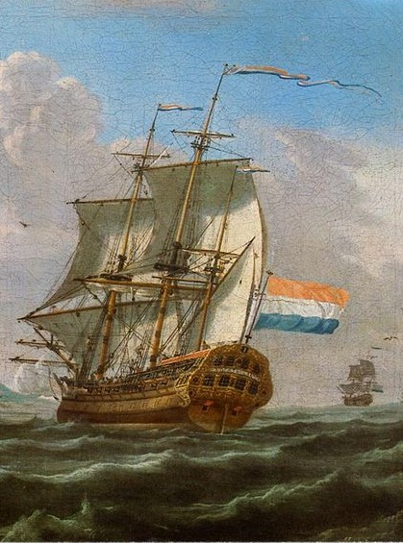
By 1621, the Dutch had
forced the Portuguese out
of the Spice Islands
The Portuguese dominated the
spice trade in the 16th century
Portuguese Trade Ship, 1540
Notes:
In the absence of competition, prices soared. Dutch and English broke this control in the early 17th century. Dutch were even more ruthless in their control over the market, and uprooted 75% of the nutmeg and clove trees in the Spice Islands in order to drive up the price. Dutch East India Company was the officially sanctioned trading conglomerate.�

Slide 23
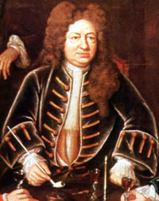
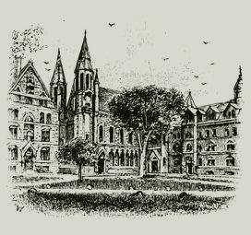
Elihu Yale, benefactor of Yale
University, made his fortune in the
spice trade
Notes:
1672, the first colonial American took an active part in spice-trading: Boston-born Elihu Yale - later to give his money and name to the great university - arrived in Madras, India, as a clerk of the British East India Company. There he established contacts on which he built a fortune in spices.�

Slide 24
Spices

Slide 25
Spices of the Old World Tropics

Slide 26
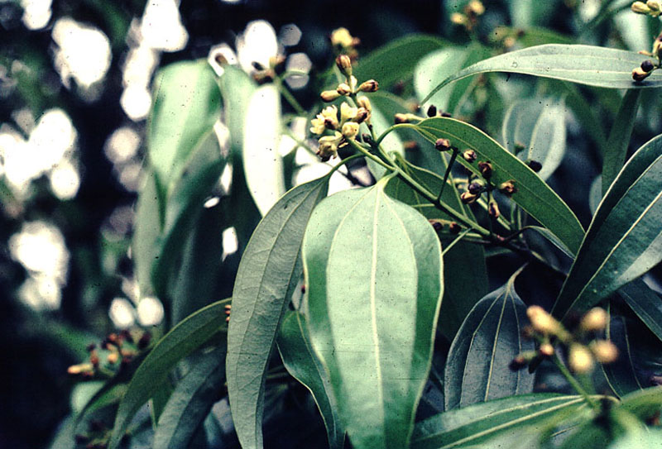
Cinnamon Cinnamomum zeylanicum
India and Sri Lanka (Ceylon)
The part used is the inner bark of two year old twigs
Notes:
Two year old stems and twigs are cut and the bark removed with a special curved knife. The outer bark is scraped away and the inner bark curls into 賭uills� (cinnamon sticks) as it dries
Native to India and Sri Lanka
Cinnamon is one of the oldest herbal medicines known, having been mentioned in Chinese texts as long as 4,000 years ago

Slide 27
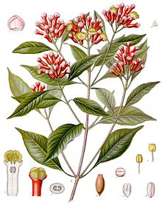
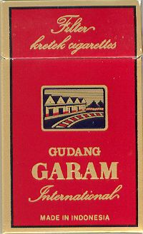
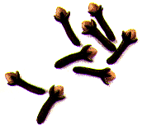
Cloves:
Syzygium aromaticum
Molucca Islands
Production now amounts to about 36 billion cigarettes a year, requiring
almost half the world production of cloves.
Notes:
The tree grows to a height of 30 to 40 feet. It begins flowering in about seven years and continues to produce for another 80 or more years.
Geography: The clove tree is grown in many countries — Tanzania, Brazil, Sri Lanka,Indonesia and in the West Indies
Uses: Cloves are known to have antiseptic properties and their smell is often associated with the dentist. Their use as a preservative in pickles and spiced dishes is well documented. Culinary uses: desserts, beverages, meats, pickling, sauces, and gravies.
Contemporary herbalists most often suggest cloves for this or to maintain good circulation.
Indonesia is still a major producer, but it is also the largest customer for cloves, because of its national penchant for clove flavored cigarettes. Called kreteks (because they crackle when lighted), these cigarettes are two parts tobacco and one part cloves. Production now amounts to about 36 billion cigarettes a year, requiring approximately half of the world production of cloves. This cigarette phenomenon dictates today's prices for cloves.

Slide 28
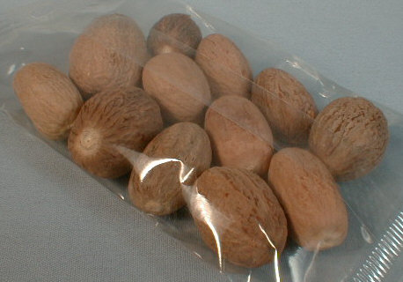
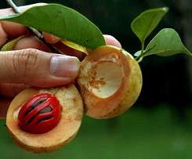
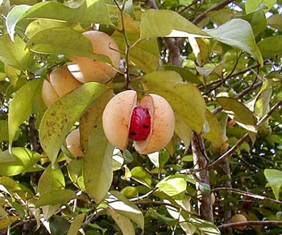
Nutmeg and Mace
Myristica fragrans
Molucca Islands
Notes:
A tropical, dioecious evergreen tree native to the Moluccas or Spice Islands of Indonesia.
Nutmeg as a hallucinogen: Nutmeg powder is eaten or sometimes "snorted." Low doses may produce mild and brief euphoria, lightheadedness, and CNS stimulation. At higher doses, there may be rapid heartbeat, excessive thirst, agitation, anxiety, acute panic, vomiting, and hallucinations. The effects begin slowly and last several hours; they may be followed by drowsiness. Recovery from nutmeg intoxication is slow and often involves unpleasant hangover effects.

Slide 29
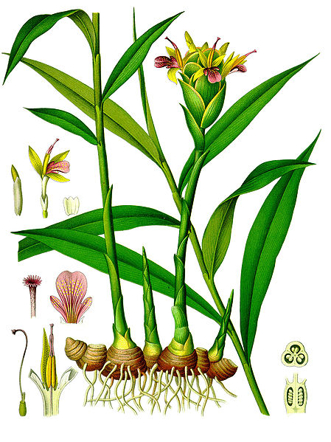
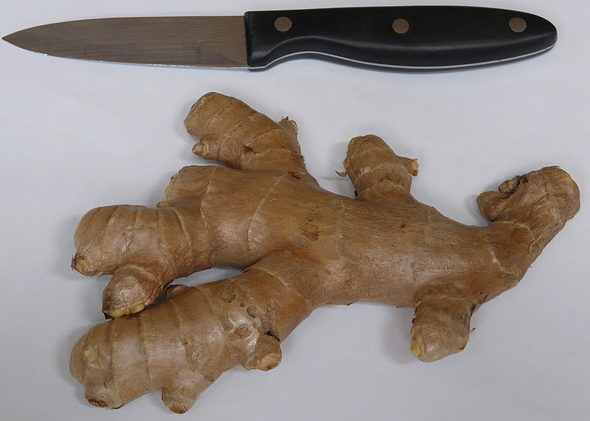
Ginger
Zingiber officinale
Southern Asia
Ginger rhizome

Slide 30
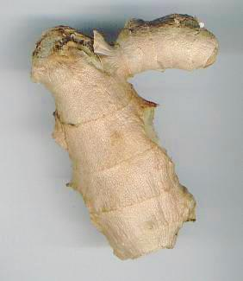
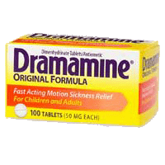
A 1983 British study
showed that ginger is
twice as effective as
Dramamine in preventing
motion sickness.

Slide 31
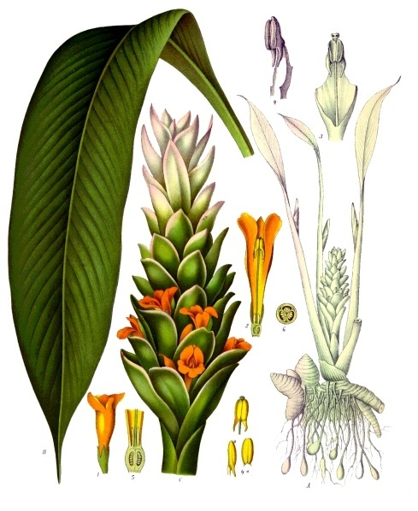
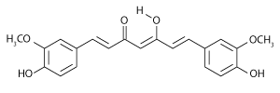
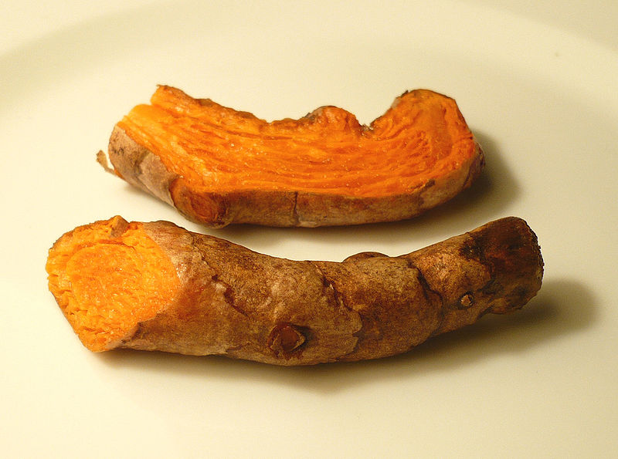
Turmeric, Curcuma longa
South Asia
curcumin
Turmeric rhizome

Slide 32
Spices from the Americas

Slide 33
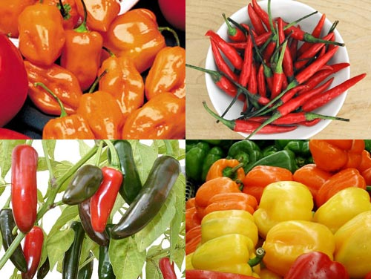
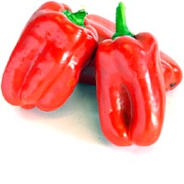
Here are some typical Scoville ratings:
Pure Capsaicin 16,000,000
Habanero 100,000-450,000
Thai; Chiletepin, Pepin 50,000-100,000
Tabasco; Cayenne 30,000-50,000
Chile De Arbol 15,000-30,000
Serrano 5,000-15,000
Jalapeno 2,500-5,000
Ancho; Pasilla 1,000-1,500
Anaheim 500-1,000
Bell; Pimento 0-100
Hot Peppers
Capsicum spp.
(Solanaceae)
Notes:
History: Cultivated by indigenous Americans for thousands of years. Starch grains determined to be from chili peppers have been found in a 6000 year old archaeological site in Ecuador
No one thought to check for chillies, because everyone assumed early farmers would have focused on food staples.
First imported to Europe by Columbus. Use spread from Spain throughout Europe to Asia and Africa.

Slide 34
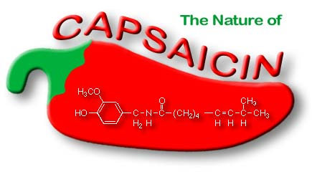
The active principle that causes the heat in jalapeno peppers is an alkaloid called capsaicin.

Slide 35
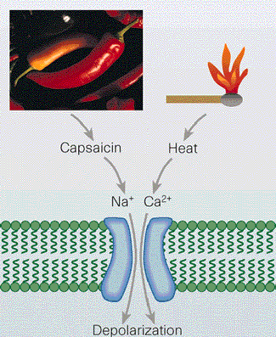
Notes:
Capsaicin itself is tasteless and odorless. What we describe as the "taste" of chili might better be described as the "pain" of chili (and we perceive this in parts of the body that clearly have no taste buds, to wit, the sphincter). One possible explanation for the appeal of chilies is that the body manufactures painkilling endorphins, akin to morphine, to counteract the pain, and endorphins themselves are pleasurable. In other words, we eat chilies because it feels so good when we stop.

Slide 36
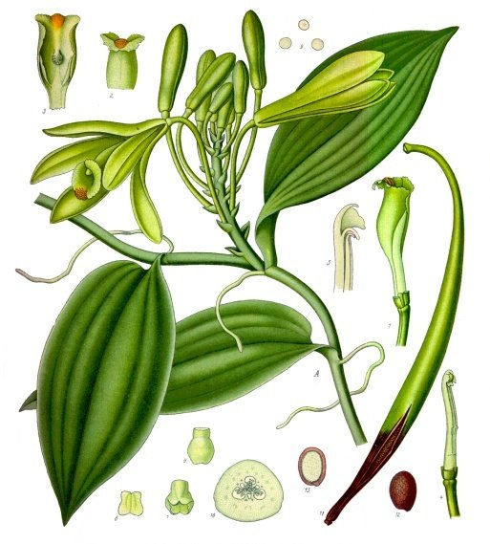
VANILLA
Vanilla planifolia
Orchid Family – Orchidaceae
Mexico and Central America
Notes:
An orchid, vanilla is the only member of the world’s largest family of plants that people use as food. Vanilla is a viney plant native to Mexico and Central America. It can grow as long as 350 feet, climbing up a host tree. The vines produce yellow-white flowers which turn into slender beans or pods.

Slide 37
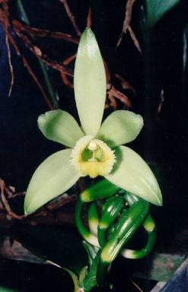
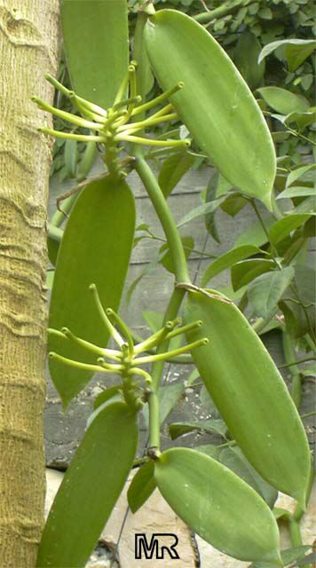
Vanilla flower
Vanilla pod or “bean”
Notes:
An orchid, vanilla is the only member of the world’s largest family of plants that people use as food. Vanilla is a viney plant native to Mexico and Central America. It can grow as long as 350 feet, climbing up a host tree. The vines produce yellow-white flowers which turn into slender beans or pods.

Slide 38
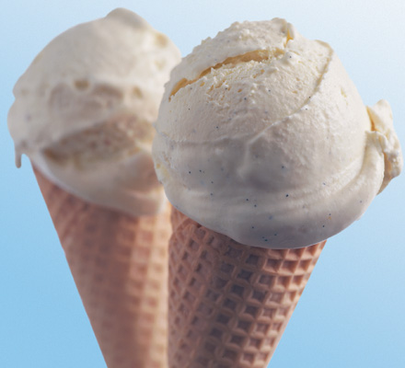
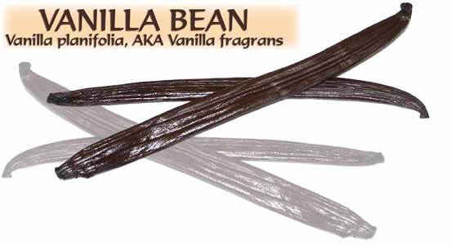
The pods, once harvested, are scalded, fermented, then
dried and aged for three months.
Notes:
The pods must be scalded, then fermented, dried, and aged for three months, in order to become the vanilla we know and use. Vanilla remains the favorite ice cream flavor in the U. S.
The Spanish brought vanilla to Europe, along with countless other American food plants. Today Indonesia and Madagascar supply the bulk of the world’s vanilla.

Slide 39
Herbs

Slide 40
Lamiaceae - The Mint Family

Slide 41
Culinary herbs of the Mint family
rosemary
mint
sage
basil

Slide 42
Apiaceae - Parsley Family

Slide 43
Culinary Herbs of the Parsley Family
(Apiaceae)
cilantro
dill

Slide 44
Brassicaceae -
The Mustard Family

Slide 45
Horseradish
(Armoracia rusticana)

Slide 46
Wasabi
Wasabi, fresh root and prepared paste
Wasabi, growing streamside

Slide 47
Perfume

Slide 48
Patchouli
Pogostemon cablin
Mint Family - Lamiaceae
China and Indonesia
Notes:
the 40-some species of the genus Pogostemon are found mostly in China and Indonesia. Of these 40 species, only two are used to make the pungent, dark amber colored Patchouli oil.

Slide 49
Frankincense
(Boswellia carteri)
Africa and the Middle East
Notes:
Geography: A native of Africa and the Middle East
Preparation: The trunk of the frankincense tree exudes a sticky substance called oleo gum resin.The tree trunks are incised by collectors to expedite the release of the gum resin, which dries in the hot desert sun into hard knobby masses called 'tears',
Frankincense has long been associated with spirituality. One of the first oils to be used in perfume, it was commonly used for incense, medicine, embalming and as a highly valued cosmetic ingredient.

Slide 50
Frankincense is perhaps
best known as one of
the gifts brought by
the Magi.

Slide 51
In ancient Egypt, frankincense
was charred to produce kohl,
an eyeliner of sorts.
Notes:
It was a prized possession in the ancient world rivaling the value of many precious gems and metals.

Slide 52
Lavender
Lavandula sp.
Notes:
Uses: Genus name from Latin lavare meaning to wash�, referring to its use in baths by ancient Greeks and later Romans
Household--dried flowers in sachets are used to scent drawers and repel moths; rub on skin and clothes or pin flowers on clothes to discourage flies; use dried as incense
Cosmetic--lavender water is used for delicate and sensitive skin to speed cell regeneration, for an antiseptic against acne, added to soaps, or in massage oil for muscle aches
Medicinal--a tea infusion is used for headaches and calming, especially in baths; oil is used for headaches (one drop on the temple), painkiller especially for insect bites
Aromatherapy--used in massage oil for calming, depression, throat infections and skin sores

Slide 53
Aromatherapy: evidence for sedative effects of the essential oil of lavender after inhalation. Buchbauer G, Jirovetz L, Jager W, Dietrich H, Plank C. Institute of Pharmaceutical Chemistry, University of Vienna, Austria.
… thus furnishing evidence of the aromatherapeutical use
of herbal pillows employed in folk medicine since ancient times
in order to facilitate falling asleep or to minimize stressful
situations of man.
PMID: 1817516 [PubMed - indexed for MEDLINE]

Slide 54
Lecture Review, Chapter 17
What is the difference between an herb and a spice?
What kind of secondary compound lend herbs and spices their distinctive odors and flavors?
Why were spices originally used in ancient cultures? Where did familiar spices such as cloves and nutmeg originate?
Briefly describe the history of the spice trade. Which culture originally dominated the trade? Did it change?
Briefly describe the biology, history, and uses of cinnamon, clove, nutmeg, mace, ginger, turmeric, and vanilla.
Where are the capsicum peppers originally from? What is the active component that makes them spicy? Do we truly “taste” chili peppers? Explain.
Briefly describe the biology, history, and uses of herbs from the mint, parsley, and mustard families.
Name two plants from the mint family that are used for perfumes.
What is frankincense? What is the plant part from which it is obtained? From what part of the world does it come?

