Slide 1
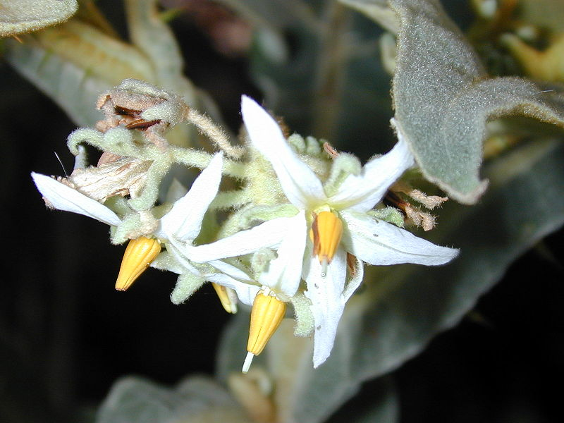
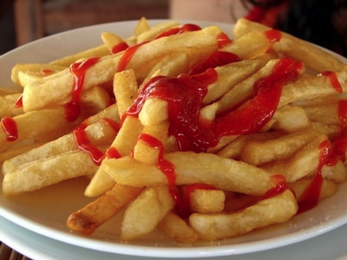
You Say Tomato, I Say Potato:
The Nightshade Family (Solanaceae)

Slide 2
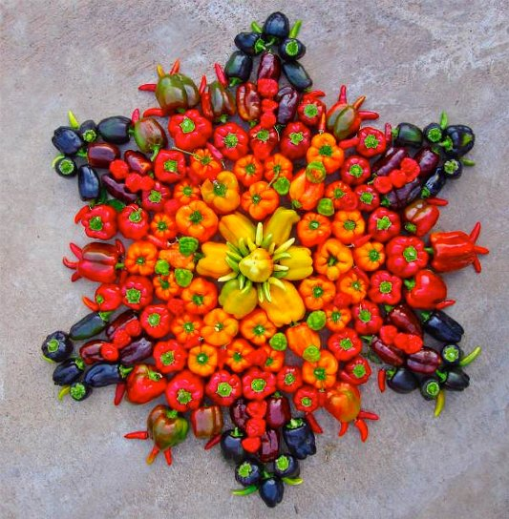
You Say Tomato, I Say Potato: the Nightshade Family
Chapter 14
Solanaceae: The Nightshade Family
Economically Important Members of the Nightshade Family
Tomato: History, Uses
Potato: Morphology, Nutritional Value, History, Uses

Slide 3
Solanaceae Family Characters
Leaves alternate
Crushed foliage pungent-smelling
Flowers radially symmetrical,
often star-shaped
4 or 5 fused petals
Fruit commonly a berry
Family is rich in poisonous
phytochemicals!

Slide 4
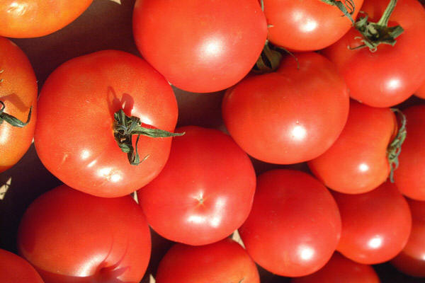
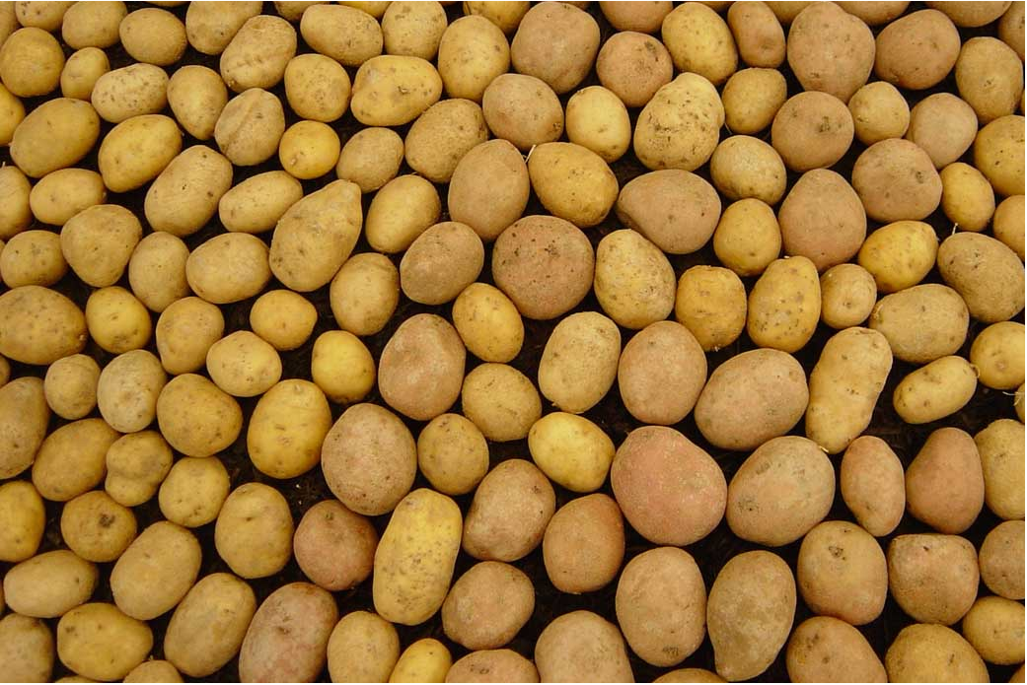
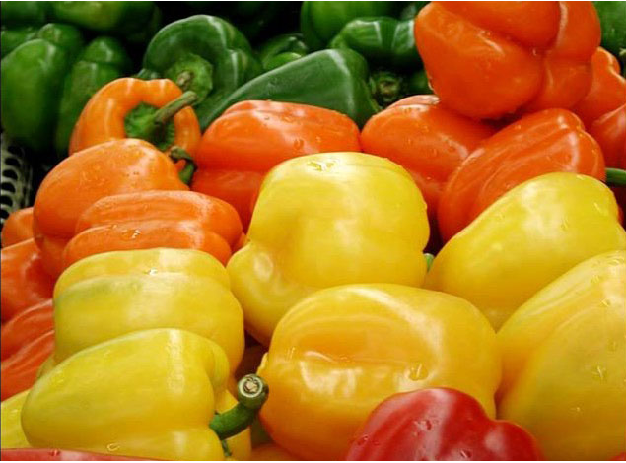
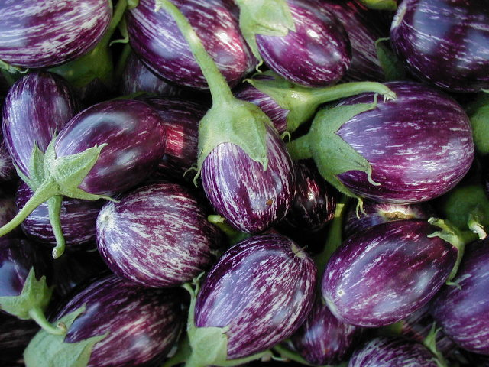
The nightshade family is the seventh-most
economically important plant family
tomato
potato
Capsicum peppers
eggplant

Slide 5
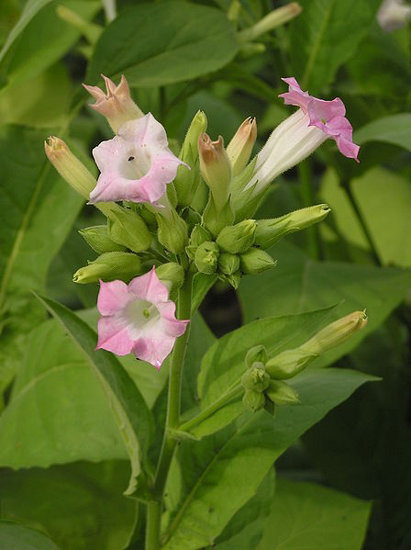
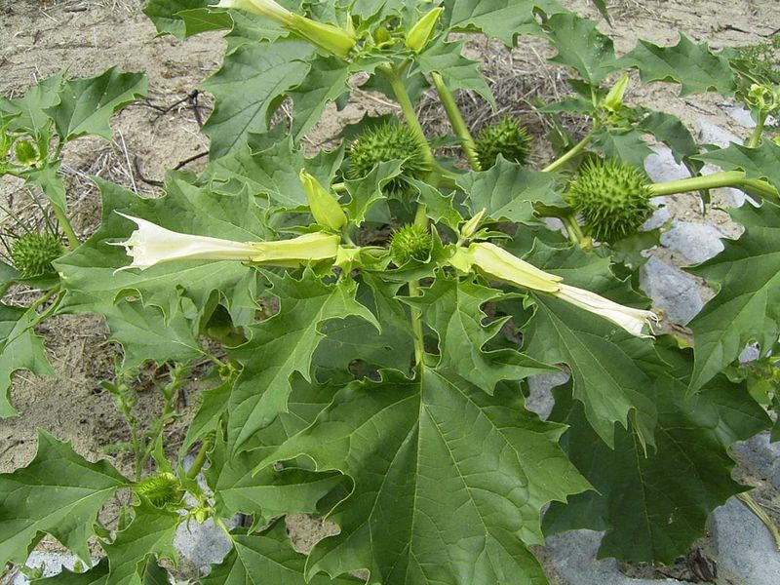
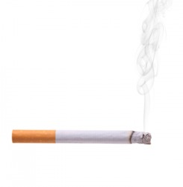
Not all of the important ones
are edibles …
Nicotiana tabacum
Tobacco
Datura stramonium
Jimson weed

Slide 6
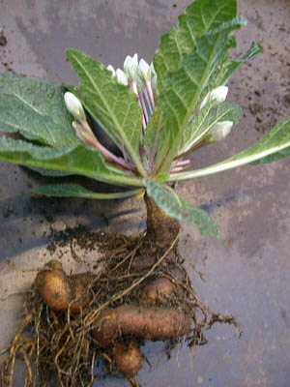
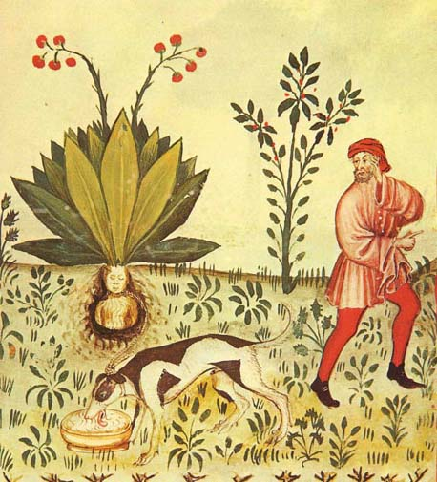
Mandrake
Mandragora officianarum

Slide 7
Tomato (Solanum lycopersicum)
“The tomato is a fruit because it develops from the ovary of the plant after fertilization,
its flesh being the pericarp wall. They also contain seeds ….”

Slide 8
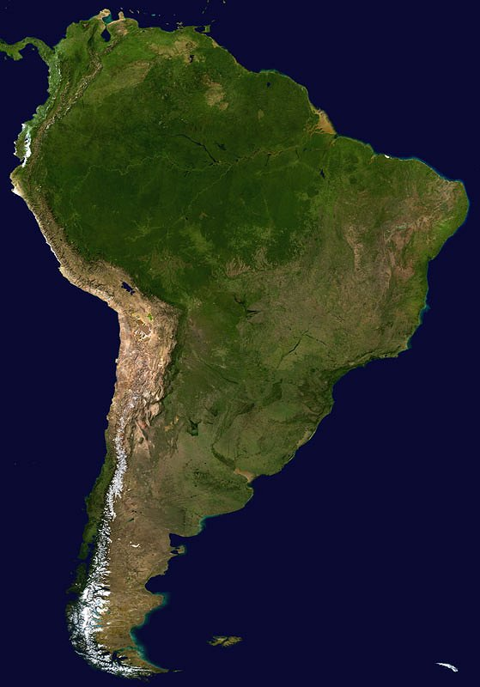
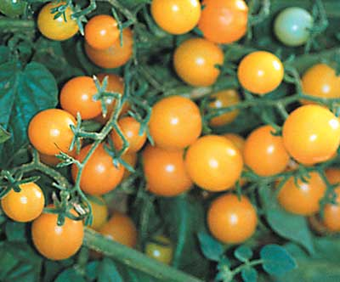
Tomato (Solanum lycopersicum)
Originated in Peru
8 species grow wild

Slide 9
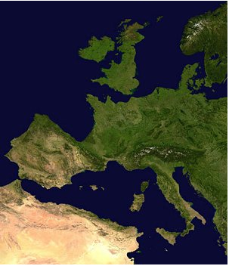
Tomato history
The common name is from the Aztec tomatl
Introduced to Spain by Cortez in 1521, or perhaps as early as 1493 by Christopher Columbus
Mostly ornamental: considered unsafe to eat, and probably poisonous

Slide 10
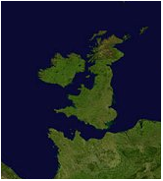
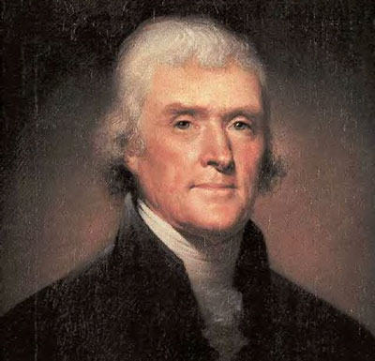
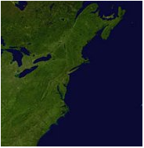
Tomato culinary history
In North America, too, tomatoes were considered poisonous, even though Thomas Jefferson, having eaten them in France, declared them safe.
Their edibility was convincingly demonstrated by Colonel Robert G. Johnson, who, at at noon on September 26, 1820, sat on the courthouse steps in Salem, New Jersey, and ate not one but a basketful of tomatoes. He lived to tell the tale!

Slide 11
 | Crop Species | Million metric tons
1 | Wheat | 468
2 | Maize | 429
3 | Rice | 330
4 | Barley | 160
5 | Soybean | 88
6 | Cane Sugar | 67
7 | Potato | 60
8 | Sorghum | 54
9 | Oats | 43
10 | Cassava | 41
11 | Sweet Potato | 35
12 | Beet Sugar | 34
13 | Rye | 29
14 | Millet | 26
15 | Rape (Canola) Seed | 19
The World’s Top
15 Food Crops
(Members of the grass family in red)
Notes:
Begin here on Monday

Slide 12
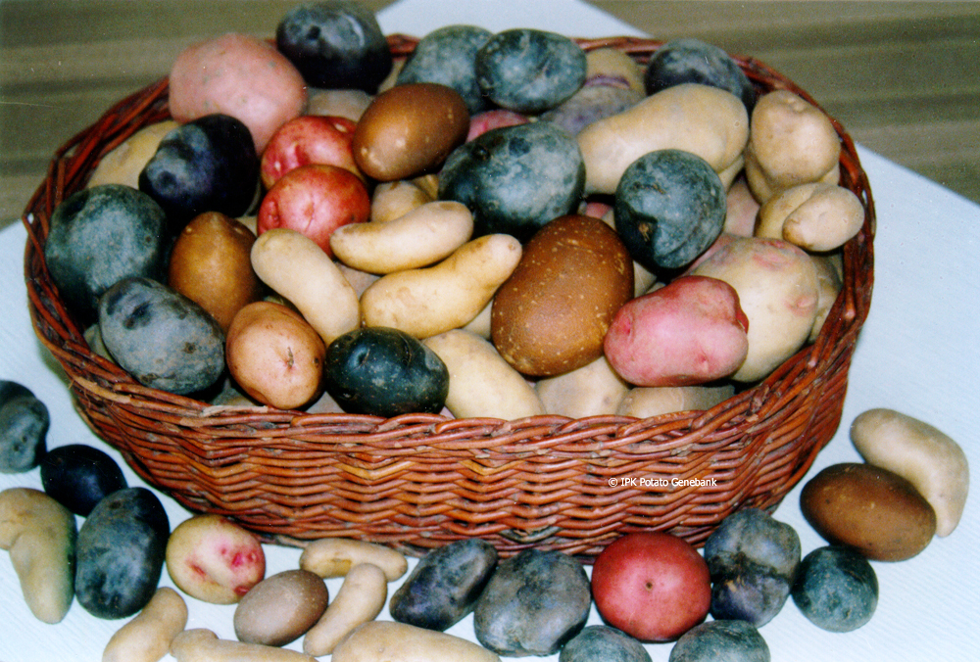
Potato (Solanum tuberosum)

Slide 13
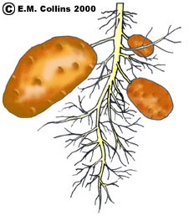
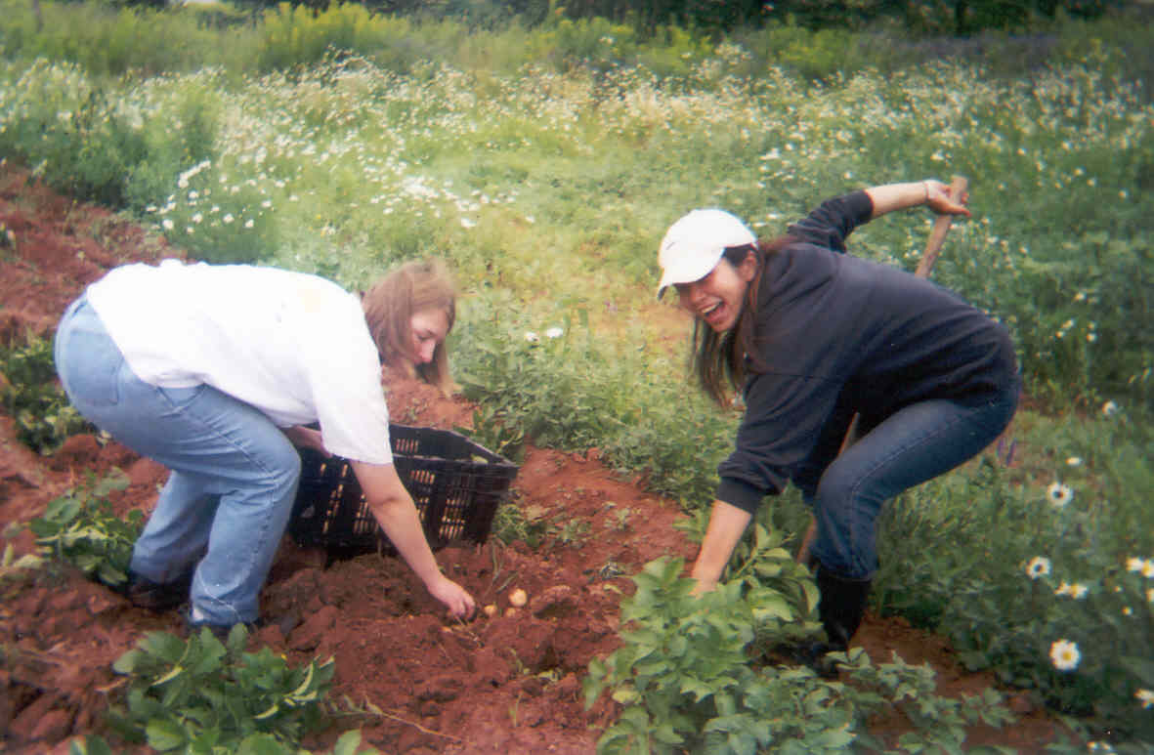
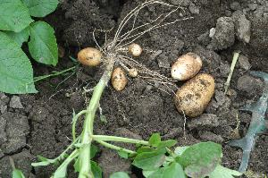
The potato is a tuber, a modified underground stem. The ‘eyes’ are axillary buds.

Slide 14
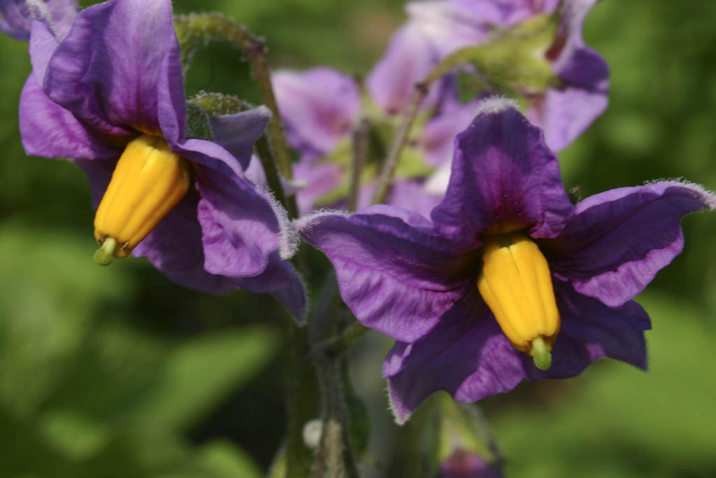
Potato (Solanum tuberosum)
Origin - Peruvian Andes
Cultivated >7000 yrs
> 5000 varieties grown worldwide
Adapted to cool, moist conditions

Slide 15
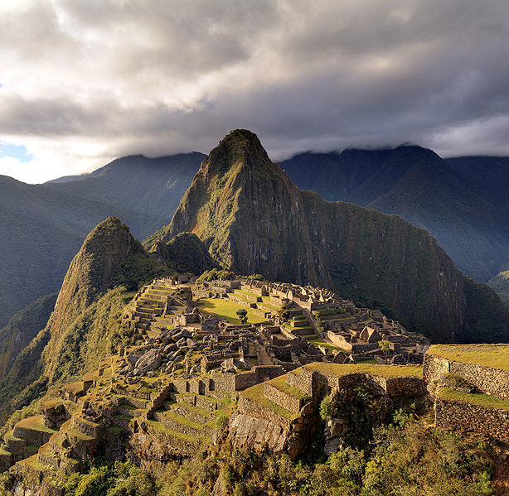
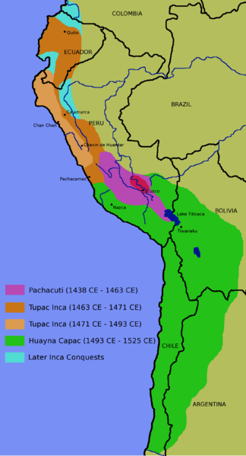
Potatoes provided the food source for the Incan Empire

Slide 16
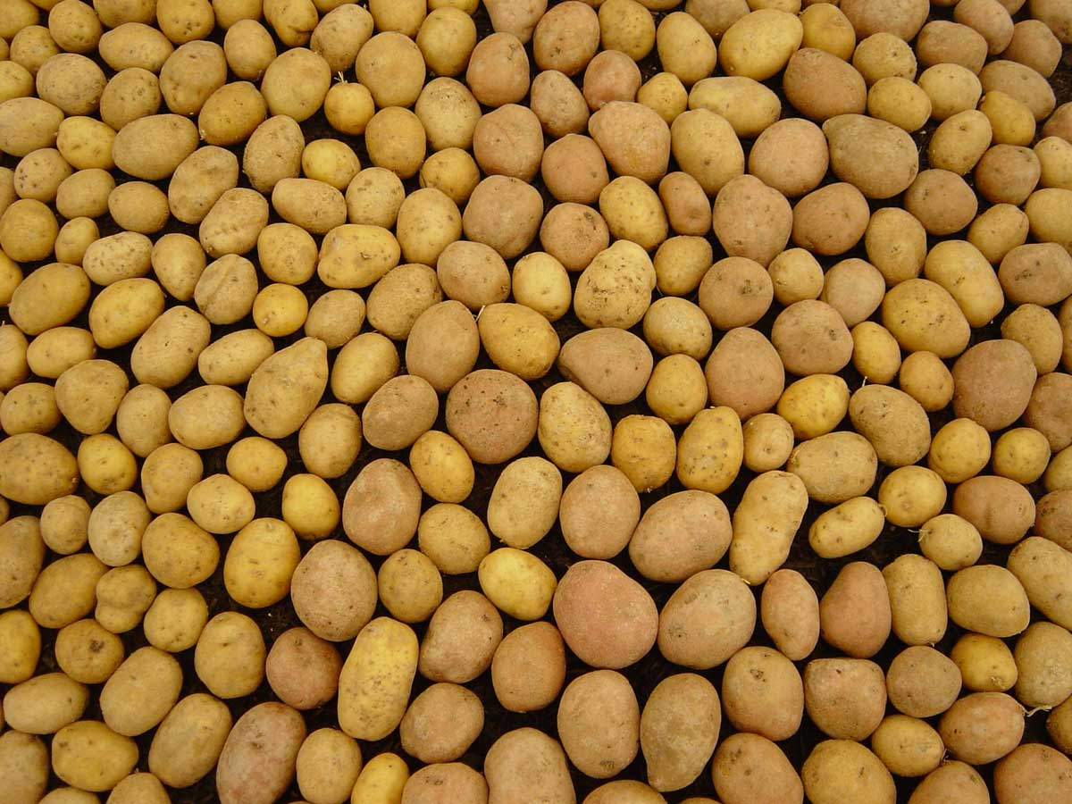
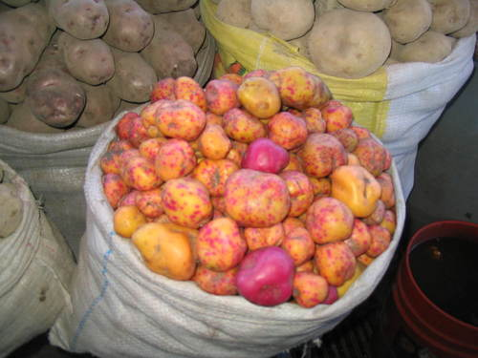
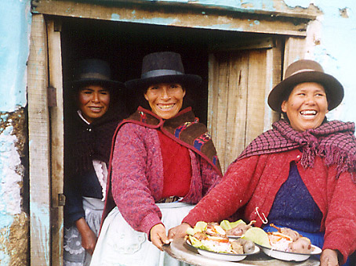
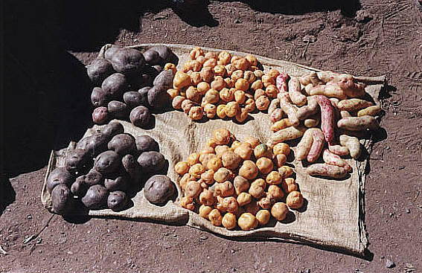
The word ‘potato’ is a compound of the Taino ‘batata’ (sweet potato) and the Quechua ‘papa’ (potato).

Slide 17
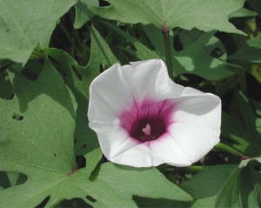
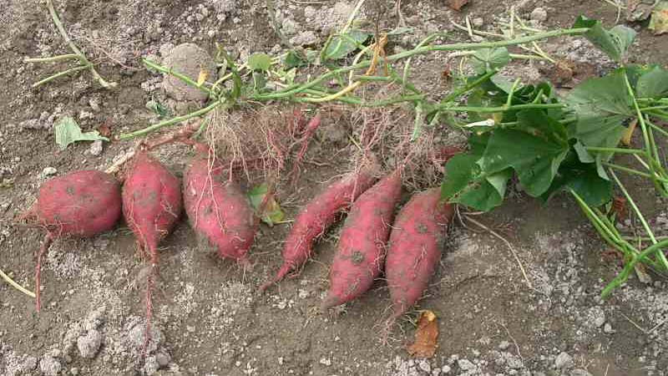
Interestingly, sweet potatoes are not very closely related
to white potatoes: the fleshy, edible parts are modified roots
(not stems) and they belong to the morning glory family!
Ipomoea batata, the sweet potato
Like the potato, it is native to the New World, probably Central American and Peru

Slide 18
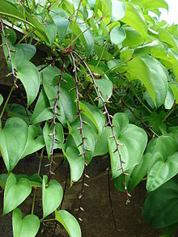
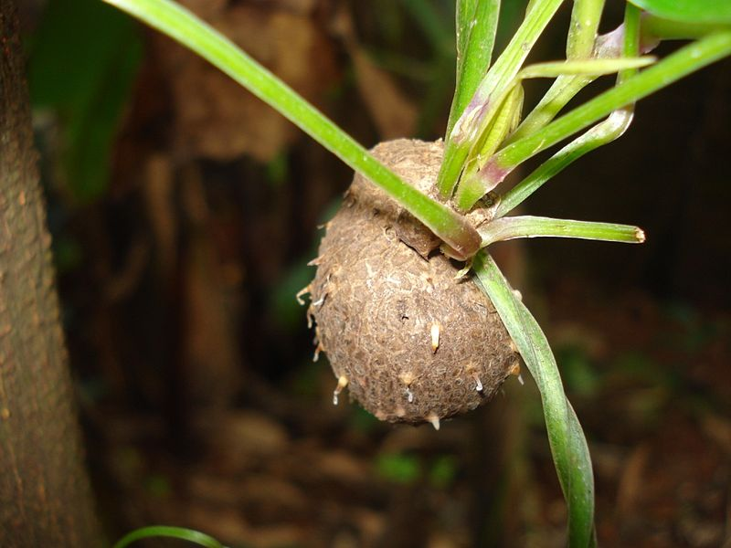
And, just to complicate the issue, neither potato nor sweet
potato is closely related to yam, a tuber of the monocot family
Dioscoriaceae. Yams are native to Africa and Asia.
The word ‘yam’ comes from the Senegalese word ‘nyami,’ which means "to eat.”
Notes:
So if yams and sweet potatoes are totally different, why are they so often confused?. African slaves in the South had already been calling the soft sweet potatoes ‘yams’ because they resembled the yams in Africa. The word ‘yam’ comes from the Senegalese word ‘nyami,’ which means "to eat," and was first recorded in America in 1676.

Slide 19
Potato Nutrition
A medium-sized 150 g potato with the skin provides:
148 calories
27 mg of vitamin C (45%)
620 mg of potassium (18%)
0.2 mg vitamin B6 (10%)
Trace amounts of the vitamins thiamin, riboflavin,
folate, and niacin
Trace amounts of the minerals magnesium, zinc,
phosphorus, and iron
It is not a rich source of protein.

Slide 20
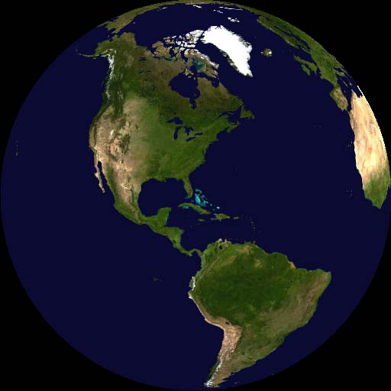
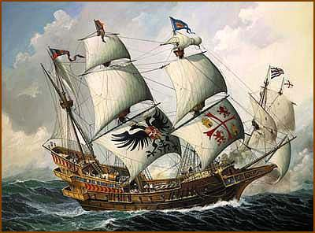
History
Spain introduced the potato to Europe in 1536.
European mariners carried them to ports throughout the world.
Sir Francis Drake introduced the potato to England in 1580
Basque fisherman introduced them to western Ireland in the late 1500s.

Slide 21
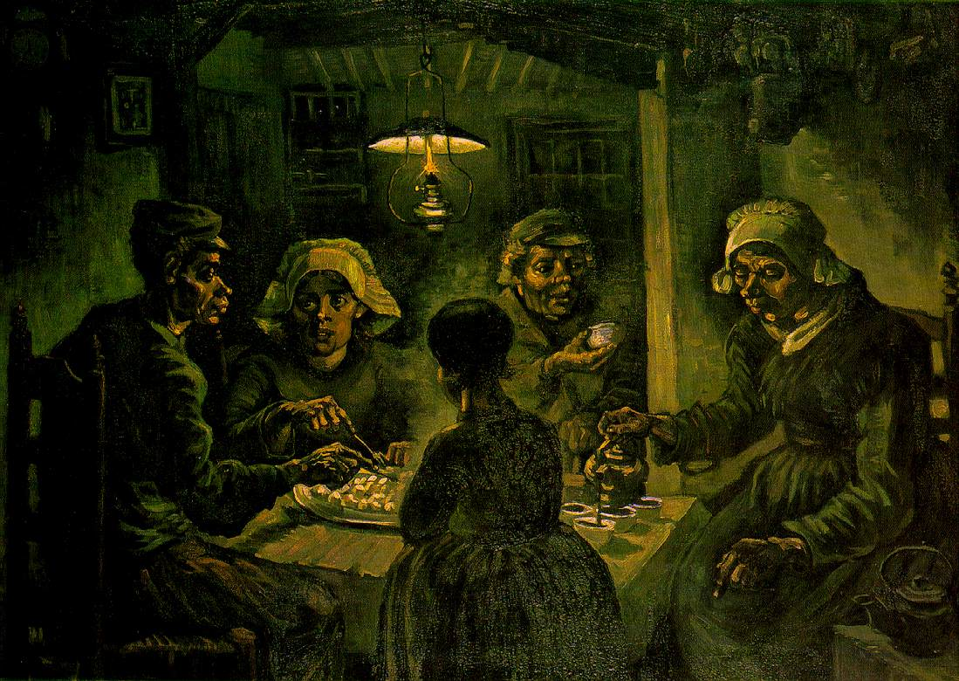
The potato was the most important new food crop
throughout Europe food in the 1800s. Potato offered 3 big advantages over other food crops:
Low rate of spoilage
Bulk, which easily satisfied hunger
They were cheap!
By 1845, potatoes made up about 10% of European caloric intake.
Van Gogh’s The Potato Eaters

Slide 22
The Great Famine: What Went Wrong?
Irish population was already living on the edge: many were tenant farmers
Their rights and access to power had previously been curtailed by the Penal Laws
A potato-based diet had allowed the population to exceed a sustainable level
Most of Ireland’s potatoes were one genetic clone

Slide 23
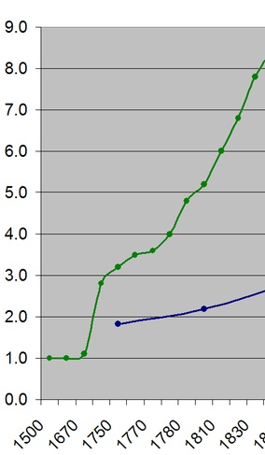
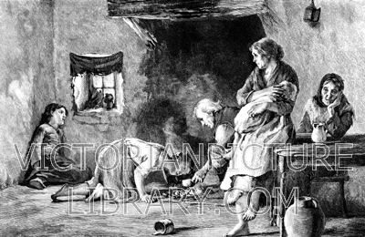
A diet of potatoes allowed the Irish population to soar: 12 tons could be produced per acre.
In the 1700s, the Irish population was ca. 4 million. By 1830, it was close to 8 million.
Population, in millions
Year
Notes:
Stopped here on Tuesday, March 12.

Slide 24
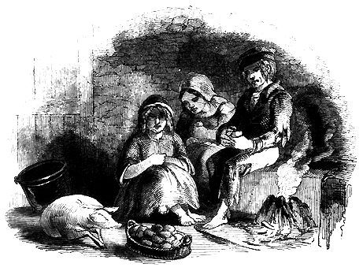
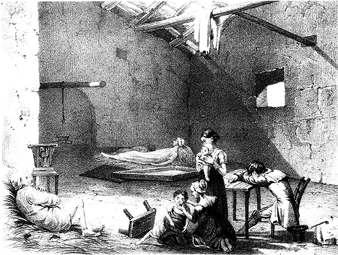
Most of the Irish lived in poverty and on the edge,
subsisting on what could be produced on 1/10 acre

Slide 25
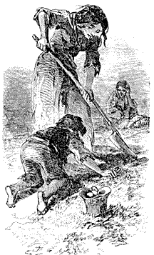
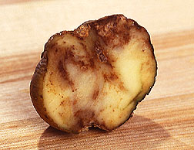
In the summer of 1845, the Late blight struck, killing 80% of the potato plants in Ireland.

Slide 26
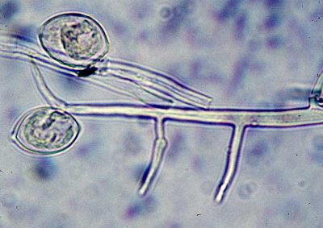
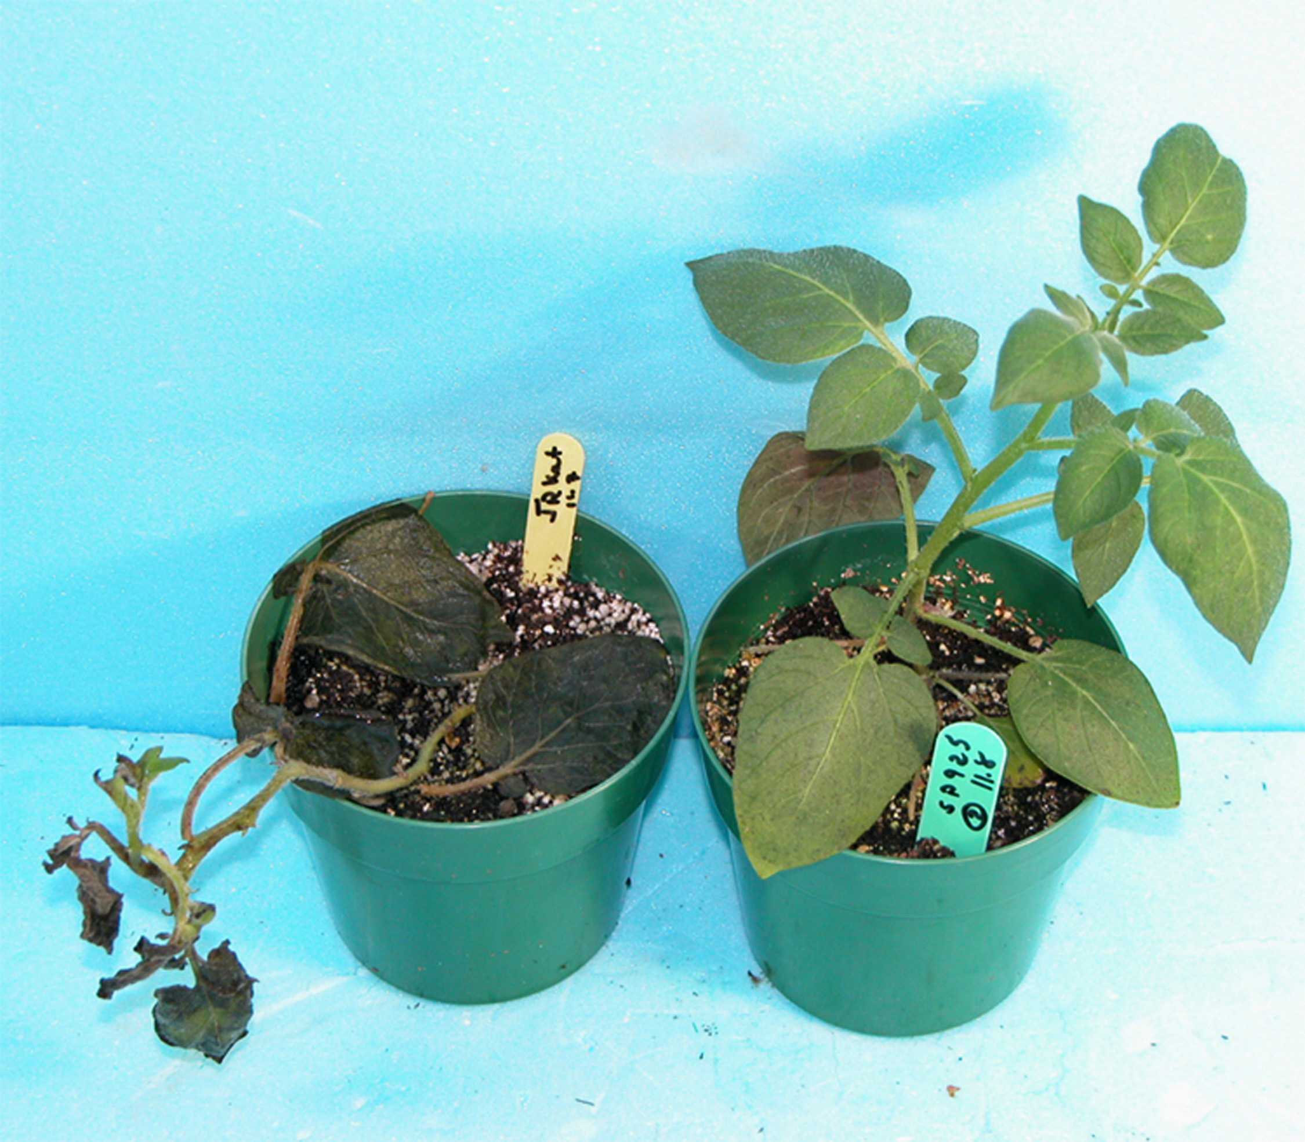
Late blight: Phytophthora infestans, a fungus-like bacterium that invades the plant and reproduces explosively. All parts of the plant become infected; the plant dies.

Slide 27
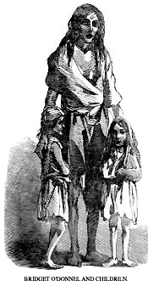
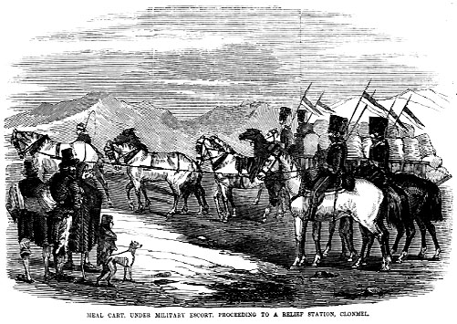
In the summer of 1846, the blight struck again, followed by a severe winter.
Troops were dispatched to control food riots and maintain order.

Slide 28
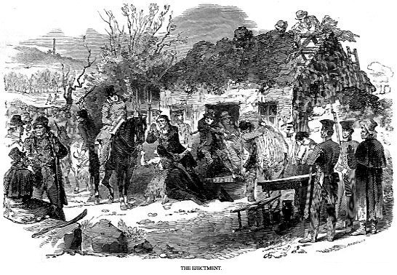
1847 - decent summer but not enough seed potatoes to plant. Landowners deprived of income, started repossessing land.

Slide 29
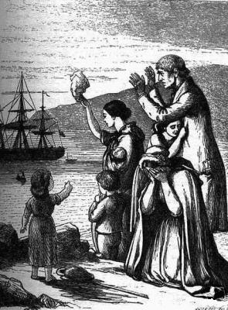
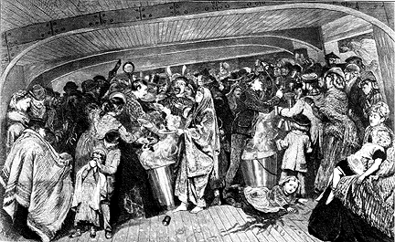
More than 500,000 Irish left the country in the famine years, many bound for North
America.
1 in 5 emigrants died during
passage, frequently of typhus.

Slide 30
an Gorta Mór: the Great Hunger
In 1841, the Irish population was 8,175,124.
By 1851, it had fallen to 6,552,385, a decrease of about 20%:
> 1 million starved
> 500,000 emigrated
The social and political effects are still felt today, including in the rise of the IRA.

Slide 31
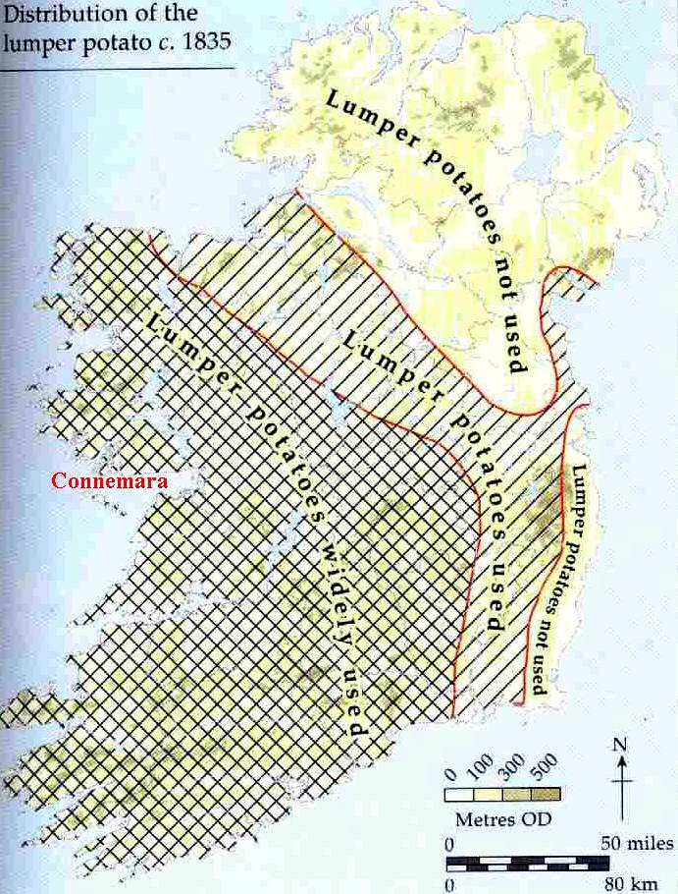
Lessons Learned
Sustainability: Do not rely on crops that are genetically uniform

Slide 32
Lessons Learned
Sustainability: a population that exceeds the environment’s carrying capacity is a population at risk

Slide 33
The Late blight struck all over Europe in the late 19th century. Why didn’t other countries experience the devastation that Ireland did as a result?
In other European countries, people’s diets were more varied. They didn’t rely so much on the potato for sustenance.
The soil is better for potato culture in other European countries, so the potato plants were healthier.
In other countries, the potato crop was more diverse genetically: crops were not one uniform clone.
They did; you just don’t hear as much about it.
Both A and C are true.

Slide 34
The Late blight struck all over Europe in the late 19th century. Why didn’t other countries experience the devastation that Ireland did as a result?
In other European countries, people’s diets were more varied. They didn’t rely so much on the potato for sustenance.
The soil is better for potato culture in other European countries, so the potato plants were healthier.
In other countries, the potato crop was more diverse genetically: crops were not one uniform clone.
They did; you just don’t hear as much about it.
Both A and C are true.

Slide 35
What about potatoes today?

Slide 37
Use of potatoes
1/3 eaten fresh
1/3 used for fries
1/3 processed as chips, flakes

Slide 39
Lecture Review, Chapter 14
Describe the flower and fruit of plants in the nightshade family (Solanaceae).
Name some economically important members of the nightshade family, both edibles and pharmaceuticals.
Explain where tomatoes originated, and trace their history to the United States.
What is a tuber?
Sweet potatoes and “Irish” potatoes are both tubers. Are they closely related? Explain.
Where did potatoes originate? When and how were they introduced to Europe? How did they come to be a staple of the ‘peasant’ diet in Europe?
Describe the ‘perfect storm’ of historical, social, and biological factors that conspired to produce the devastation of the Irish potato famine.
What impact did the Great Famine have on Irish society, history, and culture?
Where are potatoes grown today and how are they used?

